Slide 1
Thakur College of Science & Commerce
Department of Zoology
Academic Year – 2020-21
T.Y.B.Sc. Zoology
Semester – V
Applied Component Practical
Ornamental Fishes & Aquatic Plants
Dr. Vitthal T. Mohite

Slide 2
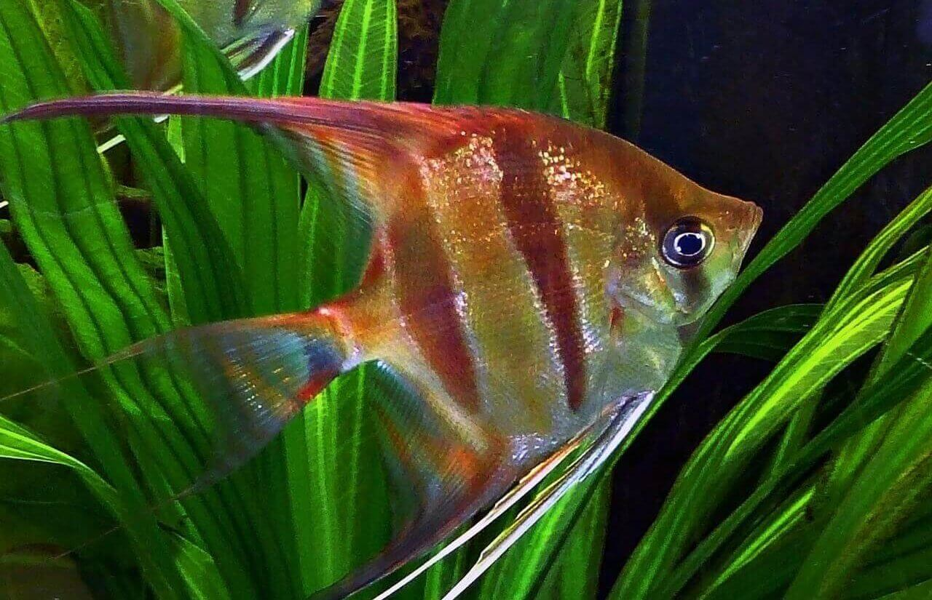
Angel Fish• Pterophyllum spp. (Angel)

Slide 3
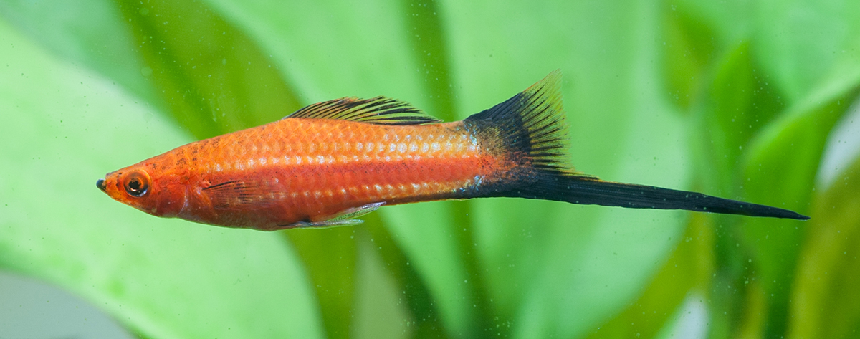
• Xiphophorus hellerii (Swordtail)

Slide 4
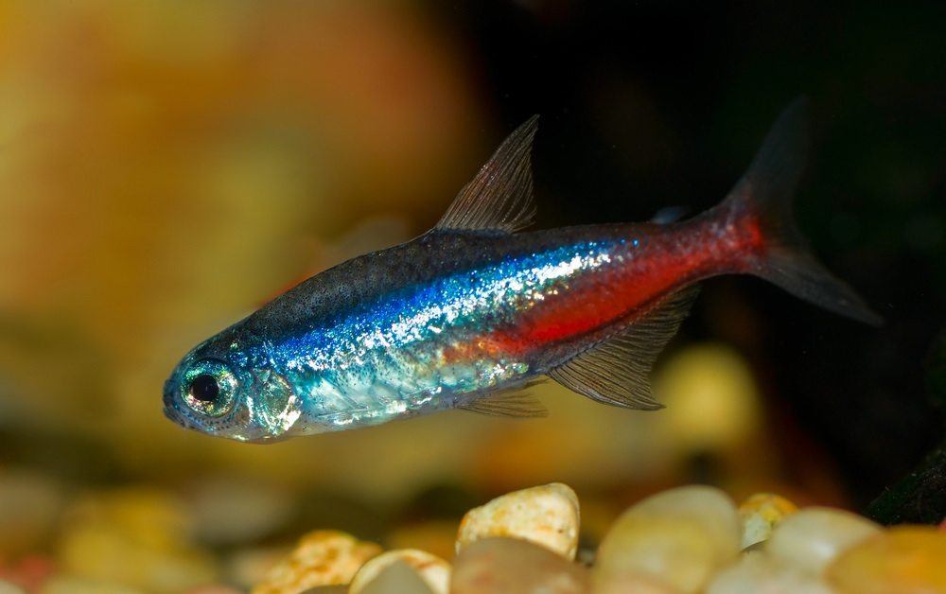
• Paracheirodon innesi (Neon tetra)

Slide 5
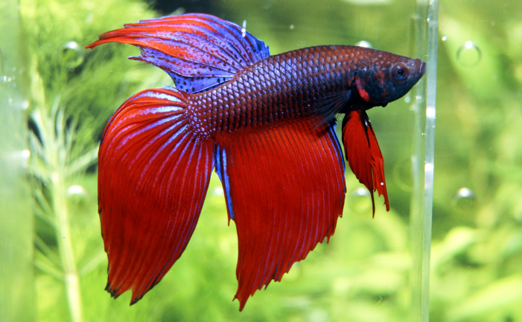
Betta splendens (Siamese fighter)

Slide 6
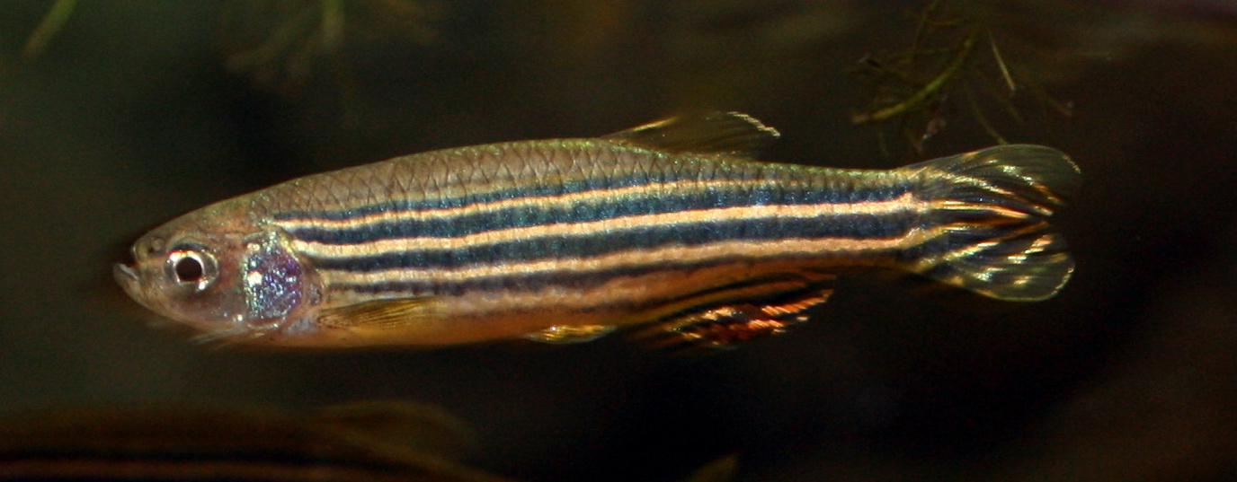
Danio spp. (Danio)

Slide 7
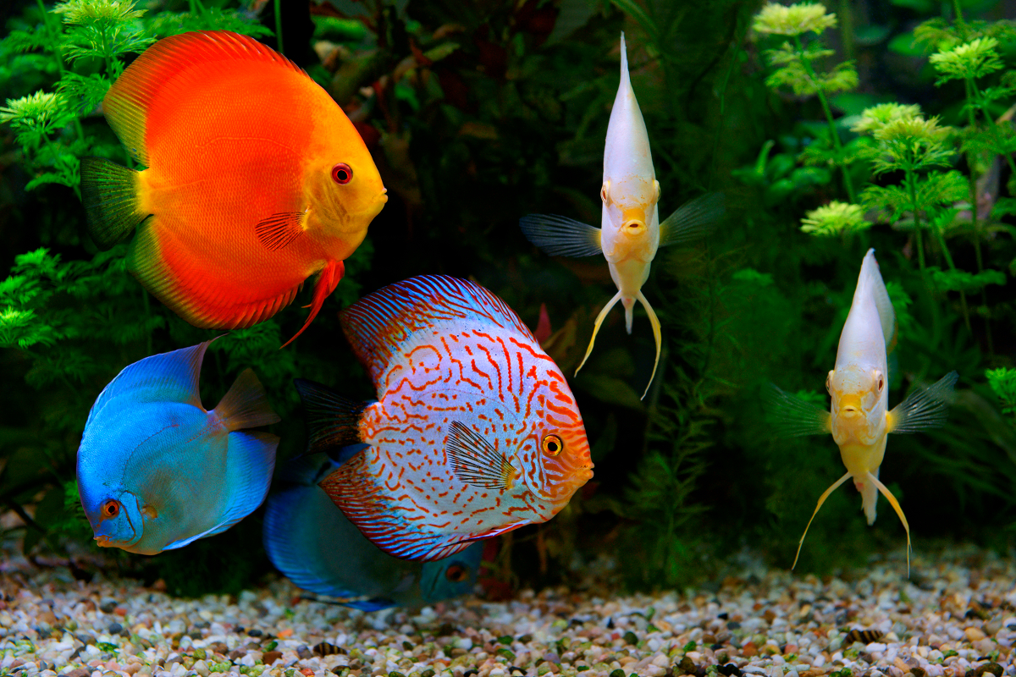
Symphysodon spp. (Discus)

Slide 8
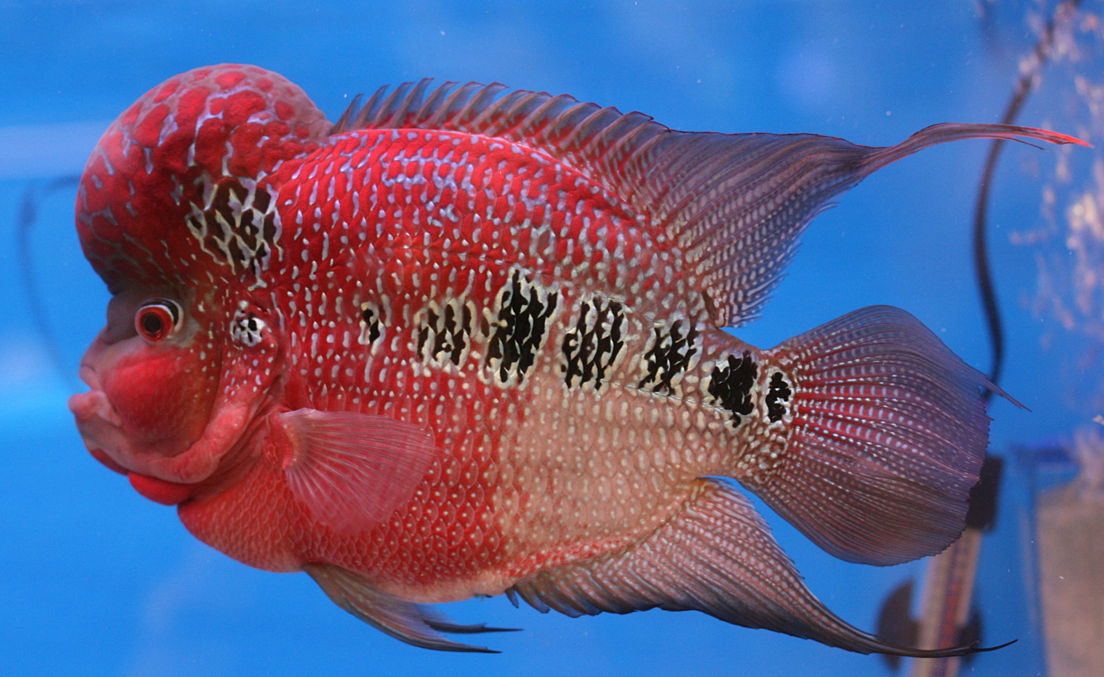
Flower Horn (Hybrid variety)

Slide 9
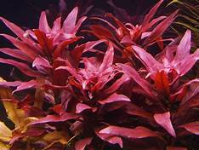
Aquatic Plants
Ludwigia

Slide 10
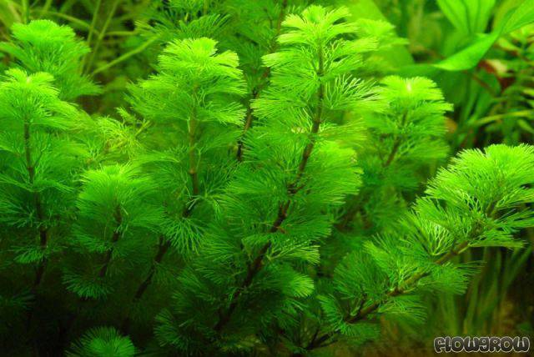
Cabomba

Slide 11
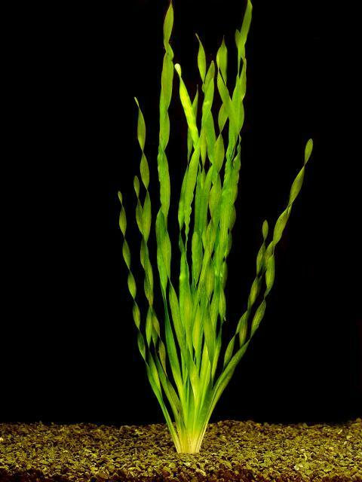
• Corkscrew Vallisneria

Slide 12
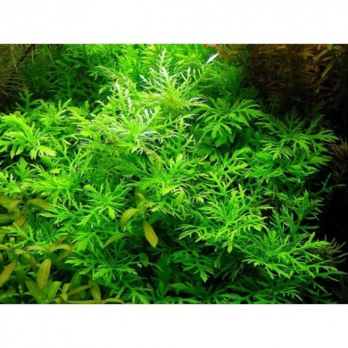
Aquarose

Slide 13
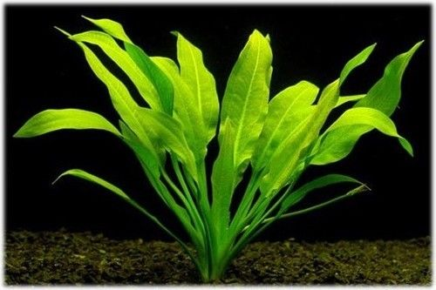
Amazon Sword plant

Slide 14
C) Aquarium accessories:
• Aerator
• Under Gravel Filter
• Internal Filter
• External / Canister Filter
• Food dispensers

Slide 15
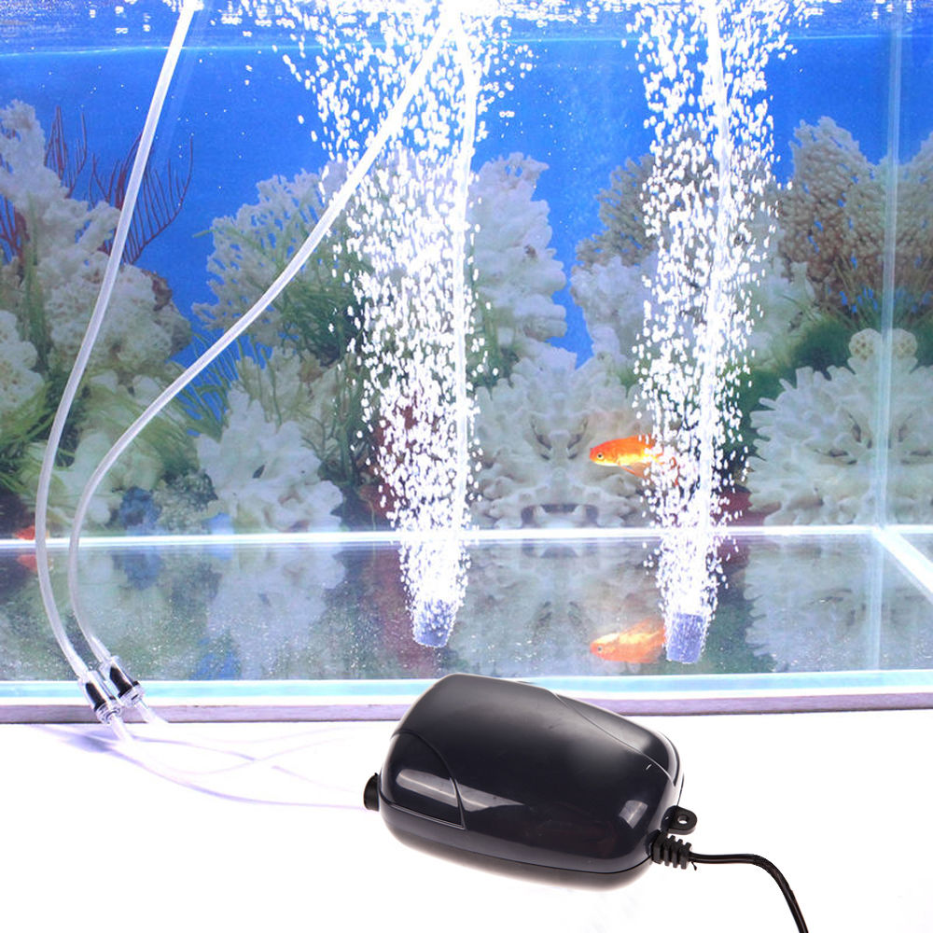
Aerator

Slide 16
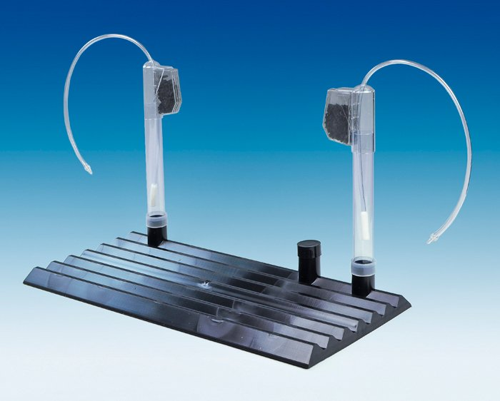
Under Gravel Filter

Slide 17
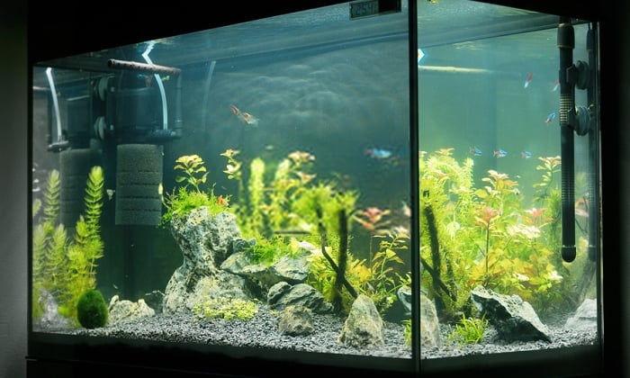
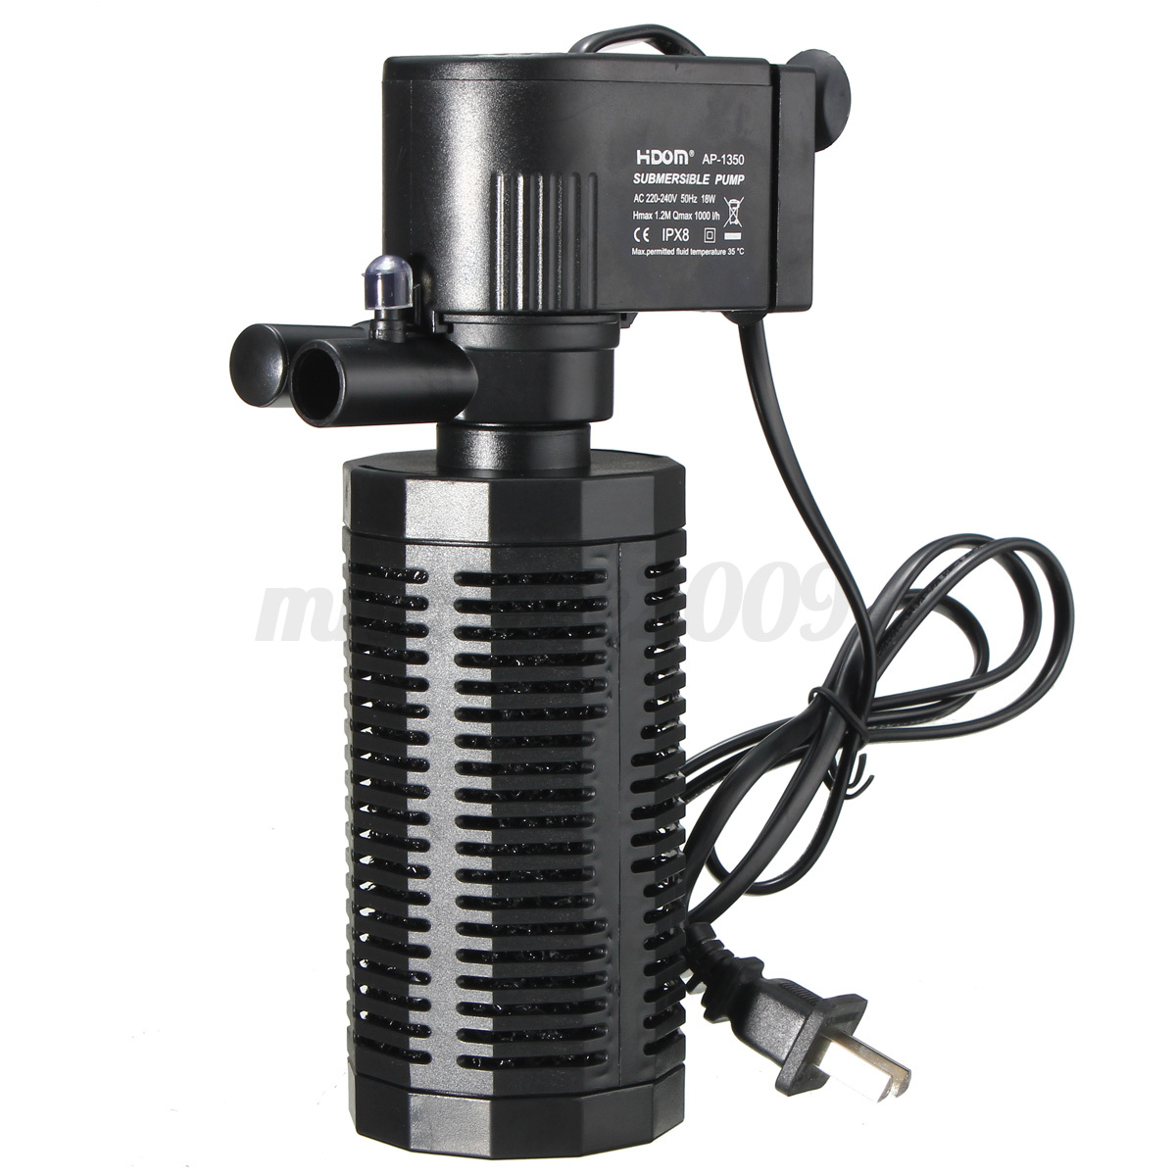
Internal Filter

Slide 18
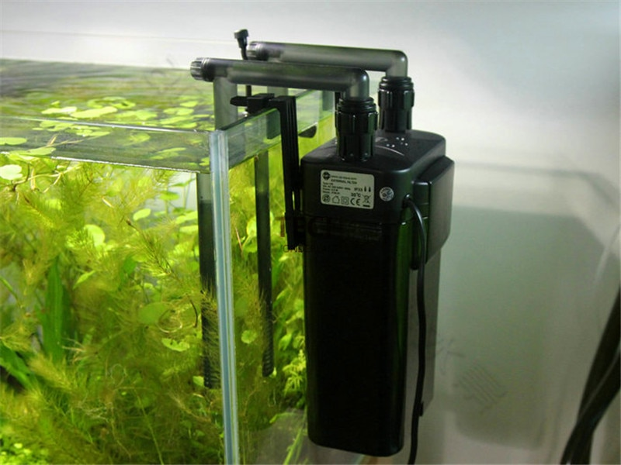
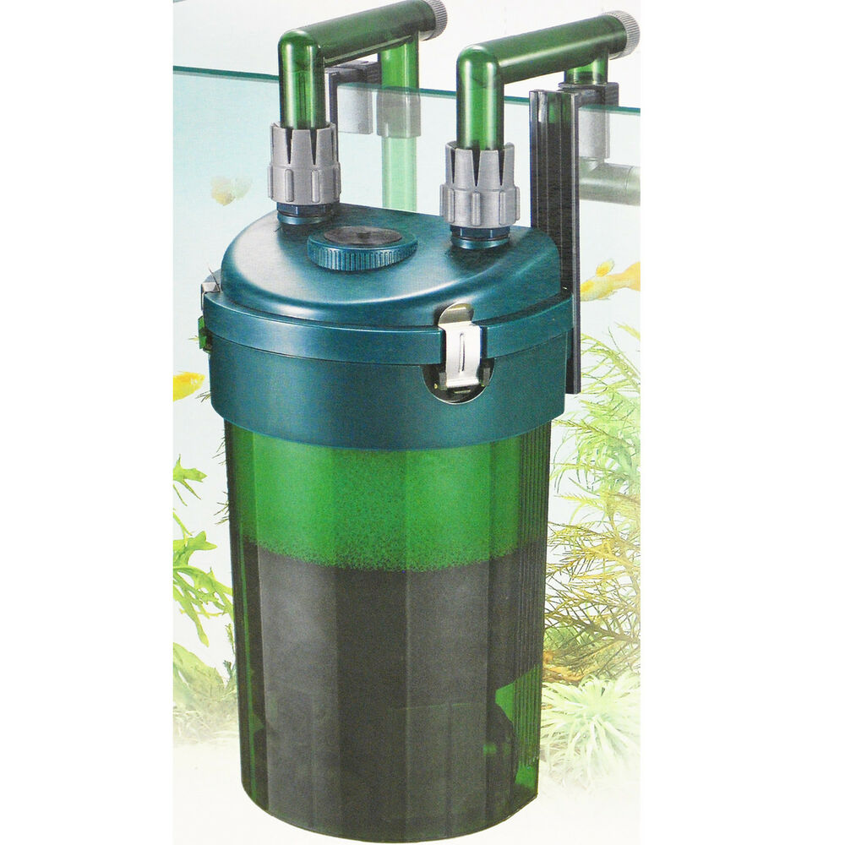
Canister Filter

Slide 19
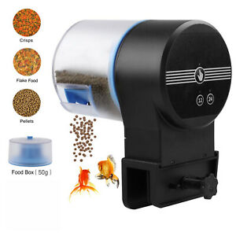
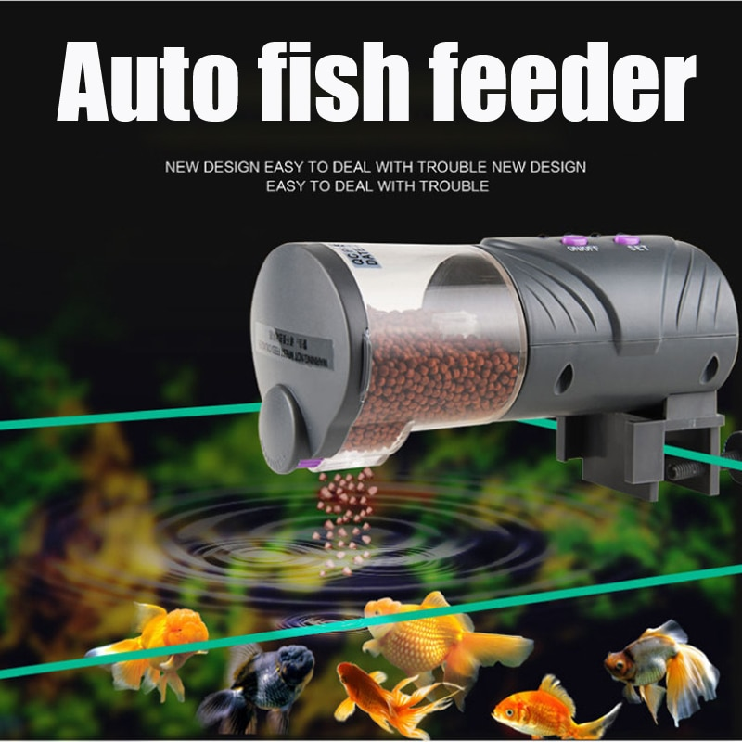
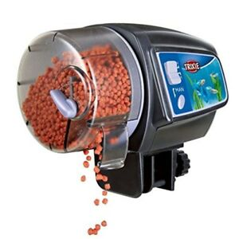
Food dispensers

