Slide 1
Break-even Analysis

Slide 2
Break-even analysis is a technique widely used by production management and management accountants. It is based on categorising production costs between variable and fixed costs.
Total variable and fixed costs are compared with sales revenue in order to determine the level of sales volume, sales value or production at which the business makes neither a profit nor a loss (the "break-even point").
At Break-even point total revenue covers total cost. i.e they both are equal to each other.
Shut-down point is another concept which refers to the point at which total revenue just covers variable cost, and not the total cost.

Slide 3
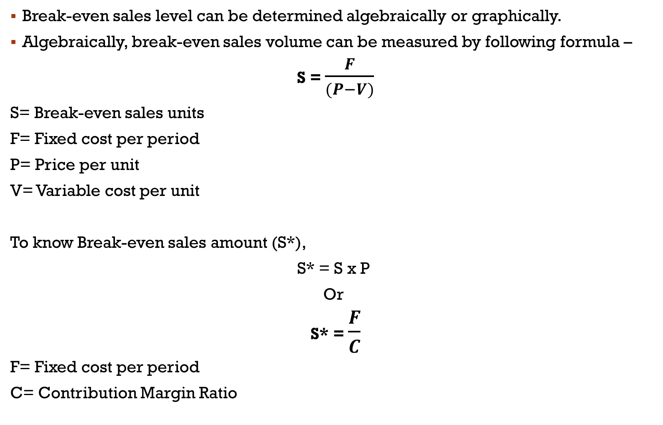
Break-even sales level can be determined algebraically or graphically.
Algebraically, break-even sales volume can be measured by following formula –
S = $\frac{F}{(P−V)}$
S= Break-even sales units
F= Fixed cost per period
P= Price per unit
V= Variable cost per unit
To know Break-even sales amount (S*),
S* = S x P
Or
S* = $\frac{F}{C}$
F= Fixed cost per period
C= Contribution Margin Ratio

Slide 4
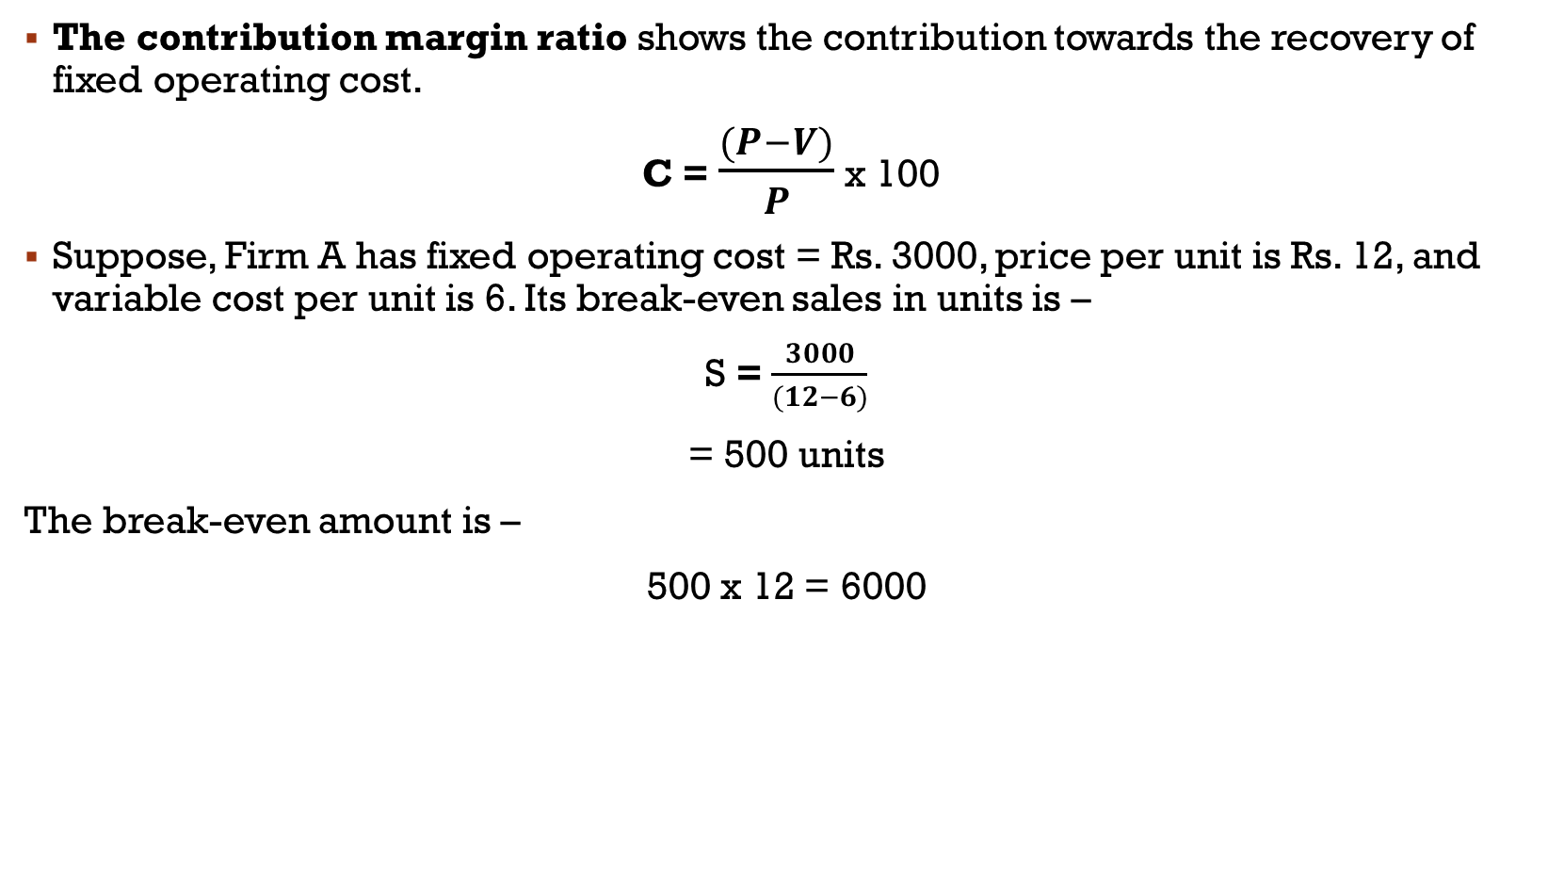
The contribution margin ratio shows the contribution towards the recovery of fixed operating cost.
C = $\frac{(P−V)}{P}$ x 100
Suppose, Firm A has fixed operating cost = Rs. 3000, price per unit is Rs. 12, and variable cost per unit is 6. Its break-even sales in units is –
S = $\frac{3000}{(12−6)}$
= 500 units
The break-even amount is –
500 x 12 = 6000

Slide 5
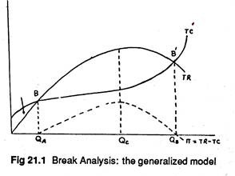
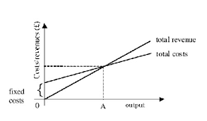
Break-even analysis- Graphical Representation
If we assume TR and TC to be constant, beak-even will take place at OA level of output.
Points B and B’ are the break-even points.

Slide 6
Variables Influencing the Break-Even Point
Changes in price: Rise in Price will lead to upward shift in the TR curve, thus fall in break-even point from right to left.
Change in fixed cost: Increase in fixed cost will lead to upward shift in the TC curve, thus an increase in the break-even point
Change in variable cost: increase in variable cost will increase the break-even point.

Slide 7
Business application of B-E Analysis
Returns on capital employed: to determine how long it will take for a firm to start generating returns on capital invested.
Cost recovery
Profit forecast
Effects of changes in costs and revenue
Determine sales and marketing strategies
Capacity utilization

