Slide 1
UNIT 4

Slide 2
MODULE 4
Legal framework for starting a business in India
• Steps involved in starting a Venture
• Institutional support to an Entrepreneur
• Venture funding, requirements of Capital (Fixed and working)Sources of finance,
• The Make in India Campaign, the Digital India Campaign and the opportunities for startups in India
• New trends in entrepreneurship – E-entrepreneur

Slide 3
Steps in setting up business venture
Identification of business opportunity
Market research
Discussion; consultations; brainstorming; observation at market place
2. Evaluation of business opportunities
Cost; benefit analysis
3. Selection of best opportunity
4. Decision on location
5. Develop a business plan

Slide 4
Continued…..
Determine the resources required.
Arrangement of resources required.
Allocation of resources required.
Launching the enterprise
Periodic review

Slide 5
FIXED CAPITAL
It is called long term capital. It is required to purchase fixed asset like plants and machinery.
FACTORS INFLUENCING FIXED CAPITAL :
Nature of business
Size of Business unit
Type of products manufactured
Technology
Scope of activities
Method of acquiring asset
Government subsidy
Nature of strategy
Economic condition

Slide 6
Sources of fixed capital
Public issue of shares
Right issue of shares
Issue of debentures
Term loans
Accumulated earnings
Lease financing
Venture capital

Slide 7
Working capital
It is also known as circulating capital and is required for the payment of recurring expenses towards material, consumables, salaries, wages etc.
FACTORS INFLUENCING WORKING CAPITAL REQUIREMENT;
Nature of the business
Competition
Condition of supply
Operating cycle
Operating cost
Seasonality of operations
Size of the firm
Technology
Terms and condition of purchase and slae
Economic condition
Expansion and growth
production policy

Slide 8
Sources of working capital
Advances by bank (cash credit; short term loans; purchase/ Discounting of bills; Letter of credit)
Dealer advances
Debentures
Short term loan from FI
Trade credit
Funds from operation
Public deposit
Commercial papers
Inter corporate deposit

Slide 9
comparison
FIXED CAPITAL
Long term capital
Invested in fixed asset
It is obtained by way of issue of shares, debentures, term loans, venture capital
This capital is required for longer period
Involve higher risk
Decision involving fixed capital taken by top mgmt
WORKING CAPITAL
Short term capital
Invested in current asset and to finance day to day business
Obtained through short term loan, cash credit/ OD
Capital is required for shorter period
Less risk
Decision can be taken at any level.

Slide 10
OTHER SOURCES OF FINANCE
Business Angels
These are the professional investors who invest either just a part or their entire wealth as well as time in the growth of innovative companies.
Venture Capital
Under this form of corporate financing, the financial investor participates in the fresh business in exchange for strategic advice and cash.
Bootstrapping
Using own fund to start a business.
Fund from friends and family

Slide 11
LEGAL FORMALITIES FOR STARTING A BUSINESS

Slide 12
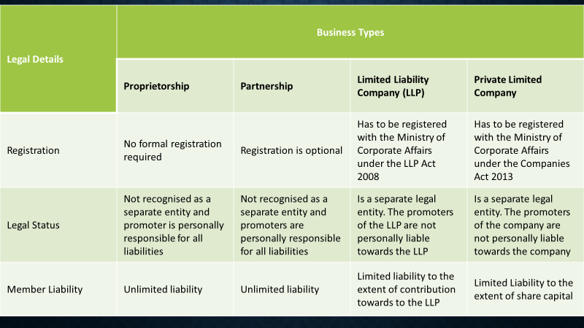

Slide 13
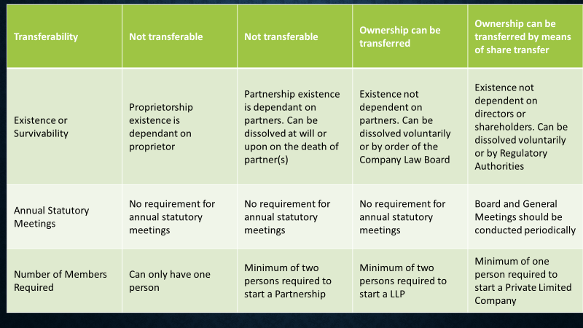

Slide 14
Legal formalities for starting a business
1. Formalizing a business structure and founders agreement
2. Applying for business licenses- Licenses are integral to running any business. Depending on the nature and size of business, several licenses are applicable in India.
3. Understanding taxation and accounting laws
Taxes are part and parcel of every business. There are a broad variety of taxes, such as, central tax, state tax and even local taxes that may be applicable for certain businesses. Different business and operating sectors attract different taxes and knowing this beforehand can prove to be useful.
Recently, the Government of India launched the ‘Startup India’ initiative to promote startups, and introduced many exemptions and tax holidays for startups and new businesses. According to this initiative, a startup can avail income tax exemption for a period of 3 years as well as tax exemptions from capital gains and investments above Fair Market Value. The conditions that startups need to qualify in order to leverage these exemptions are:
The startup should not be more than 7 years old (or 10 years for biotech) from the date of incorporation.
Is incorporated as a Registered Partnership, Limited Liability Company or Private Limited Company.
Turn over in any year should not have exceeded 25 crores.
The startup should not have been formed by splitting or reconstructing an existing business.

Slide 15
4. Adhering to labour laws
Laws with regards to minimum wages, gratuity, PF payment, weekly holidays, maternity benefits, sexual harassment, payment of bonus among others will need to be complied with. It is best to consult a legal counsel to assess the laws applicable to the startup and ensure that the startup is compliant to the required labour laws.
With regards to labour laws, startups registered under the Startup India initiative can complete a self declaration (for nine labour laws) within one year from the date of incorporation in order and get an exemption from labour inspection. The nine labour laws applicable under this scheme are:
The Industrial Disputes Act, 1947
The Trade Unit Act, 1926
Building and Other Constructions Workers’ (Regulation of Employment and Conditions of Service) Act, 1996
The Industrial Employment (Standing Orders) Act, 1946
The Inter-State Migrant Workmen (Regulation of Employment and Conditions of Service) Act, 1979
The Payment of Gratuity Act, 1972
The Contract Labour (Regulation and Abolition) Act, 1970
The Employees’ Provident Funds and Miscellaneous Provisions Act, 1952
The Employees’ State Insurance Act, 1948.

Slide 16
5. Ensuring protection of intellectual property
Intellectual property is the secret behind most of the businesses today, especially for tech centric businesses. Codes, algorithms and research findings among others are some of the most common intellectual property owned by organizations. Startups can leverage the ‘Scheme for Startups Intellectual Property Protection’(SIPP) under the Startup India initiative.
The scheme was set up to nurture and mentor innovative and emerging technologies among startups and help in the protection and commercialization of intellectual property. For the effective implementation of the scheme, facilitators have been empanelled by the Controller General of Patents, Trademarks and Design.
Such facilitators help startups by providing advisory services, assisting in patent filing and disposal of patent application among other services at a minimum charge.

Slide 17
…continued
5. Ensuring effective contract management
As per the Indian Contract Act, 1872, all agreements are contracts if they are made by the free consent of parties competent to contract, for a lawful consideration with a lawful object, and are not expressly declared to be void.
6. Details about winding down the business
Closing a company is a difficult call to make for any entrepreneur. When a startup decides to shut down, all the stakeholders from vendors to employees to customers and investors need to be informed in advance and the whole process must be properly planned and executed in order to make the exit easy on everyone.
From the legal standpoint, there are basically three ways to shut down a startup:
Fast Track Exit Mode
Court or Tribunal Route
Voluntary Closure
Of all the three ways, the Fast Track Exit Mode is the best suited for startups as it allows companies to expedite shutdown at a lower cost and a shorter time period. In order to apply for a fast track exit, a company should (a) not have any assets and liabilities (b) not have had any business operation for the past year. If these two conditions are met, the company can be struck off the registrar of the Registrar of Companies (RoC).

Slide 18
https://razorpay.com/blog/legal-basics-that-every-indian-startup-should-know/

Slide 19
STARTUP INDIA
Startup India is a Government of India flagship initiative to build Startups and nurture innovation. Through this initiative, the Government plans to empower Startup ventures to boost entrepreneurship, economic growth and employment across India.
A Startup means an entity:
incorporated or registered in India not prior to five years
with an annual turnover not exceeding INR 25 crore in any preceding financial year
working towards innovation, development, deployment or commercialization of new products, processes or services driven by technology or intellectual property
The entity shall cease to be a Startup if:
it is formed by splitting up, or reconstruction, of a business already in existence
its turnover for the previous financial years has exceeded INR 25 crore
it has completed 5 years from the date of incorporation/registration
Further, the Startup shall be eligible for tax benefits only after it has obtained certification
from the Inter-Ministerial Board, set up for such purpose.

Slide 20
Startup India’s 19-Point Action Plan
Self-certification Compliance
Single Point of Contact via Startup India Hub
Simplifying Processes with Mobile App and Portal
(for registration, filing compliances & obtaining information)
Legal Support, Fast Tracking & 80% reduction in patent registration fee
Relaxed Norms of Public Procurement
Easier & Faster Exit
Funding Support via a Fund of Funds corpus of INR 10,000 crore
Credit Guarantee Funding
Tax Exemption on Capital gains
3-Year Income Tax Exemption

Slide 21
CONTINUED…
Tax Exemption on Investments above Fair Market Value (FMV)
Annual Startup Fests (national & international)
Launch of World-class Innovation Hubs under Atal Innovation Mission (AIM)
Set up of country-wide Incubator Network
Innovation Centres to augment Incubation and R&D
Research Parks to propel innovation
Promote Entrepreneurship in Biotechnology
Innovation Focused Programs for Students
Annual Incubator Grand Challenge

Slide 22
MAKE IN INDIA
Make in India is an initiative by the Government of India to make and encourage companies to manufacture in India and incentivise dedicated investments into manufacturing. The policy approach was to create a conducive environment for investments, develop a modern and efficient infrastructure, and open up new sectors for foreign capital. The initiative targeted 25 economic sectors for job creation and skill enhancement, and aimed "to transform India into a global design and manufacturing hub."
"Make in India" had three stated objectives:
to increase the manufacturing sector's growth rate to 12-14% per annum;
to create 100 million additional manufacturing jobs in the economy by 2022;
to ensure that the manufacturing sector's contribution to GDP is increased to 25% by 2022 (later revised to 2025).^{[4]}

Slide 23
RESULT OF MAKE IN INDIA
After the launch, India gave investment commitments worth ₹16.40 lakh crore (US$230 billion) and investment inquiries worth of ₹1.5 lakh crore (US$21 billion) between September 2014 to February 2016. As a result, India emerged as the top destination globally in 2015 for foreign direct investment (FDI),
As per the current policy, 100% Foreign Direct Investment (FDI) is permitted in all 100 sectors, except for Space industry (74%), defence industry (49%) and Media of India (26%). Japan and India had also announced a US$12 billion 'Japan-India Make-in-India Special Finance Facility" fund to push investment.
In line with the Make in India, individual states too launched their own local initiatives, such as 'Make in Odisha,' 'Tamil Nadu Global Investors Meet,' 'Vibrant Gujarat,' 'Happening Haryana' and 'Magnetic Maharashtra. India received US$60 billion FDI in FY 2016–17.
The World Bank's 2019 Ease of Doing Business report acknowledges India's jump of 23 positions against its rank of 100 in 2017 to be placed now at 63rd rank among 190 countries.

Slide 24
INSTITUTIONAL SUPPORT TO AN ENTREPRENEUR
This institutional support system has been designed at following four levels:
1. Central Government
2. State Government
3. Non-Government Support System
4. District Industries Centres (DIC).

Slide 25
Institutional support to entrepreneur
Non-Government Support System
State Government
District Industries Centre
Central Government
Indian Council of Small Industries (ICSI)
Laghu Udyog Bharti (LUB)
Federation of Indian Chambers of Commerce and Industry (FICCI)
Associated Chambers of Commerce and Industry of India (ASSOCHAM):
Confederation of Indian Industry (CII):
Small Scale Industries Board (SSIB)
NABARD
SIDO
NSIC
State Financial Corporation (SFC)
State Small Industries Development Corporation (SSIDC)
Technical Consultancy Organisations (TCOs):
Khadi and Village Industries Commission (KVIC):
Industrial Estate

Slide 26
https://www.businessmanagementideas.com/entrepreneurship-2/institutional-support-system-for-entrepreneurs/18184
LINK FOR MORE ON INSTITUTIONAL SUPPORT TO ENTREPRENEURS

Slide 27
CENTRAL GOVERNMENT
I) Small Scale Industries Board (SSIB):
It was established in 1954 to provide effective coordination and inter- institutional linkages for the benefit of small scale sector.
ii) National Bank for Agriculture and Rural Development (NABARD):
NABARD is designated as an apex development bank in the country. This national bank was established in 1982 by a Special Act of the Parliament, with a mandate to uplift rural India by facilitating credit flow in agricul­ture, cottage and village industries, handicrafts and small-scale industries.
iii) Small Industries Development Organisation (SIDO):
It was constituted in 1954 to develop support services for promotion of SSS. Over the years, it has seen its role evolve into an agency for advocacy, hand holding and facilitation for the small industries sector
iv) National Small Industries Corporation (NSIC):
The National Small Industries Corporation (NSIC) Ltd. was established by the Government as a Public Sector Company in 1955.

Slide 28
STATE GOVERNMENT INSTITUTION
State Financial Corporation (SFC):
i. To provide term loans for the acquisition of land, building, plant and machinery.
ii. To promote of self-employment.
iii. To encourage women entrepreneurs
iv. To bring about expansion of industry
v. To provide seed capital assistance.
State Small Industries Development Corporation (SSIDC):
The State Small Industries Development Corporations (SSIDC) were set up in various states under the companies’ act 1956, as state government undertakings to cater to the primary developmental needs of the small tiny and village industries in the state/union territories under their juris­diction.

Slide 29
NON GOVERNMENT INSTITUTION
Indian Council of Small Industries (ICSI):
It was established in 1979 to help tiny, cottage and small industries and artisans of rural areas. Membership of ICSI constitutes about 1500 associations of the decentralized sector.
Laghu Udyog Bharti (LUB):
Laghu Udyog Bharti (LUB) was founded in 1995 to promote and safe­guard the interest of tiny and small scale industries.
Federation of Indian Chambers of Commerce and Industry (FICCI):
The FICCI was established in 1927 as the national agency through which the chambers of commerce and trade association in India could crystallize their views on current economic problems.
Associated Chambers of Commerce and Industry of India (ASSOCHAM):
Assocham is another apex organisation like FICCI to which some of the older chambers of commerce are affiliated. It was founded in December 1920.
Confederation of Indian Industry (CII):
It was created in 1992 by changing the name of Confederation of Engineering Industry.

Slide 30
FUTURE OF ENTREPRENEURSHIP
The future of eCommerce is poised for rapid evolution, driven by advances in technology, changing consumer behavior, and new business models. Key trends shaping the future include:
1. Artificial Intelligence (AI) and Machine Learning (ML)
Personalization: AI and ML are enabling hyper-personalized shopping experiences. Algorithms can analyze customer behavior, preferences, and past purchases to offer tailored product recommendations, dynamic pricing, and targeted marketing campaigns.
Chatbots and Virtual Assistants: AI-powered chatbots provide 24/7 customer service, handle inquiries, and even facilitate product searches with conversational AI, enhancing the overall shopping experience.
2. Augmented Reality (AR) and Virtual Reality (VR)
Enhanced Shopping Experiences: AR and VR allow customers to virtually try on clothes, accessories, or preview how furniture will look in their homes. This helps reduce uncertainty and returns, creating a more interactive experience.
Virtual Showrooms: Brands are increasingly using VR to create immersive online shopping environments, allowing users to explore and interact with products in a virtual space.

Slide 31
3. Voice Commerce
Smart Speakers and Assistants: Devices like Amazon Echo and Google Home are making voice shopping more common. Consumers are increasingly using voice commands to search for products, place orders, and even reorder essentials.
Natural Language Processing (NLP): Advances in NLP will enhance the accuracy of voice search, making it easier for consumers to find exactly what they want, while brands can optimize for voice-based queries.
4. Sustainability and Ethical Commerce
Eco-Friendly Practices: Consumers are more conscious about the environmental impact of their purchases. eCommerce platforms are focusing on sustainable packaging, carbon-neutral delivery, and promoting products from ethically sourced brands.
Circular Economy Models: Online platforms that facilitate buying and selling secondhand or refurbished goods, such as clothing and electronics, are gaining popularity as consumers prioritize reducing waste.
5. Social Commerce
Shoppable Social Media: Platforms like Instagram, Facebook, TikTok, and Pinterest are increasingly integrating shopping features, allowing users to purchase products directly within social apps. This blurs the line between social interaction and eCommerce.
Influencer Marketing: Influencers are playing a major role in driving eCommerce, with brands leveraging their reach to sell products directly through posts, videos, and live streams.

Slide 32
6. Subscription and Direct-to-Consumer (D2C) Models
Subscription Services: The rise of subscription-based models (for everything from meal kits to beauty products) reflects a shift towards convenience and curated experiences.
D2C Brands: Direct-to-consumer companies continue to bypass traditional retailers, offering personalized experiences, lower costs, and stronger brand-customer relationships.
7. Omnichannel Integration
Seamless Integration: Consumers increasingly expect a seamless experience across online, mobile, and physical stores. Retailers are enhancing their omnichannel strategies to integrate digital and in-store experiences, such as "buy online, pick up in-store" (BOPIS) and curbside pickup.
Connected Devices: IoT and connected devices will also play a role in this, allowing consumers to shop via various channels, including wearables and smart home devices.
8. Blockchain and Cryptocurrency
Transparent Supply Chains: Blockchain technology could enhance transparency in the supply chain, helping consumers verify product authenticity, trace sourcing, and ensure ethical practices.
Cryptocurrency Payments: As digital currencies like Bitcoin and Ethereum gain mainstream acceptance, more eCommerce platforms may integrate them as payment options, offering customers greater flexibility and privacy.

Slide 33
9. Faster and More Flexible Delivery
Same-Day Delivery: Customers are demanding faster delivery, and eCommerce companies are investing in logistics, automation, and partnerships to make same-day or even one-hour delivery possible.
Drones and Autonomous Vehicles: Drone deliveries and autonomous vehicles are emerging technologies that could revolutionize logistics, making last-mile deliveries faster and more efficient.
10. Mobile Commerce (M-Commerce)
Mobile-First Shopping: As more consumers shop via their smartphones, mobile commerce is becoming the dominant eCommerce channel. Mobile-optimized websites and apps, along with digital wallets, will be key to improving the mobile shopping experience.
Progressive Web Apps (PWAs): PWAs combine the best features of websites and apps, offering fast, reliable, and engaging experiences on mobile without requiring a download, thus streamlining the mobile shopping journey.
11. Data Privacy and Security
Stronger Privacy Protections: As data breaches and privacy concerns grow, eCommerce companies must invest in stronger data security measures and comply with global regulations (e.g., GDPR, CCPA) to protect customer information.
Decentralized Data Control: The future might see consumers taking more control over their data, with blockchain-based solutions offering decentralized identity management, where users have more say over what data is shared.
.

Slide 34
12. Global eCommerce Expansion
Cross-Border Commerce: The growing ease of cross-border eCommerce, thanks to improved logistics, localized experiences, and better payment solutions, is enabling businesses to reach new global audiences.
Localized Experiences: To succeed in international markets, companies are focusing on offering localized shopping experiences, including language support, regional payment methods, and culturally relevant marketing
13. Green Logistics
Sustainable Delivery: Beyond just the product, consumers are also looking for environmentally friendly shipping options. The future of eCommerce will include more electric vehicles, optimized delivery routes, and eco-friendly packaging to reduce the carbon footprint of deliveries.

