Slide 1
Theory of Demand

Slide 2
Demand
Demand is an economic principle referring to a consumer's desire to purchase goods and services backed by willingness and ability to pay a price for a specific good or service.
A desire will be considered demand when it is backed by adequate purchasing power and readiness to part with money in exchange for the goods that are desired.
Thus, demand in economics should have the following characteristics:
Desire to have a particular commodity
Ability to purchase: Purchasing power will depend on –
  Income of the consumer
  Price of the commodity
Willingness to spend

Slide 3
Law of Demand
The law of demand is a fundamental principle of economics which states that at a higher price consumers will demand a lower quantity of a good.
The law of demand states that other things remaining the same, quantity demanded of commodity ‘X’ is inversely related to the price of ‘X’.
The law of demand is based on the assumption of ceteris paribus, i.e. ‘other things will remain unchanged.’

Slide 4
Assumptions of Law of Demand
No change in the income : The first assumption regarding the law of demand to operate is that the income of the consumer must remain same or should not change (i.e. neither rise nor fall).
  Income is assumed to remain constant, since, its rise may lure the consumer to buy more goods and raise demand despite an increase in the commodity prices.
No change in size and composition of the population : The second assumption for the law of demand to function is that the population must neither increase nor decrease.
  Here, it is assumed that the population size and its composition must remain constant because a rise in the number of people would also increase demand for commodities even when their prices are higher and vice-versa.

Slide 5
3. No change in prices of related goods
The third basic assumption of the law of demand considers that the Prices of Related Goods (i.e. Substitute Goods and Complementary Goods) don't change and remains same.
Here, it is assumed that the Prices of Substitute Goods (like Tea and Coffee) and Complementary Goods (e.g. Petrol and Cars) should not change. It is considered so, since, a change in consumer's liking or choice makes the law of demand stand invalid and inapplicable.
4. No change in consumer's taste, preference, etc.
The fourth assumption of the law of demand considers that the taste, preference, habit, fashion, etc., of the consumer, should remain unchanged. That is, there should not arise a newer choice or change in the mood to try something different.
Here, it is assumed that the consumer's taste, preference, habit, style, so on., should not change because it breaks the functionality or validity of the law of demand.

Slide 6
5. No expectation of a price change in future.
The fifth basic assumption of Law of Demand to remain valid is that not to expect any future possibilities regarding a change or fluctuation in the prices of commodities.
Here, it is assumed not to keep any expectation of future price change because it will affect the current demand of goods.
6. No change in the climatic conditions
The sixth assumption of the law of demand is that the weather conditions or climate of a region or geographical area should remain same and not alter at all.
There is a need to assume the climate to stay unchanged because a seasonal shift changes the essential needs of people.

Slide 7
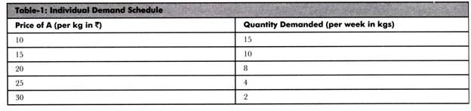
Demand Schedule
Demand schedule refers to a tabular representation of the relationship between price and quantity demanded. It demonstrates the quantity of a product demanded by an individual or a group of individuals at specified price and time.
Demand schedule can be categorized into two types:
Individual Demand Schedule: Refers to a tabular representation of quantity of products demanded by an individual at different prices and time.

Slide 8
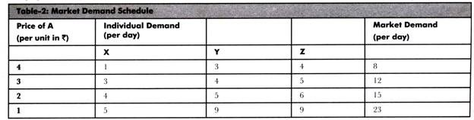
Following are the characteristics of individual demand schedule:
a. Demonstrates the effect of changing price on the buying behavior of customers rather than change in the demand for a product
b. Expresses the disparity in demand with the difference in the product’s price
c. Represents that at higher prices the quantity demanded reduces and vice versa
ii. Market Demand Schedule: Shows a tabular representation of quantity demanded in aggregate by individuals at different prices and time. Therefore, it demonstrates the demand of a product in the market at different prices.

Slide 9
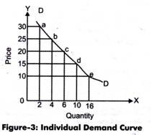
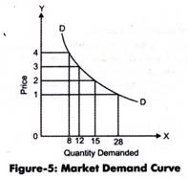
Demand Curve
Demand curve shows a graphical representation of demand schedule. It can be made by plotting price and quantity demanded on a graph. In demand curve, price is represented on Y-axis, while quantity demanded is represented on X-axis on the graph.
Demand curve can be of two types, namely, individual demand curve and market demand curve. Individual demand curve is the graphical representation of individual demand schedule, while market demand curve is the representation of market demand schedule.

Slide 10
Slope of the Demand Curve
The law of demand expresses the negative relationship between price and quantity demanded and hence demand curve slopes downward.
Causes of Downward Sloping Demand Curve
The following are some of the causes explaining why demand curves always slope downwards:
1) Relationship between Marginal Utility and Price
A consumer’s equilibrium takes place at a point where MU_{x} = P_{x .}
If we assume that price of commodity X falls, Px will fall below the level of MU_{x}. This will disturb the consumer’s equilibrium.
To bring back the equality, MU_{x} should reduce to the level of P_{x}.
For MU_{x} to reduce, quantity demanded should be increased.
Hence, as price falls, quantity demanded rises.

Slide 11
2) Substitution effect
Consumers often classify various commodities as substitutes. For example, many Indian consumers may substitute coffee and tea with each other for various reasons. When the price of coffee rises, consumers may switch to buying tea more as it will become relatively cheaper.
Economists refer to this as the substitution effect. Hence, if the price of tea reduces, its demand will increase and the demand curve will be downward sloping.
3) Income effect
According to this principle, the real income of people increases when the prices of commodities reduce. This happens because they spend less in case of falling prices and end up with more money. With more money, they will, in turn, purchase more and more. Therefore, the demand increases as prices fall.

Slide 12
4) New buyers
Whenever the price of a commodity decreases, new buyers enter the market and start purchasing it. This is because they were unable to purchase it when the prices were high but now they can afford it. Thus, as the price falls, the demand rises and the demand curve becomes downward sloping.
5) Old buyers
This rule is basically a corollary of the new buyers rule. When the price of a commodity decreases, the old buyers can afford to buy even more quantities of it. As a result, this results in demand increasing and the demand curve slopes downwards.

Slide 13
Exceptions to the Law of Demand
1. Speculative Demand:
Law of demand will not hold good when people expect prices to rise still further. In that case, although the prices have risen today consumers will demand more in anticipation of further increase in price.
This type of behaviour can be observed in the stock exchange.
2. Giffen Goods:
A Giffen good is a low income, non-luxury product that have very few close substitutes and that defies standard economic and consumer demand theory.
Demand for Giffen goods rises when the price rises and falls when the price falls.
This results in an upward-sloping demand curve, contrary to the fundamental law of demand which creates a downward sloping demand curve.
Examples of Giffen goods can include bread, rice, and wheat.

Slide 14
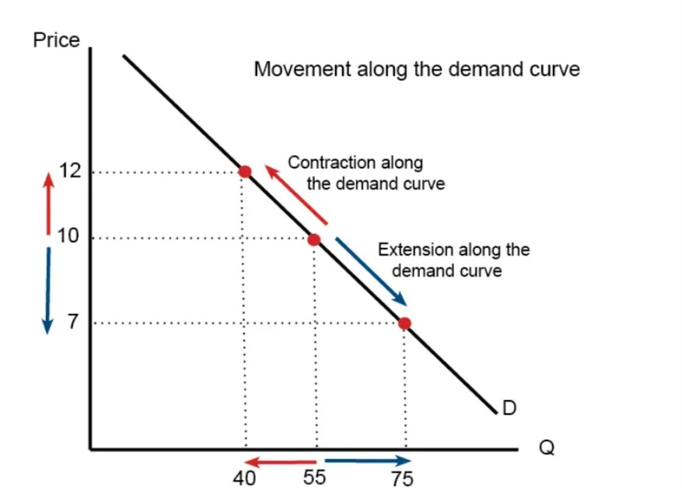
Changes in Demand
Movement along demand curve: When price of a good changes, with no change in any other determinants of demand, it can be shown by movement on the same demand curve.
Thus, other things remaining the same, if price falls, quantity demanded will rise, which is called as extension of demand and if price rises, quantity demanded will fall which is called as contraction of demand.

Slide 15
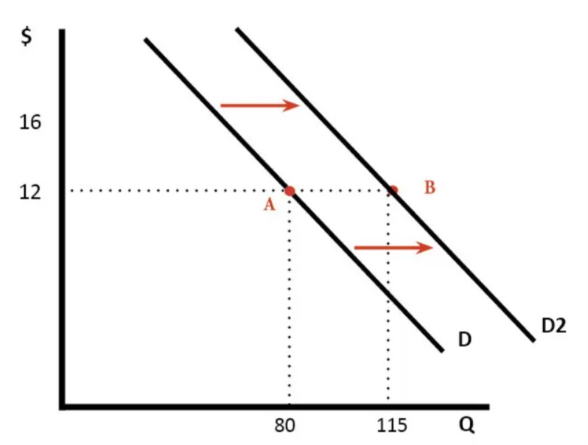
B. Shifts in demand curve: The demand curve will shift upward (to the right) or downward (to the left) when there is a change in the non-price determinants of demand.
E.g. if consumer’s income rises, the demand curve will shift to the right. On the other hand, if there is a fall in income the demand curve will shift to the left.

