Slide 1
Module 2

Slide 2
Internet Protocols
In the world of technology, there are vast numbers of users' communicating with different devices in different languages.
That also includes many ways in which they transmit data along with the different software they implement.
So, communicating worldwide will not be possible if there were no fixed 'standards' that will govern the way user communicates for data as well as the way our devices treat those data.
“Protocols" are set of rules that help in governing the way a particular technology will function for communication.
In other words, it can be said that the protocols are digital languages implemented in the form of networking algorithms.

Slide 3
Types of Protocols
  Transmission Control Protocol (TCP)
  Internet Protocol (IP)
  User Datagram Protocol (UDP)
  Post office Protocol (POP)
  Simple mail transport Protocol (SMTP)
  File Transfer Protocol (FTP)
  Hyper Text Transfer Protocol (HTTP)
  Hyper Text Transfer Protocol Secure (HTTPS)
  Telnet
  Gopher

Slide 4
Transmission Control Protocol (TCP): TCP is a popular communication protocol which is used for communicating over a network. It divides any message into series of packets that are sent from source to destination and there it gets reassembled at the destination.
Internet Protocol (IP): IP is designed explicitly as addressing protocol. It is mostly used with TCP. The IP addresses in packets help in routing them through different nodes in a network until it reaches the destination system. TCP/IP is the most popular protocol connecting the networks.

Slide 5
User Datagram Protocol (UDP): UDP is a substitute communication protocol to TCP implemented primarily for creating loss-tolerating and low-latency linking between different applications.
Post office Protocol (POP): POP3 is designed for receiving incoming E-mails.
Simple mail transport Protocol (SMTP): SMTP is designed to send and distribute outgoing E-Mail.
File Transfer Protocol (FTP): FTP allows users to transfer files from one machine to another. Types of files may include program files, multimedia files, text files, and documents, etc.

Slide 6
Hyper Text Transfer Protocol (HTTP):
HTTP is designed for transferring a hypertext among two or more systems.
HTML tags are used for creating links.
These links may be in any form like text or images.
HTTP is designed on Client-server principles which allow a client system for establishing a connection with the server machine for making a request.
The server acknowledges the request initiated by the client and responds accordingly.

Slide 7
Hyper Text Transfer Protocol Secure (HTTPS):
HTTPS is abbreviated as Hyper Text Transfer Protocol Secure is a standard protocol to secure the communication among two computers one using the browser and other fetching data from web server.
HTTP is used for transferring data between the client browser (request) and the web server (response) in the hypertext format, same in case of HTTPS except that the transferring of data is done in an encrypted format.
So it can be said that https thwart hackers from interpretation or modification of data throughout the transfer of packets.

Slide 8
Telnet:
Telnet is a set of rules designed for connecting one system with another.
The connecting process here is termed as remote login.
The system which requests for connection is the local computer, and the system which accepts the connection is the remote computer.
Gopher:
Gopher is a collection of rules implemented for searching, retrieving as well as displaying documents from isolated sites.
Gopher also works on the client/server principle.

Slide 9
OSI Model
OSI stands for Open Systems Interconnection.
It has been developed by ISO – ‘International Organization of Standardization‘, in the year 1984.
It is a 7 layer architecture with each layer having specific functionality to perform.
All these 7 layers work collaboratively to transmit the data from one person to another across the globe.

Slide 10
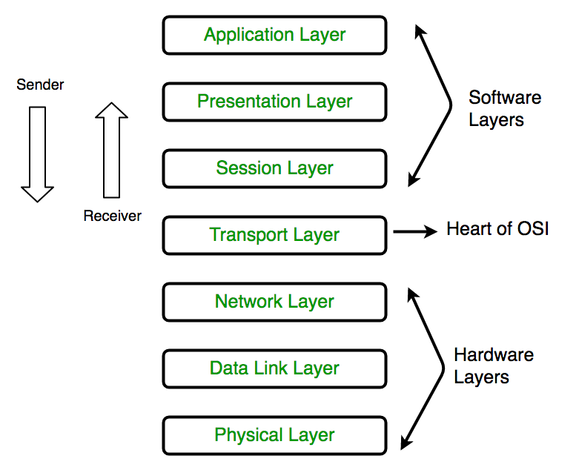
These are the seven layers of the OSI model
Physical Layer
Datalink Layer
Network Layer
Transport Layer
Session Layer
Presentation Layer
Application Layer

Slide 11
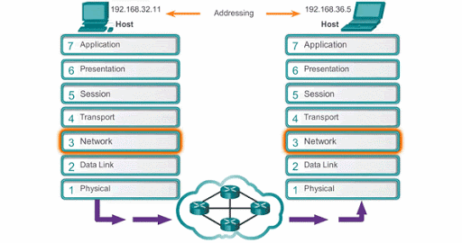
Working of OSI Layer

Slide 12
1. Physical Layer (Layer 1) :
The lowest layer of the OSI reference model is the physical layer.
It is responsible for the actual physical connection between the devices.
The physical layer contains information in the form of bits.
It is responsible for transmitting individual bits from one node to the next.
When receiving data, this layer will get the signal received and convert it into 0s and 1s and send them to the Data Link layer, which will put the frame back together.

Slide 13
The functions of the physical layer are :
Bit synchronization: The physical layer provides the synchronization of the bits by providing a clock. This clock controls both sender and receiver thus providing synchronization at bit level.
Bit rate control: The Physical layer also defines the transmission rate i.e. the number of bits sent per second.
Physical topologies: Physical layer specifies the way in which the different, devices/nodes are arranged in a network i.e. bus, star or mesh topology.
Transmission mode: Physical layer also defines the way in which the data flows between the two connected devices. The various transmission modes possible are: Simplex, half-duplex and full-duplex.

Slide 14
2. Data Link Layer (DLL) (Layer 2) :
The data link layer is responsible for the node to node delivery of the message.
The main function of this layer is to make sure data transfer is error-free from one node to another, over the physical layer.
When a packet arrives in a network, it is the responsibility of DLL to transmit it to the Host using its MAC address.
The packet received from Network layer is further divided into frames depending on the frame size of NIC(Network Interface Card).
DLL also encapsulates Sender and Receiver’s MAC address in the header.

Slide 15
The functions of the data Link layer are :
Framing:
Framing is a function of the data link layer.
It provides a way for a sender to transmit a set of bits that are meaningful to the receiver.
This can be accomplished by attaching special bit patterns to the beginning and end of the frame.
Physical addressing:
After creating frames, Data link layer adds physical addresses (MAC address) of sender and/or receiver in the header of each frame.

Slide 16
Error control:
Data link layer provides the mechanism of error control in which it detects and retransmits damaged or lost frames.
Flow Control:
The data rate must be constant on both sides else the data may get corrupted thus , flow control coordinates that amount of data that can be sent before receiving acknowledgement.
Access control:
When a single communication channel is shared by multiple devices, MAC sub-layer of data link layer helps to determine which device has control over the channel at a given time.

Slide 17
3. Network Layer (Layer 3) :
Network layer works for the transmission of data from one host to the other located in different networks.
It also takes care of packet routing i.e. selection of the shortest path to transmit the packet, from the number of routes available.
The sender & receiver’s IP address are placed in the header by the network layer.

Slide 18
The functions of the Network layer are :
Routing: The network layer protocols determine which route is suitable from source to destination. This function of network layer is known as routing.
Logical Addressing: In order to identify each device on internetwork uniquely, network layer defines an addressing scheme. The sender & receiver’s IP address are placed in the header by network layer. Such an address distinguishes each device uniquely and universally.

Slide 19
4. Transport Layer (Layer 4) :
Transport layer provides services to application layer and takes services from network layer.
The data in the transport layer is referred to as Segments.
It is responsible for the End to End Delivery of the complete message.
The transport layer also provides the acknowledgement of the successful data transmission and re-transmits the data if an error is found.

Slide 20
The functions of the transport layer are :
Segmentation and Reassembly: This layer accepts the message from the (session) layer , breaks the message into smaller units . Each of the segment produced has a header associated with it. The transport layer at the destination station reassembles the message.
Service Point Addressing: In order to deliver the message to correct process, transport layer header includes a type of address called service point address or port address. Thus by specifying this address, transport layer makes sure that the message is delivered to the correct process.

Slide 21
The services provided by the transport layer :
Connection Oriented Service: It is a three-phase process which include
– Connection Establishment – Data Transfer – Termination / disconnection
In this type of transmission, the receiving device sends an acknowledgement, back to the source after a packet or group of packet is received. This type of transmission is reliable and secure.
Connection less service: It is a one-phase process and includes Data Transfer. In this type of transmission, the receiver does not acknowledge receipt of a packet. This approach allows for much faster communication between devices. Connection-oriented service is more reliable than connectionless Service.

Slide 22
5. Session Layer (Layer 5) :
This layer is responsible for establishment of connection, maintenance of sessions, authentication and also ensures security.
The functions of the session layer are :
Session establishment, maintenance and termination: The layer allows the two processes to establish, use and terminate a connection.
Synchronization : This layer allows a process to add checkpoints which are considered as synchronization points into the data. These synchronization point help to identify the error so that the data is re-synchronized properly, and ends of the messages are not cut prematurely and data loss is avoided.
Dialog Controller : The session layer allows two systems to start communication with each other in half-duplex or full-duplex.

Slide 23
6. Presentation Layer (Layer 6) :
Presentation layer is also called the Translation layer. The data from the application layer is extracted here and manipulated as per the required format to transmit over the network.
The functions of the presentation layer are :
Translation : For example, ASCII to EBCDIC.
Encryption/ Decryption : Data encryption translates the data into another form or code. The encrypted data is known as the cipher text and the decrypted data is known as plain text. A key value is used for encrypting as well as decrypting data.
Compression: Reduces the number of bits that need to be transmitted on the network.

Slide 24
7. Application Layer (Layer 7) :
At the very top of the OSI Reference Model stack of layers, we find Application layer which is implemented by the network applications.
These applications produce the data, which has to be transferred over the network.
This layer also serves as a window for the application services to access the network and for displaying the received information to the user.
Ex: Application – Browsers, Skype Messenger etc.
**Application Layer is also called as Desktop Layer.

Slide 25
The functions of the Application layer are :
Network Virtual Terminal
FTAM-File transfer access and management
Mail Services
Directory Services
OSI model acts as a reference model and is not implemented in the Internet because of its late invention. Current model being used is the TCP/IP model.

Slide 26
TCP/IP (Transmission Control Protocol/Internet Protocol)
TCP/IP, is a suite of communication protocols used to interconnect network devices on the internet.
TCP/IP can also be used as a communications protocol in a private computer network (an intranet or extranet).
The entire IP suite -- a set of rules and procedures -- is commonly referred to as TCP/IP.
TCP and IP are the two main protocols, though others are included in the suite.
The TCP/IP protocol suite functions as an abstraction layer between internet applications and the routing/switching fabric.

Slide 27
TCP/IP specifies how data is exchanged over the internet by providing end-to-end communications that identify how it should be broken into packets, addressed, transmitted, routed and received at the destination.
TCP/IP requires little central management and is designed to make networks reliable with the ability to recover automatically from the failure of any device on the network.

Slide 28
The two main protocols in the IP suite serve specific functions.
TCP defines how applications can create channels of communication across a network.
It also manages how a message is assembled into smaller packets before they are then transmitted over the internet and reassembled in the right order at the destination address.
IP defines how to address and route each packet to make sure it reaches the right destination.
Each gateway computer on the network checks this IP address to determine where to forward the message.

Slide 29
A subnet mask is what tells a computer, or other network device, what portion of the IP address is used to represent the network and what part is used to represent hosts, or other computers, on the network.
Network address translation (NAT) is the virtualization of IP addresses.
NAT helps improve security and decrease the number of IP addresses an organization needs.

Slide 30
Common TCP/IP protocols include the following:
HTTP (Hypertext Transfer Protocol), which handles the communication between a web server and a web browser;
HTTPS (HTTP Secure), which handles secure communication between a web server and a web browser; and
FTP (File Transfer Protocol), which handles transmission of files between computers.

Slide 31
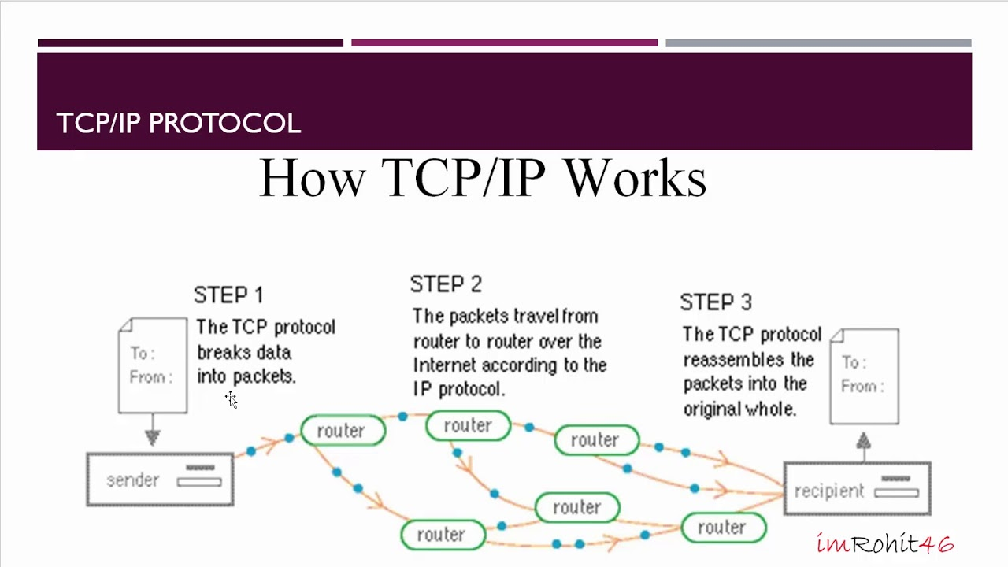
How TCP/IP works
TCP/IP uses the client-server model of communication in which a user or machine (a client) is provided a service, like sending a webpage, by another computer (a server) in the network.
Collectively, the TCP/IP suite of protocols is classified as stateless, which means each client request is considered new because it is unrelated to previous requests. Being stateless frees up network paths so they can be used continuously.

Slide 32
The transport layer itself, however, is stateful.
It transmits a single message, and its connection remains in place until all the packets in a message have been received and reassembled at the destination.
The TCP/IP model differs slightly from the seven-layer Open Systems Interconnection (OSI) networking model designed after it.
The OSI reference model defines how applications can communicate over a network.

Slide 33
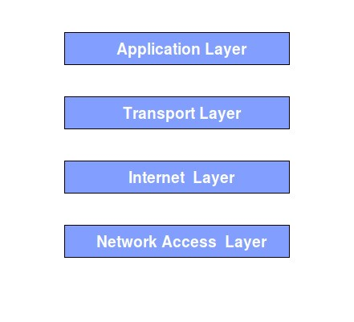
The 4 layers of TCP/IP
TCP/IP functionality is divided into four layers, each of which includes specific protocols:

Slide 34
1. Application layer:
The application layer provides applications with standardized data exchange.
Its protocols include HTTP, FTP, Post Office Protocol 3 (POP3), Simple Mail Transfer Protocol (SMTP) and Simple Network Management Protocol (SNMP). At the application layer, the payload is the actual application data.

Slide 35
2. Transport layer
The transport layer is responsible for maintaining end-to-end communications across the network.
TCP handles communications between hosts and provides flow control, multiplexing and reliability.
The transport protocols include TCP and User Datagram Protocol (UDP), which is sometimes used instead of TCP for special purposes.

Slide 36
3. Network layer
The network layer, also called the internet layer, deals with packets and connects independent networks to transport the packets across network boundaries.
The network layer protocols are IP and Internet Control Message Protocol (ICMP), which is used for error reporting.
4. Physical layer
The physical layer, also known as the network interface layer or data link layer, consists of protocols that operate only on a link -- the network component that interconnects nodes or hosts in the network.
The protocols in this lowest layer include Ethernet for local area networks (LANs) and Address Resolution Protocol (ARP).

Slide 37
The importance of TCP/IP
TCP/IP is nonproprietary and, as a result, is not controlled by any single company.
Therefore, the IP suite can be modified easily.
It is compatible with all operating systems (OSes), so it can communicate with any other system.
The IP suite is also compatible with all types of computer hardware and networks.
TCP/IP is highly scalable and, as a routable protocol, can determine the most efficient path through the network.
It is widely used in current internet architecture.

Slide 38
The history of TCP/IP
The Defense Advanced Research Projects Agency (DARPA), the research branch of the U.S. Department of Defense (DOD), created the TCP/IP model in the 1970s for use in ARPANET, a wide area network (WAN) that preceded the internet.
TCP/IP was originally designed for the UnixOS, and it has been built into all of the OSes that came after it.
The TCP/IP model and its related protocols are now maintained by the Internet Engineering Task Force (IETF).

Slide 39
File Transfer Protocol (FTP)
FTP is a standard internet protocol provided by TCP/IP used for transmitting the files from one host to another.
It is mainly used for transferring the web page files from their creator to the computer that acts as a server for other computers on the internet.
It is also used for downloading the files to computer from other servers.
Objectives of FTP
It provides the sharing of files.
It is used to encourage the use of remote computers.
It transfers the data more reliably and efficiently.

Slide 40
Why FTP?
Although transferring files from one system to another is very simple and straightforward, but sometimes it can cause problems.
For example, two systems may have different file conventions.
Two systems may have different ways to represent text and data.
Two systems may have different directory structures.
FTP protocol overcomes these problems by establishing two connections between hosts.
One connection is used for data transfer, and another connection is used for the control connection.

Slide 41
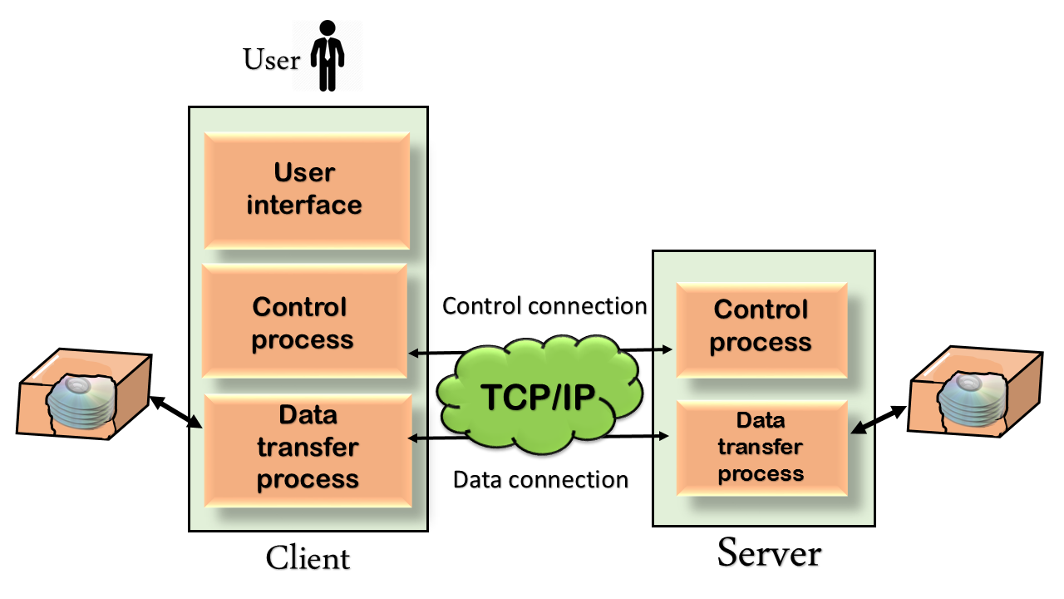
Mechanism of FTP

Slide 42
There are two types of connections in FTP:
Control Connection:
The control connection uses very simple rules for communication.
Through this, we can transfer a line of command or line of response at a time.
The control connection is made between the control processes.
This connection remains connected during the entire interactive FTP session.
Data Connection:
The Data Connection uses very complex rules as data types may vary.
The data connection is made between data transfer processes.
The data connection opens when a command comes for transferring the files and closes when the file is transferred.

Slide 43
FTP Clients
FTP client is a program that implements a file transfer protocol which allows you to transfer files between two hosts on the internet.
It allows a user to connect to a remote host and upload or download the files.
It has a set of commands that we can use to connect to a host, transfer the files between you and your host and close the connection.
The FTP program is also available as a built-in component in a Web browser.
This GUI based FTP client makes the file transfer very easy and also does not require to remember the FTP commands.

Slide 44
Advantages of FTP:
Speed: The FTP is one of the fastest way to transfer the files from one computer to another computer.
Efficient: It is more efficient as we do not need to complete all the operations to get the entire file.
Security: To access the FTP server, we need to login with the username and password.
Back & forth movement: FTP allows us to transfer the files back and forth. Suppose you are a manager of the company, you send some information to all the employees, and they all send information back on the same server.

Slide 45
Disadvantages of FTP:
The standard requirement of the industry is that all the FTP transmissions should be encrypted. However, not all the FTP providers are equal and not all the providers offer encryption. So, we will have to look out for the FTP providers that provides encryption.
FTP serves two operations, i.e., to send and receive large files on a network. However, the size limit of the file is 2GB that can be sent. It also doesn't allow you to run simultaneous transfers to multiple receivers.
Passwords and file contents are sent in clear text that allows unwanted eavesdropping. So, it is quite possible that attackers can carry out the brute force attack by trying to guess the FTP password.
It is not compatible with every system.

Slide 46
Computer Networks
There are various types of computer networks available.
We can categorize them according to their size as well as their purpose.
The size of a network should be expressed by the geographic area and number of computers, which are a part of their networks.
It includes devices housed in a single room to millions of devices spread
Some of the most popular network types are:
PAN - Personal Area Network
LAN – Local Area Network
MAN – Metropolitan Area Network
WAN – Wide Area Network

Slide 47
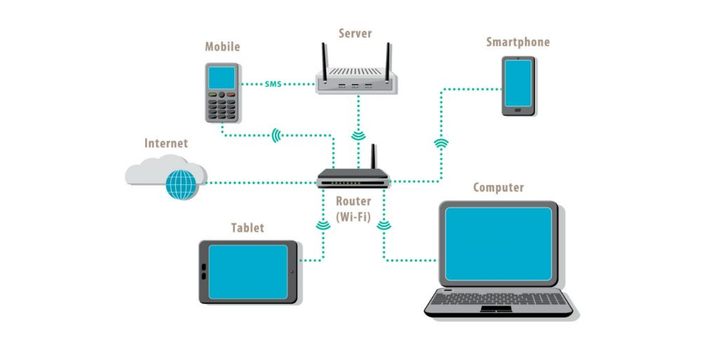
Local Area Network (LAN)
What is LAN?
A Local Area Network (LAN) is a group of computer and peripheral devices which are connected in a limited area such as school, laboratory, home, and office building.
It is a widely useful network for sharing resources like files, printers, games, and other application.
The simplest type of LAN network is to connect computers and a printer in someone's home or office.
In general, LAN will be used as one type of transmission medium.
It is a network which consists of less than 5000 interconnected devices across several buildings.

Slide 48
Features of LAN:
Network size is limited to a small geographical area, presently to a few kilometers.
Data transfer rate is generally high. They range from 100 Mbps to 1000 Mbps.
In general, a LAN uses only one type of transmission medium, commonly category 5 coaxial cables.
A LAN is distinguished from other networks by their topologies. The common topologies are bus, ring, mesh, and star.

Slide 49
Features of LAN:
The number of computers connected to a LAN is usually restricted. In other words, LANs are limitedly scalable.
IEEE 802.3 or Ethernet is the most common LAN. They use a wired medium in conjuncture with a switch or a hub. Originally, coaxial cables were used for communications. But now twisted pair cables and fiber optic cables are also used. Ethernet’s speed has increased from 2.9 Mbps to 400 Gbps.

Slide 50
Wireless LANs (WLAN)
Wireless LANs use high-frequency radio waves instead of cables for communications.
They provide clutter free homes, offices and other networked places.
They have an Access Point or a wireless router or a base station for transferring packets to and from the wireless computers and the internet.
Most WLANs are based on the standard IEEE 802.11 or WiFi.

Slide 51
Virtual LANs (VLAN)
Virtual LANs are a logical group of computers that appear to be on the same LAN irrespective of the configuration of the underlying physical network.
Network administrators partition the networks to match the functional requirements of the VLANs so that each VLAN comprise a subset of ports on a single or multiple switches.
This allows computers and devices on a VLAN to communicate in the simulated environment as if it is a separate LAN.

Slide 52
Characteristics of LAN
Here are important characteristics of a LAN network:
It is a private network, so an outside regulatory body never controls it.
LAN operates at a relatively higher speed compared to other WAN systems.
There are various kinds of media access control methods like token ring and ethernet.

Slide 53
Advantages of LAN
Computer resources like hard-disks, DVD-ROM, and printers can share local area networks. This significantly reduces the cost of hardware purchases.
You can use the same software over the network instead of purchasing the licensed software for each client in the network.
Data of all network users can be stored on a single hard disk of the server computer.
You can easily transfer data and messages over networked computers.
It will be easy to manage data at only one place, which makes data more secure.
Local Area Network offers the facility to share a single internet connection among all the LAN users.

Slide 54
Disadvantages of LAN
LAN will indeed save cost because of shared computer resources, but the initial cost of installing Local Area Networks is quite high.
The LAN admin can check personal data files of every LAN user, so it does not offer good privacy.
Unauthorized users can access critical data of an organization in case LAN admin is not able to secure centralized data repository.
Local Area Network requires a constant LAN administration as there are issues related to software setup and hardware failures

Slide 55
Importance of Local Area Network in an Organization
Reduced Costs: LANs present a significant reduction in Local Area Network hardware costs and efficient resource pooling.
Increased Storage Capacity: By pooling all data into a central data storage server, the number of storage servers required is decreased and the efficiency of operations is increased.
Optimized Flexibility: Data can be accessed by any device from anywhere via Internet connection.‍
Streamlined Communication: Files and messages can be transferred in real time and accessed easily from anywhere on any device.

Slide 56
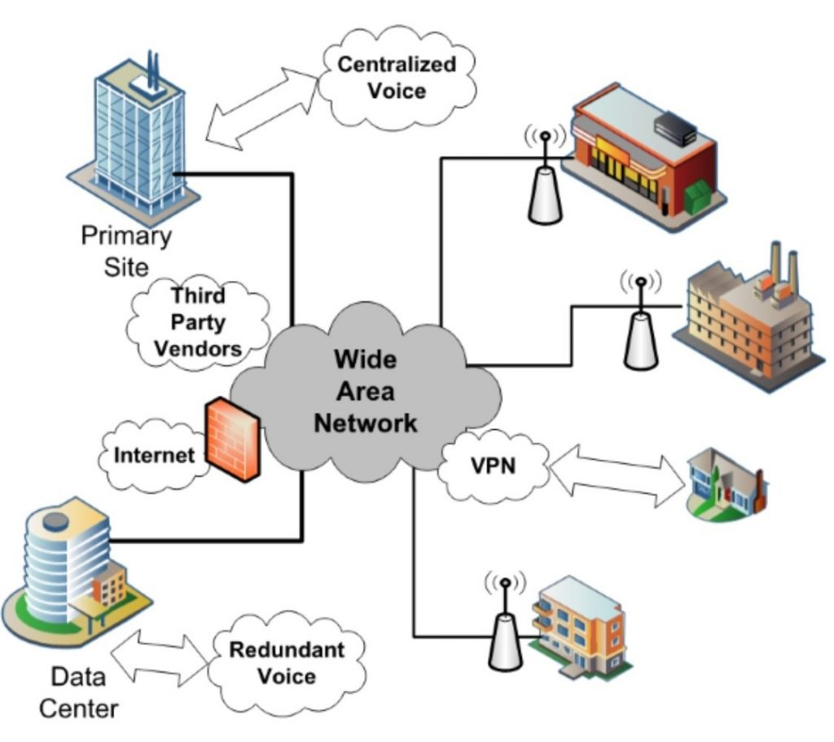
Wide Area Network (WAN)
WAN (Wide Area Network) is another important computer network that which is spread across a large geographical area.
WAN network system could be a connection of a LAN which connects with other LAN's using telephone lines and radio waves.
It is mostly limited to an enterprise or an organization.

Slide 57
Characteristics of WAN:
The software files will be shared among all the users; therefore, all can access to the latest files.
Any organization can form its global integrated network using WAN.

Slide 58
Advantages of WAN
WAN helps you to cover a larger geographical area. Therefore business offices situated at longer distances can easily communicate.
Contains devices like mobile phones, laptop, tablet, computers, gaming consoles, etc.
WLAN connections work using radio transmitters and receivers built into client devices.

Slide 59
Disadvantage of WAN
The initial setup cost of investment is very high.
It is difficult to maintain the WAN network. You need skilled technicians and network administrators.
There are more errors and issues because of the wide coverage and the use of different technologies.
It requires more time to resolve issues because of the involvement of multiple wired and wireless technologies.
Offers lower security compared to other types of networks.

Slide 60
HTML
HTML stands for Hyper Text Markup Language, which is the most widely used language on Web to develop web pages.
HTML was created by Berners-Lee in late 1991 but "HTML 2.0" was the first standard HTML specification which was published in 1995.
HTML 4.01 was a major version of HTML and it was published in late 1999.
Though HTML 4.01 version is widely used but currently we are having HTML-5 version which is an extension to HTML 4.01, and this version was published in 2012.

Slide 61
Why to Learn HTML?
Originally, HTML was developed with the intent of defining the structure of documents like headings, paragraphs, lists, and so forth to facilitate the sharing of scientific information between researchers.
Now, HTML is being widely used to format web pages with the help of different tags available in HTML language.
HTML is a MUST for students and working professionals to become a great Software Engineer specially when they are working in Web Development Domain.

Slide 62
Some of the key advantages of learning HTML:
Create Web site - You can create a website or customize an existing web template if you know HTML well.
Become a web designer - If you want to start a carrier as a professional web designer, HTML and CSS designing is a must skill.
Understand web - If you want to optimize your website, to boost its speed and performance, it is good to know HTML to yield best results.
Learn other languages - Once you understands the basic of HTML then other related technologies like javascript, php, or angular are become easier to understand.

Slide 63
Applications of HTML
Web pages development - HTML is used to create pages which are rendered over the web. Almost every page of web is having html tags in it to render its details in browser.
Internet Navigation - HTML provides tags which are used to navigate from one page to another and is heavily used in internet navigation.
Responsive UI - HTML pages now-a-days works well on all platform, mobile, tabs, desktop or laptops owing to responsive design strategy.
Offline support - HTML pages once loaded can be made available offline on the machine without any need of internet.
Game development- HTML5 has native support for rich experience and is now useful in gaming development arena as well.

Slide 64
URL (Uniform Resource Locator)
Also known as a internet address or web address, a URL (Uniform Resource Locator) is a form of URI and standardized naming convention for addressing documents accessible over the Internet and Intranet.
The URL also specifies how to retrieve that resource, also known as the "protocol", such as HTTP, HTTPS, FTP, etc.

Slide 65
What is a URL?
A URL is human-readable text that was designed to replace the numbers (IP addresses) that computers use to communicate with servers.
They also identify the file structure on the given website.
A URL consists of a protocol, domain name, and path (which includes the specific subfolder structure where a page is located) and has the following basic format:
protocol://domain-name.top-level-domain/path

Slide 66
The protocol indicates how a browser should retrieve information about a resource. The web standard is http:// or https:// (the "s" stands for "secure"),.
The domain name (or hostname) is the human-readable name of the specific location where a resource (in most cases, a website) is located.
Think of the top-level domain (TLD) as something of a category for websites. While you're likely familiar with .com, there is also .edu for educational sites, .gov for governmental sites, and many, many more.

Slide 67
URLs also contain things like the specific folders and/or subfolders that are on a given website, any parameters (like click tracking or session IDs) that might be stored in the URL, and anchors that allow visitors to jump to a specific point in the resource.
There are 3 main benefits of URLs:
    1. Improved user experience
    2. Rankings
    3. Links

Slide 68
Where is the URL located?
A URL is located at the top of the browser window in the address bar or omnibox depending on your browser window.
On desktop computers and laptop, unless your browser is being displayed in fullscreen the URL is always visible.
In most smartphone and tablet browsers, the address bar containing the URL will disappear as you scroll down and only show the domain when visible.
When the address bar is not visible, scroll up the page. If only the domain is shown, tapping on the address bar shows the full address.

Slide 69
Hypertext Transfer Protocol (HTTP)
The Hypertext Transfer Protocol (HTTP) is an application-level protocol for distributed, collaborative, hypermedia information systems.
This is the foundation for data communication for the World Wide Web (i.e. internet) since 1990.
HTTP is a generic and stateless protocol which can be used for other purposes as well using extensions of its request methods, error codes, and headers.

Slide 70
Basically, HTTP is a TCP/IP based communication protocol, that is used to deliver data (HTML files, image files, query results, etc.) on the World Wide Web.
The default port is TCP 80, but other ports can be used as well. It provides a standardized way for computers to communicate with each other.
HTTP specification specifies how clients' request data will be constructed and sent to the server, and how the servers respond to these requests.

Slide 71
Basic Features:
There are three basic features that make HTTP a simple but powerful protocol:
HTTP is connectionless:
HTTP is media independent
HTTP is stateless

Slide 72
Basic Architecture
The HTTP protocol is a request/response protocol based on the client/server based architecture where web browsers, robots and search engines, etc. act like HTTP clients, and the Web server acts as a server.
Client
The HTTP client sends a request to the server in the form of a request method, URI, and protocol version, followed by a MIME-like message containing request modifiers, client information, and possible body content over a TCP/IP connection.

Slide 73
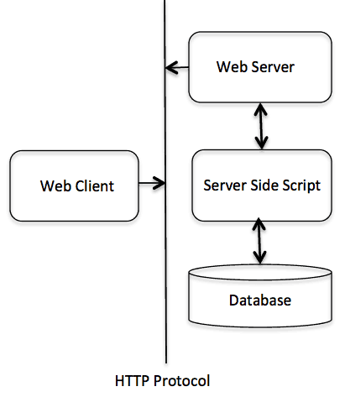
Server
The HTTP server responds with a status line, including the message's protocol version and a success or error code, followed by a MIME-like message containing server information, entity meta information, and possible entity-body content.

Slide 74
HTML Forms
An HTML form is used to collect user input. The user input is most often sent to a server for processing.
The <form> Element
The HTML <form> element is used to create an HTML form for user input:
  <form>
  .
  form elements
  .
  </form>
The <form> element is a container for different types of input elements, such as: text fields, checkboxes, radio buttons, submit buttons, etc.

Slide 75
The <input> Element
The HTML <input> element is the most used form element.
An <input> element can be displayed in many ways, depending on the type attribute.
Here are some examples:
Type | Description
<input type="text"> | Displays a single-line text input field
<input type="radio"> | Displays a radio button (for selecting one of many choices)
<input type="checkbox"> | Displays a checkbox (for selecting zero or more of many choices)
<input type="submit"> | Displays a submit button (for submitting the form)
<input type="button"> | Displays a clickable button

Slide 76
XML
XML stands for Extensible Markup Language.
It is a text-based markup language derived from Standard Generalized Markup Language (SGML).
XML tags identify the data and are used to store and organize the data, rather than specifying how to display it like HTML tags, which are used to display the data.
XML is not going to replace HTML in the near future, but it introduces new possibilities by adopting many successful features of HTML.

Slide 77
There are three important characteristics of XML that make it useful in a variety of systems and solutions −
XML is extensible − XML allows you to create your own self-descriptive tags, or language, that suits your application.
XML carries the data, does not present it − XML allows you to store the data irrespective of how it will be presented.
XML is a public standard − XML was developed by an organization called the World Wide Web Consortium (W3C) and is available as an open standard.

Slide 78
XML Usage
XML can work behind the scene to simplify the creation of HTML documents for large web sites.
XML can be used to exchange the information between organizations and systems.
XML can be used for offloading and reloading of databases.
XML can be used to store and arrange the data, which can customize your data handling needs.
XML can easily be merged with style sheets to create almost any desired output.
Virtually, any type of data can be expressed as an XML document.

Slide 79
What is Markup?
XML is a markup language that defines set of rules for encoding documents in a format that is both human-readable and machine-readable.
So what exactly is a markup language? Markup is information added to a document that enhances its meaning in certain ways, in that it identifies the parts and how they relate to each other.
More specifically, a markup language is a set of symbols that can be placed in the text of a document to demarcate and label the parts of that document.

Slide 80
Is XML a Programming Language?
A programming language consists of grammar rules and its own vocabulary which is used to create computer programs.
These programs instruct the computer to perform specific tasks.
XML does not qualify to be a programming language as it does not perform any computation or algorithms.
It is usually stored in a simple text file and is processed by special software that is capable of interpreting XML.

Slide 81
The Difference Between XML and HTML
XML was designed to carry data - with focus on what data is
HTML was designed to display data - with focus on how data looks
XML tags are not predefined like HTML tags are

Slide 82
Features and Advantages of XML
XML is widely used in the era of web development.
It is also used to simplify data storage and data sharing.
The main features or advantages of XML are given below.
1) XML separates data from HTML
2) XML simplifies data sharing
3) XML simplifies data transport
4) Simplifies platform change
5) Increases data availability
6) Can be used to create new internet languages

Slide 83
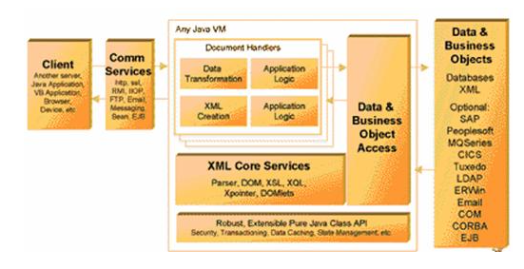
XML Server Architecture
An XML MOM application server can be a small, specialized application -- nothing you couldn't do with a Perl script -- or it can be a complete application development framework for general-purpose use.

Slide 84
The major components are:
1. Client:
This can be any application that sends or receives XML documents.
Clients can range from a device like a Palm Pilot, to a browser or Web server, to another XML server application.
2. Communications Services:
An XML MOM application server must be able to support a variety of communication protocols.
Email and HTTP are the most useful, but some applications might need to multicast or broadcast XML documents to a large number of clients, or may need the guaranteed delivery of a message queuing product.
Ideally, an XML MOM application server should provide a framework for any communications protocol to be used as the transport layer for an application.

Slide 85
3. XML Server:
Bluestone's XML-Server was mentioned for illustration purpose as it was written in Java for reasons of portability, scalability, and productivity.
Java provides an excellent framework for integrating new services and reusing objects across applications.
Java also leverages work from many vendors that provide core XML services as well as base-server functionality.

Slide 86
4. Document Handlers:
The key functional unit in an XML MOM application server is called a document handler.
A document handler is a particular piece of business logic that can operate on a certain class of documents.
Each document handler will usually have multiple methods -- functions that can be performed on a particular type of document.
Each of these methods would incorporate application-specific logic and they might call different back-end data objects such as a database.

Slide 87
5. Data Object Access:
The document handler calls the appropriate back-end data object and passes the appropriate input fields based on the method processing.
An XML MOM application server should have an implementation with production-level features such as connection pooling, secure database login, JDBC support, error handling, and transitioning.
Access to other non-JDBC or XML data sources, including SAP, PeopleSoft, mainframes, middleware, and "new-age" objects like Java, EJB, CORBA, and COM are also important for many implementations.

Slide 88
6. XML Core Services:
The XML application server uses core XML services such as a parser and DOM, as well as XSL and XML Query Language (XQL).
In particular, the aforementioned Bluestone XML-Server bundled the IBM Parser for Java (XML4J), Lotus XSL, and Datachannel XQL implementations.
You could also plug in other implementations such as Sun's or Microsoft's parser.
These tools were used by Bluestone XML-Server as core services for parsing the incoming document to determine the appropriate class and method to call, as well as getting the data out of the XML format for manipulation by the database.

