Slide 1
Unit 3 Resource Consideration in Project
By
Prof Aarti Vyas

Slide 2
Resource consideration
Expert Judgment
Alternative Analysis
Published Estimated Data
Bottom up estimating

Slide 3
Resource Allocation
In project management, resource allocation or resource management is the scheduling of activities and the resources required by those activities while taking into consideration both the resource availability and the project time

Slide 4
Resource allocation—part art, part science as some call it—is recognizing the best available resources for the project, assigning them to your team and monitoring their workload throughout the work, and re-assigning resources if needed.

Slide 5
How to allocate resource
Know the project and the team
Uncover risks early on
Keep track of the project
Analyse the project

Slide 6
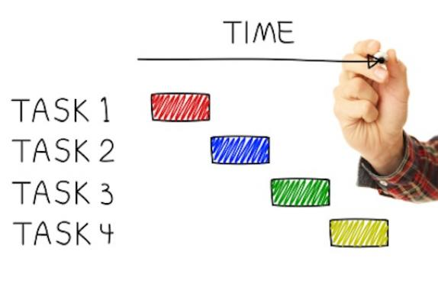
Project Scheduling
Project Scheduling is concerned with the techniques that can be employed to manage the activities that need to be undertaken during the development of a project

Slide 7
Project Scheduling
Identifying the tasks that need to be carried out
Estimating how long they will take
Allocating resources
Schedulling when the tasks will occur

Slide 8
Tools and techniques of Project Scheduling
Bar/ Gantt Chart
Line of Balance
Linear Programming
Splitting and Multitasking
Network Analysis

Slide 9
PROJECT COST ESTIMATION
NEED FOR LONG TERM FINANCING
NEED FOR SHORT TERM FINANCING
SHORT TERM FINANCE
MEDIUM TERM FINANCE
LONG TERM

