Slide 1
Thakur College of Science & Commerce
Department of Zoology
Welcomes
Academic Year – 2020-21
(Paper – III Unit- II)
Parasitology
Dr. Vitthal T. Mohite
Head, Department of Zoology

Slide 2
Parasitology
Study of parasite with reference to their host, life cycle, pathogenicity and control measures
Applied Branch of Science.
Parasite is microscopic to macroscopic.
E.g. viruses, bacteria, fungi, protists , worms, arthropods, few vertebrates.
Depends on the others for their survival.
Parasitism- Association with the other species depends on another for its existance.
Kind of association one is getting benefited and other is getting harm.
Host – Any living organism which harbours the parasites, it provides food and shelter to the parasite.
Parasite – living organism which derives food and shelter from the organism where it lives.
Vector – disease transmitting agent. Carry parasite form one host to another.

Slide 3
Types of Parasites
Ectoparasite- e.g leech, mosquito, bedbugs
Endoparasite – e.g. P. vivax, leishmania
Temporary parasite – e.g. bedbug mosquito
Permanent parasite – e.g. Ascaris, Wucheraria
Intracellular parasite- e.g Plasmodium
Extracellular parasite – e.g. Ascaris , liver fluke
Monogenic parasite –e.g. Ancylostoma duodenale (man)
Digenetic parasite- e.g. Dracunculus, Taenia solium
Obligatory parasite- e.g. P. vivax, Trypanosoma gambiense
Facultative parasite-e.g. free living nematodes
Occasional or Accidental parasite – e.g. liver fluke found in dogs, cats and humans
Pathogenic parasite – e.g. W. bancrofti
Non pathogenic parasite –e.g. Entamoeba

Slide 4
Types of Vectors
Biological Vectors
Mechanical vectors

Slide 5
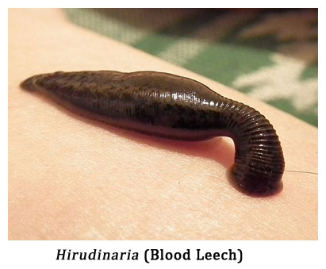
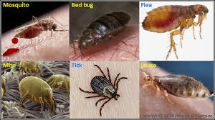
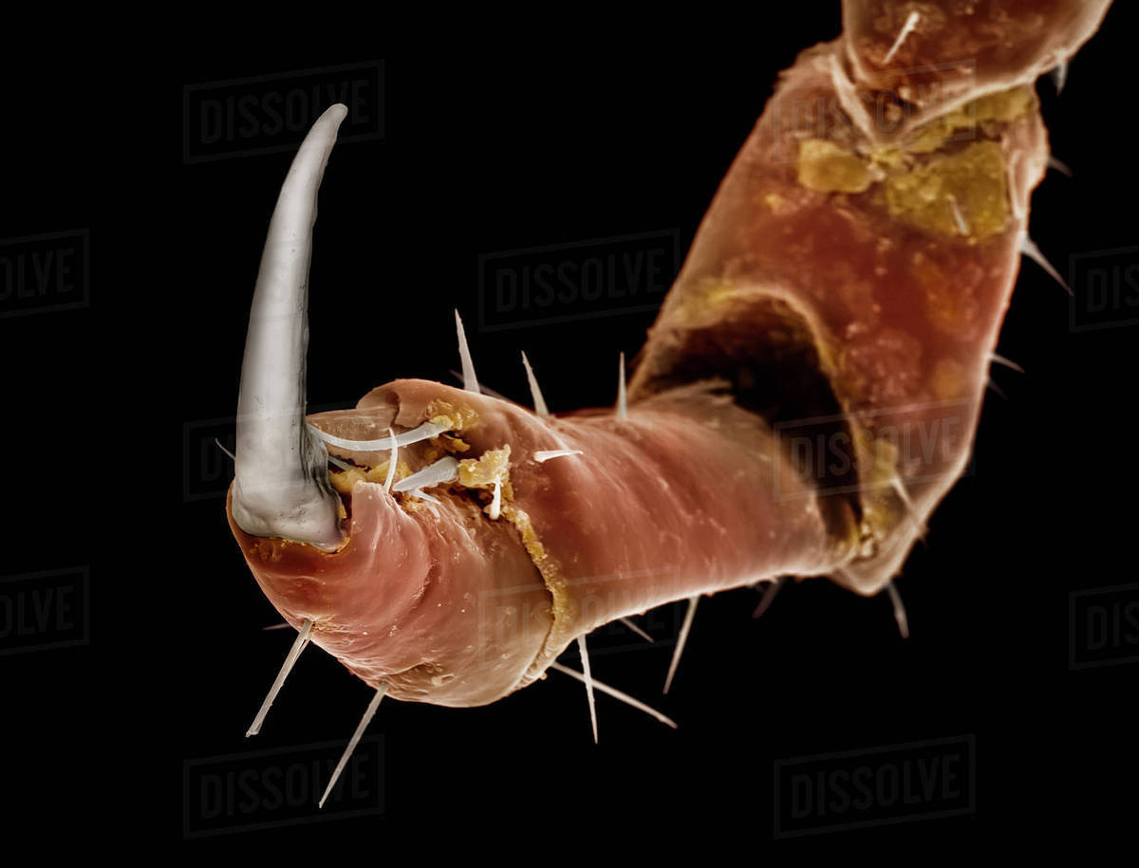
Parasitic adaptation
Ectoparasite :
1. Adaptation for nutrition. e.g. Mouth parts in mosquito, Sucker in leech
2. Organs of Attachment. E.g. Sucker in leech
3. Rate of Reproduction. E.g. Mosquito, bedbugs

Slide 6
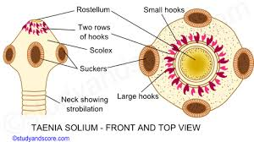
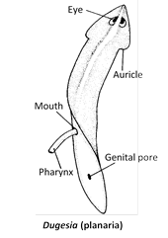
Endoparasite :
1. Structural organs
  A) Degeneration of Organs
  B) Development of Special Device – cuticle, Suckers and Hooks, Suctorial Pharynx, Special structure to penetrate host, Cystwall formation
  2. Physiological Adaptation
  a) Aerobic respiration
  b) High Fecundity
  c) Chemotaxis - movement of a cell or organism, or part of one, in a direction corresponding to a gradient of increasing or decreasing concentration of a particular substance.
  d) Protective Secretion.
  e) Tolerance against environment

Slide 7
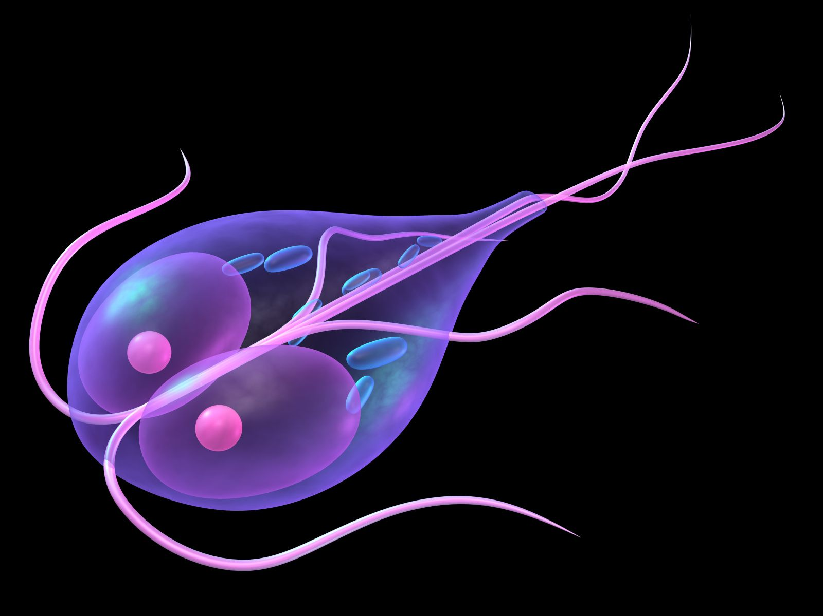
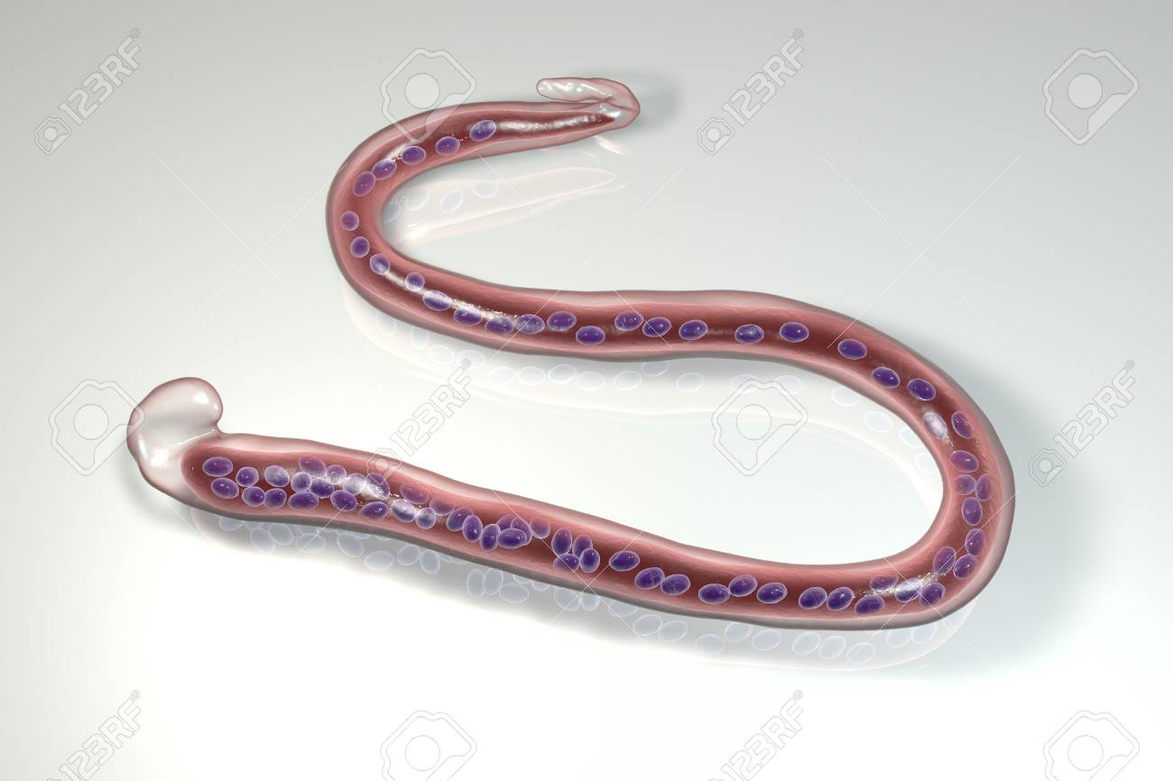
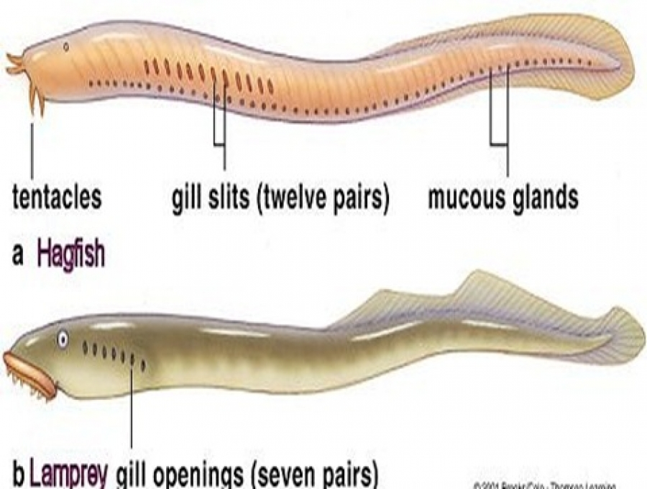
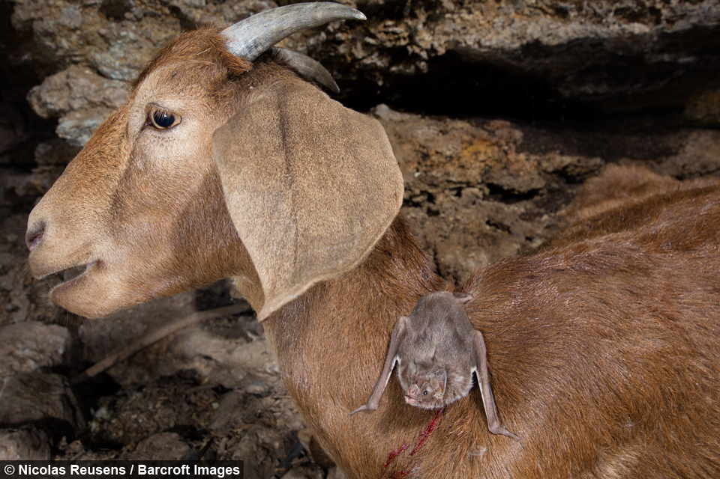
Parasitism in Animal Kingdom
Giardia
Non -Chordata
Protozoa – Class : Rhizopoda e.g. Entamoeba
Class: Flagellata e.g. Giardia
Class : Sporozoa e.g. Plasmidium (Monocyte)
Platyhelminthes : Class : Cestoda : e.g. Tapewarm
                Class :Termatoda e.g. Fascicola
Aschelminthes : Class : Nematoda e.g. Ascaris, Wuchereria.
Annelida : Class Hirudina e.g. Indian Cattle leech
Arthropoda : Class: Insecta : e.g. Head louse, bedbug.
            Class :Arachnida e.g. Itching mite( Tick Mite)
Mollusca : Class : Bivalvia e.g. Glochidium larva.
Chordates
Class : Cyclostomata e.g. Petromyzon, Myxine
Class : Mammalia e.g. Vampire Bats
Wuchereria.

Slide 8
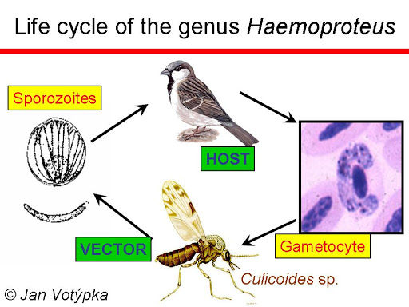
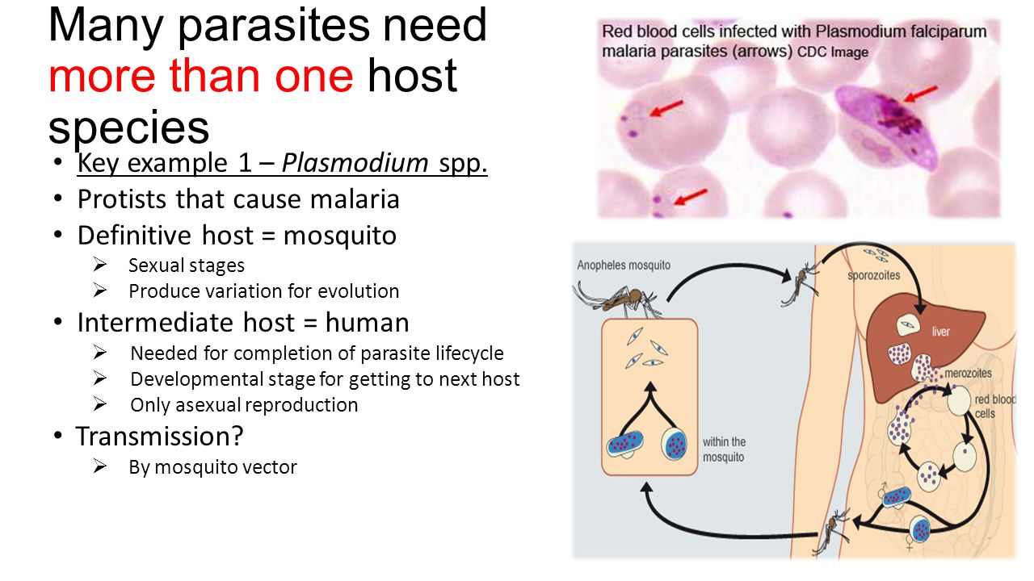
Types of Hosts
Definitive Host or Primary Host : Host Harbors adult stage of parasite e.g. Liverfluke
Intermediate Host or Secondary Host: Host harbors larval or asexual stage of parasite e.g Mosquito for Wucheraria, For p.vivax man is intermediate host. Red Sheep, Goat, Eurasian Elk, Moose, American Bison; Cervus elaphus L., 1758, Red Deer, Elk, Wapiti.

Slide 9
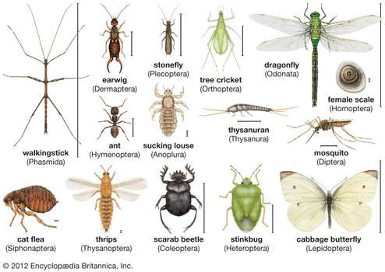
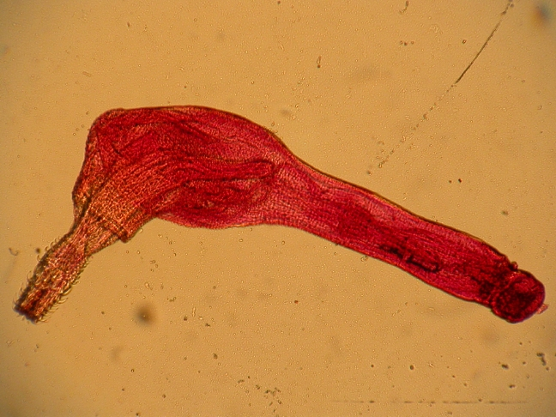
Types of Hosts
Reservoir Host : Host store parasitic stage at dormant condition e.g. Trypanosoma brucei.
bats, rodents, cows, pigs, sheep, swine, rabbits, raccoons, dogs, other mammals.
Paratenic Host or Carrier Host: Host in which the parasite retains viability without further development . E.g. Spiney headed worm. trematode Alaria americana, snakes

Slide 10
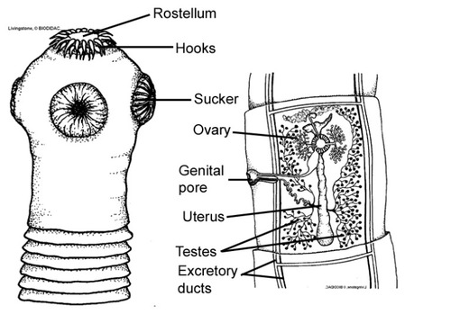
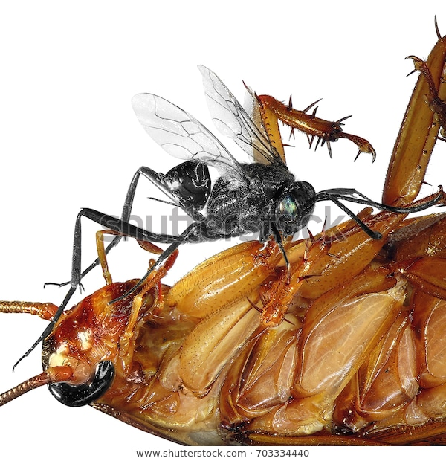
Hosts-Parasite Relationship
Highly specific.
Parasite invade only those host which provides nutrition, shelter.
Intracellular parasite attack live host.
Viruses reproduce in host cells.
Types:
1. Structural Specificity : e.g. Mosquito,
2. Physiological specificity e.g. Tapeworm circulatory and digestive syst. absent
3. Ecological specificity e.g. common habitat shared by man bat.
Parasitic Wasp in American Cockroach

Slide 11
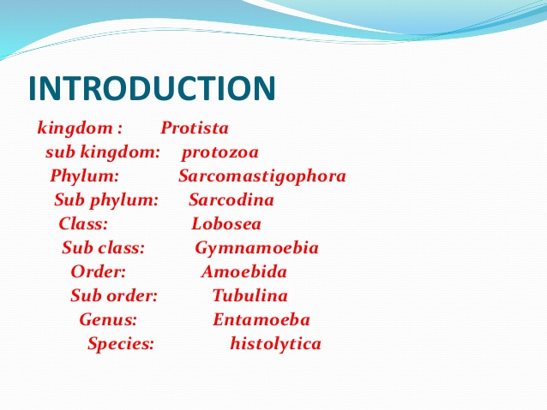
Entamoeba histolytica

Slide 12
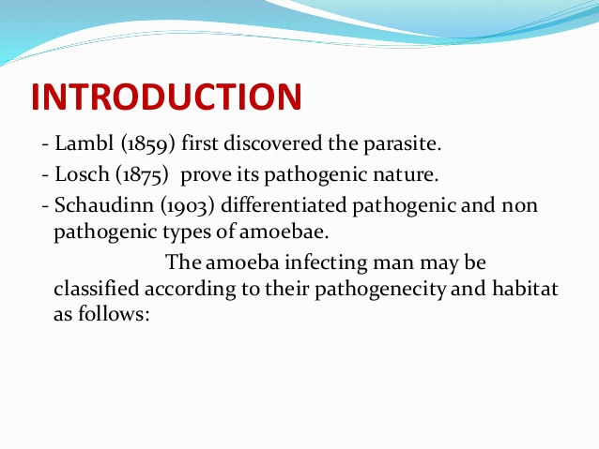
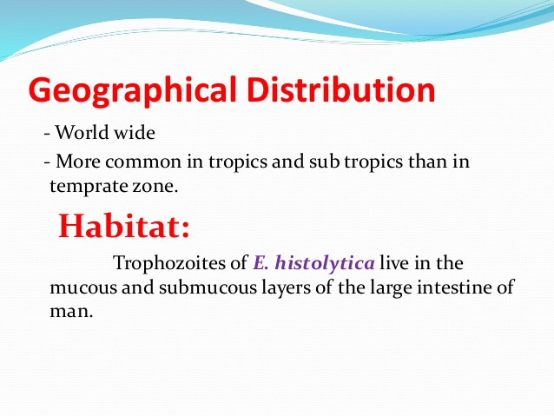

Slide 13
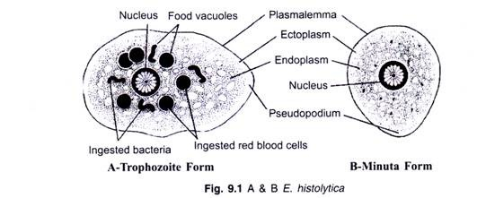
Introduction
Unicellular Microscopic, intestinal parasite of man.
It hydrolyze tissues by secreting proteolytic enzyme hence named Entamoeba hystolytica.
Monogenetic parasite.
Shape- no definite shape constantly changing its shape.
Size- Adult 20 to 30 µm
Present in RBCs, Leucocytes and some time in cell debris.
Some species are pathogenic some are nonpathogenic.
Three different stages- trophozite, pre-cystic stage and cyst stage

Slide 14
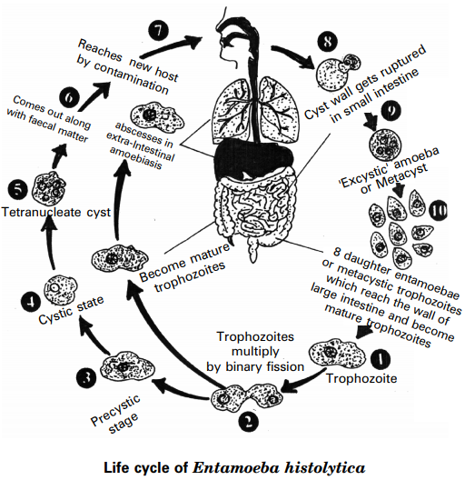
Life Cycle-Entamoeba

Slide 15
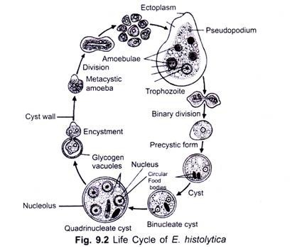
Life Cycle-Entamoeba

Slide 16
Pathogenicity
Non-invasive infection: In many cases, the trophozoites remain confined to the intestinal lumen of individuals who are thus asymptomatic carriers and cysts passers.
Intestinal disease: In some patients, the trophozoites invade the intestinal mucosa,
Extra-intestinal disease : through the bloodstream, trophozoites invade extraintestinal sites such as the liver, brain, and lungs, with resultant pathologic manifestations.
Amoebic Dysentery :
Abscess formation in organs : Lungs, Brain, Liver,
Amoebic liver abscess
Amebic abscess of the liver is characterized by right upper quadrant pain, weight loss, fever, and a tender enlarged liver.
Right-lobe abscesses can penetrate the diaphragm and cause lung disease (pulmonary amoebiasis)
Other metastatic lesions: Cerebral amoebiasis
Amoebic pericarditis
Cutaneous amoebiasis
Splenic abscess etc.

Slide 17
Control Measures
Improved sanitation will help to reduce the liklihood of transmission.
washing fruits and vegetables with clean water (or by peeling them yourself).
Personal Hygiene to be strictly followed.
Children's should be trained for their hygiene.
Water should be boiled before drinking.
Proper sewerage system should be constructed.
Cysts may be destroyed by using 1 % formaldehyde, HgCl₂, HCl or 50 % alcohol.

Slide 18
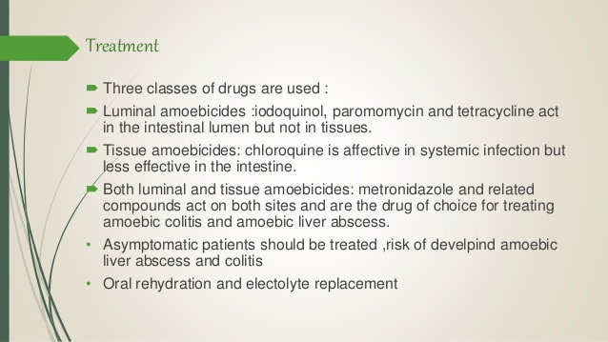
Treatment

Slide 19
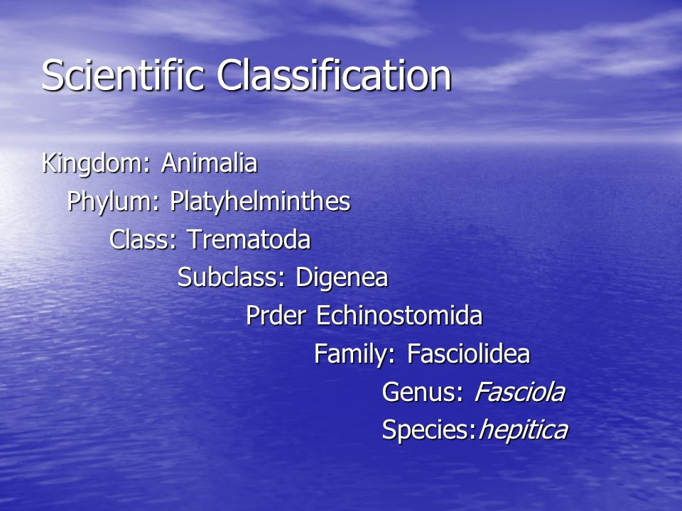
Fasciola hepatica – Liver fluke

Slide 20
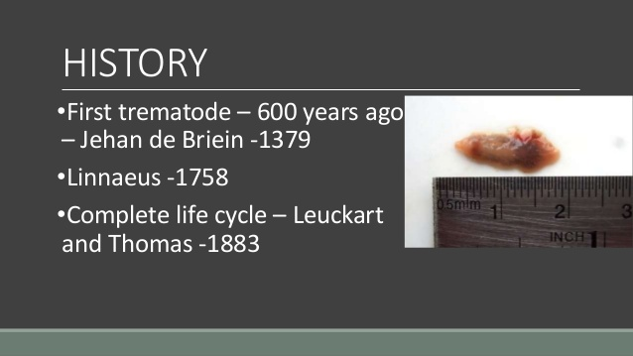

Slide 21
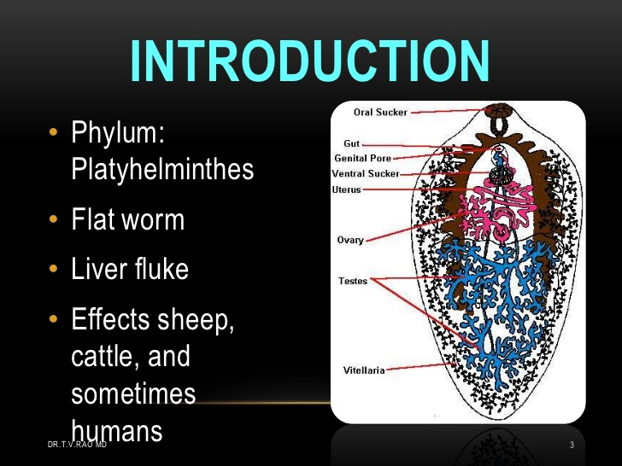

Slide 22
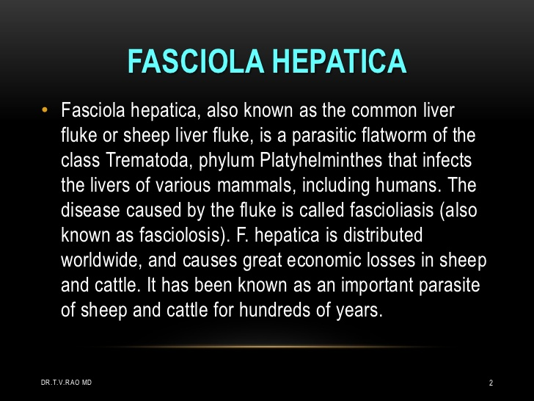

Slide 23
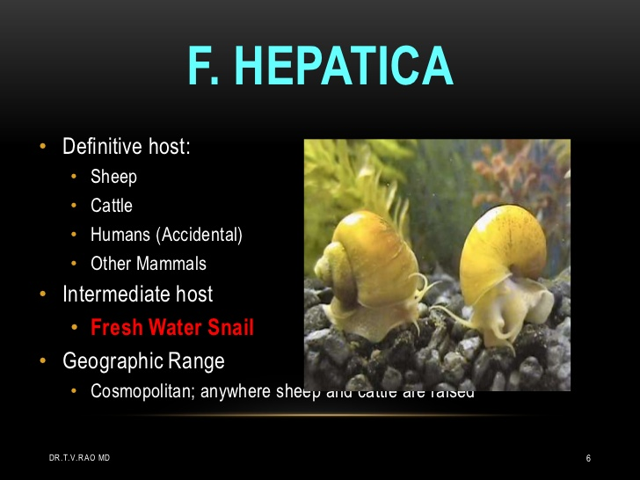

Slide 24
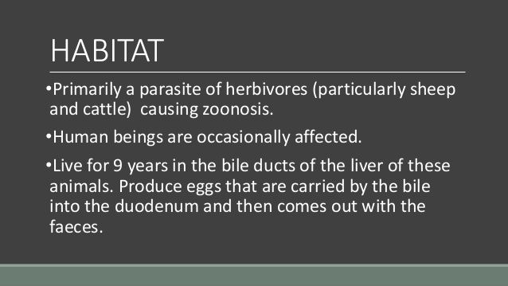

Slide 25
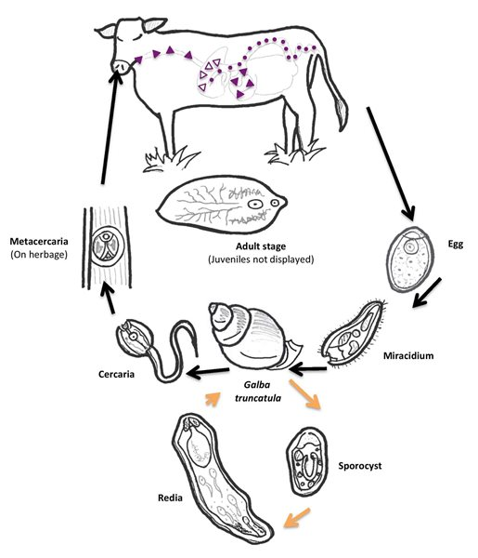
Fasciola hepatica-Life Cycle

Slide 26
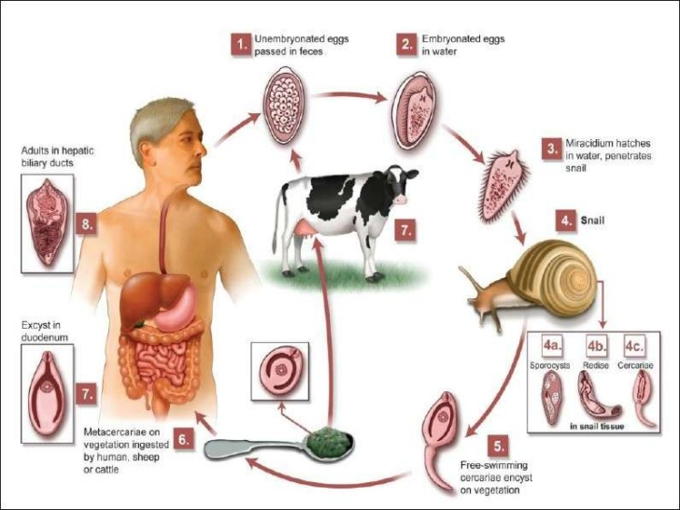

Slide 27
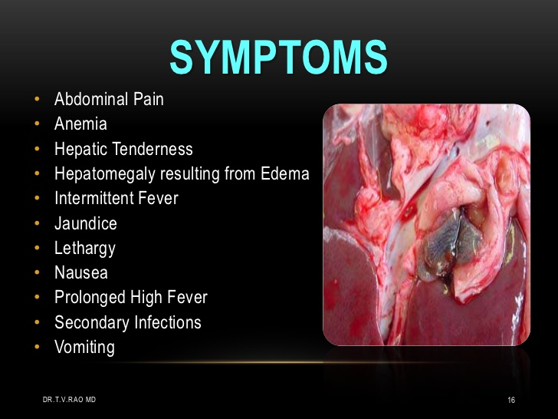

Slide 28
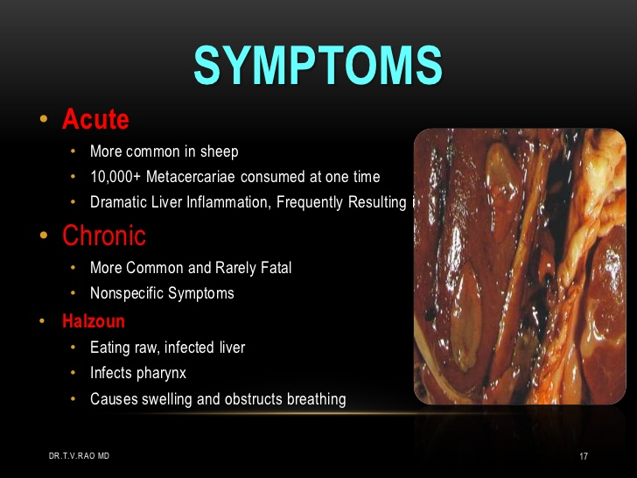

Slide 29
Control Measures
Human infection can be checked.
From a public health perspective, control of human fascioliasis mainly relies on timely treatment with triclabendazole.
individual case-management following a simplified diagnostic protocol.
The population of pond snail ; an intermediate host in infected area should be controlled.
prevents cattle grazing the snail habitat.

Slide 30
Treatment
The first step is to make sure the diagnosis is correct.
Triclabendazole. Triclabendazole, a benzimidazole compound active against immature and adult Fasciola parasites.
Bithionol found to be most effective drug against this parasite.
Liver rot is treated by Emetin hydrochloride, filicin compounds and tetrachloroethane.
Nitazoxanide is a good alternative to triclabendazole, especially in the chronic stage of infection. It is given as 500 mg twice a day for 7 days in adults

Slide 31
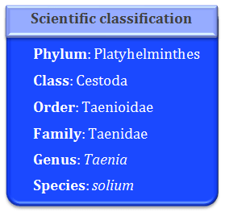
Taenia solium- Tape worm

Slide 32
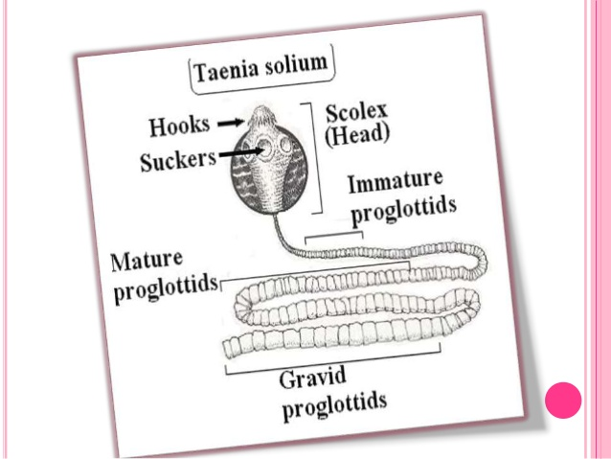
Taenia solium

Slide 33
Habitat and distribution
Geographic Distribution
worldwide in distribution.
Taenia solium is more prevalent in poorer communities where humans live in close contact with pigs and eat undercooked pork.
Habitat :-
Tapeworms live in almost all land, sea, and freshwater habitats where vertebrates live.
Most adult tapeworms live in the intestines of the final hosts, but a few species live in the body cavity.
The pork tapeworm has several different habitats depending on the stage in its life cycle.
The preadult tapeworm and adult tapeworm can be found in the small intestine of a human host.

Slide 34
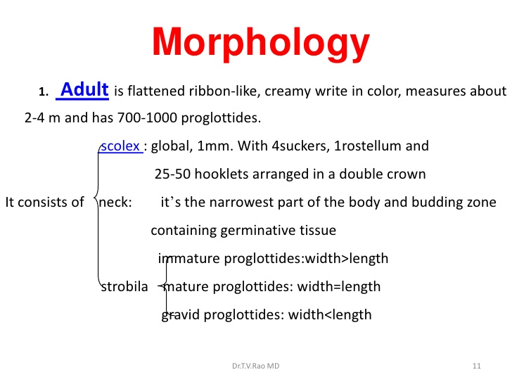

Slide 35
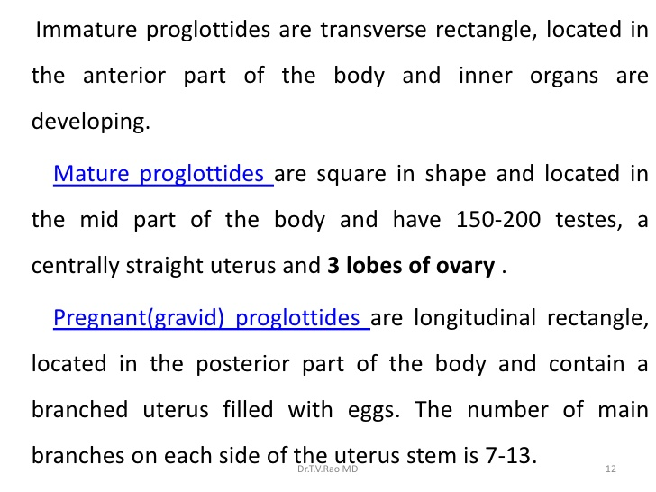

Slide 36
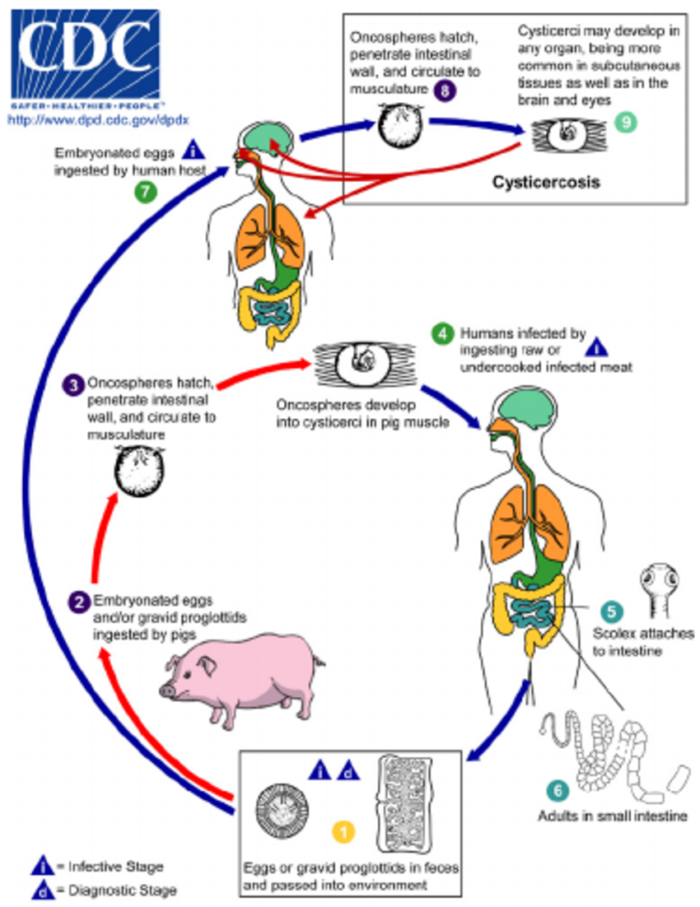
Taenia solium-Life Cycle

Slide 37
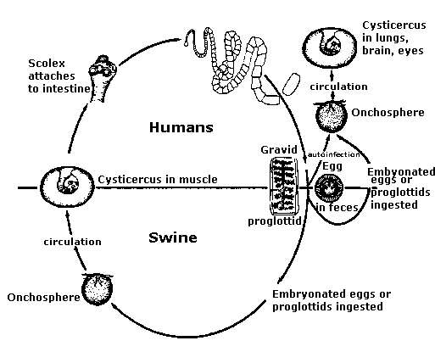

Slide 38
Taenia solium -Pathogenicity
Pathogenesis of Taenia solium taeniasis and cysticercosis.
Taenia solium may cause two different infections in humans, intestinal taeniasis (the intestinal infection with the adult tapeworm).
cysticercosis (a tissue infection with the cystic larvae or cysticercus).

Slide 39
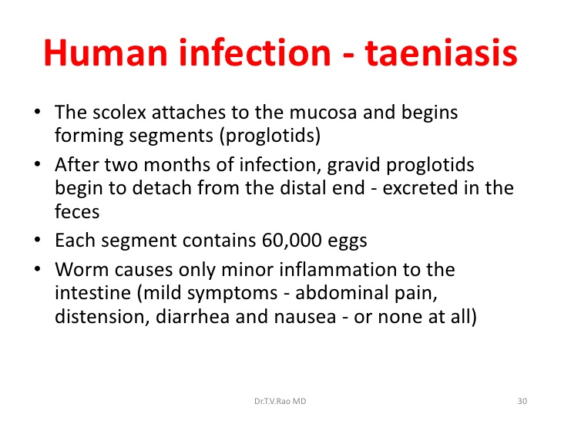

Slide 40
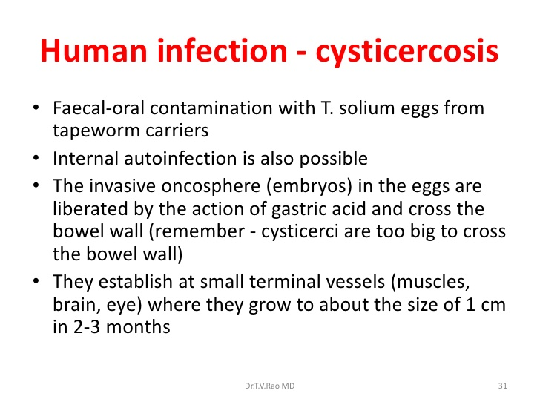

Slide 41
Control Measures
Taenia solium is endemic in most of the world, causing seizures and other neurological symptoms. Transmission is mainly maintained in rural areas by a human to pig cycle.
Infection by Taenia solium adults can be prevented by fully cooking pork before eating it.
Prevention of cysticercosis includes the prompt identification and removal of adult infections to eliminate the possibility of autoinfection.
The Slaughter houses should be checked time to time.
Strict awareness about parasitic diseases and personal cleanliness is to be created through print and electronic media.

Slide 42
Treatment
Adult worms can be eradicated with praziquantel.
Treatment of symptomatic neurocysticercosis is complicated; it includes corticosteroids, antiseizure drugs, and, in some situations, albendazole or praziquantel.
Vermifuge : remove worms from the intestine without killing by Mepacrine hydrochloride.
Surgery may be required. Presentation, diagnosis, and management of intestinal infection with the adult T.
Treating individual with Taeniasis is important because it may prevent cases of cysticercosis.

Slide 43
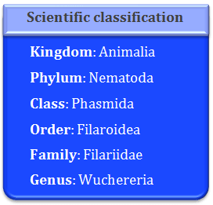
Wuchereria bancrofti – Filarial worm

Slide 44
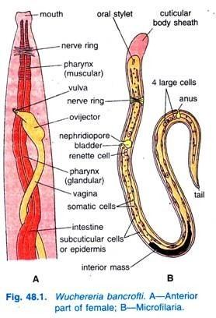
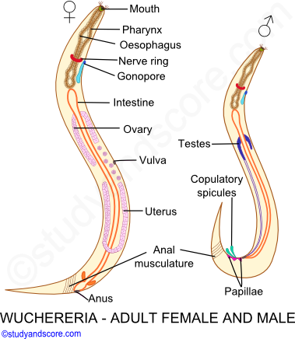

Slide 45
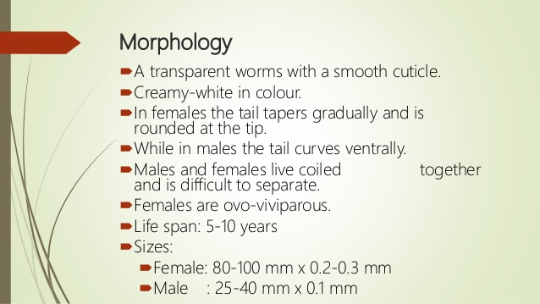

Slide 46
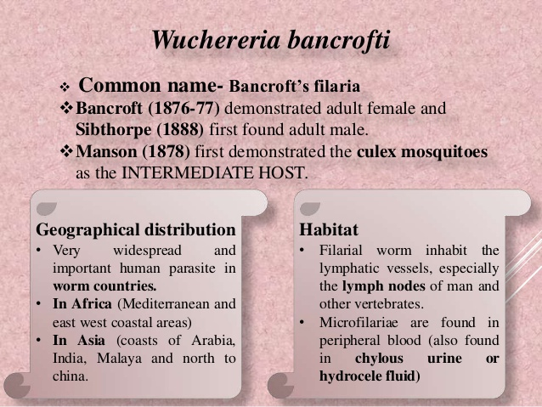

Slide 47
Distribution & Habitat
Geographical Distribution :
Found in tropical and subtropical countries of the world.
India, west Indies, Southern China, japan, Pacific Island, west and Central Africa, South America.
In India river bank of Indus and also states like Rajasthan, Punjab, Delhi, Different areas of U.P.
Habitat:
It is a dreadful endoparasite of man; adults harbouring the lymphatic vessels and lymph nodes.
Its life history is digenetic, as it involves a secondary host, the blood­sucking insects, i.e., the female mosquitoes of the genus Culex, Aedes or Anopheles
It is viviparous or to say ovo-viviparous; its larvae are referred to as microfilariae which/harbour the blood of human beings.

Slide 48
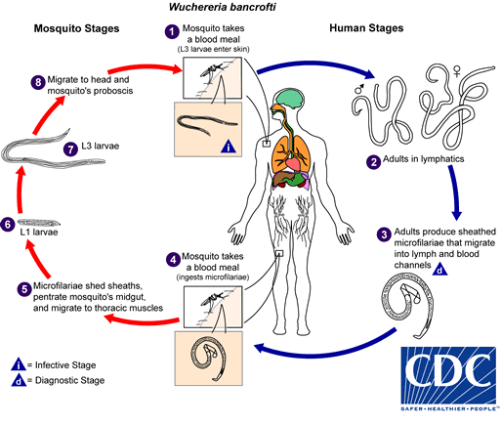
Wuchereria bancrofti – Life Cycle

Slide 49
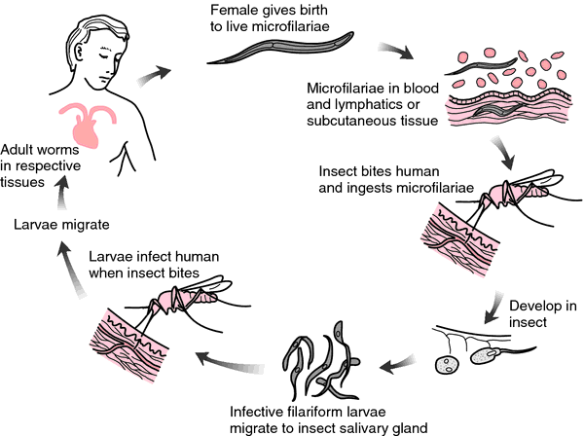

Slide 50
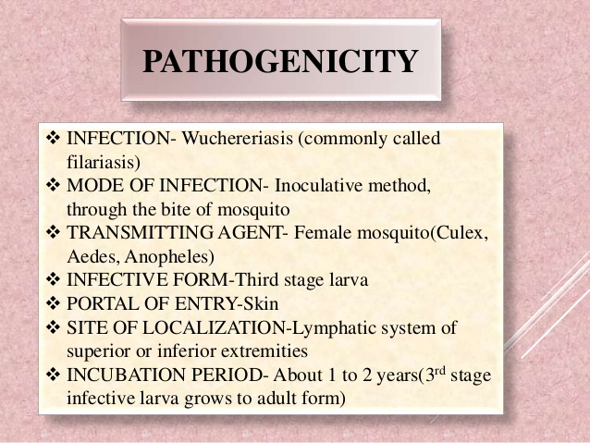

Slide 51
Pathogenicity
Lymphangitis
Filarial Fever
Elephantiasis

Slide 52
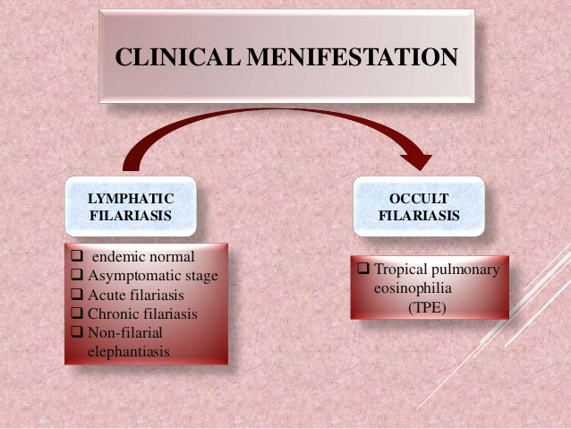

Slide 53
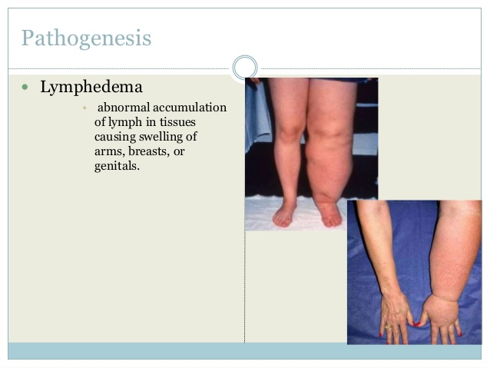

Slide 54


Slide 55

W. bancrofti

Slide 56

Treatment

Slide 57


Slide 58


Slide 59


Slide 60

Head Louse – (Peciculus humanus capitis)

Slide 61


Slide 62
Distribution & Habitat
Distribution : World wide including Australia, Denmark, France, Ireland, Israel, and Sweden.
Asia, Africa, Europe, America,Australia.
6-12 millions of people get affected only in USA.
Habitat : The number of children per family, the sharing of beds and closets, hair washing habits.
local custom social contacts, healthcare in a particular area (e.g. school), and socioeconomic status were found to be significant factors in head louse infestation.
Girls are two to four times more frequently infested than boys.
Children between 4 and 14 years of age are the most frequently infested group.

Slide 63

Morphology
Female head lice are generally larger than males length is 2.8 to 4 mm in length male is 2.5 to 3 mm in length..
The louse is wingless and white to gray and has a long, dorsoventrally flattened, segmented abdomen.
Body is divided in Head, thorax and abdomen.
Abdomen is with 9 segments.
It has 3 pairs of clawed legs.
Head is small with paired compound eyes, pair of five jointed antennae.
Piercing and sucking type mouth parts.
Average life span is one month

Slide 64

Life Cycle

Slide 65
Pathogenicity
Body lice may transmit bacterial pathogens that cause trench fever, relapsing fever, and epidemic typhus.
These are potentially life-threatening diseases that remain relevant in contemporary times.
Recent data from some settings suggest that head lice may harbor pathogens.
It causes irritation and red spots at the site of injury.
It is considered as biovector.

Slide 66
Control Measures
Avoid head-to-head (hair-to-hair) contact during play and other activities at home, school, and elsewhere (sports activities, playground, slumber parties, camp).
Do not share clothing such as hats, scarves, coats, sports uniforms, hair ribbons, or barrettes.
Do not share combs, brushes, or towels.
4. Do not lie on beds, couches, pillows, carpets, or stuffed animals that have recently been in contact with an infested person.
5. Head lice survive less than 1–2 days if they fall off a person and cannot feed.
6. Proper shampoo should be used to control its population.
7. Infected cloth should be fumigated by Methyl bromide.

Slide 67
Treatment
Permethrin lotion 1% is approved by the FDA for the treatment of head lice.
Permethrin is safe and effective when used as directed.
Permethrin kills live lice but not unhatched eggs. Permethrin may continue to kill newly hatched lice for several days after treatment.
An insecticides powder of 2% malathion or 1% lindane is found to be effective.
Dust composed of carbamyl is also effective.

Slide 68


Mite (Saarcoptes scabiei)

Slide 69
Distribution & Habitat
The Italian biologists Giovanni Cosimo Bonomo and Diacinto Cestoni discovered Sarcoptes scabiei; this discovery of the itch mite in 1687
Distribution
The mite is found in all parts of the world, particularly in tropical areas.
Mites have a very patchy distribution over small areas because of their special requirements.
Humans are not the only mammals that can become infected.
Other mammals, such as wild and domesticated dogs and cats (in which it is one cause of mange) as well as ungulates, wild boars, bovids, wombats, koalas, and great apes are affected.
Habitat The best conditions in which to harbor S. scabiei is in areas with frequent skin-to-skin contact, such as the hands and wrists
Infestations of S. scabiei are commonly found in pigs.

Slide 70

Morphology
Body is small, whitish, dorsoventrally flattened.
Body has long pointed, sensory spines.
Body divided in prostoma & Ophisthosoma.
Mouth parts are piercing and sucking type.
Eyes & Trachea are absent.
4 pairs of legs, two legs are shorter with long bristle.
Tortoise like body.

Slide 71


Slide 72

Life Cycle

Slide 73
Pathogenicity
Causes extreme itching sensation after scratching forms ugly sores and dry scabs.
Sarcoptic mange, caused by the parasitic mite Sarcoptes scabiei, causes a substantive burden of disease to humans, domestic animals and wildlife, globally.
There are many effects of S. scabiei infection, culminating in the disease which hosts suffer.
Pathological condition is known as Scabies or itch.
Continuous itching may leads to eczema

Slide 74
Mite - Control Measures
Scabies is prevented by avoiding direct skin-to-skin contact with an infested person.
Avoid with items such as clothing or bedding used by an infested person.
The children should avoid the contact with infected children while playing.
Personal Cleanliness and sterilization of garments and beddings prevents spread.
Fumigation of cattle shade.
Early diagnosis of infestation is suggested.

Slide 75
Treatment
Medications commonly prescribed for scabies include: Permethrin cream (Elimite).
Permethrin is a topical cream that contains chemicals that kill scabies mites and their eggs.
Antihistamines, such as Benadryl (diphenhydramine) or pramoxine lotion to help control the itching
Antibiotics to kill any infections that develop as a result of constantly scratching your skin
Steroid creams to relieve swelling and itching
5 percent permethrin cream
25 percent benzyl benzoate lotion
10 percent sulfur ointment
10 percent crotamiton cream
1 percent lindane lotion

Slide 76

Bed bug- Cimex lectularis

Slide 77


Slide 78

History

Slide 79
Distribution & Habitat
Distribution : World wide distribution. Temperate, & Tropical areas.
Found in America, Europe, India, Northern China, Siberia, West Africa, Canada and Australia.
Habitat - They like to live to a human environment.
Bed bugs are most often found in bed parts, mattresses, box springs and folded areas.
They are also behind wallpaper, upholstery, picture frames, electrical switch plates, and in furniture.

Slide 80
Bed bug - Morphology
Oval Brown red colour wigless insect ovate, dorsoventrally flattened.
Size-5mm in length and 3 mm in width.
Their wings are represented by short, non-functional wing pads and they cannot fly.
Body is divided in head, thorax and abdomen.
Head bears compound eyes and single pair of antennae.
Thorax is pro, meso and metathorax.
Sucking type of mouth parts.
Abdomen is with 7 segments.
Female has copulatroy pouch called “Organ of Berlese”.

Slide 81

Bed bug – Life cycle

Slide 82
Pathogenicity
Bed bug dose not cause any disease directly but it works like vector of different for diseases.
It puncture the skin and fed on the blood of man and rodents.
Bed bug bite induces swelling and irritations.
It can transmit the parasite of Chagas disease.
It is suspected to be vector for disease like Kala-azar, bubonic plague, typhoid and T.B. of human.

Slide 83
Control Measures
Make the bed an island: Keep bed away from wall and do not let bedding touch the floor.
Install bed bug interceptors under bed and furniture legs.
Remove clutter where bed bugs can hide.
Keep clothing off of the floor.
Isolate infested items in sealed plastic bags or containers.
Seal cracks where bed bugs can hide.
Launder bed sheets and clothing regularly. Dry for 30 minutes on highest heat setting
Diatomaceous Earth (DE): DE is a natural, white powder-like substance that kills insects.
Began, Khatnil, hit spray, insectide to control poplulation.

Slide 84
Treatment
One can apply hydrogen peroxide or ammonia at the place of puncture.
Calamine lotion or skin ointment should applied for getting soothing effect.

Slide 85
Parasitological Significance
Zoonosis : Disease of animals.
WHO – diseases and infections which are naturally transmitted between vertebrates and animals.
1415 pathogens are known to cause infections to man.
61 % causes diseases.
Three types
Anthropozoonoses : vertebrates to man e.g. Plague and Rabies
Zooanthroponoses : man to vertebrates e.g. T. B. in cattle and Amoebiosis in dogs
Amphixenoses : Both e.g. Trypanosoma cruzi (Chagas Disease) & Schistosoma japonicum (Schistosomiasis)
Zoonosis :
Bird flu, Anthrax, Rabies and Taxoplasmosis

Slide 86


Bird Flu
It is called avian influenza, is a viral infection that can infect not only birds,
Also humans and other animals.
Most forms of the virus are restricted to birds.
H5N1 is the most common form of bird flu.
Causes acute respiratory infection.
Rarely, the virus has spread from one person to another.
There are five subtypes have been known to infect humans: H5N1, H7N3, H7N7, H7N9, and H9N2.

Slide 87

Causative agent
Avian influenza is caused by those influenza viruses that mainly affect birds and poultry, such as chickens or ducks.
Three strains A,B,C.
H – the haemoagglutinin and N – Neuraminidase.
H5N1 was first discovered in geese in china in 1995 and in humans in 1997.
The virus isn’t known to spread via human-to-human contact.

Slide 88

Bird Flu- Mode of Transmission

Slide 89
Transmission
(Incubation period : 18 to 72 hrs.)
You may have a greater risk of contracting H5N1 if you are:
Transmitted to one person to another by droplet infection.
Birds to man through excreta and secration from mouth, eyes and nasal cavity
a poultry farmer
a traveler visiting affected areas
exposed to infected birds
someone who eats undercooked poultry or eggs
a healthcare worker caring for infected patients
a household member of an infected person
It is found to be originated in aquatic birds.

Slide 90
Symptoms
You may have an H5N1 infection if you experience typical flu-like symptoms such as:
Cough, sore throat, fever (over 100.4°F or 38°C), Trachea and Bronchi undergo necrotic changes.
diarrhea
respiratory difficulties, inflammation to RT.
Headache, muscle aches severe viral pneumonia.
Malaise, runny nose.
Multi – organ failure at later stage of disease.

Slide 91
Control
Avoid direct contact with infected poultrybirds.
open-air markets
contact with infected birds
undercooked poultry.
Residential area should have good ventilation.
Stimulate localized immunity by vaccines.

Slide 92
Treatment
The flu drugs oseltamivir (Tamiflu), zanamivir (Relenza), or peramivir (Rapivab) should work against bird flu.
These drugs must be given soon after symptoms appear.
Unfortunately, H5N1 in humans can be a severe illness requiring hospitalization, isolation, and intensive care.
Many influenza viruses have become resistant to the effects of a category of antiviral drugs that includes amantadine and rimantadine (Flumadine).

Slide 93

Anthrax- Bacillus anthracis
Caused by Bacillus anthracis develops Black skin lesions.
It can occur in four forms: skin, lungs, intestinal, and injection.
Symptom onset occurs between one day to over two months after the infection is contracted.
It is disease of herbivores like goat, sheep, cattle and horses.
Cat, dogs and pigs are resistant.

Slide 94


Slide 95
Anthrax- Causative agent
Anthrax is a serious infectious disease caused by gram-positive, rod-shaped bacteria known as Bacillus anthracis.
It is a facultative anaerobic bacterium about 1 by 9 μm in size.
Anthrax can be found naturally in soil and commonly affects domestic and wild animals around the world.
Humans can become infected through direct or indirect contact with sick animals.
There's no evidence that anthrax is transmitted from person to person,

Slide 96
Mode of transmission
Ingestion of infected carcass diseased wild or domestic herbivores.
Humans can become infected through direct or indirect contact with sick animals.
There's no evidence that anthrax is transmitted from person to person,
it's possible that anthrax skin lesions may be contagious through direct contact or through contact with a contaminated object (fomite).
Direct contact of skin of human with pathogen from soil.
Site of Infection & Incubation period :
Skin – 2-5 days
Lungs – 1-3 days
Digestive tract – 7 days.

Slide 97


Slide 98


Symptoms
Pain areas: in the chest or muscles
Skin: blister, dark scab, small bump, or ulcers
Whole body: fever or malaise
Respiratory: respiratory distress or shortness of breath
Also common: coughing, headache, itching, nausea, sore throat, or swollen lymph nodes
Fever and chills.
Chest Discomfort.
Shortness of breath.
Confusion or dizziness.
Cough.
Nausea, vomiting, or stomach pains.
Headache.
Sweats (often drenching)

Slide 99
Control
Antibiotics are usually used to treat anthrax.
Antibiotics that may be prescribed include penicillin, doxycycline, and ciprofloxacin.
Inhalation anthrax is treated with a combination of antibiotics such as ciprofloxacin plus another medicine.
Biothrax vaccine can prevent disease anthrax due to active immunization.

Slide 100

Rabies
Viral infection caused by Lyssavirus.
Human being called hydrophobia.
It is 100% fatal disease if not prevented.
In India rabies occurs all parts.
Annually 30000 deaths are reported.
The rabies virus infects the central nervous system of mammals, ultimately causing disease in the brain and death.
Rabies is usually transmitted through an animal bite, for example, from stray dogs.
Seek immediate medical attention after a bite or suspected bite.
There is no specific treatment for rabies. Once symptoms appear, it's nearly always fatal.

Slide 101

Causative agent
The causative agent of rabies is rabies virus (RV), a negative-stranded RNA virus of the rhabdovirus family.
Neuroinvasiveness and neurotropism are the main features that define the pathogenesis of rabies.
Rabies is a zoonotic disease affecting a wide range of domestic and wild mammals, including bats. T
he virus is present primarily in the saliva, and infection of humans usually occurs through the bite of an infected animal, usually a dog, which may not show signs of rabies.
Rabies virus and Australian bat lyssavirus (ABLV) belong to a group of viruses called lyssaviruses.
These viruses are usually transmitted via a bite from an infected (“rabid”) animal. They all cause a similar illness known as rabies, which affects the central nervous system and is usually fatal.

Slide 102
Symptoms
Signs and symptoms of rabies virus and Australian bat lyssavirus infection
headache.
fever.
malaise (feeling of being unwell)
sensory changes around the site of the bite or scratch.
excitability.
an aversion to fresh air and water.
weakness.
delirium, seizures (fits) and coma.
Incubation Period
20-60 days in dogs 4days to many years in humans.

Slide 103
Mode of transmission
Animal bite
Licks dogs
Person to person
Aerosol- contact of works in lab
Control
No Specific treatment
Vaccines develop immunity.
Nervous tissues vaccines.
Duck embryo vaccines
Cell culture vaccines.

Slide 104
Toxoplasmosis – Toxoplasma gondii
Toxoplasmosis (tok-so-plaz-MOE-sis) is a disease that results from infection with parasite, one of the world's most common parasites.
Infection usually occurs by eating undercooked contaminated meat, exposure from infected cat feces, or mother-to-child transmission during pregnancy.
Toxoplasmosis may cause flu-like symptoms in some people, but most people affected never develop signs and symptoms.
For infants born to infected mothers and for people with weakened immune systems, toxoplasmosis may cause serious complications.
I

Slide 105


Slide 106


Causative agent

Slide 107
Symptoms
Most healthy people who are infected with toxoplasmosis have no signs or symptoms
Some people, however, develop signs and symptoms similar to those of the flu, including:
Body aches.
Swollen lymph nodes.
Headache.
Fever.
Fatigue.
Incubation period : few months to many years depends on resistance of host body.

Slide 108
Mode of transmission
1. Congenital : mother to fetus through placental route.
2. Acquired : Improperly cooked meat, milk, excreta.
by inhelation and direct contact with infected animals.
Control
Do not adopt cat.
Cat’s litter box should be cleared.
Fruits vegetables should be washed before eating.
Meat should be properly cooked.

Slide 109
Treatment
But if you're otherwise healthy and have signs and symptoms of acute toxoplasmosis, your doctor may prescribe the following drugs:
Pyrimethamine (Daraprim). This medication, typically used for malaria, is a folic acid antagonist. ...
Sulfadiazine. This antibiotic is used with pyrimethamine to treat toxoplasmosis.

Slide 110
Thank You

