Slide 1
Lets’ Revise Previous Lecture.....
Management is the art of getting things done through people.
Nature of Management
Group Activity
Management is profession
Management is art as well as science
Management is Dynamic in nature
Management is continuous process
All pervasive
Achieve Result

Slide 2
FUNCTIONS OF MANAGEMENT

Slide 3
Functions Described in the Definitions of Management
"Management is a distinct process consisting of planning, organizing, directing and controlling to determine and accomplish the objectives by the use of people and resources."- G.R. Terry
"To manage is to forecast and plan, to organise, to command, to co-ordinate and to control."
Henry Fayol

Slide 4
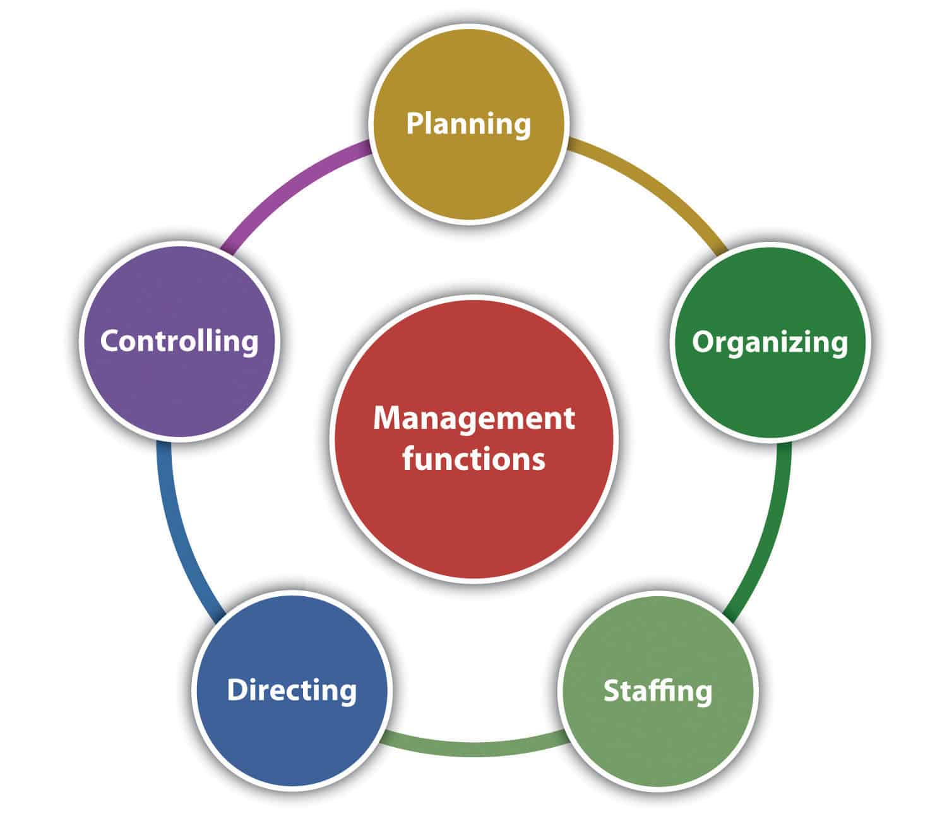
FIVE FUNCTIONS OF MANAGEMENT
Koontz and O'Donnell explained five functions of management. They have become widely accepted functions of management everywhere. They are

Slide 5
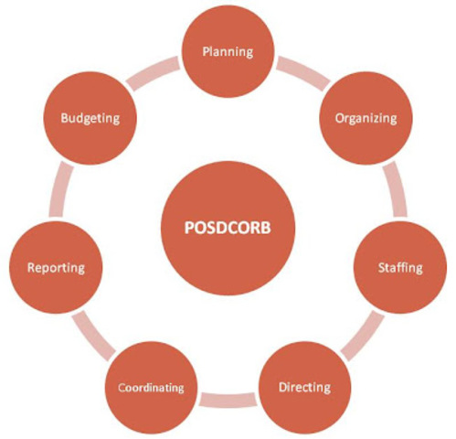
7 Functions of Management by Luther Gullick

Slide 6

PLANNING

Slide 7
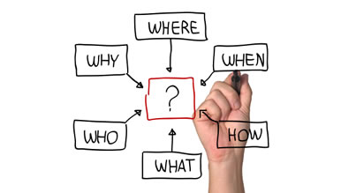
Meaning and Definition of Planning
Koontz and O’Donnell, “Planning is deciding in advance what to do, how to do it, when to do it, and who is to do it.”

Slide 8
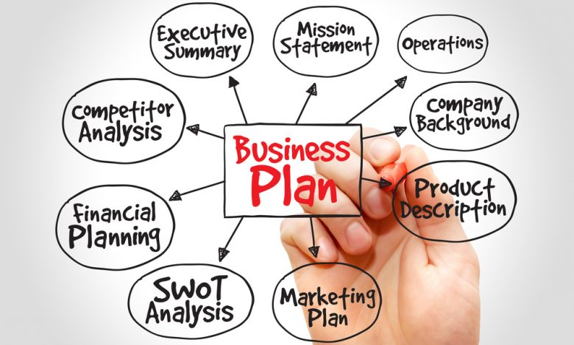
For Example before set up any business we need to make business plan and decide following points

Slide 9
Features of planning
Planning focuses on achieving objectives
Planning is a primary function of management
Planning is pervasive
Planning is continuous
Planning is futuristic
Planning involves decision making
Planning is a mental exercise

Slide 10

ORGANIZING

Slide 11
Meaning and Definition of Organizing
Definition
"Organization is the process of identifying and grouping of the works to be performed, defining and delegating responsibility and authority and establishing relationships for the purpose of enabling people to work most efficiently".
- Louis A. Allen
Meaning from above definition Organizing means,
Division of work into functions and sub-functions,
grouping of activities
assigning of duties and responsibilities
delegation of authority

Slide 12
Importance of Organizing
helps to reap the benefit of specialization.
Optimum utilization of resources.
helps in Effective administration.
channels for Expansion and growth.
achieves co-ordination among different departments.
creates scope for new change.

Slide 13

STAFFING

Slide 14
In the simplest terms, staffing in management is ‘putting people to jobs’.
Definition
"Staffing is the function by which managers build an organisation through the recruitment, selection, and development of individuals as capable employees"
- McFarland
Staffing Involves
Placing the right person at right job
Training and development of the employees
Motivation and Performance appraisal of the employees
Retention of employees

Slide 15

DECISION MAKING

Slide 16
Definition of Decision Making
“ the process of identifying and selecting a course of action to solve a specific problem”.
- James Stoner
It is essence of management.
Managers must take right decision at the right time.
Mangers need to take proactive decisions.

Slide 17

DIRECTING

Slide 18
Meaning and Definition
Directing is nothing but guiding and leading the people in an organization. It is not just giving instructions by a superior to the subordinates but also is a process of supervising, guiding and motivating to achieve the organizational goals.
Definition
"Activating deals with the steps a manager takes to get sub- ordinates and others to carry out plans".
- Newman and Warren.

Slide 19
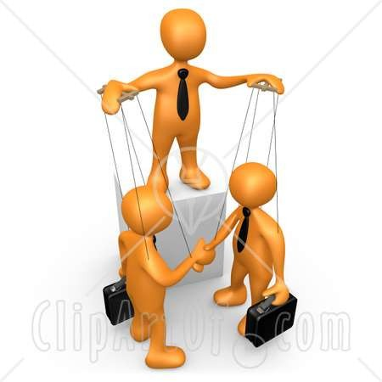
CONTROLLING

Slide 20
Definition
Meaning and Definition of Controlling
to monitor actual performance and take corrective measures if required.
"Controlling is the process of ensuring that actual activities conform to the planned activities.”
- James Stoner

Slide 21

Coordination
Integration of activities or actions of the subordinates by the superiors.

Slide 22
Summary
Functions of Management
(POSDCORB)
Planning
Organizing
Staffing
Directing
Decision Making
Controlling
Coordination
Reporting
Budgeting

Slide 23

For any query message me on : 9892349293

