Slide 1
Advertising Agencies
Divya Narang Tinna
AP, TCSC

Slide 2
Advertising
Advertising is a form of marketing communication
Which is used to persuade an audience to take or continue some action
Usually with respect to a commercial offering, or political or ideological support
In Latin, ad vertere means "to turn toward“
Advertising messages are usually paid for by sponsors and viewed via various old media and new media
TV, Radio, Newspapers, Blogs, Websites, Transit Media etc.

Slide 3
Advertising Agencies
According to American marketing Association, "An Advertising agency is an independent business organisation composed of creative and business people who develop, prepare and place advertising in advertising media for sellers seeking to find customers for their goods and services."

Slide 4
Activities performed by Ad Agencies
Planning: Advertising agency studies the product or services of clients
To identify the inherent qualities in relation to competitor's product or services,
It analyses competition and marketing environment to formulate advertising plan

Slide 5
Activities performed by Ad Agencies
Preparing: After the study of product, competition, and marketing environment the experts of agency has to write, design, and produce the advertisement, it is also called formulation of ad-copy.

Slide 6
Activities performed by Ad Agencies
Executing: Now, media is selected for time or space, ad is delivered to media, checked, verified, and released in media.
After ad release payment is done to media and client is billed for the services provided.

Slide 7
Activities performed by Ad Agencies
Executing: Now, media is selected for time or space, ad is delivered to media, checked, verified, and released in media.
After ad release payment is done to media and client is billed for the services provided.

Slide 8
Functions of Advertising Agency
1. Contacting Clients:
Advertising agency first of all identify and contact firms which are desirous of advertising their product or services.
Ad-agency selects those firms which are financially sound,
Makes quality products or services and have efficient management

Slide 9
Functions of Advertising Agency
2. Planning Advertisement: Advertising agency's next function is to plan ad for its client.
For ad planning following tasks are required to be performed by ad agency
Study of client’s product to identify its inherent qualities in relation to competitor’s product.
Analysis of present and potential market for the product.
Study of trade and economic conditions in the market.
Study of seasonal demand of the product
Study of competition, and competitor’s spending on advertising.
Knowledge of channels of distribution, their sales, operations, etc.
Finally, formulation of advertising plan

Slide 10
Functions of Advertising Agency
6. Media Selection and scheduling: It is very important function of ad agency to select appropriate media for its clients.
Ad-agency has to consider various factors like- media cost, media coverage, ad-budget, nature of product, client's needs, targeted customer etc. while selecting media.
7. Ad-Execution: After approval, verification, and required changes, the ad copy is handed to the media for ad-execution.

Slide 11
Functions of Advertising Agency
8.Evaluation Function: After execution, it is the responsibility of ad-agency to evaluate the effectiveness of ad to know how beneficial the ad is for its client.
9. Marketing Function: The advertising agency also performs various marketing function like- selecting target audience, designing products, designing packages, determining prices, study of channel of distribution, market research, sales promotion, publicity, etc.

Slide 12
Functions of Advertising Agency
10. Research Function: Ad-agency performs various research functions like research of different media, media cost, media reach, circulation, entry of new media, information regarding ratings, and TRP's of TV programs, serials.
11. Accounting Function: Accounting function of ad-agency includes checking bills, making payments, cash discounts allowed by media, collection of dues from clients, payment to staff, payment to outside professionals like- writers, producers, models, etc

Slide 13
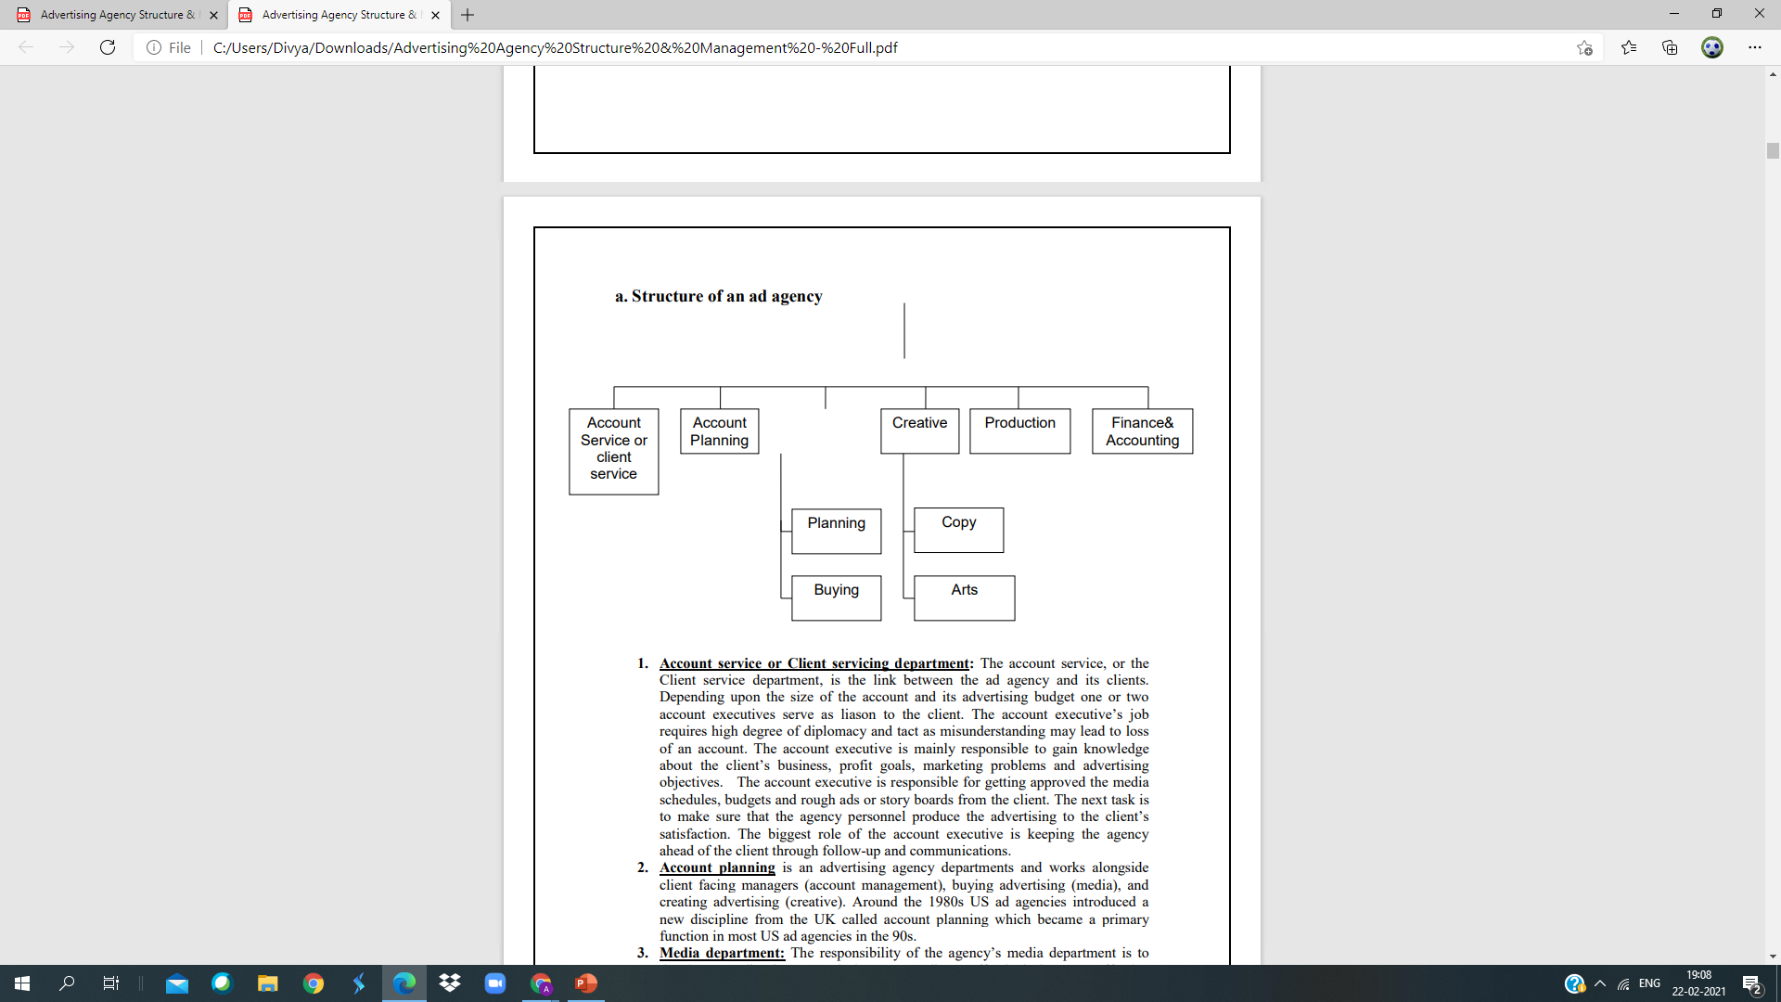
Structure of an AD Agency

Slide 14
Structure of an AD Agency
1. Account service or Client servicing department:
The account service, or the Client service department, is the link between the ad agency and its clients.
Depending upon the size of the account and its advertising budget one or two account executives serve as liason to the client.
The account executive’s job requires high degree of diplomacy and tact
As misunderstanding may lead to loss of an account.

Slide 15
Structure of an AD Agency
The account executive is mainly responsible to gain knowledge about the client’s business, profit goals, marketing problems and advertising objectives.
The account executive is responsible for getting approved the media schedules, budgets and rough ads or story boards from the client.
The next task is to make sure that the agency personnel produce the advertising to the client’s satisfaction.

Slide 16
Structure of an AD Agency
2. Account planning-
It is an advertising agency department and works alongside client facing managers (account management), buying advertising (media), and creating advertising (creative).

Slide 17
Structure of an AD Agency
3. Media department
The responsibility of the agency’s media department is to develop a media plan
To reach the target audience effectively in a cost-effective manner.
The staff analyses, selects and contracts for media time or space that will be used to deliver the ad message.
This is one of the most important decisions since a significantly large part of the client’s money is spent on the media time and/or space

Slide 18
Structure of an AD Agency
4. Creative department
To a large extent, the success of an ad agency depends upon the creative department responsible for the creation and execution of the advertisements.
The creative specialists are known as copywriters
They are the ones who conceive ideas for the ads and write the headlines, subheads and the body copy.
They are also involved in deciding the basic theme of the advertising campaign, and often they do prepare the rough layout of the print ad or the commercial story board.

Slide 19
Structure of an AD Agency
5. Production department:
After the completion and approval of the copy and the illustrations the ad is sent to the production department.
Generally agencies do not actually produce the finished ads
Instead they hire printers, photographers, engravers, typographers and others to complete the finished ad.
For the production of the approved TV commercial, the production department may supervise the casting of actors to appear in the ad, the setting for scenes and selecting an independent production studio.

Slide 20
Structure of an AD Agency
6. Finance and accounting department:
An advertising agency is in the business of providing services and must be managed that way. Thus, it has to perform various functions such as accounting, finance, human resources etc.
It must also attempt to generate new business.
Also this department is important since bulk of the agency’s income approx. 65% goes as salary and benefits to the employees.

Slide 21
TYPES of ad agencies
1.In-house agencies
2. Creative boutiques
3. Media buying agencies
4. Full-service agencies
5. Virtual Agencies
6. Satellite Agencies or Subsidiaries of Large Agencies or Second Agency
7. Specialized Agencies

Slide 22
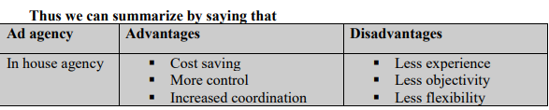
TYPES of ad agencies
1. In-house Agencies
An in-house agency is an ad agency set up, owned and operated by the advertiser. Many companies use in-house agencies exclusively
Others combine inhouse efforts with those of outside agencies.

Slide 23
TYPES of ad agencies
1980, Reliance launhced Mudra to service its own communication needs
It won Vimal and then Rasna and gradually Mudra which started with 15 employees became a large player in the advertising industry with clients across categories

Slide 24
TYPES of ad agencies
2. Full-Service Agency-
The function of an advertising agency is to see to it that its client’s advertising leads to greater profits in the long run
Most such agencies are large in size and offer their clients a full range of services in the area of marketing, communications and promotions.
These include planning, creating and producing the advertisement, media selection and research.

Slide 25
TYPES of ad agencies
The full-service agency is composed of various departments
Each is responsible to provide required inputs to perform various functions to serve the client.
BBDO (Batten, Barton, Durstine, and Osborn)

Slide 26
TYPES of ad agencies
3. Creative boutiques: Creative boutique is an agency that provides only creative services.
These specialized companies have developed in response to some client’s desires to use only the creative talent of an outside provider while maintaining the other functions internally.
The client may seek outside creative talent for two reasons:
a. Because he wants an extra creative effort
b. May be because its own employees of the in-house agency or the agency that he has appointed do not have sufficient skills in this regard.

Slide 27
TYPES of ad agencies
Examples of creative boutiques are:
RMG David (Drops RMG now) (Creative+Full service)
Vyas Gianetti Creatives (https://www.vgc.in/work/)
Chlorophyll

Slide 28
TYPES of ad agencies
4. Media buying agencies: Media buying agencies are independent companies
That specialize in the buying of media, particularly radio and television.
Media buying services have found a niche by specializing in the analysis and purchase of the advertising time and space.
Agencies and clients generally develop their own media plans and then hire the buying services to execute them.
Some media buying agencies do help advertisers plan their media strategies.
Because media buying agencies purchase such large amounts of time and space

Slide 29
TYPES of ad agencies
Examples-
Mindshare
Zenith Media (Bates, Saatchi & Saatchi)
Optimedia (Publicis)
Starcom (Leo Burnett)

Slide 30
TYPES of ad agencies
5. Virtual Agencies- Group of Freelancers
This type of agency abandons conventional office space.
Staff members do not have fixed offices
They work at home, in their cars, or at their clients’ offices.

Slide 31
TYPES of ad agencies
6. Satellite Agencies
Bigger agencies these days form smaller subsidiary agencies called satellite agencies
It is a sensible way for a big agency to offer nimbleness and personal service of a small shop.
Subsidiaries can have fresh, creative approach and can cater to smaller accounts.
Forming subsidiary does not mean partitioning a little office space and putting a new sign-board
It must be totally independent resource-- wise.

Slide 32
TYPES of ad agencies
7. Specialized Agencies
Some agencies develop a reputation for working only in certain areas and therefore they are called specialists
They either specialize in certain functions (creative or media buying),
Audiences (minority, youth),
or industries healthcare, computers, agriculture, or business-to business communication).

Slide 33
TYPES of ad agencies
. 1.JWT
2. O&M
3. Rediffusion Y&R
4. Grey Worldwide
5. Lowe.
6. Bates Enterprise

