Slide 1
Development Media Theory
Presented by
Deepak Kumar Tiwari

Slide 2
Is Growth Same as Development?

Slide 3
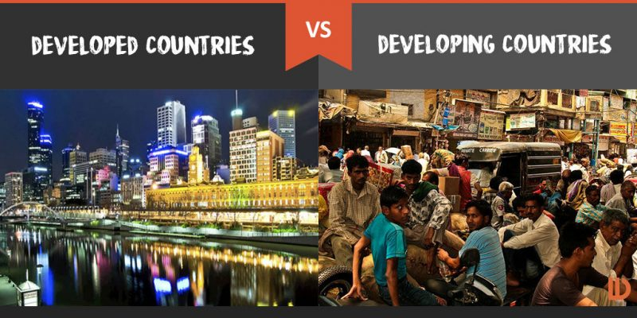
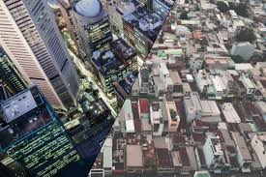
The idea of Development
Development was believed to be the process which made the third world countries follow the first world countries/ western countries, which were considered to be fully developed.
The under-developed countries had to follow their kind of political and economic systems, like heavy industries, capital intensive technology, etc.
The underdeveloped countries had to replicate a single form of development process which was practiced in some specific countries.

Slide 4
Read this very carefully
This was propounded by Dennis McQuail (1987). It talks about media support for an existing government and its efforts to bring about socio-economic development.
It argues that until a nation is well established and its economic development well underway, media must be supportive rather than critical of government, but assist them in implementing their policies.
Media should therefore give priorities to the coverage of those areas that touch on the lives of the people. In other words, content should be development-driven and should center on socio-economic and political lives of the people.

Slide 5
Development Media Theory
Development media theory relates to media in third world nations.
It proposes that media should support economic, social and political development.
It favors journalism that seeks out good news, requires that bad news stories are treated with caution. As such stories could be economically damaging to a nation.
Media should play an active role in development.
This was the theory of social change

Slide 6
The state has the right to intervene in media operations by the use of censorship devices, especially when the activities of the press are not in consonance with the development objectives of the government.

Slide 7
Development Media Theory- Features
Development roles and objectives
To help people
No manipulation or propaganda
Generates genuine response from the audience
Used to develop critical consciousness
Self-responsibility and self-determination
Two way communication flow
Uses development communication tools

Slide 8
Development= Westernization
????

Slide 9
Weaknesses of Development Media Theory
It enforces westernization more than modernization.
Cultural hegemony is occurred through development communication implementation

Slide 10
References
MASS COMMUNICATION THEORY- Foundations, Ferment, and Future- SEVENTH EDITION- by Stanley J. Baran and Dennis K. Published by Ceneage Learning
Encyclopedia of Communication Theory- by Stephen W. Littlejohn Karen A. Foss- Sage Publication
Development Communication Theory- explained by Shraddha Bajracharya -https://www.businesstopia.net/mass-communication/development-communication-theory

Slide 11
The End

