Slide 1
Thakur College of Science & Commerce
Department of Zoology
Welcomes
Academic Year – 2020-21
Dr. Vitthal T. Mohite

Slide 2
Semester – V
Paper – III Unit- III
General Pathology

Slide 3
Pathology
General pathology involves all aspects of pathology. It deals with the diagnosis and management of disease
Introduction : Important field of modern medical & Medical Research.
Typical examples include cervical smear, sputum and gastric washings.
Forensic pathology - post mortem examination of a corpse for cause of death using a process called autopsy.
Dermatopathology concerns the study of skin diseases.
Anatomical, Clinical and molecular pathology.
Pathology consider four main component of Disease:
1. Causes of disease.
2. Mechanism of development of disease(Pathogenesis)
3. Structural alterations of cells (morphological changes)
4. Consequences of changes ( Clinical Symptoms)

Slide 4
Fields of Pathology
Anatomical Pathology
Cytopathology
Dermatopathology
Forensic pathology
Histopathology
Nephro-pathology or Renal Pathology
Neuropathology
Pulmonary Pathology
Surgical pathology
Clinical Pathology
Hematopathology
Immunopathology
Radiation pathology
Molecular pathology
Psychopathology

Slide 5
Scope of Pathology
Separate field in medical practice.
Contribute greatly to disease diagnosis.
Blood analysis, epidemiology, etiology, immunology, parasitology.
Also involves biomedical research of disease.
Experimental pathology.
Disease diagnosis
Therapy
Histopathology
Cytopathology
Clinical Pathology
Parasitology

Slide 6
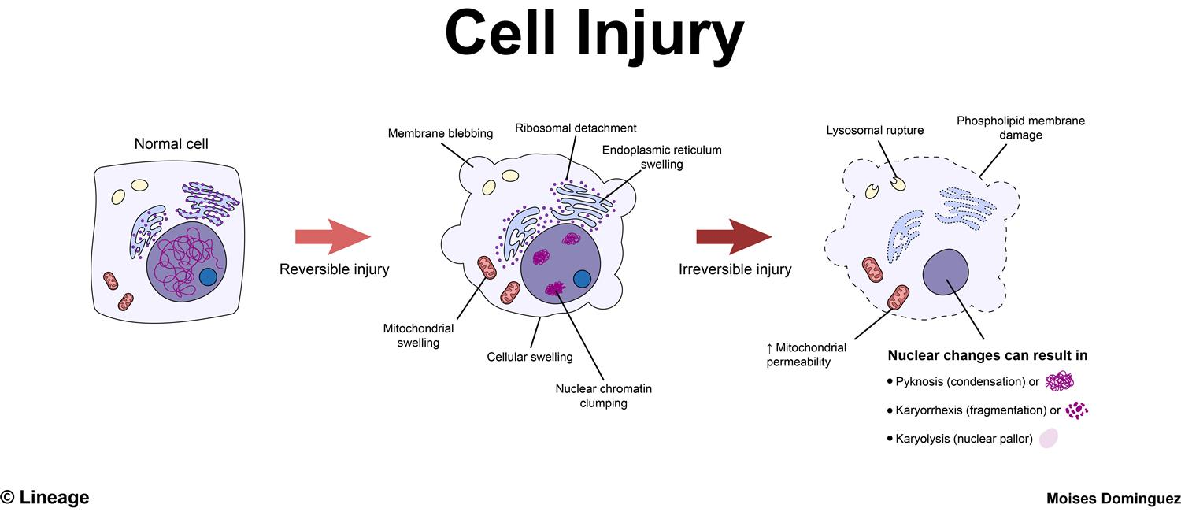
Cell Injury
Definition- The effect of variety of stresses due to etiological agents a cell encounters resulting in changes in its internal and external environment.
Cellular Response depends on:-
1. Host factors – types of cell and tissues involved.
2. Factors pertaining to injurious agents- extent and type of cell injury.
Types of Cell Injury
I Genetic Causes
II Acquired causes-
1. Physical agents –
2. Chemical Agents and drugs-
3. Microbial agents-
4. Immunological agents-
5. Nutritional Imbalance -

Slide 7
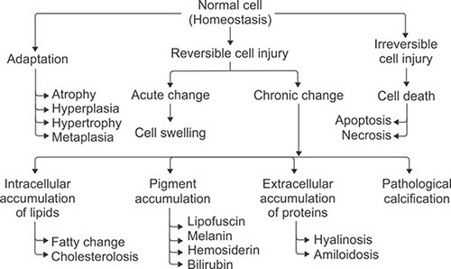
Cell Injury- Mechanism

Slide 8
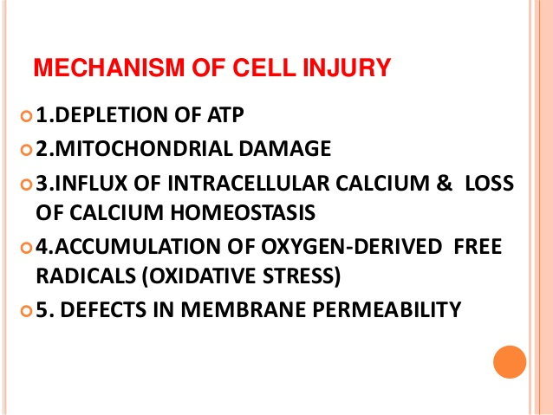

Slide 9
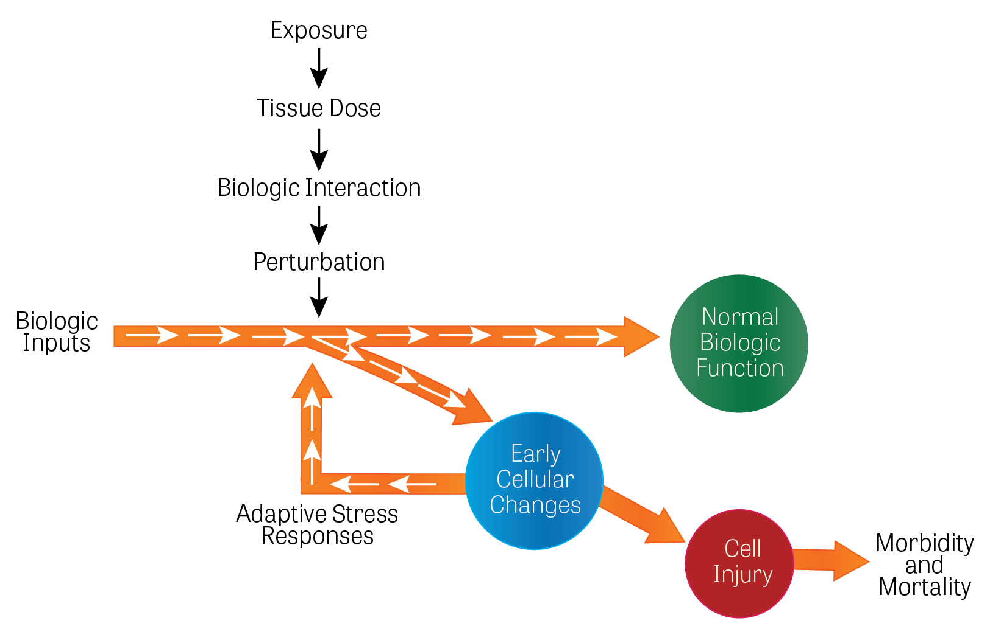
Physiological alterations in cell injury

Slide 10
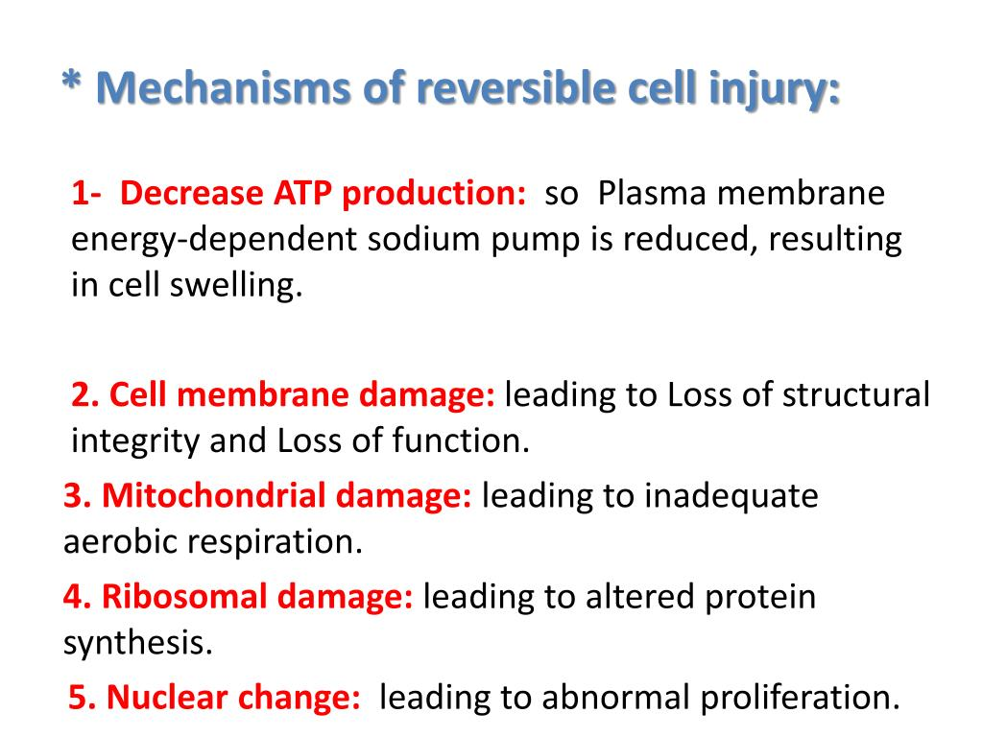

Slide 11
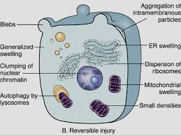

Slide 12
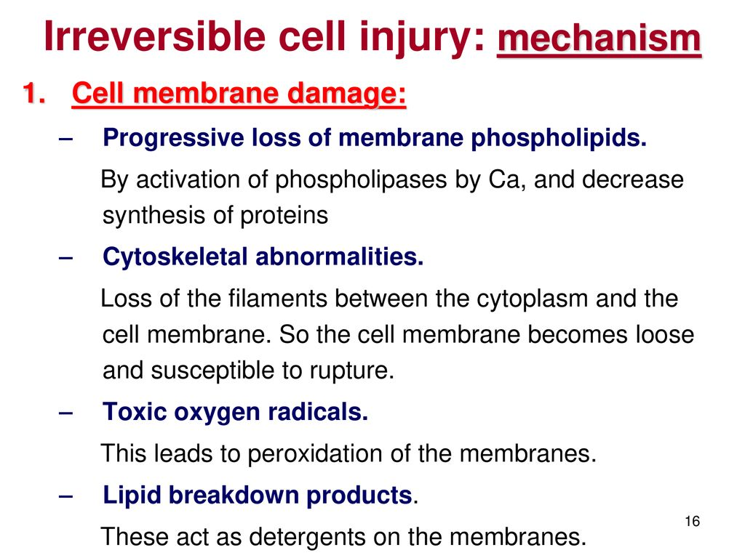

Slide 13
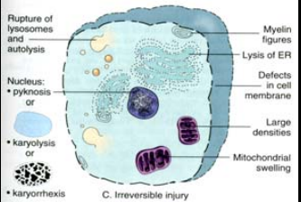

Slide 14
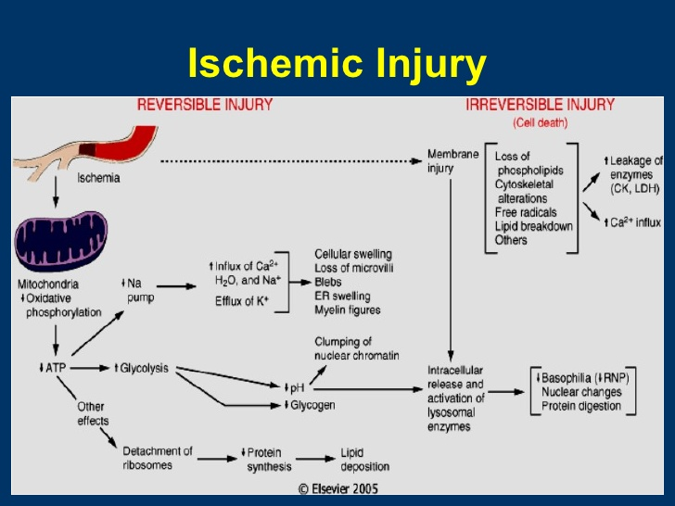

Slide 15
Types of Ischemic Cell Injury
Renal Ischemia -
Heart
Colon- Ischemic colitis
Brain
Limbs
Skin

Slide 16
Hypoxic Cell Injury
Reduction in blood flow.
Inadequate oxygenation of the blood due to cardiorespiratory falure.
Decrease in oxygen carrying capacity of the blood.
Severe blood loss.

Slide 17
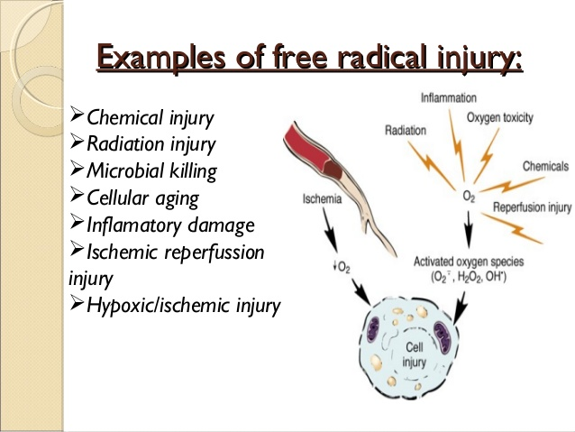
Free Radical Mediated Cell Injury

Slide 18
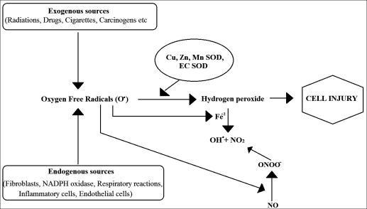

Slide 19
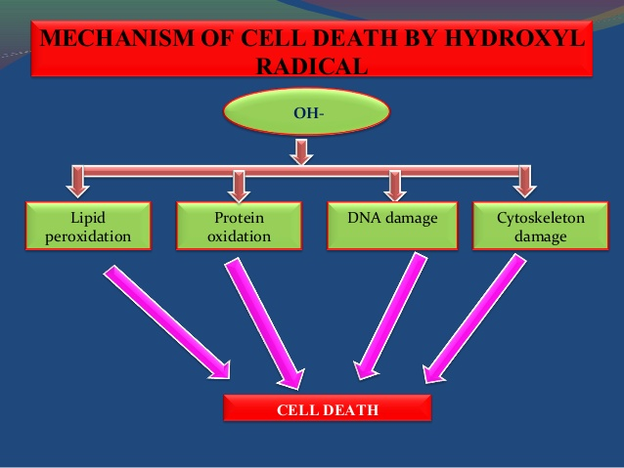

Slide 20
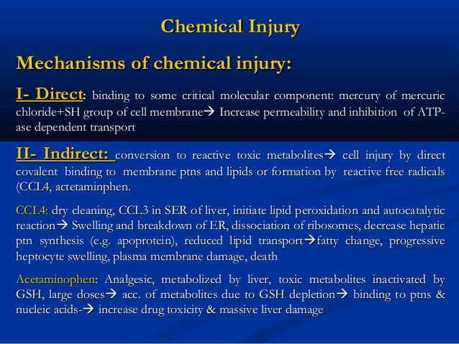
Chemical Cell Injury

Slide 21
Retrogressive changes in cell injury
Two Processes
1. Degenerations – Accumulation of metabolite & other material in the cell.
2. Infiltration – Overloading of normal cell material by quantity & Quality.
Patterns of Degeneration and Infiltration
I) Water Overload
II)Metabolic Overload
III)Storage loading

Slide 22
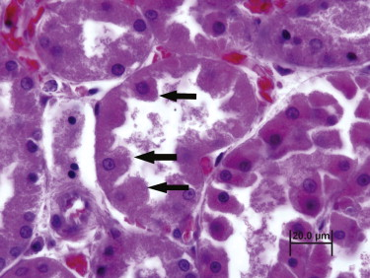
Cloudy Swelling
1. Normal Epithelium
2. Beginning of Cloudy Swelling.
3. Marked degeneration
4. Desquamated degenerated epithelium

Slide 23
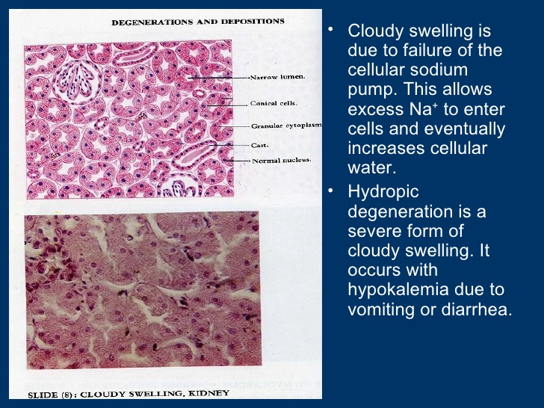

Slide 24
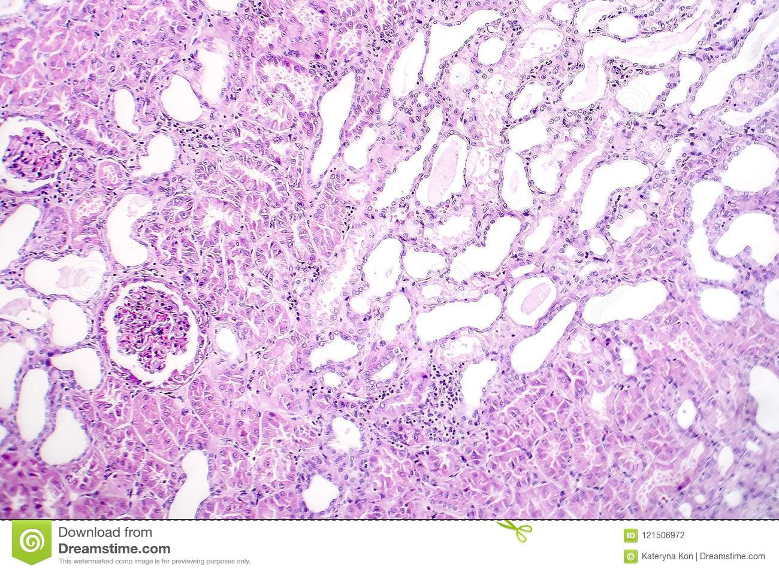

Slide 25
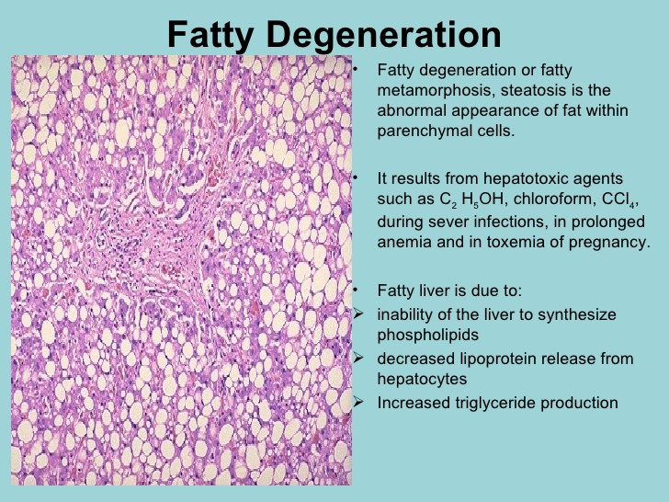

Slide 26
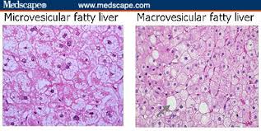

Slide 27
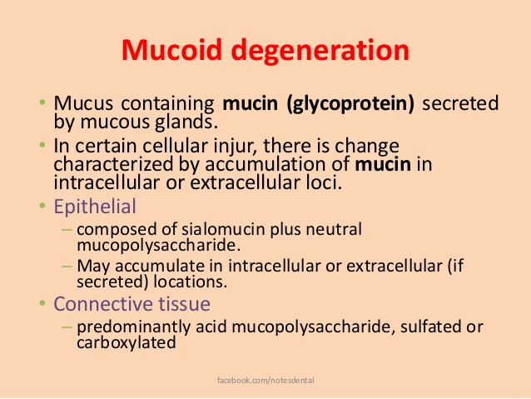

Slide 28
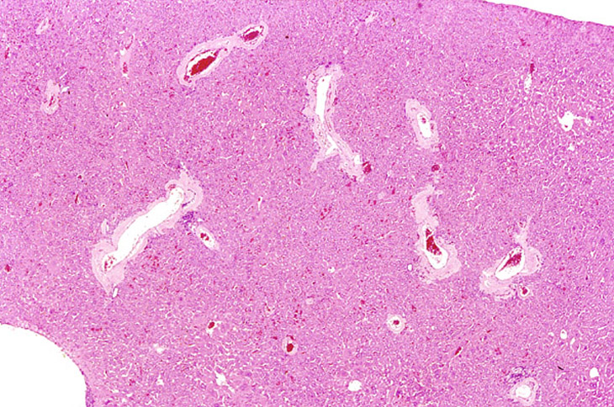
Amyloid Degeneration
Amyloidosis is when an abnormal protein called amyloid builds up in your tissues and organs. When it does, it affects their shape and how they work.
Amyloidosis is a serious health problem that can lead to life-threatening organ failure
1. AL Amyloidosis – Primary Amyloidosis : Immunoglobulin light chain Amyloidosis
2. AA Amyloidosis - Secondary Amyloidosis
3. Dialysis related Amyloidosis
4. Hereditary Amyloidosis
5. Age related systemic Amyloidosis
6. Organ Specific Amyloidosis

Slide 29
Effects of Amyloidosis
Change in skin Color.
Sudden weight loss.
Shortness in breath.
Swelling of tongue.
Low RBC count.
Joint pain. Numbness in legs and feet.
Severe weakness.
Types
Cardiac Amyloidosis
Renal Amyloidosis
Gastrointestinal Amyloidosis
Neuropathy Amyloidosis

Slide 30
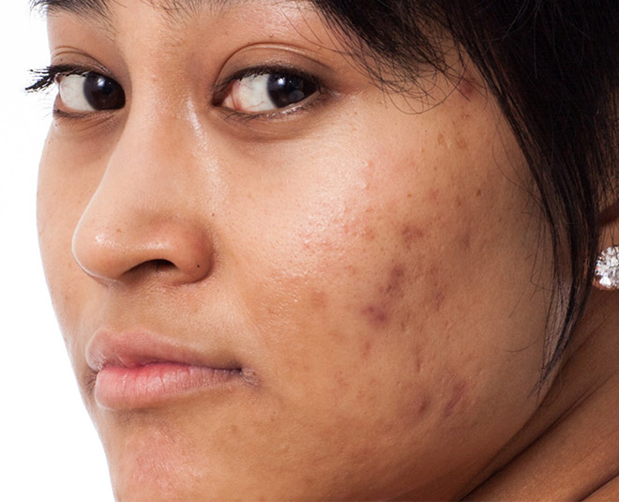
Disorders of Pigmentation
Responsible to develop body color.
Disorders of pigmentation can change skin colour.
Special cells in the skin produces melanin pigment.
More melanin production leads darker skin & less leads lighter color.
Missing of skin color due to genetic disorder called Albinism.
Types of Pigments
1. Exogenous pigments – Coming from outside the body.
2. Endogenous pigments – Synthesized within the body

Slide 31
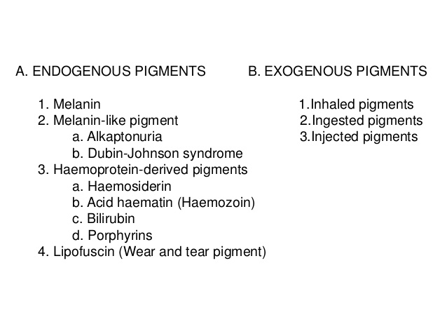

Slide 32
1. Exogenous pigments
1. pigments are characterized as agents containing color that are formed outside of the body but found within tissues.
2. Exogenous pigments can find their way into the body in a variety of ways.
3. Examples of exogenous pigments are carbon, asbestos fibers, tattoo ink, and metals.
4. Copper is the most commonly visualized exogenous pigment found in liver tissue.
5. Carbon, dust , pollutants, lubricants, tattooing.

Slide 33
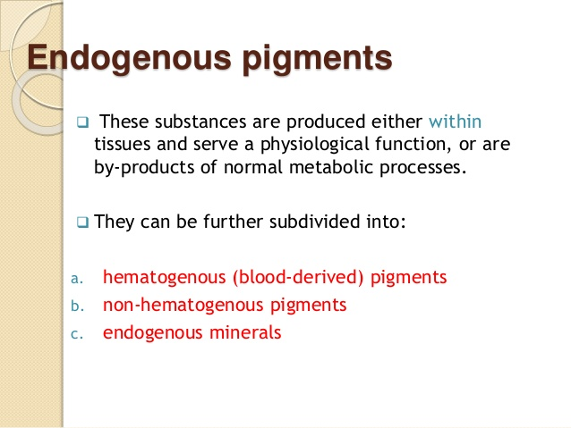

Slide 34
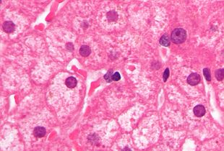
Lipofuscin – Aging pigment
Yellow brown colour due to extracellular peroxidation of poly-saturated lipids.
It is made up of lipids and phospholipids attached to protein.
Extra accumulation of lipofuscin causes disease called Lipofuscinosis.
Types
Primary : Hereditary
Accumulation in certain organs e.g. Liver , brain.
Dabin –johnson Syndrome and Gilbert syndrome.
Secondary : Found in cells show slow changes.
Mainly seen in malnutrition people.
Can show effect on liver or myocardium muscle.

Slide 35
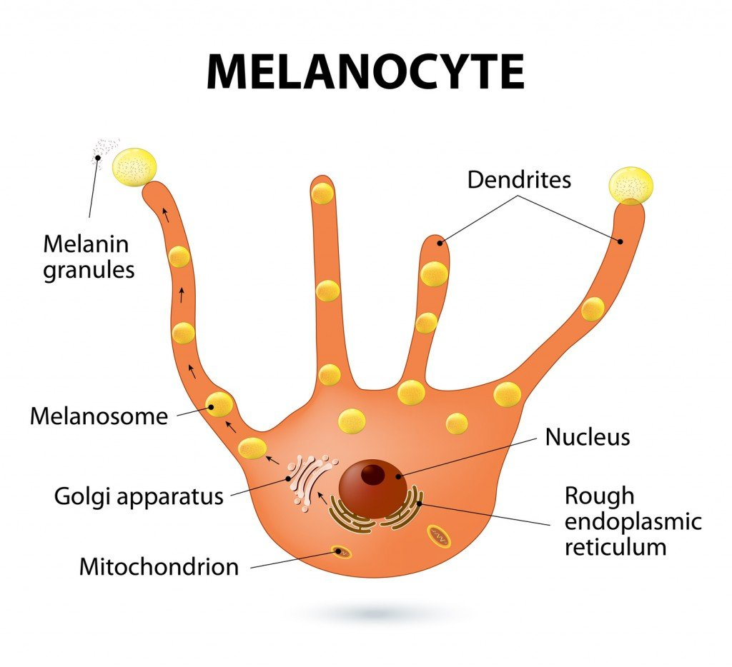
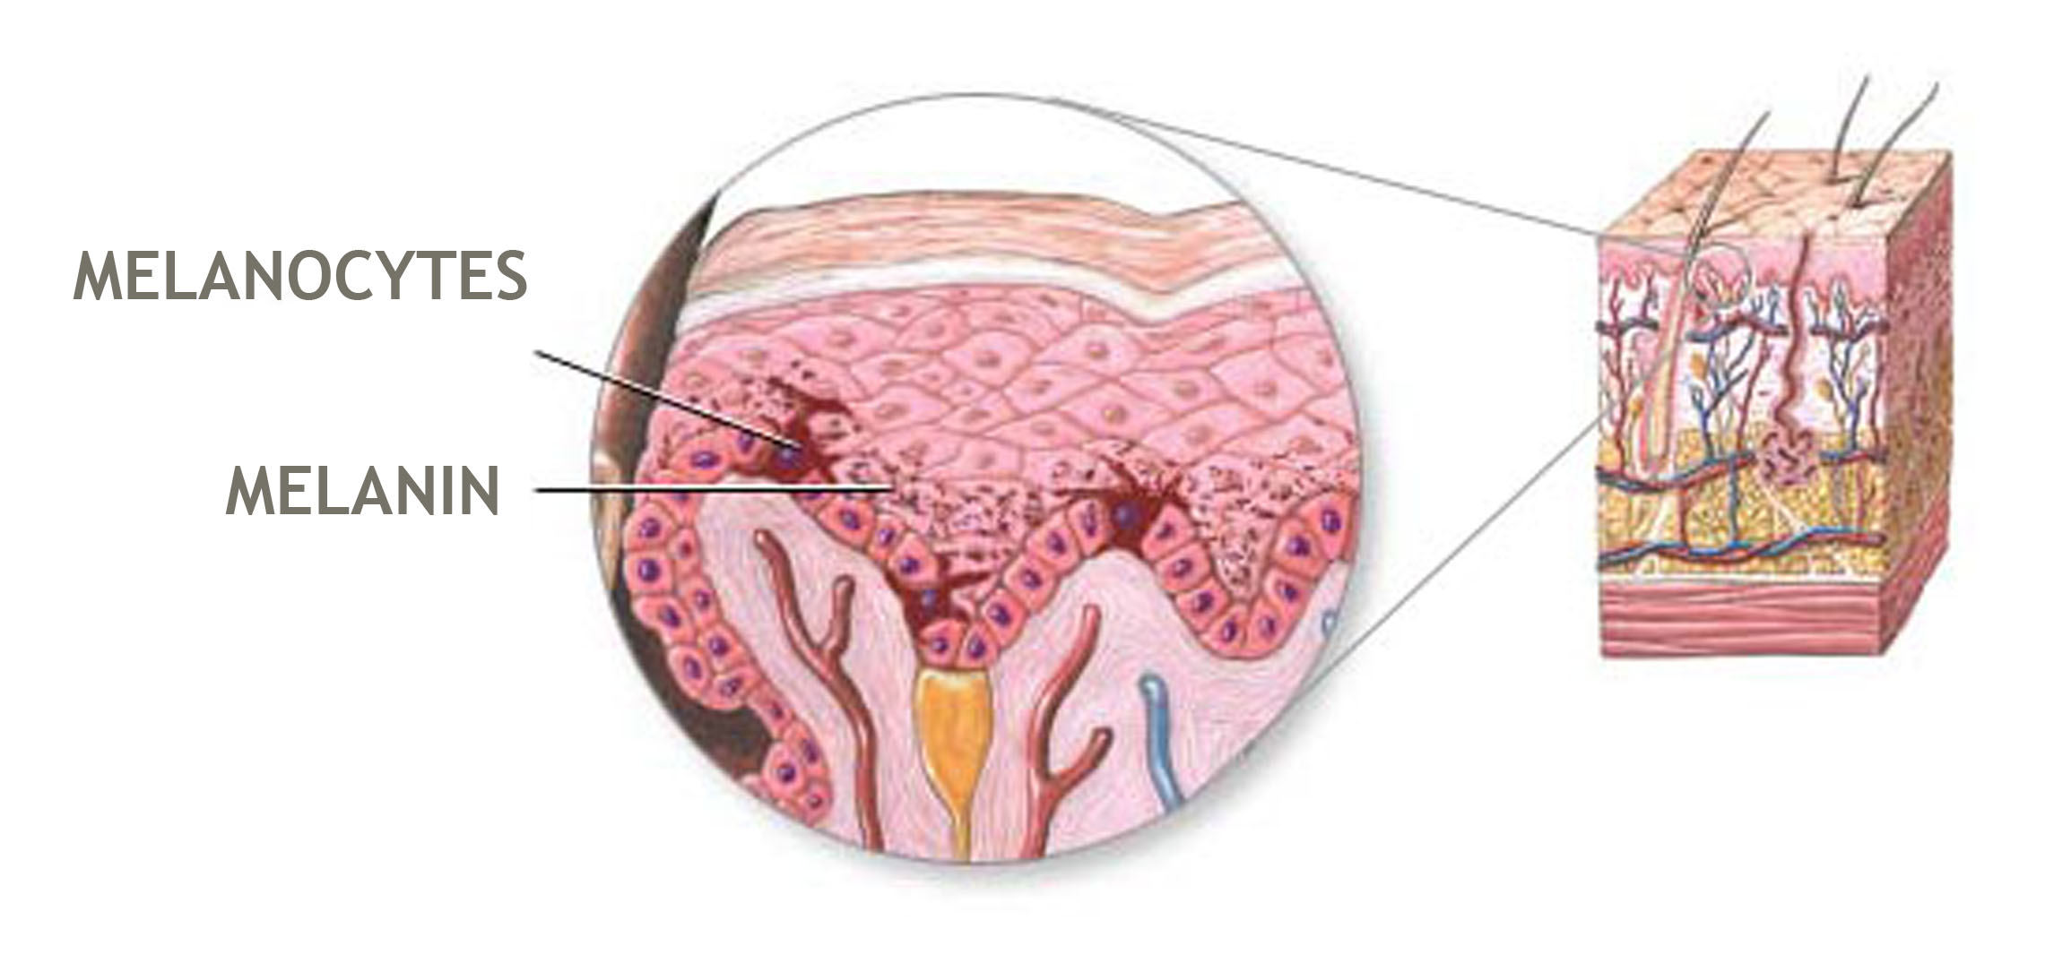
Melanin –
More important endogenous pigment brownish black in colour

Slide 36
Melanin
Melasnoblasts is precursor cell of melanocyte.
Located basal layer of epidermis and hair follicles.
Skin colour depends on type & Amount of melanin present in the skin of individuals.
Melanin content changes at various sites of skin of the same individuals.
In humans, melanin exists as three forms:
eumelanin (which is subdivided further into black and brown forms),
pheomelanin,
neuromelanin.
Four different types of pigments
Oxygenated hemoglobin ( Red) - Arteries
Reduced Hemoglobin (Blue) -Veins.
Exogenous – Carotenoids (Yellow)
Endogenously – melanin (Brown)

Slide 37
Factors controlling Pigmentation
Extrinsic Factors :
Body distribution, Sex, genetic problems, age, variable hormones, responsiveness, hair cycle dependent changes, climate, UV radiations, toxins, pollutants, infestations.
Intrinsic Factors :
Keratinocytes, fibroblast, hormonal secretion, blood supply, working of nervous system.
Number of melanocyte
Expression and function of melanosomal enzymes.
The amount of eumelanin and pheomelanin synthesized.

Slide 38
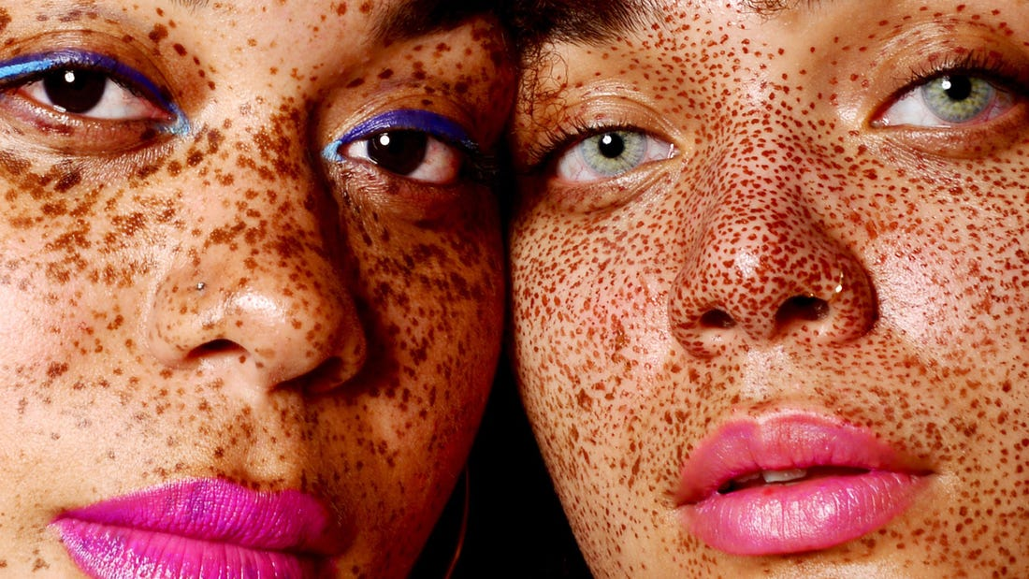
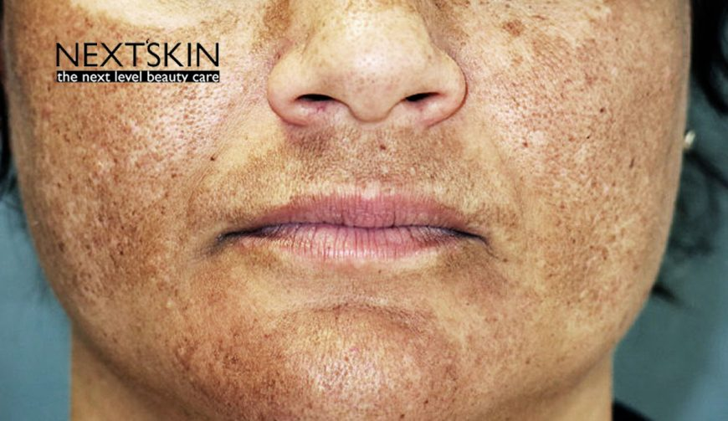
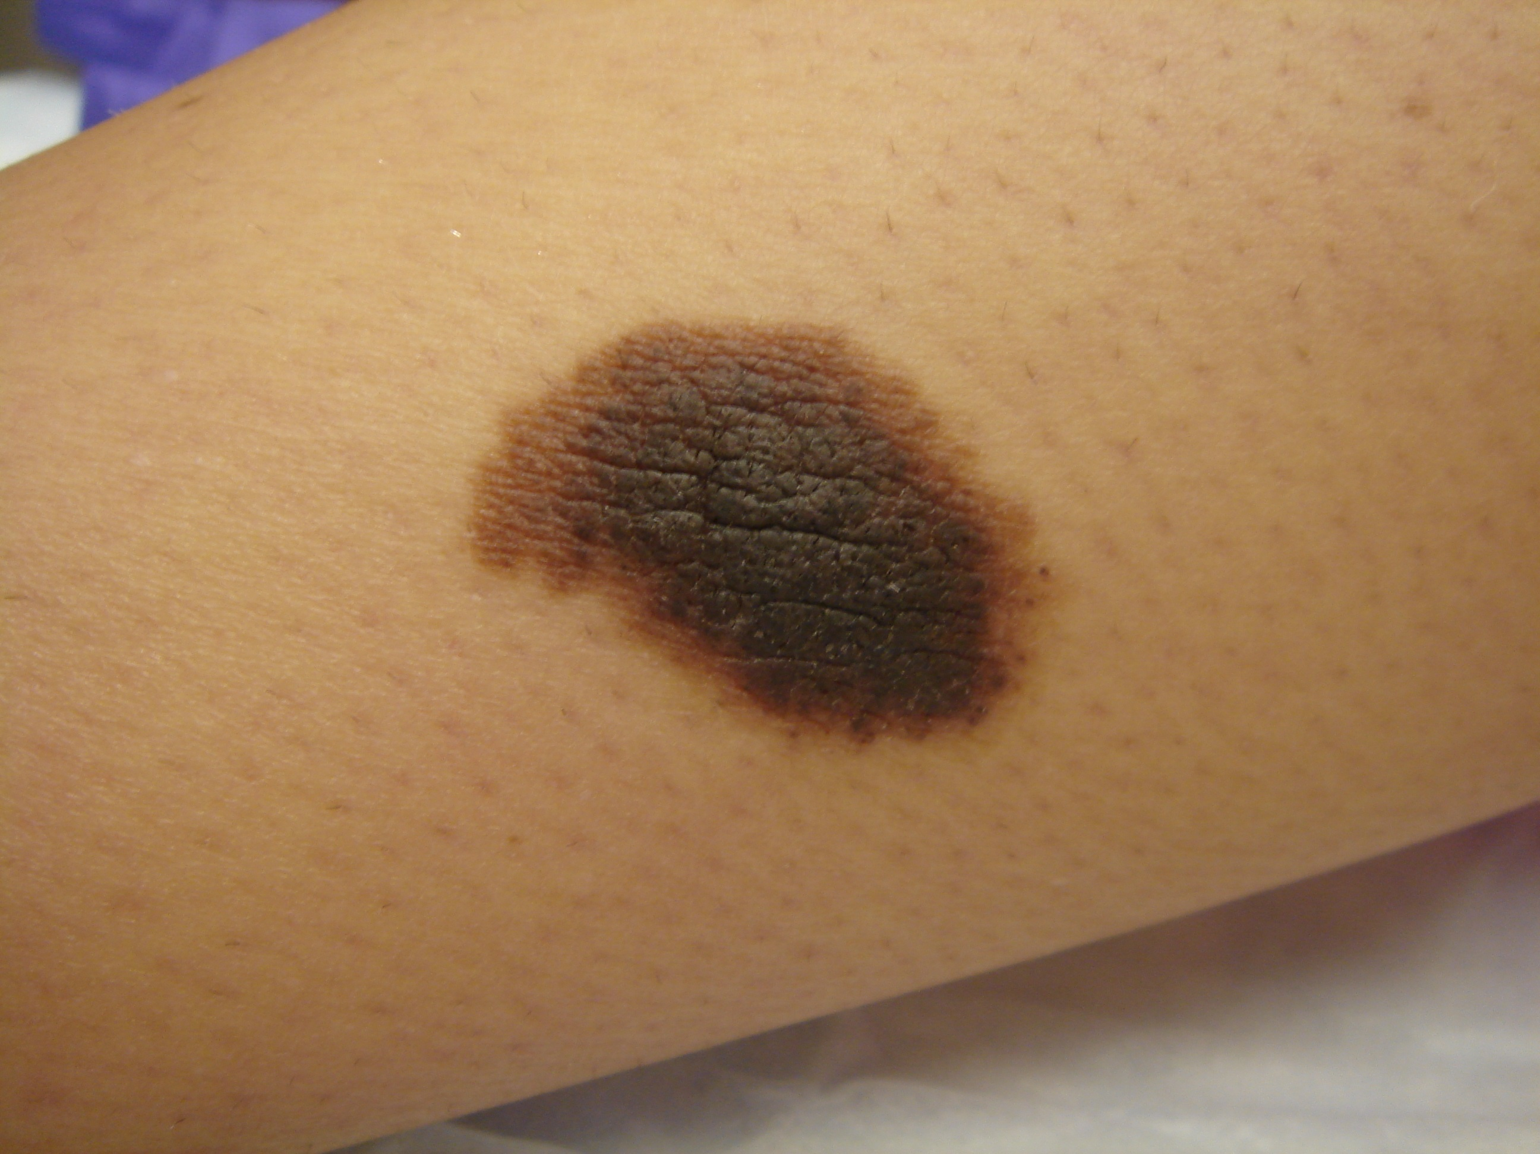
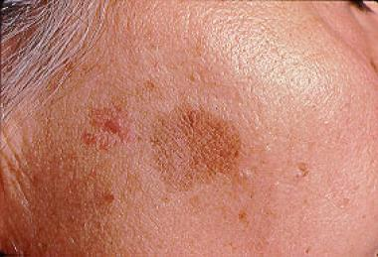
Melanosis
Freckles
Disorder by melanin metabolism
Hyper pigmentation & Hypopigmentation.
Hereditary
Acquired
Local hyperpigmentation :
  1. Freckles
  2. Melanoderma
  3. Lentigo
  4. Non –Cell nevus (Birth Marks)
Common
Melanoderma
Non –Cell nevus ( Birth marks)
Lentigo

Slide 39
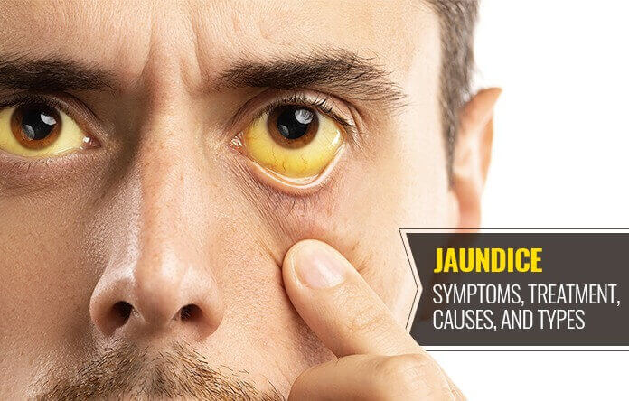
Jaundice
Jaundice is a condition in which the skin, whites of the eyes and mucous membranes turn yellow because of a high level of bilirubin, a yellow-orange bile pigment.
Jaundice has many causes, including hepatitis, gallstones and tumors.
In adults, jaundice usually doesn't need to be treated.
Jaundice is caused by a buildup of bilirubin, a waste material, in the blood.
An inflamed liver or obstructed bile duct can lead to jaundice, as well as other underlying conditions.
Three types
1. Hepatocellular - due to liver injury.
2. Hemolytic – due to hemolysis of erythrocytes.
3. Obstructive – Obstruction in bile duct.

Slide 40
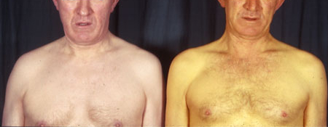
Jaundice- Causes
Due to accumulation of bilirubin in tissues.
Bilirubin level in blood gets increased. ( Above 2-3 mg/dl) gives rise to jaundice.
High bilirubin is of two types :
Unconjugated type : bilirubin excess in RBCs e.g Gilbert’s Syndrome, Newborn jaundice.
Conjugated Type: due to liver disorders like cirrhosis, hepatitis, infections, medicines, obstruction in the bile.
It is detected by using ultrasound medical imaging.
Inner disorders : Acute inflammation of liver.
Obstruction of bile duct.
Hemolytic anemia
Gilbert Syndrome
Cholestasis
Gilbert’s Syndrome

Slide 41
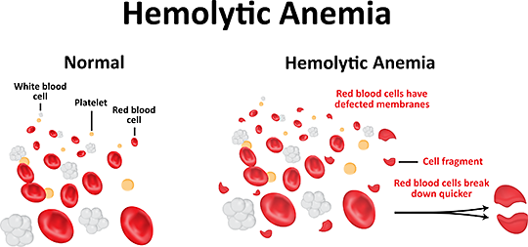
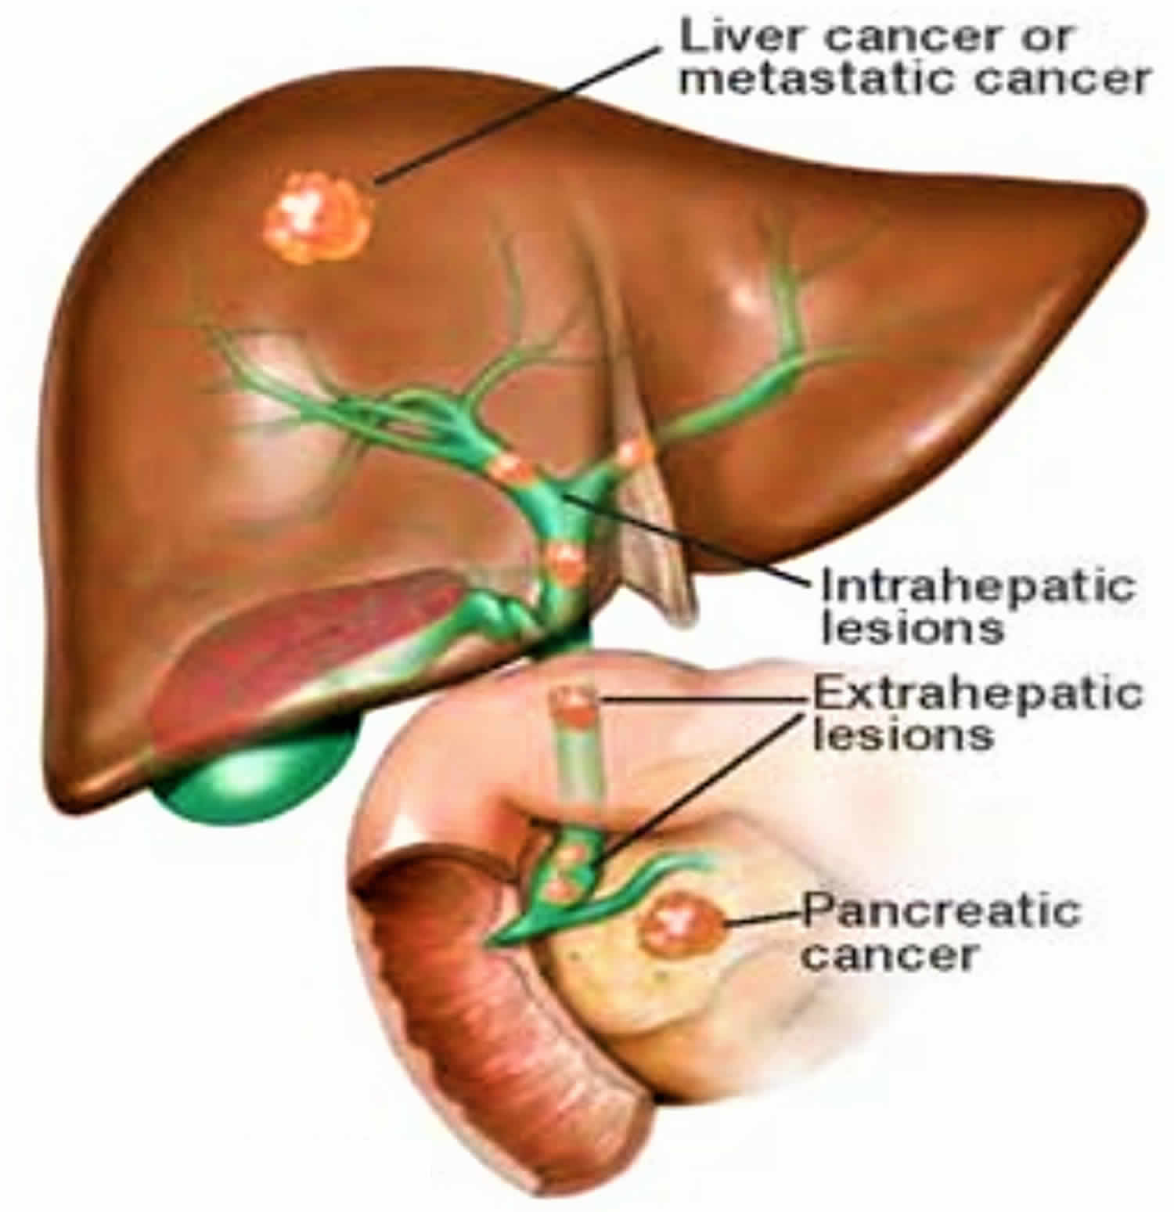
Obstruction of liver

Slide 42
Rarer conditions that may cause jaundice include:
Crigler-Najjar syndrome:
This is an inherited condition that impairs the specific enzyme responsible for processing bilirubin.
Dubin-Johnson syndrome:
This is an inherited form of chronic jaundice that prevents conjugated bilirubin from being secreted from of the cells of the liver.
Pseudojaundice:
This is a harmless form of jaundice. The yellowing of the skin results from an excess of beta-carotene, not from an excess of bilirubin. Pseudojaundice usually arises from eating large quantities of carrot, pumpkin, or melon.

Slide 43
Jaundice- Effects
a yellow tinge to the skin and the whites of the eyes.
normally starting at the head and spreading down the body
pale stools
dark urine
Itchiness.
Stools are pale.
Accompanying symptoms of jaundice resulting from low bilirubin levels include:
fatigue
abdominal pain
weight loss
vomiting
fever

Slide 44
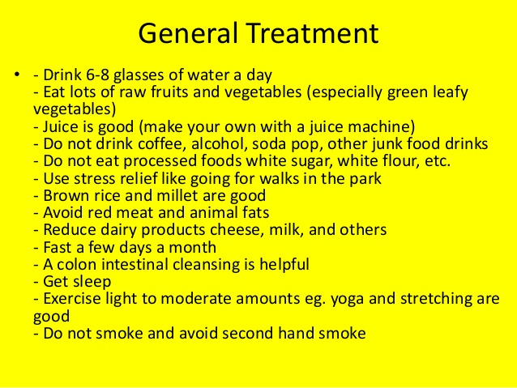

Slide 45
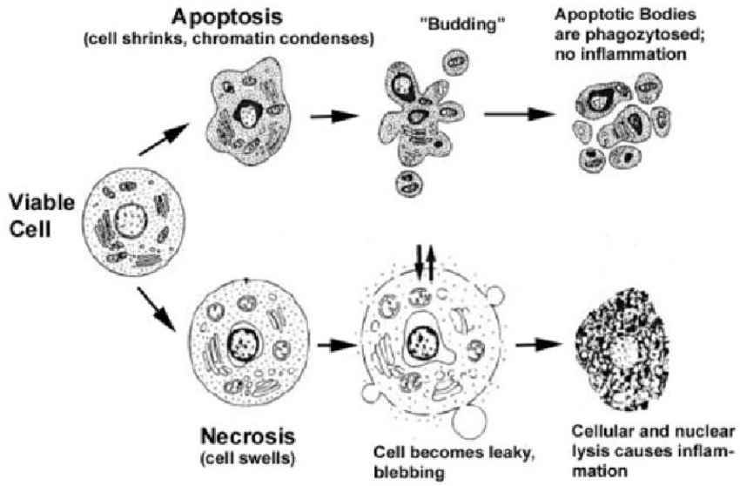
Necrosis
Cell injury leads programmed premature death.

Slide 46
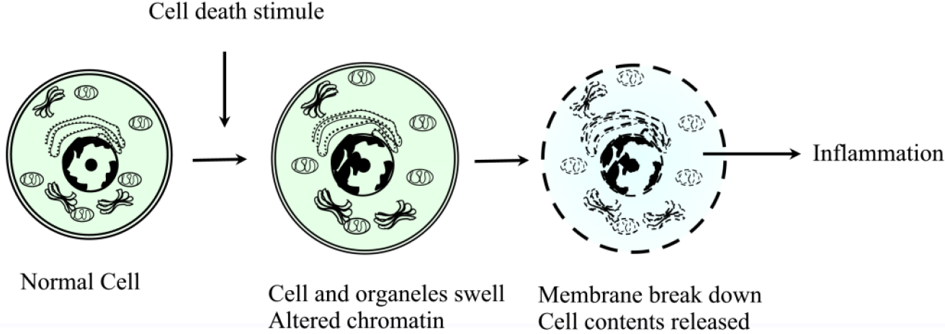

Slide 47
Factors affecting necrosis:
External Factors :
1.Mechanical trauma
2. Damage to blood vessels.
3. Cellular Ischemia or Cellular burns
4. Low temperature
5. Toxin mediated necrosis e.g. snake venom
Internal factors :
1. Injury & paralysis to nervous tissues.
2. Pancreatic enzyme causes fat necrosis
3. Denature of cellular protein.
4. Enzymatic digestion of cellular debris in dead

Slide 48
Types of necrosis:
Coagulative necrosis.
Liquefactive necrosis.
Caseous necrosis.
Fat necrosis.
Fibroid necrosis.
Gangrenous necrosis.

Slide 49
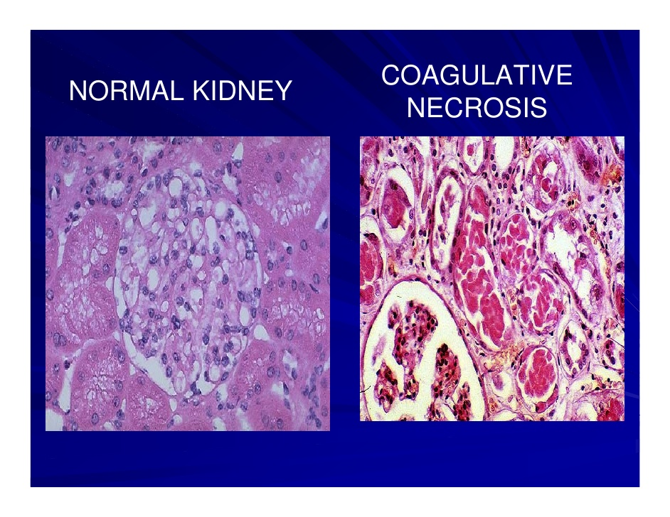
1. Coagulative necrosis
Formation of gelatinous substance in dead tissues.
Proteins denatured and transformed in firm , opaque state resulting coagulation
This occurred during hypoxic condition.
Show effect on kidney, heart, adrenal glands, GI and lower limbs.

Slide 50
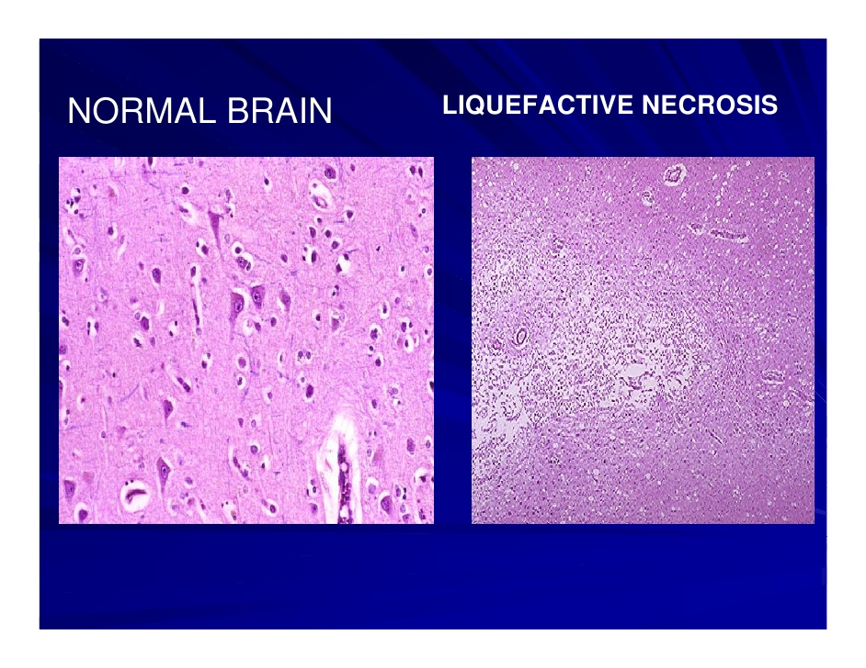
2. Liquefactive necrosis
Liquefactive necrosis (or colliquative necrosis) is a type of necrosis which results in a transformation of the tissue into a liquid viscous mass.
Often it is associated with focal bacterial or fungal infections, and can also manifest as one of the symptoms of an internal chemical burn.
While the reason for liquefactive necrosis following ischemic injury in the brain is poorly understood,
Gross Appearance: The tissue is in a liquid form and sometimes creamy yellow because of pus formation.
Microscopic: Inflammatory cells with numerous neutrophils.

Slide 51
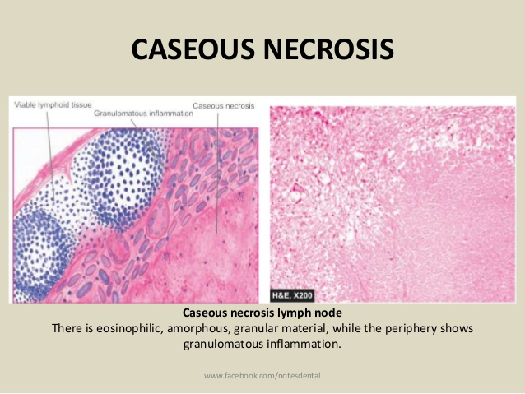
3. Caseous necrosis
Due to combine effect of Coagulative & Liquefactive necrosis.
Infection of Mycobacteria, fungi, some foreign substance responsible for this necrosis.
Digestion of dead cells in incomplete , but disintegrate living molecules.
Microscopic observation shows amorphous granules.
Results in inflammatory borders.

Slide 52
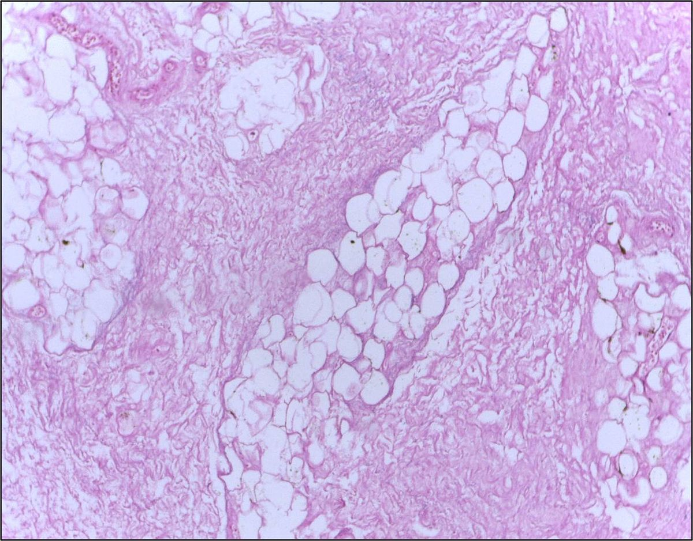
4. Fat necrosis
Fatty tissues shows this type of necrosis.
In Pancreases these tissues acted upon by lipase enzyme during cell injury.
Pancreatic fluid flow out the peritoneal cavity.
Appears chalky white substance due to binding of Ca, Mg, K to these lesions.

Slide 53
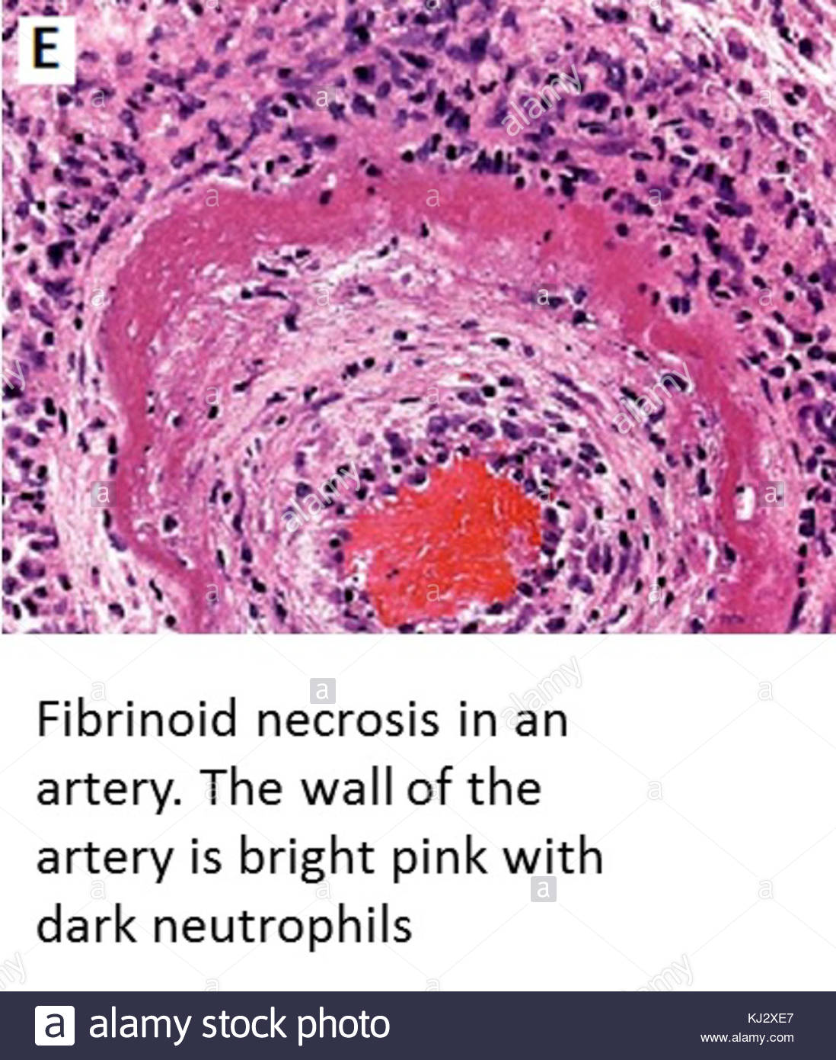
5. Fibrinoid necrosis
Fibrinoid necrosis is a specific pattern of irreversible, uncontrolled cell death.
It is immune mediated vascular damage results into necrosis.
when antigen-antibody complexes are deposited in the walls of blood vessels along with fibrin.
It is common in the immune-mediated vasculitis which are a result of type III hypersensitivity.
very high blood pressure, pre-eclampsia, vasculitis, and rejection of organ transplants.

Slide 54
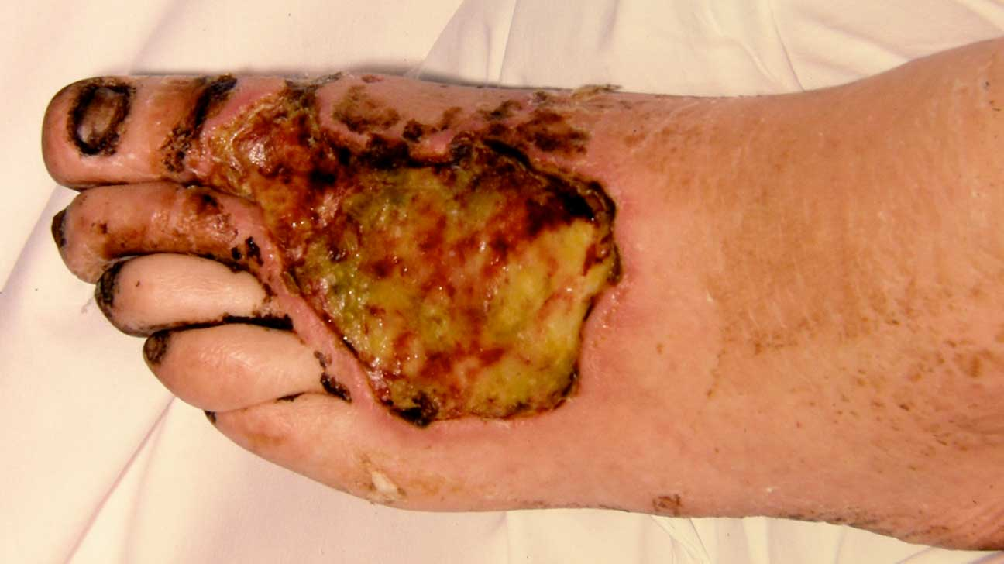
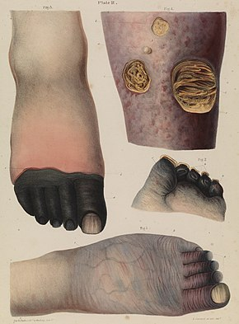
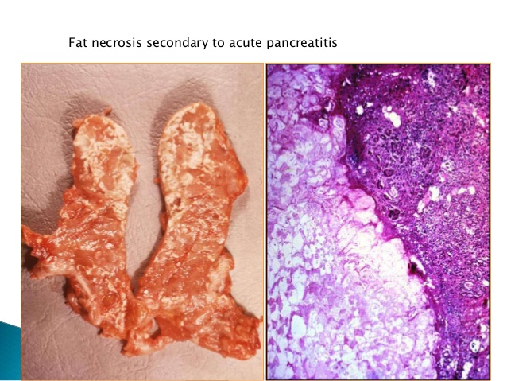
6. Gangrenous necrosis
Gangrenous necrosis refers to the death of tissue due to a lack of blood flow, and can be broken up into categories.
Most affected part is hands & feet.
The condition often affects toes, fingers and limbs, but can affect muscles and organs.
Dry, Wet and gaseous gangrine

