Slide 1
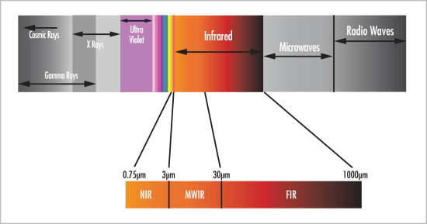
Electromagnetic Spectrum

Slide 2
Infrared Waves

Slide 3
Vibrations Of Molecules
Symmetrical Stretching
Anti symmetrical Stretching
Scissoring
Rocking
Wagging
Twisting

Slide 4
Theory of IR…
There must be change in the dipole moment of the molecule as a result of molecular vibration/rotation.
Symmetric molecules do not absorb IR radiation since there is no dipole moment.
If the frequency of the radiation matches the natural frequency of vibration, the IR photon is absorbed and the amplitude increases.

Slide 5
In Organometallic Compounds
These compounds contain ligands that are bonded to metal atoms through carbon bonds.
M-C stretching of OMC are observed in 600-400 cmˉ¹
In M-CH_{³} Groups, the IR bands appear in the range of 1210-1180 cmˉ¹ (M = Hg & Sn).

Slide 6
When the compound is a Pb compound the IR spectra is observed at a lower wave number i.e. 1170-1150 cmˉ¹.
Aromatic organometallic molecules show a strong band at 1430 cmˉ¹.

Slide 7
In Coordination Compounds
M + NH₃ [M(NH₃)_{n}]
Free N-H group = 3300 cmˉ¹
Differences in the IR values i.e.
M- NH₃ rocking = 900-600 cmˉ¹
M-NH₃ bending = 1400-1100 cmˉ¹
N-H stretching = 3700-2500 cmˉ¹
N-H bending = 1750-1500 cmˉ¹

Slide 8
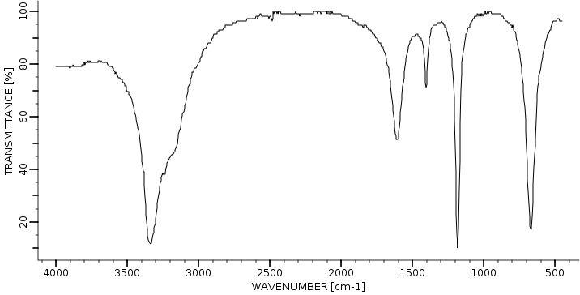
e.g. Consider [Ni(NH₃)₆]²⁺

Slide 9
Metal – Sulphur Complex
Another example can be M-S complex i.e. [M-Tu] Complex.
NH₂ asymmetric stretching = 3395 cmˉ¹
NH stretching = 3179 cmˉ¹
NH₂ stretching = 2674 cmˉ¹
CN asymmetric stretching = 1464 cmˉ¹
C=S asymmetric stretching=1395 cmˉ¹
C=S stretching = 729 cmˉ¹
NCN asymmetric bending = 485 cmˉ¹

Slide 10
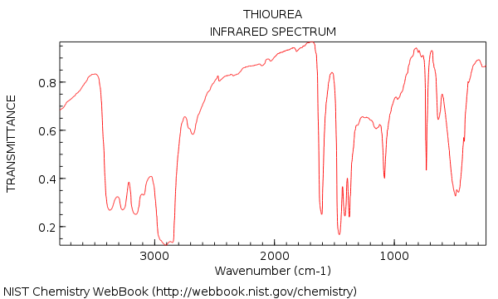

Slide 11
Electron Spin Resonance (ESR)

