Slide 1

ATTEND LECTURES ON TIME OR EVEN BATMAN WILL NOT BE ABLE TO SAVE YOU.

Slide 2
TOPIC: risk and risk management

Slide 3
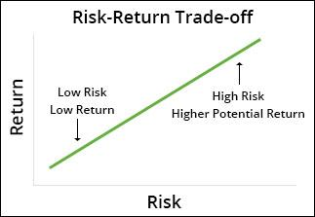

Slide 4
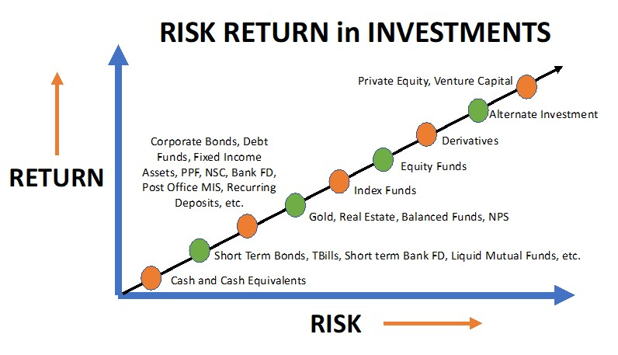

Slide 5
Risk appraisal
(foreign exchange risk)
Transaction Risk
Economic Risk
Translation Risk
Risk of an exchange rate changing between transaction and settlement date
Long-term affects of changes in exchange rates on the market value of a company
Translation from foreign currency to home currency
Size of the transaction, hedging period, volatility
Doesn’t mean real conversion from one currency to another

Slide 6
Risk appraisal
(investment risk)
Market Risk- economic developments or markets
Liquidity Risk- unable to sell investment at fair price
Concentration Risk – loss due to concentration in one type of investment
Credit Risk- unable to pay interest or repay the principal at maturity
Reinvestment Risk- loss from reinvesting principal or income at a lower interest rate
Inflation Risk- loss of purchasing power
Horizon Risk- risk that your investment may be shortened because of an unforeseen event
Longevity Risk- risk of outliving your savings
Foreign Investment Risk- loss when investing in foreign countries
Equity Risk- drop in share price (shares)
Interest Rate Risk- due to change in interest rates (bonds)
Currency Risk- movements in exchange rate

Slide 7
Risk Management through Hedging
Hedging and important of hedging in the financial markets
It can be done in two
Internal Hedging Methods
External Hedging Methods

Slide 8
Internal Hedging Methods
Exposure Netting (Appreciation and Depreciation of Currencies)
Denomination in local currency
Foreign Currency Accounts
Leading
Lagging
Matching

Slide 9
External HEDGING METHODS
Derivatives
Forward Contracts
Future Contracts
Swaps
Options

