Slide 1
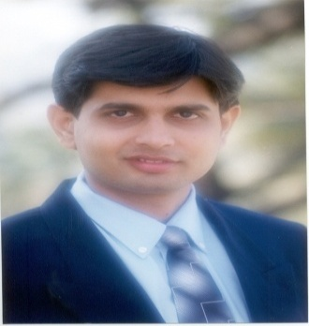
Profile:
Lion Dr. Nishikant Jha
ICWA, PGDM (MBA), M.Com., Ph. D., D. Litt. [USA]'
CIMA Advocate [CIMA U.K.], BEC [Cambridge University],
International Executive MBA [UBI Brussels, Belgium, Europe],
Recognise M. Phil. & Ph. D. Guide [Research Supervisor] by University of Mumbai.
Board of Study Member for B. Com. (Accounting & Finance) and (Financial Management) for [University of Mumbai], SRTM University Nanded, (Many Autonomous Colleges),
HOD (Accounting & Finance), Thakur College of Science & Commerce, University of Mumbai.
Visiting faculty in JBIMS & KPB Hinduja College for MBA, M.Phil & M. Com, University of Mumbai
CFA & CPF (USA), CIMA (UK), Indian & International MBA, CA & CS Professional Course
Honorary Secretary All India Accounting Association - Thane Branch, Maharashtra
Executive Committee Member Maharashtra in Indian Economic Association & Maharashtra Commerce Associations [MCA]
Editorial Board Member for Many Indian and International Research Journals on Comm. & Mgmt.
Awarded as an Outstanding Faculty by JARO-UBI 2012 & 2013, Best Commerce Author & Researcher Award 2013-14 from Maharashtra Commerce Association in Mumbai, National Citizen Gold Medal Award for Outstanding Individual Achievement in the field of Education and Social Service from Global Economic Progress & Research Association Chennai Tamil Nadu. Rajiv Gandhi Gold Medal Award GEPRA New Delhi 2014-15, State level Mahatma Jyotiba Phule Excellent Teacher Award, Kalyan 2015-16, Maharashtra Guru Gaurav Award, Thane 2016-17, Maharashtra State level Exemplary Teacher Award, Nasik 2017-18. Swami Vivekananda Human Service Award at All India Talent Conference Vasco Goa 2018-19. Community Leader Award by PWD Government of Maharashtra MMV Dept. & CASI Global at YBC opp. Mantralaya Mumbai 2019-20.
Life Member for All India Commerce Association, All India Economic Association, All India Accounting Association and All India Accounting Association Research Foundation.
Lion Dr. Nishikant Jha
“Where there is a will there is a way”
# Disclaimer: The views expressed in these slides and during our discussion is purely my personal and individual opinion and does not have anything to do with my Institution Thakur College of Science & Commerce or University of Mumbai.
* Facts, figures and certain graphical representations have been used from secondary data available. Due attribution to the source has been made at appropriate places. Any misses is purely inadvertent. They continue to belong to the original owner.

Slide 2
DR. NISHIKANT JHA
Member BOS BAF & BFM
University of Mumbai
‘Role of Faculty of Commerce, Students and Entrepreneurs During the Pandemic’
∆

Slide 3
GST
GOODS & SERVICE TAX

Slide 4
Semester V & VI with Effect from the Academic Year 2018-19 & 19-20
Indirect Taxation- Goods and Services Tax Act
Good Morning
DEAR
TCSC TYBAF STUDENTS

Slide 5
1. Where from to study ?
(Text Book /Reference Book/Anything Else)?
2. What to study ? How Much ?
3. What is a Level of Knowledge ?
( Expert / Reasonable / Working - Knowledge)
5

Slide 6
Semester V with Effect from the Academic Year 2019-2020
Indirect Taxation- Goods and Services Tax Act
BAF
Sr No | Modules | No of lectures
1 | Introduction to Indirect Taxation & GST | 10
2 | Levy and Collection of Tax | 08
3 | Time, Place and Value of Supply | 08
4 | Input Tax Credit & Computation of GST | 20
5 | Registration under GST Law | 06
 | MARKS- 75 LECTURES | 60

Slide 7
Semester VI with Effect from the Academic Year 2019-2020
Indirect Taxation- Goods and Services Tax Act
BAF
Sr No | Modules | No of lectures
1 | Payment of tax & refund | 10
2 | Returns | 10
3 | Accounts, Audit, Assessment, Records | 10
4 | Customs Act- I | 15
5 | Customs Act- II | 15
 | MARKS- 75 LECTURES | 60

Slide 8
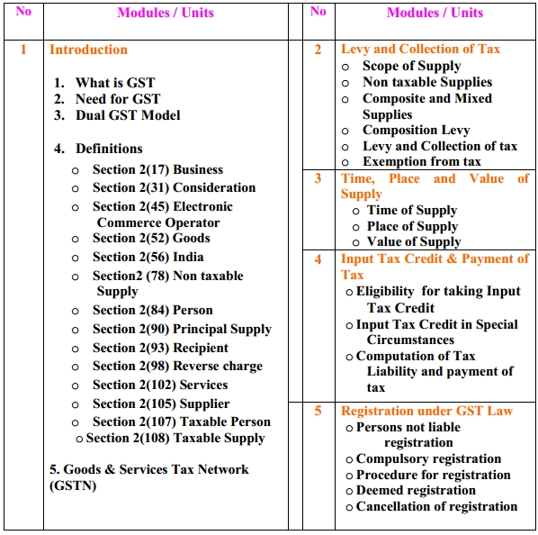
8

Slide 9
INTRODUCTION
GST means Goods & Service Tax.
It is an indirect tax.
It is applicable to entire India including Jammu & Kashmir.
It is applicable with effect from 1st July,2017.
GST is a tax on supply of goods & services except for those given in a negative list.
GST is a destination based consumption tax.
GST helps to avoid double taxation.

Slide 10
Indirect Taxation-Goods and Services Tax Act
What is GST ?
  Taxes on Goods , Services or “Goods+Services”
  “Supply of Goods or Services” rather than “Manufacture/Sale of Goods or Services rendered”
  Concept of Dual GST ie Central Tax and State Tax simultaneously.
10
Notes:
10
10

Slide 11
Indirect Taxation-Goods and Services Tax Act
NEED OF GST ?
  1. To simplify tax structure and Remove cascading effect of tax
  2. Ultimate reduction on price
  3. Increase tax revenue
  AND SO ON
11
Notes:
11
11

Slide 12
Indirect Taxation-Goods and Services Tax Act
NEED OF GST ?
  1. To simplify tax structure and Remove cascading effect of tax
  Central Taxes
    Central Excise Duty,
    Additional Excise Duties-on Goods of special importance, Textile
    Additional duties on Customs (CVD)
    Special Additional duty on Customs( SAD)
    Excise Duty levied under the Medicinal and Toilet preparations
    Service Tax,
    Central Surcharges and Cesses on Excise/Service tax
  State Taxes
    State VAT/Sales Tax, Purchase Tax
    Entertainment tax (unless it is levied by the local bodies)
    Central Sales tax (levied by Centre and collected by States)
    Octroi and Entry Tax,
    Luxury Tax,
    Taxes on lottery, betting and gambling.
    State Surcharges and Cesses
  2. Ultimate reduction on price
  3. Increase tax revenue …..
12
Notes:
12
12

Slide 13
Indirect Taxation-Goods and Services Tax Act
NEED OF GST ?
  1. To simplify tax structure and Remove cascading effect of tax
  2. Ultimate reduction on price
  Section 171 of the Central Goods and Services Tax Act, 2017 provides for Anti Profiteering measure.
  PROFIT IS FINE, PROFITEERING IS NOT.
  Profiteering- make or seek to make an
  excessive or unfair profit, especially illegally.
  Anti-profiteering Rules, 2017 , Section 171 : “Any reduction in rate of tax on any supply of goods or services or the benefit of input tax credit shall be passed on to the recipient by way of commensurate reduction in prices.”
  3. Increase tax revenue
13
Notes:
13
13

Slide 14
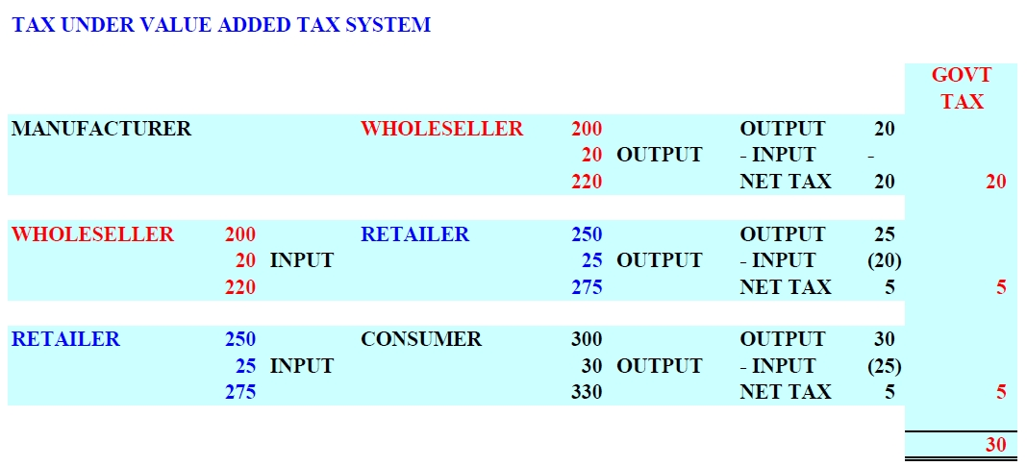

Slide 15
Indirect Taxation-Goods and Services Tax Act
DUAL GST MODEL
  LEVY OF TAX BY CENTRAL AND STATE SIMULTANEOUSLY
  INTERSTATE TRANSACTIONS
  IGST ( INTEGRATED GST)
  if rate is 18 % then IGST-18%
  Value Rs. 100 + IGST Rs. 18
  = Invoice Value Rs. 118
  INTRA-STATE TRANSACTIONS
  SGST/UTGST + CGST
  if rate of tax is 18% then SGST=9%+CGST=9%
  Value Rs. 100 + CGST Rs. 9 + SGST Rs. 9
  = Invoice Value Rs. 118
  S(STATE ), UT ( UNION TERRITORY), C( CENTRAL)
15
Notes:
15
15

Slide 16
B.A.F. Indirect Taxation Paper-I
Goods and Services Tax Act
Definitions
Long (lengthy) | 5
Short | 9
Total | 14

Slide 17
B.A.F. Indirect Taxation Paper-I
Goods and Services Tax Act
Definitions
Long (Lengthy) Business Consideration India Person Recipient | 5
Short | 9
Total | 14

Slide 18
B.A.F. Indirect Taxation Paper-I
Goods and Services Tax Act
Definitions
Long (Lengthy) Business Consideration India Person Recipient | 5
Short Electronic Commerce Operator Goods Non-Taxable Supply Principal Supply Reverse Charge Services Supplier Taxable Person Taxable Supply | 9
Total | 14

Slide 19
B.A.F. Indirect Taxation Paper-I
Goods and Services Tax Act
Long (Lengthy) Definitions
  (17) “business” includes––
    (a) any trade, commerce, manufacture, profession, vocation, adventure, wager or any other similar activity, whether or not it is for a pecuniary benefit;
    (b) any activity or transaction in connection with or incidental or ancillary to sub-clause (a);
    (c) any activity or transaction in the nature of sub-clause (a), whether or not there is volume, frequency, continuity or regularity of such transaction;
    (d) supply or acquisition of goods including capital goods and services in connection with commencement or closure of business;
    (e) provision by a club, association, society, or any such body (for a subscription or any other consideration) of the facilities or benefits to its members;
    (f) admission, for a consideration, of persons to any premises;
    (g) services supplied by a person as the holder of an office which has been accepted by him in the course or furtherance of his trade, profession or vocation;
    (h) services provided by a race club by way of totalisator or a licence to book maker in such club ; and
    (i) any activity or transaction undertaken by the Central Government, a State Government or any local authority in which they are engaged as public authorities

Slide 20
B.A.F. Indirect Taxation Paper-I
Goods and Services Tax Act
Lengthy Definitions
  (31) “consideration” in relation to the supply of goods or services or both includes––
  (a) any payment made or to be made, whether in money or otherwise, in respect of, in response to, or for the inducement of, the supply of goods or services or both, whether by the recipient or by any other person but shall not include any subsidy given by the Central Government or a State Government;
  (b) the monetary value of any act or forbearance, in respect of, in response to, or for the inducement of, the supply of goods or services or both, whether by the recipient or by any other person but shall not include any subsidy given by the Central Government or a State Government: Provided that a deposit given in respect of the supply of goods or services or both shall not be considered as payment made for such supply unless the supplier applies such deposit as consideration for the said supply;
Notes:
20

Slide 21
B.A.F. Indirect Taxation Paper-I
Goods and Services Tax Act
Lengthy Definitions
  (56) “India” means the territory of India as referred to in article 1 of the Constitution, its territorial waters, seabed and sub-soil underlying such waters, continental shelf, exclusive economic zone or any other maritime zone as referred to in the Territorial Waters, Continental Shelf, Exclusive Economic Zone and other Maritime Zones Act, 1976, and the air space above its territory and territorial waters;

Slide 22
B.A.F. Indirect Taxation Paper-I
Goods and Services Tax Act
Lengthy Definitions
(84) “person” includes—
  (a) an individual;
  (b) a Hindu Undivided Family;
  (c) a company;
  (d) a firm;
  (e) a Limited Liability Partnership;
  (f) an association of persons or a body of individuals, whether incorporated or not, in India or outside India;
  (g) any corporation established by or under any Central Act, State Act or Provincial Act or a Government company as defined in clause (45) of section 2 of the Companies Act, 2013;
  (h) any body corporate incorporated by or under the laws of a country outside India;
  (i) a co-operative society registered under any law relating to co-operative societies;
  (j) a local authority;
  (k) Central Government or a State Government;
  (l) society as defined under the Societies Registration Act, 1860;
  (m) trust; and
  (n) every artificial juridical person, not falling within any of the above;

Slide 23
B.A.F. Indirect Taxation Paper-I
Goods and Services Tax Act
Short Definitions
(45) “electronic commerce operator” means any person who owns, operates or manages digital or electronic facility or platform for electronic commerce;

Slide 24
B.A.F. Indirect Taxation Paper-I
Goods and Services Tax Act
Short Definitions
(52) “goods” means every kind of movable property other than money and securities but includes actionable claim, growing crops, grass and things attached to or forming part of the land which are agreed to be severed before supply or under a contract of supply;

Slide 25
B.A.F. Indirect Taxation Paper-I
Goods and Services Tax Act
Short Definitions
(78) “non-taxable supply” means a supply of goods or services or both which is not leviable to tax under this Act or under the Integrated Goods and Services Tax Act;

Slide 26
B.A.F. Indirect Taxation Paper-I
Goods and Services Tax Act
Short Definitions
(90) “principal supply” means the supply of goods or services which constitutes the predominant element of a composite supply and to which any other supply forming part of that composite supply is ancillary;

Slide 27
B.A.F. Indirect Taxation Paper-I
Goods and Services Tax Act
Short Definitions
(98) “reverse charge” means the liability to pay tax by the recipient of supply of goods or services or both instead of the supplier of such goods or services or both under sub-section (3) or sub-section (4) of section 9, or under sub-section (3) or subsection (4) of section 5 of the Integrated Goods and Services Tax Act;

Slide 28
B.A.F. Indirect Taxation Paper-I
Goods and Services Tax Act
Short Definitions
Service : - According to Section 2(102) of CGST Act, “ Services means anything other than goods, money and securities but includes activities relating to the use of money or its conversion by cash or by any other mode, from one form, currency or denomination, to another form, currency or denomination for which a separate consideration is charged”.

Slide 29
B.A.F. Indirect Taxation Paper-I
Goods and Services Tax Act
Short Definitions
(105) “supplier” in relation to any goods or services or both, shall mean the person supplying the said goods or services or both and shall include an agent acting as such on behalf of such supplier in relation to the goods or services or both supplied;

Slide 30
B.A.F. Indirect Taxation Paper-I
Goods and Services Tax Act
Short Definitions
(107) “taxable person” means a person who is registered or liable to be registered under section 22 or section 24;

Slide 31
B.A.F. Indirect Taxation Paper-I
Goods and Services Tax Act
Short Definitions
(108) “taxable supply” means a supply of goods or services or both which is leviable to tax under this Act;

Slide 32
DEFINITIONS
GOODS ➔
According to Sec.2(52) of CGST Act, “Goods means every kind of movable property other than money & securities but includes actionable claim, growing crops, grass and things attached to or forming part of the land which are agreed to be served before supply or under a contract of supply.

Slide 33
PRINCIPAL
According to section 2(88) of CGST Act, Principal means “ a person on whose behalf an agent carries on the business of supply or receipt of goods or services or both”.

Slide 34
Agent
According to Section 2(5) of CGST Act, “Agent means a person including a factor, broker, commission agent, arhatia, del-credere agent, an autioneer or any other mercentile agent, by whatever name called, who carries on the business of supply or receipt of goods or services or both on behalf of another.”

Slide 35
ACTIONABLE CLAIM
According to section 2(1) of CGST Act, “ Actionable claim means a claim to any debt, other than a debt secured by mortgage of immovable property or by hypothecation or pledge of movable property, or to any beneficial interest in movable property not in the possession, either actual or constructive, of the amount, which the civil courts recognise as affording grounds for relief, whether such debt or beneficial interest be existant, accuring, conditional or contingent”

Slide 36
MANUFACTURE
According to section 2(72) of CGST Act, “ Manufacture means processing of raw material or inputs in any manner that results in emergence of a new product having a distinct name, character and use the term “Manufacturer” shall be constructed accordingly”.

Slide 37
TAXABLE TERRITORY
According to section 2(109) of CGST Act, “Taxable territory means the territory to which the provisions of this Act apply”.

Slide 38
SUPPLY U/S (7) INCLUSIVE :
All forms of supply of goods or services or both such as sale, transfer, barter exchange, licence, rental, lease, or disposal, made or agreed to be made for a consideration by a person in the course or furtherance of business.
Should be goods or services and other than goods or services like money, securities, etc.
Made for consideration
Furtherance of business [ u/s 1(1)(9)]
Made by taxable person.

Slide 39
TYPES OF SUPPLY U/S 8
Composite supply
Mixed supply
Deemed supply

Slide 40
Composite Supply
Composite supply means a supply made by taxable person to a recipient and :
Comprises two or more taxable supplies of goods or services or both, or any combination thereof.
Are naturally bundled & supplied in conjunctions with each other, in the ordinary course of business.
One of which is a principal supply.
Explanation➔ This means that in a composite supply, goods & services or both are bundled owing to natural necessities. The elements in a composite supply are dependent on the “Principal Supply”.
E.g.➔ Supply of T.V. with Warranty, Maintenance services, installation etc.
Note:- GST will be charged on Principal Supply Rate & Not on Composite Supply Rate

Slide 41
Mixed Supply
According to sec.2(74) of CGST Act, “Mixed supply means :
Two or more individual supplies of goods & services, or any combination thereof, made in conjuction with each other by a taxable person.
For a single price where such supply does not constitute a composite supply.
Explanation➔ The individual supply are independent of each other and are not naturally bundled.
E.g. ➔ A package of chocolates & sweets.
Note:- GST will be charged on Highest Rate of Supply in that mixed supply & Not on lower rate supply.

Slide 42
Deemed supply
This include all supplies made to a taxable or non-taxable person, even if the same is without consideration.
These are specifically mentioned in schedule 1 appended to the CGST Act.
As per schedule 1, in the following four cases supplies made without consideration will be treated as supply U/S 7 of CGST Act.

Slide 43
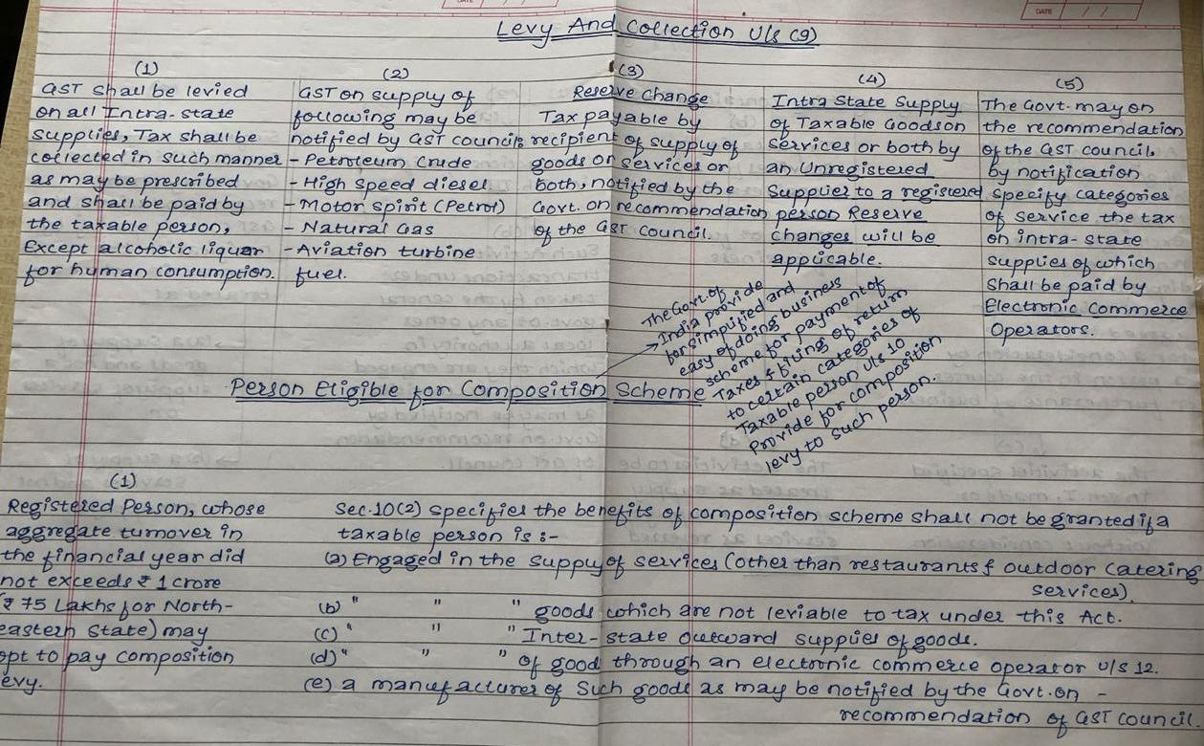

Slide 44
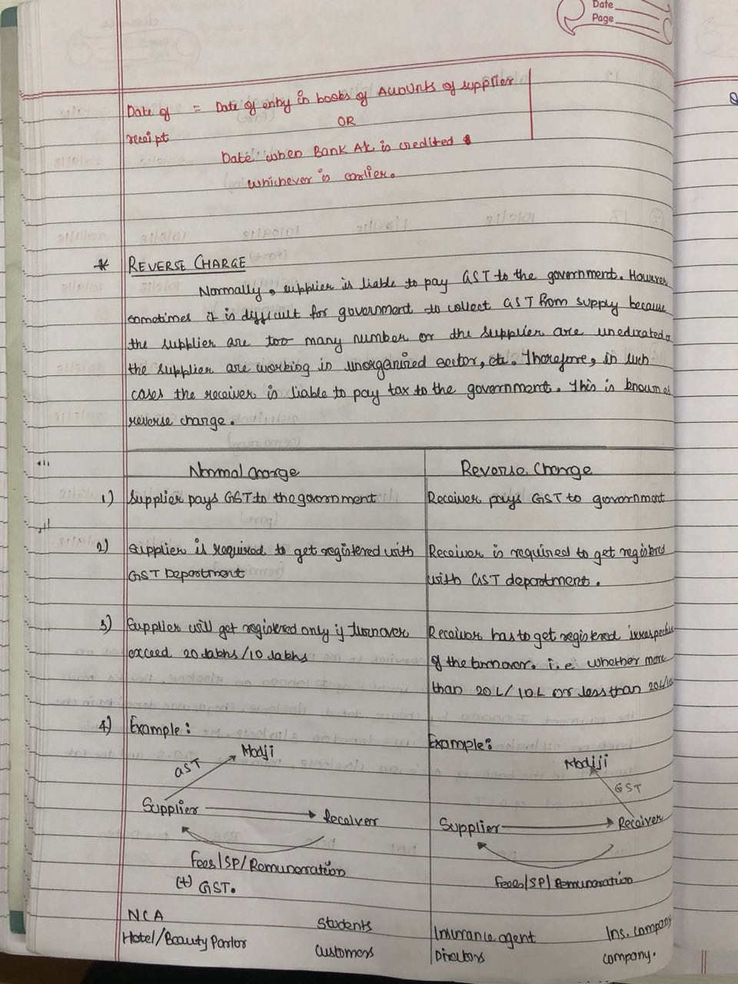

Slide 45
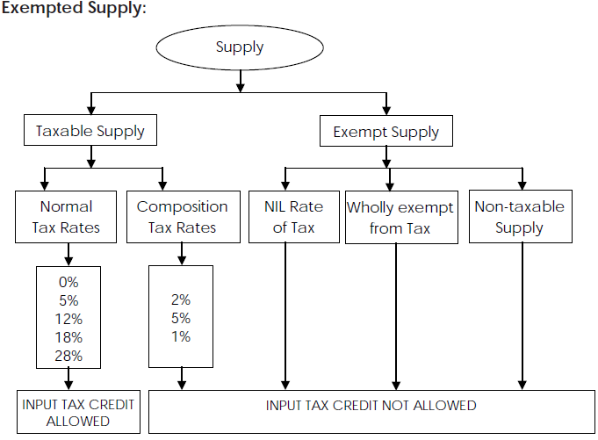

Slide 46
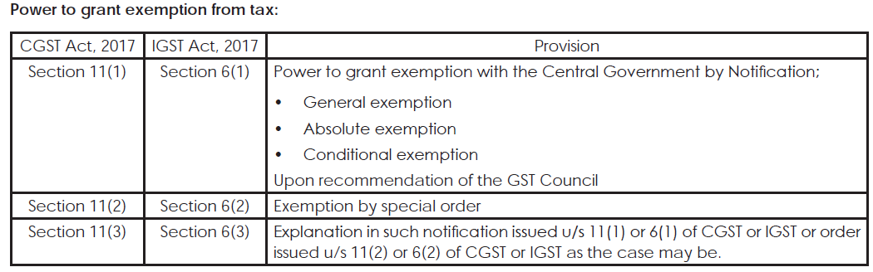

Slide 47
Exemptions
Supply U/S 11 (1) Exempted from GST :
Charitable Activities (u/s 12 AA of Income Tax Act)
Pure services to Govt.➔
Central/State/UT/LA
Panchayat (Article 243G)
Municipality
Services by Government ➔
Postal
Aircraft or vessel
To CG/SG/UT/LA
Consideration ≤ ₹5000/-
Pure Labour Contract ➔
P.M.A.Y. (Pradhan Mantri Aavaas Yojana)
Other than residential complex.

Slide 48
Religious ceremony (u/s 12AA).
Services by hotel (tariff ≤ ₹1000/- per day).
Transport of passengers:
Air (Seven Sisters North East).
Non A.C. Transport service to govt.
Railway (Except 1st class A.C.)
Metro/Mono/Transmission.
Auto-rickshaw.
Inland water-way.
Transportation of Goods (Except transport Agency, courier Agency) :
Defence/materials
Newspaper/Magazines
Railway equipments
Agriculture produce.

Slide 49
Toll charges
Services by way of loading, unloading, packaging, storage, warehouse of rice.
Distribution of elementary.
RBI, EPF, IRDA, SEBI.
Insurance :
National Pension Scheme.
Deface good insurance.
General insurance :
ESI Act 1948.
PMITY / AAAY
Service provided by :
Arbitral Tribunal (turnover ≤ 20)
Advocate partnership Firm
Senior Advocate.
Services by a veterinary clinic.

Slide 50
Services by RTO:
Technology business
Technology Entrepreneurship Park
Under department of biotechnology Govt. Of India.
Services by :
Journalist
Press trust of India (PTI)
United News of India (UNI)
Services by public libraries.
Services by goods & services tax network.
Services by organising business exhibition outside India.

Slide 51
Sponsorship of sporting events organised :
All India Sport Council.
Special Olympic Bharat.
Indian Olympic Association.
Services to :
Cultivation of Plants/Agriculture.
Supply of Farm labour.
Agro machinery.
Services by slaughtering of Animals
Services by Foreign diplomatic mission in India.
Religious, Pilgrimimage ministry of external affairs, The government of India bilateral agreements.
Insurance of passport, visa, driving licence, birth certificate/death certificate.

Slide 52
Services by educational institution :
Students/Staff.
Transportation.
Catering, Security.
Services by IIM, CAT, etc.
To recognised Sports :
Players/ Referee.
Coach/Team manager.
NSDC/DDV GKY.
Cord Blood Bank.
Clinical establishment, Medical practitioner ambulance.
Public Conveniences.

Slide 53
NPO [ ≤ RS. 5000/- per month subscription]
Artist – Folk/Classical (≤ Rs. 15000/- charges)
Museum, National Park, Zoo.
Circus, Dance Award function Ticket [≤ Rs. 250/- charges].

Slide 54
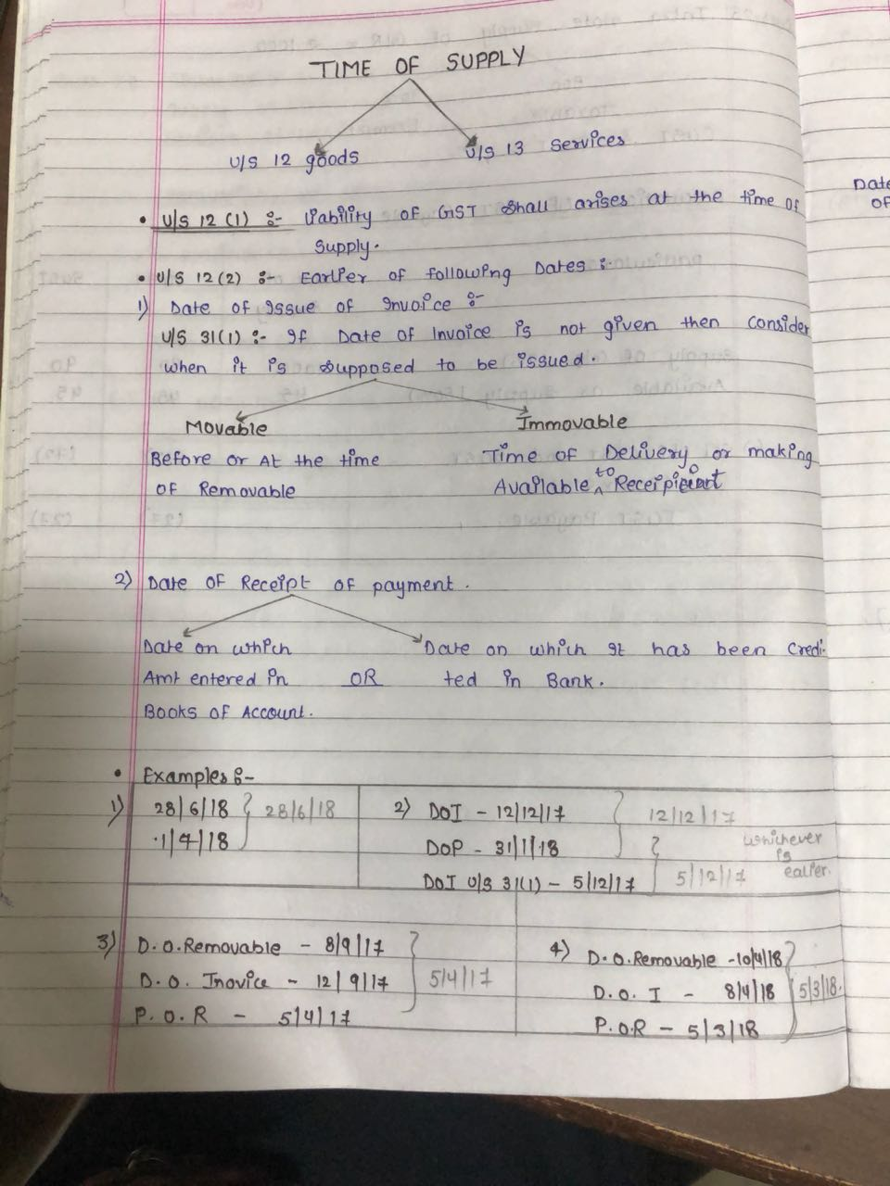
Time Of Supply For Goods U/S 12

Slide 55
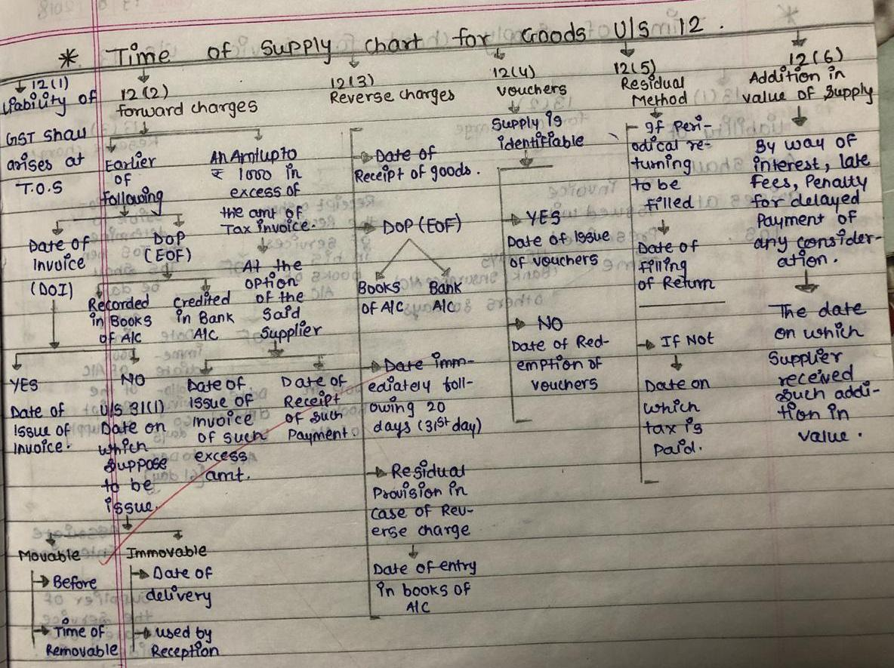

Slide 56
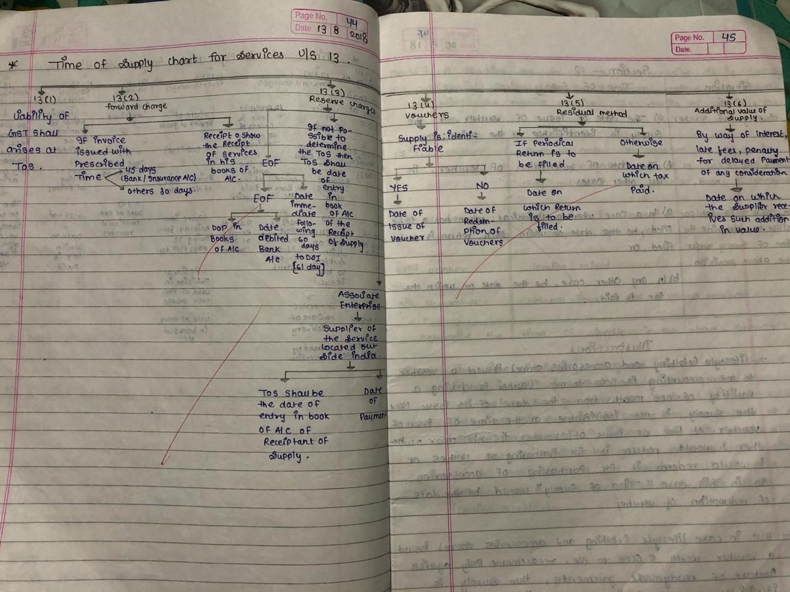

Slide 57
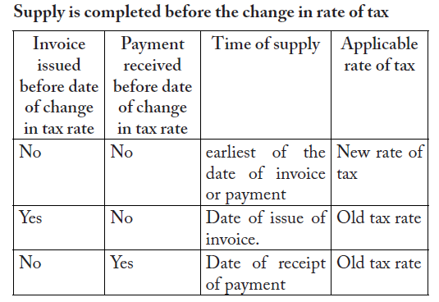
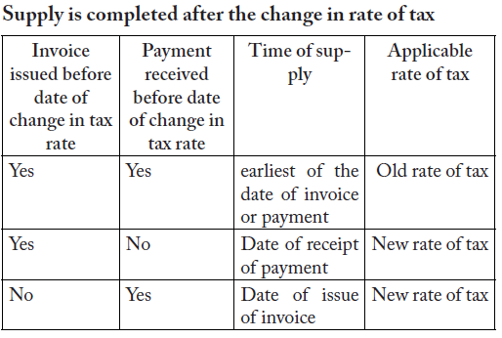
U/S 14 Change in rate of tax in respect of supply of goods or services

Slide 58
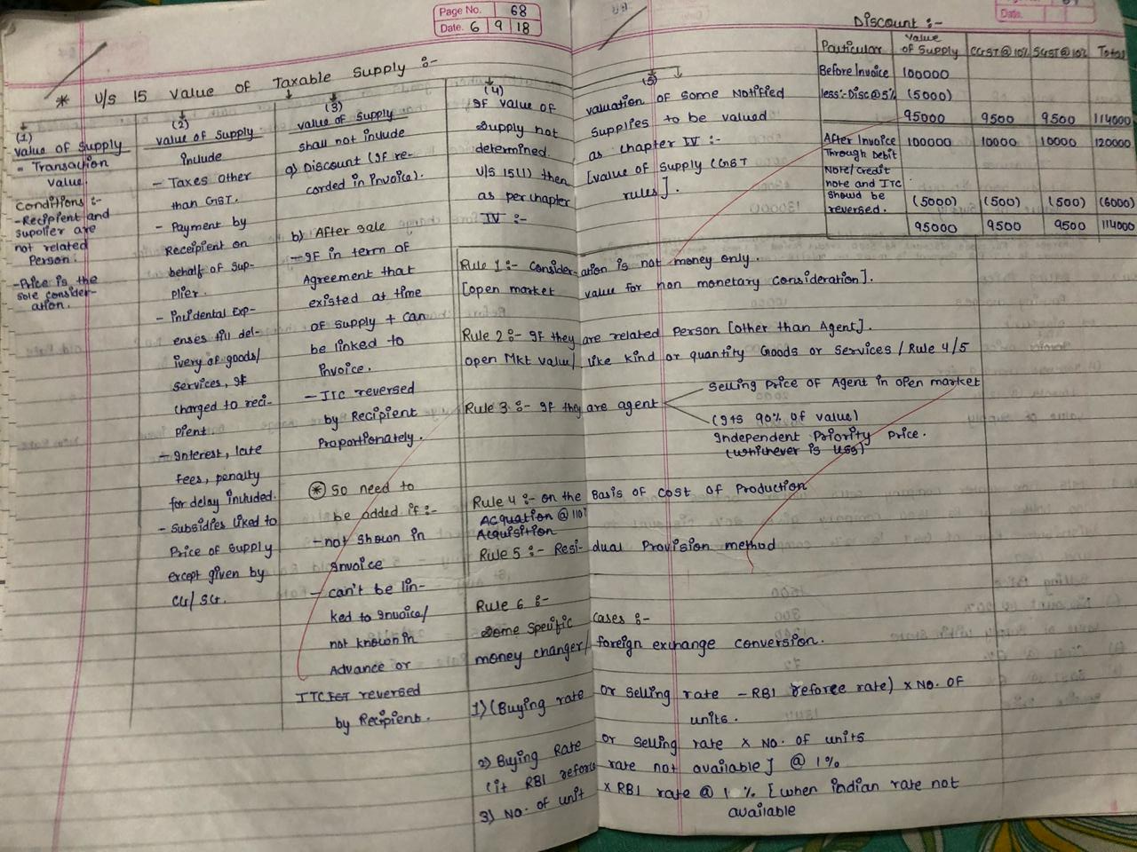

Slide 59
U/S 10 IGST Act - PLACE OF SUPPLY
Movement
possible
Location of supplier :
Services
Does not involve movement of goods
Place of registration
None of above available then place of resident by service provider.
Import /Export
Goods (When Supplier ready with goods)
If registration NA there (then location of Service).
More than one establishment (from where more service provided)
L.O.R. (Recipient)– India outside
P.O.S. (Payment) - Outside India
Place Of Supply - India outside
Note: Inter state deemed Supply (IGST)
Between 2 State or U. T.
SEZ / Development of SEZ
Import till Custom forntier
Export
Foriegn Tourist
L.O.S.(Supplier) – Outside India

Slide 60
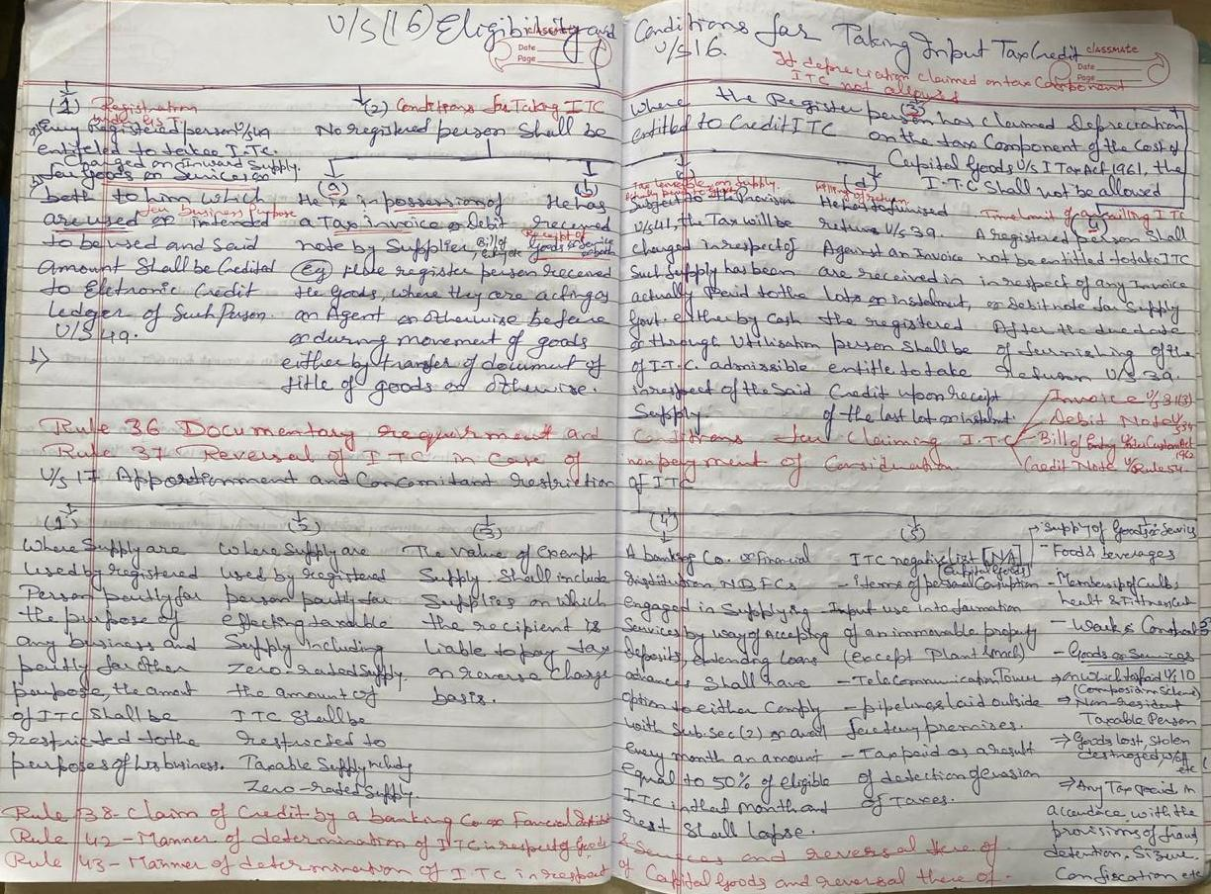

Slide 61
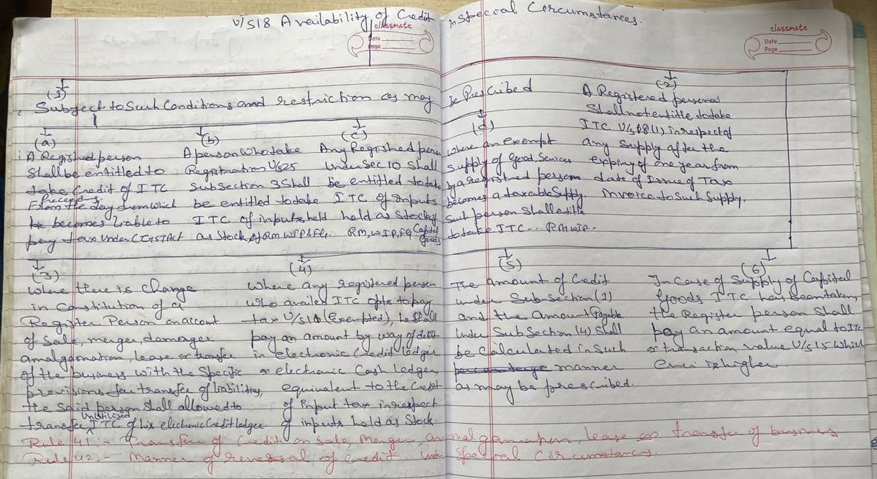
Section 19 of the CGST Act, 2017 provides that the principal (a person supplying taxable goods to the job worker) shall be entitled to take the credit of input tax paid on inputs sent to the job- worker for the job work. section 20 of CGST Act,2017, explains about Manner of distribution of credit by Input Service Distributor under CGST
Section 21(1) says that the Input Service Distributor shall distribute, in such manner as may be prescribed, the credit of CGST as CGST or IGST and IGST as IGST or CGST, by way of issue of a prescribed document containing, inter-alia, the amount of input tax credit being distributed or being reduced thereafter,

Slide 62
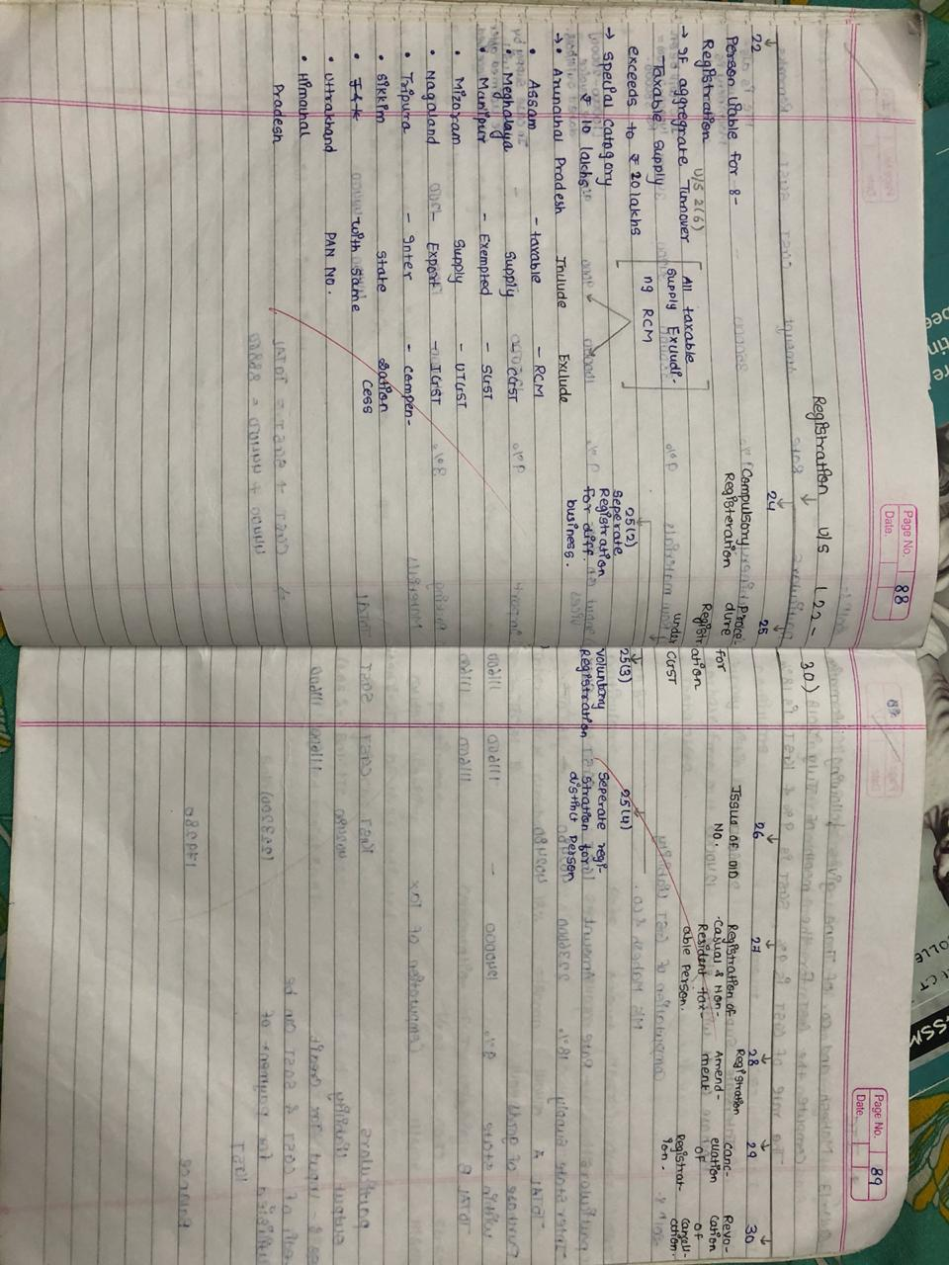

Slide 63
Today Students are not Careless but they are Cared Less
&
They are not Useless but they are Used Less
Dear Students…..You Do… What You Love….& Love… What You Do….
Thank You
For Future Assistance Feel Free To:
Contact : Lion Dr. Nishikant Jha
Tel: +91- 9004883439 or 9820373439
Email: drnishikantjha@gmail.com
nishisir2001@gmail.com
Website: www.drnishikantjha.com

