Slide 1
Emerging Trends on ERP
Module-4

Slide 2
ERP Vendors, Consultants and Employees
Vendors
ERP vendors are business software developers and providers that create, sell and implement enterprise resource planning systems.
The ERP vendor is either the company that creates the software or a representative of that company.
It sells the software to the client.
Vendors are also responsible for developing updates and additional releases to keep up with changes in their clients’ industries.
ERP vendors spent a large amount of money so that they become experts to develop flexible ERP Package.
Examples include Oracle, Infor, SAP and Microsoft Dynamics.

Slide 3
Roles of Vendors:
The vendors should supply product and its documentation as soon as the contract is signed.
Vendor is responsible to fix bugs that are found during implementation process.
Vendor also provides training to the company’s users and also to the people who are involved in implementation process.
Vendors take care of quality control factors while developing ERP.
Vendors participate in all phases of an implementation in which he gives advice, answers to all technical questions about product and technology.

Slide 4
ERP Consultants
Consultants are professional people who develop the different methods and techniques to deal with the implementation process and with the various problems that will help during implementation.
They are experts in the field of Administration, management, and control activities.
They have experience that ensures successful implementation.
The only limitation to Consultants is that they are expensive.

Slide 5
Roles of Consultants:
They have to make a plan to carry activities in the right direction during the implementation process.
They provide best optimum result such as reduction in cycle time, increased response time, improved productivity to satisfaction of customers.
They have to make ERP implementation for an organization as their own business.

Slide 6
Types of ERP consultants?
In reality, some consultancies may choose to specialize in particular phases of the process, while others are adept at delivering an end-to-end solution.
ERP Functional Consultant
ERP Implementation Consultant
ERP Software Consultant
ERP Technical Consultant
ERP Finance Consultant

Slide 7
1. ERP Functional Consultant
An ERP functional consultant helps you to identify the existing business process that needs to be addressed through the ERP and whether they need to be changed or improved in any way.
The functional consultant will use the information you provide along with his own industry and specialization to judge the best solution for you.

Slide 8
2. ERP Implementation Consultant
An ERP implementation consultant is responsible for providing a consultative approach to the successful and timely implementation of the ERP software at the clients’ site.
The consultant’s core responsibility, in this case, is to make sure the integration/implementation process goes smoothly from start to finish.
Regardless of whether you were responsible for need identification and capacity assessment, the ERP implementation consultant’s goal is to ensure all the factors identified are considered during implementation.

Slide 9
3. ERP Software Consultant
An ERP software consultant is responsible for the maintenance and customization of the software itself to meet the customer’s needs.
This differs from the technical consultant’s job in the sense that the professional consultant focuses on troubleshooting and the ERP software consultant focuses on adapting the software itself to solve the problem

Slide 10
4. ERP Technical Consultant
An ERP Technical Professional provides technical support, performs troubleshooting functions and resolves customer issues.
The consultant is not only an expert in the ERP being used but will also have a good understanding of your industry and the unique requirements that go with it.
To that end, the consultant will make sure to investigate the condition of your before making recommendations thoroughly.

Slide 11
5. ERP Finance Consultant
The ERP finance consultant will still play the role of an ERP consultant but will focus on the finance and accounting modules.
The consultant will be an expert in the field of finance and accounting, thereby allowing a more comprehensive assessment of issues and hiccups faced in the implementing of finance and accounting modules.
This is especially important for companies that heavily rely on automated financial and accounting transactions.

Slide 12
Employees:
Employees are the people who use the ERP system once it has been developed. Employees are given training as to how to use various functions that are automated in the software.
Roles Of Employees :
Employees are the people who are doing functions that are automated by ERP System.
They analyze and provide suggestions where customization needs to take place.
They should be able to balance their loyalty to the client and project.
Consultant should create a knowledge base and train people so that knowledge stays in the organization when consultants leave the project.

Slide 13
Resistance by Employees
One of the most baffling and recalcitrant of the problems which business executives face is employee resistance to change.
Such resistance may take a number of forms—persistent reduction in output, increase in the number of “quits” and requests for transfer, chronic quarrels, sullen hostility, wildcat or slowdown strikes, and, of course, the expression of a lot of pseudo logical reasons why the change will not work.
Even the more petty forms of this resistance can be troublesome.
All too often when executives encounter resistance to change, they “explain” it by quoting the cliche that “people resist change” .

Slide 14
Yet changes must continually occur in industry.
This applies with particular force to the all-important “little” changes that constantly take place—changes in work methods, in routine office procedures, in the location of a machine or a desk, in personnel assignments and job titles.
No one of these changes makes the headlines, but in total they account for much of our increase in productivity.
They are not the spectacular once-in-a-lifetime technological revolutions that involve mass layoffs or the obsolescence of traditional skills, but they are vital to business progress.

Slide 15
Dealing with employee Resistance
1. A solution which has become increasingly popular for dealing with resistance to change is to get the people involved to “participate” in making the change. But as a practical matter “participation” as a device is not a good way for management to think about the problem. In fact, it may lead to trouble.
2. Resistance is usually created because of certain blind spots and attitudes which staff specialists have as a result of their preoccupation with the technical aspects of new ideas.

Slide 16
3. The key to the problem is to understand the true nature of resistance. Actually, what employees resist is usually not technical change but social change—the change in their human relationships that generally accompanies technical change.
4. Management can take concrete steps to deal constructively with these staff attitudes. The steps include emphasizing new standards of performance for staff specialists and encouraging them to think in different ways, as well as making use of the fact that signs of resistance can serve as a practical warning signal in directing and timing technological changes

Slide 17
5. Top executives can also make their own efforts more effective at meetings of staff and operating groups where change is being discussed. They can do this by shifting their attention from the facts of schedules, technical details, work assignments, and so forth, to what the discussion of these items indicates in regard to developing resistance and receptiveness to change.

Slide 18
Role of Top Management
1. Give ERP the importance it deserves
ERP is not an IT project, although it is based on implementing new software.
Don’t leave your ERP implementation to languish under IT supervision – or for that matter under line management.
Make sure your ERP team represents all the major groups which will be affected by the changes – which is basically everyone.

Slide 19
2. Get involved with the implementation
It isn’t enough to stand by passively once the project is launched.
You and the rest of the management team need to be actively involved.
At a minimum plan on being briefed on the project on a weekly or biweekly basis.
This not only keeps you up to date on the project, it shows continuing interest and helps communicate the importance of the project to everyone in the company.

Slide 20
3. Set realistic schedules and resource budgets
An ERP implementation can’t be done in an arbitrary amount of time.
At the beginning of the project make realistic estimates of time and resources and then stick to those schedules as closely as you can.
Don’t try to set your schedule by external factions, such as the closing of the year.
Instead pay attention to the internal factors.
Trying to rush an ERP project is a sure way to give yourself more trouble – and it probably won’t reduce the time to a successful go-live.

Slide 21
4. Promote change
ERP means changing the way you do things, often in fundamental ways.
It’s important for the people at the top to promote organizational change as part of the process.
Make sure everyone understands that ERP means the way the company does things is going to change and that you and the rest of top management supports that change.
In fact it can be the most difficult part of the entire implementation process.
It will take steady pressure from the top to make sure the change is accepted.

Slide 22
5. Let end users make decisions
Although support and effort from the top is vital, it is almost equally important to involve the people who will actually be doing the work in the decision-making process.
Not only does that build support for the implementation, it also results in better decisions since the people who are actually doing the work know the most about how things are done.

Slide 23
Role of implementation partner in ERP
Companies often use an implementation partner to handle the technical work involved in deploying the system and to take on some of the responsibilities of the ERP implementation team.
Generally, the implementation partner won’t cover every role on the implementation team, but it can spearhead the effort, make sure timelines are adhered to and take care of the challenging technical work that requires special expertise.
Your implementation partner should have a strong track record within your industry.

Slide 24
Different industries have different requirements, and the more your partner knows about your business, the more they will be able to configure the software to cover your particular needs.
Plus, software that is configured to cover typical industry processes is less expensive and time-consuming to implement.
In addition, your implementation consultant should be familiar with how your business operates and fully understand your pain points.
A partner who has superior product expertise and experience of working with businesses who have similar operations and productivity goals will be able to effectively tailor your chosen ERP solution to fit your unique business needs.

Slide 25
Most implementation partners are well-versed in basic system training.
However, it is critical that they also have competencies in organizational change management because this too can lead to failure if not adequately addressed.
Software and technology must be supported by methods that are tailor-made to manage the organizational changes they entail.

Slide 26
Different ERP Vendors
  SAP
  Oracle
  Microsoft
  Infor
  IFS
  Epicor
  Acumatica
  Syspro
  IQMS
  Salesforce

Slide 27
SAP
Whether opening up new markets or servicing existing ones, SAP is committed to its tested strategy: concentrating on its core business—developing and selling standard enterprise applications software—and partnering with hardware vendors, software suppliers, technology providers, value-added resellers, and consulting firms.

Slide 28
SAP-AG
SAP AG is the third-largest independent software supplier worldwide and the largest producer of standard enterprise wide business applications for the client-server software market.
The company's principal business activities are the development and marketing of an integrated line of computer software for over 1,000 predefined business processes, from financial accounting, supply chain management, and business work flow to human resources, sales and distribution, and customer relationship management.

Slide 29
SAP AG was founded in 1972 by five German engineers with IBM in Mannheim, Germany; interestingly three of the founders, Hasso Plattner, Dietmar Hopp, and Klaus Tschira, were still with SAP in mid-2001.
When an IBM client asked IBM to provide enterprise-wide software to run on its mainframe, the five engineers began writing the program only to be told the assignment was being transferred to another unit.
Rather than abandon the project altogether, they left IBM and founded SAP in Walldorf, near Heidelberg.
While the company originally took its name from the abbreviation for Systemanalyze und Programmenentwicklung (systems analysis and program development.

Slide 30
Without the benefit of loans from banks, venture capitalists, or the German government, SAP began fashioning its software business gradually through cash flow generated by an ever-growing stable of customers.
Working at night on borrowed computers to land their first contracts, Plattner and colleagues built SAP's client list with German firms in its region, beginning with a German subsidiary of the global chemical company ICI and later adding such major German multinationals as Siemens and BMW.

Slide 31
Product and Technology: R/3 Overview
What is SAP R/3?
R/3 is the comprehensive set of integrated business applications from SAP, the German company that states it is the market and technology leader in business application software.
R/3 replaced an earlier system, R/2, which is still in use.
R/3 uses the client/server model and provides the ability to store, retrieve, analyze, and process in many ways corporate data for financial analysis, production operation, human resource management, and most other business processes.

Slide 32
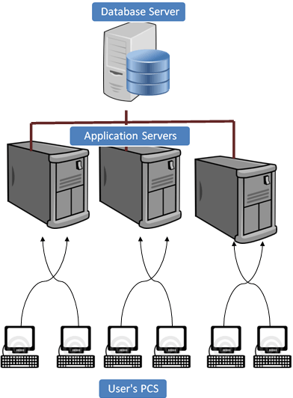
SAP R/3 is a 3 tier architecture consisting of 3 layers
  Presentation
  Application
  Database
In simple words, it’s a client server architecture.
R signifies Real-time system
3 represents - 3-tier architecture.

Slide 33
User's PC:-
Users can access SAP system in two ways:-
  Through SAP GUI
  Through Web browser
It's called front-end. Only the front-end is installed in the user's PC not the application/database servers.
Front-end takes the user's requests to database server and application servers.

Slide 34
Application Servers: -
Application server is built to process business-logic. This workload is distributed among multiple application servers. With multiple application servers, the user can get the output more quickly.
Application server exists at a remote a location as compared to the location of the user PC.
Database Server: -
Database server stores and retrieves data as per SQL queries generated by ABAP and Java applications.
Database and Application may exist on the same or different physical location.

Slide 35
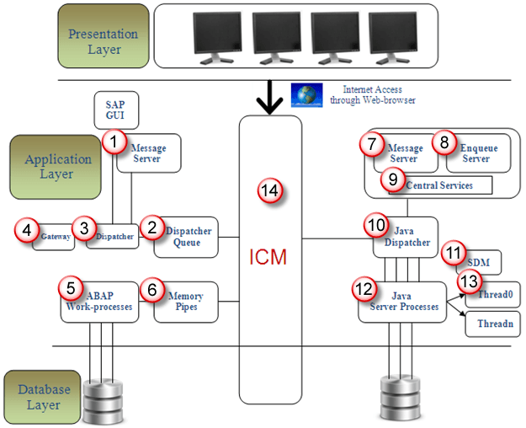
Understanding the components of SAP R/3 3-tier Architecture:-

Slide 36
Message Server: It handles communication between distributed Dispatchers in ABAP system.
Dispatcher Queue: Various work process types are stored in this queue.
Dispatcher: It distributes requests to the work processes.
Gateway: It enables communication between SAP system and between SAP system and external systems

Slide 37
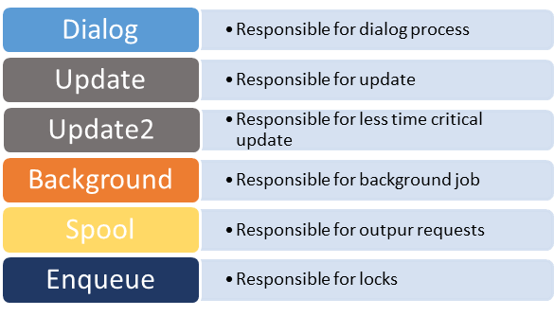
ABAP-Work processes: - It separately executes dialog steps in R/3 applications.
Types of work processes are given as below:-

Slide 38
Memory-pipes: It enables communication between ICM and ABAP work processes.
Message Server: It handles java dispatchers and server processes.It enables communication within java runtime environment.
Enqueue Server: It handles logical locks that are set by the executed Java application program in a server process.
Central Services: Java cluster requires a special instance of the central services for managing locks and transmitting messages and data. Java cluster is a set of processes that work together to build the reliable system. Instance is group of resources such as memory, work processes and so on

Slide 39
Java Dispatcher: It receives the client requests and forwards to the server process.
SDM: Software Deployment Manager is used to install J2EE components.
Java Server Processes: It can processes a large number of requests simultaneously.
Threading: Multiple Processes executes separately in the background, this concept is called threading.
ICM: It enables communication between SAP system and HTTP, HTTPS, SMTP protocol. It means by entering system URL in the browser you can access SAP from browser also.
One more component is JCO. JCO is used to handle communication between java dispatcher and ABAP dispatcher when system is configured as ABAP+Java.

Slide 40
SAP advantages
Delivering Efficiency in Work
SAP allows all data to be well integrated with various databases. For this reason, this system is able to streamline business processes so that companies can collect data more easily and efficiently.
Increase Productivity
The SAP system can increase employee productivity because the program is well integrated.
Complete Features
SAP has various analytical features, such as evaluating performance as well as making decisions. The availability of features allows this software to meet many business needs.

Slide 41
Suitable for All Business Dimensions
The SAP system is very suitable for use in almost all existing business dimensions. This system provides flexibility for company growth, including small and medium enterprises.
There is integration with E-Commerce
In today's digital era, e-commerce plays a very important role. The existence of a system that can be integrated with e-commerce will obviously be very helpful for e-commerce businesses.
The existence of a module that makes work easier
There are various modules that make up the SAP system. Each of these modules has different functions in the same system. These modules share information so that this can facilitate business managerial obligations.

Slide 42
Consistent
The SAP system always prioritizes consistency, both in the same division and in opposite divisions.
Data Cannot Be Replicated
Data stored in the SAP system cannot be duplicated. This of course can ensure the confidentiality of important data owned by the company.
Implementing Standardization
Every business process recorded in this system will be standardized.

Slide 43
Baan Company
The Baan Corporation was created by Jan Baan in 1978 in Barneveld, Netherlands, to provide financial and administrative consulting services. With the development of his first software package, Jan Baan and his brother Paul Baan entered what was to become the ERP industry. The Baan company focused on the creation of enterprise resource planning (ERP) software.
Jan Baan developed his first computer program on Durango F-85 computers in BASIC language. In the early ’80s, Baan Company began to develop application on Unix computers with C and self-developed Baan-C language, whose syntax was very similar to BASIC language.

Slide 44
Baan gained its popularity in the early nineties. Baan software is famous for its Dynamic Enterprise Modeler (DEM), technical architecture and its 4GL language. Baan 4GL and Tools nowadays is still considered to be one of the most efficient and productive database application development platforms. Baan became a real threat to market leader SAP after winning a large Boeing deal in 1994. It went IPO in 1995 and became a public listed company in Amsterdam and US Nasdaq.

Slide 45
Several large consulting firms throughout the world partnered to implement Baan IV for multi-national companies. It acquired several other software companies to enrich its product porfolio, including Aurum, Berclain, Coda and Caps Logistics. Sales growth rate was once claimed to reach 91% per year.
However the fall of the Baan Company began in 1998. The management exaggerated company revenue by booking “sales” of software licenses that were actually transferred to a related distributor. The discovery of this “creative” revenue manipulation led to a sharp decline of Baan’s stock price at the end of 1998.

Slide 46
Product version
Triton 1.0 to 2.2d, 3.0 to last version of Triton is 3.1bx, then the product is renamed to Baan
Baan 4.0 (last version of BaanIV is BaanIVc4 SP30) & Industry extensions (A&D,…)
Baan 5.0 (last version of BaanV is Baan5.0 c SP26)
Baan 5.1, 5.2 (for specific customers only)
SSA ERP 6.1 /Infor ERP LN 6.1 / Infor10 ERP Enterprise
ERP Ln 6.1 FP6, released in December, 2009
ERP Ln 6.1 FP7, released in January, 2011 – latest version
Infor ERP Ln 6.1 supports Unicode and comes with additional language translations.
[edit]Supported Platform and Database (Server)

Slide 47
Server Platform:
Windows Server, Linux, IBM AIX, Sun Solaris, HP-UX, AS400(Obsolete), OS390 (Obsolete)
Database:
Oracle, DB2, Informix, MS SQL Server, MySQL (Obsolete since year 2010), Bisam (Obsolete), Btam (Obsolete)
[edit]Standard Modules
Baan IV modules:
Common (tc), Finance (tf), Project (tp),Manufacturing (ti),Distribution (td),Process (ps),Transportation (tr),Service (ts),Enterprise Modeler (tg),Constraint Planning (cp),Tools (tt),Utilities (tu), Baan DEM ( tg)
ERP Ln 6.1 modules:
Enterprise Modeler (tg), Common,Taxation (tc),People(bp), Financials (tf),Project (tp),Enterprise Planning (cp),Order Management (td), Electronic Commerce (ec),Central Invoicing (ci),Manufacturing (ti),Warehouse Management (wh),Freight Management (fm), Service (ts), Quality Management (qm), Object Data Management (dm), Tools (tt)
[edit]Baan Virtual Machine – bshell

Slide 48
Bshell is the core component of Baan application server. It is a process virtual machine to run Baan 4GL language. Bshell were ported to different server platforms and make Baan program scripts platform independent. For example, a Baan session developed on Windows platform can be copied to Linux platform without re-compiling the application code. Bshell is similar to nowaday’s Java VM or .Net CLR.

Slide 50
https://www.softwaretestinghelp.com/oracle-products-and-services/

