Slide 1
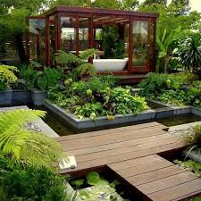
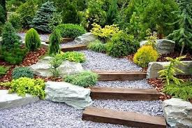
Garden designs and principle of landscaping
Outdoor & Indoor Garden.

Slide 2
Garden design
Garden design is the art and process of designing and creating plans for layout and planting of gardens and landscapes.
Garden design may be done by the garden owner themselves, or by professionals of varying levels of experience and expertise. Most professional garden designers have some training in horticulture and the principles of design.
Whether gardens are designed by a professional or an amateur, certain principles form the basis of effective garden design, resulting in the creation of gardens to meet the needs, goals, and desires of the users or owners of the gardens.

Slide 3
Elements of garden design include the layout of hard landscape, such as paths, walls, water features, sitting areas and decking; as well as the plants themselves.
considering their horticultural requirements, their season-to-season appearance, lifespan, growth habit, size, speed of growth, and combinations with other plants and landscape features.
Considering the maintenance and needs of the garden, including the time or funds available for regular maintenance, which can affect the choice of plants in terms of speed of growth, spreading or self-seeding of the plants, whether annual or perennial, and bloom-time, and many other characteristics.

Slide 4
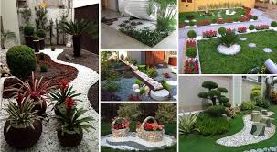

Slide 5
Landscaping
Landscaping refers to any activity that modifies the visible features of an area of land, including:
living elements, such as flora or fauna; or what is commonly called gardening, the art and craft of growing plants with a goal of creating a beauty within the landscape.
Natural elements such as landforms, terrain shape and elevation, or bodies of water
Abstract elements such as the weather and lighting conditions.
Landscaping requires expertise in horticulture and artistic design.

Slide 6
Principles of Landscaping…
Basic Principles
Before actually drawing the master-plan, the following points should be kept in mind in home landscaping.
Background : The background in a garden, whether a wall, tall trees or a hedge should be neutral in nature, that is to say this should not become a distracting feature over the main features of the garden.
Contrast : The design should be such that it should break monotony. To achieve this, a variation in form, texture, or colour has to be brought in.
Balance or Proportion : A balance has to be maintained between different components (masses, forms, colour, etc.) of a garden. In a formal garden, this is achieved by balancing the quantity or by objects, whereas in an informal garden this can be achieved by planting a small mass of colour in front of a large neutral mass. Overcrowding of plants or other garden features should be avoided.
Open Centre : The central area of the garden should be left out of any items of major interest. The best way to achieve this is to have a lawn, which also gives an effect of largeness to the property. A specimen shrub in the center of the lawn is unsuitable as this counters the principle of spaciousness, but a tree branching at higher levels from the ground could be planted.

Slide 7
Repetition : The repetition or duplicating some features of a garden helps achieve rhythm, balance, and unity. In a formal garden, generally the same feature is repeated. But for an informal design this need not be done.
Rhythm : A landscape designer should have an artistic sense to understand how to bring in rhythm in the design. Arranging the different elements haphazardly, without harmony, does not enhance beauty. Harmonious lines, often artistically curved, bring in rhythm to the landscape.
Variety : To break the monotony in a garden, variety is essential. This is achieved by contrast of colour, form, and texture. Planting of different seasonal flowers all in red colour, does not necessarily mean variety.
Besides these, a design should be simple, easy to maintain, and provide comfort.

Slide 8
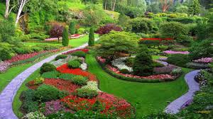

Slide 9
Indoor Gardening
Indoor gardening is nothing more than the act of growing plants indoors.
This might be at a residential home, within a business location like an office building or restaurant, or any other enclosed area.
There are multiple types of indoor gardening, including container gardening, hydroponic gardening, controlled environment agriculture, vertical farms, and many more.
It can be used as decorative purposes, such as the trees and flowers sometimes seen in shopping malls, or the trailing vines sometimes used in restaurants to provide a sense of serenity and privacy.
Even office buildings can be used for indoor gardening, and the beneficial impact that growing plants in office can improve the air.

Slide 10
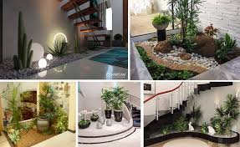

Slide 11
Outdoor Garden
It is a planned space usually set aside for the display, cultivation, or enjoyment of plants and other forms of nature.
Gardens may exhibit structural enhancements, including water features such as fountains, ponds (with or without fish), waterfalls or creeks, dry creek beds, statuary, arbors, trellises and more. Some gardens are for ornamental purposes only, while some gardens also produce food crops.
The main garden types are:-

Slide 12
Flower gardens:-Trees and shrubs are the mainstay of a well-designed flower garden. These permanent features are usually planned first, and the spaces for herbaceous plants, annuals, and bulbs are arranged around them. The range of flowering trees and shrubs is enormous.
Rock gardens:- In a well-designed rock garden, rocks are arranged so that there are various exposures for sun-tolerant plants such as rockroses and for shade-tolerant plants such as primulas, which often do better in a cool, north-facing aspect. Many smaller perennial plants are available for filling spaces in vertical cracks among the rock faces.
Water gardens:-The water garden represents one of the oldest forms of gardening. Egyptian records and pictures of cultivated water lilies date as far back as 2000 BCE. water gardens range from formal pools with rectangular or circular outline, sometimes with fountains in the centre and often without plants or with just one or two water lilies , to informal pools of irregular outline planted with water lilies and other water plants and surrounded by boggy or damp soil where moisture-tolerant plants can be grown.

Slide 13
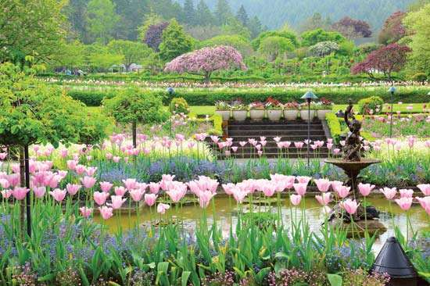
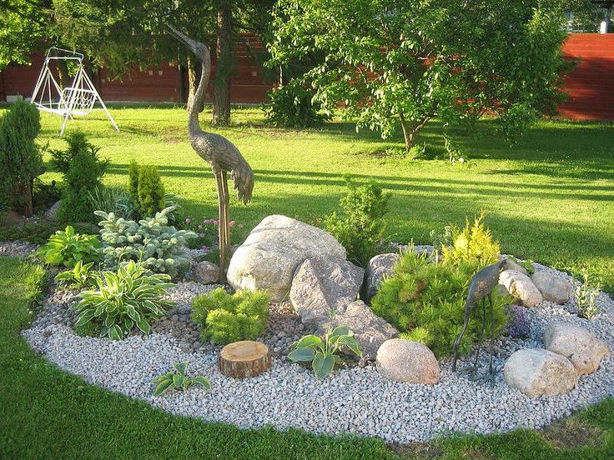
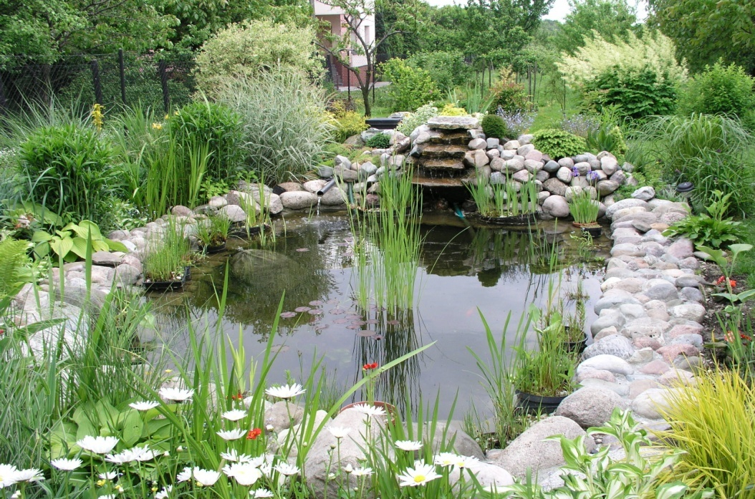
Flower garden
Rock garden
Water garden

Slide 14
Other types are
Public :-A public garden is an institution that maintains collections of plants for the purposes of public education and enjoyment, in addition to research, conservation, and higher learning. It must be open to the public and the garden's resources and accommodations must be made to all visitors. Public gardens are staffed by professionals trained in their given areas of expertise and maintain active plant records systems.
Private :-Private gardens are defined as the private open space surrounding residential dwellings where the householders have sole responsibility for management. In Westminster, this includes private squares, private communal gardens, small and large, front and back gardens.

Slide 15
Why do we have specific indoor and outdoor plants?
There are some differences between indoor and outdoor gardening. These include:
Plant species
Climate greatly affects the plants to grow indoor or outdoor. Indoor plants need controlled climate. So that indoor plants grow inside as the climate can be controlled and environment can be manipulated to suit the plant requirements. Outdoor plants can withstand climate changes and can grow in the open air.
Space requirement
Indoor plants require less space to grow where outdoor plants require more space. Unlike outdoor plants, indoor plants can not grow to the mature size. Its growth depends on the container in which the plant is growing, so there is a big difference between indoor and outdoor plant pots. Its growth is restricted by the container. The size of the container we choose for indoor planting is based on the space we have in home or office.
Lighting
Every plant species require light but the amount required varies depending on the plant species. Outdoor plants require more light that they can get through sun light where as indoor plants gets light through windows. The lighting can be provided to indoor plants by proving artificial lights too. Some indoor plants require little sunlight and must be placed in shadowed places. Light is very important and a main factor in regards to whether plants grow faster outdoors than indoors and vise versa..

Slide 16
Water
Another difference between the indoor and outdoor plants is the water regulation. Indoor plants can be provided water by ourselves where as outdoor plants receive periodic water supply from rainfall. Adequate water should be provided to the indoor plants. Excess water makes the indoor plant become susceptible to fungus which leads to damage to the plant where as outdoor plant drains the excess water. Inadequate water supply leads to the binding of indoor plant roots by their containers where as outdoor plants continue to grow in search of water.
Soil preparation
Soil preparation and maintenance is the complex one and is required for the outdoor plants. Nutrients in the soil can be diminished on repeated planting. Soil in indoor gardening will not adjust itself as in outdoor gardening. So growing outdoor plants indoors is not recommended.
Fertilizers
Fertilizers are incorporated to kill the fungus that causes harm to the plants. Fertilizing and disease controlling are more challenging now a days. It is difficult to incorporate fertilizers to indoor plants compared to outdoor plants. Indoor plants accumulate too much of fertilizers so care must be taken to incorporate fertilizers to indoor plants. Disease or fungus found on indoor plant can be treated easily but it is difficult to treat on outdoor plants.

