Slide 1
Thakur College of Science & Commerce
Academic Year – 2020-21
S.Y. B.Sc. - Zoology
Semester – IV Paper –II
Unit - III
Biomolecules
Dr. Vitthal T. Mohite
Head, Department of Zoology

Slide 2
Biomolecules
A biomolecule or biological molecule is a loosely used term for molecules present in organisms.
They are essential to one or more typically biological processes, such as cell division, morphogenesis, or development.
Biomolecules include large macromolecules (or polyanions) such as proteins, carbohydrates, lipids, and nucleic acids, as well as small molecules such as primary metabolites, secondary metabolites and natural products.
A more general name for this class of material is biological materials.
Biomolecules are an important element of living organisms, those biomolecules are often endogenous, produced within the organism but organisms usually need exogenous biomolecules, for example certain nutrients, to survive.
Biology and its subfields of biochemistry and molecular biology study biomolecules and their reactions.
Most biomolecules are organic compounds, and just four elements—oxygen, carbon, hydrogen, and nitrogen—make up 96% of the human body's mass.
But many other elements, such as the various biometals, are present in small amounts.

Slide 3
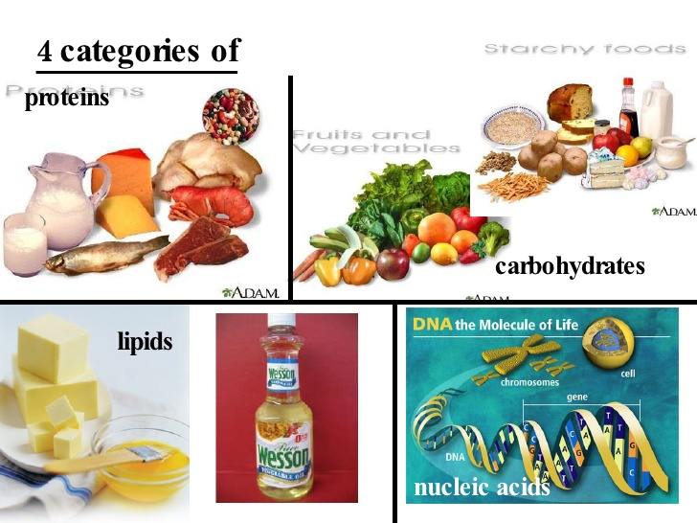
Biomolecules

Slide 4
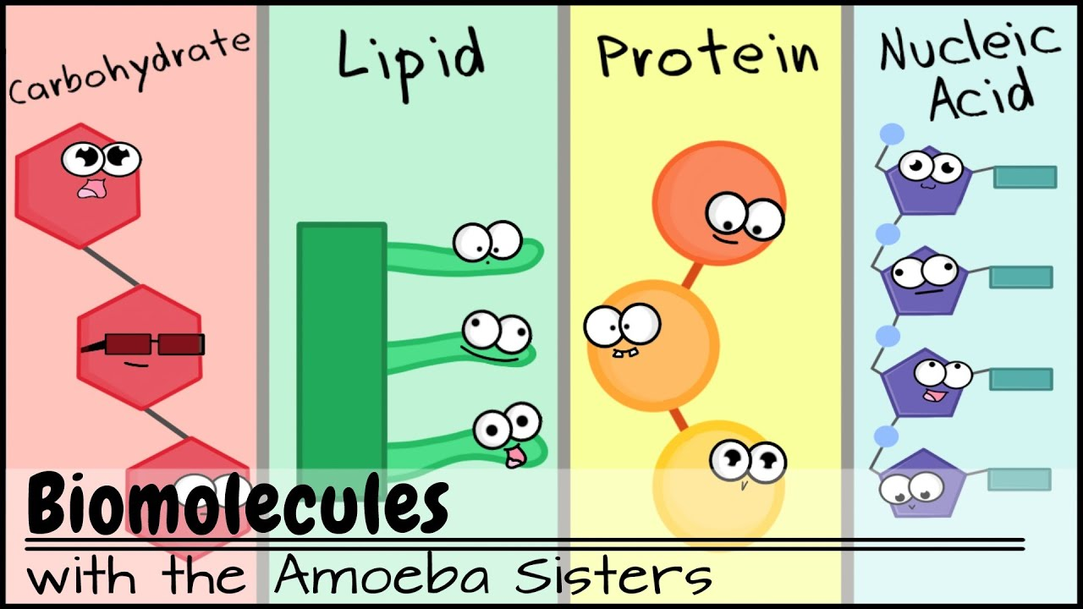

Slide 5
Biomolecules:
Carbohydrates- General classification and functions of: monosaccharides (glucose, ribose and deoxyribose), disaccharides (maltose, lactose and sucrose), polysaccharides (glycogen, starch, cellulose, inulin, and chitin).
Proteins- Amino acids – (structure: glycine, alanine, serine); amino acids as zwitter-ion; examples of acidic, basic, neutral, sulphur containing amino acids; essential and nonessential amino acids; levels of protein structure (primary, secondary, tertiary and quaternary); functions of proteins.
Lipids – classification, structure and functions of fats and oils ​
​
Nucleotides and nucleic acids – structure and functions of DNA, types of RNA. Differences between DNA and RNA

Slide 6
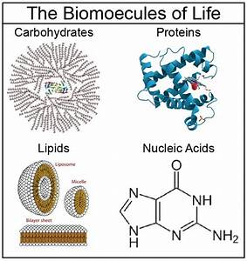

Slide 7
Basics of biochemistry
A. Common elements
Oxygen (O), carbon (C), hydrogen (H), and nitrogen (N) make up 96% of most living organisms.
Trace elements are elements that are necessary, but present in very small quantities.(1% of the body weight)
Sulphur: an important element in some amino acids.
Calcium: used during nerve impulses
Iron: found in hemoglobin (oxygen transport protein)
Sodium: needed for a nerve impulse
Phosphorus: in cell membrane structures and DNA

Slide 8
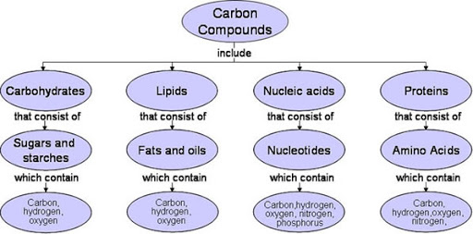

Slide 9
Types of Molecules
A biomolecule is any molecule that is present in living organisms, they are divided into macro molecules and micro molecules as follows:-
MACROMOLECULES  M > 1000  EXAMPLES 1. Polysaccharides 2. Nucleic acids 3. Proteins
MICROMOLECULES  M < 1000  EXAMPLES 1.
Micromolecules. A molecule that is relatively smaller (than a macromolecule), or of low molecular weight that may regulate a biological process.
Monomers are considered a micromolecule that can be linked together to form polymer.
Macromolecules are large molecules composed of thousands of covalently connected atoms. Carbohydrates, lipids, proteins, and nucleic acids are all macromolecules.
Macromolecules are formed by many monomers linking together, forming a polymer.

Slide 10
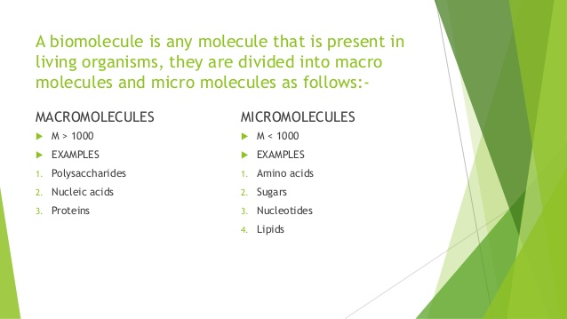

Slide 11
