Slide 1

THAKUR COLLEGE OF SCIENCE & COMMERCE
DEPARTMENT OF COMMERCE
MODULE III
SOCIAL ASPECTS OF ADVERTISING
Presentation by :
Ms. Shakibaa.I.Merchant

Slide 2

INTRODUCTION
• In this era of globalization and deregulation, advertising has acquired a new status.
• As a matter of fact, advertising creates employment opportunities, provides information regarding the developments taking place in the society, contributes to economic growth, and provides information about products and services available in the market which helps in taking buying decisions.

Slide 3

ETHICS
ETHICS
Ethics Is A Branch Of Philosophy Which Seeks To Address Questions About Morality; That Is, About Concepts Such As Good And Bad, Right And Wrong, Justice, And Virtue.
Ethics Is A Branch Of Philosophy Which Seeks To Address Questions About Morality; That Is, About Concepts Such As Good And Bad, Right And Wrong, Justice, And Virtue.
WHAT IS ETHICS IN ADVERTISING ?
Ethics In Advertising Means A Set Of Well Defined Principles Which Govern The Ways Of Communication Taking Place Between The Seller And The Buyer
WHAT IS ETHICS IN ADVERTISING ?
Ethics In Advertising Means A Set Of Well Defined Principles Which Govern The Ways Of Communication Taking Place Between The Seller And The Buyer

Slide 4

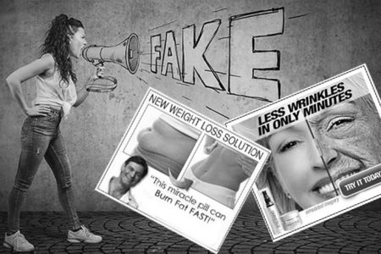
UNETHICAL ADVERTISING
Advertisement is considered unethical in the following situations:
When it has degraded or underestimated the substitute or rival's product.
When it gives false or misleading information on the value of the product.
When it fails to give useful information on the possible reaction or side effects
of the product. And
When it is immoral

Slide 5


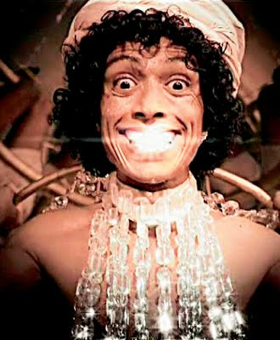

FORMS OF UNETHICAL ADVERTISING
1. EXAGGERATION
Using False Claims In The Advertisements About The Product

Slide 6



FORMS OF UNETHICAL ADVERTISING
2. MISUSE OF TESTIMONIALS
A testimonial is a statement given by a popular personality or any other person claiming the superiority of the brand .

Slide 7



FORMS OF UNETHICAL ADVERTISING
3. FREE GIFTS, DISCOUNTS AND CONTESTS
Some advertisers offer free gifts, discounts and attractive prizes for winning some contest. Most of such advertising is another trick to fool the innocent customers

Slide 8



FORMS OF UNETHICAL ADVERTISING
4. TOTAL LIES
Some of the advertisers blatantly lie in their ads to trick customers.

Slide 9



FORMS OF UNETHICAL ADVERTISING
5. COMPARATIVE ADVERTISING
These days , advertisers make unhealthy brand comparison for sales promotion . Such comparisons confuse the consumers in making a choice.

Slide 10

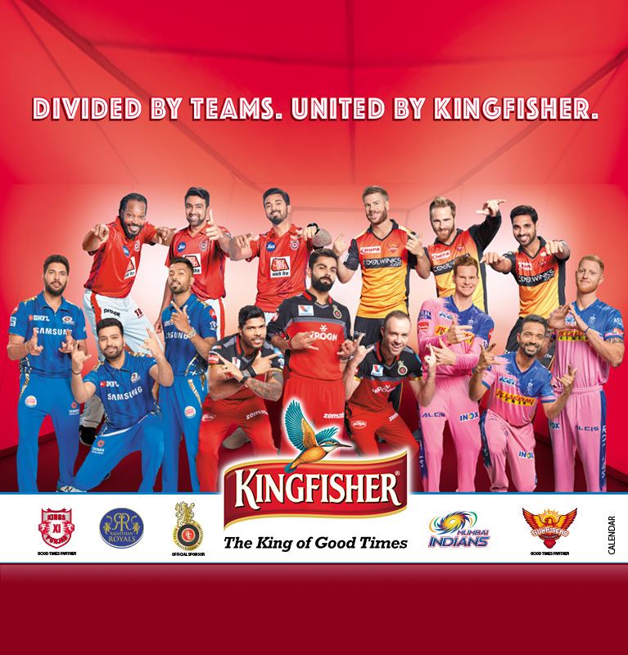
FORMS OF UNETHICAL ADVERTISING
6. SURROGATE ADVERTISING
Surrogate advertising is used to promote banned products, like cigarettes and alcohol, through another product carrying the same brand name .

Slide 11

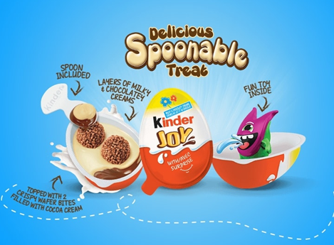
FORMS OF UNETHICAL ADVERTISING
7. ADVERTIISNG TO CHILDREN
Advertisers try to exploit children . Many products which adversely affect their health are advised . At times, advertisements develop inferiority complex amongst children for not using the advertised brand .

Slide 12
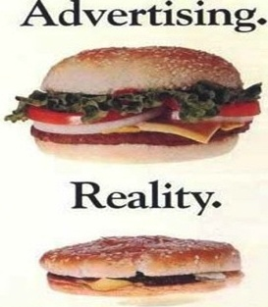
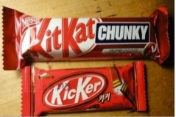
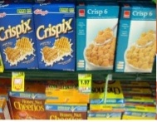
FORMS OF UNETHICAL ADVERTISING
8. MISREPRESENTATION
Competing brands with similar names & some sellers may claim that their product is of export quality , to fool the innocent consumers.

Slide 13


FORMS OF UNETHICAL ADVERTISING
9. FALSE STATISTICS
There are advertisers who make use of false statistics to substantiate the superiority of their brands

Slide 14


FORMS OF UNETHICAL ADVERTISING
10. PUFFERY ADVERTISING
It is a form of advertising in which a product or service is praised as being superior without any evidence to back up the claim . This is done for the sole purpose of attracting buyers that might not otherwise give the product any attention.

Slide 15
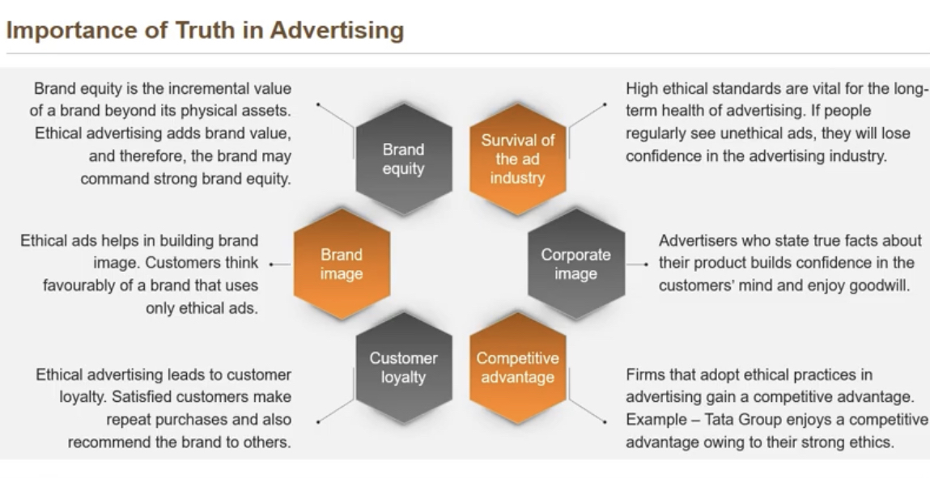

Slide 16

SOCIAL AND CULTURAL ISSUES IN ADVERTISING
Culture is informed by a society’s customs and traditions. It’s revealed through a society’s artistic and intellectual achievements, and is maintained by a series of behavioural codes passed down from generation to generation.
Paying attention to culture in advertising is extremely important for brands that work on a global scale, especially if your brand is working in markets that are culturally different to where they are based. Messages, symbols, rituals and even colours can have significantly different meanings and messages across cultures.

Slide 17
CRITICS OF ADVERTISING
PASSIVE ROLE OF WOMEN :
Ads depict woman in a passive role, as that of a mere housekeeper or as a servant of the family .
UNHEALTHY COMPETITION :
Ads create unhealthy competition among the marketers .
VULGARITY :
In ads, there is a good deal of vulgarity
MATERIALISTIC VALUES: The mass media such as magazines, tv etc encourages what is popular rather than what is good .
SURROGATE ADS :
used to promote banned products, like cigarettes and alcohol, through another product carrying the same brand name .
VIOLENCE:
Advertising sponsors serials or programmes which depicts scenes of crime & acts of violence
UNDUE INFLUENCE :
Unethical & uncultured marketers take the advantage of untruthful advertising & lure the people to buy

Slide 18


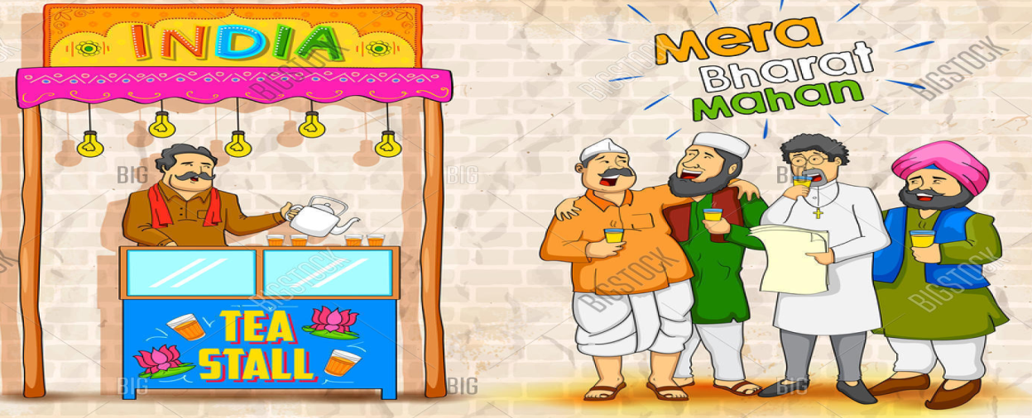
SUPPORTERS OF AVERTISING
1. CONCERN FOR GIRL CHILD
Some ads show the girl child in a positive role ; such as Rasna
2. SOCIAL AWARENESS
The public service ads such as family planning , literacy campaign , health and safety campaign etc.
3. NATIONAL INTEGRATION
There are ads on national integration, which brings people of different castes, religion, culture etc

Slide 19
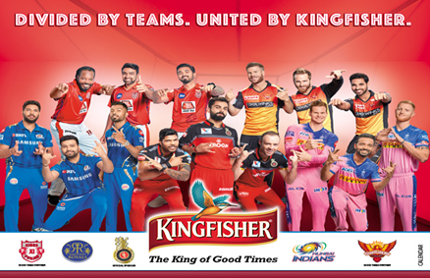


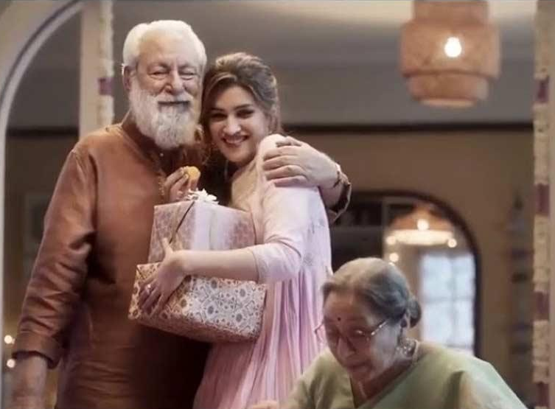
4.SPONSORSHIPS
Advertisers sponsor sports programmes, & variety of cultural programmes.
5. CUSTOMS & TRADITIONS
Ads highlights customs & traditions of India such as strong family ties.
6.CARING MALES
Ads depict malesnot only in macho roles, but that of a good father, or a good husband

Slide 20

ECONOMIC EFFECTS:
Concentration of economic power
Increase consumer prices
Unproductive use of funds
Affect economic well-being
ECONOMIC EFFECTS:
Reduce consumer price
Promotes competition
Expands business
Generates higher economic growth
SOCIAL EFFECTS:
Degrade cultural value
Create material values
Create social & racial discrimination
Affect social wellbeing
SOCIAL EFFECTS:
Higher standard of living
Upgrade cultural values
Promote communal harmony
Promote social welfare
NEGATIVE EFFECT OF ADVERTISING ON INDIAN VALUES & CULTURE
POSITIVE
EFFECT OF ADVERTISING ON INDIAN VALUES & CULTURE

Slide 21
THAKUR COLLEGE OF SCIENCE & COMMERCE
DEPARTMENT OF COMMERCE
MODULE III
THANK YOU !
Presentation by :
Ms. Shakibaa.I.Merchant

