Slide 1
Venture Capital & Private Equity
UNIT 2. Structure & Valuation Approaches

Slide 2
Contents to be learnt
UNIT 2: Structure and Valuation approaches
Structure and Regulation of Venture Capital and Private Equity- Business Cycle of PE –Structure of VC/PE firms- Limited Liability Partnerships- Routes of VC/PE investments in India- Regulatory Aspects of VC/PE investments
Valuation approaches- Risk and Returns- Analysis of Funds- Conventional Method- Revenue Multiplier Method

Slide 3
Business Cycle of Private Equity
The lifespan of a typical private equity fund is ten years, but that ten years generally doesn’t start until the team raises substantial capital and it doesn’t end until all assets are sold. So, the lifespan of a private equity fund may stretch to as long as 15 years. Below, I discuss each of the stages that attribute to the real lifespan of a private equity fund.
It’s also important to note that these stages overlap and that funds even overlap. As you raise a new fund, you may be managing and exiting investments from a previous fund. And, while you may hire new private equiteers to manage the new fund, invariably there’s a labour overlap and old funds create a hindrance.

Slide 4
Business Cycle of Private Equity
Phase One: Negotiation Stage &Raising capital and building the team (1 to 2+ years) - it can be very difficult to source capital, which is why most funds don’t even get off the ground in the first place. Private equiteers may spend upwards of two years creating hype and luring investors until they reach their funding target. If and when the final funding round closes, the managing company must then build the team to invest in and manage the portfolio businesses. This is a defining moment because the lifespan of a private equity fund is long and hence, the fund’s success firmly relies on the people chosen at this point (and specifically their resourcefulness, aptitude and ability to get along with others).

Slide 5
Business Cycle of Private Equity
Phase Two: Investment period-Sourcing deal flow (2 to 5+ years) - most mid-market firms source deals themselves, though they may entertain bankers and advisers on the odd occasion. This stage requires a dedicated team willing to sell themselves the concept of private equity. It can be tough, it can be dispiriting, but for private equiteers, it’s part and parcel of business. A motivated team can invest an entire fund in a couple of years, while slower funds may take 5+ years.
Phase Two:Managing and improving the portfolio (3 to 7 years per investee) – once a team makes an investment, it needs to work quickly to create a record of exceptional performance. A team can’t just wait until before an exit to make a difference because potential buyers look at medium-term historic performance when conducting their valuations. This can be a stressful time in difficult economic conditions or a blissful times during strong economic growth.

Slide 6
Business Cycle of Private Equity
Phase 3: Disinvestment Period Exiting the investments (varied time frames) - an exit can occur 6 months after investment if the right strategic buyers and economic conditions present. However, an exit may drag out for 7+ years if the investment underperforms, the economy teeters, and buyers don’t present. The longer an investment remains in a portfolio, the higher the required exit price.
.If investments remain at the end of the official ten year term of the fund, there are a range of options: a) the investment may be sold to a secondary fund, b) the fund may be extended for anything from 1 to 3+ years, or c) the fund can hold a fire sale. The best exits are with many potential buyers and when you’re not forced to sell, so private equiteers certainly don’t want to hold fire sales. And, since the team likely raised another fund, extending this fund will only hinder the new fund.

Slide 7
Structure of VC/PE Funds
There are three types of fund structure in Private Equity.
A. Offshore Structure
B. Co-Investment Structure
C. Unified Structure

Slide 8
Offshore Fund Structure
An offshore fund is generally a collective investment scheme domiciled in an offshore jurisdiction
The reference to offshore, in the classic case, usually means a traditional offshore jurisdiction such as the Cayman Islands, Jersey or the British Virgin Islands. However, the term is also frequently used to include other corporate domiciles popular for cross border investment structuring, such as Delaware and Luxembourg

Slide 9
Offshore Structure
An investment company in the form of limited liability company or partnership is organised in an offshore tax favourable jurisdiction
The fund makes an investment directly or through a SPV in an Indian portfolio companies
The fund is formed by Investment Manager (IM),known as Sponsors/General Partner(GP),looking to raise capital on private placement basis from Limited Partner(LP)

Slide 10
Offshore Structure
General Partner is located outside India and responsible for all funding decisions and remunerated with management fees.
Limited Partner makes capital contribution to the fund and have submissive role.
Apartment from Investment Manager outside India, there would be investment Advisor(AI) in India for identifying investment opportunities and to carry out preliminary due diligence work for investments in India.

Slide 11
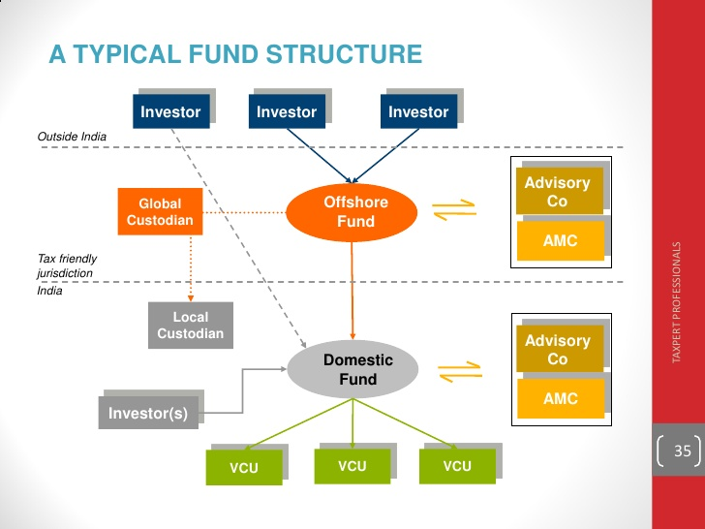

Slide 12
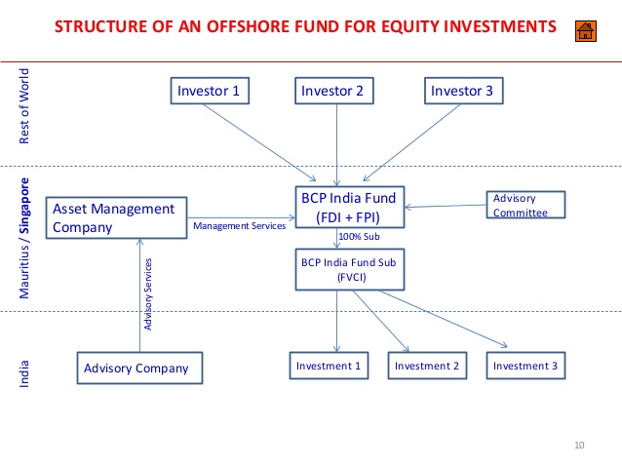

Slide 13
Co-Investment Fund Structure
Co-investment fund structure is a combination of Off shore and domestic investment, two separate pools of capital for offshore investors as well as domestic investors are been raised.A distinct domestic fund vehicle is mandatory for domestic investors which out to be registered with SEBI.
In simple terms, co-investments are investment opportunities procured by a GP which an investor has the discretion to participate in, but are parallel to an existing fund structure (the “Sponsor Fund”).

Slide 14
Co-Investment Fund Structure
Domestic fund is managed by the India based investment manager who may also act as IA to the overseas investment services.
The offshore fund and domestic fund makes investment in Indian portfolio companies.
For Domestic Fund, domestic investment vehicles pools funds from the investors and a separate Investment Advisor carries asset management activities and identify possible investee companies.

Slide 15
Unified Investment Fund Structure
Used when domestic investors are expected to participate in the Fund
A domestic Investment Vehicle is established in the form of Trust in addition to Offshore Fund.
The domestic trust is registered with SEBI.
The domestic investors directly contribute to the domestic trust, whereas overseas investors pool their investment into the offshore fund, whereby they invest in the domestic trust.
The portfolio investments are made by the trust, which will have a domestic manager or advisor.

Slide 16
Limited Liability Partnership
A limited liability partnership (LLP) is a partnership in which some or all partners (depending on the jurisdiction) have limited liabilities. It therefore can exhibit elements of partnerships and corporations
In an LLP, each partner is not responsible or liable for another partner's misconduct or negligence. This is an important difference from the traditional partnership, in which each partner has joint (but not several) liability.
In an LLP, some or all partners have a form of limited liability similar to that of the shareholders of a corporation. Unlike corporate shareholders, the partners have the right to manage the business directly

Slide 17
Limited Liability Partnership
LLPs are a flexible legal and tax entity that allows partners to benefit from economies of scale by working together while also reducing their liability for the actions of other partners
Limited liability means that if the partnership fails, creditors cannot go after a partner's personal assets or income.
LLPs are common in professional business like law firms, accounting firms, and wealth managers

Slide 18
Limited Liability Partnership
The Limited Liability Partnership Act, 2008
A corporate business vehicle that enables professional expertise and entrepreneurial initiative to combine and operate in flexible, innovative and efficient manner, providing benefits of limited liability while allowing its members the flexibility for organizing their internal structure as a partnership.

Slide 19
Distinct Features of an LLP
1. Separate legal entity
Unlike regular partnership firms, limited liability partnerships are treated as separate legal entities. This means that LLPs can own assets and incur liabilities in their own names. They can also enter into contracts and sue and be sued in their own names.
2. Limited liability of partners
The liabilities of partners of an LLP are separate and limited. Their personal assets will not liable to attachment in case the LLP is winding up or suffering certain legal consequences of repayment of debt.
Partners’ liabilities, however, can become unlimited in cases of offenses like fraud, the commission of an offense, or any other wrongful and illegal act.

Slide 20
Distinct Features of an LLP
3. Sharing of profits
All partners of limited liability partnerships share profits of business just as partners of regular firms. They are, however, free to decide the ratio in which they will share profits.
4. Partners of LLPs
Partners of a limited liability partnership can be either natural persons, i.e. individuals, or even body corporates. Furthermore, an individual cannot be a partner if he suffers from unsoundness of mind or he is insolvent.
LLPs must have a minimum of two partners at all times. Also, the maximum number of partners is unlimited, while it is restricted to 50 for regular partnership firms. If at any time, the number of partners in an LLP becomes less than two, and the sole partner carries on business for more than six months under such circumstances, his liability towards the firm’s business will become unlimited.

Slide 21
Partnerships vs. LLPs
Differences | Traditional partnerships | Limited liability partnerships
Governing law | Indian Partnership Act, 1932 | Limited Liability Partnerships Act, 2018
Separate entity? | No | Yes
Unlimited liability of partners? | No | Yes
Nature of partners | Only natural persons, i.e. individuals | Individuals as well as body corporates
Number of partners | Minimum 2, maximum 50 | Minimum 2, maximum unlimited
Registration | Optional | Mandatory
Assets | Only partners can own assets of the firm | A firm can own assets in its name

Slide 22
Limited Liability Company
The popular limited liability company (LLC) that can be registered across the world can be registered as a limited liability partnership (LLP) or as a private limited company in India. Through a LLP in India, the investors will benefit from limited liability, in the sense that they will be held accountable for the company’s debts only in the extent to which they have contributed to the company’s capital.
When starting a business in India registered as a LLP, the registration procedure is performed following the regulations prescribed by the Limited Liability Partnership Act 2008

Slide 23
Advantages of an Indian LLC?
The Indian LLC is a type of company that is very popular amongst foreign investors interested in opening a company in India. This structure provides a set of advantages, which are presented in the list below
ownership – the company can be formed with 100% foreign ownership, as there are no restrictions in this sense;
liability – the investors are protected against company debts, as the company is a separate legal entity;
shareholding structure – the company needs only two shareholders for its incorporation;
company documents – the company’s documents can be prepared in English, this being an important advantage for foreign businessmen;
capital – it requires a small capital compared to other business forms.

Slide 24
Routes of VC/PE Investments in India
Fund of Funds
Private equity fund of funds are investment vehicles that pool capital from people to invest in several different private equity funds.
Through these funds, investors can create a highly-diversified and comprehensive portfolio of indirect investments in several companies from some or all of the categories of private equity.
Private equity fund of funds helps to spread the risk of the investments made whilst maintaining healthy returns.
Smaller investors, who do not have access to larger private equity funds due to capital constraints, often invest into Private equity fund of funds to increase their exposure to the asset class.

Slide 25
Fund of Funds
A Private equity fund of funds holds the shares of many private partnerships that invest in private equities. In this way, firms increase cost effectiveness and thereby reduce their minimum investment requirement.
This also allows scope for greater diversification, since a fund of funds might invest in hundreds of companies representing many different phases of venture capital and industry sectors.
In addition, because of its size and diversification, a Private equity fund of funds has the potential to offer less risk than an individual private-equity investment

Slide 26
Fund of Funds
One of the most important advantages of a high-quality Private equity fund of funds can be summed up as access to high-quality funds with proven managers, maximum diversification, and cost effectiveness.
The disadvantage it may bring to some investors is that there is an additional fee to the Private equity fund of funds manager over and above the fees paid to the direct private equity partnership.

Slide 27
Key Features of Private Equity Funds of Funds:
Investment Strategy: A Private Equity Funds of Funds will seek to obtain superior investment returns relative to medium to long term returns in the market. To achieve this goal, a Private Equity Funds of Funds invests in other Private equity funds with similar or higher return goals such as Venture Capital funds or Hedge Funds.
Preferred Returns: A vast majority of Private Equity Funds of Funds provide preferred returns to investors which is a fixed percentage of the annual rate of return, ranging from 6%-12%.
Management Fees: The Management fees charged includes an annual amount equal to a fixed percentage of total capital commitments during a specified investment period ranging from .75%-1.5%.
Typical Investors: A full range of high net worth or high income individuals as well as smaller institutiona l investors.
Leverage: A Private Equity Funds of Funds has the ability to borrow short term loans to cover Partnership expenses or to “bridge” Capital Contributions.

Slide 28
Benefits of Private Equity Fund of Funds
Access to deal flow is especially a compelling factor since several Leveraged Buyouts or Merchant Banking funds and larger Venture Capital and Hedge Funds require minimum investment that are beyond the reach of many individual investors. A Private Equity Fund of Funds can eliminate these obstacles by pooling much smaller commitments from individuals.
Expertise is a factor which may be attractive to a wide range of institutional as well as individual investors. The Private Equity market is characterized by a relative lack of transparency and the only way to obtain crucial market information is by being an active market participant. A Private Equity Fund of Funds can help bridge this gap for investors whose resources or portfolio allocations allow for only for more limited investments in Private Equity Funds.
Economies of scale arise from the fact that a sponsor of a Private Equity Fund of Funds can perform a thorough business and legal review of prospective investments that would be expensive if undertaken by each investor in the Private Equity Fund of Funds.

Slide 29
Benefits of Private Equity Fund of Funds
Diversification is achieved because the investor in the Private Equity Fund of Funds acquires relatively small interests in a number of underlying Private Equity Funds. The pooling of capital at the Private Equity Fund of Funds level allows this even for investors who do not satisfy the minimum investment threshold at any of the underlying Private Equity Funds. Private Equity Funds of Funds are less risky since they invest capital in a maximum of twenty direct investments.
As they invest in diversified private equity asset classes, Private Equity Funds of Funds significantly improve the risk/reward profile of a portfolio
An access to high-quality funds managed by a professional team is provided.
A major advantage that experienced managers of Private Equity fund of funds is the ability to access top-performing, direct-equity partnerships. This access is very important in creating superior returns for the private equity asset class.

Slide 30
Disadvantages of Private Equity Fund of Funds
Private Equity Funds of Funds market is opaque and illiquid.
The access to performance figures in Private Equity Funds of Funds is very limited
Additional charge of asset management fees levied on investors. This can reduce the investor’s profits and total returns compared to what could be achieved through mutual funds or ETF’s.

Slide 31
Special Purpose Vehicle (SPV)
A special purpose vehicle, also called a special purpose entity (SPE), is a subsidiary created by a parent company to isolate financial risk. Its legal status as a separate company makes its obligations secure even if the parent company goes bankrupt.
A Special Purpose Vehicle (SPV) is a legal entity created for a specific purpose. In the context of raising capital, a SPV (usually structured as LLC) can be used as a funding structure, by which all investors (or investors under a given investment threshold) are pooled together into a single entity.

Slide 32
Uses of Special Purpose Vehicles
Risk sharing
A corporation’s project may entail significant risks. Creating an SPV enables the corporation to legally isolate the risks of the project and then share this risk with other investors.
Asset transfer
Certain types of assets can be hard to transfer. Thus, a company may create an SPV to own these assets. When they want to transfer the assets, they can simply sell the SPV as part of a merger and acquisition (M&A) process.
Property sale
If the taxes on property sales are higher than the capital gain realized from the sale, a company may create an SPV that will own the properties for sale. It can then sell the SPV instead of the properties and pay tax on the capital gain from the sale instead of having to pay the property sales tax

Slide 33
Benefits Of Special Purpose Vehicles
Isolated financial risk
Direct ownership of a specific asset
Tax savings, if the vehicle is created in a tax haven such as the Cayman Islands
Easy to create and set up the vehicle

Slide 34
Risks Of Special Purpose Vehicles
Lower access to capital at the vehicle level (since it doesn’t have the same credit as the sponsor)
Mark to Market accounting rules could be triggered if an asset is sold, significantly impacting the sponsor’s balance sheet
Regulatory changes could cause serious problems for companies using these vehicles
The optics surrounding SPVs are sometimes negative

Slide 35
Regulatory Aspects of VC/PE Investments in India
Company’s Act 2013
RBI
SEBI Regulations
FEMA Regulations
Income Tax Act, 1961

Slide 36
Regulatory Aspects of VC/PE Investments in India
The Company Accountability:
1) Companies Act, 2013:
Where an investor knocks on the doors of the Company, questions related to how and by what way can the investment be made and in what manner rights can be granted to the investor come to surface. Depending on the manner as mutually agreed upon between the Company and the Investor, the Private Equity Investment is made in a company and accordingly statutory compliances that the companies need to be in line with are ascertained. These statutory compliances can further be sub divided into those which relate to a) the transaction related to the investment and b) other conditions precedents to the investment

Slide 37
Regulatory Aspects of VC/PE Investments in India
a) Section 42 and Rule 14 of the Companies (Prospectus and Allotment of Securities) Rules, 2014
b) Section 62 and Companies (Share Capital and Debentures) Rules, 2014
c) Issue of debentures: For the issue of debentures, the provisions of Section 42 and Section 62 (in case they are issued through preferential allotment) need to be complied with
d) Issue of Preference Shares: Private equity investments may also be made by way of issue of preference shares. Section 55 of the Act governs the rules related to issue preference shares

Slide 38
Regulatory Aspects of VC/PE Investments in India
The Fund Accountability:
1) Foreign Direct Investment Policy:
Foreign Direct Investment (“FDI”) Policy is issued by the Department of Industrial Policy and Promotion every year. The Policy regulates the inflow of FDI in India and further imposes general conditions and sector specific conditions on these investments. The FDI Policy 2017 lays down the authorities who are empowered to provide permission for investments which fall under the government route.

Slide 39
Regulatory Aspects of VC/PE Investments in India
2) Reserve Bank of India Regulations on Transfer or Issue of Security by a Person Resident outside India and Regulations under the Foreign Exchange Management Act, 1999
Reserve Bank of India (“RBI”) in November, 2017 issued Foreign Exchange Management (Transfer or Issue of Security by a Person Resident outside India) Regulations, 2017. These regulations regulate investments made in Indian companies and the issue of equity shares, debentures, preference shares and share warrants which are classified as “Capital Instruments” under the Regulations.

Slide 40
Regulatory Aspects of VC/PE Investments in India
The Regulations also impose restriction on receiving and making investments.
Provisions in relation to permission to be given for making investment by a person resident outside India and the entry routes, sectoral caps and the investment limits are also enumerated in the Regulation and the same are in line with the FDI Policy.
Further, the Regulation also enumerates the provisions related to the transfer of capital instruments of an Indian company by or to a person resident outside India, pricing guidelines, taxes, remittance of sale proceeds and mandate certain reporting requirements.

Slide 41
Regulatory Aspects of VC/PE Investments in India
3) SEBI (Alternative Investment Funds) Regulations, 2012:
he investment in various organizations is now routed from the “Alternate Investment Funds” which are established for the purpose of making investments. These funds need to be complaint with the SEBI (Alternative Investment Funds) Regulations, 2012. The Regulations provide a legal framework for the pool investment funds in India such as real estate, private equity, hedge funds etc. The regulations mandate registration of all Alternative Investment Funds and restrict any person or entity from acting as an AIF unless registration from SEBI has been procured.

Slide 42
Regulatory Aspects of VC/PE Investments in India
The Regulation bifurcates the registration in Category I/II/II and enumerates the eligibility criteria for the same. Category II includes private equity funds within their ambit.
Private Equity Fund means an AIF which invests primarily in equity or equity linked instruments or partnership interests of investee companies according to the stated objective of the fund. It also imposes certain restrictions in terms of number of investors and amount of investments.
The regulation restricts any scheme from having more than 1000 investors and further accepting a deposit of less than 1 Crore. The investment transactions shall be in line with the restrictions and conditions imposed by the regulations

Slide 43
Regulatory Aspects of VC/PE Investments in India
4) SEBI(Venture Capital funds)Regulations,1996 & SEBI (Foreign Venture Capital Investor) Regulations, 2000:
The SEBI (Foreign Venture Capital Investor) Regulations, 2000 regulates investments by the Foreign Venture Capital Investors (“FVCI”) which are investors incorporated or established outside India and propose to make investments in venture capital funds or venture capital undertakings in India..

Slide 44
Regulatory Aspects of VC/PE Investments in India
Even though the registration under the Regulations are not mandatory, SEBI and the RBI have extended certain benefits to SEBI registered FVCIs. The regulations also mandate the appointment of a domestic custodian for the purpose of the custody of the securities.
SEBI (Issue of Capital and Disclosure Requirements) Regulations 2009 (“ICDR Regulations”) prescribes one-year post Initial Public Offering (“IPO”) lock-in period for the promoters. The same proved to be a hindrance for the investors. The FCVI regulation however, provides an exemption from the same

Slide 45
Regulatory Aspects of VC/PE Investments in India
5) SEBI (Substantial Acquisition of Shares and Takeovers) Regulations 2011:
SEBI (Substantial Acquisition of Shares and Takeovers) Regulations 2011 provide an exit option to public shareholders in case any person acquires shares or voting rights which entitles him to 25% or more voting rights.
These regulations come into force wherein the investment is of such a nature that the same delist the company or one may call as a complete buy-out of a company. Certain conditions and restrictions on those who already own shares in a company from making further investments are also imposed.
Where such an investment as that which delists the company is made, the SEBI (Delisting of Equity Shares) Regulations, 2009 also come in play.

Slide 46
Regulatory Aspects of VC/PE Investments in India
6) Income Tax Act, 1961:
The Income from the sale of shares is classified as Capital Gains. Hence, the investment transactions are regulated by the provisions of the Income Tax Act, 1961. The Income Tax Act, 1961 provides for certain exemptions for investments made in companies. Further, in order to get tax benefits it may be possible that the investors route their investments from more favorable jurisdictions. In such scenarios, Double Taxation Avoidance Agreement, Place of Effective Management and General Anti-Avoidance Rules are to be considered.

Slide 47
FAQs on Alternative Investment Funds
1. In which legal forms can an AIF be set up?
An AIF under the SEBI (Alternative Investment Funds) Regulations, 2012 can be established or incorporated in the form of a trust or a company or a limited liability partnership or a body corporate. Most of the AIFs registered with SEBI are in trust form.
2. Whether an AIF can accept investments from joint investors?
An AIF may accept the following as joint investors for the purpose of investment of not less than INR 1 Cr. from the following:
(i) an investor and his/her spouse
(ii) an investor and his/her parent
(iii) an investor and his/her daughter/son
With respect to the above investors, not more than 2 persons shall act as joint-investors in an AIF. In case of any other investors acting as joint investors, for every investor, the minimum investment amount of INR one crore shall apply. Joint investors shall mean where each of the investor contributes towards the AIF.
3. What is the validity of the certificate of registration of an AIF?
The certificate of registration of an AIF shall be valid till the AIF is wound up.

Slide 48
FAQs on Alternative Investment Funds
4. Is an AIF permitted to make an invitation to the public to subscribe to its securities?
No. AIFs are privately pooled investment vehicles. AIFs shall raise funds through private placement by issue of information memorandum or placement memorandum, by whatever name called. As an eligibility criterion for registration as an AIF, the applicant is required to be prohibited by its memorandum and articles of association/ trust deed/ partnership deed from making an invitation or solicitation to the public to subscribe to its securities.

Slide 49
FAQs on Alternative Investment Funds
5. Whether Alternative Investment Funds (AIF) registered with SEBI can invest in foreign securities?
Under SEBI (Alternative Investment Funds), 2012 , AIFs are permitted to invest in foreign securities subject to the conditions prescribed by the Reserve Bank of India (RBI). Currently, the limit for overseas investment for SEBI registered AIFs & Venture Capital Funds (VCF) is USD 750 million i.e. all investments made by AIF & VCFs . However, the investment by AIFs in foreign securities is subject to the following conditions :
(a) Prior-approval of SEBI is required for investment;
(b) Investments of up to 25% of the investible fund of the scheme of the AIF is allowed;
(c) Investments are allowed only in an Offshore Venture-Capital Undertaking , which has an Indian Connection;
(d) AIFs cannot invest in their Joint Ventures/Wholly-owned subsidiaries.
(e) The permission to invest is granted out of the total available limit, on a first-come-first-serve basis;
(f) The approval for investment has a validity period of 6 months;
(g) Upon non-utilisation of the approved limit within the validity period, the same has to be reported to SEBI within 2 days from the end of the validity period .

Slide 50
Risk & Return in Private Equity
1. Operational Risk
Operational risk is the risk of loss resulting from inadequate processes and systems supporting the organisation It is a key consideration for investors regardless of the asset classes that PE funds invest into.
2. Funding Risk
This is the risk that investors are not able to provide their capital commitments and is effectively the ‘investor default risk’. PE funds typically do not call upon all the committed investor capital and only draw capital once they have identified investments. Funding risk is closely related to liquidity risk, as when investors are faced with a funding shortfall they may be forced to sell illiquid assets to meet their commitments.
.

Slide 51
Risk & Return in Private Equity
3. Liquidity Risk
This refers to an investor's inability to redeem their investment at any given time. PE investors are ‘locked-in’ for between five and ten years, or more, and are unable to redeem their committed capital on request during that period. Additionally, given the lack of an active market for the underlying investments, it is difficult to estimate when the investment can be realised, and at what valuation.
4. Market Risk
There are many forms of market risk affecting PE investments, such as broad equity market exposure, geographical/sector exposure, foreign exchange, commodity prices and interest rates. Unlike in public markets where prices fluctuate constantly and are marked-to-market, PE investments are subject to infrequent valuations and are typically valued quarterly and with some element of subjectivity inherent in the assessment. However, the market prices of publicly listed equities at the time of sale of a portfolio company will ultimately impact realisation value.

Slide 52
Risk & Return in Private Equity
5. Capital risk
The capital at risk is equal to the net asset value of the unrealised portfolio plus the future undrawn commitments. In theory, there is a risk that all portfolio companies could experience a decline in their current value, and in the worst case drop to a valuation of zero. Capital risk is closely related to market risk. Whilst market risk is the uncertainty associated with unrealised gains or losses, capital risk is the possibility of having a realised loss of the original capital at the end of a fund's life.
There are two main ways that capital risk brings itself to bear - through the failure of underlying companies within the PE portfolio and suppressed equity prices which makes exits less attractive. The former is impacted by the quality of the fund manager, i.e. their ability to select portfolio companies with good growth prospects and to create value, hence why fund manager selection is key for investors. The condition, method and timing of the exit are all factors which can affect how value can be created for investors

Slide 53
Risk & Return in Private Equity
Other types of risk are
6.Counterparty risk/Credit risk-default in payment of interest or principal on a specified date.
7.Country risk-country restrictions
8.Legal risk
8.Regulatory /Compliance risk

Slide 54
Risks faced by PE fund Managers
Country and financial risks
Transaction risk(exchange rate variation)
Political risk
Technical and Project specific risk
Policy and regulatory risk
Environmental risk

Slide 55
Criteria for PE Investments
Industry and Product
The Company
Management
Return on investment
Availability of Debt financing
Valuation of PE

Slide 56
Rewards earned by VCPE Investments
Reward for PE fund managers and many executives in portfolio companies aligns with the PE value creation’s focus on IRR.
The classic model is that a firm will charge its investors a management fee that is a fixed percentage of the capital invested or committed and a “carried interest” that pays a percentage of a fund’s growth over and above a hurdle rate of return

Slide 57
Valuation Approach
Business Valuation is the act or process of assessing value or price of financial asset or liability.
A valuation approach is the methodology used to determine the fair market value of a business.
The most common valuation approaches are:
The Income Approach - quantifies the net present value of future benefits associated with ownership of the equity interest or asset. The estimated future benefits that accrue to the owner are discounted or capitalized at a rate appropriate for the risks associated with those future benefits. Common methods within the income approach include the capitalization of earnings (or cash flow) methodology and the discounted cash flow methodology.

Slide 58
Valuation Approach
The Market Approach - determines fair market value by reviewing actual transactions of comparable companies and assets. Both M&A activity and stock market activity are considered in deriving various value measures to apply to the subject entity.
The Asset-based Approach - uses the current value of a company’s tangible net assets as the key determinant of fair market value. This approach is typically used where a business is not a going concern, or where a business is a going concern but its value is tied directly to the liquidation value of its underlying

Slide 59
Analysis of Funds
When valuing a company as a going concern, there are three main valuation methods used by industry practitioners:
(1) DCF analysis,
(2) comparable company analysis, and
(3) precedent transactions.
These are the most common methods of valuation used in investment banking, equity research, private equity, corporate development, mergers & acquisitions (M&A), leveraged buyouts (LBO), and most areas of finance.

Slide 60
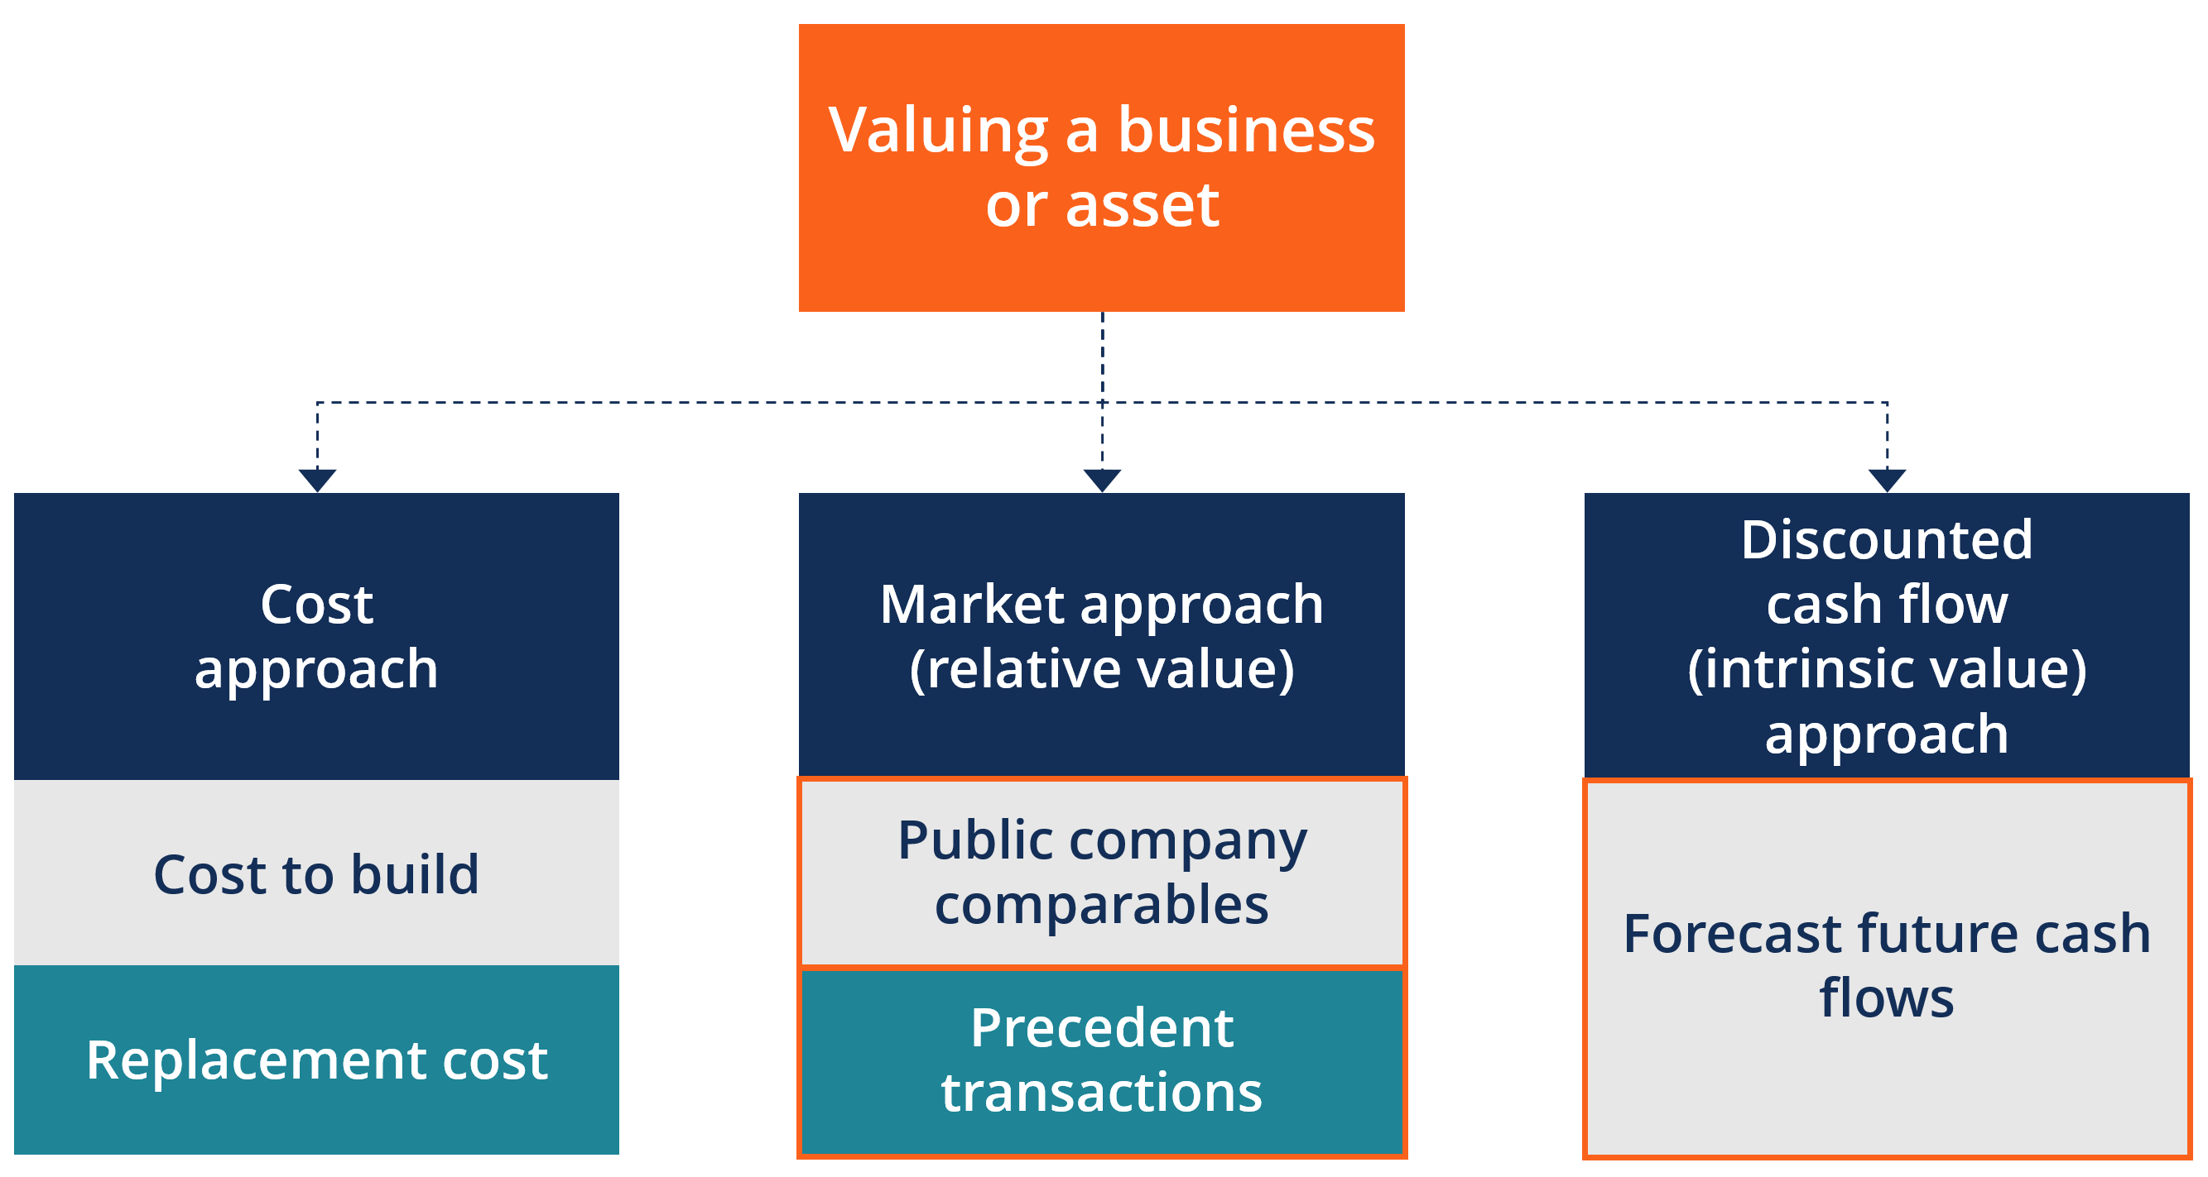
Valuation of Asset

Slide 61
Valuation of Asset
Method 1: Comparable Analysis (“Comps”)
Comparable company analysis (also called “trading multiples” or “peer group analysis” or “equity comps” or “public market multiples”) is a relative valuation method in which you compare the current value of a business to other similar businesses by looking at trading multiples like P/E, EV/EBITDA, or other ratios. Multiples of EBITDA are the most common valuation method.
The “comps” valuation method provides an observable value for the business, based on what other comparable companies are currently worth. Comps are the most widely used approach, as they are easy to calculate and always current.

Slide 62
Valuation of Asset
Method 2: Precedent Transactions
Precedent transactions analysis is another form of relative valuation where you compare the company in question to other businesses that have recently been sold or acquired in the same industry. These transaction values include the take-over premium included in the price for which they were acquired.
The values represent the en bloc value of a business. They are useful for M&A transactions, but can easily become stale-dated and no longer reflective of the current market as time passes. They are less commonly used than Comps or market trading multiples.

Slide 63
Valuation of Asset
Method 3: DCF Analysis
Discounted Cash Flow (DCF) analysis is an intrinsic value approach where an analyst forecasts the business’ unlevered free cash flow into the future and discounts it back to today at the firm’s Weighted Average Cost of Capital (WACC).

Slide 64
DCF Analysis
Dividend Discount Model
The Dividend Discount Model (DDM) is a quantitative method of valuing a company’s stock price based on the assumption that the current fair price of a stock equals the sum of all of the company’s future dividends discounted back to their present value

Slide 65
DCF Analysis
The dividend discount model was developed under the assumption that the intrinsic valueof a stock reflects the present value of all future cash flows generated by a security. At the same time, dividends are essentially the positive cash flows generated by a company and distributed to the shareholders.
Generally, the dividend discount model provides an easy way to calculate a fair stock price from a mathematical perspective with minimum input variables required. However, the model relies on several assumptions that cannot be easily forecasted.
Depending on the variation of the dividend discount model, an analyst requires forecasting future dividend payments, the growth of dividend payments, and the cost of equity capital. Forecasting all the variables precisely is almost impossible. Thus, in many cases, the theoretical fair stock price is far from reality.

Slide 66
DCF Analysis
In the DDM, a present stock value that is higher than a stocks market value indicates that the stock is undervalued and that it is a good time to purchase shares.
The formula used is
Present Value of Stock= Dividend per Share/Rdiscount-R Dividend Growth

Slide 67
DCF Analysis
There are 3 models used in the dividend discount model:
ZERO-Growth Rate, which assumes all dividends paid by a stock remains same
Constant –Growth rate model(Gordon Growth Model), which assumes that dividend grow by a specific percent annually.
Variable Growth Rate, which divides growth in to 3 phases, a fast initial phase, then a slower transition phase that ultimately ends with a lower rate that is sustainable over a long period.

Slide 68
DCF Analysis
The Gordon Growth Model (GGM) is one of the most commonly used variations of the dividend discount model. The model is called after American economist Myron J. Gordon, who proposed the variation. The GGM assists an investor in evaluating a stock’s intrinsic value based on the potential dividend’s constant rate of growth.
The GGM is based on the assumption that the stream of future dividends will grow at some constant rate in the future for an infinite time. The model is helpful in assessing the value of stable businesses with strong cash flow and steady levels of dividend growth. It generally assumes that the company being evaluated possesses a constant and stable business model and that the growth of the company occurs at a constant rate over time.

Slide 69
DCF Analysis
Mathematically, the model is expressed in the following way:
Where: V₀₌ D_{1/} r- g
V₀ – The current fair value of a stock
D₁ – The dividend payment in one period from now
r – The estimated cost of equity capital (usually calculated using CAPM)
g – The constant growth rate of the company’s dividends for an infinite time

Slide 70
DCF Analysis
Variable growth rate models-multi-stage models can take many forms,even assuming the growth rate is different every year.
Most common form is one assumes 3 different rates of growth.
An initial high growth rate, a transition to slower growth, and lastly, a sustainable steady rate of growth.
Basically, the constant growth rate model is extended,each phase of growth is calculated using constant-growth method, but using different growth rates of the 3 phases.
Present values of each stage are added together to derive the intrinsic value of the stock.

Slide 71
More Valuation Methods
The cost approach, which is not as commonly used in corporate finance, looks at what it actually costs or would cost to re-build the business. This approach ignores any value creation or cash flow generation and only looks at things through the lens of “cost = value”.
Another valuation method for a company that is a going concern is called the ability to pay analysis. This approach looks at the maximum price an acquirer can pay for a business while still hitting some target. For example, if a private equity firm needs to hit a hurdle rate of 30%, what is the maximum price it can pay for the business?
If the company will not continue to operate, then a liquidation value will be estimated based on breaking up and selling the company’s assets. This value is usually very discounted as it assumes the assets will be sold as quickly as possible to any buyer.

Slide 72
Valuation of Established companies/Analysis of funds
There are basically three methods adopted by venture capital institutions (VCI) while financing projects. These are –
Conventional venture capitalist evaluation method.
The First Chicago method.
The revenue multiplier method.

Slide 73
Conventional venture capitalist evaluation method
ln this method, VCIs give importance to two aspects, which are
the time of starting the investment and
the time of quitting the investment.
The institution will judge the borrowing concern in the following manner—
1. Annual revenue of the borrowing concern over a period of 7 years and whether these revenues are on the upward trend.
2. The borrowing concerns’ expected earnings (after deducting tax liability) at the initial stage and also at the time of quitting the borrowing concern will be taken into consideration.

Slide 74
Conventional venture capitalist evaluation method
3. Market evaluation of the borrowing concern on the basis of P/E ratio (P = price of the security and E= earnings of the security). The evaluation of this ratio is the lesser the ratio, better will be the condition of the borrowing company.
4. Finding out the net present value (NPV) of the borrowing concern, based on suitable discount factor.
5. The borrowing concern must have net worth equivalent to the borrowing amount.
Example: If the value of enterprise is Rs. 10 crores, and the borrower wants Rs. 4 crores, then he must have a net worth of 40 percent of the total value.
The above method may not be practically feasible as most of the borrowing firms will not be in a position to provide regular stream of income and in the case of firms incurring losses, this method cannot be worked out.

Slide 75
The First Chicago method
This method is different from the previous conventional method of evaluation, as it gives some discount to the starting point and the exit point. There is more consideration given for the earnings during the entire period. This scheme has the following aspects.
1. Three alternative positions are taken which are
Success
Sideways survival
failure.

Slide 76
The First Chicago method
A probability rating is given to the three positions.
2. Through the discounted cash flow, the discounted present value is assessed by giving a high discount rate to accommodate the risk factor.
3. The discounted value is multiplied by probability ratings which will provide expected present value.
4. If the expected present value is Rs. 10 lakhs, and the fund required is Rs. 5 lakhs, then the borrowing concern must have a minimum net worth of 50%.

Slide 77
Revenue Multiplier method
In this method, the value of the borrowing concern is based on an estimated value. The estimated value is calculated on the basis of
1. Present value of the borrowing concern
2. Annual revenue
3. Expected rate of growth of revenue per year
4. Expected holding period ( number of years for the repayment)
5. Profit margin after tax
6. Expected P/E ratio at the time of quitting the borrowing concern.
This method will be useful for such concerns which have started earning and where in the course of years their revenue will be increasing. But this system is based on more data which may not be available, especially in underdeveloped countries.

