Slide 1
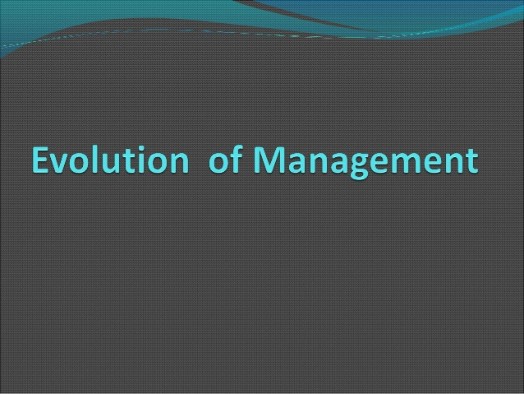

Slide 2
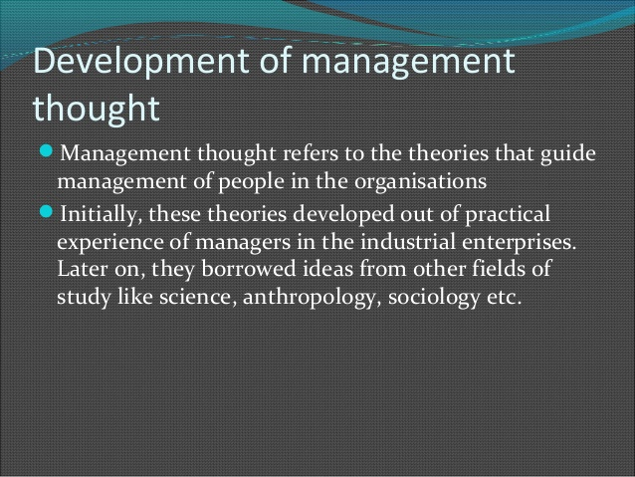

Slide 3
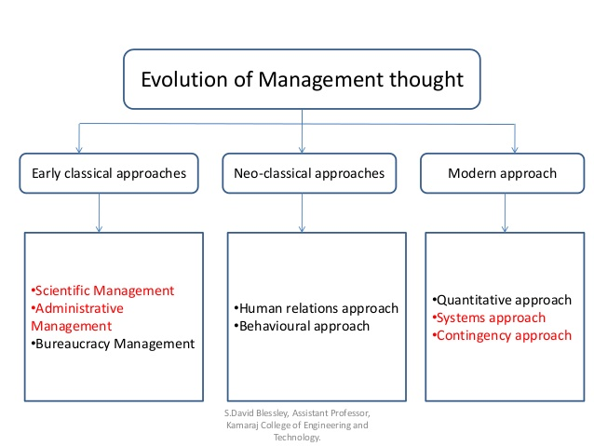

Slide 4
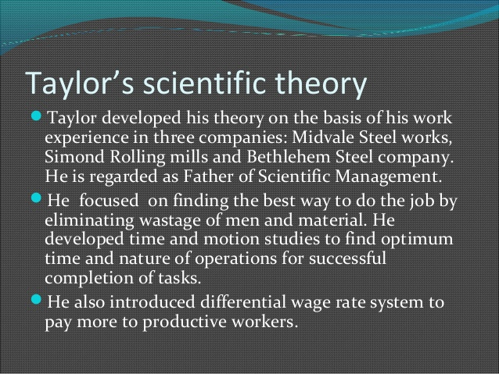

Slide 5
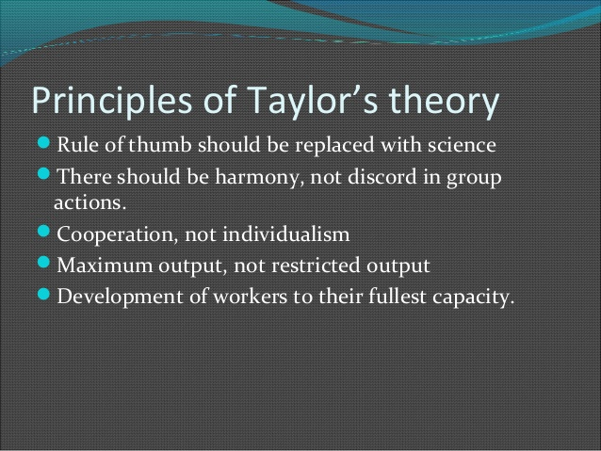

Slide 6
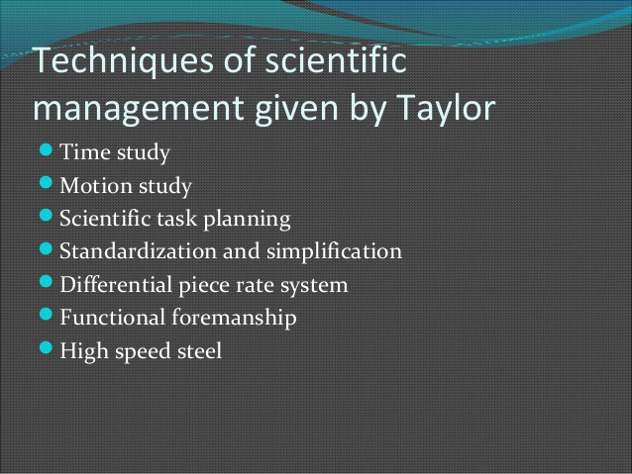

Slide 7
Administrative Management Theory by Henry Fayol
Henry Fayol- Father of Modern Management
In 1916 written book- “Industrial and General Administration”
Provided 14 Principles of Management

Slide 8
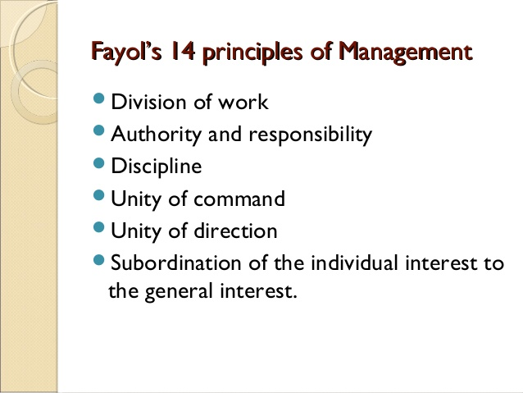

Slide 9
