Slide 1

BPEM
Dr Rakhi Bhattacharya

Slide 2
TYPES AND CLASSIFICATION OF ENTREPRENEURS
On the basis of Type of business
On the basis of technology
On the basis of ownership
Based on size of enterprise
Trading entrepreneur
Technical entrepreneur
Private entrepreneur
Small scale entrepreneur
Manufacturing entrepreneur
On-technical entrepreneur
State entrepreneur
Medium scale entrepreneur
Agricultural entrepreneur
Professional entrepreneur
Joint entrepreneur
Large scale entrepreneur
Corporate entrepreneur

Slide 3
TYPES AND CLASSIFICATION OF ENTREPRENEURS continued..
Based on gender
Based on Clarence Danhof Class
Based on motivation
Others
Male
Innovative
Pure entrepreneur
Spiritual entrepreneur
Female
Imitative
Induced entrepreneur
Social entrepreneur
Fabian
motivated
Edupreneurs
Drone
Spontaneous

Slide 4
https://www.youtube.com/watch?v=JdcQ8jh61rg
https://www.youtube.com/watch?v=W59VvNM5K7s
https://www.youtube.com/watch?v=lyHCX_zgbyw
https://www.youtube.com/watch?v=k07xq2I3_VI

Slide 5
TRADING ENTREPRENEUR
The trading entrepreneur undertake the trading activities. They procure the finished products from the manufacturers and sell these to the customers directly or through a retailer. These serve as the middlemen as wholesalers, dealers, and retailers between the manufacturers and customers.

Slide 6
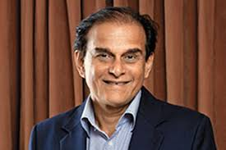

Brands like Parachute and Saffola built by Harsh Mariwala were a part of Bombay Oil Industries, out of which Marico was carved in 1990.

Slide 7
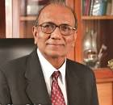

Qimat Rai Gupta, trader in electrical goods acquired Havells switchgear label in the early 70s. Since then, Gupta and the generation after him have built Havells into one of India’s largest electrical equipment marketers.

Slide 8
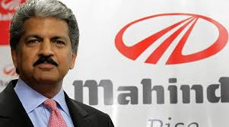
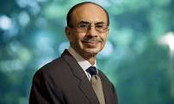
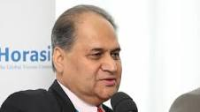
MANUFACTURING ENTREPRENEUR:
Manufacturing entrepreneurs manufacture products. They identify the needs of the customers and, then, explore the resources and technology to be used to manufacture the products to satisfy the customers’ needs.

Slide 9


AGRIPRENEUR/ AGRICULTURAL ENTREPRENEUR
Agripreneur defined as “entrepreneur whose main business is agriculture or agriculture-related” Agriculture + Entrepreneur = Agripreneur
Pramod, a former automobile engineer who switched to farming in 2006, and now gets a yearly turnover of a crore, after implementing a radically different method of cultivation.
Harish Dhandev:Another engineer, Harish left his government job to take up Aloe Vera farming in Rajasthan – which proved highly successful, earning him crores.

Slide 10
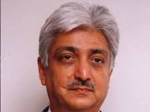
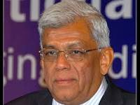
CORPORATE ENTREPRENEURSHIP
Is a set of activities to enhance a company’s ability to innovate, take a risk, and seize the opportunities that are allocated in the market. Also, Corporate entrepreneurship is targeting the new business establishment, new market allocation with further business pursuing, or both.

Slide 11
CLASSIFICATION OF ENTREPRENEUR ACCORDING TO CLARENCE DANHOFF

Slide 12
INNOVATIVE ENTREPRENEUR
They assemble and synthesis information and uses new combination of factors of production.
They sense the opportunities for introducing new ideas, new technology, new market and creating new organisations.
They are helpful for the country as they bring about a transformation in the lifestyle.

Slide 13
IMITATIVE ENTREPRENEUR
Known as adoptive entrepreneur
He simply adopts successful innovation introduced by other innovators
These entrepreneurs imitate the existing entrepreneurs and setup their enterprise in the same manner.
Instead of innovating they just imitate the technology and methods innovated by others.
These entrepreneurs are very helpful in less developed economy as they contribute significantly in the growth of enterprise and entrepreneurial culture of that country.
They generate ample employment avenues for the youth and are treated as agent of economic development.

Slide 14
FABIAN ENTREPRENEUR
They are very sceptical in their approach in adopting or innovating new technology in their business.
They are timid and cautious.
He imitates other innovation only when he is certain that failure to do so may damage his business.
They are not adaptable to changing environment.
They love to remain in the existing business with age old techniques of production.
They only adopt new technology when they see that failure is imminent.

Slide 15
DRONE ENTREPRENEURS
They are conservative and orthodox in their outlook.
They refuse to adopt change
They never like to get rid of their traditional system of business
They are laggards as they refuse to change and continue with their old ways.
They refuse to change even at a risk of reduced return.

Slide 16
ENTREPRENEURS ON THE BASIS OF MOTIVATION
Pure entrepreneurs: they are pushed to entrepreneurship due to economic gain and psychological reason.
Induced Entrepreneur take up entrepreneurship due to policy measures of the government, facilities, infrastructure, subsidy benefits etc given by the Govt at one point of time.
Motivated Entrepreneur: They are driven by the desire of self fulfilment
Spontaneous entrepreneur start business out of their natural talent.they are people with initiative, boldness confidence etc

Slide 17
On the basis of ownership
Private entrepreneur: they start enterprise of their own. They have private business.
State entrepreneur are those who take support of the state to start their new business.
Joint entrepreneurs are those who collaborate or amalgamate with others to start a business.

Slide 18


Slide 19


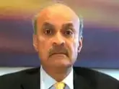

SUNDER PICHAI
SATYA NADELLA
VINDI BANGA
CHANDA KOCHAR

Slide 20
INTRAPRENEUR
GIFFORD AND ELIZABETH PINCHOT COINED THE TERM IN 1978
IN 1985 PUBLISHED THE BOOK INTRAPRENEURING BASED ON THEIR RESEARCH AND PRACTICAL APPLICATION.
DEFINITION
PURSUIT OF OPPORTUNITY FROM WITHIN THE ORGANISATION BEYOND THE RESOURCES CURRENTLY CONTROLLED- STEVENSON 2000
ACTING LIKE AN ENTRERENEUR WITHIN A LARGER ORGANISATION.- INVESTOPEDIA 2014
A PERSON WITHIN A LARGE CORPORATION WHO TAKES DIRECT PERSONAL RESPONSIBILITY FOR TURNING IDEA INTO A PROFITABLE, FINISHED PRODUCT
THROUGH
ASSERTIVE RISK TAKING
INNOVATION

Slide 21
OTHER TERMS FOR INTRAPRENEURSHIP
CORPORATE ENTREPRENEURSHIP
CORPORATE VENTURING
INTRAPRENEURING
INTERNAL CORPORATE ENTREPRENEURSHIP.

Slide 22
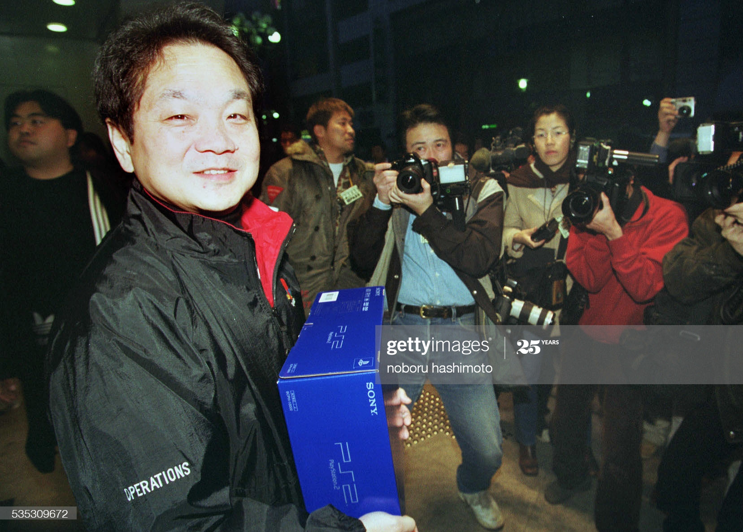
CASE STUDY
1970
Ken Kutaragi was working in the sound labs at SONY
Worked as an outside consultant for NINTENDO
Ken developed the ‘SPC7000’ for Nintendo
1980:
Ken Krtagi saw market opportunity of gaming systems for SONY.
Chairman OHGA took a major chance and backed Kuratagi’s plan
1990
Sony playstation was released in 1994. It immediately outsold Nintendo’s super NES.
Playsttion reached $7 billion sales growth in 1997

Slide 23
GM workers suggested 44,000 ideas in just one quarter and one plant saved $900K using employee suggestions
A scientist at 3M developed POST-IT notes after discovering a anew glue that was sticky, but not too sticky. It is now one of their top products.

Slide 24
Benefit of INTRAPRENEURSHIP
LEARN DIFFERENT FUNCTIONS BY WORKING LIKE A STARTUP IN A LARGE CORPORATION.
MAKE A NAME FOR THEMSELVES WITHIN A COMPANY
GAIN EXPERIENCE FOR THEIR OWN ENTREPRENEURIAL VENTURES
COMPANIES ARE NOT AS ANXIOUS AS VCs FOR A QUICK RETURN.
WORK LIKE AN ENTREPRENEUR BUT EARN A STEADY PAYCHECK.

Slide 25
CONS OF INTRAPRENEURSHIP
EMPLOYEES MAY FEEL EXTREMELY DISAPPOINTED IF THEY FAIL IN SOME IDEA.
FAILURE MAY ANNOY TOP MANAGEMENT.
THE OBJECTIVE OF TOP MANAGEMENT MAY SOMETIMES COMES IN CONFLICT WITH THAT OF INTRAPRENEUR.
INTRAPRENEUR MAY LAG BEHIND IN CLIMBING CORPORATE LADDER.
AN ORGANISATION HAS TO BET LOT OF RISK IN ORDER TO TAKEUP ENTREPRENEURSHIP

Slide 26
https://www.youtube.com/lycS9ic2YTUwatch?v=
https://unyscape.com/inspiring-examples-of-indian-intrapreneurship/

Slide 27
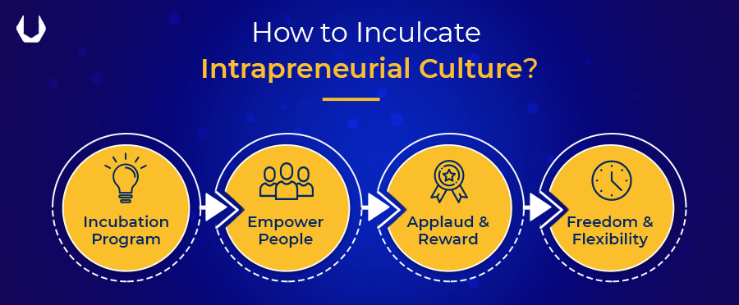

Slide 28
Freedom & Flexibility
Most organizations overload their employees so much that they hardly find enough time to think or share new ideas with management. You have to ensure that your employees have enough time to think and work around new ideas.
Empower People
Inspire them to think out-of the box and it is absolutely fine if they fail. The pressure of not to fail is enough to thwart any good idea that employee wants to share.
Recruit the Right Mindset
Hire people who are street smart and who have creative or entrepreneurial bent of mind. Create a way that motivates them to share their ideas with top management.
Incubation Centre
Create an incubation centre or an internal program to identify and motivate outstanding employees for futuristic and innovative projects of the organization. An individual from the top management should ideally be the head of such an incubation centre.
Applaud and Reward
Linking performance appraisals and reward system with innovation and creative ideas is the best way to inculcate intrapreneurial qualities among employees.
Provide Mentorship
Many great ideas do not see the light of the day due to lack of knowledge and experience of their employees. Right coaching from their superiors can help them put across their ideas clearly in front of management.

Slide 29
QUALITIES OF AN INTRAPRENEUR
INNOVATOR
VISIONARY
KNOWLEDGEABLE
FLEXIBILITY
ENCOURAGE TEAM WORK
DIPLOMATIC
OPEN TO DISCUSSUIN AND IDEA
MOTIVATOR

Slide 30
COMPARISON
INTRAPRENEUR
ENTREPRENEUR
Semi dependent on owners and promoters of the organisation.
They neither raises capital nor guarantee any returns on capital
He is from within the organisation
Doesnot bear the risk of business fully but develop and operate the business.
Lack ownership and control
Primary motive is corporate reward
Decision need to be approved.
Entry requires special qualification
He is an independent businessman.
He raises capital from various sources and guarantees ROI
He is an outsider.
Bears the entire risk of the business.
Possess ownership and control.
Rewards are independence, innovation and profit.
Make their own decision.
No entry level qualification required.

Slide 31
1. Infosys Technologies
Navin Budhiraja, head of architecture and technology at Infosys, attempted to set intrapreneurship examples within the organization. With the Zero Distance Innovation Programme, Infosys have been able to create an environment where its employees can think beyond their day-to-day jobs and bring process improvements and innovation.
2. ITC India
The idea of e-choupal, an ITC division germinated when Sivakumar a manager in the ITC Group’s agribusiness unit, approached ITC’s chairman, with a request of Rs 50 lakh to test an idea. He wanted to procure farm produce from soya farmers in Madhya Pradesh, thereby eliminating middlemen.
3. Google (Alphabet)
Google’s best products are the outcome of its 20% time policy. Google allows twenty percent of the total time that an employee spent working in the organization for personal projects. Some of its key products like Gmail, Google News, Google Adsense, Driverless Cars, Google Glasses, etc. have come into existence due to its intrapreneurial spirit. Krishna Bharat created Google News which is a highly successful product of Google
4.Bosch IERO
IERO is an artificial intelligence-based retail recommendation engine that empowers businesses working in retail, hospitality and automotive industries. This idea stemmed from Hemanth and Pawan, who were funded and supported by Bosch India. Currently, IERO has close to ten clients who want to implement AI in their retail business.

Slide 32


Slide 33
FACTS ABOUT WOMEN ENTREPRENEURSHIP IN INDIA
Of the 58.5 million entrepreneurs in India, nearly 14% are women.
Indian women-owned businesses provide employment for 13.45 million people.
About 1/3 of Indian women entreprenurs work in the agriculture sector, followed by manufacturing and retail trade.
In 2017, only 2% of startup funding went to a woman founder.
The top 10 fund raises of 2017 added up to $8.5 billion. The top 10 fund raises by a female-led startup accounted for only $136 million.
A 2015 study by McKinsey Global Institute shows India's GDP could rise by between 16-60% by 2025 if women participated equally with men in the economy. Projections show that this could mean a whopping $2.9 trillion added to the economy.
30% of India's tech workforce is female. Although, 51% of entry-level jobs in India's IT and BPM industries are women, indicating that women are leaving at junior and mid-levels.
Radhika Aggarwal of e-commerce marketplace ShopClues made history as India’s first female co-founder of a billion-dollar company.

Slide 34
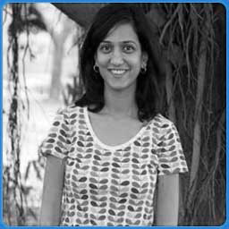
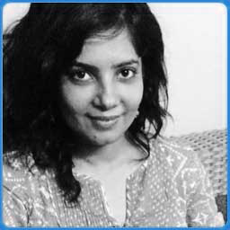
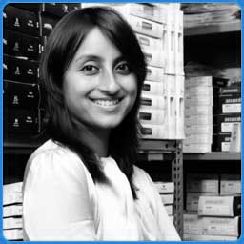
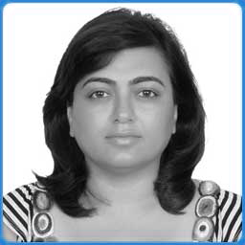
SHUBHRA CHADDA
-CHUMBAK
SHRDHA SHARMA
-YOURSTORY
RICHA KAR-ZIVAME
SABINA CHOPRA-YATRA
WOMEN ENTREPRENEURSHIP

Slide 35
DEFINITION OF WOMEN ENTREPRENEUR
‘AN ENTERPRISE OWNED AND CONTROLLED BY A WOMEN HAVING A MINIMUM FINANCIAL INTERESTOF 51%OF THE CAPITAL AND GIVING ATLEAST 51% OF THE EMPLOYMENT GENERATED BY THE ENTERPRISE TO WOMEN’– GOVERNMENT OF INDIA

Slide 36
REASONS FOR WOMEN ENTREPRENEURSHIP IN INDIA
Pull factor: daughter or wife of rich business man
Push factor: Sudden death of husband or earning member of the family;
Sudden need to earn money

Slide 37
FUNCTIONS OF WOMEN ENTREPRENEUR
Exploring the prospect of starting new enterprise.
Introduction of new innovation or bringing successful one in existence.
Undertaking risk and handling economic and non economic uncertainties.
Co-ordination of activities.
Administration
Control
Supervision
Providing leadership

Slide 38
Problems of women entrepreneur
Business related problem
Problem of finance
Marketing problem
Problem of Raw material
Problem of technology
Problem of infrastructure
Poor quality control
Low labour productivity.
Lack of professional management
Gender related problem
Problem of dual responsibility
Limited mobility.
Male dominated business community
Low risk bearing ability
Problem of managing male workers
Problem of education.

Slide 39
OVERCOMING PROBLEMS FACED BY WOMEN ENTREPRENEUR
Education
Adequate training
Marketing assistance
Making raw material available to women entrepreneur.
Institutional support for women entrepreneur
Involving women entrepreneur in decision making and policy making by govt.
SHG should be formed for self employment opportunities.
https://www.youtube.com/watch?v=S8wjCgGNuA0

Slide 40



Role of government and NGO for WOMEN ENTREPRENEUR
SIDO
NGO SIDO
Development Commission; SSI
SIDBI;
Development of Women and Child
Bank of India
State Bank of India
District Industrial Centre
State Financial Corporation
SIDC
KVIC
Women industries fund scheme run by SFC and Nationalised Bank.

Slide 41
SIDO
EDP specially for women coming from less privileged background with inadequate educational background and skill. EDP in the area of TV repairing, printed circuit board, leather goods etc
SIDO/NGO
Special award for women entrepreneur was instituted by SIDO to award ‘Outstanding Women Entrepreneur
Development Commission, SSI
Opened women cell to provide coordination and assistance to women entrepreneur facing specific problem

Slide 42
Development of Women and Child
It developed various income generating scheme for needy women
Bank Of India
‘Priyadarshini Yojana’
Here bank has appointed entrepreneur development counsellor at every zonal office to provide financial assistance
SIDBI
‘Mahila udhyam Nidhi’ it is an exclusive scheme for providing equity to women entrepreneur.
‘Mahila Vikas Nidhi’ it offer training services to women entrepreneur

Slide 43
SBI
District Industrial centre
Loans upto Rs 25,000to women entrepreneur to set up business unit. To qualify for this women has to manage the business by herself and should have 51%financial stake in the organisation
The concept of DIC was proposed in 1977 and implemented in 1979. it provide special assistance to women entrepreneur of SSI unit in respect of training, research and marketing assistance
SFC and SIDC
Women entrepreneur caan take direct finance for setting up of an enterprise

Slide 44
KVIC
They provide financial and non financial assistance to women entrepreneur to set up small business unitor cottage industries in rural and semi urban areas
Women get 15% of seed capital of the total cost. Seed Capital is subject to maximum amount of Rs 1 lakh and cost of project not to exceed 10 lakh.
Women Industries Fund scheme run by SFC and Nationalised Bank.
TREAD
(Trade Related Entrepreneurship Assistance and Development)
Economic empowerment of women through trade related training, information, counselling etc.

Slide 45
https://www.youtube.com/watch?v=FKyWINIq1Jg
https://www.youtube.com/watch?v=twpuyvezyMI

Slide 46


Slide 47
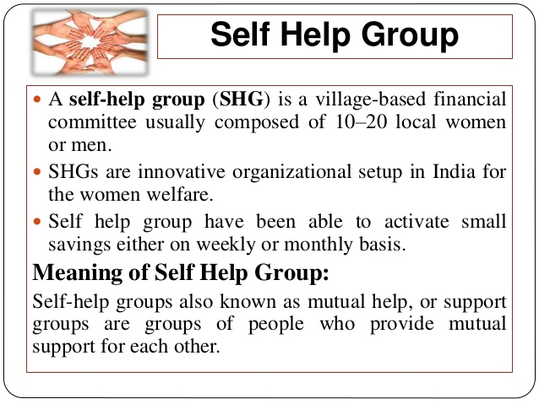
SELF HELP GROUP

Slide 48
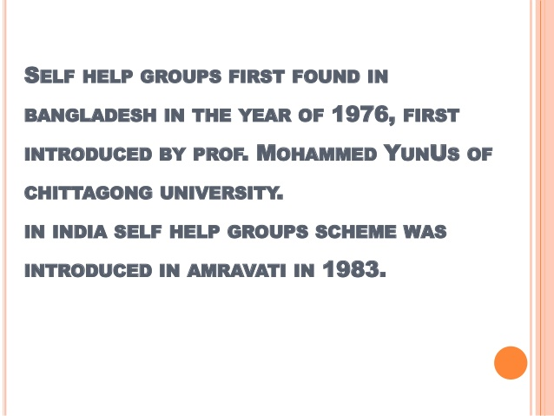

Slide 49
CHARACTERISTICS OF SELF-HELP GROUP
The ideal size of a SHG is 10 to 20 members.
The group need not be registered
The group should meet regularly.
Members have same social and financial background
The group consists of either men or of only women
Monthly meetings of members are held for solving their problems.
They create common fund by contributing their small savings on a regular basis.
Loan is given on the basis of mutual need

Slide 50
FUNCTIONS OF SELF-HELP GROUP
SHG s provide saving mechanism
Meet their emergency need.
Meet the credit need of the poor.
Enhancing the social status of members.
Facilitate members to become independent.
Solve conflicts through group guidance and mutual discussion
Developing and encouraging the decision making capacity of members
Build mutual trust and confidence between bankers and rural poor.
Providing forum for members for discussing their social and economic problem.
Providing literacy including financial literacy and increasing general awareness among members,

Slide 51
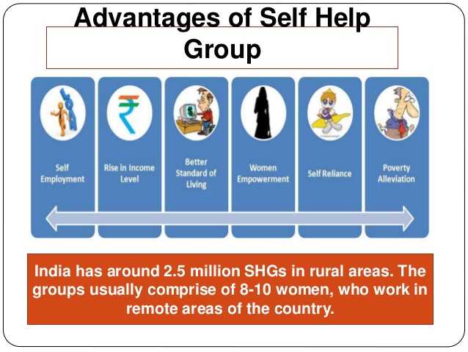

Slide 52
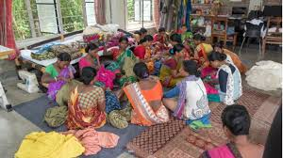
DEVELOPMENT OF WOMEN ENTREPRENEURSHIP WITH THE HELP OF SHG
Women empowerment.
Employment generation
Savings and Investment.
Financial inclusion
Better socio economic status.
Increased standard of living.
Poverty alleviation
SHG provides training.
Accounting skills to women entrepreneur.
Decision making skill.
Marketing skill.

Slide 53
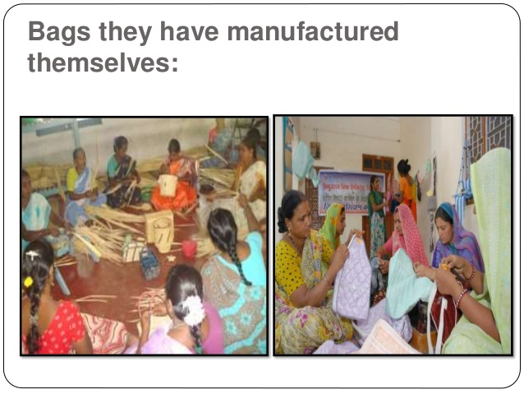

Slide 54
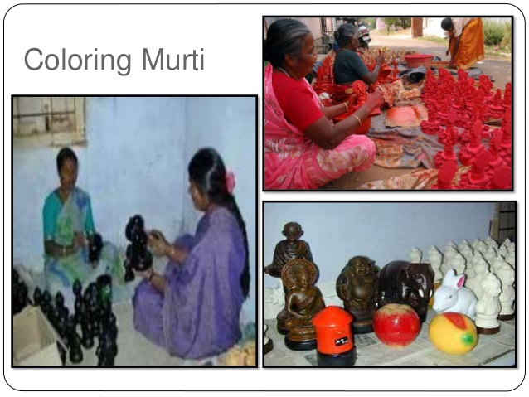

Slide 55
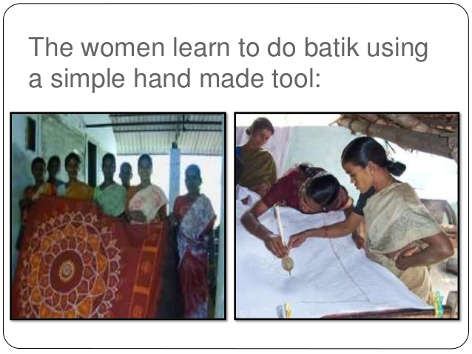

Slide 56
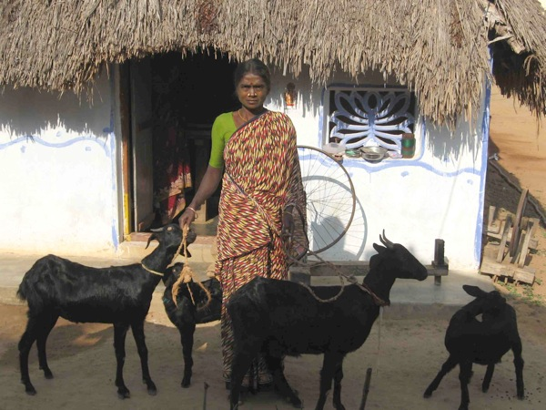
Case stories of self-help group members
Kolanchiammal Before Kolanchiammal got involved with a self-help group, her family suffered a lot from money lenders and it was very difficult for her to maintain her family. She came to know about the importance of Self Help Groups and made herself a member in the Vanavil Self-help Group which is being looked after by READ. After getting a loan from READ, she bought four goats and takes care of them well. Now she is having a habit of saving the amount for future use. Thus the total family benefited from this. One of the goats has yielded two offspring.

Slide 57
Sumathy
Sumathy (35 years old) belongs to a very poor family, and for a living she does agricultural day labor. But this work is not continuous and depends on the season. The amount earned by her and her husband was barely enough to cover their basic needs, and there was never any amount for them to save.
Previously she was ignorant about the importance and benefits of self-help groups. But through regular visits of the READ staff and the awareness given by them, she became convinced to join in the Bairavi self help group. Through the monthly meetings, she learned more how the self-help group functions and also the importance of savings.
Early 2009, Sumathy received recently a loan amount of Rs. 5000 from READ. With that amount she bought four goats and raised them well.
Later in 2009, she sold her four goats in the market and from that amount, she bought a cow which gives 7 liters of milk per day (Morning – 4 liter, Evening – 3 liter). She sells the milk to her neighbors and the rest to the milk society. Oher than this she goes for daily labor work in agriculture. She is satisfied with her income. The cow is also going to yield a calf within four months. she is taking care of the cow in a good manner. She makes the cow to graze in the field whenever she goes for her agriculture work.

Slide 58
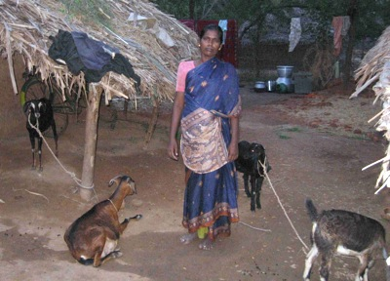
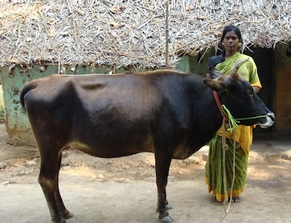

Slide 59
SHG Name | Village | Activity
Roja | Manapathur | Soap- making
Sivasakthi | Andimadam | Soap- making
Suthanthiram | Thavasukuzhi | Cashew –nut processing
Senbakam | Koovathur | Candle making
Arokia Annai | Netalakurchi | Covering chain making
Mangaiyarkarasi | Nallampalayam | Weaving

Slide 60


Slide 61
Social entrepreneurship
It refers to the practice of combining innovation, resourcefulness and opportunity to address critical social and environmental challenges.
Traits of social entrepreneur:
Creativity
Entrepreneurial quality
Social impact of the idea.
trustworthy
https://www.youtube.com/watch?v=aTo0qtdVMpM

Slide 62
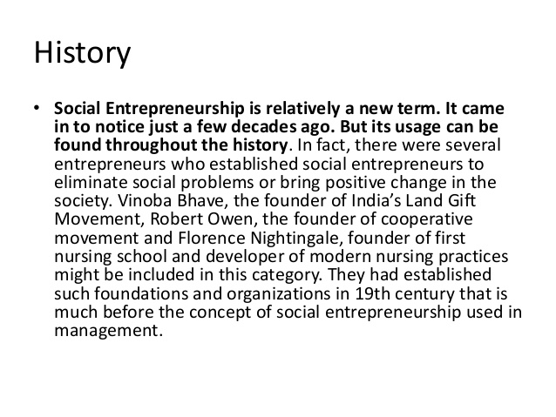

Slide 63
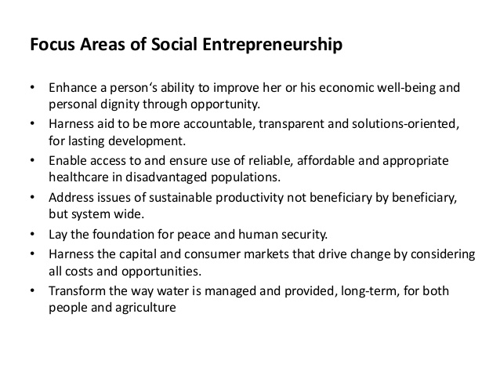

Slide 64
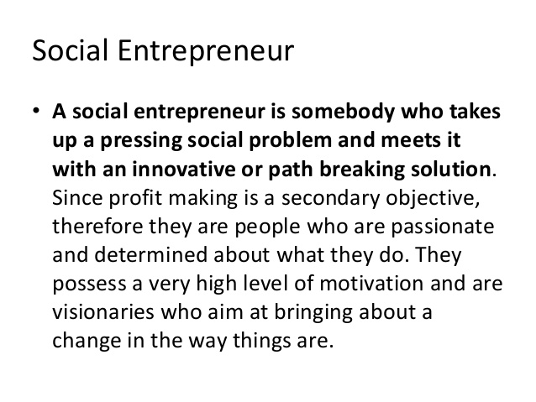
https://www.youtube.com/watch?v=1ecKK3S8DOE

Slide 65
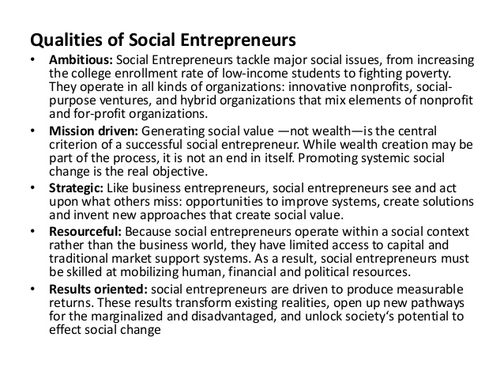

Slide 66
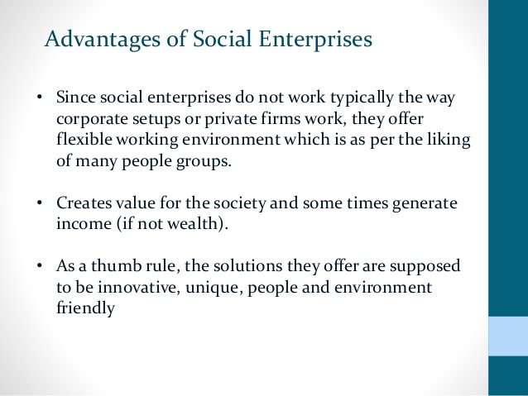

Slide 67
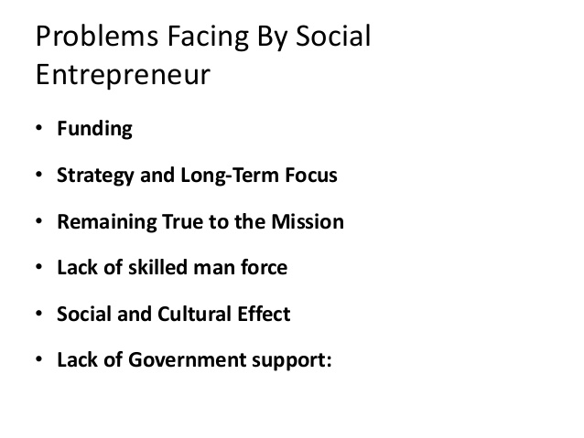

Slide 68
FUNCTIONS OF SOCIAL ENTREPRENEUR
Bringing transformational change in the society.
Addressing the problems of marginalised disadvantaged and dis enfranchised people.
Supporting people who lack financial means and political support.
Playing the role of change agent

Slide 69
IMPORTANCE OF SOCIAL ENTREPRENEURSHIP
Social development
Effect on economic growth
Generate employment
Regional development
Social order
Equitable society
Improve standard of living
Promote merit goods

Slide 70
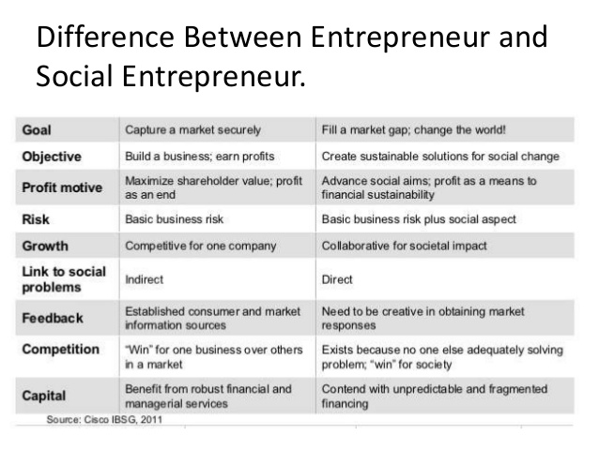

Slide 71
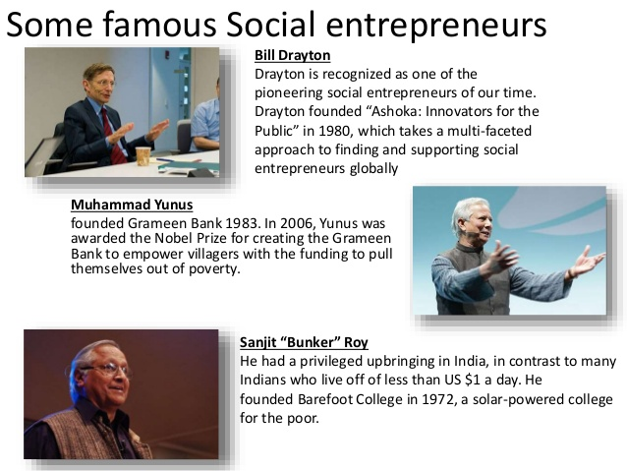

Slide 72
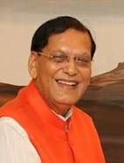
Case studies
Sulabh International (Sulabh), a not-for profit social organization, was founded by social entrepreneur Bindeshwar Pathak (Pathak) with the aim of finding a solution to the sanitation problem and emancipating human scavengers who had the inhuman task of cleaning bucket toilets in the villages of India and carrying night soil on their heads for disposal. Fired by a desire to liberate scavengers from the inhuman task of scavenging, Pathak started Sulabh in 1970 to deal with two pressing challenges in India – poor hygiene and discrimination. After much research, he designed the two pit pour-flush compost toilet known as Sulabh Shauchalaya (meaning Latrines made Easy) as a replacement for bucket toilets used across most of the villages in India. The ecological compost toilets not only provided low-cost environmentally-friendly toilets to millions of people in India but also ensured freedom to scavengers from manual scavenging.

Slide 73
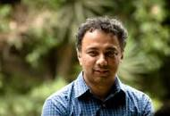
SELCO CASE STUDY
Harish Hande established SELCO in 1995 as a solar energy company focused on meeting the needs of poor households lacking adequate access to electricity. Hande believed that solar energy’s decentralized method of providing electricity could play a role in bridging India’s economic divide and overcoming the country’s notoriously flawed electrical grid.
As SELCO began operations, Hande realized that solar solutions had to be customized to the particular requirements of each client group. Rural householders required different technical and financial arrangements than did urban street hawkers or midwives or schools. The company became noted for creating innovative solutions to bring solar energy to market segments that others considered impractical. Because of the intense design process, SELCO’s growth was slow, but steady. By the end of its first decade of operation, SELCO had reached more than half a million people by electrifying some 80,000 households, micro-enterprises and community facilities, making it one of the largest photovoltaic (PV) providers in the world. In 2001, SELCO broke even for the first time and managed to earn small levels of profit for a number of years afterwards, peaking at a profit of $88,380 in fiscal 2005.

Slide 74

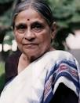
CASE STUDY OF SEWA
In 1971, a few women handcart pullers approached Ela Bhatt (Bhatt), head of the Women's wing of the Textile Labor Association (TLA), in Ahmedabad, India, with problems like low and erratic wages, poor working conditions, etc. Bhatt was aware that most of the women did petty jobs, working as garment makers, vegetable vendors, handcart pullers, milkmaids, hawkers, etc., to supplement their family income. About 97% of the women lived in slums and 93% were illiterate. Bhatt soon realized that women employed in the informal⁸ sector were unorganized, unprotected, economically weak and had no bargaining power...
n 1972, the garment workers formed their own co-operative. They were the first group to be organized under SEWA. By 1977, six other groups - used garment dealers, handcart pullers, vegetable vendors, junk-smiths, milk producers and miscellaneous workers - formed their own cooperatives.

Slide 75
NGO
They are defined as social, cultural, legal and environmental advocacy groups having goals that are primarily non commercial. They are usually non profit organisation that gain a portion of their funding from private sources.

Slide 76
CHARACTERISTICS OF NGO
It is registered under an appropriate Act
It is a voluntary association of people
They are well aware of the need and problems of people at grassroot level
NGO raise funds through self financing, donations
Such organisation functions on service and charity basis
NGO may be sponsored by the govt to implement certain social welfare project on behalf of central and state govt
Non political in nature
https://www.shethepeople.tv/drafts/10-ngos-working-womens-empowerment-know/

Slide 77
SOCIAL RESPONSIBILITY OF NGO
EDUCATION AND TRAINING
CHILD WELFARE
YOUTH DEVELOPMENT
PHYSICALLY HANDICAPPED
RURAL DEVELOPMENT
ENVIRONMENT PROTECTION
CREATE AWARENESS
CONSUMER PROTECTION

Slide 78
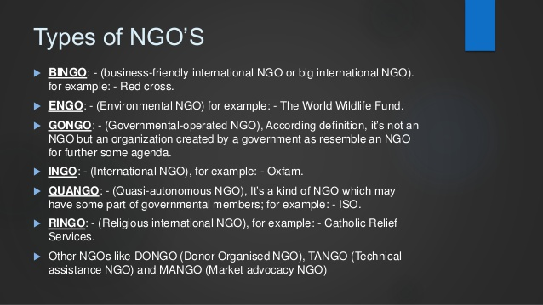

Slide 79
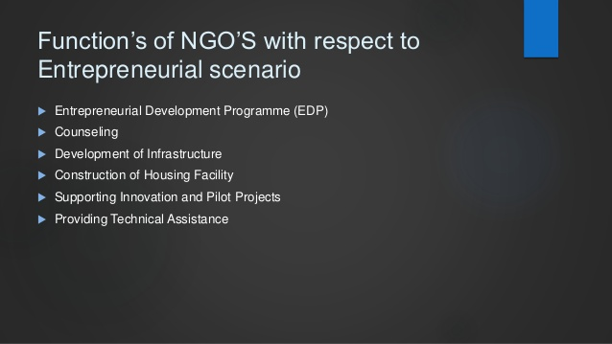

Slide 80
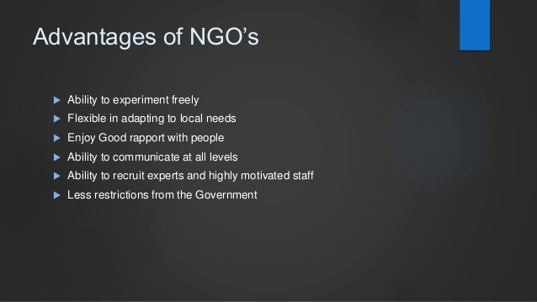

Slide 81
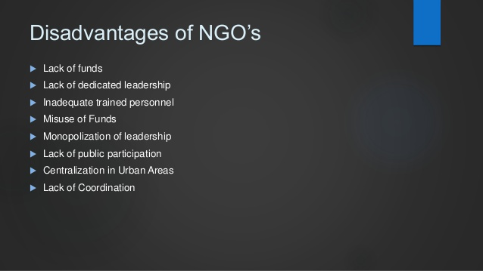

Slide 82
Who coined the term Intrapreneur and in which year?
Define an entrepreneur. Give example of an entrepreneur.
_______________ is the other name for intrapreneurship.
Intrapreneur works as entrepreneur with the security of ______________.
Intrapreneur lags behind in climbing ______________.
____________,_________ and _____________ facilitate entrepreneurship in the organisation.
Make a comparative analysis between intrapreneur and entrepreneur.
Capital investment required for women entrepreneurship is ____________.
State some business related problem of women entrepreneur.
State some gender related problem faced by women entrepreneur.
Priyadarshini yojana is promoted by which bank?
_____________ bank started with Mahila Vikas Nidhi and Mahila Udhyam nidhi.
Initial capital required to give shape to the business plan is known as _________________.
Name the famous personality associated with the SHG?
SHG helps in ________________ and ________________.
Entrepreneurs who bring innovative solution to social problems are known as ______________
entrepreneur.
17) ______________ is one of the important quality of a social entrepreneur.
18) Point of difference between entrepreneur and social entrepreneur.

Slide 83
ENTREPRENEURSHIP DEVELOPMENT PROGRAM

Slide 84
It is defined as a programme designed to help an individual in strengthening their entrepreneurial motive and acquiring skills and capabilities necessary for playing the role of entrepreneurship effectively.

Slide 85
NEED AND IMPORTANCE OF ENTREPRENEURSHIP
To develop entrepreneurial culture in a country
To utilise untapped productive and natural resources
It gives alternative to employment
It improves standard of living in the society
Increase NI, reduce income inequalities and decentralise economic power
Bring social peace by reducing crime
Help candidate with enterprise launching; product selection and overall mgmt
Inform about govt scheme and support activitties
It inculcate achievement motivation among employees
It help individuals to scan through environment and look for business opportunities.

Slide 86
OBJECTIVES OF EDP
To analyse entrepreneurial opportunities relating to small industry and small business.
To develop managerial skill (communication skill, leadership skill, conceptual skill, administrative skill).
To generate decision making skill.
To develop discipline among individuals.
To familiarise with financial planning, market situation, legal formalities.
to teach people to be innovative.
To instil ethical values.
To understand the process and procedure of setting up of small enterprise
To know the support needed for launching an enterprise

Slide 87
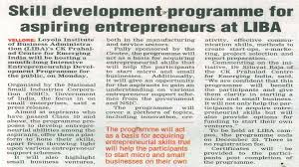

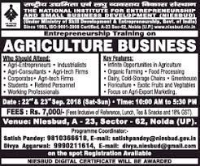


Slide 88
Phases of PR
PRE- TRAINING PHASE
TRAINING PHASE
POST TRAINING PHASE

Slide 89
THINGS TO DO IN PRE TRAINING PHASE
DESIGNING COURSE CURRICULAM AND CONTENT
EXPLORING AND SELECTING APPROPRITA FACULTY AND RESOURCE PERSON
INSERT ADVERTISEMENT
SCREENING AND SELECTION OF POTENTIAL ENTREPRENEURS.

Slide 90
TRAINING PHASE
MEASURE AND MONITOR BEHAVIOURAL CHANGES THAT ARE BROUGHT THROUGH TRAINING PROGRAM
RAISING THE MOTIVATION LEVEL OF ENTREPRENEUR.
DEVELOPING GOAL DIRECTED BEHAVIOUR PATTERN.
RAISING POSITIVE THINKING AND BELIEF.
RAISING INNOVATIVE ATTITUDE
DEVELOPING SELF CONFIDENE
DEVELOPING PSYCHE OF RISK TAKER.
DEVELOPING STRONG SENCE OF PERSEVERENCE AND COMMITMENT

Slide 91
POST-TRAINING PHASE
REVIEW THE PRE TRAINING WORK
REVIEW THE PROCESS OF TRAINING PROGRAM
REVIEW PAST TRAINING APPROACH

Slide 92
CONTENT AND CURRICULUM OF EDP`
General introduction to entrepreneurship.
Motivation training
Fundamentals of project feasibility study.
Organising plant visit
Acquaint with legal formalities
Developing business idea
Communication skill
Human skill
Conceptual skill
Leadership skill
Train to think innovatively
https://www.udyami.org.in/help-desk

Slide 93
Follow up
Objective of EDP
Proper communication
stakeholders
ESSENTIALS OF EDP
Method of EDP
Infrastructure facilities
Selection of trainees
Course curriculum of EDP
Selection of Trainers/ Faculty
https://www.nqr.gov.in/sites/default/files/Annexure%20III%20Curriculum_1.pdf

Slide 94
CHALLENGES OF EDP
Trainers lack required motivation.
ED organisation lack in commitment and sincerity in conducting the EDPs. Many a times EDPs are considered to generate income for ED organisation
Non conducive training environment.
Selection of wrong trainees with least interest in entrepreneurship.
Lack of support from banking and financial agencies.

Slide 95
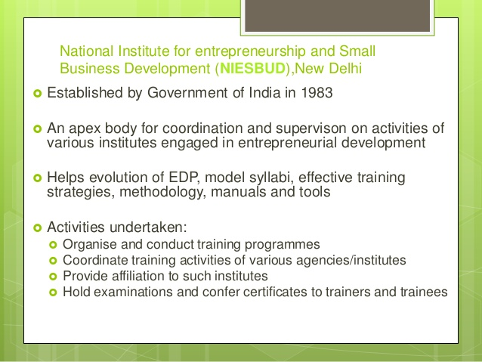

Slide 96
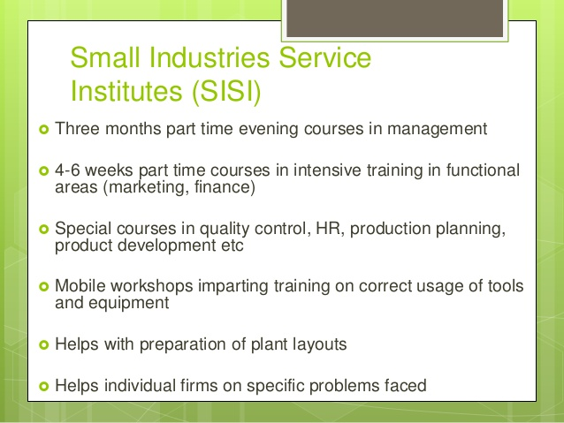

Slide 97
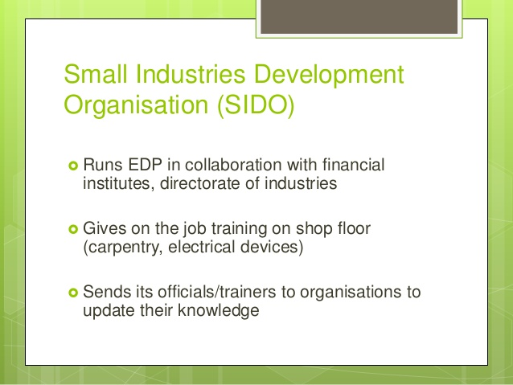

Slide 98
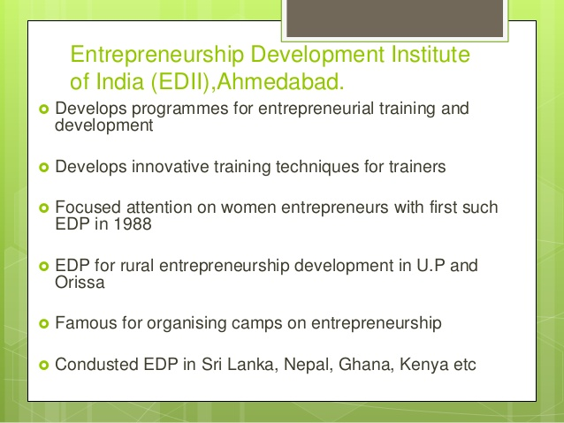

Slide 99
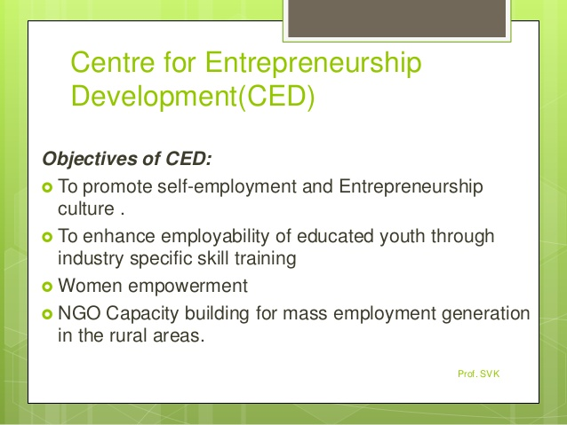

Slide 100
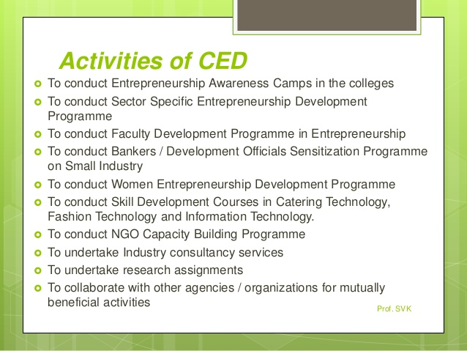

Slide 101
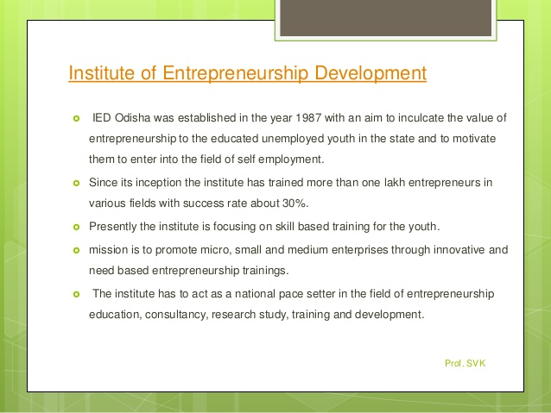

Slide 102
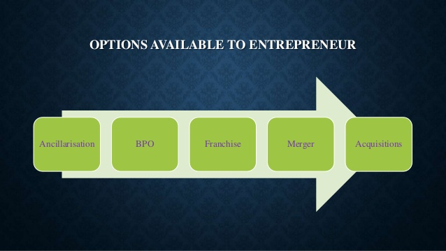

Slide 103
ANCILLARY INDUSTRY
An ancillary unit is defined as an Industrial undertakings having investment in fixed assets, in plant & machinery whether held on ownership or on hire purchase not exceeding Rs. 100 crore & engaged in ;
manufacturer of parts & components, sub-assemblies, tooling or intermediates &
rendering of service or proposing to supply or render not less than 50 % of his production or service to one or more other industrial undertaking for production.

Slide 104
Major benefits of ancillarisation drive to a country is that :
Growth of employment
Growth of GDP
Growth of entrepreneurship
Regional Development
Revenue to the government

Slide 105
Advantages of Ancillarisation
Minimise investments of setting up of large units as the required production can be sourced at a lower rate with same quality through subcontracting from an ancillary unit.
Ancillary units JIT( just in time) concept helps the large co.s to bring down the inventory level and saves a lot of money.
Sourcing is economical from ancillary units that are normally located near to the co.
Ancillary units work with the parent co.s in the process & product development

Slide 106
Dis advantages of Ancillarisation
Delay in payments puts ancillary co.s in big trouble. If the parent co. is big then the ancillary co. finds it diffucult to take any legal action also.
When parent co.s revise the specification, ancillary units are some times not given the expected support for adopting the higher technology. They are not given sufficient time to bring changes in the technology to match with that of parent co.
Multiplication of suppliers makes the ancillary units operate below BEP(Breakeven point) as a result these units incur losses because of capacity un-utilisation.

Slide 107
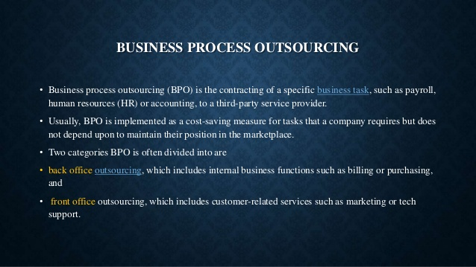

Slide 108


Slide 109


Slide 110


Slide 111


Slide 112


Slide 113


Slide 114


Slide 115


Slide 116


