Slide 1
Let’s Revise Previous lecture ....
Contribution Called as Scientific management theory of classical Management Theory of F.W. Taylor
Science not thump of rule
Scientific selection and training
Separation of planning and execution
Functional Foremanship
Maximum Output
Differential Piece Wage Rate
Mental Revolution
Time Study
Motion study and Fatigue study

Slide 2
PRINCIPLES
OF
MANAGEMENT
(Administrative Management)

Slide 3
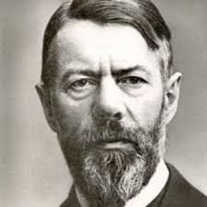
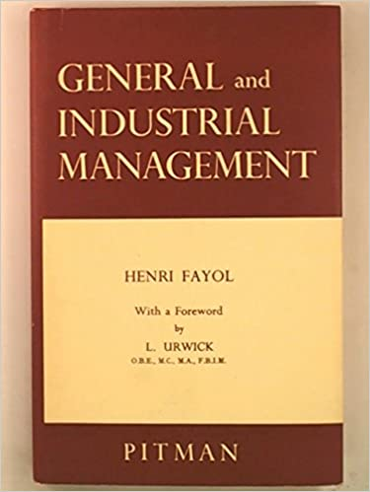
HENRI FAYOL
Henry Fayol was a French Industrialist
Written 14 Principles of Management in French language in 1916.
Published in English in 1949
Published book ‘General and Industrial Management .
Concentrated on Top Management

Slide 4
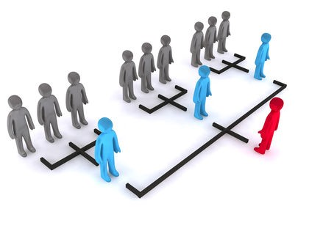
1. DIVISION OF WORK
Dividing full work into individuals and departments
As per capacities, skills and interests.
It leads to specialisation
Avoids waste of time
Increases output and profits

Slide 5
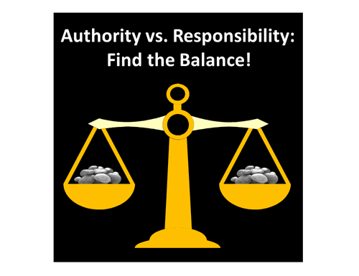
2. Authority and responsibility
Authority means power to take decisions
Responsibilities means obligations for accepting authority
Balance between authority and responsibility
If authority more misuse by manager
If responsibility more manager feels frustrated

Slide 6

3. Discipline
Following rules and regulations
Application and Dedication
Flow from top level to lower level
Clear and fair policies

Slide 7
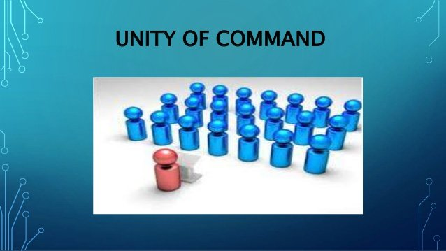
4. Unity of Command
Receive order from one superior
To avoid confusion

Slide 8

5. Unity of Direction
Same directions to all employees doing similar job
One head for one plan
One plan of action for a group of activities

Slide 9

6. Subordination of interest
Interest of the organisation is above individual interest
Avoid self interest

Slide 10
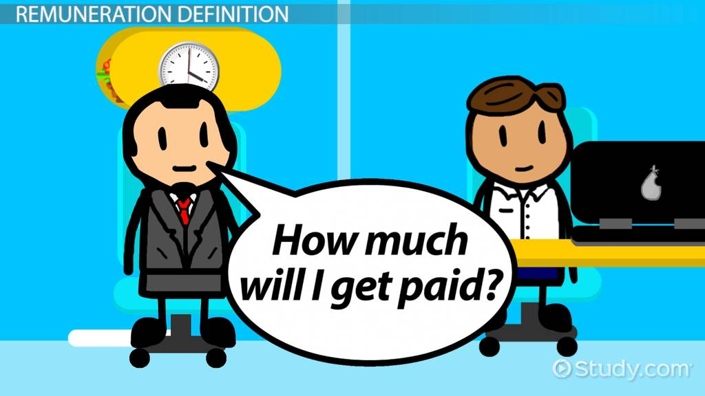

7.Remuneration
Wages and salaries should be fair
Paid on time
Consider many factors – cost of living, skills of employees, responsibilities etc.

Slide 11
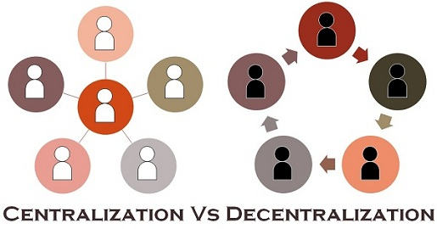
8. Centralisation
Concentration of decision power at top level
Proper balance between centralisation and decentralisation

Slide 12
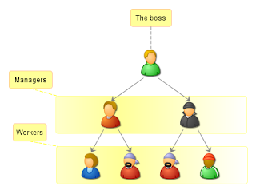
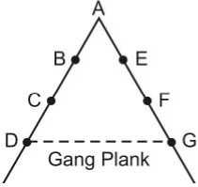
9. Scalar chain
Formal line of authority or line command
Moves from top level to lower level
Can be broken in emergency
Called Gang Plank

Slide 13

10. order
There should be place for everything and everything should be in its place
Placement of men, material and other resources
Personnel selected scientifically

Slide 14

11. equity
Means fairness, kindness and social justice
Not equality
All employees treated equally
No partiality in policies

Slide 15
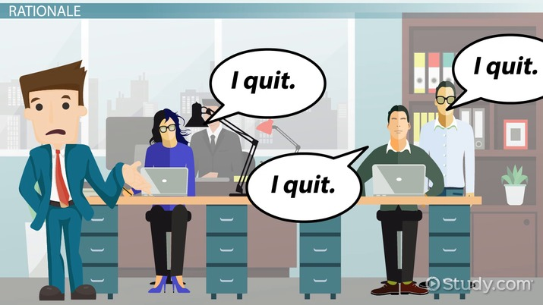
12. Stability of tenure
Means job security
Employees should not keep temporary
It will waste training time

Slide 16

13. initiative
It means taking first step
Give freedom to come up with suggestions and ideas
Take decisions after getting suggestions from subordinates

Slide 17

14. Esprit de corps
Means union is strength or team spirit
Put together as team to achieve organisation objectives
Build sense of togetherness

Slide 18
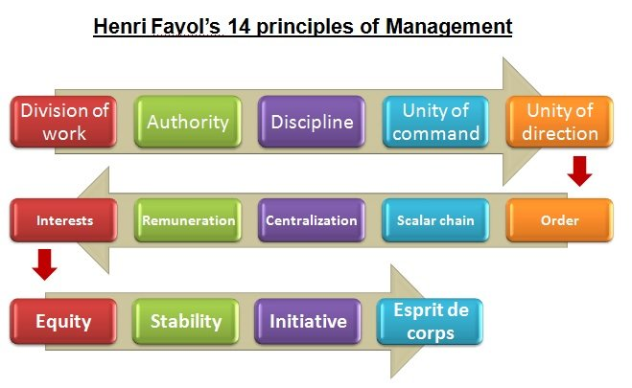
Summary.....

Slide 19


