Slide 1
Hypodermic Needle Theory
Also Called as
Magic Bullet Theory

Slide 2

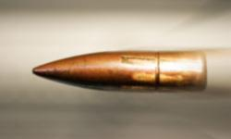
Magic Bullet Theory
The media (Magic Gun) fires the message (Magic Bullet) directly into audience head without their own knowledge.
Hypodermic Needle Theory
The media (needle) injects the message into audience mind and it cause changes in audience behavior and psyche towards the message.
Audience are passive and they can’t resist the media message.
Message

Slide 3
Magic Bullet theory or the hypodermic needle theory came out in the 1920s.
The theory suggests that audiences are passive receivers of the information from the media and are immediately influenced by the media messages.
The audience is like a Sponge, they will absorb whatever they are exposed to. Examples- Advertisements and Violent Video Games
This theory tries to explain a relationship between Propaganda and people consuming it

Slide 4
The most famous incident
In 1938, Orson Welles and his friends at the Mercury Theater created a radio drama on the day before Halloween.
Based on H. G. Wells’ War of the Worlds, the drama was broadcast as if it were a live news report at the scenes of alien invasions.
Reporters, screams, and noise were very realistic enough to make the audience believe that this was an actual event. Millions of listeners were panicked.

Slide 5
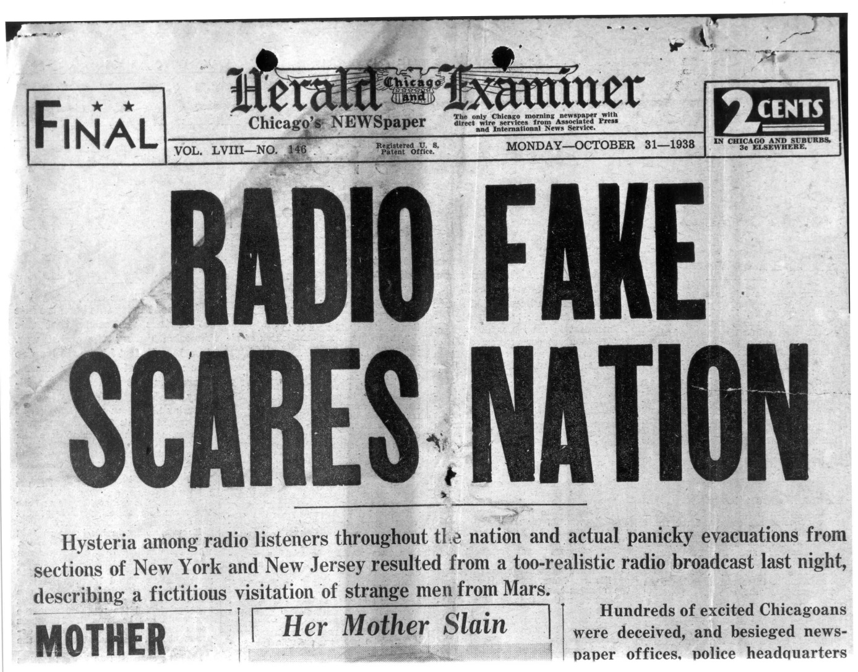
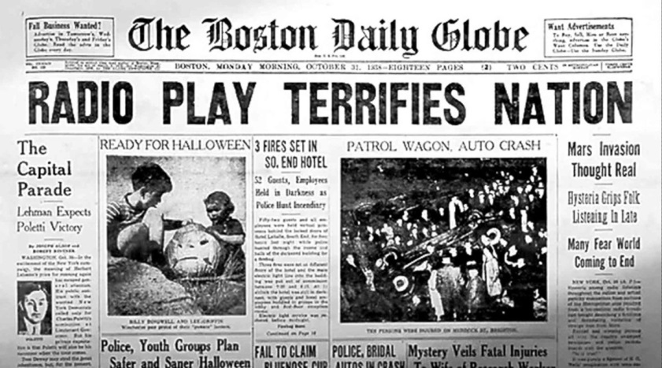
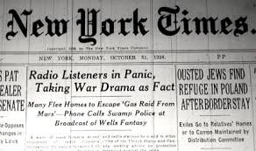
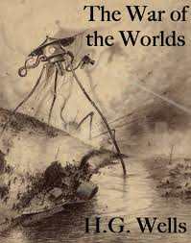
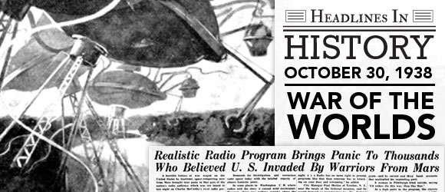

Slide 6
Mass media were thought to stick messages into people much as a hypodermic needle squirts drugs into a body.
Thus, producers of media texts were thought to inject representations and images into viewers (who had no choice but to accept them).
These ‘stimuli’ were expected directly to influence individuals’ behavior, opinions, attitudes or mind-set.

Slide 7
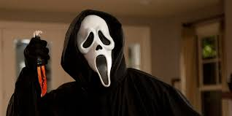
Examples
Scream Attackers Given 6 Years
Two schoolboys who brutally stabbed a 13-year-old friend and left him for dead after watching the horror film Scream have each been ordered to be detained for six years. Daniel Gill, 14, and Robert Fuller, 15, both of Harrogate, North Yorkshire, were found guilty of the attempted murder of Ashley Murray in August but were sentenced at Hull Crown Court in Friday.

Slide 8
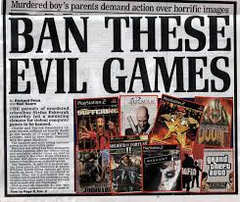
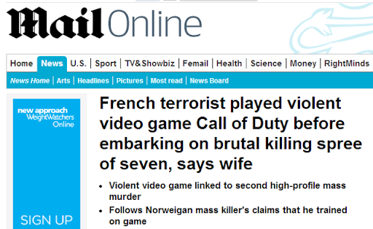

Slide 9
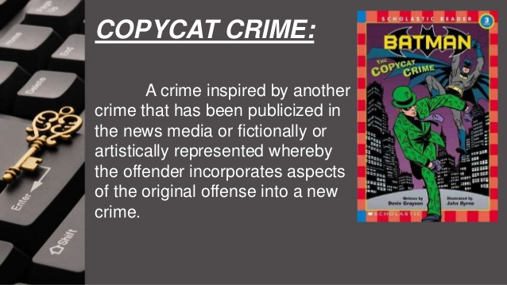

Slide 10
Scream: A 24-year-old young man, Thierry Jaradin, stabbed a young girl, Alisson Cambier, 30 times; similar to the way the victim was stabbed in the movie. He had been wearing the Ghostface costume, and later confessed that he had planned the murder in a similar way to the movie.
Fight Club: There have been many incidents inspired by the movie. One of the incidents occurred in 2009 during the Memorial Day weekend in New York City. Bombs were set off in various locations supposedly representing their oppression. Kyle Shaw was found guilty, and was himself a member of the local fight club.
Saw: In Salt Lake City two teenage boys were turned in after they had been overheard that they were planning on kidnapping, torturing and murdering people. The boys had been planning on teaching a few people, who had been harming others, a lesson. They had also set up cameras around so they could record their killings. In Tennessee, two girls were charged with phone harassment after they had left a 52-year-old woman a voicemail (similar to the ones in the movie) stating that they had her friend and were about to release a toxic gas. The voicemail stated that the woman could either risk her life to save her friend, or let her friend die.
The Dark Knight has inspired many copycat crimes. In 2012, a mass shooting in a movie theatre filled with Batmanfans occurred, wherein the perpetrator, when arrested, claimed he was 'the Joker'. In 2010, a Wisconsin man assaulted his cousin and girlfriend, dressed as the Joker, when he found them sleeping together. In 2009, a young girl attacked her teacher with a razor blade. Her face had been painted in a similar way to the Joker.

Slide 11
TWO–STEP-FLOW THEORY
THEORIST- PAUL LAZARASFELD &
ELIHU KATZ

Slide 12

The two-step flow model was formulated in 1948 by Paul Lazarsfeld, Bernard Berelson, and Hazel Gaudet in the book The People’s Choice, after research into voters’ decision-making processes during the 1940 U.S. presidential election.

Slide 13
The Two Steps
Media
Opinion Leader
Opinion Followers
Step I
Step 2

Slide 14
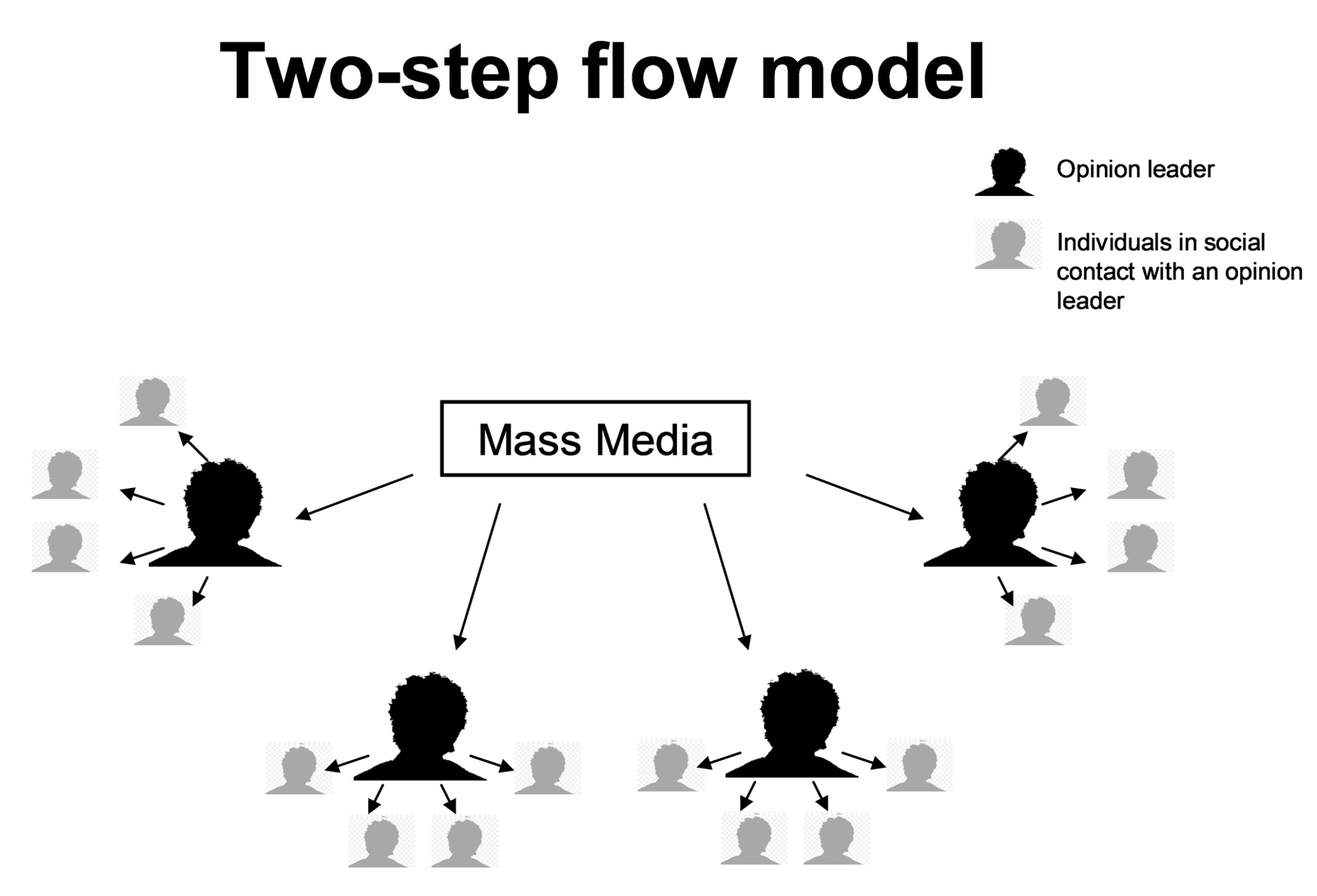

Slide 15
We’re more likely to be influenced by other people than the mass media. Lazarsfeld called these people ‘opinion leaders’.
Opinion leaders pay close attention to the media and its message. They are influential among their peer group as they are usually more informed then their friends or family.

Slide 16
Who are they????
Opinion Leaders- people who are active media users and who collect, interpret, and diffuse the meaning of media messages
Opinion Followers- less-active media consumers

Slide 17
Example
Mrs. Sharma watching Discovery Channel -“ Some kinds of toys are responsible for the children’s aggressive and Violent behavior”. That day Mrs. Sharma calls her all the friends and warns them about such toys (it stops mental growth…blah blah blah) and Mrs. Sharma warn her son some toys are not good and made skin allergy which leads her son to avoid those toys.
Opinion leader: Mom
Audience: Her Son/ Her Friends
Added information in actual content: Skin Allergy/Mental Growth

Slide 18
More examples of opinion leaders
Politicians
Business leaders
Community leaders
Journalists
Educators
Experts
Sports stars
A friend/Co-worker/Boss/ It could be anyone

Slide 19
Comparison with Hypodermic needle/Magic Bullet Theory
Hypodermic needle/Magic Bullet Theory | Two- Step Flow Theory
Audiences are Passive | Audiences are Active
Direct- One Step | Two Step
Extra information is not added | Extra information may be added

Slide 20
Applications
Advertisers realized that word of mouth and recommendations are a powerful way to sell products.
we’re more likely to buy a product if it’s been recommended by a friend or someone that we trust.
Twitter…and other social media followers
Examples- Sonam Wangchuk, Major Gaurav Arya

Slide 21
References
MASS COMMUNICATION THEORY- Foundations, Ferment, and Future- SEVENTH EDITION- by Stanley J. Baran and Dennis K. Published by Ceneage Learning
Encyclopedia of Communication Theory- by Stephen W. Littlejohn Karen A. Foss- Sage Publication
https://www.communicationtheory.org/magic-bullet-or-hypodermic-needle-theory-of-communication/
https://in.bookmyshow.com/entertainment/movies/hindi/10-films-inspired-people-commit-crimes-real-life/
Tufekci, Zeynep (2012-12-19). "The Media Needs to Stop Inspiring Copycat Murders. Here's How". The Atlantic. Retrieved August 10, 2014.

