Slide 1
UNIT- 1
PRODUCTION POSSIBILITY CURVE
THAKUR COLLEGE OF SCIENCE AND COMMERCE
POWER POINT REPRENSENTATION BY
RUKHSANA H. SHAIKH

Slide 2
production possibilities
frontier
a graph that shows the
combinations of output
that the economy can
possibly produce given
the available factors
of production and the
available production
technology
PRODUCTION POSSIBLITY CURVE
TRANSFORMATIONAL CURVE
BY
SAMUELSON

Slide 3
The production possibilities frontier is a graph that
shows the various combinations of output—in this case, cars and computers—
that the economy can possibly produce given the available factors of pro
duction and the available production technology that firms use to turn these
factors into output.
An outcome is said to be efficient if the economy is getting all it can from the
scarce resources it has available. Points on (rather than inside) the production
possibilities frontier represent efficient levels of production.
The production possibilities frontier shows one trade-off that society
faces. Once we have reached an efficient point on the frontier, the only way of
producing more of one good is to produce less of the other.
The production possibilities frontier shows the opportunity cost of one
good as measured in terms of the other good

Slide 4
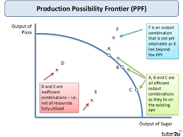

Slide 5
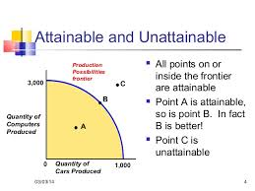
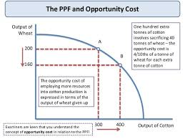
PPC illustrate the trade off facing an economy producing two goods.
PPF line shows all the possible combination of the two goods using all the available resources.
Since , we are using all the available resources, increasing production of one of the goods means decreasing the production of the other goods.

Slide 6
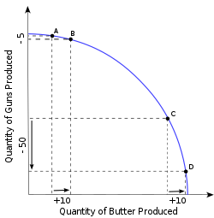
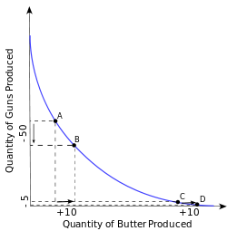
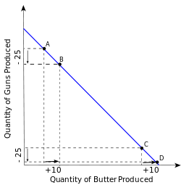
Marginal rate of transformation
The slope of the production–possibility frontier (PPF) at any given point is called the marginal rate of transformation (MRT). The slope defines the rate at which production of one good can be redirected (by reallocation of productive resources) into production of the other. It is also called the (marginal) "opportunity cost" of a commodity, that is, it is the opportunity cost of X in terms of Y at the margin. It measures how much of good Y is given up for one more unit of good X or vice versa. The shape of a PPF is commonly drawn as concave to the origin to represent increasing opportunity cost with increased output of a good. Thus, MRT increases in absolute size as one moves from the top left of the PPF to the bottom right of the PPF.[

Slide 7
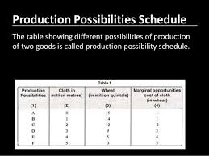
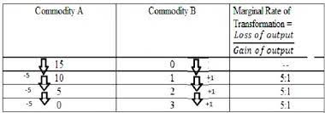

Slide 8
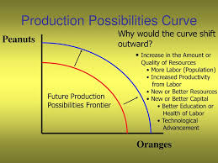
Shifts in PPC
Notes:
PPC illustrate the trade off facing an economy producing two goods.
PPF line shows all the possible combination of the two goods using all the available resoures.
Since , we are using all the available resources, increasing production of one of the goods means decreasing the production of the other goods.

