Slide 1


Slide 2
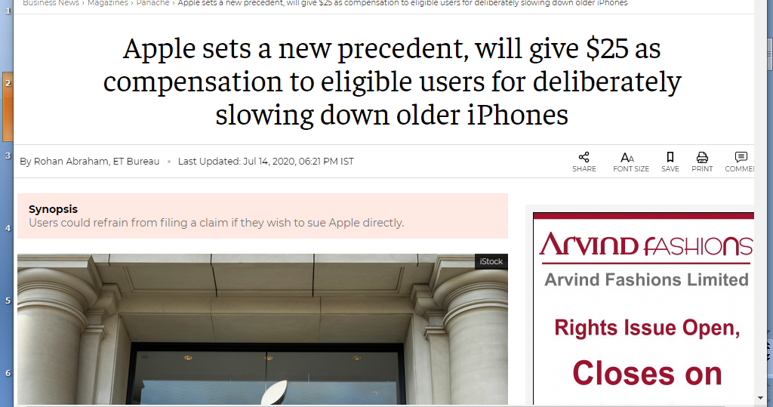

Slide 3
UNIT II
Planning & Decision Making

Slide 4
Meaning of Planning
Primary Function of Management
Basic requirement of Management Process
Pre-decided course of action
Bridges gap from where we are and where we want to go
Plan activities to achieve objectives

Slide 5
Let's say your goal is to buy a milk. It may sound like a simple task, but if you break it down, there are many small tasks involved: obtain keys, obtain wallet, start car, drive to store, find and obtain milk, purchase milk, etc.

Slide 6
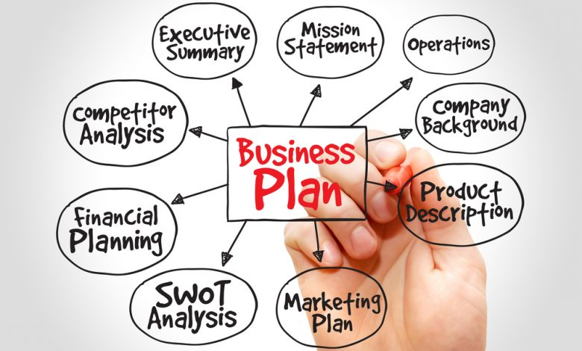
For Example before set up any business we need to make business plan and decide following points

Slide 7
Definitions of Planning
Planning is deciding in advance what to do , how to do it, where to do it and who is to do it
Koontz and O’Donnell
Planning is deciding in advance what is to be done. It involves the selection of objectives, policies, procedures and programmes from among alternatives.
M.E. Hurely
Planning is an ability to visualize a future process and its results.
- J.P. Barger

Slide 8
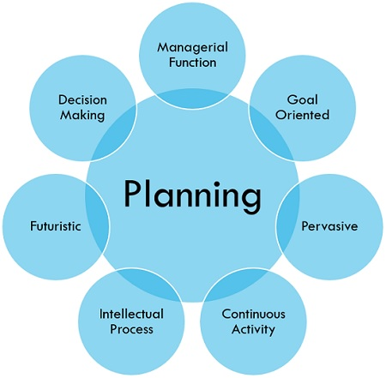
Nature of Planning
Primary Function
Goral Oriented
Future Oriented
Intellectual Process

Slide 9






Nature of Planning
Pervasive
Continuous Process
Result in Higher Efficiency
Certain Limitations

Slide 10
SUMMARY
Planning means deciding future course of action
Planning is deciding in advance what to do , how to do it, where to do it and who is to do it - Koontz and O’Donnell
Nature of Planning
Primary Function
Goral Oriented
Future Oriented
Intellectual Process
Pervasive
Continuous Process
Result in Higher Efficiency
Certain Limitations

Slide 11


