Slide 1
https://youtu.be/Dz4IJU8vYlk
Consumer Behaviour

Slide 2


Slide 3
Utility Concepts
The Cardinal Utility Theory (TUC)Utility is measurable in a cardinal sense
cardinal utility - assumes that we can assign values for utility, (Jevons, Walras, and Marshall). E.g., derive 100 utils from eating a slice of pizza
The Ordinal Utility Theory (TUO)Utility is measurable in an ordinal sense
ordinal utility approach - does not assign values, instead works with a ranking of preferences. (Pareto, Hicks, Slutsky)

Slide 4
The Cardinal Approach

Slide 5
The Cardinal Approach
The theory of Cardinal utility was formulated by Alfred Marshall, who feels that utility is measurable and can be expressed quantitatively or cardinally, i.e. 1, 2, 3, and so on.
A term UTIL was used to measure utility numerically.
It is assumed that one util is equal to one unit of money. Nineteenth century economists, such as Jevons, Menger and Walras, assumed that the difference between two measurement is itself numerically significant.

Slide 6
Assumptions of Cardinal Utility Analysis
: 1. Rationality
2. Utility is cardinally Measurable
. 3. Constant Marginal Utility of Money
4. Diminishing Marginal Utility
5. Independent Utilities
6. Limited Resources (Money

Slide 7
Total utility, Marginal utility
Total utility (TU) - the overall level of satisfaction derived from consuming a good or service
Marginal utility (MU) additional satisfaction that an individual derives from consuming an additional unit of a good or service.
Formula :MU = Change in total utilityChange in quantity= ∆ TU∆ Q

Slide 8
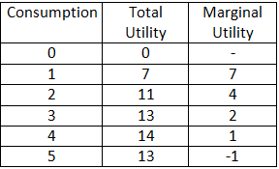
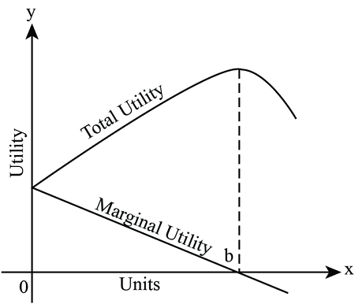
Total and Marginal Utility

Slide 9
Law of Diminishing Marginal Utility
Law of Diminishing Marginal Utility was first developed by a German Economist Herman Heinrich Gossen, in 1854.
This law is known as The First Law of Gossen and later on, it was popularized by Alfred Marshall.
The law of diminishing marginal utility states that all else equal, as consumption increases, the marginal utility derived from each additional unit declines. ..

Slide 10
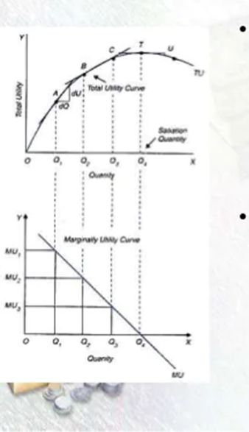
Law of Diminishing Marginal Utility
The Law of Diminishing Marginal Utility States That
As more and more of a good are consumed, the process of consumption will (at some point) yield smaller and smaller additions to utility

Slide 11
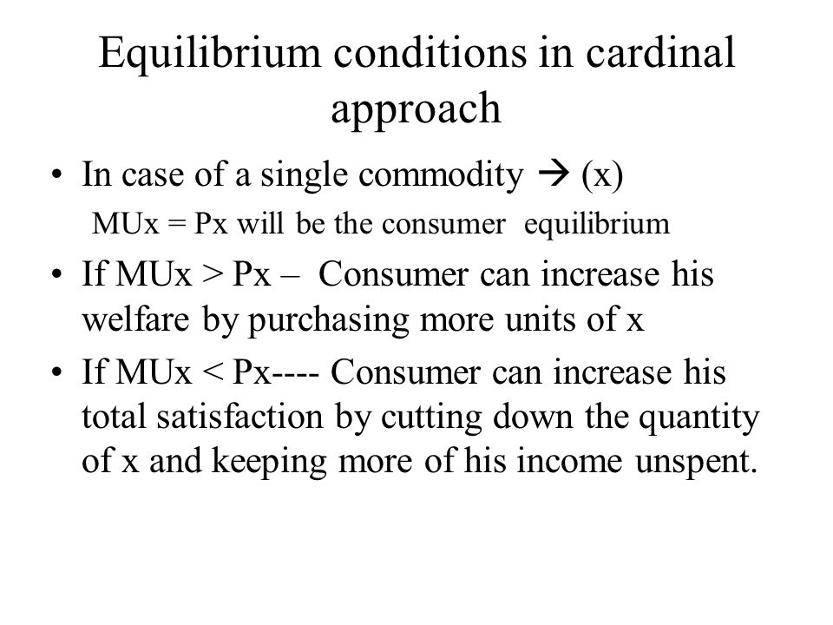

Slide 12
Limitations of the Law
• Suitable Units – It is assumed that commodity is taken in suitable units. If not suitable then MU may increase instead of falling. – e.g spoon of water or glass of water.
• Suitable Time – Commodity is taken within suitable time otherwise law will not apply – e.g taking a glass of water after an hour
• No change in Consumer’s Tastes – No change of consumer’s taste otherwise law will not apply• Normal Persons – Law of MU applies to normal persons and not to abnormal persons
• Constant Income – It is essential that income of a person remains constant

Slide 13
Limitations of the Law
Rare Collection – This law does not hold in case of rare collections – e.g in case of collection of ancient coins utility increases with having more coins
• Change in Other People’s Stock – Changes in other people’s stock may increase MU. – e.g utility of my telephone increases as the number of connection increases
• Other Possessions – Utility also depends on other possessions we have – e.g a carriage may be lying useless with us, but as soon as we are able to buy a horse, its utility goes up
• Fashion – The utility of my dress goes up when that dress comes in fashion
• Not applicable to money – The law does not apply to money. More money one has, the more one wants

Slide 14
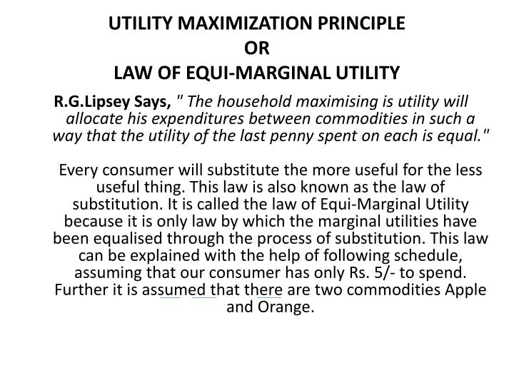

Slide 15
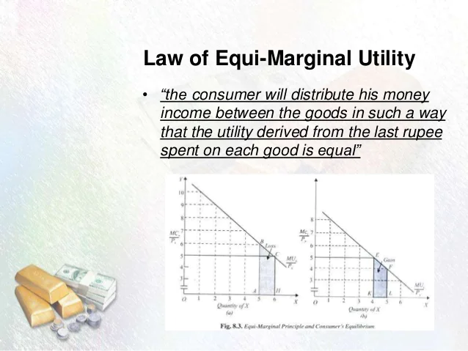

Slide 16
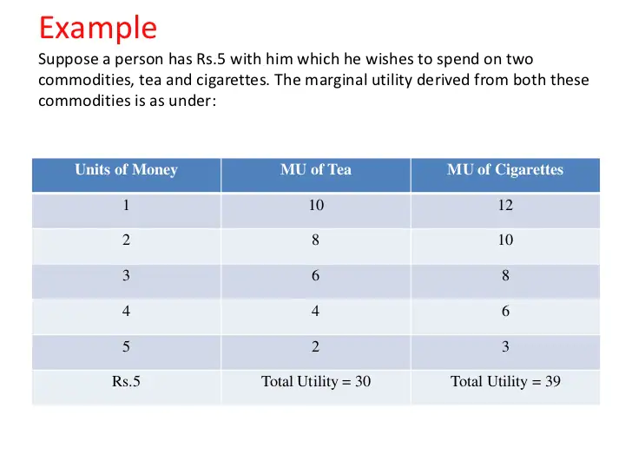

Slide 17
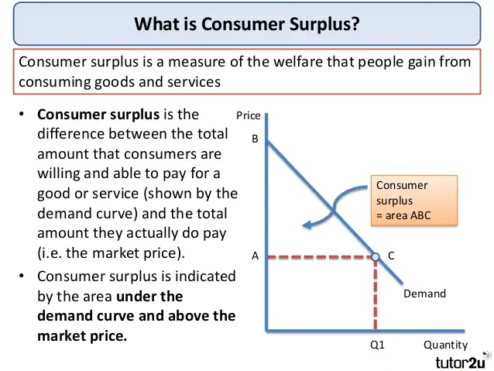
https://youtu.be/oL20S7c0ZJE

Slide 18
DIAMOND-WATER PARADOX
. “The paradox of value (also known as the diamond– water paradox) is the apparent contradiction
although water is on the whole more useful, in terms of survival, than diamonds,
Diamonds command a higher price in the market”
History • it was first presented by the economist adam smith in the 1700s.
• Carl menger published the new theory of value in 1871
• in the same year English economist william stanley jevons independently published a similar theory

Slide 19
DIAMOND-WATER PARADOX
Menger believed that value is completely subjective:
A product’s value is found in its ability to satisfy human wants.
The actual value depends on the product’s utility in its least important use.
If the product exists in abundance, it will be used in less-important ways.
As the product becomes more scarce, greater utility will be derived from the product.

Slide 20
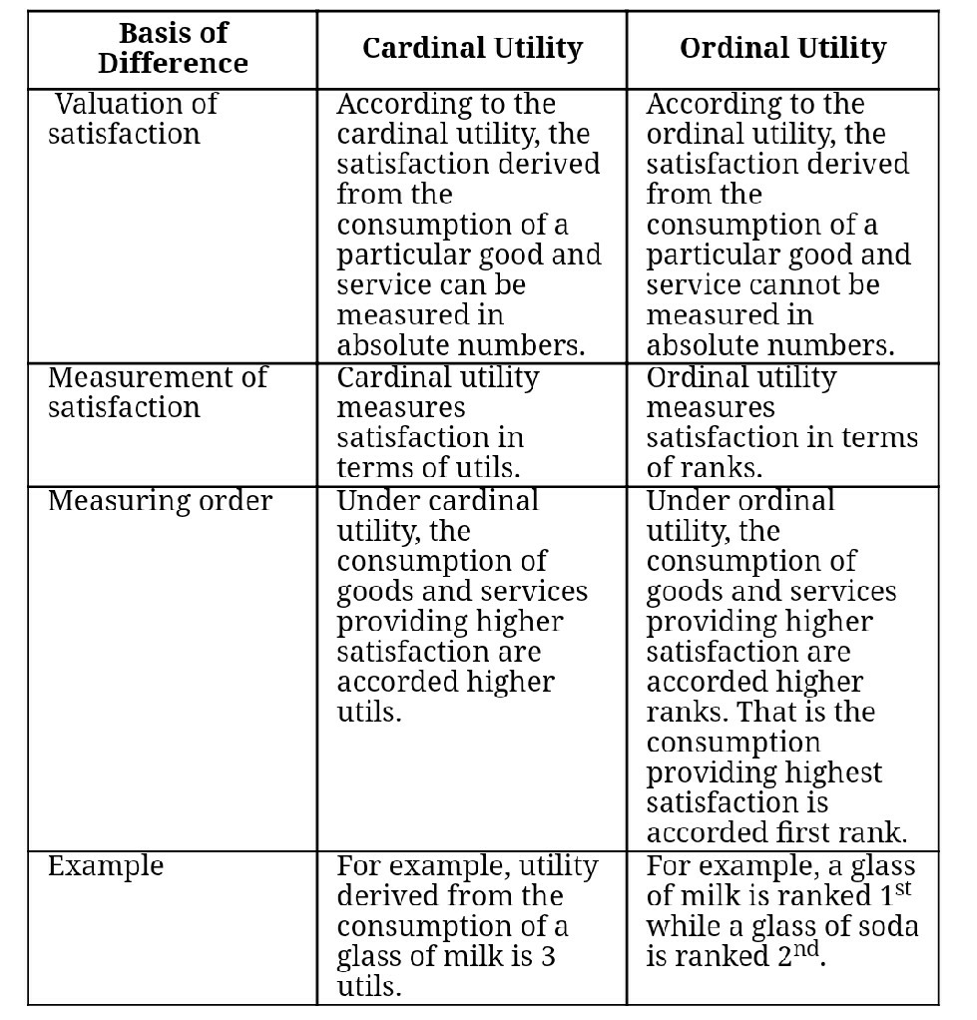

Slide 21
The Ordinal Approach

Slide 22
Indifference curve analysis
Developed By - Edge worth
It was later preferred by J.R Hicks & R.J.D. Allen
Indifference curve approach is also known as ordinal utility approach..
consumer express their utility in terms of preference not in term of quantity.

Slide 23
The Ordinal Approach
Economists following the lead of Hicks, Slutsky and Pareto believe that utility is measurable in an ordinal sense-
The utility derived from consuming a good, such as X, is a function of the quantities of X and Y consumed by a consumer.U = f ( X, Y )
Utility can be measured in qualitative, not quantitative,
but only lists the main options (indifference curves & budget line).
Rational human beings will choose to maximize the utility by selecting the highest utility
Difference consumers, difference utilities.

Slide 24
What is indifference Curve?
Definition: An indifference curve is a graph showing combination of two goods that give the consumer equal satisfaction and utility. Each point on an indifference curve give the consumer same utility.
Description: Graphically , the indifference curve is drawn as a downward sloping convex to the origin. The graph shows a combination of two goods that the consumer consumes.

Slide 25
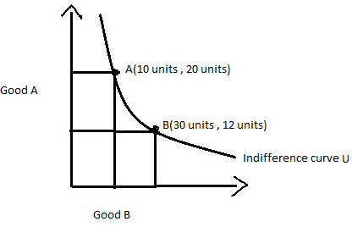
Indifference Curve
The diagram shows the U indifference curve showing bundles of goods A and B. to the same utility as both of them give him the equal satisfaction.
In other words, point A gives as much utility as point B to individual .
The consumer will be satisfied at any point along the curve assuming that other things are constant.

Slide 26
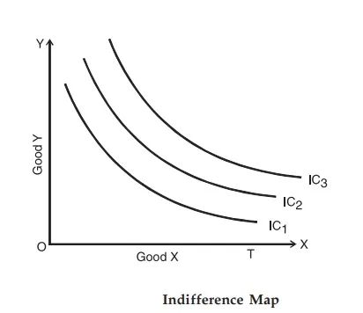
Indifference map
Collection of indifference curve is called indifference map.
Each indifference curve represents a certain level of satisfaction

Slide 27
Assumptions of Indifference Curve Analysis
https://youtu.be/7dwCBn1OTn8
a) Consumer is rational.
b) Utility can be measured in Ordinal numbers.
c) Marginal rate of substitution (MRS) diminishes
MRS=marginal rate of substitution is the rate at which a consumer is ready to give up one good in exchange for another good while maintaining the same level of utility)

Slide 28
Assumptions of Indifference Curve Analysis (contn..)
d) Consumer’s behavior is Consistent.
E.g. if consumer prefers A combination > B combination at one time, then at another time he will not prefer more of B combination than A combination.
e) Transitivity.
E.g. if consumer prefers A combination to B combination and B combination to C combination, then he will definitely prefer A combination to C combination.
f) Consumer’s scale of Preference is Independent of his income and prices of goods in the market.

Slide 29
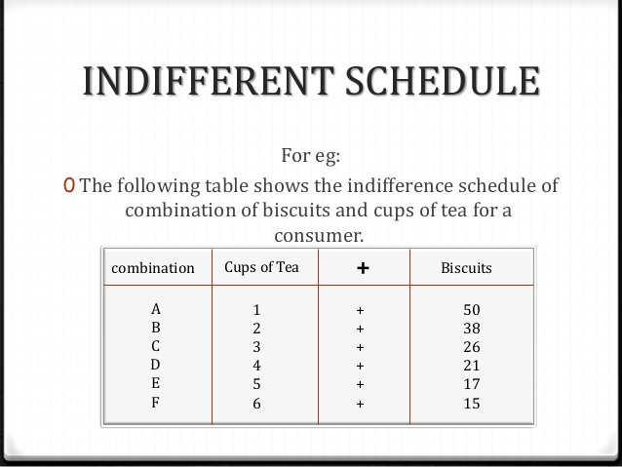
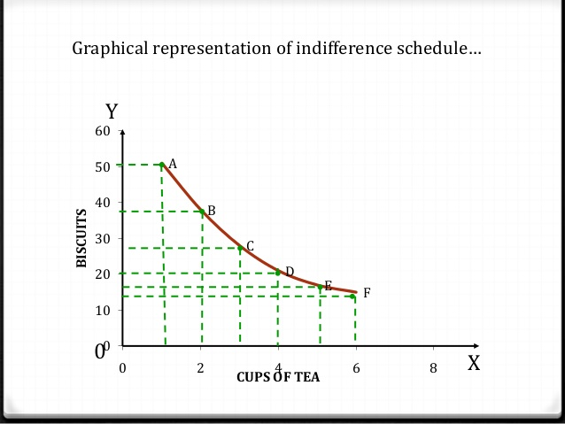

Slide 30
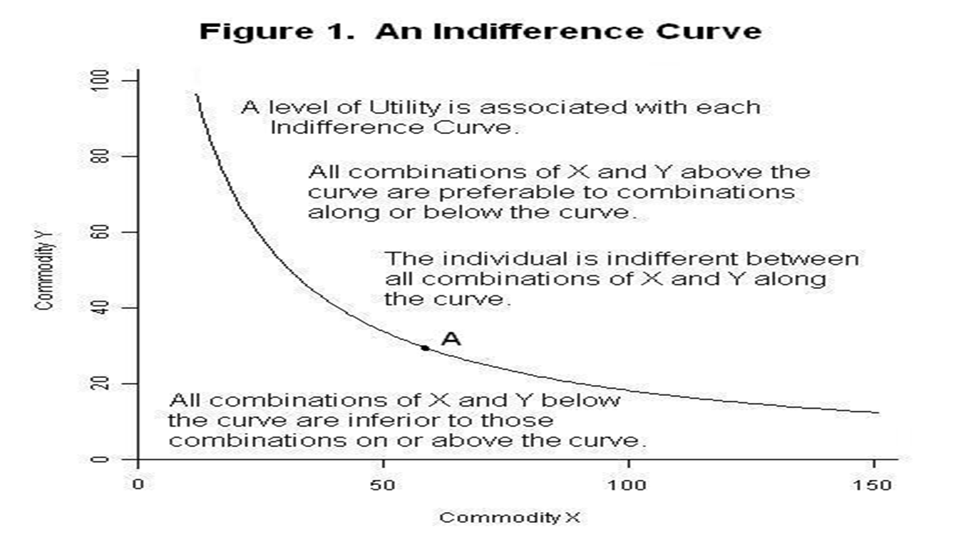
https://youtu.be/wrdib31J7wg

Slide 31
Properties of indifference curves
An indifference curve slope down. which means, that with the more consumption of one good the consumption of the other is to be reduced to maintain the utility.
Indifference curves are convex to the origin. indifference curves are convex to the origin because of the diminishing marginal rate of substitution.
Higher indifference curve represents higher level of satisfaction. The consumer derives more satisfaction from the combination of two goods on a higher indifference curve because more units of both the commodities are used that will surely be more satisfying than the lower quantity combinations.

Slide 32
Properties of indifference curves
Indifference curves cannot intersect each other.
It is because at the point of tangency, the higher curve will give as much as of the two commodities as is given by the lower indifference curve.
indifference curves cannot be thick .
The indifference curves cannot be thick because if they are thick, they would be violating "non-satiation" assumption.
indifference curve never touches horizontal axis or vertical axis. it implies that the customer never prefers only one commodity because when it touches axes, one of the commodities becomes zero quantity. ... Hence, an indifference curve does not touch either horizontal axis or vertical axis

Slide 33
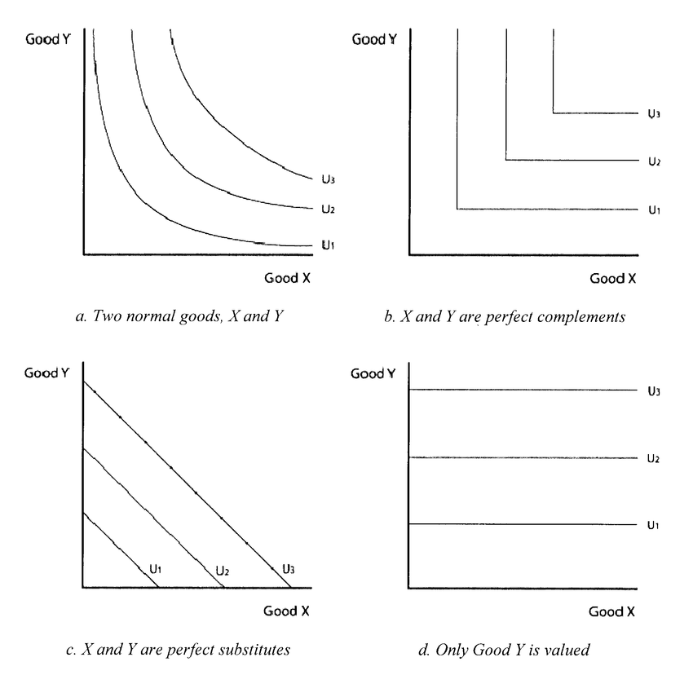

Slide 34
Review
Downward slopping convex IC…Both Goods are normal
L shaped IC…Commodities are perfect Complementary
Linear downward IC…Commodities are Perfect Substitute
Horizontal Ic…Commodity Y is valued
Vertical IC….Commodity X is valued

Slide 35
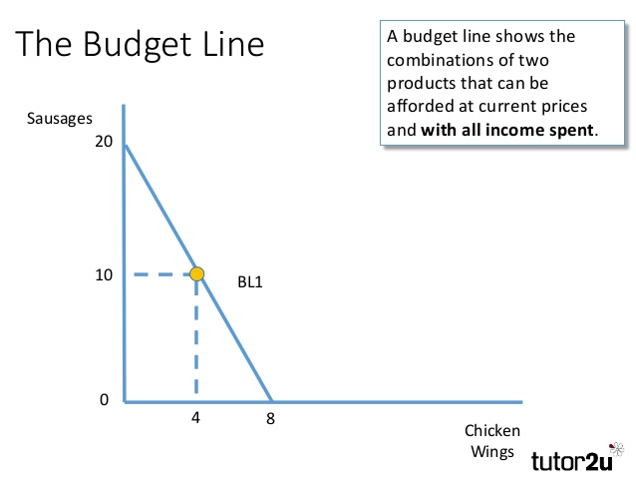

Slide 36
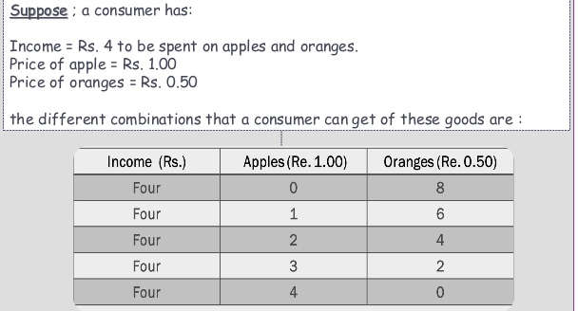
Illustration

Slide 37
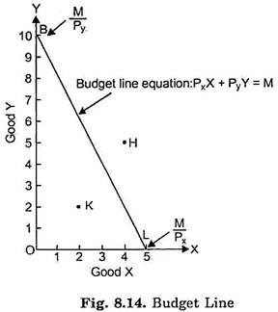
Budget line
https://youtu.be/kfqsakiQUb8
Definition:
The budget constraint presents the combinations of goods that the consumer can afford given her income and the price of goods.
Equation: Px * X + Py * Y=I
Rearrange: Y = I/ Py + (-Px / Py) *X
intercept slope

Slide 38
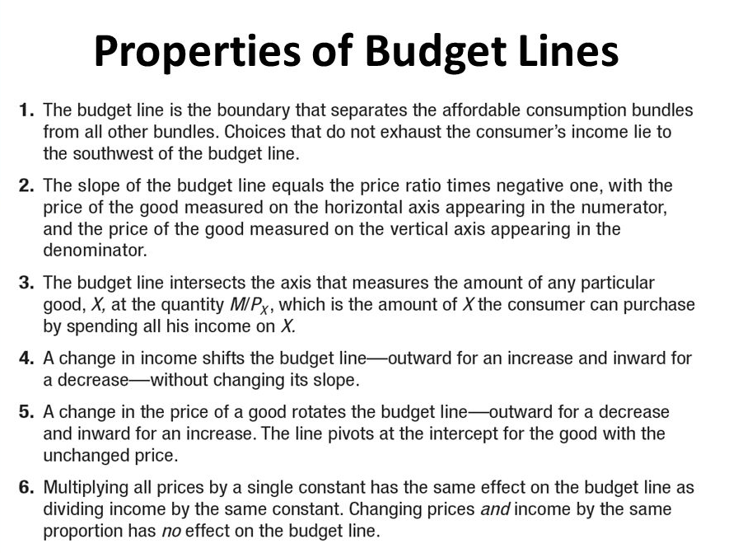

Slide 39
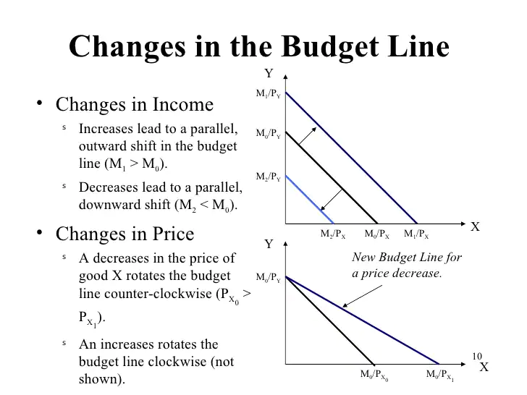

Slide 40
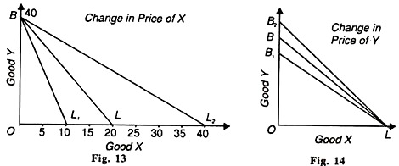
Rotation of Budget Line

Slide 41
REVIEW
An increase in Money Income will shift the budget line parallelly outward.
A reduction in money income will shift the budget line parallelly Inward.
A fall in Price of x.. BL will rotate outward along X axis
A fall in price of Y BL will rotate upward along Y axis.

Slide 42
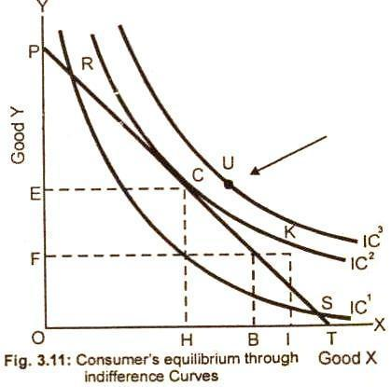
Consumer equilibrium under indifference curve analysis
https://youtu.be/JiJlZGqZXZk
First order condition: a given price line should be tangent to an indifference curve or marginal rate of satisfaction of good x for good y (MRSxy) must be equal to the price ratio of two goods.
MRSxy = Px/Py
Slop of IC= slop of budget line

Slide 43
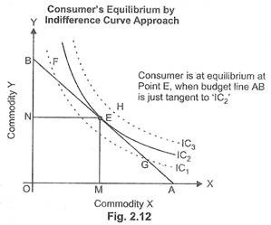
Contn…
Second order condition: the second order condition is that indifference curve must be convex to the origin at the point of tangency.

Slide 44
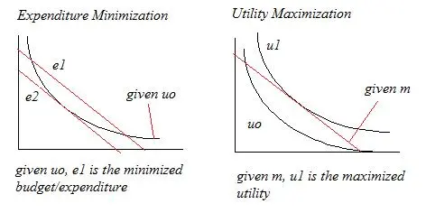
Consumer Equilibrium

Slide 45
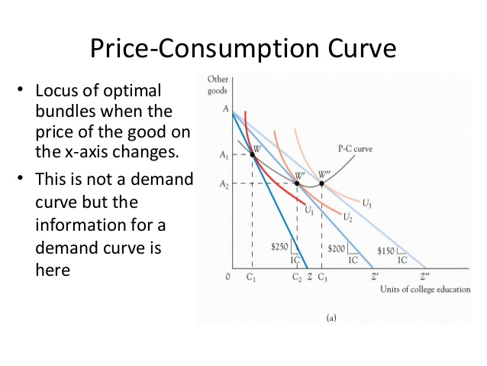
https://youtu.be/CnEXknMo_FE

Slide 46
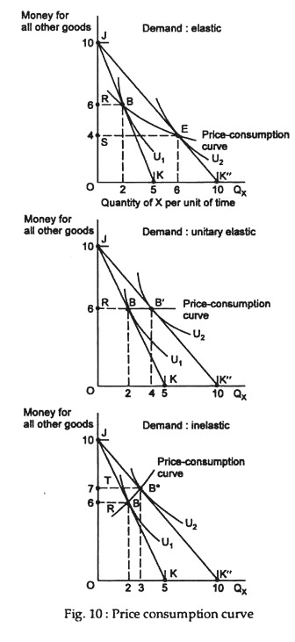
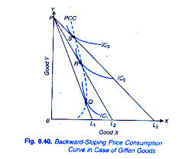
Price Consumption Curve

Slide 47
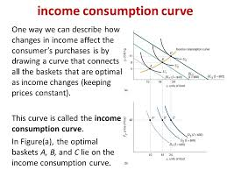
https://youtu.be/fh6RvLH7Q1Q

Slide 48
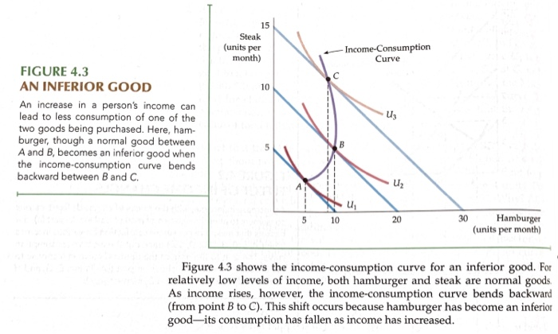

Slide 49
Revealed Preference Theory

Slide 50
The revealed preference approach
The revealed preference approach is quite distinct from the two approaches.
The revealed preference approach has been propounded by the American Economists, Prof. Paul A. Samuelson in his article “Consumption Theory In Terms Of Revealed Preference” in 1938.
This theory relies on the market behaviour of the consumer to know about his preferences with regard to the various combinations for the two reactions and responses of the consumer

Slide 51
ASSUMPTIONS
 The consumer has only two combinations of commodities
 The income of the consumer, prices of the two commodities are constant during the period of analysis
 The tastes of the consumer are given and remain unchanged during the period of analysis
 The consumer should choose only one combination of the commodities in a given price-income situation
 Based on observed facts and ordinal utility analysis

Slide 52
ASSUMPTIONS
 A consumer can be persuaded to buy more of a commodity if its price is subjected to substantial cut
 The choice of the consumer reveals his preference and market behaviour of the consumer  Consistency states strong ordering preference hypothesis of Samuelson
 Transitivity states that no two observations of choice behaviour can conflict with regard to an individual consumer’s preferences.

Slide 53
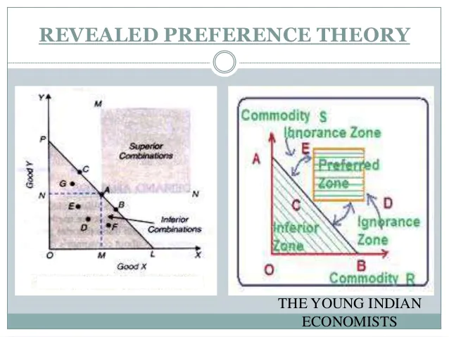

Slide 54
Explanation
When a consumer purchases some commodities either because, he likes them more than other cheaper than other commodities
 There are two combinations of commodities; X and Y  Consumer buys combination of X and not combination of Y
 Assuming that both the commodities are equally same cost and are equally good
 If the consumer buys X combination rather than Y commodity, because he like X combination better and revealed preference took place
 The price line PL reflects the income-price situation for the consumer

Slide 55
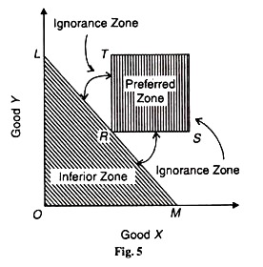
The consumer can choose any combination lying on the price line i.e. C, A, B; below and to the left of the price line G, E, D, F
The consumer can purchase any combination within the triangle known as Consumer’s Choice Triangle
These are all alternative combinations and the consumer is free to choose any one of them
The combinations lying on the price line is equally costly
The combinations lying below the price line i.e. Consumer’s Choice Triangle is inferior zone
The combinations lying above the price line is superior zone
The gap between preferred zone and inferior zone is said to be ignorance zone.

Slide 56
Importance
Prof. Samuelson’s revealed preference theory is really an improvement upon the indifference curve analysis
 It has more implications for welfare economics  The method of actual observation makes it superior to other demand theories
 The revealed preference theory is restrictive. “In Samuelson’s revealed preference theory what is gained is rigour and methodology is lost in the narrowness of the scope of its application”.

