Slide 1
E-COMMERCE AND DIGI MARKETING
Dr Rakhi Bhattacharya

Slide 2
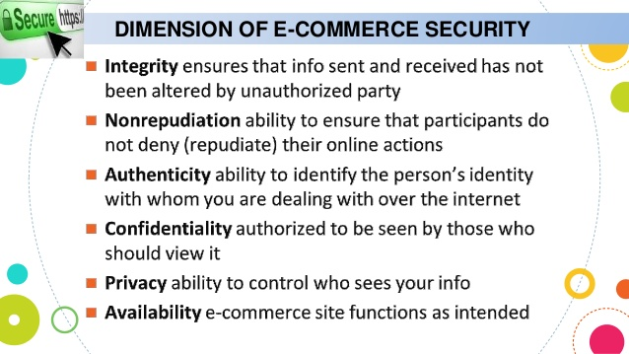

Slide 3
SECURITY ISSUES OF ECOMMERCE
NETWORK SECURITY
IDENTITY AND X.509 CERTIFICATION
ENCRYPTION
AUTHORISATION
HOST AND APPLICATION SECURITY
TRANSACTION SECURITY
HUMAN ERROR AND MALICE

Slide 4
THE ECOMMERCE SECURITY ENVIRONMENT
Theft of proprietary information or fraud
40% reported attacks from outside the organisation
38% show denial of service attack
94% show virus attack

Slide 5
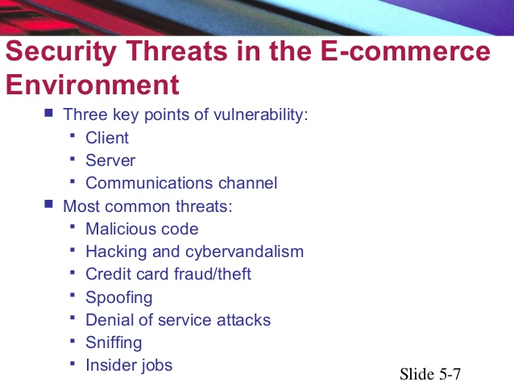

Slide 6
SECURITY THREAT IN ECOMMERCE ENVIRONMENT
Malicious Code: designed to breach system security and threaten digital information
Viruses
Worms
Trojan horses
Bots, botnet
Unwanted programs
Browser parasites
Adware
spyware

Slide 7
HACKING AND CYBERVANDALISM
HACKER
WHITE HAT
BLACK HAT
GREY HAT
CRACKER
CYBERVANDALISM

Slide 8
CONTINUED…..
CREDIT CARD FRAUD
SPOOFING
DENIAL OF SERVICE(DoS)
DISTRIBUTED DENIAL OF SERVICE(DDoS)
SNIFFING
INSIDER JOB

Slide 9
HOW TO PROTECT INTERNET COMMUNICATION???
ENCRYPTION
DIGITAL CERTIFICATE AND PUBLIC KEY INFRASTRUCTURE
SECURITY PROTOCOLS IN INTERNET (SSL;SHTTP)
SECURE ELECTRONIC TRANSACTION (SET)
DIGITAL SIGNATURE

Slide 10
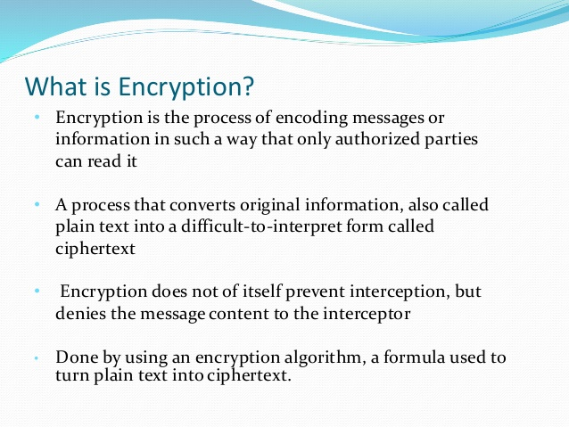
ENCRYPTION

Slide 11
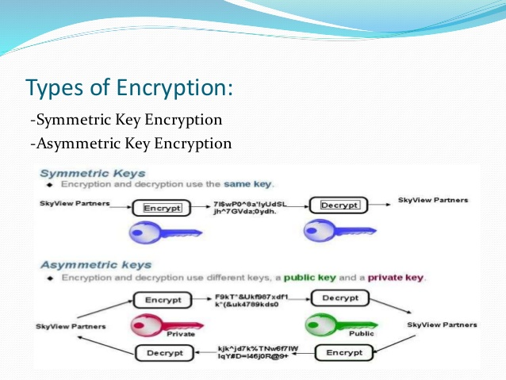

Slide 12
SYMMETRIC KEY ENCRYPTION
A secret key, is applied to the text of a message to change the content in a particular way.
Same key is used for encryption of plain text and decryption of cyphertext
The keys, represent a shared secret between two or more parties that can be used to maintain a private information link.
One of the main drawback of symmetric key encryption is that both the parties have access to the secret key.

Slide 13
Asymmetric key encryption or public key encryption
Also known as public-private key.
Uses two different keys for encrypting and decrypting data.
Public key is used to encrypt data and private key is used o decrypt it.
Any message, once encrypted cannot be decrypted by the sender. It can only be decrypted by using the private key possessed by the user.
Since this private key is never distributed, hackers cannot intercept a key that decrypts the message.
Encryption keeps the data in meaningless form.

Slide 14
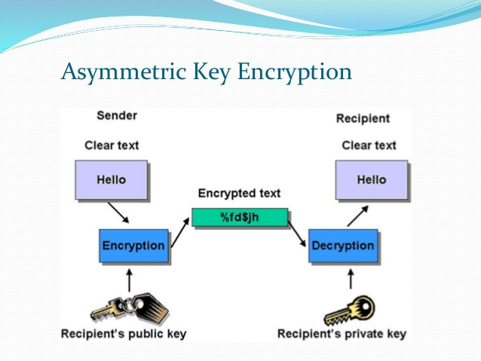

Slide 15
Use of encryption
Authentication
protects personal data such as passwords
Privacy
provides for confidentiality of private information
Integrity
ensures that a document or file has not been altered
Accountability
prevents denials or plagiarism

Slide 16
Digital certificate and public key infrastructure
A digital certificate is a digital file that certifies the identity an individual or institution, or even a router seeking access to computer based information. It is issued by a certification Authority.
Certification authorities issues digital certificate and validate holder’s identity and authority. They embed an individual or institutiton’s public key along with other identifying information into each digital certificate and then cryptographically sign it as a tamper proof seal verifying the integrity of the data within it and validating its use.

Slide 17
Where are digital certificate used?
In a number of internet applications that include
1 secure socket layer
2. Secure multipurpose internet mail extensions(S/MIME) Standard for securing email and electronic data interchange.
3. Secure Electronic Transaction
4. Internet Protocol Secure Standard

Slide 18
Advantages of digital signature
Decrease the number of passwords a user has to remember to gain access to different network domain.
They create an electronic audit trail that allows companies to track down who executed a transaction or accessed an area

Slide 19
disadvantages
Owner has to protect their own digital certificate
If the owner walks away from his computer, others can gain access to it and use his digital certificate to execute unauthorised business.
These vulnerabilities are addressed today by combining them with biometric technology as that confirms the actual identity of the sender rather than the computer.

Slide 20
PUBLIC KEY INFRASTRUCTURE
The comprehensive system that provide public key encryption and digital signature services is known as a public key Infrastructure.
The purpose of Public key infrastructure is to manage key and certificates.
PKI enables an organisation to a trustworthy networking environment.
PKI also ensure encryption and digital signature services across a wide variety of application.
One of the demerits of PKI is that it shifts the security risk to the certificate authorities. There is always a question who will certify the certifier and how safe their key data will be in these hands.

Slide 21
SECURITY PROTOCOLS IN INTERNET
The protocols used over the internet which ensures security of transactions made over the internet. They are
SSL(Secure Socket Layer)
Secure Hypertext Transfer Protocol(SHTTP)
SSL
It is an Internet protocol for secure exchange of information between web browser and a web server .
It provides authentication and confidentiality
SHTTP
SHTTP extends the HTTP internet protocol with public key encryption, authentication and digital signature over the internet. It provide security mechanism to the end user. It works by negotiating encryption scheme types used between client and server.

Slide 22
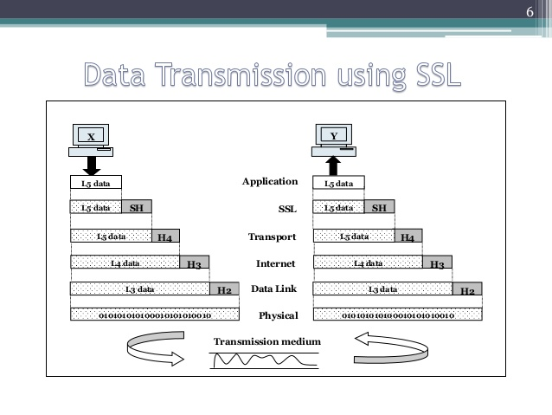

Slide 23
HYPER TEXT TRANSFER PROTOCOL
Protocol for transfer of various data formats between server and client.
Plaintext
Hypertext
Images
Video sound
A network protocol is the set of rules governing a conversation between a client and a server

Slide 24
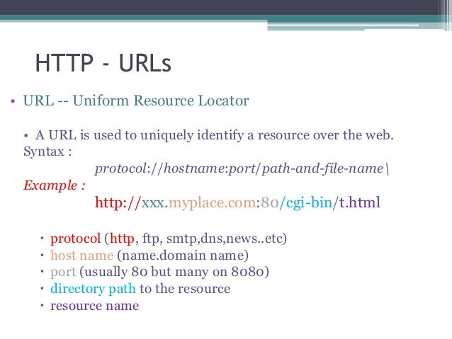

Slide 25
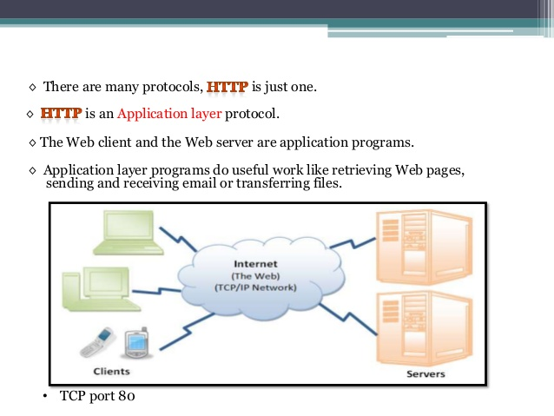
There are many protocols, HTTP is just one
HTTP is an application layer protocol.
Web client and the web server are application programs
Application layer do useful work like retrieving web pages, sending and receiving email and transferring files.

Slide 26
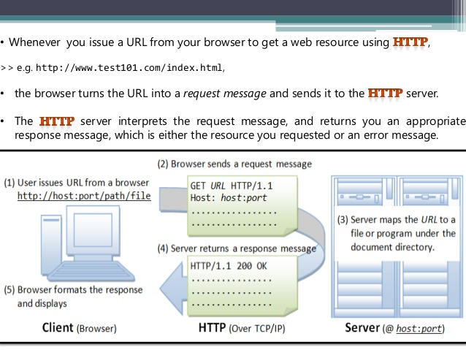

Slide 27
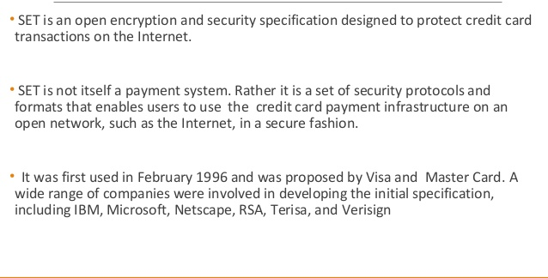
SET PROTOCOL(SECURE ELECTRONIC TRANSACTION)

Slide 28
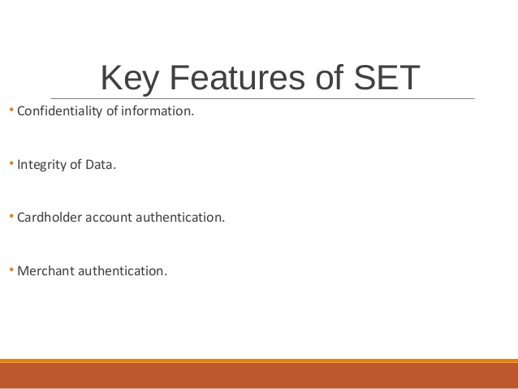

Slide 29
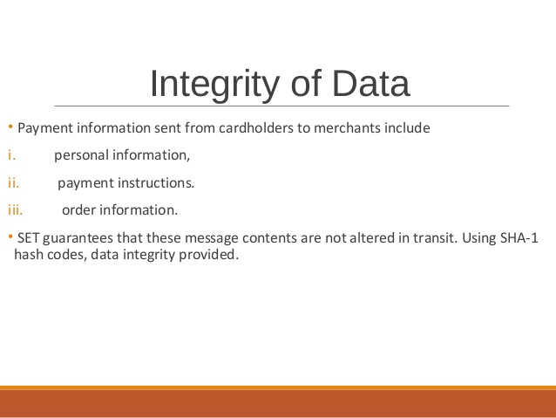

Slide 30
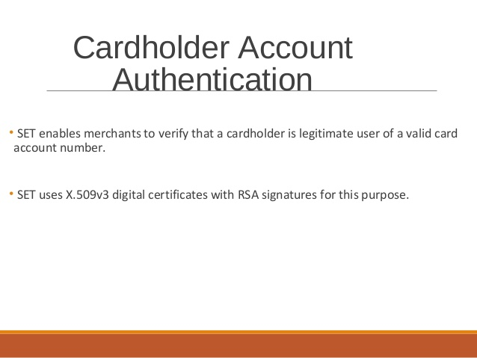

Slide 31
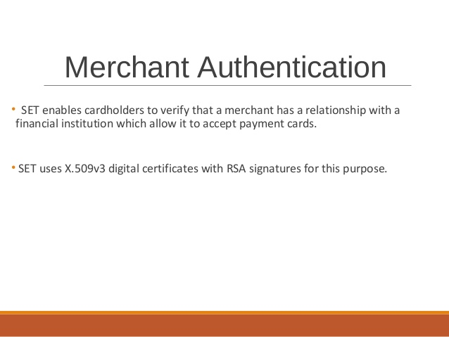

Slide 32
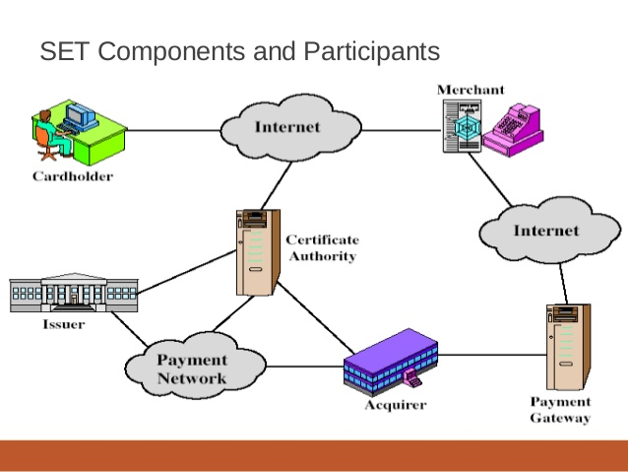

Slide 33
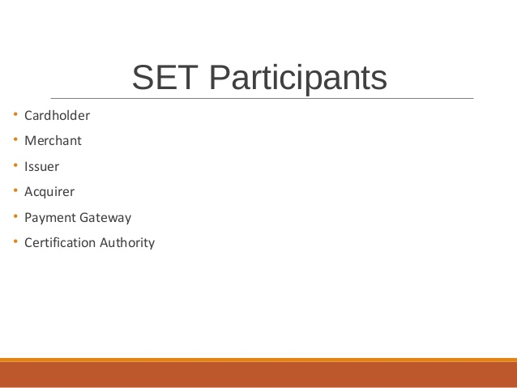

Slide 34
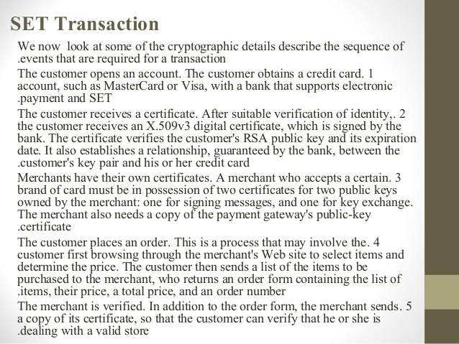
HOW SET WORKS

Slide 35
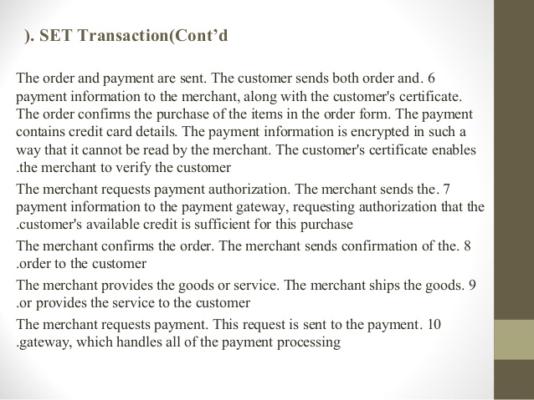

Slide 36
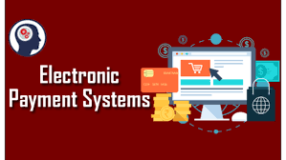

Slide 37
ELCTRONIC PAYMENT SYSTEM(EPS) is a system of financial exchange between buyers and sellers in the online environment that is facilitated by a digital financial instrument such as encrypted credit card numbers, electronic checks, digital cash) backed by a bank, an intermediary or by legal tender.

Slide 38
TYPES OF EPS
Electronic cash system
Smart card based EPS
Digital Wallet; E-Wallet
Digital money
Online credit card payment system
Electronic Cheque system
Electronic fund transfer

Slide 39
HOW CREDIT CARD PROCESSING WORKS
Consumer
Merchant
Processor
Card Network
Consumer Bank
Back to merchant

Slide 40
Consumer bank or issuing bank
Merchant Bank/acquiring Bank
Parties involved in Credit card payment
Card network/Card Association
Credit card processor

Slide 41
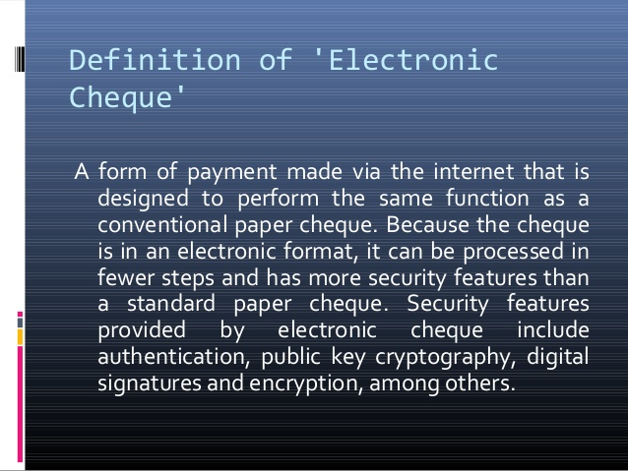
ELECTRONIC CHEQUE SYSTEM

Slide 42
FEATURES OF AN ELECTRONIC CHEQUE
ELECTRONIC CHEQUE has more security features than standard paper checks including authentication, public key cryptography, digital signatures, and encryption, among others.
An electronic check is part of the larger electronic banking field and part of a subset of transactions referred to as electronic fund transfers (EFTs).
It includes not only electronic checks but also other computerized banking functions such as ATM withdrawals and deposits, debit card transactions and remote check depositing features.
The transactions require the use of various computer and networking technologies to gain access to the relevant account data to perform the requested actions.
Electronic checks were developed in response to the transactions that arose in the world of electronic commerce.
Electronic checks can be used to make a payment for any transaction that a paper check can cover, and are governed by the same laws that apply to paper checks.
This was the first form of Internet-based payment used by the U.S. Treasury for making large online payments.

Slide 43
BENEFIT OF ELECTRONIC CHEQUE
The costs associated with issuing an electronic check are notably lower than those associated with paper checks.
No requirement for a physical paper check, which costs money to produce
Electronic checks do not require physical postage in cases of payments being made to entities outside the direct reach of the entity issuing the funds.

Slide 44
Electronic cash system
eCash was an electronic platform created to transfer funds anonymously. It was a pioneer in cryptocurrency.
eCash was created by Dr. David Chaum and implemented via his company, DigiCash, in 1990.
eCash worked on the premise of blind signatures where message content is invisible before signing, resulting in no user being able to link withdrawal and spend transactions.
Despite the initial interest and bringing large banks on board to use the system, eCash never fully took off and DigiCash filed for bankruptcy in 1998.
Chaum launched a new startup in 2018 focused on cryptography.

Slide 45
ELECTRONIC FUND TRANSFER
Electronic Funds Transfer (EFT) is a system of transferring money from one bank account directly to another without any paper money changing hands. One of the most widely-used EFT programs is direct deposit, through which payroll is deposited straight into an employee's bank account. However, EFT refers to any transfer of funds initiated through an electronic terminal, including credit card, ATM, Fedwire and point-of-sale (POS) transactions. It is used for both credit transfers, such as payroll payments, and for debit transfers, such as mortgage payments.

Slide 46
Types of EFTs
Direct deposit: Enables businesses to pay employees. During the employee onboarding process, new employees typically specify the financial institution to receive the direct deposit payments.
Wire transfers: Used for non-regular payments, such as the down payment on a house.
Automated Teller Machines (ATMs): Allows cash withdrawals and deposits, fund transfers and checking of account balances at multiple locations, such as branch locations, retail stores, shopping malls and airports.
Debit cards: Allows users to pay for transactions and have those funds deducted from the account linked to the card.
Pay-by-phone systems: Allows users to pay bills or transfer money over the phone.
Online banking: Available via personal computer, tablet or smartphone. Using online banking, users can access accounts to make payments, transfer funds and check balances.

Slide 47
SMART CARD BASED EPS
A smart card is a plastic card about the size of a credit card, with an embedded microchip that can be loaded with data.
The standard definition of a smart card or Integrated Circuit card(ICC), is any pocket sized card with embedded integrated circuits.

Slide 48
FEATURE OF A SMART CARD
It resemble a credit card in size and shape but is different from credit card.
smart card has embedded micro processor
microprocessor is under gold contact pad on one side of the card.
Smart card can provide authentication, identification, data storage and application processing.

Slide 49
History of smart card
1970 Smart card was patented first in Germany and later in France and Japan.
1980 mass usage in pay phones and debit card.
1990 Smart card based Mobile Chips and Sim cards.
2000 payment and ticketing applications credit card; Mass transit, healthcare, insurance information and drivers licence

Slide 50
Why use smart card
Can store currently upto 7000 times more data than a magnetic strip card.
Information stored on the card can be updated
Magnetic strip card is vulnerable to many fraud
Can provide greater security
A single card can be used for multiple purpose.

Slide 51
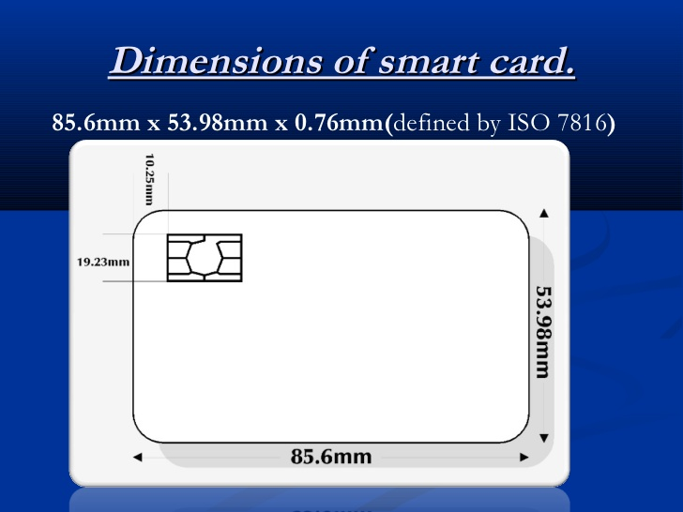

Slide 52
Digital wallet or e- wallet or Virtual wallet
Digital wallet (or e-wallet) is a software-based system that securely stores users' payment information and passwords for numerous payment methods and websites. By using a digital wallet, users can complete purchases easily and quickly with near-field communications technology. They can also create stronger passwords without worrying about whether they will be able to remember them later.

Slide 53
Uses of digital wallet
It is used in conjunction with mobile payment systems, which allows cutomers to pay for purchases with their smartphone.
It is used to store loyalty card info and digital coupons
Eliminate the need to carry physical wallet as it can store consumer’s payment information securely and compactly.
Igitl wallet can collect consumer data.
Help members of developing countries to participate in globalisation.
It also allow funds or remittances from friends and families.
Digital wallet do not require bank account with a physical firm or branch.
Cryptocurrencies solely depend on digital wallet to maintain balances and make transation

Slide 54
E-wallets
E-Wallets are prepaid wallets that requires money to be loaded prior to any transaction. It can either be accessed on the e-wallet’s website or applications via laptop, tablet, or phone. Some of e-wallet functions include:
Storing credit and debit card information
Storing funds (e-money)
Keeping coupons or loyalty credits
Enabling payment for purchases at physical or online store,
Splitting bills
Peer-to-peer transfer,
And of course, security.

Slide 55
How does e wallet work
This digital payment system keeps track of the buyer’s payment information.
When a consumer approaches the payment page on a site or an app, the e-wallet can supply the payment information on the spot for immediate, straight forward transactions.
Consumers can set up an e-wallet account that’s available any time.
Some items that might be stored in an e-wallet account are credit card data, debit card data, banking information, and payment platform connectivity, such as PayPal.
Fast and convenient.

Slide 56
Difference between
Digital wallet
E-wallet
Store credit/debit card Information.
Payment deducted directly from bank/credit account
Stores credit value in the wallet.
Requires reload to deduct amount from wallet account.

Slide 57
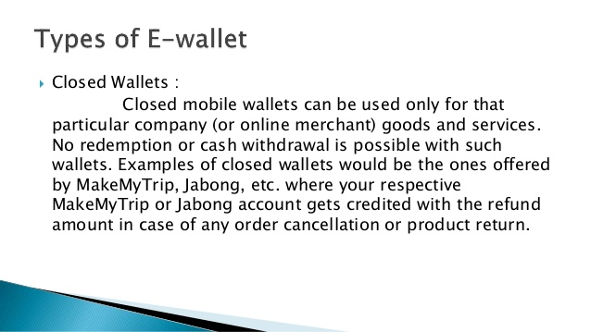

Slide 58
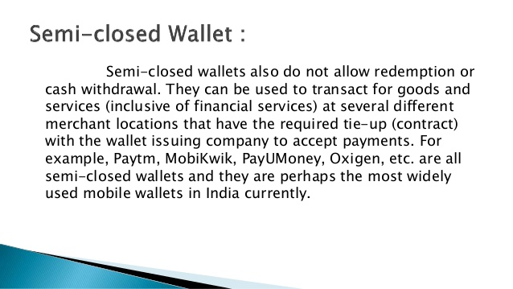
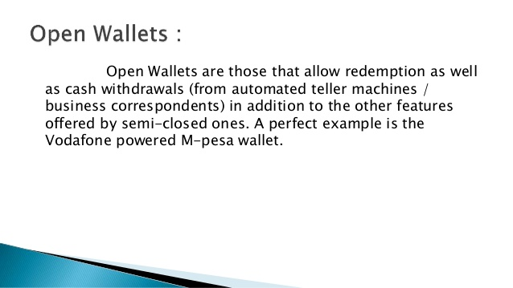

Slide 59
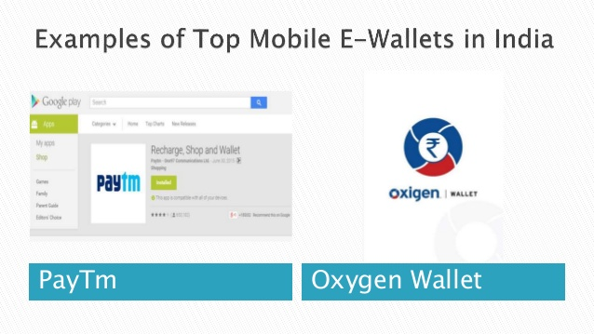

Slide 60
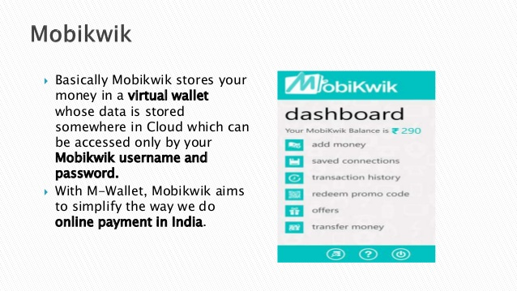

Slide 61
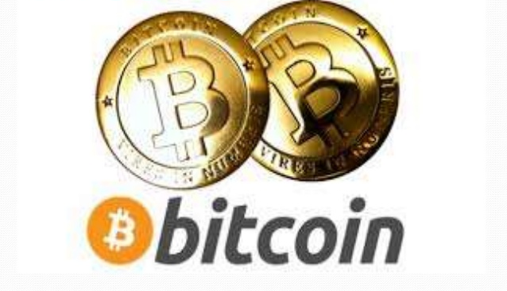

Slide 62
INTRODUCTION
BITCOIN is a cryptocurrency and a digital payment system developed by an unknown programmer or a group of programmer under the name of Satashi Nakamoto. It was released as open source software in 2009.
The system is peer to peer and transaction takes place between the user directly without any intermediary.
Bitcoin can be exchanged for other currencies, product or services in legal or black market.

Slide 63
What is bitcoin
It is a form of digital currency, created and held electronically. They are nor printed like dollars or euros but produced by people and businesses by using software that solves mathematical problem.
It is different from conventional money because it is decentralised. No single institution controls the bitcoin network.

Slide 64
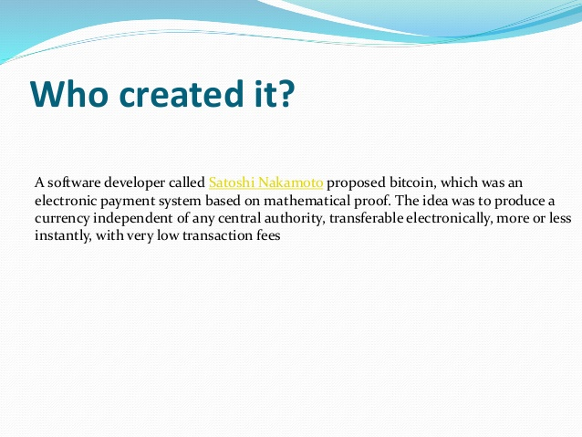
WHO CREATED IT

Slide 65
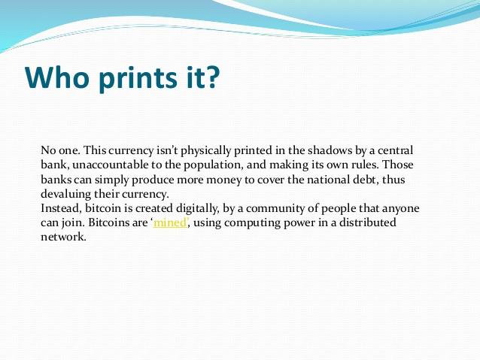
WHO PRINTS IT

Slide 66
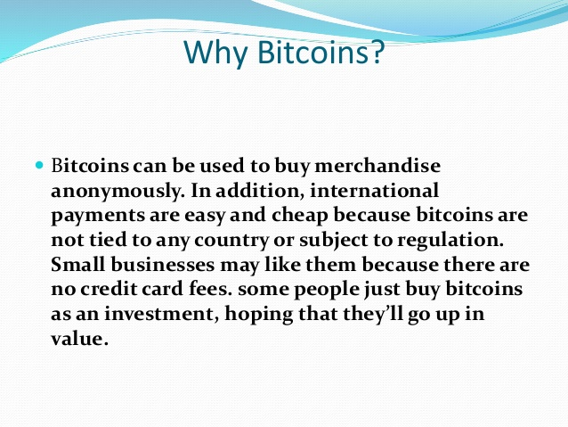
WHY BITCOINS

Slide 67
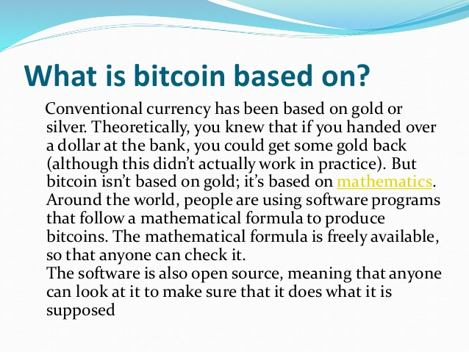
WHAT IS BITCOIN BASED ON

Slide 68
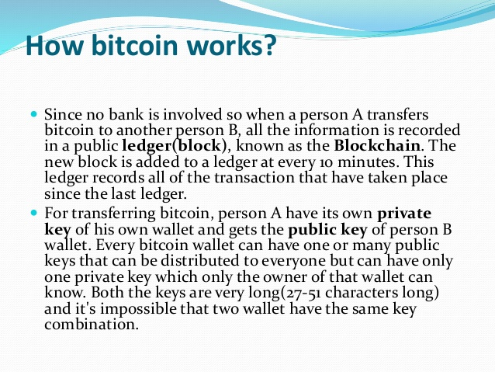
HOW BITCOINS WORK

Slide 69
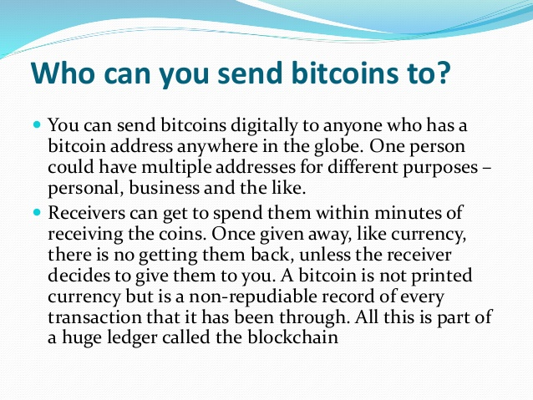
To whom bitcoin can be sent

Slide 70
HOW NEW BITCOIN IS GENERATED
Bitcoin is not illegal in India and can be used through zebpay.
Bit coin is generated when a person or a business uses software power to solve a mathematical puzzle that makes the blockchain more secure. The difficulty level of solving the problem is high enough to ensure that entire process takes time.

Slide 71
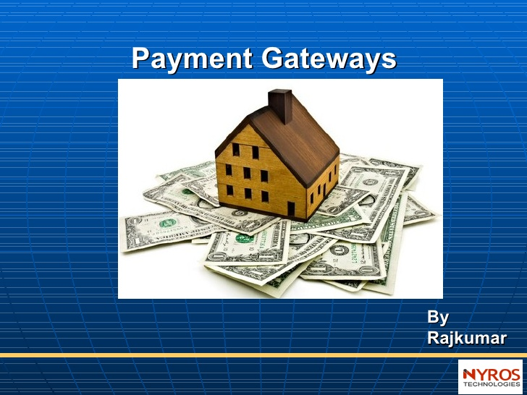
PAYMENT GATEWAY

Slide 72
What is payment gateway
It is an ecommerce application service provider that authorises payment for e business.
There are thousand of ways by which online payment can be made including paypal; EFT Transactions.
Most of these online payment are based on payment gateway technology.
A payment gateway allows connection directly between website and a bank.
Payment gateway is a server that is dedicated to linking websites and banks

Slide 73
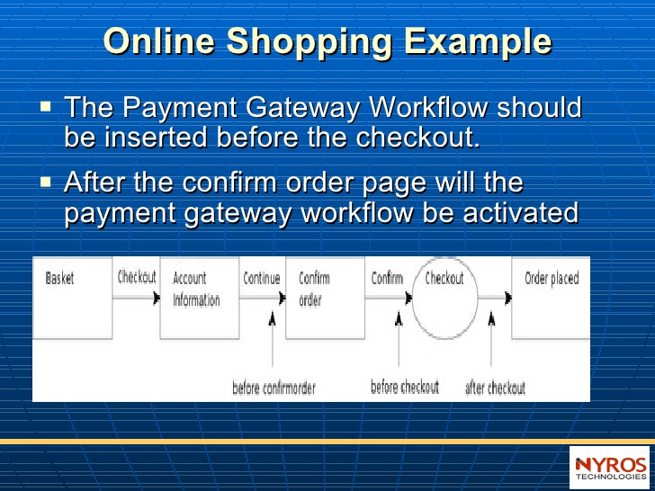
How does a payment gateway work?

Slide 74
REQUIREMENT FOR A PAYMENT GATEWAY
Main requirements for a payment gateway required:
A website that meets the security and eligibility requirement for the bank to issue a merchant account.
Merchant account. It is a special kind of bank account that can be linked directly to a payment gateway. These bank account are issued only upon review of website to ensure it meets privacy and security requirements.
a payment gateway provider. This payment gateway provider offer the server that acts as a link between website and the bank. The server has very special configuration and a very high level of security.

Slide 75
Benefits of payment gateway
It ensures that the customer stay on site and don’t leave the site for payment.
it allows real time transaction. i.e the merchant get paid immediately and the customers get instant feed back of payment made.
It removes the need for manual card processing or third party account consolidation.
It also saves time as transaction happen on real time where credit card are processed and amount submitted directly to the account.

Slide 76
Working of payment gateway
buyer places the order on the website and is sent to the merchant’s web server in encrypted format. This is done via SSL ( Secured Socket Layer) encryption.
the transaction details are then forwarded to the concerned payment gateway.
the transaction information is then passed on to the merchant’s acquiring bank by the payment gateway.
Merchant’s acquiring bank then forwards the transaction information to the issuing bank ( one that issued the credit card to the customer)
Then the card issuing bank sends response back to the payment gateway. The response includes information whether the payment has been approved or declined.

Slide 77
Continued…..
the response is then forwarded by the payment gateway to the merchant’s server.
at merchant’s server the response is encrypted again and is relayed back to the customer. This allow customer to know whether the order has been placed successfully or not.
this entire process typically takes less than 5 seconds.

Slide 78
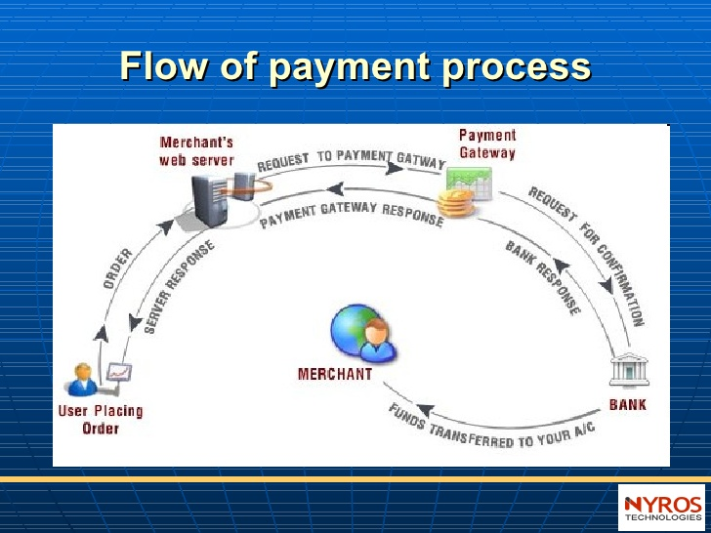
FLOW OF PAYMENT PROCESS

Slide 79
Cyber laws
It is the law governing cyber space.
Cyber space is very wide term and includes computers, networks, software, data storage devices( hard disk and USB)
The internet, websites, emails and even electronic devices such as cell phone ATM Machines etc.

Slide 80
CYBER LAW DEALS WITH
Cyber crimes
Electronic or digital signatures
Intellectual property
Data protection and privacy

Slide 81
Cyber crime
it is unlawful Acts where computers are used either as a tool or a target or both.
The growth of e-commerce and online share trading has led to a growth in incidents of cyber crime
cyber crime are any illegal Act committed using a computer network ( especially the internet).
Criminal activities that take place in the cyber space like defamation, sexual harassment; trolling; phishing
Computer used to commit a crime ( stalking, pornography)

Slide 82
Categories of cyber crime
crimes against person
Crimes against property
Crime against government

Slide 83
Crime against a person
Cyberstalking
Impersonation
Loss of privacy
Transmission of obscene material
Harassment with the use of computer

Slide 84
Against property
unauthorised computer trespassing
computer vandalism
transmission of harmful programme
Siphoning of fund from financial institution
Stealing secret info and data
Copyright

Slide 85
Against government
Hacking government website
Cyber extortion
Cyber terrorism
Computer viruses

Slide 86
IT ACT 2000
It empowers government department to accept filing, creating and retention of official document in digital format.
It deals with legal framework essential for the authentication of electronic records and communication through digital signature
The act legalises email as official document.
The Act authenticate digital signature and digital records
The law allows government to issue notification on the website.
The law lays down guidelines for submitting any forms application or document to any appropriate office

Slide 87
Continued…..
the law provides statutory remedy to the corporates for any incident of crime like breaking into computer system, damaging or copying the data etc. Monetory penalty not exceeding 1 crore is levied.
The law sets up territorial jurisdiction of the adjudicating officer for cyber crime
The law has also laid guidelines for providing internet services on a licence on non exclusive basis.

Slide 88
Problems with IT Act
The law misses out completely the issue of intellectual property rights and make no provisions whatsoever for copyrighting, trade marking or patenting of electronic information and data.
the law stays silent over the regulation of electronic payment gateway and segregates the negotiable instruments from the applicability of the IT Act, which may have major effect on the growth of ecommerce in India.
Internet is a borderless medium; it spreads to every corner of the world where life is possible
the act empowers the deputy superintendent of police to llok up into the investigation and filling of charge sheet when case related to cyber law is called

Slide 89
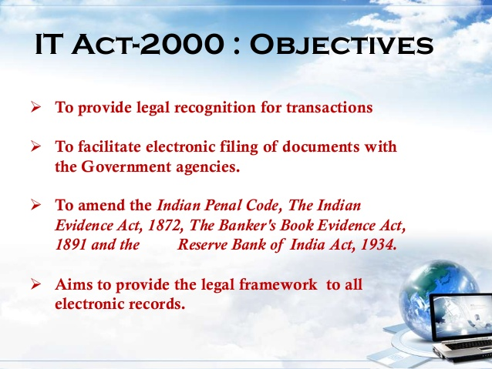

Slide 90
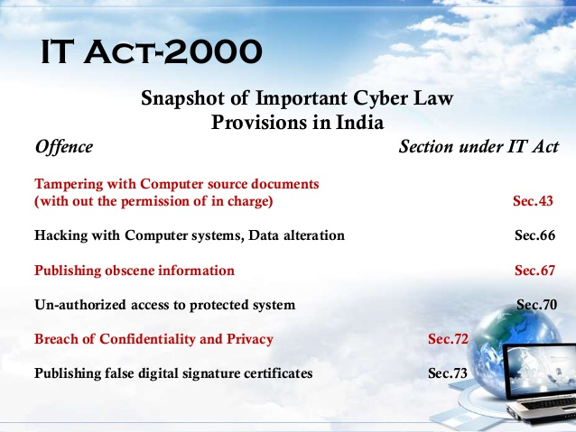

Slide 91
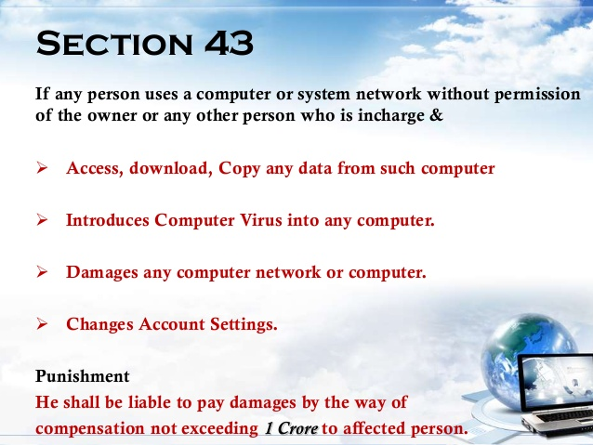

Slide 92
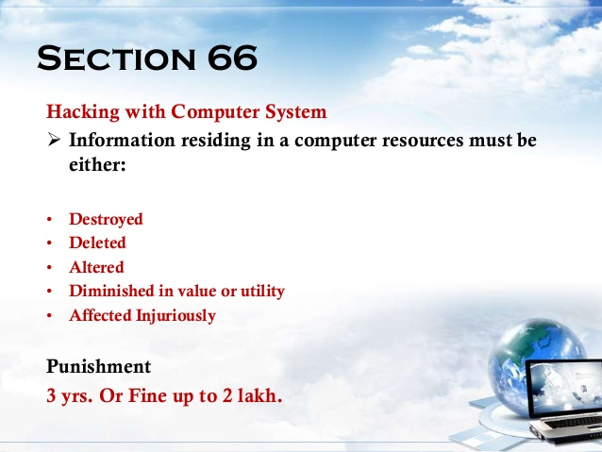

Slide 93
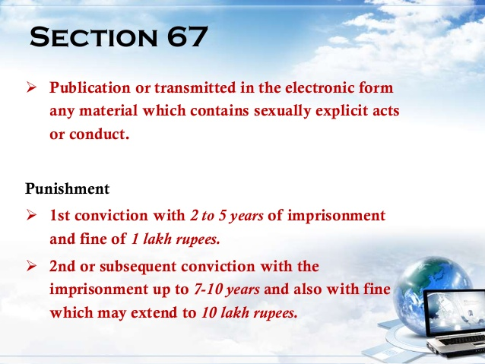

Slide 94
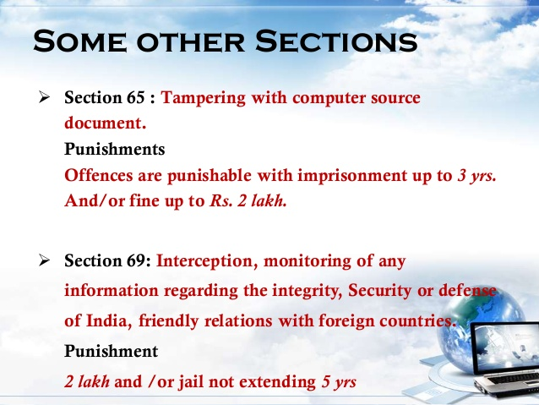

Slide 95
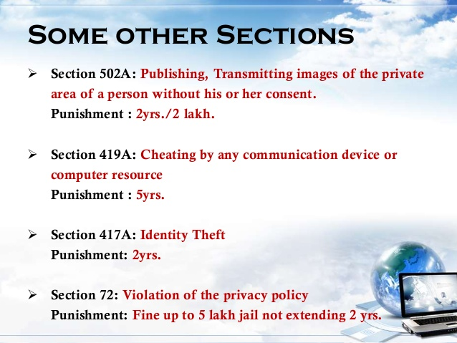

Slide 96
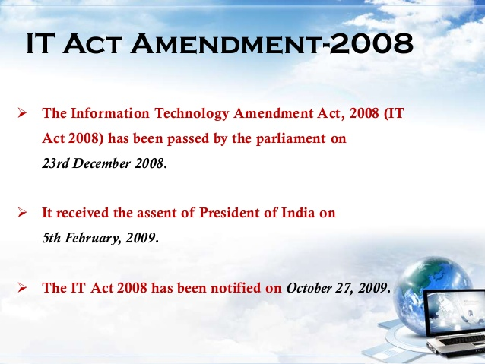
.net/AdityaShukla7/cyber-law-in-india-its-need-importance

Slide 97
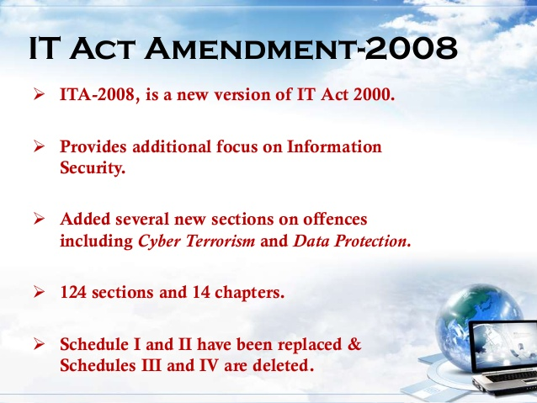

Slide 98
Need and importance of cyber law
tackling cyber crime
Successful and smooth functioning of ecommerce and virtual communication
No jurisdictional boundaries
Increasing use of mobile banking and internet banking.
Economic efficiency
http://www.cyberlawclinic.org/casestudy.htm

Slide 99
DIGITAL MARKETING

Slide 100
Introduction to digital marketing
Digital Marketing refers to the advertisement delivered through digital channels such as search engines, websites, social media, email and mobile apps.
It is the process of marketing a brand using the internet. Hence digital marketing encompasses all the activities a business onducts via worldwide web with the aim of attracting new business, retaining current business and developing its brand identity.

Slide 101
Benefit of digital marketing
Reach
Scope
Interactivity
Immediacy

Slide 102
Disadvantages of online marketing
outdated information
Web visitors expect something for free. So you need to have offer available for free.
There are lot of competition in the market

Slide 103
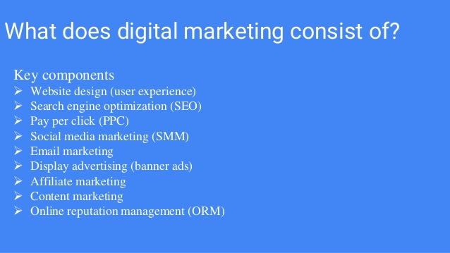

Slide 104
TOOLS OF ONLINE MARKETING
SEARCH ENGINE MARKETING
PAY PER CLICK
SEARCH ENGINE OPTIMISATION
ONLINE ADVERTISING
AFFILIATE MARKETING
VIRAL MARKETING
ONLINE REPUTATION MANAGEMENT
WEB PR
EMAIL MARKETING

Slide 105
SEARCH ENGINE MARKETING
An internet based tool that searches an index of documents for a particular term, phrase or text specified by the user. Commonly used to refer to large web-based search engines that search through billions of pages on the internet.

Slide 106
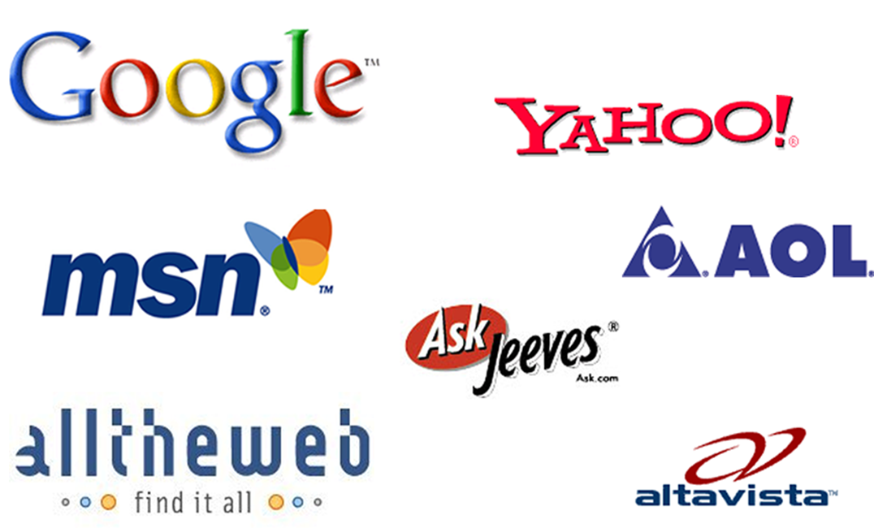
Search engine

Slide 107
Reason FOR search engine marketing
85% of all traffic on the internet is referred from a search engine
90% of all users don’t look past the first 30 results (most only view top 10)
Many websites aren’t even indexed, most are poorly optimized and get very little traffic from the search engines
Cost-effective advertising
Clear and measurable ROI
Operates under this assumption:
  More (relevant) traffic + Good Conv. Rate = More Sales/Leads

Slide 108
CATEGORIES OF SEARCH ENGINE MARKETING
PAID SEARCH. (PPC)
ORGANIC SEARCH (SEO)

Slide 109
Major search engines
Google feeds AOL, Netscape, Earthlink & others
Yahoo owns Overture, AltaVista, AlltheWeb, FAST & others
Google, Yahoo & MSN results account for 80-90% of all search traffic (rough estimate)

Slide 110
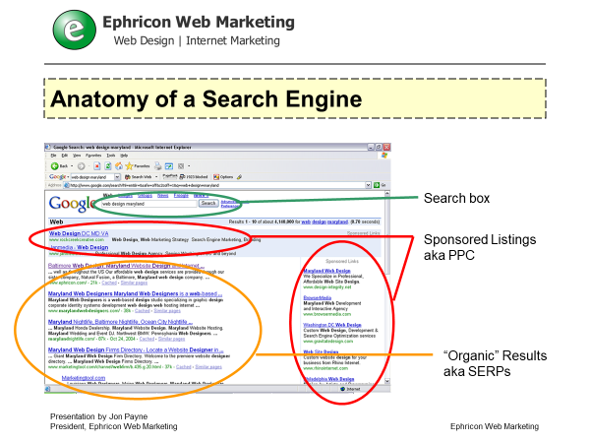
Anatomy of a search engine

Slide 111
How do search engines work?
Spider “crawls” the web to find new documents (web pages, other documents) typically by following hyperlinks from websites already in the database
Search engine indexes the content (text, code) in these documents by adding it to their huge databases and periodically updates this content
Search engine searches its own database when user enters in a search to find related documents (not searching web pages in real-time)
Search engine ranks resulting documents using an algorithm (mathematical formula) that assigns various weights to various ranking factors

Slide 112
seo
  Refers to the process of “optimizing” both the on-page and off-page ranking factors in order to achieve high search engine rankings for targeted search terms.
  Refers to the “industry” that revolves around obtaining high rankings in the search engines for desirable keyword search terms as a means of increasing the relevant traffic to a given website.
  Refers to an individual or company that optimizes websites for its clientele.
  Has a number of related meanings, and usually refers to an individual/firm that focuses on optimizing for “organic” search engine rankings

Slide 113
What does a seo do?
Identifies search phrases to target (should be relevant to business/market, obtainable and profitable)
“Cleans” and optimizes a website’s HTML code for appropriate keyword density, title tag optimization, internal linking structure, headings and subheadings, etc.
Helps in writing copy to appeal to both search engines and actual website visitors
Studies competitors (competing websites) and search engines
Implements a quality link building campaign
Pushes for more content!
Monitors rankings for targeted search terms

Slide 114
PAY PER CLICK SEM
Sponsored adverts are bought on Search Engine result pages (SERP) that are displayed at the right side of the display page. Here payment is made purely on the basis of performance.
Advert positioning is based on a bidding system. The highest bidder gets highest placement.
It is a dynamic strategic process.an appropriate keyword strategy ensures the clicks you pay for are as targeted as possible.
PPC ads appear as “sponsored listings”
Companies bid on price they are willing to pay “per click”
Typically have very good tracking tools and statistics
Ability to control ad text
Can set budgets and spending limits
Google AdWords and Overture are the two leaders

Slide 115
PPC VS ORGANIC SEO
PPC
results in 1-2 days
easier for a novice or one without much knowledge of SEO
ability to turn on and off at any moment
generally more costly per visitor and per conversion
fewer impressions and exposure
easy to compete in highly competitive market space (but it will cost you)
can generate exposure on related sites (AdSense)
ability to target “local” markets
better for short-term and high-margin campaigns
“Organic” SEO
results take 2 weeks to 4 months
requires ongoing learning and experience to reap results
very difficult to control flow of traffic
generally more cost-effective, doesn’t penalize for more traffic
SERPs are more popular than sponsored ads
very difficult to compete in highly competitive market space
can generate exposure on related websites and directories
more difficult to target local markets
better for long-term and lower margin campaigns

Slide 116
Online advertising
Online advertising is a form of marketing and advertising which uses the Internet to deliver promotional marketing messages to consumers. It is also known as online marketing or internet marketing.

Slide 117
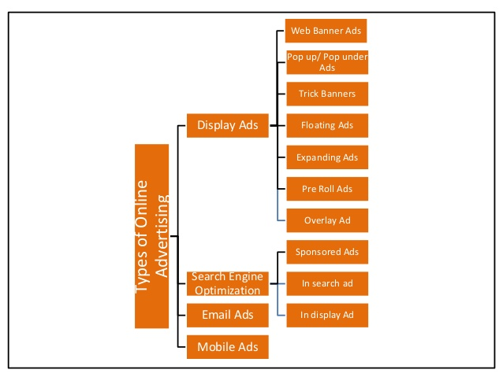

Slide 118
CPM( COST PER CLICK)
It is also known as Pay per click. Advertisers pay each time a user clicks on their listing and is redirected to their website. They do not actually pay for their listing, but only when the listing is clicked on.
Clicks are a way to measure attention and interest. The main purpose of an ad is to generate a clisk.
COST PER VISITOR (CPV)
It is online advertising ad model based on where advertisers pay for the delivery of a targeted visitor to the advertiser’s website.
Trick banner
A banner ad that looks like a dialogue box with buttons. It stimulates an error message alert.
FLOATING AD
An ad which moves across the user’s screen or floats above the content.
EMAIL AD
Here mailer send the promotional material to the targeted user

Slide 119
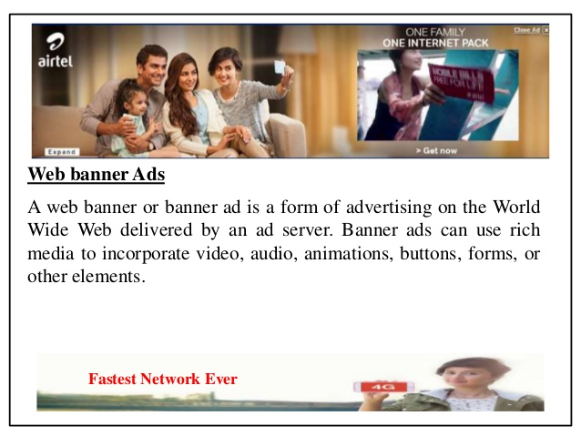

Slide 120


Slide 121


Slide 122


Slide 123


Slide 124


Slide 125
Online advertising
BENEFIT
Coverage
Low cost
Multimedia
targeting
PROBLEMS
Ad blocker
Unnoticed
Avoid
Too many choices

Slide 126


Slide 127


Slide 128


Slide 129


Slide 130


Slide 131


Slide 132


Slide 133


Slide 134


Slide 135


Slide 136


Slide 137

Online Reputation Management
It is the practice of monitoring the internet reputation of a person, brand or business with the goal of suppressing any negative mentions entirely.

Slide 138
Online reputation
Negative effect
could loose existing customer
Difficulty getting new customer
Business can suffer financial loss
Positive effect
retain existing customers
Easier to get new customers
Maintain a positive brand image

Slide 139
How to maintain reputation
Be proactive instead of reactive
Monitor online conversation
Respond and interact with customers
Create and distribute positive content regularly.
Actively seek reviews

Slide 140
EMAIL MARKETING
It is directly marketing a commercial message to a group of people to build loyalty, trust or brand awareness
Reasons for email marketing
Email has larger reach
Email deliver message
Email has higher ROI

Slide 141


Slide 142
webpr
Making use of PR in online platform.
Online press release to pull maximum traffic to the site.
In online platform press releases need to be optimised with the appropriate key phrases and links.
The link posted at the end of press release or feature article is a valuable source of driving internet traffic to your website

Slide 143
CONVERSION RATE OPTIMISATION
CRO is the process of optimising your site to increase the likelihood that visitors will complete specific actions

Slide 144


Slide 145
Two phases of conversion optimisation
ANALYSE
Website usability
Site analytics
The relative ROI of each e-marketing techniques
Any other available measure
OPTIMISE
Minimise drop off rate and making most of the traffic a site is getting
Based on analysis, incremental changes are made to the most inefficient factors

Slide 146
continued
TESTING
Constantly tweak and test to find out which is working best. This way e marketing technique can be optimised for a specific market.
Maximise efficiency by focussing on those which brings maximum efficiency in the organisation.

Slide 147
CONTENT MARKETING

Slide 148


Slide 149


Slide 150


Slide 151

CONTENT CREATION

Slide 152
FEATURES OF CONTENT MARKETING
Free content created and shared to attract customers and to convert prospective customers.
It is a way of educating people so that they know , like and trust you enough to agree to buy your products
content marketing attract and retain customers by consistently creating and curating relevant and valuable content with the intention of changing or enhancing consumer behaviour.
it is an art of communication with your customers and prospects without selling.
Content marketing strategy comes before social media strategy.

Slide 153


Slide 154


Slide 155


Slide 156


Slide 157


Slide 158


Slide 159
CONTENT Influencer MARKETING
it is a practice of engaging internal and industry expert with active networks to help achieve measurable business goals.
Bloggers are highly influential.
Customers trust recommendation than content.
influencer marketing goes hand in hand with social media marketing and content marketing.

Slide 160
Types of marketing
Word to word marketing
Here marketing takes place through real communication
Advocate Marketing
Advocate marketing focus on incentivising and encouraging already loyal customer to share their love for brand or product by way of product reviews and customer references.

Slide 161


Slide 162
blogging
The act of creating and maintaining a blog.
it is the act of posting a content on a blog or posting comments on someone else’s blog.
It was first developed by Peter Merholz.
blogging is a way of expressing one’s thought , ideas, opinions or experiences
the word blog has come from the term ‘weblog’ which was coined by Jorn Barge in 1997.
the term blog started to become popular when Peter Merholz broke the word weblog into two words ‘ we blog’

Slide 163
Features of blogging
blog is a website driven by content management system which features articles and comments on blog post.
blogosphere is the popular term used for the world of blogs, bloggers and blog post.
Blogging has become better with RSS( really Simple Syndication)
blogs need to be marketed for better viewing.

Slide 164
How to market blogs
Search Engine Optimisation
Comments. Keeping the blog active by using comments.
Listing the blog in blog directories
Ping webservices with your updated content.
Content of the blog should be as per the need of the customer.
frequency of posting new content should be maintained.
blogs should be set up to be as searh engine friendly as possible.

Slide 165

PODCAST

Slide 166
What is podcasting
it is the method of distributing multimedia files, such as audio, video programs over the internet using either the RSS or Atom Syndication formats, for playback on mobile devices and personal computers.
The name has come from iPod( a personal digital audio player made by Apple) and broadcasting

Slide 167
Benefits of podcasting
allows listeners to time shift and place shift media consumption.
very efficient since episodes are only downloaded by listeners on an opt-in basis.
easily accessible to global audience.
access to an educated, influential audience with a high disposable income.
Ability to leverage electronic programming without an outside news media filter.

Slide 168
Advantages of podcasting
available anytime, anywhere
easy to create, distribute and download- no professional equipment is required.
New podcasts are auto downloaded
It gives power to audio over text.
No need to invest in a new piece of hardware.
People can create their own podcast studio with very little investment.

Slide 169
disadvantages
entire file is downloaded which may have undesired content
need sufficient bandwidth to download the podcast in timely fashion
Limited usefulness for people with hearing impairment
no interactivity among audience

Slide 170
vodcast
vodcast is a term used for delivering Video on demand files online via RSS feed.
vodcasting is different from video files online.
Vodcasts are video files in different format and hence special format is needed for special devices to understand and play the video,
rich site summary is described as a technology used by marketers around the world in order to track their favorite websites. RSS feed keeps one informed by retrieving the latest update from the site you wish to receive information from

Slide 171
Content marketing vs blog marketing
Content marketing
it provides useful content that guides customer in the buying process
it is very strategic in its approach
It is larger in scope
Blog marketing
it tells story about the company and let the customer know that you care
it tries to connect at emotional level.
Narrow in scope and is used only to connect

Slide 172
CREATING RELEVANT CONTENT USING KEYWORD
1. SEARCH VOLUME
2. COMPETITIVENESS
3. PROPENSITY TO CONVERT

Slide 173

Meta data
Metadata is data in data warehouse, to represent other data.
Metadata is data about data.
It is summarised data that leads to detailed data
It is road map about data warehouse.

Slide 174
Role of metadata
Act as directory
Directory helps decision support system to allocate the content of data warehouse.
Helps in mapping of data when data is transformed from operational environment to data warehouse environment.
Used as query tools
used as extraction or cleaning tool.

Slide 175
Title tag; header tag; keyword density
Title Tag: indicate what the webpage is all about.
Header tag: used to structure page and act as an indicator of page theme.
Keyword density: it says how many times key phrase occurs on your page in relation to the total number of words. If overdone then it need to be reduced.
Bolding and using Italics
Alt tags: since search engine spiders cannot read images. Alt tags are used to describe the image.
Bullets: they make it easy to convey message in concise manner.

Slide 176


Slide 177
Accessibility issue of web spider
Clean URL: it means search engine friendly URL that improve the usability and accessibility of a website and web service
A URL comprise of path, script name and query string
Uncleaned URL | Clean URL
http://example.com/index.php?page=name | http://example.com/name
http://example.com/about.html | http://example.com/about
http://example.com/index.php?page=consulting/marketing | http://example.com/consulting/marketing
http://example.com/products?category=12&pid=25 | http://example.com/products/12/25

Slide 178
Things to avoid to let spider crawl in
Frames:
They are structure that allows dividing the webpage into two or more independent parts.
Using frames should be avoided as it break the URL structure
Flash
It is a technology which helps in making interactive banner and button advertisement

Slide 179
Feeding the spider
Links
Inbound link: a link from a site outside of your site.
They are also known as backlink.
Outbound link
link on the site that will take them to relevant site.

Slide 180
Search engine marketing
It is a broader term that encompasses all kind of internet marketing.
SEO is a subset of SEM

Slide 181
PPC
There are two types of PPC.
Search Targeted: this refer to SERPs( Search Engine Research Pages) where a user has searched for a specific word and search result has come.
Content targeted: This is also known as contextual advertising. They are displayed on content pages

Slide 182
Bidding wars
FACTORS CONSIDERED IN BIDDING
Bidding higher amount of money result in higher position.
Search engine like Google uses QUALITY SCORE.
Quality score is an estimate of the quality of your ads, keywords, landing pages. Higher quality ads can lead to lower prices and better ad positions

Slide 183
Other method of advertising
CPM means Cost Per Thousand. (M in Roman numeral for thousand.
CPC means cost per click
CPA means cost per action
CTR means Click Through Rate. This is the percentage rate at which people click on your ad banner.
Number of clicks
Number of time ad is seen x 100
CPL( Cost Per Lead)total cost of online advertisement campaign divided by the number of lead generated.
CPS( Cost Per Sale)

Slide 184
WEB PR AND ONLINE REPUTATION MANAGEMENT
ORM is a vital component of any PR strategy.
ORM involves monitoring the internet for conversation about their brand and even competitor’s brand.
There are ORM tools available to do the job.
It helps to gain awareness about brand attack and service problem in real time. This helps brand to respond without delay.
Depending on the seriousness of the online attack and the credibility of the source, senior management should be alerted.

Slide 185
ORM BY MAKING YOUR VOICE HEARD
Why?
To respond to others
To build a voice
How?
Online Article Syndication: contributing articles to online article directories. The article should be broad, informative and not just disguised adverts. With keywords and proper link they are highly useful.
Online press release: Online press release should drive traffic to your site. Press release should also be search engine optimised.
Featured Article:
Blogs: being active in blogs and also commenting on other’s blog

Slide 186
Social media marketing
It is a form of internet marketing that implements various social media networks in order to achieve marketing communication and branding goals.
Objective of Social Media Marketing:
Increasing website traffic
Building conversions
Raising brand awareness
Creating a brand identity and positive brand association
Improving communication and interaction with key audiences

Slide 187
Popular social media
Meerkat/Periscope
Yahoo Answer
Twitter
Instagram
Pinterest
Google+
Facebook
Reddit
Linkedin
Snapchat
Slideshare
Blogging, Podcasting and video.

Slide 188
Advantages of social media marketing
Large audience
Free to create
Encourages sharing
Increases brand loyalty
Uncover valuable insight

Slide 189
Disadvantages of social media marketing
Negative feedback
Potential for embarrassment
Time intensive

Slide 190
DISPLAY ADVERTISING
It is also known as banner advertising. It refers to advertisement that incorporates text, logos, pictures or images positioned on a website or search engine.
It is not very expensive. It is proportional to the size and placement on host site.
Dynamic display ad is also referred to as dynamic creatives or dynamic banners. They are not pre programmed with fixed content.
They are also called targeted advertising as they changes on the basis of users activity.
By using signals from each user’s data Dynamic Display Ad can determine the most relevant products and offers for each person

Slide 191
Who benefits from dynamic display ad
Businesses with lots of product
Businesses that update product a lot
Businesses with direct competition

Slide 192
Web banner
It is a form of advertising used online.
The size of web banner depends on where you are placing the banner.
Since internet users are annoyed with web banner they have come out with ad blockers.
There are two types of web banner. Static and Animated. Better animated banner can be made using flash technology.
Flash banner result in high CTR. It can create smooth animation and special effect can be developed in Flash. Even though Flash involve lots of animation it occupy much lesser space. This is due to inherent nature of Flash which is a vector based program.
Flash banners are interactive responding to mouse clicks and mouse over.

Slide 193



Slide 194
Continued…
Composite banner contain graphic element and HTML CODE. HTML code are embedded in such composite banner to bring interactivity.

Slide 195
Web analytics
Web Analytics is the measurement, collection, analysis and reporting of web data to understand and optimise web usage.
It is essentially the study of website visitor behaviour.
Information gathered from web analytics is used to maximise revenues from pay per click advertising, improve click through on email campaign or even increase your search engine ranking.
Web analytics monitors traffic and can show who the visitors are, where they came from, what they did on site, how long they were in the site.
Benefit of Web Analytics is having information to take better decision about the site.

Slide 196


Slide 197


Slide 198
Categories to consider for good web analytics program
Features : it gives view of several features that is useful in measuring website traffic.
Traffic : it keep track of large variety of data starting from who visit the site, what time to the time one exit from the site.
Referrals:
Report stat intervals: this involve setting applicable date range. Example monthly, yearly, weekly, daily or hourly.
Events : An event is any logged or recorded action that has a specific date and time assigned to it bey either the browser or server.

Slide 199
Continued…..
Visitor Detail: web analytics keep track of each visitor in the site. This is required to identify target audiences, develop campaigns or learn what might work better to increase conversions.
File exporting: web Analytics program offer a variety of exporting options

Slide 200
Tech support and help
Tools to gain more support for web analytics:
Google analytics: free tool but slow.
Spring metrics: it use simple analytic tool and real time conversions.
Woopra: it also offers real time analytics tracking
Clicky: it gives free service if one have only one website and a pro account for a monthly fee.
Mint: it is an analytical tool that is self hosted.
Chartbeat: they keep constant watch on your visitors as to what they are doing on the website.

Slide 201
continued
Kissmetrics : this tools allow client to track the movement of individual visitor through out their websites. It help one to see how behaviour change over time.
User Testing:the user and their activity is recorded on the video. It helps to know what the users are thinking in target demographics.
Crazy Egg : uses heatmap technology to see what site visitor are doing on web pages. It shows where the visitor is moving their mouse and where they click. These technology helps you to see which area of the site is getting maximum attention.
Mouseflow: it is a combination of UserTesting and Crazy Egg. You can see video of users interacting with your site, including every mouse click, movement, scrolling etc. pricing changes depending on number of site one tries to cover.

Slide 202
WEB TRAFFIC
Web Analytics data is used to increase web traffic or increase sales.
Based on web Analytics report, one has to choose method of advertising, SEO, SMM, Email marketing, viral marketing.
Web analytics even shares the figures for paid and organic search or clicks.

Slide 203
Free traffic
This is mostly generated through social media or search engine optimisation. It is generating organic traffic through optimising your blog. Content or website for search engine.
Free traffic is also generated by linking your site to social media platform.
ADVANTAGES
It is free.
It is less demanding
traffic flow may continue long after the campaign has been stopped.

Slide 204
Disadvantages of free campaign
It can be time wasting if not well managed.
Success of free marketing is not guaranteed.

Slide 205
Paid traffic
It involves making payment to divert traffic to your site.
This include strategies like PPC
There are many social media platform to carry paid advertisement for paid traffic.
Advantages:
Traffic is fast to get
Easier to reach target market
Disadvantages :
It can be costly
One might have to wait.

