Slide 1

Financial Markets
Evolution and structure

Slide 2
VINIT SANGHVI
BRIEF PROFILE
MSc. (Finance) – JBIMS (Gold Medalist)
Worked with ICICI Bank in Structured Finance Group
7+ years of training expertise across
Mentored 5000+ students for International Certifications such as CFA, FRM, CISI, CWM, CMT, CCFR
Investment Banking
Equity Research
Financial Analysis
Wealth Management
Investment Management

Slide 3
AGENDA
1
2
3
4
EVOLUTION OF CAPITAL MARKETS
WHAT ARE CAPITAL MARKETS?
HISTORY OF CAPITAL MARKETS
TYPES OF MARKETS
INDEX CONSTRUCTION
STRUCTURE
PARTICIPANTS

Slide 4
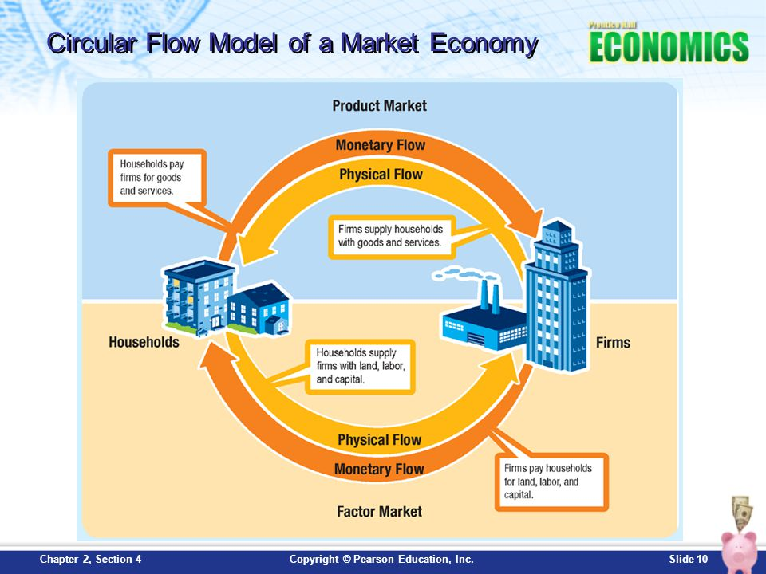
Capital markets and CIRCULAR FLOW OF MONEY
Saver Borrower
Optimum allocation of Capital

Slide 5
EVOLUTION OF FINANCIAL MARKETS
The Calcutta Stock Exchange Association
1927 – BSE got recognized under Bombay Securities Contracts Control Act, 1925
Establishments of FI and SFC
1955 – SBI established
1870-1900
1931-1947
1977
1901-1930
1948 -1976
Establishment of Native Shares and Stock Brokers’ Association in Bombay
Ahmedabad Shares and Stock Brokers’ Association
Establishment of RBI under RBI Act
Several Stock Exchanges established
DHIRUBHAI AMBANI ENTERS CAPITAL MARKETS

Slide 6
EVOLUTION OF FINANCIAL MARKETS
SEBI Act and Incorporation of NSE
Harshad Mehta Scam
Shift to Electronic Trading
9/11 Terrorist Attacks
Corporate Frauds
A young Indian warned of Financial Bubble
1978 -1991
2000
2008 -2009
1992 -1994
2001-2007
Explosive Growth
Liberalization, Privatization, and Globalization
Dot.com Bubble
Ketan Parekh Scam
Derivatives Trading Launched
GLOBAL FINANCIAL CRISIS

Slide 7
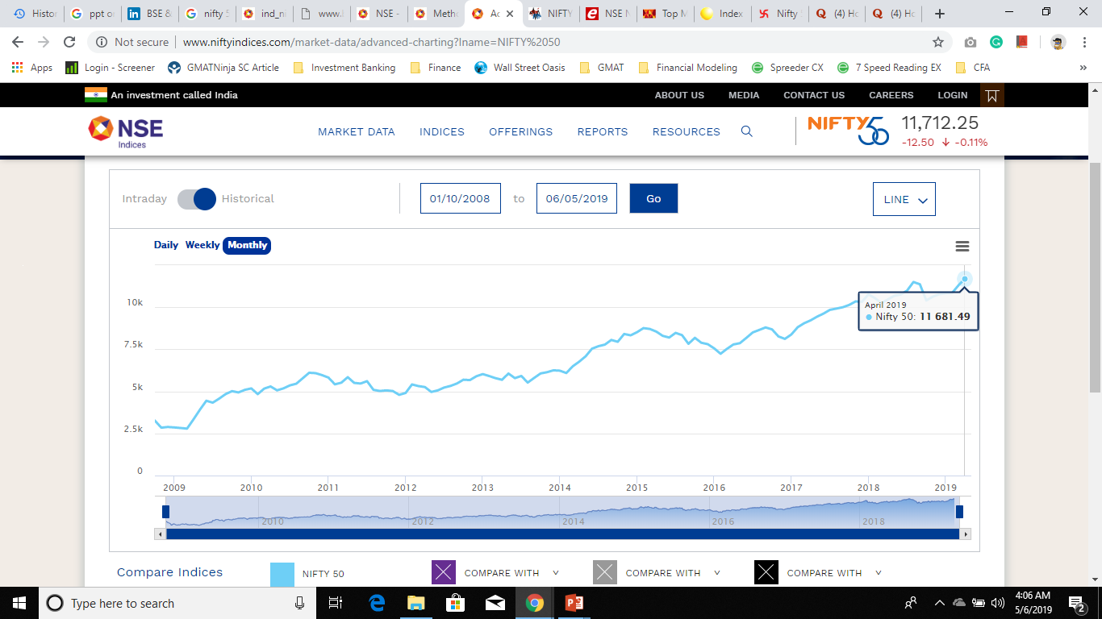
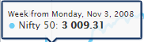
EVOLUTION OF FINANCIAL MARKETS

Slide 8
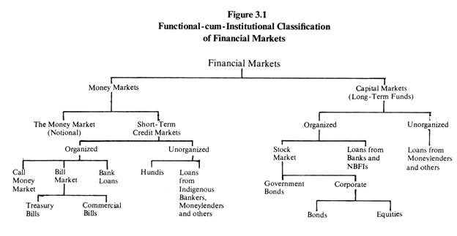

TYPES OF FINANCIAL MARKETS

Slide 9
AGENDA
1
2
3
4
PARTICIPANTS OF FINANCIAL MARKETS
INTENTION FOR PARTICIPATION
FINANCIAL INTERMEDIARIES
OTHER PARTICIPANTS
INDEX CONSTRUCTION
STRUCTURE
EVOLUTION

Slide 10




INTENTION OF PARTICIPATION
CORPORATES
GOVERNMENTS
REGULATORS
FINANCIAL INTERMEDIARIES
RAISE FUNDS FOR BUSINESS OPERATIONS AND EXPANSIONS
INCREASE SHAREHOLDER’S WEALTH BY GENERATING PROFITS
RAISE FUNDS FOR CAPITAL EXPENDITURE SUCH AS INFRASTRUCTURE SPENDINGS, SEZ
PROVIDE ESSENTIAL SERVICES SUCH AS HEALTHCARE, WATER SUPPLY, ELECTRICITY ETC.
ENSURES FAIR TRADE PRACTICES
ESTABLISHES POLICIES AND RULES FOR SMOOTH FUNCTIONING
PROTECT INVESTOR’S INTERESTS
PROVIDE FINANCIAL SERVICES
ACTS AS CUSTODIANS AND TRUSTEES
PROVIDE CENTRALISED TRADING PLATFORM

Slide 11
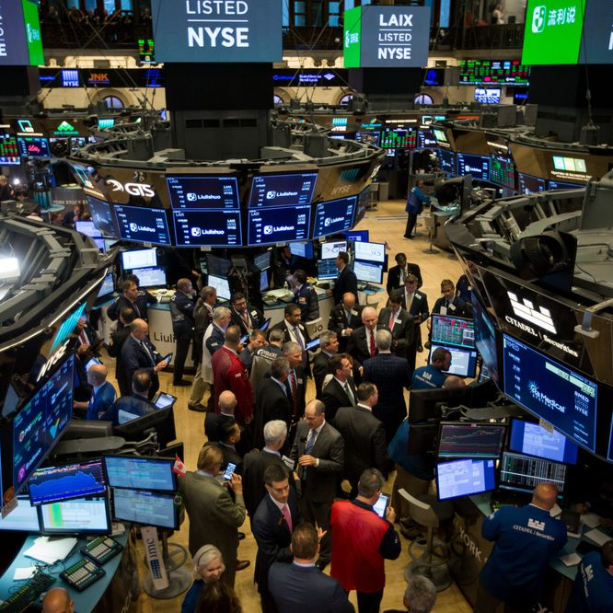


FINANCIAL INTERMEDIARIES
STOCK EXCHANGES
BROKERS AND DEALERS
CREDIT RATING AGENCIES
DEPOSITORY INSTITUTIONS
MATCHES BUYERS AND SELLERS
BEARS COUNTERPARTY RISK
GUARANTEES DELIVERY OF ASSETS
PROVIDE TRADING SOFTWARES
INTERMEDIARIES BETWEEN BUYER/SELLER AND EXCHANGE
MARKET MAKERS
PROVIDE INFORMATION ABOUT THE CREDITWORTHINESS OF FINANCIAL INSTRUMENTS
AAA+ TO D RATINGS
PROVIDE LOANS AND DEPOSIT SERVICES
EARN INCOME THROUGH INTEREST

Slide 12




FINANCIAL INTERMEDIARIES
INSURANCE COMPANIES
CLEARINGHOUSES AND CUSTODIANS
INVESTMENT BANKS
MUTUAL FUNDS
GUARANTEES PAYMENTS IN CASE OF AN EVENT
PROVIDE ASSET SAFEKEEPING AND ESCROW SERVICES
ENSURES CONTRACT COMPLETION
PROVIDE FUND RAISING FACILITIES AND ADVISORY SERVICES
WIDE NETWORK OF INVESTORS
PROVIDE ASSET ALLOCATION AND DIVERSIFICATION BENEFITS

Slide 13
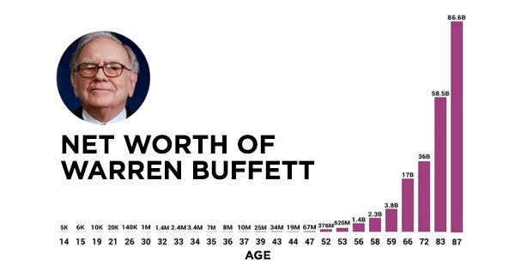
OTHER PARTICIPANTS

Slide 14
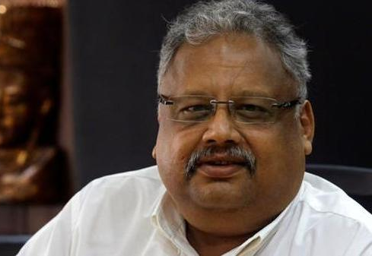
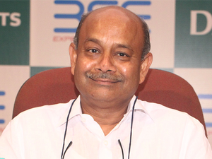
OTHER PARTICIPANTS

Slide 15

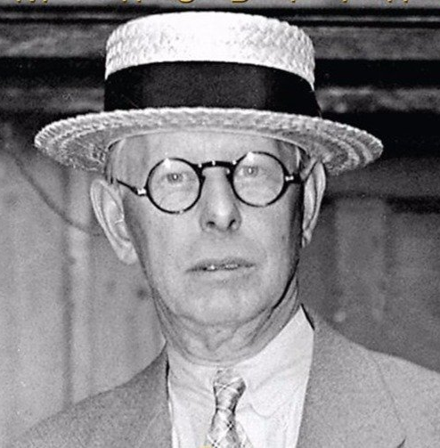
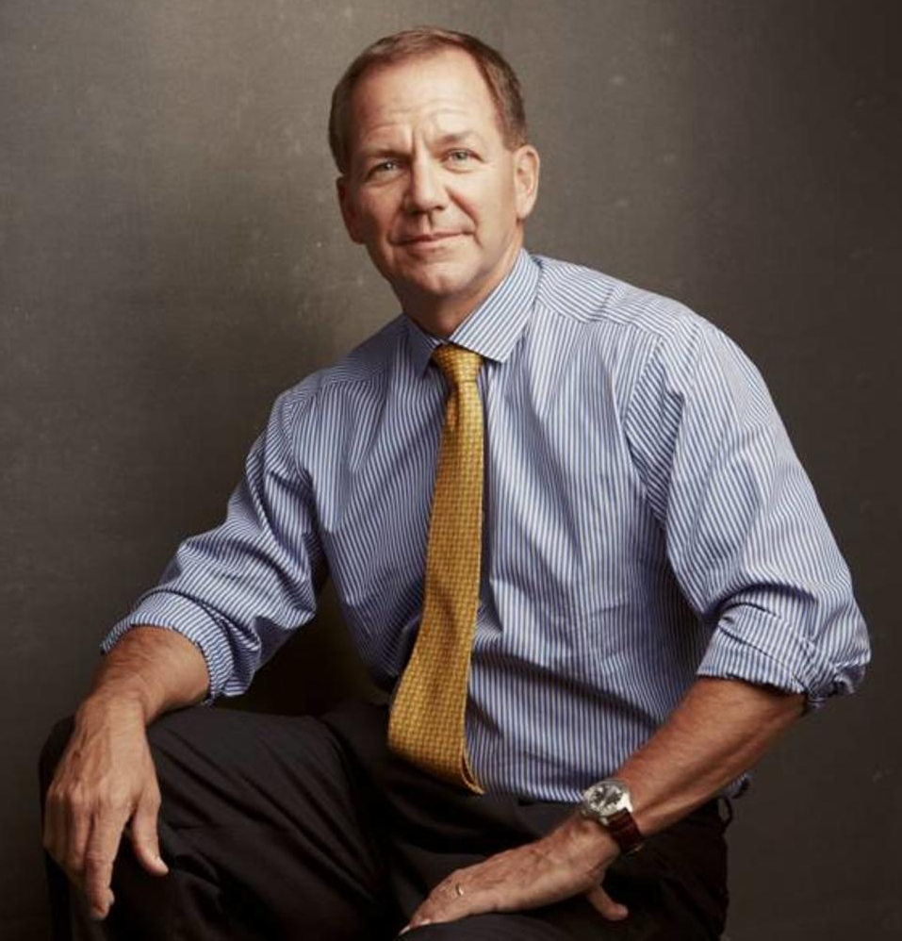
OTHER PARTICIPANTS

Slide 16
AGENDA
1
2
3
4
STRUCTURE OF FINANCIAL MARKETS
TYPES OF FINANCIAL MARKETS
DIFFERENT EXCHANGES IN INDIA
NIFTY 50 P/E HEATMAP
INDEX CONSTRUCTION
EVOLUTION
PARTICIPANTS

Slide 17

MARKET TYPES
Call Market
  Active at a specific time
Continuous Market
  Active all the time
Over-the-counter Market
Equity Market
  Primary Market
  Secondary Market
Derivatives Market

Slide 18

PRIMARY MARKETS
PUBLIC OFFERING
PRIVATE PLACEMENT & OTHER TRANSACTIONS
First offering by a corporate to public - IPO
DRHP
Book Building
Underwriting
Best-effort basis
Shelf Registration
Dividend Reinvestment Plan (DRIP)
Rights offering
Warrants

Slide 19

SECONDARY MARKET
EXCHANGE TRADING
Securities trade on the exchange after the primary offering
Provides Liquidity
Brokered markets

Slide 20

BOMBAY STOCK EXCHANGE (BSE)
Oldest stock exchange in Asia. Commonly known as Dalal Street
Established in 1875 by Premchand Roychand
10th largest stock exchange in the world with a market capitalization of $4.9 trillion as on April, 2018
Has 5400+ listed companies
First listed Stock Exchange of India
Initially known as The Native Share and Stock Brokers’ Association
Publishes the index SENSEX
Sensex comprises of 30 stocks
Started offering Derivatives trading in 2017

Slide 21
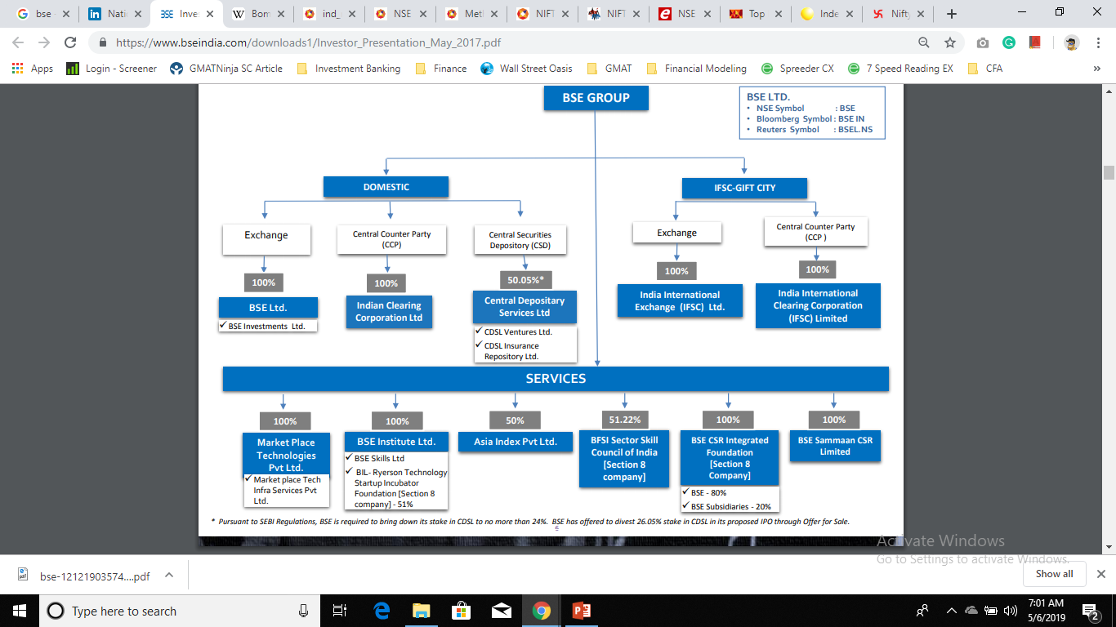
BOMBAY STOCK EXCHANGE (BSE)

Slide 22
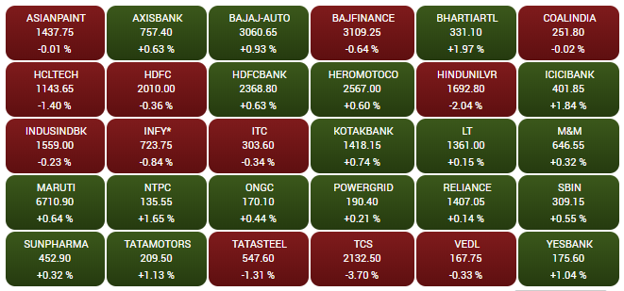
BOMBAY STOCK EXCHANGE (BSE)
Sector | % Weight
Finance | 43.22
Information Technology | 14.20
Oil and Gas | 12.68
FMCG | 9.58
Transport Equipment | 6.75
Capital Goods | 4.18
Metals | 2.71
Power | 2.39
Chemical/Petrochemical | 1.64
Telecom | 1.41
Healthcare | 1.23

Slide 23

National stock exchange (nse)
Established in 1992 in Mumbai
11th largest stock exchange in the world with a market capitalization of $2.27 trillion as on April, 2018
Has 1900+ listed companies
Publishes the index NIFTY. Also known as Nifty50
NIFTY comprises of 50 stocks
NIFTY performance is closely followed to understand the performance of Indian Economy

Slide 24
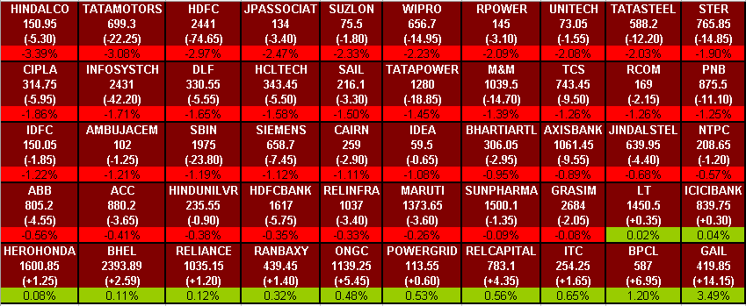
National stock exchange (nse)

Slide 25
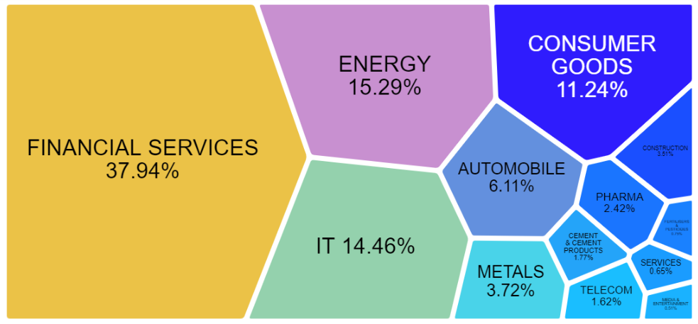
National stock exchange (nse)

Slide 26

MULTI COMMODITY exchange (MCX)
Established in 2003 in Mumbai
7th largest global commodity bourse in the world
Metal - Aluminium, Aluminium Mini, Copper, Copper Mini, Lead, Lead Mini, Nickel, Nickel Mini, Zinc, Zinc Mini,Brass(futures)
Bullion - Gold, Gold Mini, Gold Guinea, Gold Petal, Gold Petal ( New Delhi), Gold Global, Silver, Silver Mini, Silver Micro, Silver 1000.
Agro Commodities - Cardamom, Cotton, Crude Palm Oil, Kapas, Mentha Oil, Castorseed, RBD Palmolien, Black Pepper.
Energy - Brent Crude Oil, Crude Oil, Crude Oil Mini, Natural Gas.

Slide 27
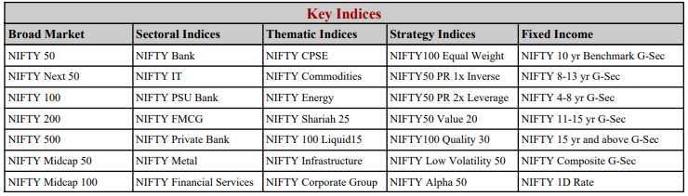
OTHER KEY INDICES

Slide 28
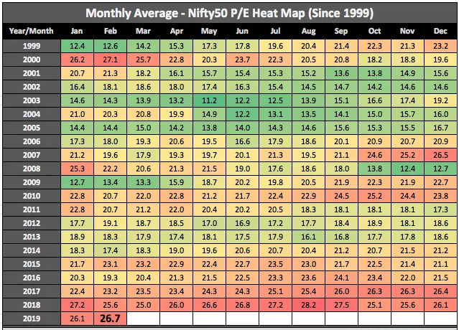

Slide 29
AGENDA
1
2
3
4
INDEX CONSTRUCTION
PRICE-WEIGHTED INDEX
MARKET CAPITALISATION WEIGHTED INDEX
FLOAT ADJUSTED MARKET CAPITALISATION WEIGHTED INDEX
EQUAL WEIGHTING INDEX
EVOLUTION
STRUCTURE
PARTICIPANTS

Slide 30
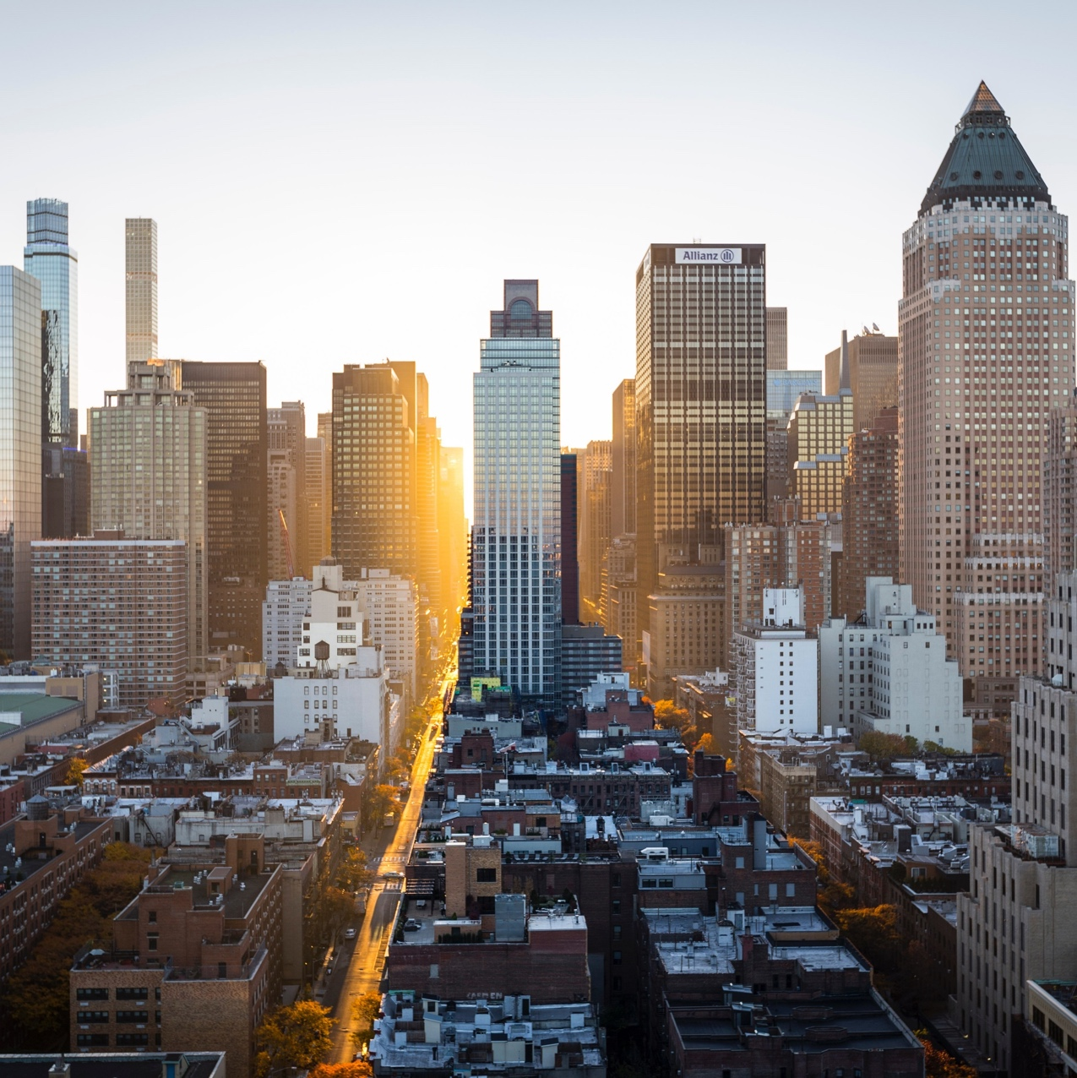
Thank you
Vinit.Sanghvi@Hotmail.com
+91-9503337108

