Slide 1

FOUNDATION COURSE II
POOJA MISHRA

Slide 2
UNIT I
Liberalization
Concept, Benefits and Limitation
1.2 Privatization
Objectives, Advantages and Criticism
1.3 Globalization
Features, Impact-Positive and Negative
1.4 Information Technology and Communication (ITC)
Growth and Its Impact-Positive and Negative
1.5 Globalization-Industry and Employment
1.6 Globalization and Migration-Causes and Effects.
1.7 Changes in Agrarian Sector due to Globalization
1.8 Corporate Farming and Farmers Suicide

Slide 3
UNIT II
UNIT-2 : Human Rights Concept of Human Right, origin and evolution of the concept , the Universal declaration of Human Right. Human Rights constituents with special reference to fundamental Rights stated in the Constitution.

Slide 4
UNIT-III : Ecology
Importance of Environment studies in the current developmental context ,. Understanding concept of Environment , Ecology, and their interconnectedness . Environment as natural capital and connection to quality of human life. Environmental degradation –Cause and impact of human life. Sustainable development concept and components, poverty and Environment .

Slide 5
UNIT-IV : Understanding Stress and Conflict
Causes of stress and conflict in individual life and society. Agents of socialization and the roll played by them in developing the individual. Significance of values , ethics, and prejudices in developing the individual. Stereotyping and prejudice as significant factors in causing conflict in society. Aggression and violence as the public expression of conflict

Slide 6
UNIT-V : Managing stress and conflicts in contemporary society.
Types of conflict and use of coping mechanisms for Managing individual stress. Mallows Theory of Self-actulazation., Different methods of responding to conflicts in society. Conflict – resolution and efforts toward the building Peace and harmony in society.

Slide 7

UNIT VI: Contemporary societal issues

Slide 8
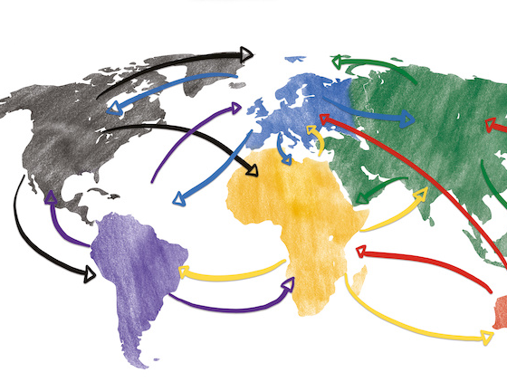
Globalization and Indian Society.

Slide 9

LIBERALIZATION
The term liberalization indicates freedom or relaxation to business enterprises from government control.
Liberalization can be defined as a process of moving from directed planning and controlled economy to gradual decontrol, deregulation and indicative planning.

Slide 10
Meaning of Liberalization
Liberalization is the process or means of the elimination of the control of the state over economic activities. It provides greater autonomy to the business enterprises in decision-making and eliminates government interference.

Slide 11
Objectives
To boost competition between domestic businesses
To promote foreign trade and regulate imports and exports
Improvement of technology and foreign capital
To develop a global market of a country
To reduce the debt burden of a country
To unlock the economic potential of the country by encouraging the private sector and multinational corporations to invest and expand.
To encourage the private sector to take an active part in the development process.
To reduce the role of the public sector in future industrial development.
To introduce more competition into the economy with the aim of increasing efficiency.

Slide 12
Economic liberalisation involves the following major changes.
1. Change in the outlook of industrial policy with the aim of facilitating private sector growth.
2. It is concerned with the technological up gradation and computerization.
3. It aims at bringing about the changes in trade, prices and industrial policies.
4. It opens the door of economy to foreign investment.
5. It leads to delicensing import and enhancing export incentives.

Slide 13
The financial sector was opened to foreign investors.
Fiscal Reforms
Direct Tax Reforms: To bring about an increase in the collection of income-tax.
Indirect Tax Reforms: Different indirect taxes are:- Custom duties, Excise duties, Service Tax, State level (Value Added Tax) VAT.
Privatization of public sector
Encouraging foreign tie-ups.
Liberalized NRI investment policy.
Removal of import restrictions
Simplification of industrial licensing
Liberalization of industrial location

Slide 14
Benefits of Economic Liberalization
It has led to increase in foreign collaborations.
It helps in solving fiscal burden and fiscal crisis.
Economic liberalization generates better competition
It encourages free mobility of foreign capital and Foreign Direct Investment (FDI) that helps the economy develop rapidly.

Slide 15

Limitations of Economic Liberalization
Economic liberalization has been criticized on the ground that it will make us more dependent on foreign collaboration and lead to economic exploitation.
Economic liberalization is concerned with technological upgradation and computerization thereby increasing unemployment, inequalities of income and poverty.
Liberalization has also far-reaching effects on socio-cultural fabric of the nation. Along with the foreign goods the Indian culture is getting fast eroded by the materialistic, hedonist western culture.

Slide 16


PRIVATISATION

Slide 17
Privatization is the transfer of control of ownership from public sector to private sector in business and nonbusiness activities.

Slide 18
Objectives Benefits or Advantages of Privatization
Improvement in performance and efficiency
Fixing responsibility is easier
As private sector is subject to capital market discipline
Political interference is unavoidable in public sector enterprise.
Successful planning
Privatization leads to better service to customers
Organizational culture

Slide 19
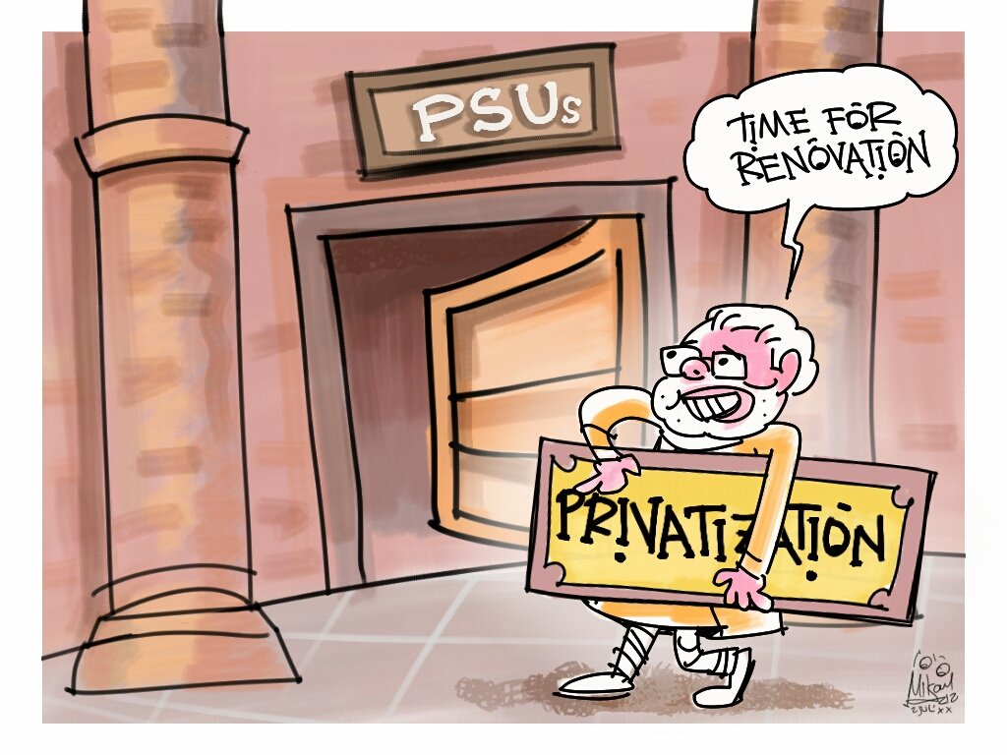
Criticism/Arguments against Privatization
The question being raised today is, whether privatization is the answer to all problems faced by the public sector.

Slide 20
1. Social justice: private sector cannot ensure material progress of every section in society nor ensure social justice. There is fear of increase in income inequalities, which is harmful to developing economies.
2. Standard of living: change of ownership from public to private sector does not ensure higher income and better standard of living of employees.
3. Private sector in India has displayed poor performance, as they rely on government incentives.
4. Privatization has introduced the element of monopoly, leading to concentration of economic power.
5. Private sector enterprise keeps away from infrastructure development, which is important for social and economic progress. So the economic development is bound to suffer in the long run.
6. The private sector has been performing under a regulated and protected environment. They have relied on fiscal incentives and protected from foreign competition by the government.

Slide 21

globalization

Slide 22
Globalization means integrating the national economy with world economy.
It is the concept that underlines the growth of connections between the people on a worldwide scale.
It is simply the expansion of economic activities across political boundaries of nation-states.
It implies free flow of goods and services, capital, technology and labour across national boundaries.
The main purpose of globalization is to exploit the global opportunities for local growth.

Slide 23
1. Greater international movement of commodities. I.e., increase in international trade at faster rate.
2. Increase in international flow of capital including foreign direct investment (FDI)
3. Greater transborder data flow, using technology such as Internet, telephones etc.
4. Greater international cultural exchange. Eg through export of Hollywood and Bollywood movies.
5. Greater international travel and tourism.

Slide 24

Features/Characteristics of Globalization
In global business, production and marketing operations are conducted on large scale to meet the needs of global market.
Various policies encouraging globalization and due to technological developments of past few decades, all this has led to increase in cross border trade, investment and migration.
Domestic production has increased and has led to new opportunities for international trade and investment. Government has also negotiated reductions in barriers to commerce and has established international agreements to promote trade in goods, services and investments.

Slide 25

Globalization is made possible due to technology. i.e. due to advance in information technology, economic life has transformed.
Globalization has led to establishment of multinational (MNC) and transnational companies. MNCS are large parent corporation, which operates in different countries through its branches. These branches of MNCS conduct business activities independently, but with policy decision taken by head office.

Slide 26

Positive Impact of Globalization
Import of quality goods, which has improved the standard of living, and consequently led to good competition within the domestic industry.
More foreign capital and has resulted in up gradation of technology in Indian companies.
Globalization facilitates transfer of capital from one country to other due to free convertibility.
Globalization provides opportunities to participating countries to grow and expand production and marketing activities.

Slide 27
positive impact
Employment in service sectors
Impact of FDI on Employment
Increase in contractual workers

Slide 28
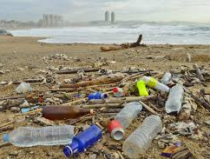
Negative impact of Globalization
The domestic firms find it difficult to compete with highly professional foreign MNCS due to their superior quality and effective cost.Eventually small scale and agro industries are adversely affected due to liberal policies with regard to globalization.
FDI results in outflow of foreign exchange due to payment of dividends and royalties.
Though globalization has led to the extensive use of capital-intensive technology, such modern technology/automation has not created large scale employment opportunities in the developing countries which is a priority.

Slide 29
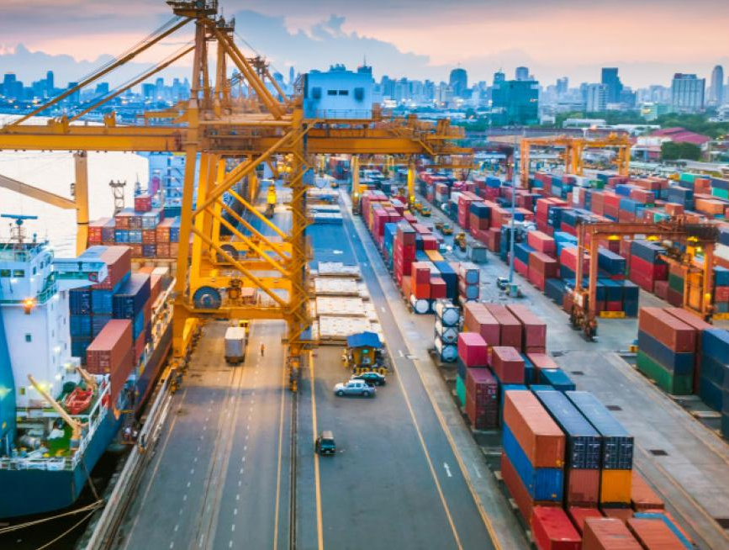
NEGATIVE IMPACT OF GLOBALIZATION
Introduction to labor saving devices
Negative growth of employment in public sector.
Employment in small scale sector

Slide 30

World Wide Web (WWW): On the World Wide Web a large amount of latest data is available on the various subjects.
Geographical Information System (GIS) is a computer system that can hold and use data describing places on the earth’s surface.
Global Positioning System (GPS) is a set of satellites and control systems that allows a specially designed GPS receiver to determine its location anywhere on the earth 24 hours in a day.
Remote sensing means observation of the earth from space. Satellites used for this purpose are known as remote sensing satellites.

Slide 31
Positive Impact
IT has led to globalization. It has not only brought the world closer but has allowed the world’s economy to become a single inter-dependent system.
With the help of information technology communication has become cheaper, quicker and more efficient.
Information technology has streamlined business through computerization and also has made them cost effective.
IT has made business to be open 24 hours in a week (24X7) all over the globe. This means business can be opened anytime anywhere making purchases from different countries and more convenient.
IT has created many new and interesting jobs. Computer programmers, systems analyzers, hardware and software developers, web designers are some of the many new employment opportunities available today.

Slide 32

NEGATIVE IMPACT
IT has streamlined the business process by creating new jobs, but it has also paved the way for job redundancies, downsizing and outsourcing.
Information technology no doubt has made communication quicker, easier and convenient but it has also brought privacy issues along with it.
Job security a big issue as technology changes with each day. This means that one must be in constant learning mode to secure their job.
IT has made the world a global village, but it has also contributed of one culture dominating the other weaker one.

Slide 33

MIGRATION
Local migration
Regional migration
Rural to urban migration
Urban to rural migration
Mass migration
Forced migration

Slide 34
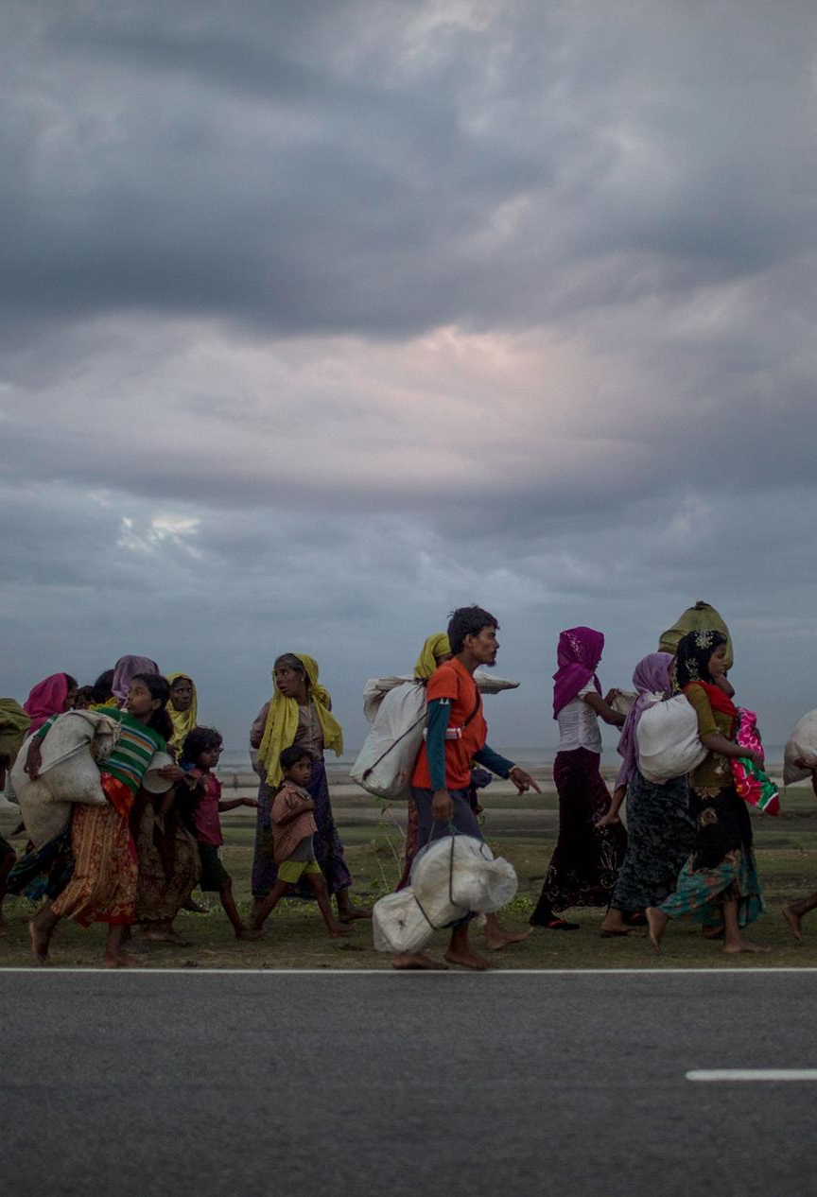
CAUSES
ECONOMIC
SOCIAL FACTORS
ENVIRONMENTAL FACTORS
MEDICAL REASONS
POLITICAL FACTORS

Slide 35
EFFECTS
Brain drain
Foreign exchange reserves
Fusion of cultures
Social problems
Psychological problems
Hostilities towards migrants

Slide 36

Globalization and agrarian sector

Slide 37
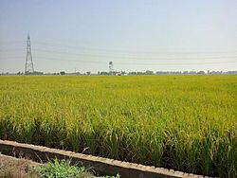
Changes in food basket
Changes in agricultural marketing systems
Changes in agricultural exports
Changes in the share of agricultural employment
Share of agriculture in GDP
Area of cultivation
Contract farming and corporate farming

Slide 38

Corporate farming
Corporate farming is the practice of large-scale agriculture on farms owned or greatly influenced by large companies.

Slide 39

advantages
Consolidation of land holdings
Production for exports
Marketing of agricultural produce

Slide 40
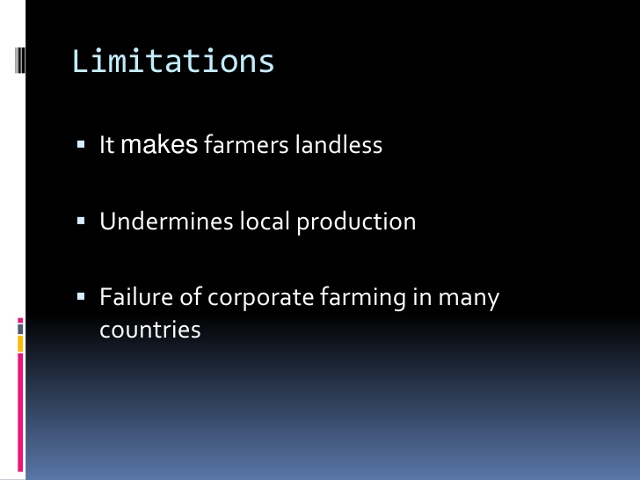

Slide 41
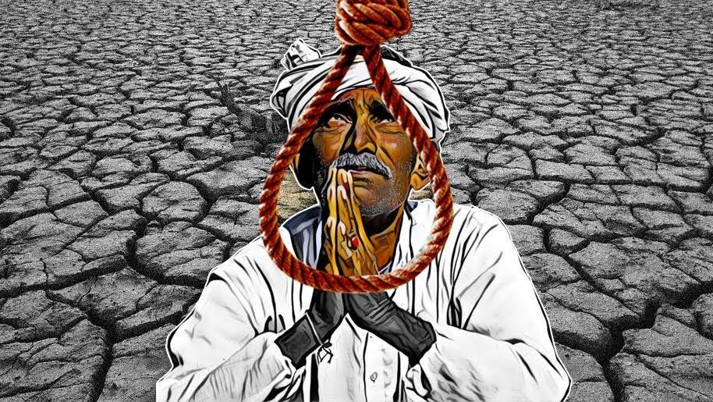
Farmer’s suicide

Slide 43


