Slide 1
Research Methodology
Unit 4: Advanced Statistical Techniques

Slide 2
Contents
Introduction,Characteristics and Application of
Correlation & Regression Analysis
Factor Analysis
Cluster analysis
Discriminant Analysis
Multidimensional Scaling

Slide 3
Correlation & Regression Analysis
Correlation is a statistical technique that can show whether and how strongly pairs of variables are related. For example, height and weight are related; taller people tend to be heavier than shorter people. The relationship isn't perfect
Correlation is a statistic that measures the degree to which two variables move in relation to each other.
In finance, the correlation can measure the movement of a stock with that of a benchmark index, such as the S&P 500.
Correlation measures association, but doesn't show if x causes y or vice versa, or if the association is caused by a third–perhaps unseen–factor.

Slide 4
Correlation
Correlation shows the strength of a relationship between two variables and is expressed numerically by the correlation coefficient. The correlation coefficient's values range between -1.0 and 1.0.
A perfect positive correlation means that the correlation coefficient is exactly 1. This implies that as one security moves, either up or down, the other security moves in lockstep, in the same direction.
A perfect negative correlation means that two assets move in opposite directions, while a zero correlation implies no linear relationship at all.

Slide 5
Correlation
When two sets of data are strongly linked together we say they have a High Correlation.
The word Correlation is made of Co- (meaning "together"), and Relation
Correlation is Positive when the values increase together, and
Correlation is Negative when one value decreases as the other increases

Slide 6
Correlation Is Not Causation
A common saying is "Correlation Is Not Causation".
What it really means is that a correlation does not prove one thing causes the other:
One thing might cause the other
The other might cause the first to happen
They may be linked by a different thing
Or it could be random chance!
There can be many reasons the data has a good correlation.

Slide 7
Example
A few years ago a survey of employees found a strong positive correlation between "Studying an external course" and Sick Days.
Does this mean:
Studying makes them sick?
Sick people study a lot?
Or did they lie about being sick so they can study more?
Without further research we can't be sure why.

Slide 8
Scatter Plot
A scatter plot (also called a scatterplot, scatter graph, scatter chart, scattergram, or scatter diagram) is a type of plot or mathematical diagram to display values for typically two variables for a set of data. If the points are coded (color/shape/size), one additional variable can be displayed. The data are displayed as a collection of points, each having the value of one variable determining the position on the horizontal axis and the value of the other variable determining the position on the vertical axis.

Slide 9
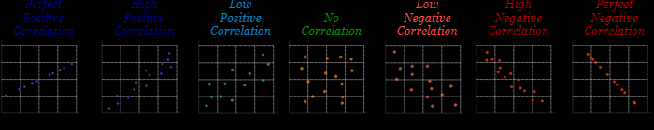
Types of Correlation

Slide 10
Types of Correlation
1.Perfect Correlation: Positive & Negative
2.Strong Correlation: Positive & Negative
3.Weak Correlation: Positive & Negative
4. No Correlation
5.Non-Linear:

Slide 11
Some uses of Correlations
Prediction
If there is a relationship between two variables, we can make predictions about one from another.
Validity
Concurrent validity (correlation between a new measure and an established measure).
Reliability
Test-retest reliability (are measures consistent).
Inter-rater reliability (are observers consistent).
Theory verification
Predictive validity.

Slide 12
Correlation Coefficient
Correlation Coefficient measures the degree of linear relationship between the variables. It is introduced by Karl Pearson.
Karl Pearson's Coefficient of Correlation is an extensively used mathematical method in which the numerical representation is applied to measure the level of relation between linear related variables. The coefficient of correlation is expressed by “r”.

Slide 13
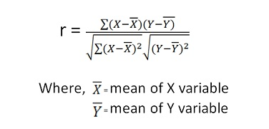
Karl Pearson Correlation Coefficient Formula

Slide 14
Value of Coefficient Correlation
When a correlation coefficient is (1) that means every increase in one variable, there is a positive increase in other fixed proportion. For instance, shoe sizes change according to the length of the foot and are (almost) perfect correlation.
When a correlation coefficient is (-1) that means every positive increase in one variable, there is a negative decrease in other fixed proportion.
When a correlation coefficient is (0) for every increase, it means there is no positive or negative increase, and the two variables are not related.

Slide 15
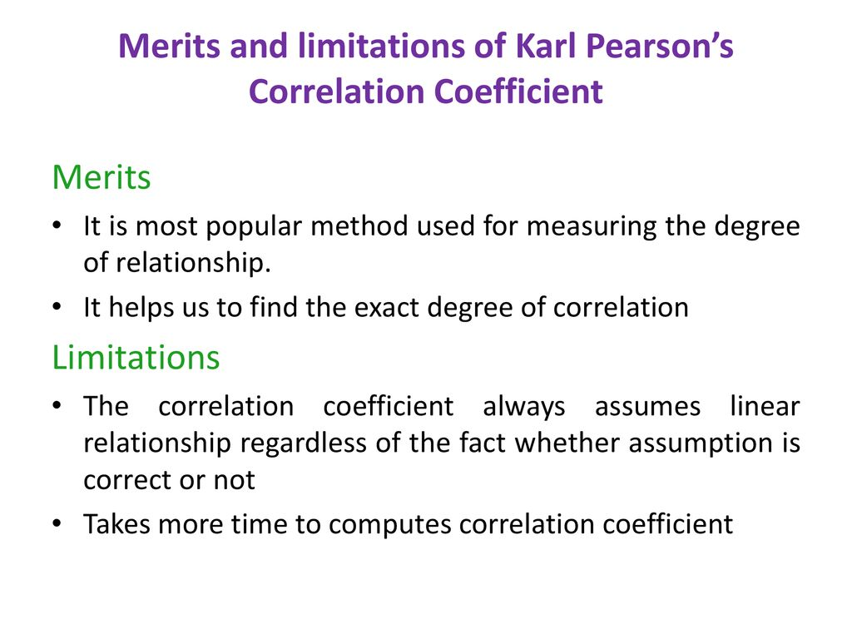

Slide 16
Regression
Regression is a statistical method used in finance, investing, and other disciplines that attempts to determine the strength and character of the relationship between one dependent variable (usually denoted by Y) and a series of other variables (known as independent variables).
Correlation & Regression are closely related.Correlation is only measure of association and is of no use in prediction.Regression is more powerful than correlation

Slide 17
Regression
Regression methods are useful in developing quantitative relationship between variables which can be used in prediction.
It plays a important role in human activities, as it is a powerful tool which used to forecast the past,present and future events on the basis of present or past events.

Slide 18
Types of regression
The two basic types of regression are
simple linear regression and
multiple linear regression,
although there are non-linear regression methods for more complicated data and analysis. Simple linear regression uses one independent variable to explain or predict the outcome of the dependent variable Y, while multiple linear regression uses two or more independent variables to predict the outcome.

Slide 19
Uses of Regression
Regression can help finance and investment professionals as well as professionals in other businesses. Regression can also help predict sales for a company based on weather, previous sales, GDP growth, or other types of conditions.
The capital asset pricing model (CAPM) is an often-used regression model in finance for pricing assets and discovering costs of capital.

Slide 20
Formula for Regression
Simple linear regression: Y = a + bX + u
Multiple linear regression: Y = a + b₁X₁ ⁺ b₂X₂ + b₃X₃ + ... + b_{t}X_{t} + u
Where:
Y = the variable that you are trying to predict (dependent variable).
X = the variable that you are using to predict Y (independent variable).
a = the intercept.
b = the slope.
u = the regression residual.

Slide 21
Application of Regression
Regression is often used to determine how many specific factors such as the price of a commodity, interest rates, particular industries, or sectors influence the price movement of an asset. The aforementioned CAPM is based on regression, and it is utilized to project the expected returns for stocks and to generate costs of capital. A stock's returns are regressed against the returns of a broader index, such as the S&P 500, to generate a beta for the particular stock.
Beta is the stock's risk in relation to the market or index and is reflected as the slope in the CAPM model. The return for the stock in question would be the dependent variable Y, while the independent variable X would be the market risk premium.
Additional variables such as the market capitalization of a stock, valuation ratios, and recent returns can be added to the CAPM model to get better estimates for returns. These additional factors are known as the Fama-French factors, named after the professors who developed the multiple linear regression model to better explain asset returns.¹

Slide 22
Discriminant Analysis
Discriminant analysis is statistical technique used to classify observations into non-overlapping groups, based on scores on one or more quantitative predictor variables.
For example, a doctor could perform a discriminant analysis to identify patients at high or low risk for stroke. The analysis might classify patients into high- or low-risk groups, based on personal attributes (e.g., chololesterol level, body mass) and/or lifestyle behaviors (e.g., minutes of exercise per week, packs of cigarettes per day).

Slide 23
Discriminant Analysis
During a study, there are often questions that strike the researcher that must be answered. These questions include questions like ‘are the groups different?’, ‘on what variables, are the groups most different?’, ‘can one predict which group a person belongs to using such variables?’ etc. In answering such questions, discriminant analysis is quite helpful.

Slide 24
Discriminant analysis
Discriminant analysis is a technique that is used by the researcher to analyze the research data when the criterion or the dependent variable is categorical and the predictor or the independent variable is interval in nature.
The term categorical variable means that the dependent variable is divided into a number of categories. For example, three brands of computers, Computer A, Computer B and Computer C can be the categorical dependent variable.

Slide 25
Objective of discriminant analysis
The objective of discriminant analysis is to develop discriminant functions that are nothing but the linear combination of independent variables that will discriminate between the categories of the dependent variable in a perfect manner. It enables the researcher to examine whether significant differences exist among the groups, in terms of the predictor variables. It also evaluates the accuracy of the classification.
Discriminant analysis is described by the number of categories that is possessed by the dependent variable.

Slide 26
Applications of discriminant analysis
There are many examples that can explain when discriminant analysis fits.
It can be used to know whether heavy, medium and light users of soft drinks are different in terms of their consumption of frozen foods.
In the field of psychology, it can be used to differentiate between the price sensitive and non price sensitive buyers of groceries in terms of their psychological attributes or characteristics.
In the field of business, it can be used to understand the characteristics or the attributes of a customer possessing store loyalty and a customer who does not have store loyalty

Slide 27
Applications of discriminant analysis
For a researcher, it is important to understand the relationship of discriminant analysis with Regression and Analysis of Variance (ANOVA) which has many similarities and differences. Often we can find similarities and differences with the people we come across. Similarly, there are some similarities and differences with discriminant analysis along with two other procedures. The similarity is that the number of dependent variables is one in discriminant analysis and in the other two procedures, the number of independent variables are multiple in discriminant analysis. The difference is categorical or binary in discriminant analysis, but metric in the other two procedures. The nature of the independent variables is categorical in Analysis of Variance (ANOVA), but metric in regression and discriminant analysis.

Slide 28
Cluster Analysis
Cluster analysis is a class of techniques that are used to classify objects or cases into relative groups called clusters. Cluster analysis is also called classification analysis or numerical taxonomy. In cluster analysis, there is no prior information about the group or cluster membership for any of the objects.
Cluster Analysis has been used in marketing for various purposes. Segmentation of consumers in cluster analysis is used on the basis of benefits sought from the purchase of the product. It can be used to identify homogeneous groups of buyers.

Slide 29
Cluster Analysis
Cluster analysis involves formulating a problem, selecting a distance measure, selecting a clustering procedure, deciding the number of clusters, interpreting the profile clusters and finally, assessing the validity of clustering.
The variables on which the cluster analysis is to be done should be selected by keeping past research in mind. It should also be selected by theory, the hypotheses being tested, and the judgment of the researcher. An appropriate measure of distance or similarity should be selected; the most commonly used measure is the Euclidean distance or its square.

Slide 30
Cluster Analysis
Clustering procedures in cluster analysis may be hierarchical, non-hierarchical, or a two-step procedure. A hierarchical procedure in cluster analysis is characterized by the development of a tree like structure. A hierarchical procedure can be agglomerative or divisive. Agglomerative methods in cluster analysis consist of linkage methods, variance methods, and centroid methods. Linkage methods in cluster analysis are comprised of single linkage, complete linkage, and average linkage.

Slide 31
Cluster Analysis
The non-hierarchical methods in cluster analysis are frequently referred to as K means clustering. The two-step procedure can automatically determine the optimal number of clusters by comparing the values of model choice criteria across different clustering solutions. The choice of clustering procedure and the choice of distance measure are interrelated. The relative sizes of clusters in cluster analysis should be meaningful. The clusters should be interpreted in terms of cluster centroids.

Slide 33
Applications of cluster analysis
Medicine: What are diagnostic clusters?
Marketing:What are customer segments?
Education:What are student groups that need special attention?
Biology:What is the taxonomy of species?

