Slide 1
Law of Supply

Slide 2
Supply
Supply is a fundamental economic concept that describes the total amount of a specific good or service that is available to consumers.
Supply can relate to the amount available at a specific price or the amount available across a range of prices if displayed on a graph.

Slide 3
Law of Supply
The law of supply is the microeconomic law that states that, all other factors being equal, as the price of a good or service increases, the quantity of goods or services that suppliers offer will increase, and vice versa.
The law of supply says that as the price of an item goes up, suppliers will attempt to maximize their profits by increasing the quantity offered for sale.
In other words, higher the price higher will be the supply and lower the price lower will be the supply.
This law can be explained with the help of a supply schedule as well as by a supply curve based on an imaginary figures and data.

Slide 4
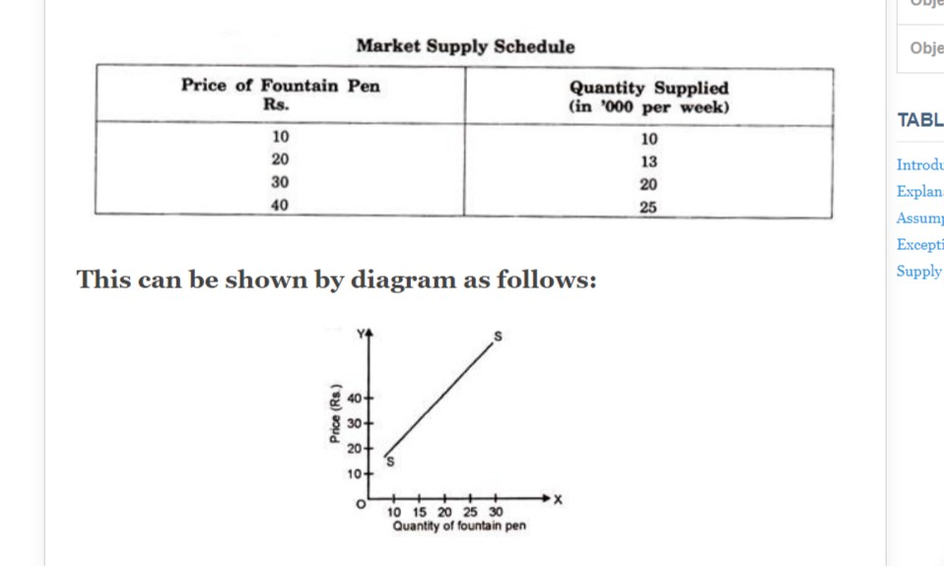
Market supply describes the quantity of a specific good or service that all sellers in a market combined are willing to sell. In other words, it represents the sum of all individual supplies for a particular good or service.

Slide 5
Assumptions Underlying the Law of Supply
1. No change in the income:
There should not be any change in the income of the purchaser or the seller.
2. No change in technique of production:
There should not be any change in the technique of production. This is essential for the cost to remain unchanged. With the improvement in technique if the cost of production is reduced, the seller would supply more even at falling prices.

Slide 6
3. There should be no change in transportation cost:
It is assumed that transport facilities and transport costs are unchanged. Otherwise, a reduction in transport cost implies lowering the cost of production, so that more would be supplied even at a lower price.
4. Cost of production be unchanged:
It is assumed that the price of the product changes, but there is no change in the cost of production. If the cost of production increases along with the rise in the price of product, the sellers will not find it worthwhile to produce more and supply more. Therefore, the law of supply will be valid only if the cost of production remains constant. It implies that the factor prices such as wages, interest, rent etc., are also unchanged.

Slide 7
Supply Function
The supply function of price can be expressed as:
Q_{SX} = f(P_{X})
The above supply function in the linear form can be expressed as:
Q_{SX} = - c + dP_{X}
Here, c = quantity supplied when price is zero.
d = correlation coefficient between quantity supplied and price. It represents ∆ Q_{SX} /∆ P_{X} or slope of the supply curve.

Slide 8
If the supply function is Q_{SX} = - 40 + 30P_{X ,} then the supply schedule would be –
Price per Unit | Quantity Supplied in Units
0 | -40
1 | -10
2 | 20
3 | 50
4 | 80
5 | 110
6 | 140

Slide 9
Determinants of Supply
1. Price of the Good/ Service
The most obvious one of the determinants of supply is the price of the product/service. With all other parameters being equal, the supply of a product increases if its relative price is higher. The reason is simple. A firm provides goods or services to earn profits and if the prices rise, the profit rises too.
2. Price of Related Goods
If the price of related goods rises, then the firm increases the supply of the goods having a higher price. This leads to a drop in the supply of the goods having a lower price.

Slide 10
3. Price of the Factors of Production
Production of a good involves many costs. If there is a rise in the price of a particular factor of production, then the cost of making goods that use a great deal of that factors experiences a huge increase. The cost of production of goods that use relatively smaller amounts of the said factor increases marginally.
For example, a rise in the cost of land will have a large effect on the cost of producing wheat and a small effect on the cost of producing automobiles.
Therefore, the change in the price of one factor of production causes changes in the relative profitability of different lines of production. This causes producers to shift from one line to another, leading to a change in the supply of goods.

Slide 11
4. State of Technology
Technological innovations and inventions tend to make it possible to produce better quality and/or quantity of goods using the same resources. Therefore, the state of technology can increase or decrease the supply of certain goods.
5. Government Policy
Commodity taxes like excise duty, import duties, GST, etc. have a huge impact on the cost of production. These taxes can raise overall costs. Hence, the supply of goods that are impacted by these taxes increases only when the price increases. On the other hand, subsidies reduce the cost of production and usually lead to an increase in supply.
6. Other Factors
There are many other factors affecting the supply of goods or services like the government’s industrial and foreign policies, the goals of the firm, infrastructural facilities, market structure, natural factors etc.

Slide 12
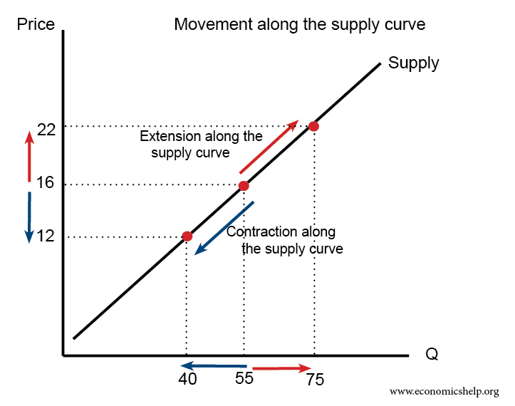
Changes in Supply
Movement along the supply curve: When the price of a product changes, with no change in the other determinants of supply, it can be shown with the movement on the same supply curve.
Thus, other things remaining the same, if price falls, quantity supplied will fall, which is called as contraction of supply and if price rises, quantity supplied will rise which is called as extension of supply.

Slide 13
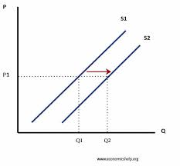
B. Shifts in the supply curve: The supply curve will shift to the right or to the left when there is a change in the non-price determinants of demand.
E.g. if material cost rises, the producer will cut down the supply and supply curve will shift to the left or the supply will decrease. On the other hand, if there is an increase in material cost, the supplier will increase the supply, thus supply curve will shift towards right.

Slide 14
Market Equilibrium
Equilibrium is a situation where market demand and market supply are equal to each other. When the supply and demand curves intersect, the market is said to be in equilibrium. This is where the quantity demanded and quantity supplied are equal.
The corresponding price is the equilibrium price or market-clearing price, the quantity is the equilibrium quantity.
Thus, at the equilibrium price,
Q_{dx} = Q_{sx}
or
a-bP_{x} = -c+dP_{x}
Any deviation from the equilibrium price will lead to under-supply or over-supply.

Slide 15
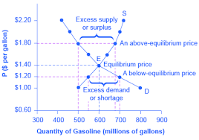
The equilibrium can be explained with the help of a diagram.

Slide 16
Numericals
Calculate equilibrium demand in the following market, where D=50-3P, S=4P-6.
In the equation Q=100-5p, what is quantity demanded for price Rs 20?
When the price of a product X is 60 Rs. per unit, the quantity demand is 2000 units. When the price of X is increased to 100 Rs. Per unit, the market demand contracted to 1000 units. Then the price elasticity of demand coefficient is:

Slide 17
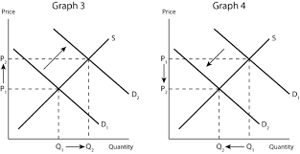
Changes in Market Equlibrium
Changes in Demand:

Slide 18
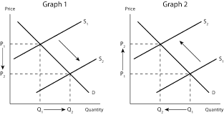
B. Changes in Supply:

Slide 19
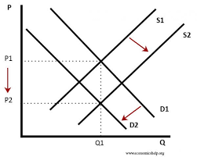
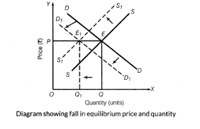
C. Changes in both demand and supply:

Slide 20
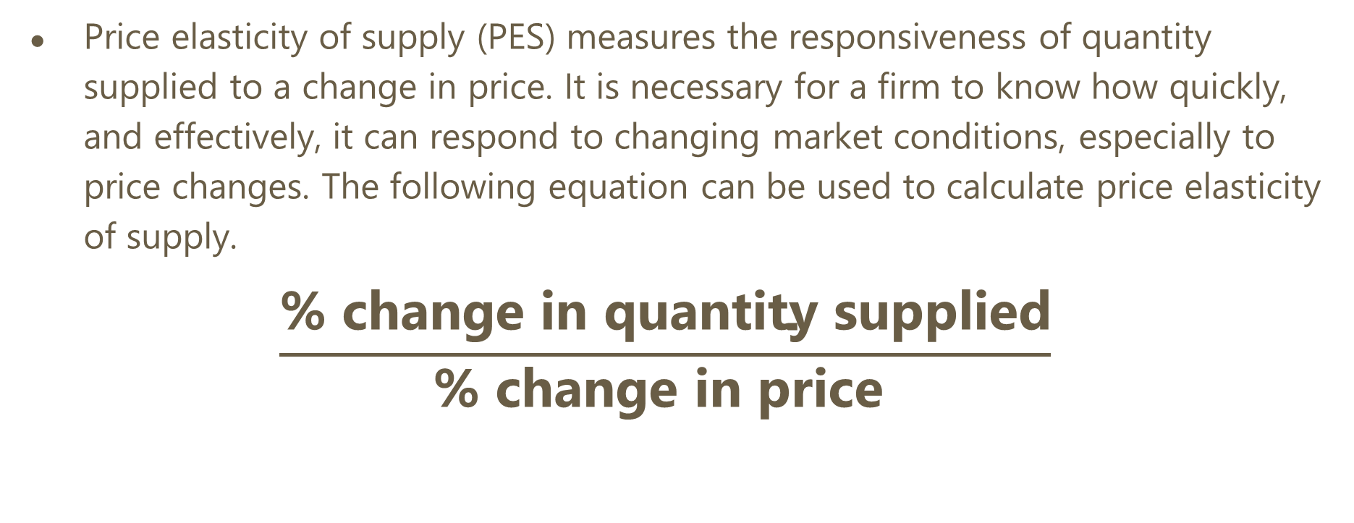
Price Elasticity of Supply
(For FYBCom)
Price elasticity of supply (PES) measures the responsiveness of quantity supplied to a change in price. It is necessary for a firm to know how quickly, and effectively, it can respond to changing market conditions, especially to price changes. The following equation can be used to calculate price elasticity of supply.
$$\frac{\text{\% }\text{change} \text{in} \text{quantity} \text{supplied}}{\text{\% }\text{change} \text{in} \text{price} }$$

Slide 21
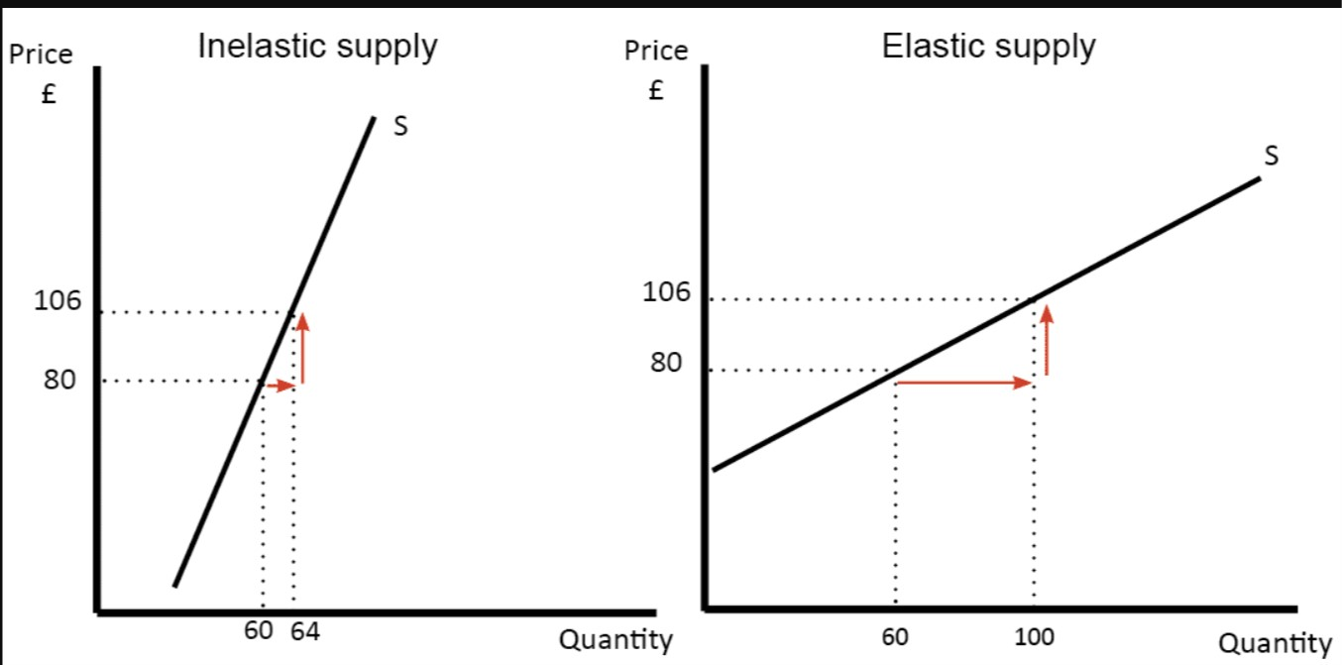
Relatively Inelastic and Elastic Supply

Slide 22
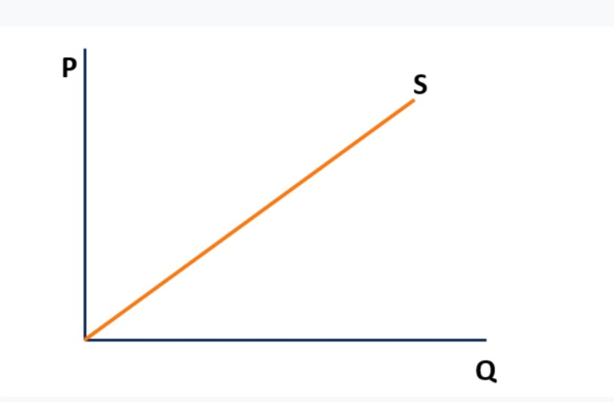
Unit Elastic Supply

Slide 23
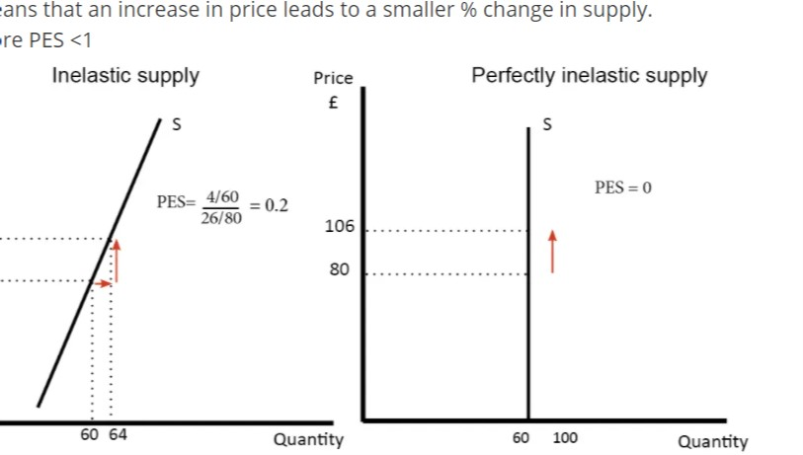
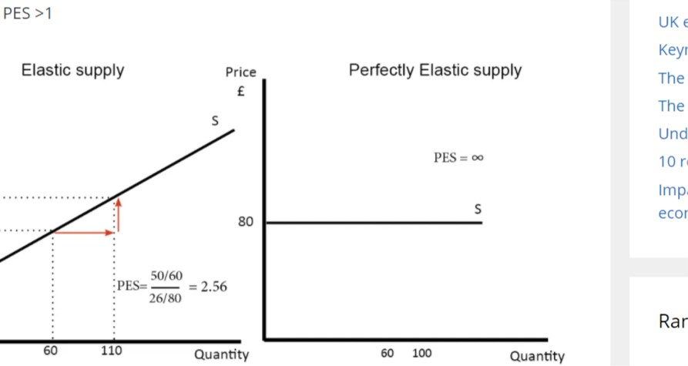

Slide 24
Producer’s Surplus
(For FYBCom)

Slide 25
Producer’s surplus is defined as the difference between the price at which the producer is willing to supply goods and the actual amount received by him when he makes the trade.
Producer’s surplus is a measure of producer’s welfare. It is shown graphically as the area above the supply curve and below the equilibrium price.

Slide 26
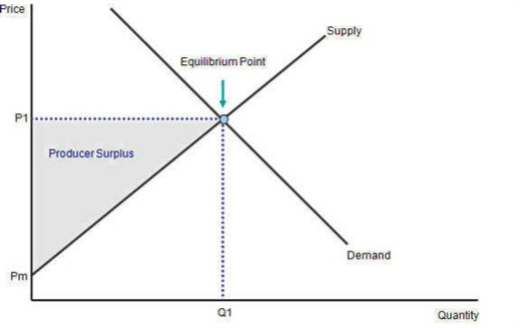
Here the producer surplus is shown in gray. If the equilibrium price increases, supplier will produce more goods, thereby increasing the producer’s surplus.

