Slide 1
UNIT1
●
●
●
●
●
●
●
●
●
●
Definition of Entrepreneur Internal & External Factors Functions
Entrepreneurial Motivation & Barriers Classification
Theories Concept
Development of Entrepreneurship Culture
Stages in entrepreneurial process

Slide 2
What is an Entrepreneur?
One who creates a new business in the face of risk and uncertainty for the purpose of achieving profit and growth by identifying and assembling the necessary resources to capitalize on them.

Slide 3
CONCEPT OF ENTERPRENEUR
RISK BEARER
ORGANISER
INNOVATOR

Slide 4
Schumpter’s Definition of
Entrepreneur
Reform or revolutionize the pattern of production by exploiting an invention or more generally , an untried technological possibility for producing a new commodity

Slide 5
Drucker’s view on Entrepreneur
Innovation is a specific tool of entrepreneurs, this means by which they exploit changes as an opportunity for different business or a different service.

Slide 6
Characteristics of Entrepreneurs
Desire for responsibility
Preference for moderate risk
Confidence in their ability to succeed
Desire for immediate feedback
High level of energy
Future orientation
Skilled at organizing
Value achievement over money

Slide 7
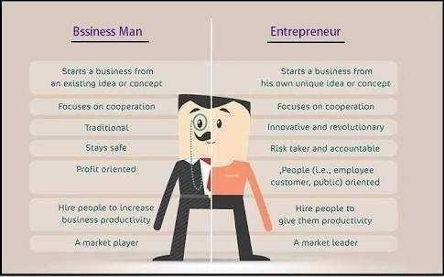

Slide 8
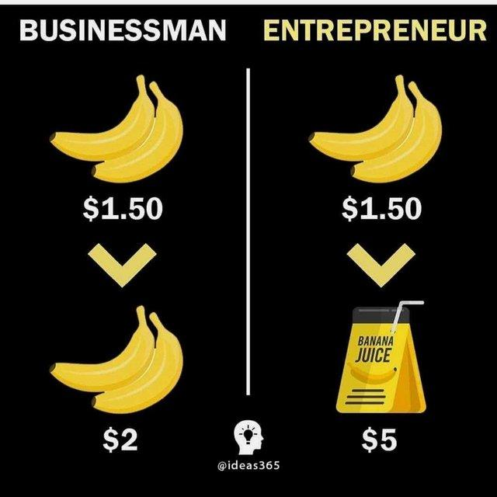

Slide 9
Functions of Entrepreneur
Innovation
Risk Taking
Organization Building
Absorb uncertainty
Frame the Challenge
Build Commitment

Slide 10
Entrepreneurs...Traits
Self-confident and optimistic
Able to take calculated risk
Respond positively to changes
Flexible and able to adapt
Knowledgeable of markets
Able to get along well with others
Independent minded

Slide 11
Entrepreneurs...Traits II
Energetic and diligent
Creative, need to achieve
Dynamic Leader
Responsive to suggestions
Take initiatives
Resourceful and persevering
Perceptive with foresight

Slide 12
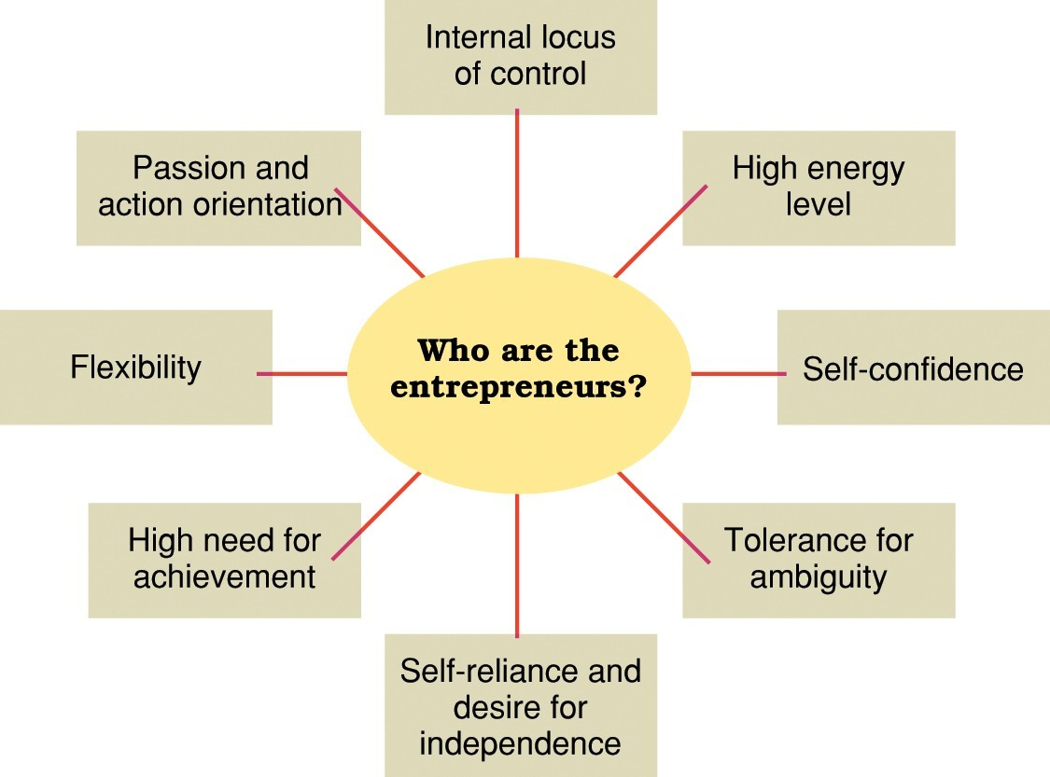
Personal traits and characteristics of entrepreneurs.

Slide 13
Entrepreneurial Motivation
Motivation is an inner spirit that activates and direct our behavior towards our goal.

Slide 14
What motivates an individual to behave entrepreneurially is explained by the behavioral scientists?

Slide 15
FACTORS RESPONSIBLE FOR ENTREPRENEURS

Slide 16
INTERNAL FACTORS
Desire to do something new
Educational Background
Experience

Slide 17
EXTERNAL FACORS
Govt. assistance and support
Availability of labor and raw material
Encouragement from big business houses
Promising demand for the product

Slide 18
TYPES OF ENTREPRENEUR
According to the type of business
According to the use of technology
According to the motivation
According to the growth
According to the area
According to the gender & age
According to the sale of operation

Slide 19
Type of Business
●
Business Entrepreneur( individuals who conceive an idea for a new product or service & then create a business to materialize their idea.)
Trading Entrepreneur (Is one who undertakes trading activities & is not concerned with the manufacturing work)
Industrial Entrepreneur (a manufacturer who identifies the potential needs of customers & tailors a product to meet the marketing needs)
Corporate Entrepreneur (Is a person who demonstrates his innovative skill in organizing & managing corporate undertaking)
Agricultural Entrepreneur ( Is one who undertake agricultural activities as raising & marketing of crops, fertilizers & other input.) Retail Entrepreneur
Service Entrepreneur
●
●
●
●
●
●

Slide 20
Use of Technology
Technical Entrepreneur (he demonstrates his innovative capabilities in matter of production of goods & rendering services)
Non- Technical Entrepreneur (concerned only with developing alternatives marketing & distribution strategies to promote their business)
Professional Entrepreneur (a person who is interested in establishing the business but does not have interest in managing it once)

Slide 21
According to Motivation
Pure Entrepreneur (an individual who is motivated by psychological & economic rewards)
Induced Entrepreneur (is one who induced to take up entrepreneurial task due to the policy measures of the Govt.)
Motivated Entrepreneur (they are motivated by the desire of self fulfillment)
Spontaneous Entrepreneur (those who start their business their by natural talents (inborn abilities)

Slide 22
According to area
Urban Entrepreneur
Rural Entrepreneur

Slide 23
According to gender & age
Men Entrepreneur
Women Entrepreneur

Slide 24
According to sale of operation
Small scale Entrepreneur
Large scale Entrepreneur

Slide 25
Barriers to Entrepreneurship
Lack of viable concept
Lack of market knowledge
Lack of technical skills
Lack of capital
Lack of business know how
Time presences and distractions
Legal constraints and regulations

Slide 26
Culture
The sum total of social behavior that includes at least three elements namely, knowledge and beliefs, ideals and preferences.
Entrepreneurial culture implies vision,values,norms and traits that are conductive for the development of the economy.
The emerging market environment and globalization is challenging every organization & every person in the organization to consider, evaluate and bring out the changes in thinking, vision and action.

Slide 27
Nature of Culture
Basic beliefs and assumptions about the company
Emotional aspect
Reflect history
Inherently symbolic
Substance and Form

Slide 28
Components of Culture
Values
Rules of Conduct
Vocabulary
Methodology
Rituals
Myths and Stores

Slide 29
Elements of an Entrepreneurial Culture
People and empowerment focused
Value creation through innovation and change
Attention to the basics
Hands-on management
Doing the right thing
Freedom to grow and to fail
Commitment and personal responsibility
Emphasis on the future and a sense of urgency

Slide 30
Individualism vs Collectivism
●
Individualism
–
–
–
–
Self-orientation
Emphasis on self-efficiency and control Pursuit of individual goals
Value system driven by pride in their own accomplishments
●
Collectivism
–
–
–
–
Group-orientation
Subordination of personal interests and goals Emphasis on sharing
Concern for group welfare
●
Entrepreneurial Intensity is achieved by balance between individualism and collectivism

Slide 31
Steps in the Entrepreneurial
Process
Discovery
Concept Development
Resourcing
Actualization
Harvesting

Slide 32
Steps in the Entrepreneurial Process
1. Discovery: The stage in which the entrepreneur generates ideas, recognizes opportunities, and studies the market

Slide 33
Steps in the Entrepreneurial Process
2. Concept Development:
–
Develop a business plan: a detailed proposal describing the business idea

Slide 34
Concept Development
–
–
Choose business location
Will a patent or trademark be required?

Slide 35
Steps in the Entrepreneurial Process
3. Resourcing: The stage in which the entrepreneur identifies and acquires the financial, human, and capital resources needed for the venture startup, etc

Slide 36
Steps in the Entrepreneurial Process
4. Actualization: The stage in which the entrepreneur operates the business and utilizes resources to achieve its goals/objectives.

Slide 37
Steps in the Entrepreneurial Process
5. Harvesting: The stage in which the entrepreneur decides on venture’s future growth, development, or demise.

Slide 38
FACTORS AFFECTING ENTREPRENEURSHIP DEVELOPMENT

Slide 39
Facto1. Economic Environment:
  Capital:
  Labor
  Materials
  Market
  Infrastructure

Slide 40
Facto2. Social Environment:
1.Family
Family Background – Joint Family can Provide Family Resources to Invest and Expand Family Business.
  E.g Sindhis,Marwadis,Shetty,Gujaratis
  Friends and Relatives, Religion, Social status

Slide 41
2 . Education
3. Technical knowhow
4. Attitude of the society
5. Cultural Values

Slide 42
Political Factors

Slide 43
1. Political Stability
Iraq, Afghanistan,Srilanka,Nepal,Syria

Slide 44
2. Type of Political System
Capitalist system
Private sector is more dominant
e.g : US, UK,Italy,Australia
Communist System
Public sector is more dominant
e.g China , Cuba

Slide 45
Type of Political System
Mixed System
Both Public sector and Private sector
exists
e.g India, South Africa,Brazil

Slide 46
3. Government Policies
Taxation –Corporate tax – 25
Monetary Policy
Fiscal policy - Budget
Import Policy
Rules and Regulations – Laws related to environment,consumer protection
Intellectual Property rights law

Slide 47
4. Bureaucracy
Corruption
Ease of doing business

Slide 48
Personal Factors

Slide 49
Aspiration and Attitude

Slide 50
2. The entrepreneur having qualities of :
Immense imaginations
Maturity
Optimism
Foresightedness
Ability to bear risks

Slide 51
Efficiency
Self-confidence
Leadership ability
Dynamic thinking
Hard work
Honesty

Slide 52
3. Family Circumstances
Parental background

Slide 53
4. Education and Experience
No. of years of experience
Occupation background
Educational background

Slide 54
