Slide 1
Types Of Garden

Slide 2
Types Of Garden
Buddhist Garden
English Garden
Japanese Garden
Mughal Garden

Slide 3

Buddhist Garden

Slide 4
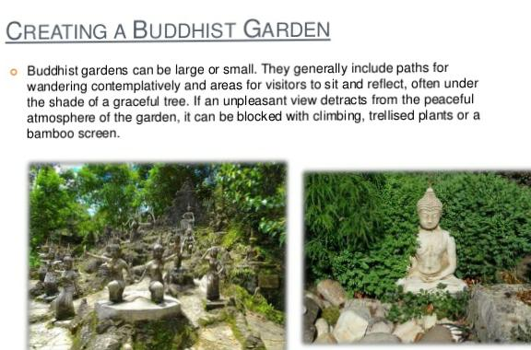

Slide 5
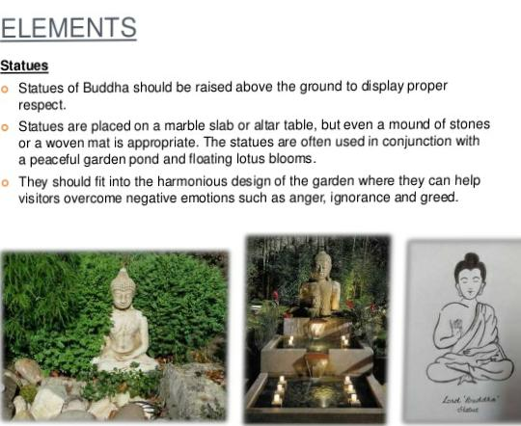

Slide 6
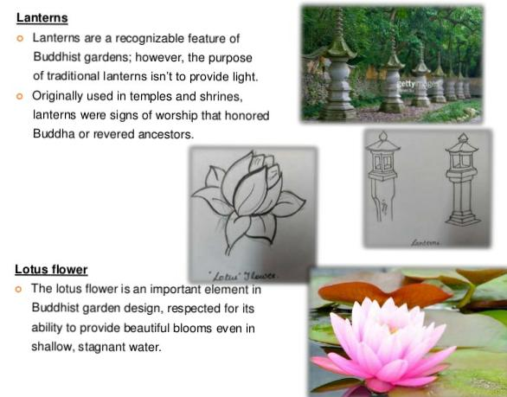

Slide 7


Slide 8
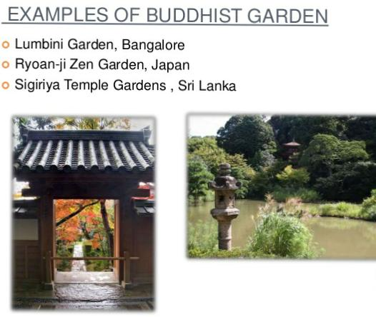

Slide 9
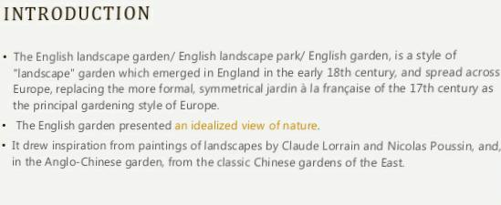
English Garden

Slide 10
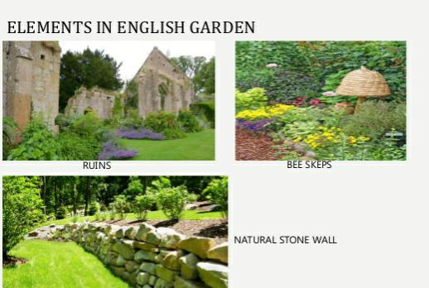

Slide 11
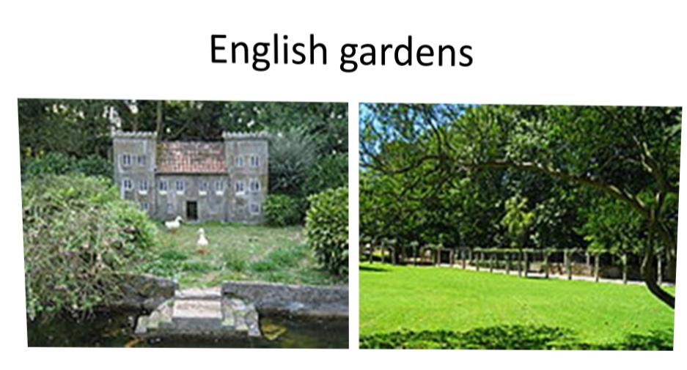

Slide 12
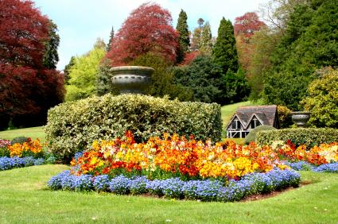
Flowers in English Garden
Aquilegia
Asters
Chrysanthemum
Columbine
Daisies (all types)
Echinacea
Lavender
Lilly of the Valley
Lupine
Peonies

Slide 13
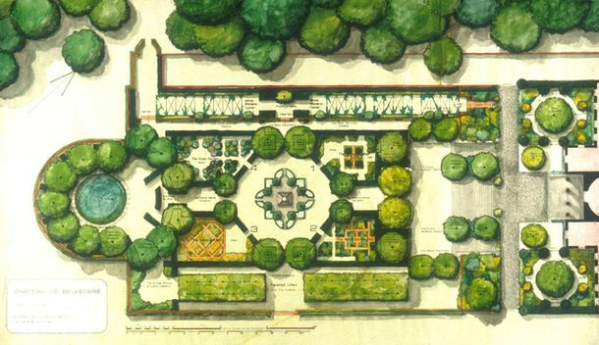
Layout Of English Garden

Slide 14
Japanese Garden
Japanese gardens are traditional gardens whose designs are accompanied by Japanese aesthetic and philosophical ideas, avoid artificial ornamentation, and highlight the natural landscape. Plants and worn, aged materials are generally used by Japanese garden designers to suggest an ancient and faraway natural landscape, and to express the fragility of existence as well as time's unstoppable advance.

Slide 15
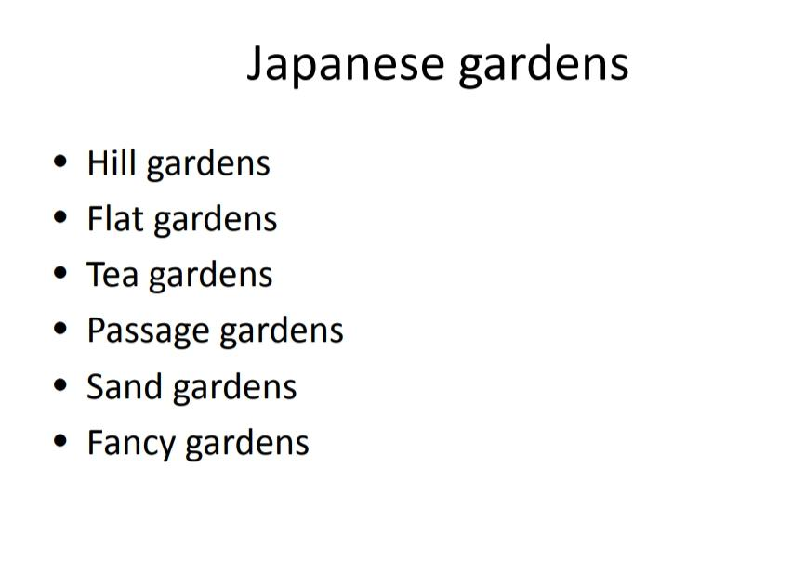

Slide 16
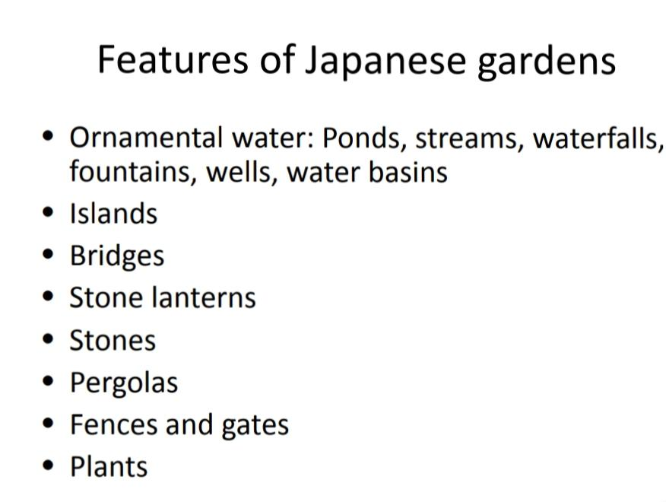

Slide 17
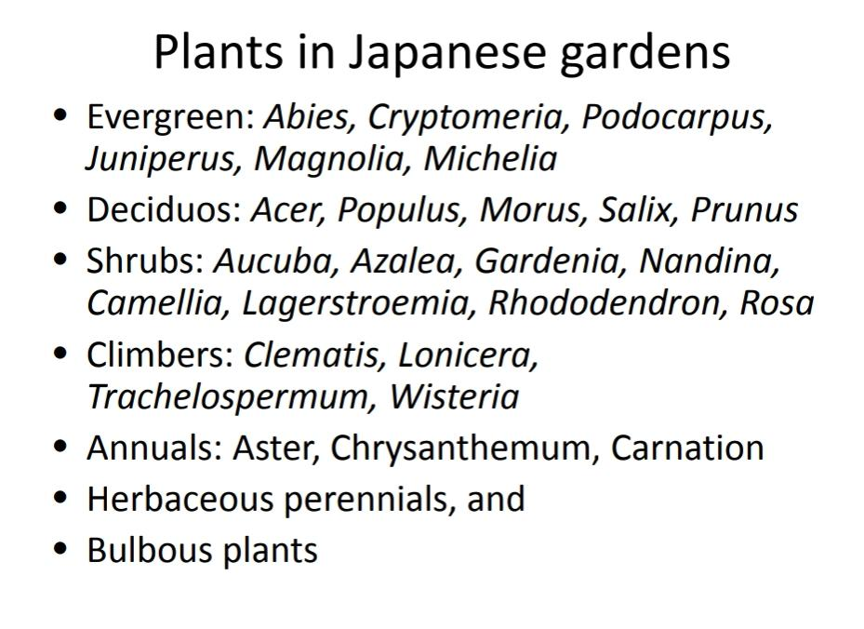

Slide 18


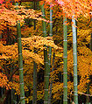
Azaleza
Pine Tree
Bamboo Tree

Slide 19
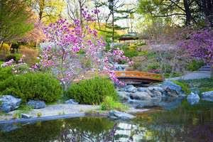
Layout

Slide 20
Mughal Garden
Mughal gardens are a group of gardens built by the Mughals in the Persian style of architecture. This style was heavily influenced by the Persian gardens particularly the Charbagh structure. Use of rectilinear layouts are made within the walled enclosures. Some of the typical features include pools, fountains and canals inside the gardens.

Slide 21
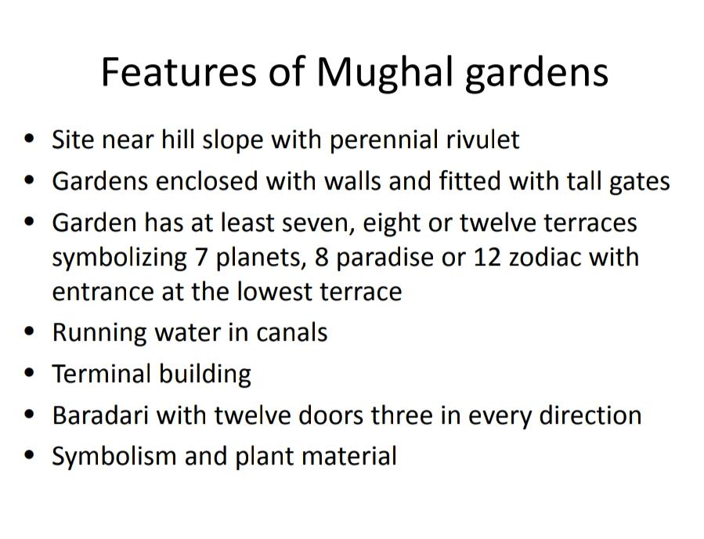

Slide 22
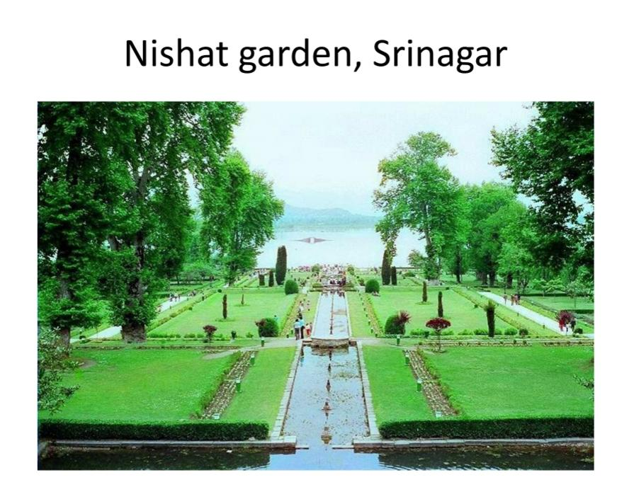
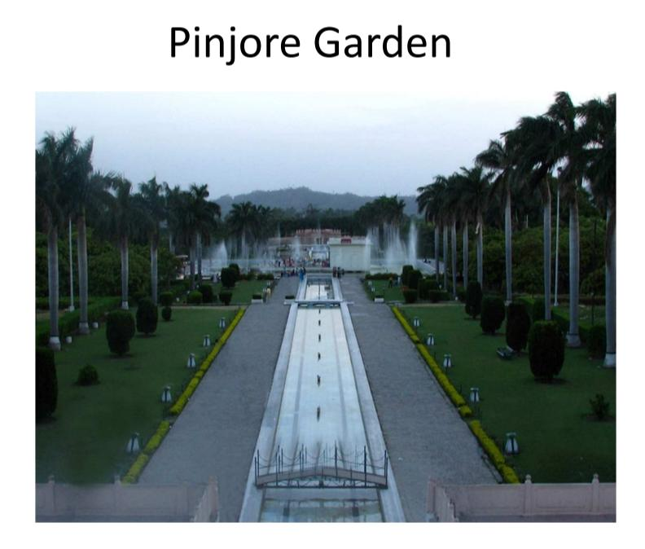
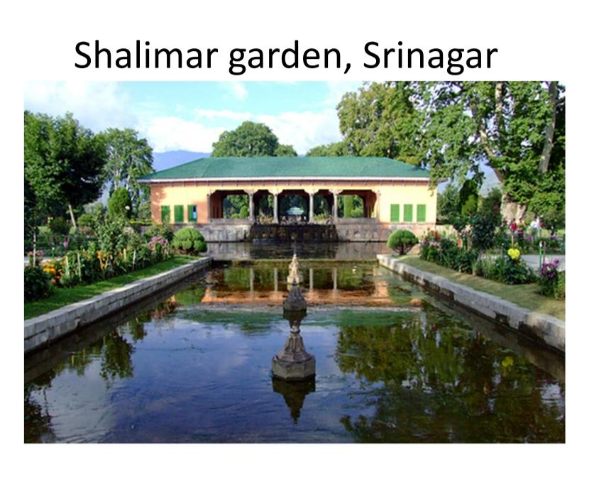

Slide 23
Flowers In Mughal Garden
Rose remains a key feature of the Mughal Gardens even today. The Gardens boasts of growing 159 celebrated varieties of roses which blossom primarily in the month of February and March. They include, Adora, Mrinalini, Taj Mahal, Eiffel Tower, Modern Art, Scentimental, Oklahoma (also called black rose), Belami, Black Lady, Paradise, Blue Moon and Lady X. The Mughal Gardens also include roses named after people of national and international fame such as Mother Teresa, Raja Ram Mohan Roy, Mr. Lincoln, John F. Kennedy, Jawahar, Queen Elizabeth, Christian Dioramongst others. Arjun and Bhim, from the Mahabharata, also find place in the presidential palace.
Apart from roses, tulips, Asiatic lilies, daffodils, hyacinth and other seasonal flowers beautify the gardens of Rashtrapati Bhavan. There are more than seventy varieties of seasonal flowers including exotic bulbous and winter flowering plants. The garden also grows 60 of the 101 known types of bougainvilleas. Edging and flowering of flower beds is done with alyssum, daisy, pansy etc. The grass that covers the garden is the doob grass, which was originally brought from Calcutta (now Kolkata) when the Mughal Gardens was being planted. The Gardens has almost 50 varieties of trees, shrubs and vines including Moulsiri tree, Golden Rain tree, flower bearing Torch Tree and many more. At present over three hundred permanent and casual employees are deployed for the development and maintenance of the gardens of Rashtrapati Bhavan.

Slide 24
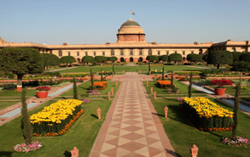
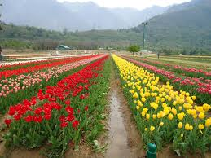
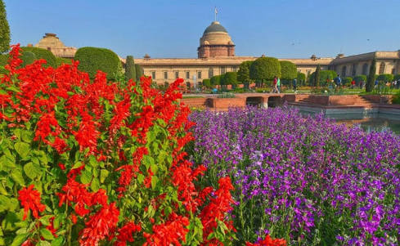
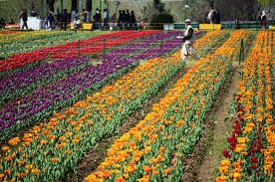

Slide 25
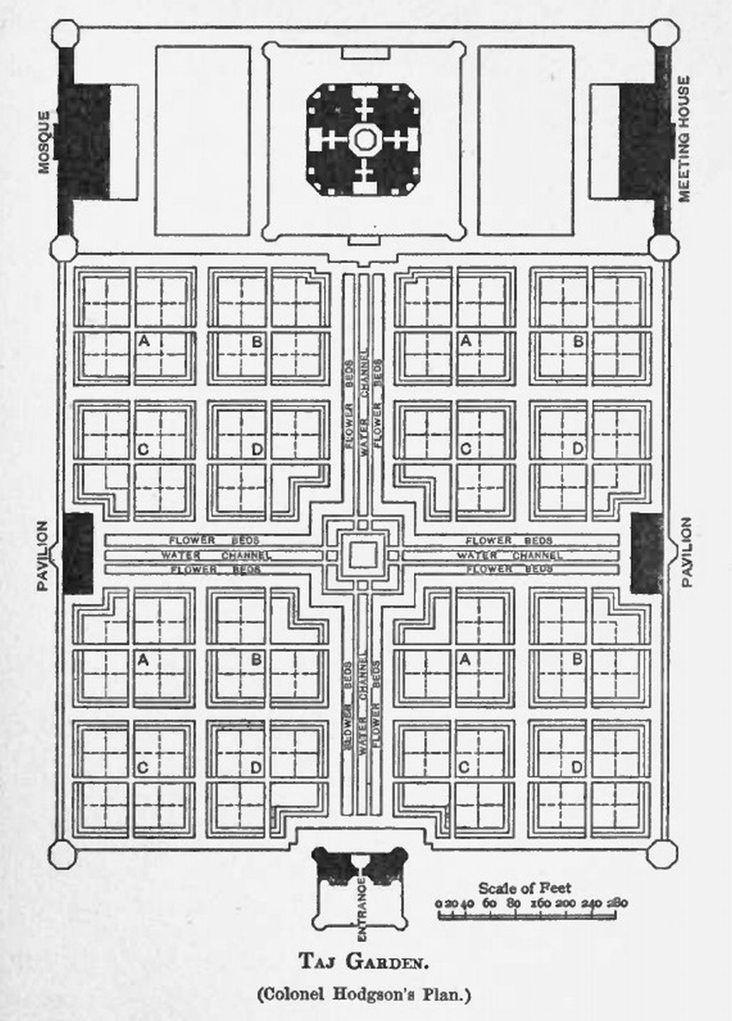
Layout Of Mughal Garden

