Slide 1

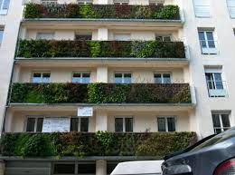
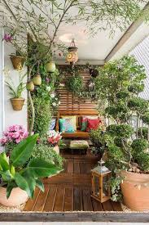
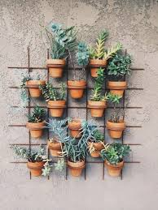
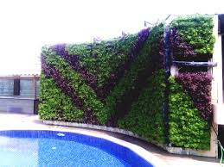
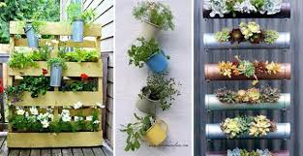
VERTICAL GARDEN & TERRACE GARDEN
An Innovative Element of Green Building Technology

Slide 2
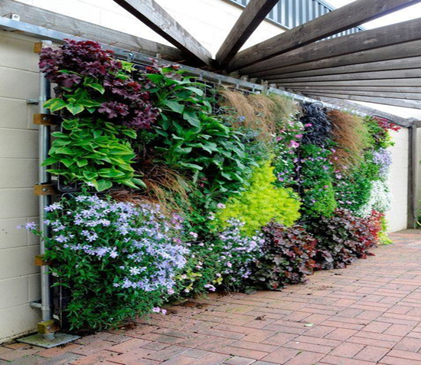

VERTICAL GARDEN
A vertical garden also known as green wall or living wall is self sufficient vertical garden attached to exterior or interior walls of a building.
The plants receive water and nutrients from within the vertical support instead of from the ground.
Vertical garden was invented by Stanley Hart White who patented a green wall system in the late 1930s.

Slide 3

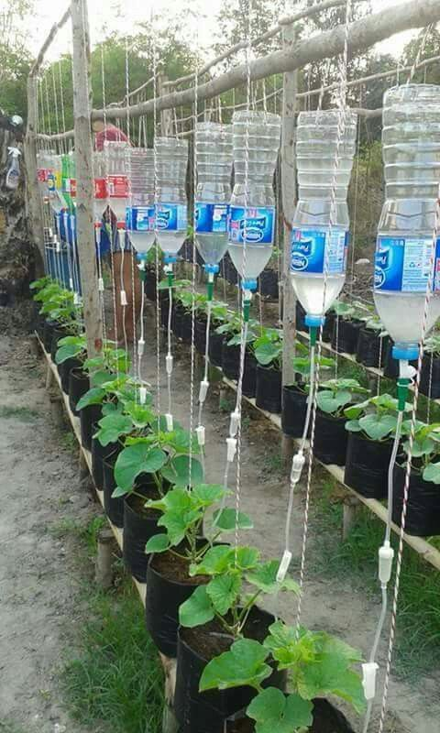
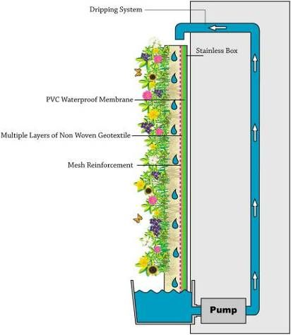
In vertical gardens, various types of modular panels can be used along with geo-textile fabrics, growing media, irrigation systems, and plants.
Living walls are particularly suitable for cities, as they allow good use of available vertical surface areas.

Slide 4
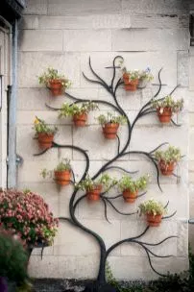
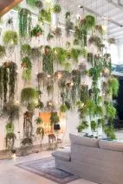
The living wall could also function for urban agriculture, urban gardening, or for its beauty as art. Green walls may be indoors or outside, freestanding or attached to an existing wall, and come in a great variety of sizes.
A vertical garden can be installed in almost any location and as a living material; the potential of integrating plants in our urban environments is interesting. Places never thought of as possible could be inhabited by plants, like subway stations or other intensely frequented places where horizontal space is difficult to spare.

Slide 5
Classification of vertical garden

Slide 6
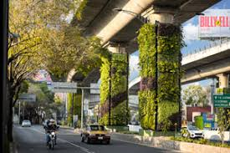
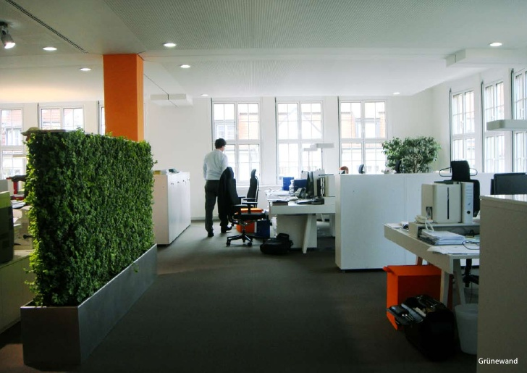

Slide 7
Transformation of concrete structure into vertical gardens.

Slide 9
Benefits of Vertical Garden: There are various benefits of vertical gardens or green wall. It can be sum up into 3 categories:
Public benefits
Aesthetic Improvements.
Reduction of the Urban Heat Island Effect.
Private benefits
Improved Energy Efficiency
Building Structure Protection
Increased Biodiversity.
Improved Exterior Air Quality
Local Job Creation
Improved Indoor Air Quality
Noise Reduction.
Marketing Potential
Design specific benefits
Improved Health and Well-Being.
Urban Agriculture.
Onsite Wastewater Treatment

Slide 10
Creating a vertical garden can be problematic. Some of the problems encountered are:
1. Getting a messy soil to stay in place when the planter is turned 90 degrees.
2. Watering and rooting problems.
3. Growing problems of plant vertically.

Slide 11
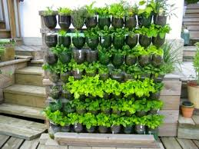
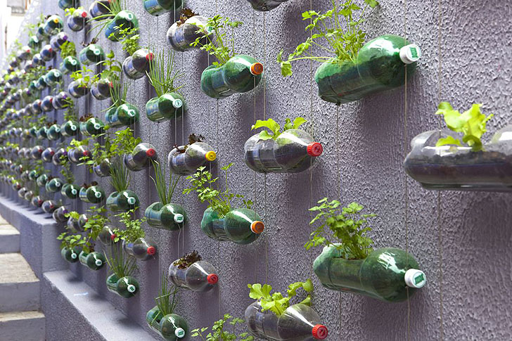
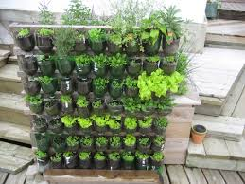

Slide 12
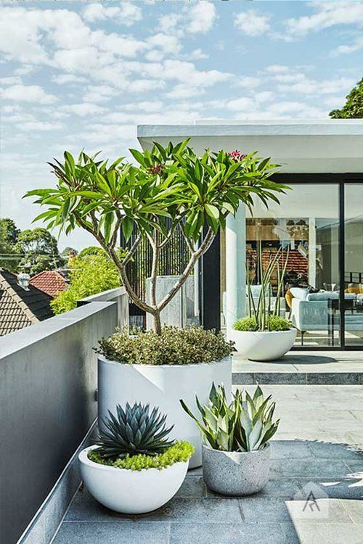
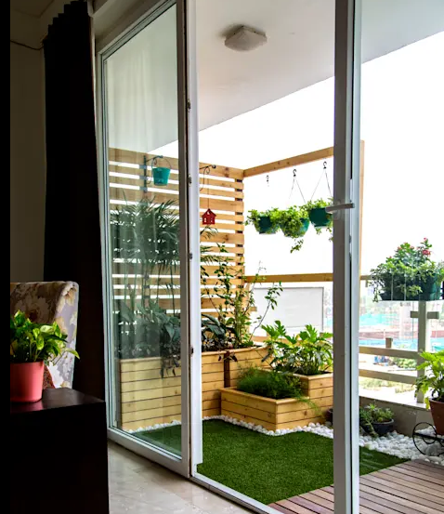
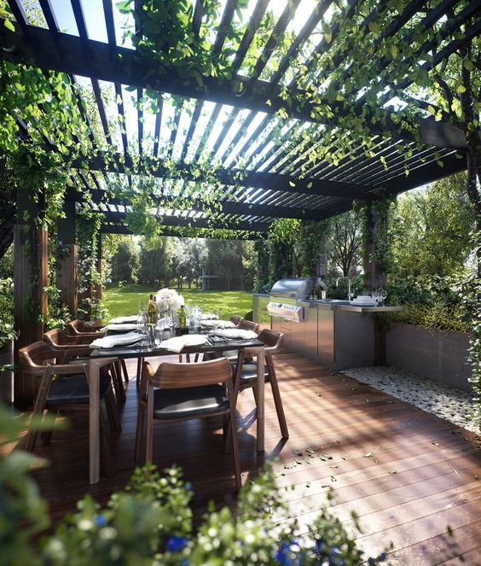
What is a terrace garden?
Also called a roof garden ,it is a garden that cultivates vegetables, fruits or flowers on the terrace, balconies or roof of buildings, also called as a roof garden. The kitchen garden, a standard in every Indian household, has shifted to the roof due to constraints of space, and called a terrace garden.

Slide 13
Design Considerations There are several important design and structural differences between ground level landscape development and rooftop developments. The following are the special construction requirements and considerations when developing a roof garden.
Protection of the integrity of the roof and structure
Positive drainage
A long-term, lightweight planting medium Irrigation for optimum plant growth and sustainability
Adaptation to the climatic conditions
Selection of hardscape materials (paving, structural materials, site furnishings and water as a design element) and their special use and requirements as part of a roof garden system
Provisions for utilities
Public safety and security
Ease of maintenance

Slide 14
How do I start on a terrace garden?
You can begin greening your terrace with these simple steps, and then move on to bigger ideas:
Take any simple pot or ‘gamla’ or better still recycle any of your old container .
Get the soil ready and mix compost, soil, coir peat (or sand) and vermicompost in equal quantities
Cover the drainage hole at the bottom of the container with a broken pot piece or a flat stone, and fill it up with the mixture.
You will have to drill a hole in the recycled container first.
Pour water and check that no soil is discharged through the bottom hole.
Wet the soil and plant your seed or sapling
Watch your greens grow.

Slide 15
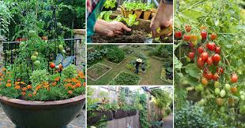
What can I plant in my garden?
You can start with something from your kitchen shelf, that is available and used in everyday cooking like coriander (dhaniya), fenugreek (methi), gram (chana) and chilli (mirchi). Once you gain confidence you can move onto vegetables of your choice and even fruit trees like banana and pomegranate. Almost all vegetables can be grown - creepers, drumsticks, lime, tomatoes etc.

Slide 16
What are the advantages of terrace gardens?
Some of the benefits to health, aesthetics and environment are Convenience of safe, pesticide free, healthy green and fresh vegetables
Conducive to a routine of physical exercise, clean air and close to nature
Increases amount of oxygen in air
Reduces overall heat absorption of buildings, Insulates the building against heat and cold
Reduces sound pollution.
Acts as a habitat for city weary birds and animals
Reduces indoor temperature by 6- 8 degree and can reduce air conditioning cost by 25% to 50%.

Slide 17
The glory of gardening: hands in the dirt, head in the sun, heart with nature. To nurture a garden is to feed not just the body, but the soul. ~ Alfred Austin

