Slide 1
Principles of Management
Dr.Rupal Shroff
https://study.com/academy/lesson/management-skills-definition-examples.html

Slide 2


Slide 3

Is this Management ??

Slide 4
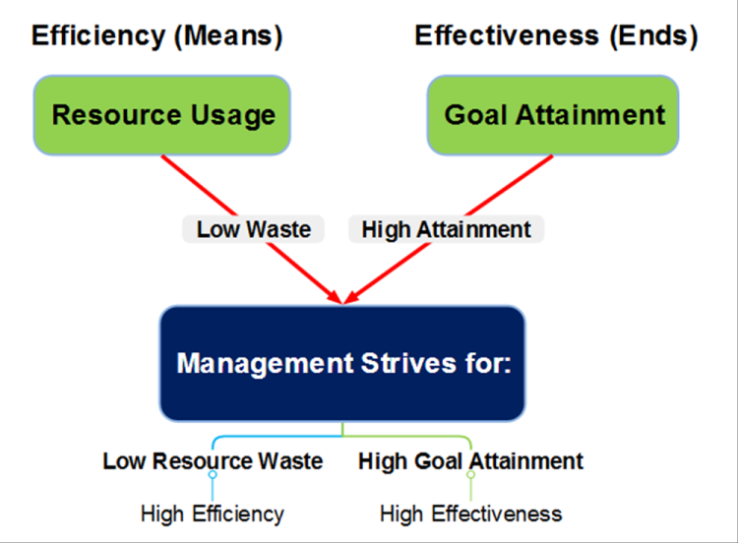

Slide 5
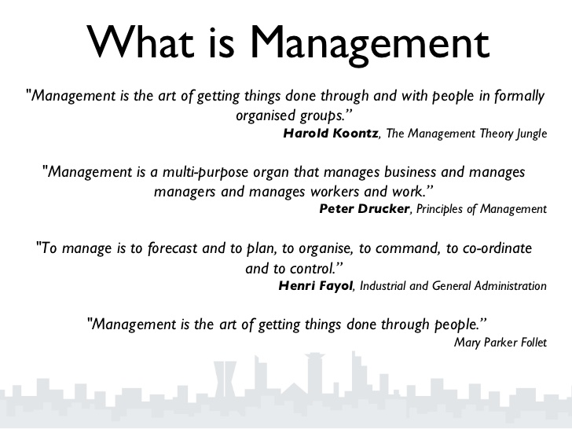

Slide 6
Management
Inputs
Men
Money
Process
Planning
Directing
Output
Aims
Goals
Materials
Machines
Methods
Markets
Organising
Staffing
Co-ordinating
Reporting
Budgeting
Objectives

Slide 7
Nature of Management
Integrating Process
Universal Process
Group Activity
Goal Oriented
Dynamic Process
Social Process
Intangible
Art, Science & Profession
Irreplaceable
Based on Principles
Multi Disciplinary

Slide 8

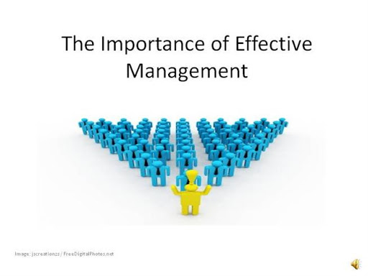
Importance of Management
Achieving Group Goals
Optimum Utilization of Resources
Establishes Sound Organization –
Maximises results through minimum input by proper planning
Establishes Equilibrium by adapting to Environment
Essentials for Prosperity of Society

Slide 9
Functions of Management
PLANNING
STAFFING
OTHER FUNCTIONS
FUNCTIONS
ORGANISING
DECISION MAKING
DIRECTING
CONTROLLING
COORDINATION

Slide 10
Management, Is it a Science, Art or Profession?
PROFESSION
ART
SCIENCE

Slide 11
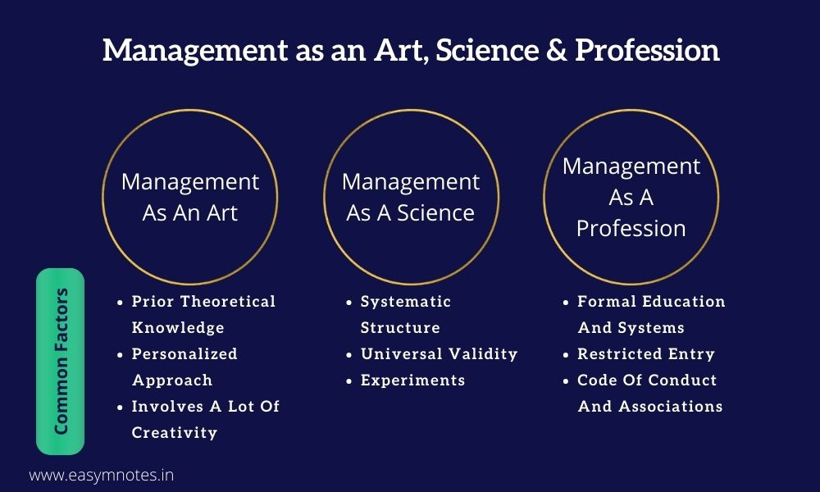

Slide 12
Management as a Science
Science:
Science is a systematized body of
knowledge
which establishes between cause and
relationship effect.

Slide 13
Testing of Management as a Science
Systematised Body of knowledge
Based on collection of facts, Analysis and experiments
Universal Application
Cause and effect Relationship
Verification of validity and Prediction of results possible

Slide 14
Management as an Art
Art:
Art is bringing about of a desired as a result through application of skill.

Slide 15
Testing of Management as an Art
Personal Skill
Practical Knowledge
Concrete Result-Oriented Approach
Development through Practice
Creative Power

Slide 16
Management as a Profession
Profession:
Profession is that occupation in which one professes to have acquired specialised knowledge, which is used either in instructing, guiding or advising others.

Slide 17
Testing of Management as a Profession
Body of Specialised knowledge and technique
Formalised Methods of Acquiring Training and experience Establishment of representative
professional Association
•

Slide 18
Roles of a Manager – Henry Mintzberg
Interpersonal Roles
Decisional Roles
Informational Roles

Slide 19
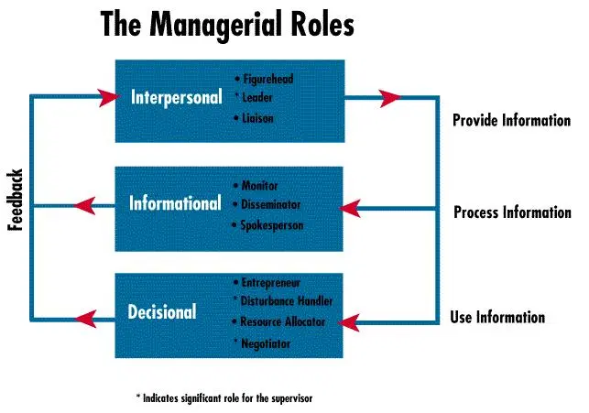

Slide 20
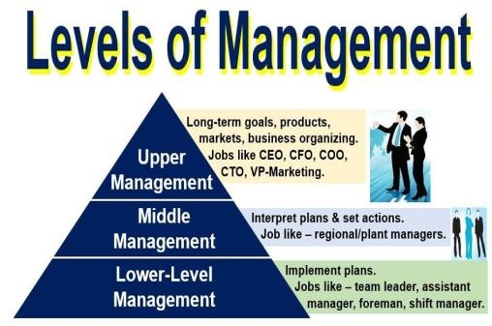

Slide 21
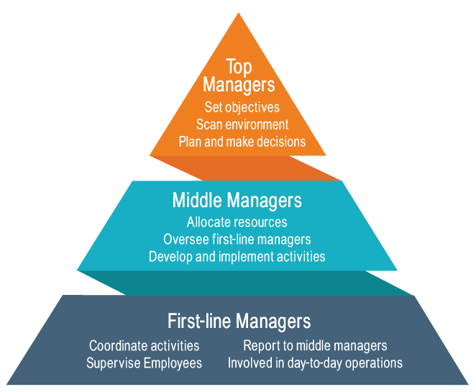
Functions of Managers at each Level

Slide 22
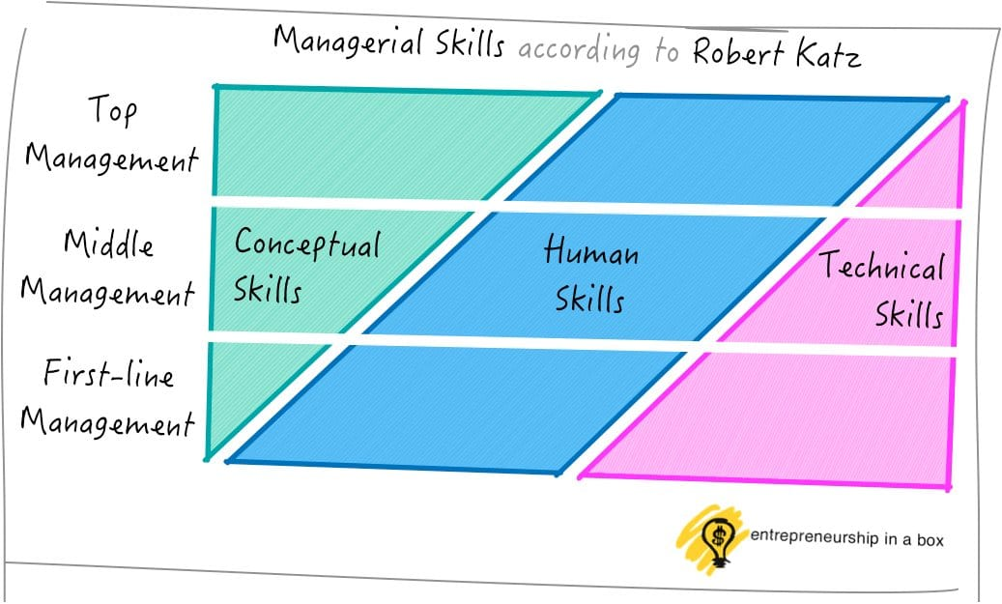
Skills Reqd at each Managerial Level

Slide 23
Other Managerial Skills needed
Behavioural & Interpersonal Skills
Administrative Skills
Design Skills
Analytical Skills
Diagnostic Skills
Communication Skills
Time Management Skills
Effectiveness Skills

Slide 24
Management Skills and Competencies in 21st Century
CONCEPTUAL SKILLS
HUMAN SKILLS
TECHNICAL SKILLS
DECISION MAKING SKILLS
DESIGN SKILLS
ADMINISTRATIVE SKILLS

Slide 25

Evolution of Management Thoughts

Slide 26
Evolution of Taylor’s Scientific Management
Criticisms by Employees
Criticisms by Employers
Criticisms by Industrial Psychologists

Slide 27
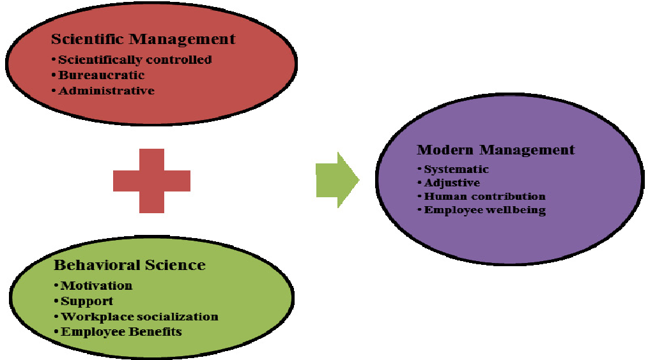

Slide 28
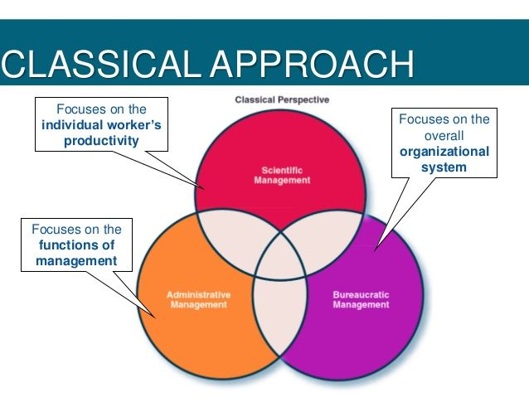
CLASSICAL ORGANISATION THEORY

Slide 29


Slide 30
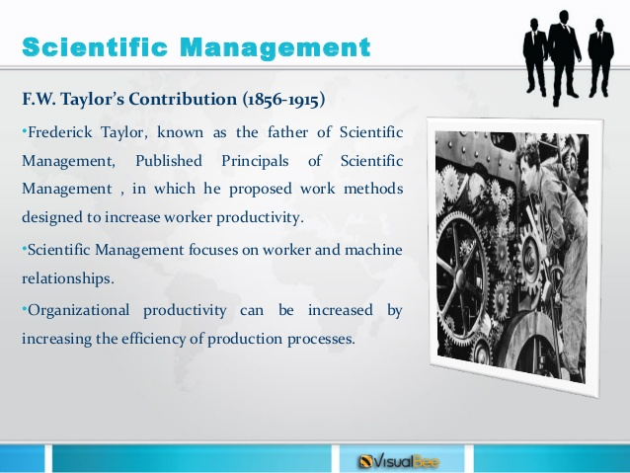

Slide 31
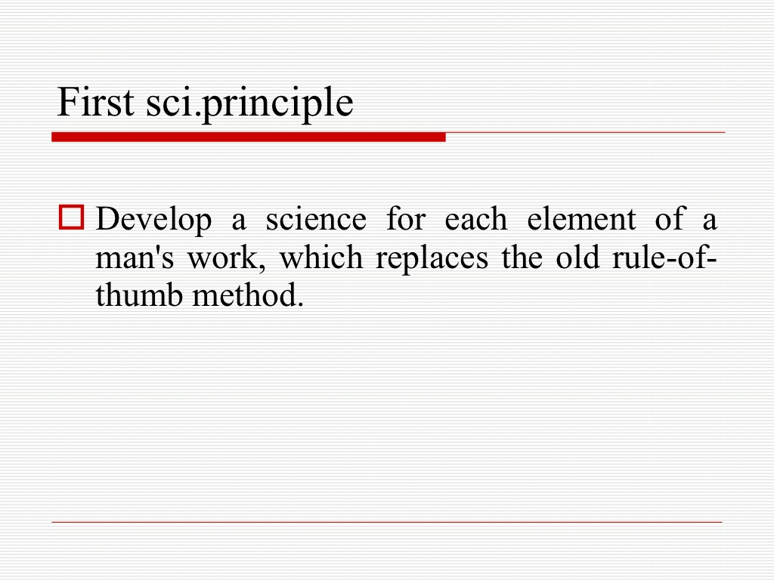

Slide 32
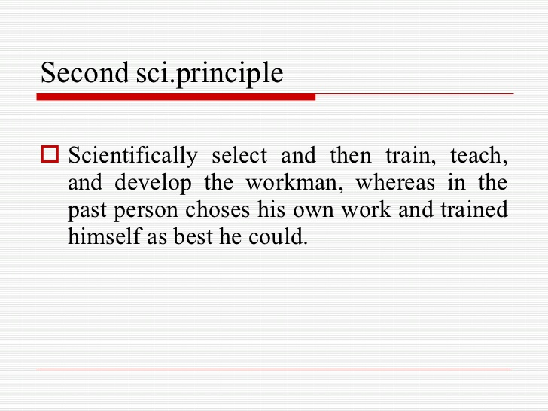

Slide 33
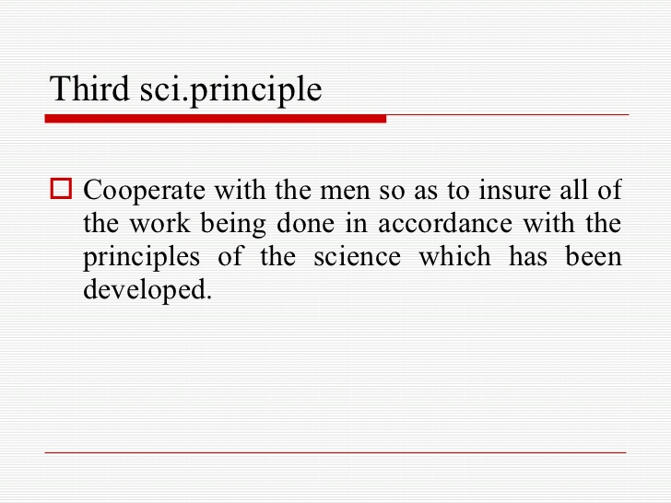

Slide 34
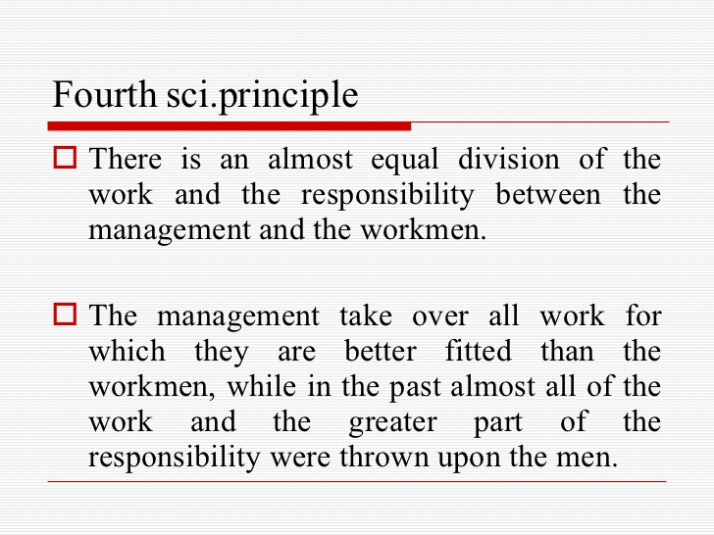

Slide 35
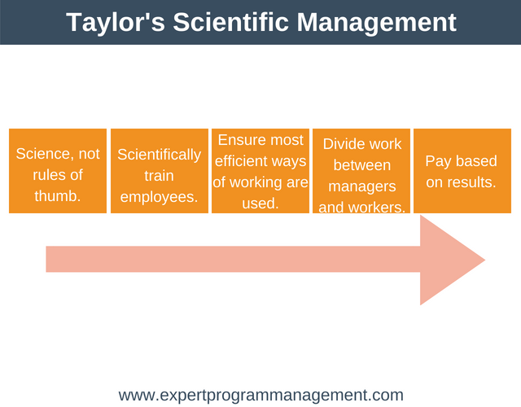

Slide 36
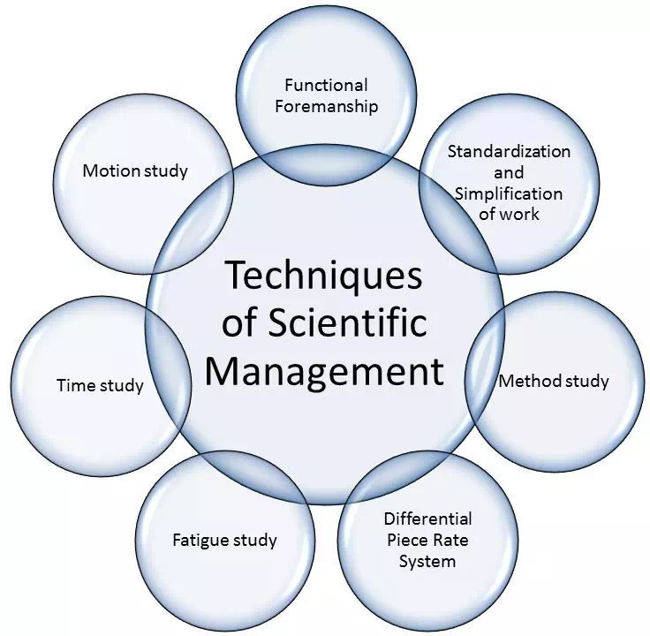

Slide 37
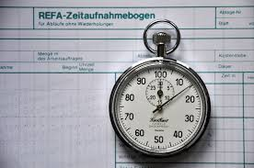
Elements of Scientific Management
Time Study- technique to determine the standard time taken by a worker of average skill and knowledge to complete a standard task.

Slide 38
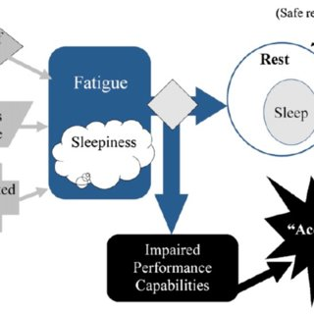
Elements of Scientific Management
Fatigue study seeks to determine the amount and frequency of rest intervals required in completing a task.

Slide 39
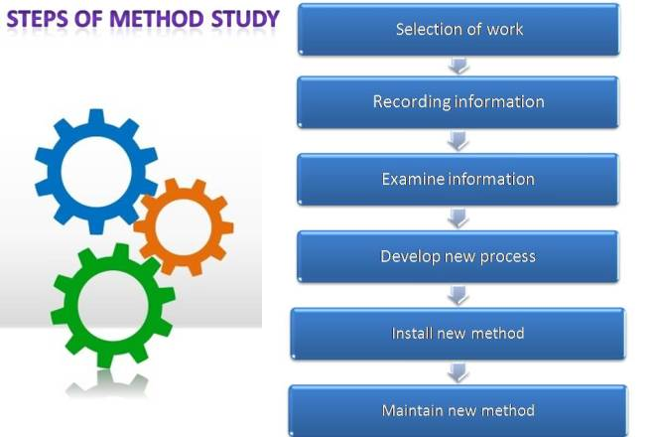
Elements of Scientific Management
Method study seeks to find out one best way of doing the job

Slide 40
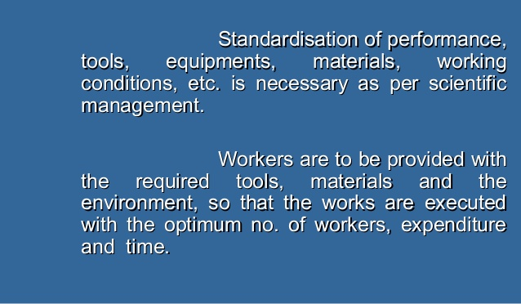
Elements of Scientific Management
Standardisation refers to the process of setting standards for every business activity Simplification aims at eliminating superfluous varieties, sizes and dimensions of products

Slide 41
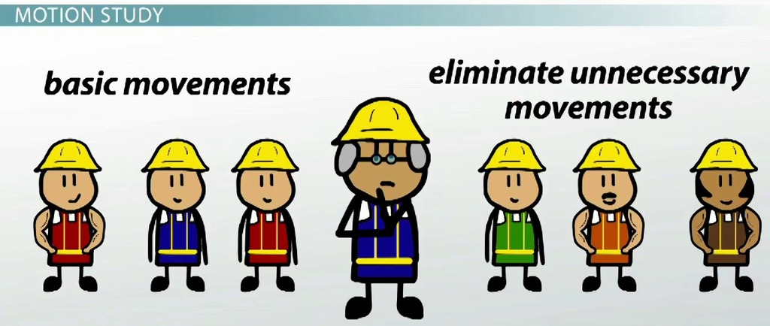
Elements of Scientific Management
Motion study refers to the study of movements of limbs which are undertaken while doing a typical job. This helps to eliminate unnecessary movements so that it takes less time to complete the job efficiently.

Slide 42
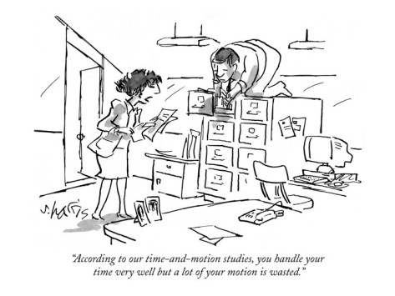
Motion Study

Slide 43
Elements of Scientific Management
Functional foremanship is an extension of the principle of division of work and specialisation to the shop floor. Each worker is supposed to take orders from eight foremen in the related process or function of production namely
  Instruction Card Clerk: He assigns work to all the employees.
  Route Clerk: He decides how work will progress regarding total productions. So that production is on time.
  Time and Cost Clerk: He determines what will be the total cost and how much time each job take.
  Disciplinarian: He sees that there is discipline at work place.
  Speed boss: He ensures that the work is moving at a suitable pace.
  Gang Boss: He ensures sufficient availability of raw material, tools etc.
  Repair Boss: He sees that whenever some repair is involved in any work, the work is done properly.
  Inspector: He sees that whether the quality of output is good or not.

Slide 44
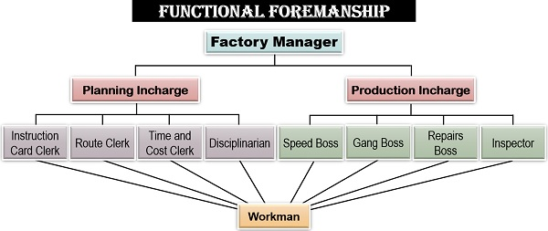
Functional Foremanship

Slide 45

Elements of Scientific Management
Differential piece wage system was introduced to reward efficient workers by paying them at a higher rate than those who performed below standard.

Slide 46
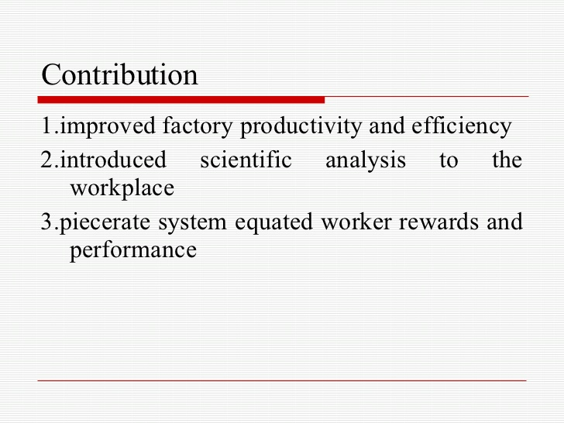

Slide 47
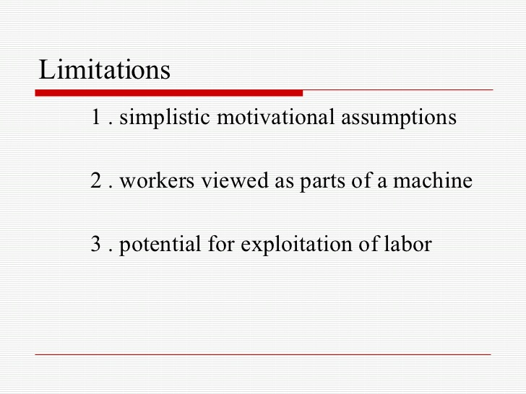

Slide 48
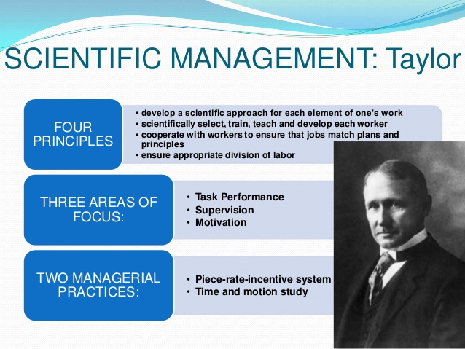

Slide 49
Video on scientific management theory
https://www.youtube.com/watch?v=fK4tyKvrj04
https://www.youtube.com/watch?v=-SqwmwiUt_Y
https://www.youtube.com/watch?v=jemmuKxGKL8

Slide 50


Slide 51
Advantages of Scientific Management Theory
Enhanced Production
Better Control
Reduction in cost of production
Increased wages
Benefits of division of labour
Avoidance of disputes between labour & management

Slide 52
Advantages of Scientific Management Theory
Proper methods of selection and training of workers
Provision of better working conditions
Better utilisation of resources
Gains to Consumers
Gains to Owners / Investors

Slide 53
Disadvantages / Criticisms - by Employees
Loss of Initiative
Exploitation of Workers = ‘speed up’
Mechanical Approach – too robotic
Undemocratic in nature
Problem of Unity of Command

Slide 54
Disadvantages / Criticism – by Employers
Expensive
Not suitable for small firms
Problem of re-organization
Problem of Over Production
Narrow Applicability

Slide 55
Disadvantages / Criticism – by Industrial Psychologists
Faulty Assumptions
Individualistic Approach
Problem of separation of Planning from doing work
Monotony
Lack of Non-Monetary Incentives

Slide 56
Henry Fayol’s – 14 Principles of Management

Slide 57
Henry Fayol’s Contribution
Contribution
Classification of Industrial Activities
Classification f Managerial Functions
Criticisms
Too Formal
Lack of Empirical Evidence
Universal Principles of Management
Significance of Management Function
Managerial Qualities & Training
Macro Approach to Management
Human Aspect of Management
Too Vague
Inconsistency
Pro-Management Bias
Historical Value

Slide 58
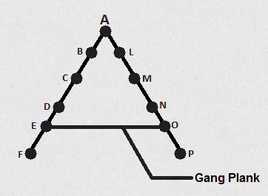
Henry Fayol’s Contribution
14 Principles of Management
Division of Labour & Specialisation
Authority & Responsibility
Discipline
Unity of Command
Unity of Direction
Subordination of Individual Interest to General Interest
Remuneration
Centralisation
Order
Equity
Stability of Tenure
Initiative
Esprit de Corps
Scalar Chain

Slide 59
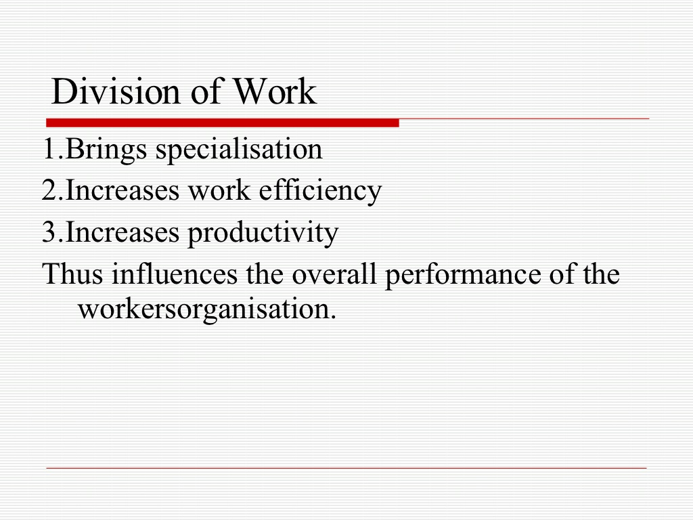

Slide 60
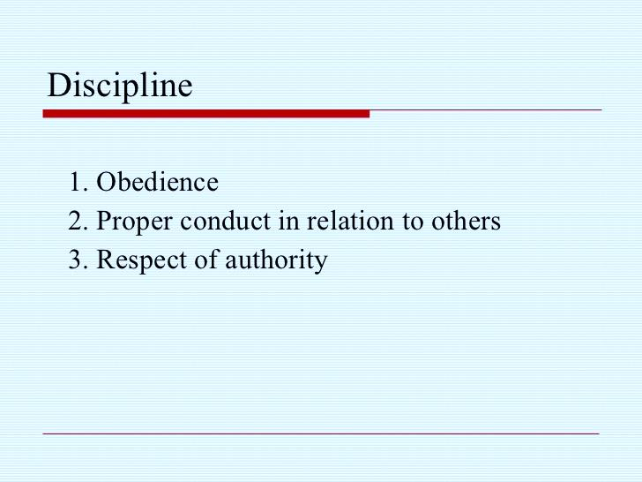

Slide 61
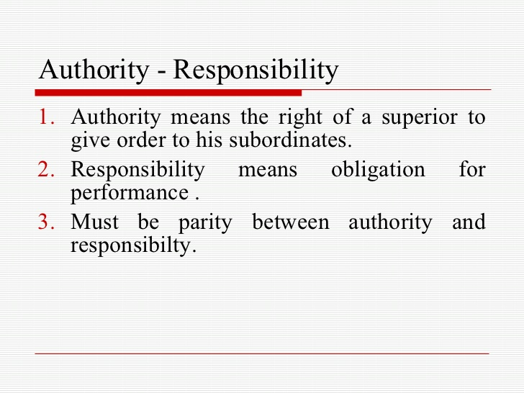

Slide 62
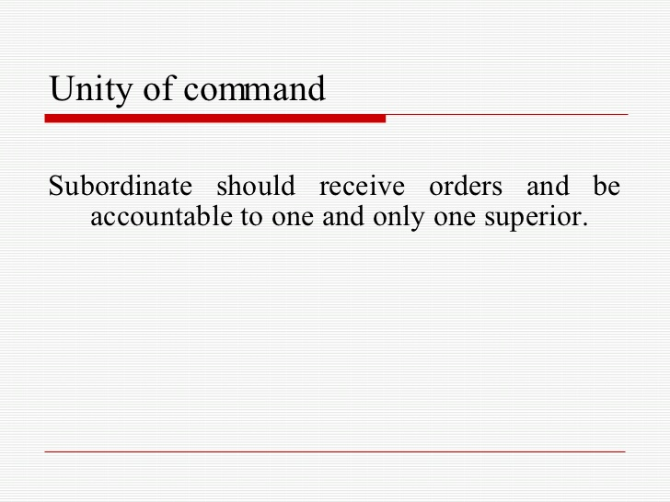

Slide 63
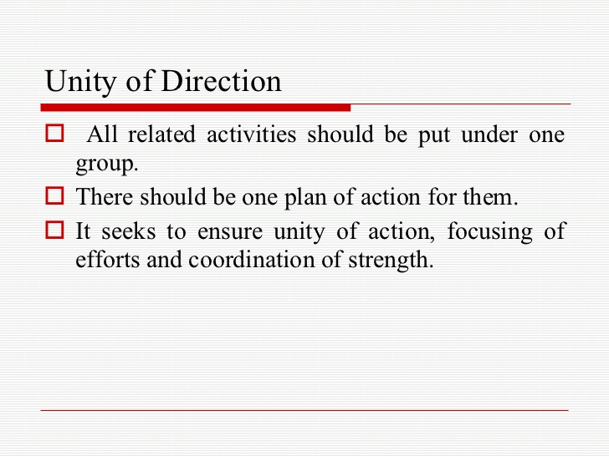

Slide 64
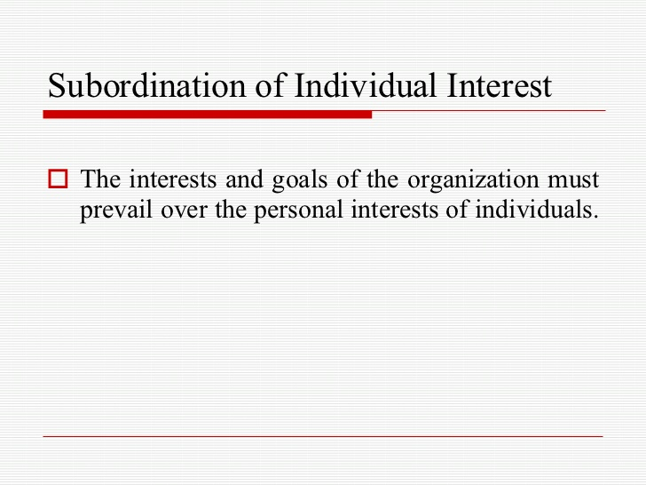

Slide 65
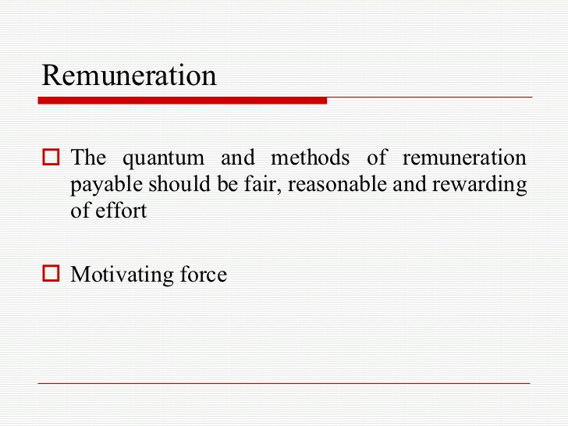

Slide 66
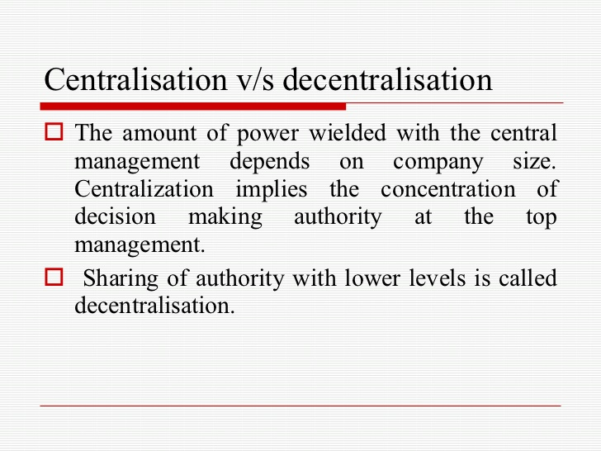

Slide 67
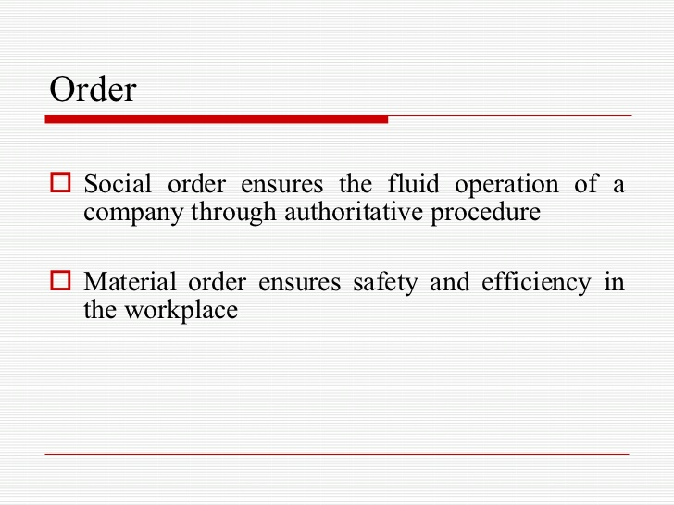

Slide 68
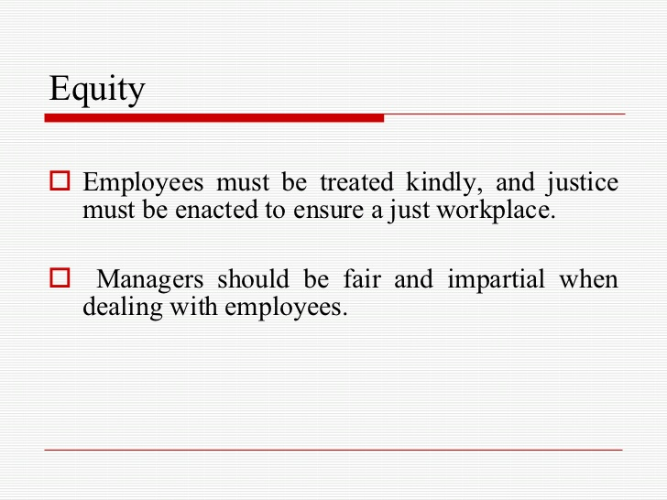

Slide 69
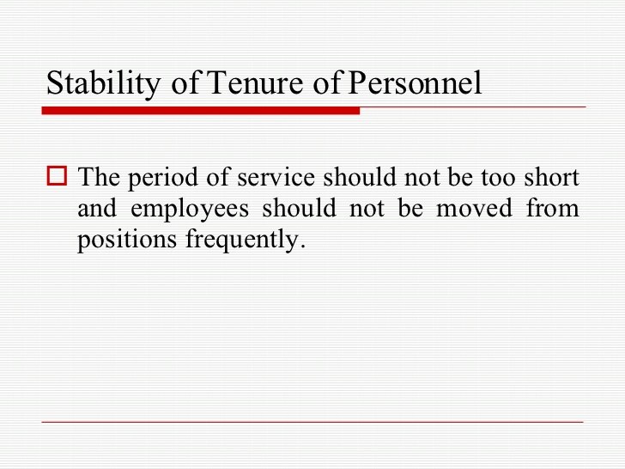

Slide 70
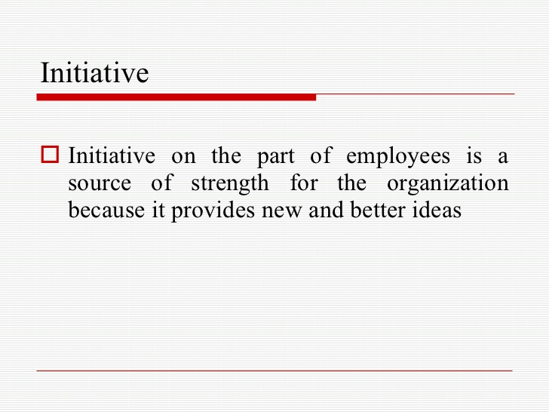

Slide 71
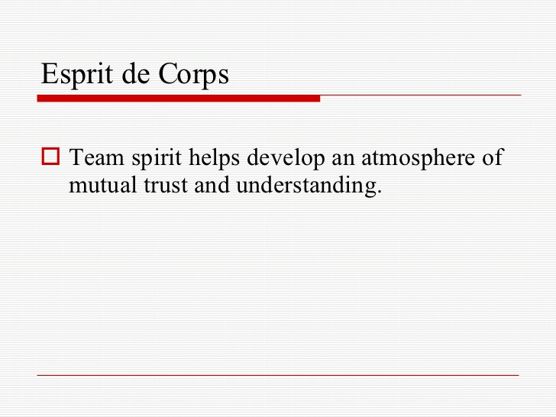

Slide 72
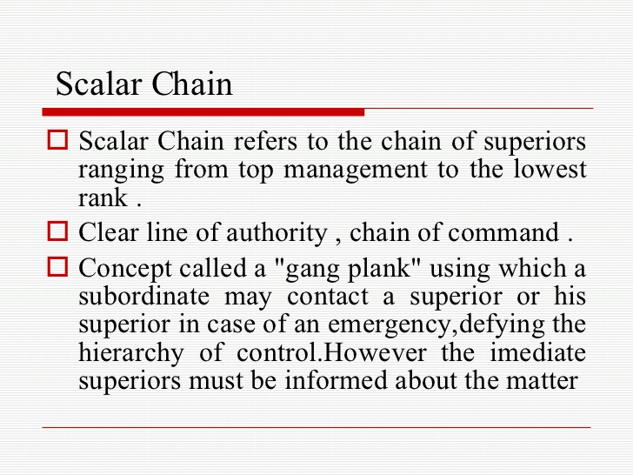

Slide 73
S.No. | Basis | Unity of Command | Unity of Direction
1. | Meaning | One subordinate should receive orders from and should be responsible to only one superior. | Each group of activities having same objective must have one head and one plan.
2. | Aim | It prevents dual subordination. | It prevents overlapping of activities.
3. | Implications | It affects an individual employee | It affects the entire organization.

Slide 74
Video on 14 principles of management
https://www.youtube.com/watch?v=tUrjAn24ZiA

Slide 75
Differentiation :
Basis | Henry Fayol | F.W. Taylor
1. Nature of Research | He developed the theory of Functional management or Management process. | He developed the concept of Scientific management.
2. Concern | His principles are concerned with management efficiency. | His principle and techniques are concerned with workers efficiency.
3. Level | He designed principles for top level of management. | He designed principles for lower level of management.
4. Focus | Improving overall administration by observing certain principles was his main focus. | For him increasing productivity through work simplification was main focus.
5. Personality | He developed the personality of a researcher and practioner and was called as ‘father of general management. | He developed the personality of scientist and was called as ‘father of scientific management

Slide 76
Basis | Henry Fayol | F.W. Taylor
6. Major contribution | Hid main contribution was to produce a systematic theory of management with the help of fourteen principles of general management. | He provided a basis on accomplishment on production line with the help of scientific techniques and management.
7. Human element | He gave due emphasis to human elements by suggesting principles like equality, initiative, fair renumeration etc. | He ignored the human element and emphasized more on increasing productivity.
8. Rigidity and flexibility | His principles were flexible. | He was rigid in his approach and he felt that there should be no deviation from fixed standards.
9. Applicability | His principles are applicable to business as well as non-business organizations i.e. are applicable universally. | His principles are applicable to production and manufacturing i.e. are applicable to specific situations.
10. Unity of command | He strictly follow this principles i.e. one boss for one employee. | He did not follow this principle instead he insisted on minimum eight bosses.

Slide 77
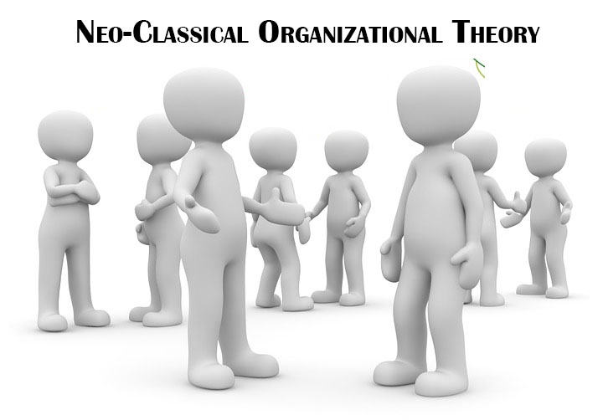

Slide 78
Philosophy of Human Relations
Recognition and Appreciation
Job Security and Job Satisfaction
Communication
Freedom from Strict Supervisions
Participate on Decision Making

Slide 79
Modern approach to Management
Quantitative Approach
Systems Approach
Contingency Approach

Slide 80
Quantitative Approach
Known as “Management Science Approach.”
Developed during 1950.
Based on Scientific Management Approach.
It offers Systematic & Scientific Analysis & solution to the problems faced by managers.

Slide 81
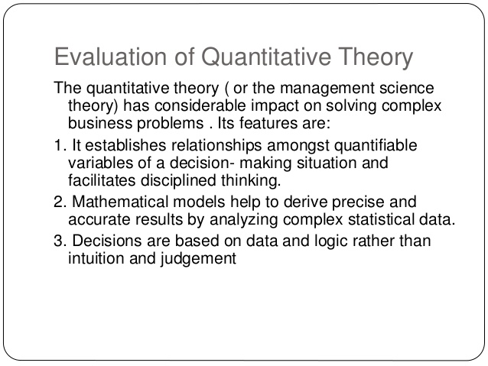

Slide 82
Aims at achieving High degree of precision, perfection & Objectivity.
Complex Problems : Mathematical & Statistical tools
Operation Research : Liner Programming, Simulation, Queuing theory & game theory, etc.
Use of Computer aided technology.
Field : Production, Finance, Costing, Transportation, & Storage etc.

Slide 83
Features
Management is essentially decision making & organisation is a decision making unit.
Organisational Efficiency depends upon the quality of managerial decisions.
A problem is expressed in the form of a quantitative or mathematical model containing mathematical tools & relationships.
The different variables in management can be quantified & expressed in the form f an equation.

Slide 84
Approach provides sharp tool for rational decision making.
Mathematical Formula enables manager to discover significant relationship that they could control.
Approach provides a rational base for making decision with precision & perfection.
Applied for Planning & Control, but for Organising, Staffing, Leadership. (Human & Technical Nature)
Not applied for Total Approach to Management.

Slide 85
Merits of the Quantitative Approach
It provides exactness of management principle
It helps the decision maker make better decisions through informed and reasoned (rational) judgements

Slide 86
System theory of Management
organizations are seen as systems composed of a set of interdependent parts which co-ordinate their efforts in order to achieve common goals.

Slide 87
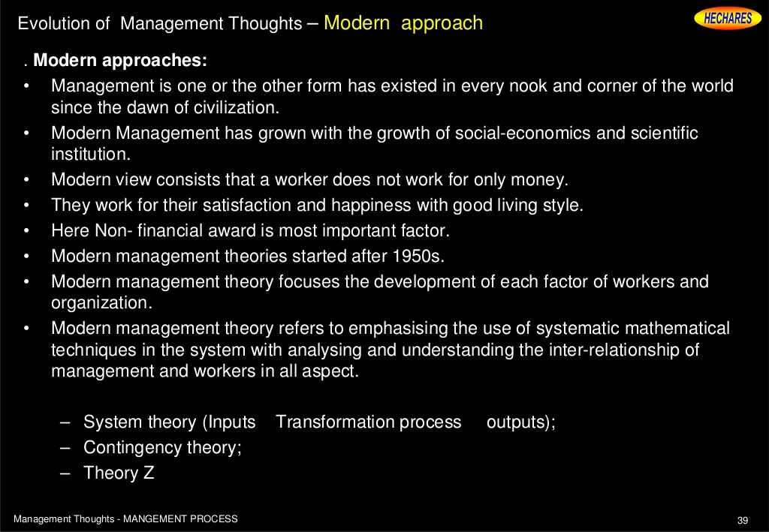

Slide 88
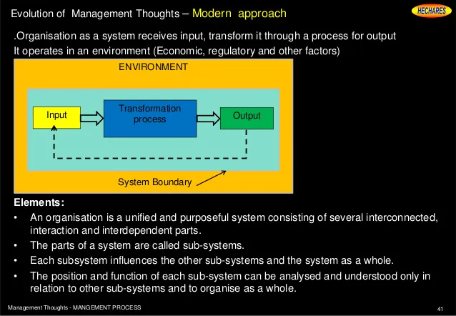

Slide 89
Systems Theory - Four Elements:
1. Inputs - the organizational resources, e.g. raw materials, human resources, financial resources, information and equipment.
2. Transformation processes - the conversion of inputs into outputs through managerial functions, technological operations and production activities
3. Outputs - the results of the transformation processes, which include profits/losses, goods/services and so on. Some of these outputs, like for example products and services, are returned to the environment for use by other organizations and individuals.
4. Feedback - the environment's reactions to these outputs are relayed back to the system.

Slide 90
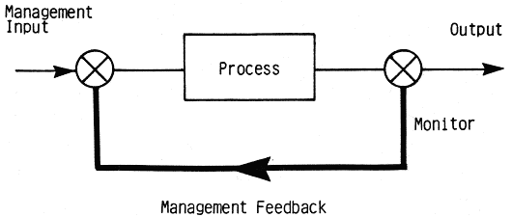

Slide 91
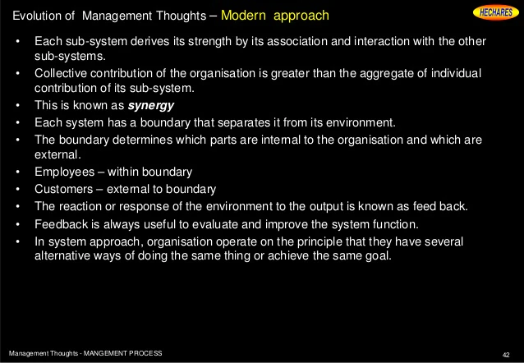

Slide 92
System Management
Plans (Goals)
Objectives
Schedules
Inputs (Resources)
Information
Energy
Process ( Production)
Conversion of Inputs into Outputs through Men & Machine System
Information
Outputs (FG)
Policies
Procedures
Programmes
Methods
Materials
Energy
Materials

Slide 93
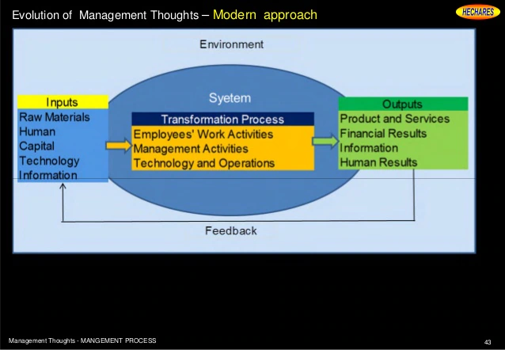

Slide 94
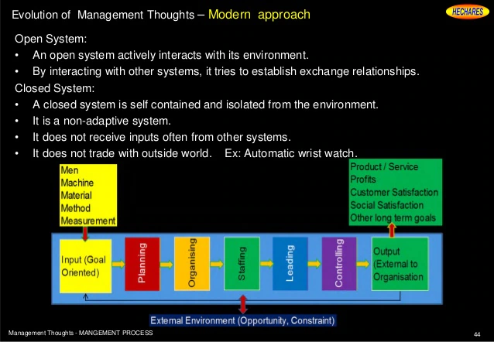

Slide 95


Slide 96
Drawbacks
System concepts are said to be abstract & vague.
2. Too many subsystems & interdependence among them make task of manager very difficult.
3. The system approach neither offers any tool 7 technique for analysis & synthesis nor it recognises the differences which exist between the system.

Slide 97


Slide 98
https://www.youtube.com/watch?v=WgbO1BGJCJI

Slide 99

Contingency Theory

Slide 100


Slide 101
Characteristics of Contingency Approach
Situational
Organizational Adaptation
Contingency leadership
Adapting to situation
Changed thinking
Relationship with environment

Slide 102

Real life business examples
Steve Jobs
“there is no one right way of leading and that a leader must adjust their style depending on the context“

Slide 103
Activity
Question:
You are the owner of medium sized marketing company with 50 employees, 10 of your employees spend their entire 8hr shift putting data into a computer and only leave their desk to have a 30min lunch break, leaving a total of 7.5hrs on a computer per day. The Government has introduced a new health & safety legislation, which states that data entry employees can only spend a total of 5hrs on the computer per day, entering data.
Being a manager using contingency management, how would you work with this new legislation?

Slide 104
Summary and comparison of management approaches
Classical Approach | Organisation and allocation of staff | Organisational Structure | Levels of Management
 | Programmed staff performing simple, repetitive tasks Division of labour into functional units | Hierarchical pyramid structure Strict channels of responsibility for all levels of management | - Many management levels with clearly distinguishable organisational positions
 | - Appraisal or reward based on achievement for production | - Considerable management and supervisory control at each level | Actions decided by management Bureaucratic management believed to be the most effective means

Slide 105
Summary and comparison of management approaches
Behavioral Approach | Organisation and allocation of staff | Organisational Structure | Levels of Management
 | Recognition that workers have both social and economic needs (social life and income) Teamwork and informal working groups are important for productivity | Hierarchical pyramid structure More communication with workers but still no participative partnership | Many management and supervisory levels Development of peoples management skills, particularly communication and social motivation skills

Slide 106
Summary and comparison of management approaches
Contingency Approach | Organisation and allocation of staff | Organisational Structure | Levels of Management
 | - Flexibility and adaption of a variety of ideas and principles that are pursued to suit the business’s requirements | May be a pyramid The structure depends on the business’s requirements | - Depends on the business’s requirements (the nature of the operation and abilities of employees)

