Slide 1
Thakur College of Science & Commerce
Department of Zoology
Academic Year – 2020-21
T.Y.B.Sc. Zoology
Semester – V
Paper –III Unit - I
Integumentary System & Derivatives
Dr. Vitthal T. Mohite

Slide 2
Integumentary System
The integumentary system comprises the skin and its appendages acting to protect the body from various kinds of damage, such as loss of water or damages from outside.
The integumentary system includes hair, scales, feathers, hooves, and nails.
It has a variety of additional functions; it may serve to waterproof, and protect the deeper tissues.
It excrete wastes, and regulate body temperature.
Itis the attachment site for sensory receptors to detect pain, sensation, pressure, and temperature.
In most land vertebrates with significant exposure to sunlight, the integumentary system also provides for vitamin D synthesis.
The integumentary system is an organ system consisting of the skin, hair, nails, and exocrine glands.
The skin is only a few millimeters thick yet is by far the largest organ in the body.
The average person's skin weighs 10 pounds and has a surface area of almost 20 square feet.

Slide 3
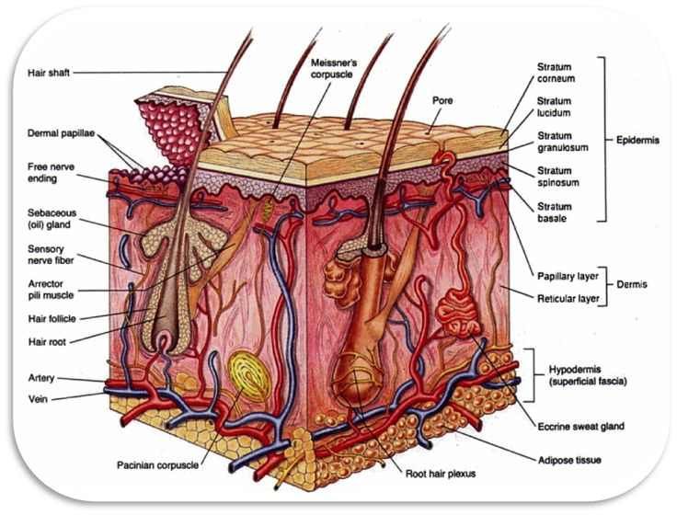

Slide 4
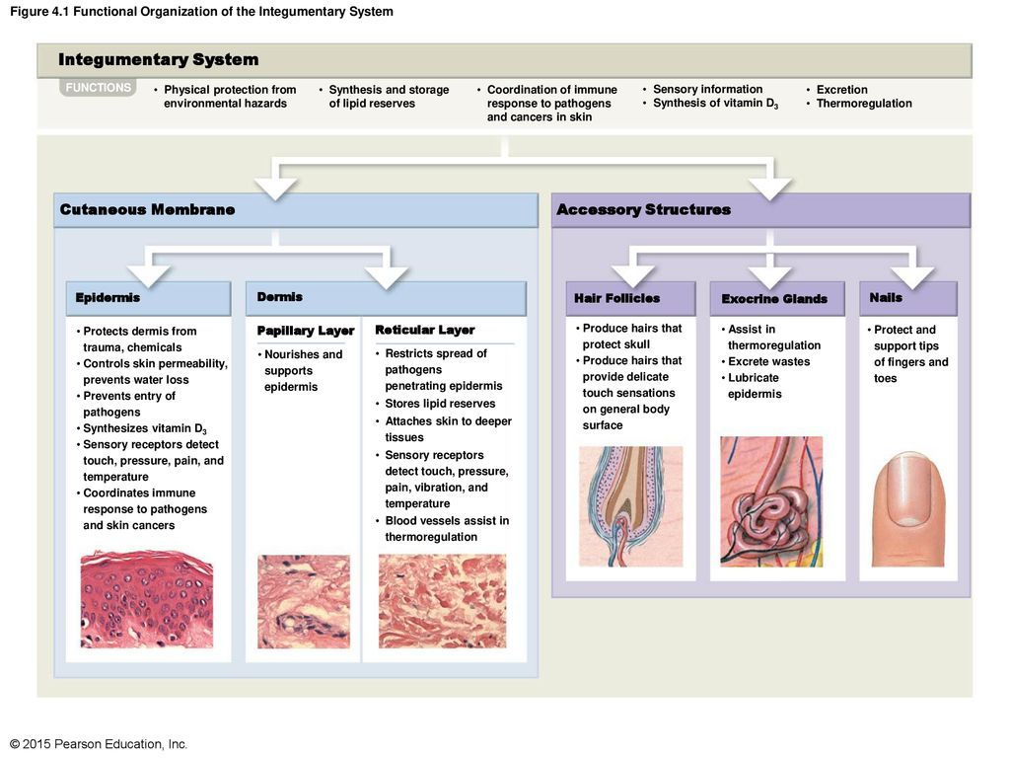

Slide 5
Function of Integumentary System
The integumentary system has multiple roles in maintaining the body's equilibrium.
All body systems work in an interconnected manner to maintain the internal conditions essential to the function of the body.
The skin has an important job of protecting the body and acts as the body's first line of defense against infection, temperature change, and other challenges to homeostasis.^{[4][5]} Functions include:
Protect the body's internal living tissues and organs
Protect against invasion by infectious organisms
Protect the body from dehydration
Protect the body against abrupt changes in temperature, maintain homeostasis
Help excrete waste materials through perspiration
Act as a receptor for touch, pressure, pain, heat, and cold (see Somatosensory system)
Protect the body against sunburns by secreting melanin
Generate vitamin D through exposure to ultraviolet light
Store water, fat, glucose, vitamin D
Maintenance of the body form
Formation of new cells from stratum germinativum to repair minor injuries
Protect from UV rays.
Regulates body temperature
It distinguishes, separates, and protects the organism from its surroundings.
Small-bodied invertebrates of aquatic or continually moist habitats respire using the outer layer (integument).
This gas exchange system, where gases simply diffuse into and out of the interstitial fluid, is called integumentary exchange.

Slide 6
Skin
The skin is the largest organ of the body. In humans, it accounts for about 12 to 15 percent of total body weight and covers 1.5-2m² of surface area.
The human skin (integument) is composed of at least two major layers of tissue: the epidermis and dermis.
The epidermis is the outermost layer, providing the initial barrier to the external environment.
It is separated from the dermis by the basement membrane.
The epidermis contains melanocytes and gives color to the skin.
The deepest layer of epidermis also contains nerve endings. Beneath this, the dermis comprises two sections, the papillary and reticular layers, and contains connective tissues, vessels, glands, follicles, hair roots, sensory nerve endings, and muscular tissue.
deepest layer, the hypodermis, is primarily made up of adipose tissue.
Substantial collagen bundles anchor the dermis to the hypodermis in a way that permits most areas of the skin to move freely over the deeper tissue layers.

Slide 7
Structure of Skin
Skin consists of two principle tissue layers: the outer epidermis and the deeper dermis.
A hypodermis is situated below the skin, deep to the dermis.
It is composed of subcutaneous adipose tissue, it varies throughout the body and among individuals.
Thick skin found in palms of the hands soles of feet.
In total four layers from deep to superficial
  1. Stratum Basale
  2. Stratum spinosum
  3. Stratum granulosum
  4. Stratum corneum.
  Fifth layer stratum lucidum is present in between stratum corneum & S. granulosum.

Slide 8
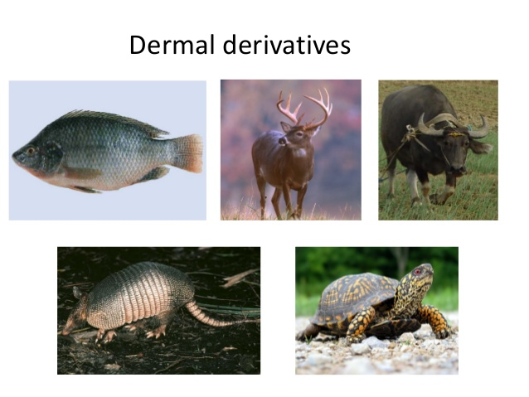
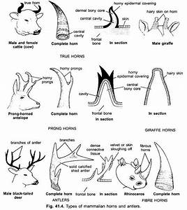
Epidermal derivatives of Vertebrates
INTEGUMENT. derivatives (sweat glands, sebaceous glands, mammary glands, hair, nails, claws, hooves, horns, antlers, combs, wattles, and feathers)

Slide 9
Epidermal Scales
Epidermal scales are horny, tough extensions of the stratum corneum.
Well developed in reptiles, they are also common on exposed skin in birds and mammals.
Such scales are periodically molted or shed gradually along with the rest of the stratum corneum.
Epidermal scales are absent in fishes, but dermal, or bony, scales are abundant.
Claw like epidermal scales are present in certain amphibians, including a few toads, certain burrowing, wormlike caecilians.
The so-called horns of the horned lizard are specialized epidermal scales;
The rattle of rattlesnakes is a series of dried scales loosely attached to each other, the last one always remaining despite molting of the rest of the stratum corneum.
Epidermal scales cover the bony scales of the carapace (top) and plastron (bottom) of turtles’ shells.
The beak of turtles is composed of a modified epidermal scale covering the jawbone.

Slide 10
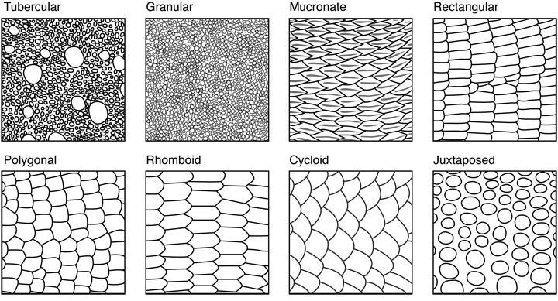
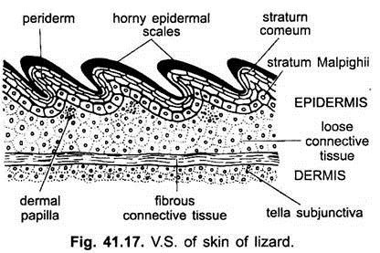
Reptilian Scales (Lizards)
Reptilian skin is covered with scutes or scales distinguish reptiles from animals of other classes.
Scales are made of alpha and beta-keratin and are formed from the epidermis.
They may be ossified or tubercular, as in the case of lizards,
scales vary in form from tubercular to platelike, or overlapping.
These scales, which on the surface are composed of horny (keratinized) epidermis, may have bony plates underlying them; these plates are called osteoderms.
Lizard scales may differ strongly in form on different parts of the lizard
For instance, the scales between the nostrils are sometimes called supranasals^{[2]} and sometimes internasals

Slide 11
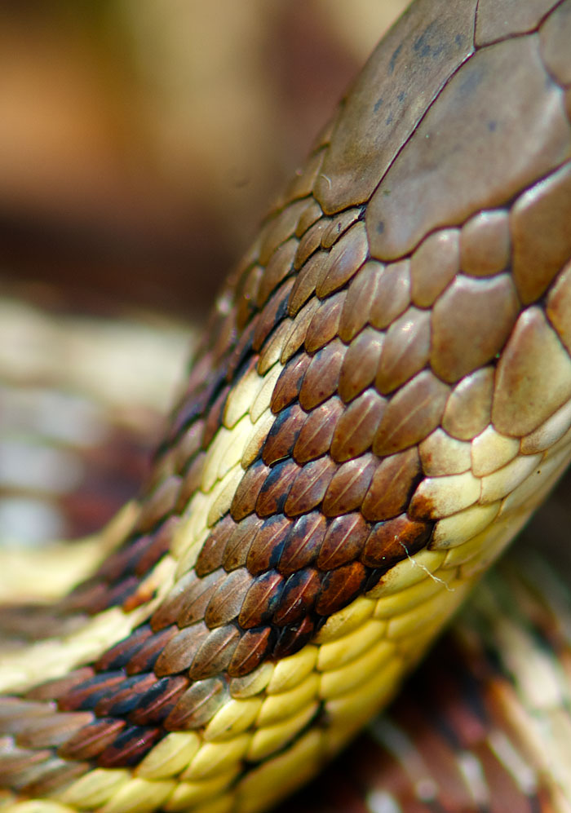
Snake Scales
Snakes are entirely covered with scales or scutes of various shapes and sizes.
Scales protect the body of the snake, aid it in locomotion,
It allow moisture to be retained within complex colouration patterns which help in camouflage and anti-predator display.
In some snakes, scales have been modified over time to serve other functions such as 'eyelash' fringes, and protective covers.
Snakes periodically moult their scaly skins and acquire new ones.
This permits replacement of old worn out skin, disposal of parasites and is thought to allow the snake to grow.
The shape and arrangement of scales is used to identify snake species.
The shape and number of scales on the head, back and belly are characteristic to family, genus and species.
In "advanced" (Caenophidian) snakes, the broad belly scales and rows of dorsal scales correspond to the vertebrae.

Slide 12
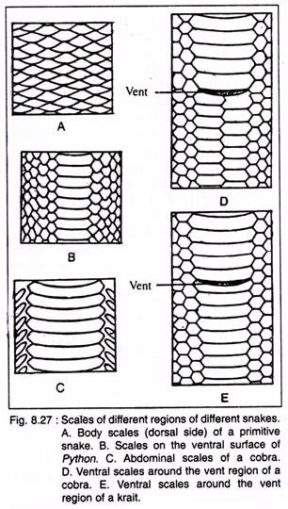

Slide 13
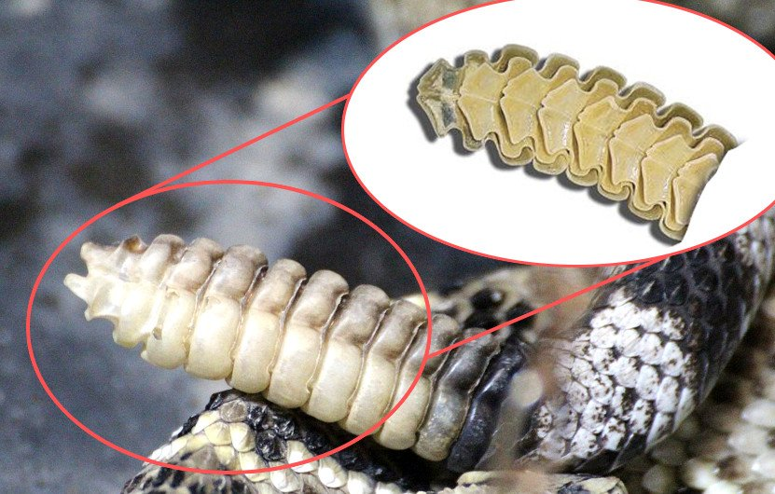
Rattle in Rattle snake
Rattlesnake skin has a set of overlapping scales which cover the entire body,.
It providing protection from a variety of threats including dehydration and physical trauma.
The typical rattlesnake, genus Crotalus, has the top of its head covered with small scales.
The rattle serves as a warning for predators of the rattlesnake.
The rattle is composed of a series of hollow, interlocked segments made of keratin, which are created by modifying the scales that cover the tip of the tail.
The contraction of special "shaker" muscles in the tail causes these segments to vibrate against one another, making the rattling noise in a behavior known as tail vibration.
The muscles that cause the rattle to shake are some of the fastest known, firing 50 times per second on average, sustained for up to three hours.

Slide 14
Small, Large & Modified Scales
Small Scales: Reptilian scales are small scales undergoes various modifications.
Snakes & lizards have continuous scales.
Snakes dorsal side have large scales.
Crocodiles and turtles have large thick scales called scutes.
Hedgehog, porcupine, monotremes has modified scales from spines.
Spiney ant eaters show modified scales of spines.
Most of the birds have typical epidermal keratin scales on the feet and also on long leg & base of beak.
Horny sheath of beak is modified keratin or s. corneum called rhamphotheca.

Slide 15
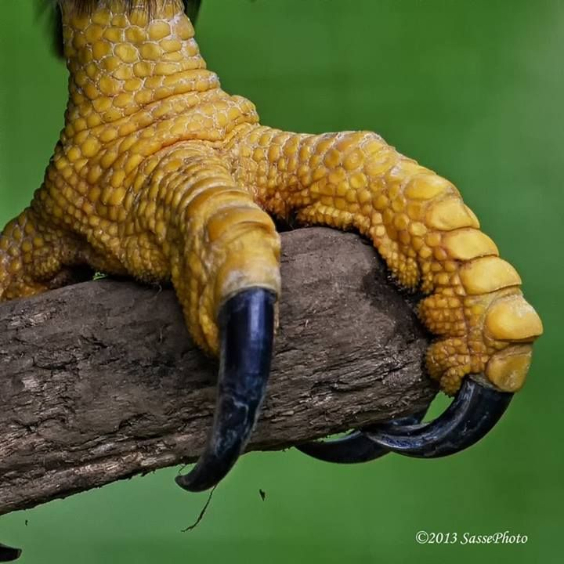
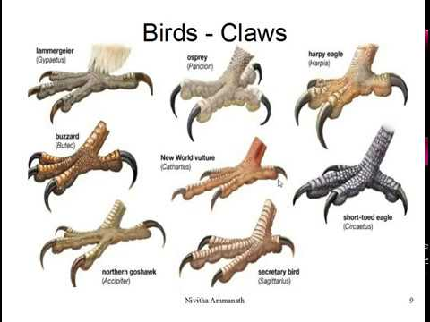
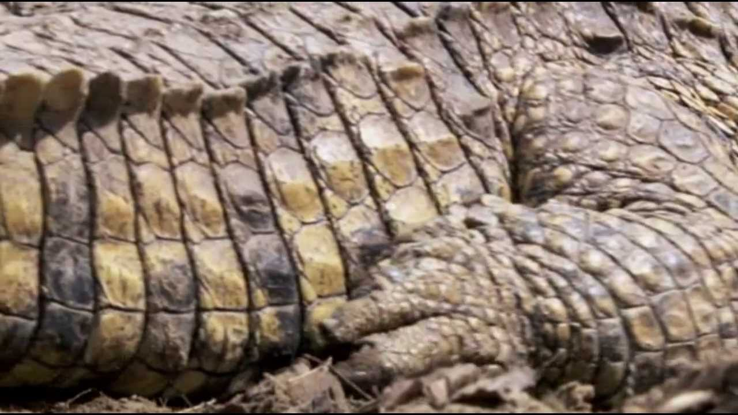
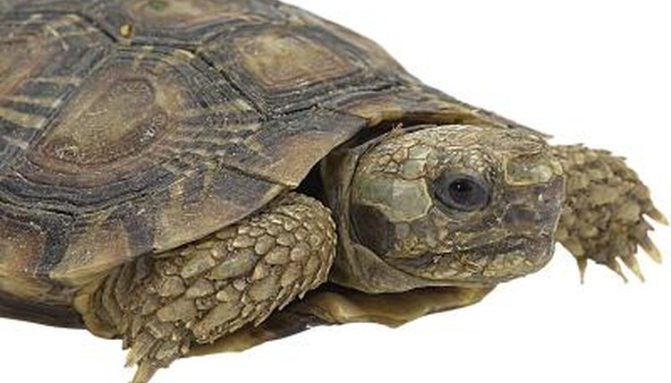
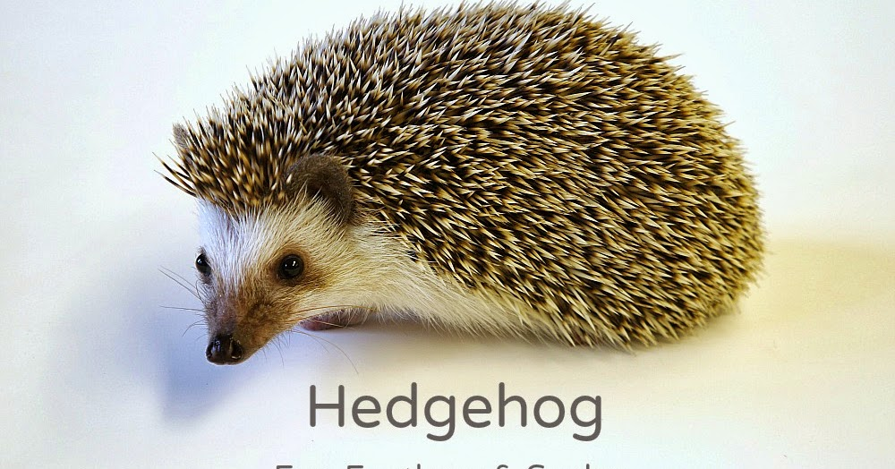
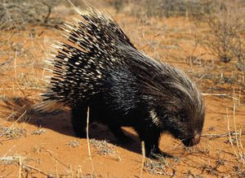
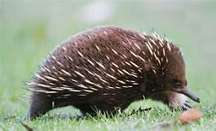

Slide 16
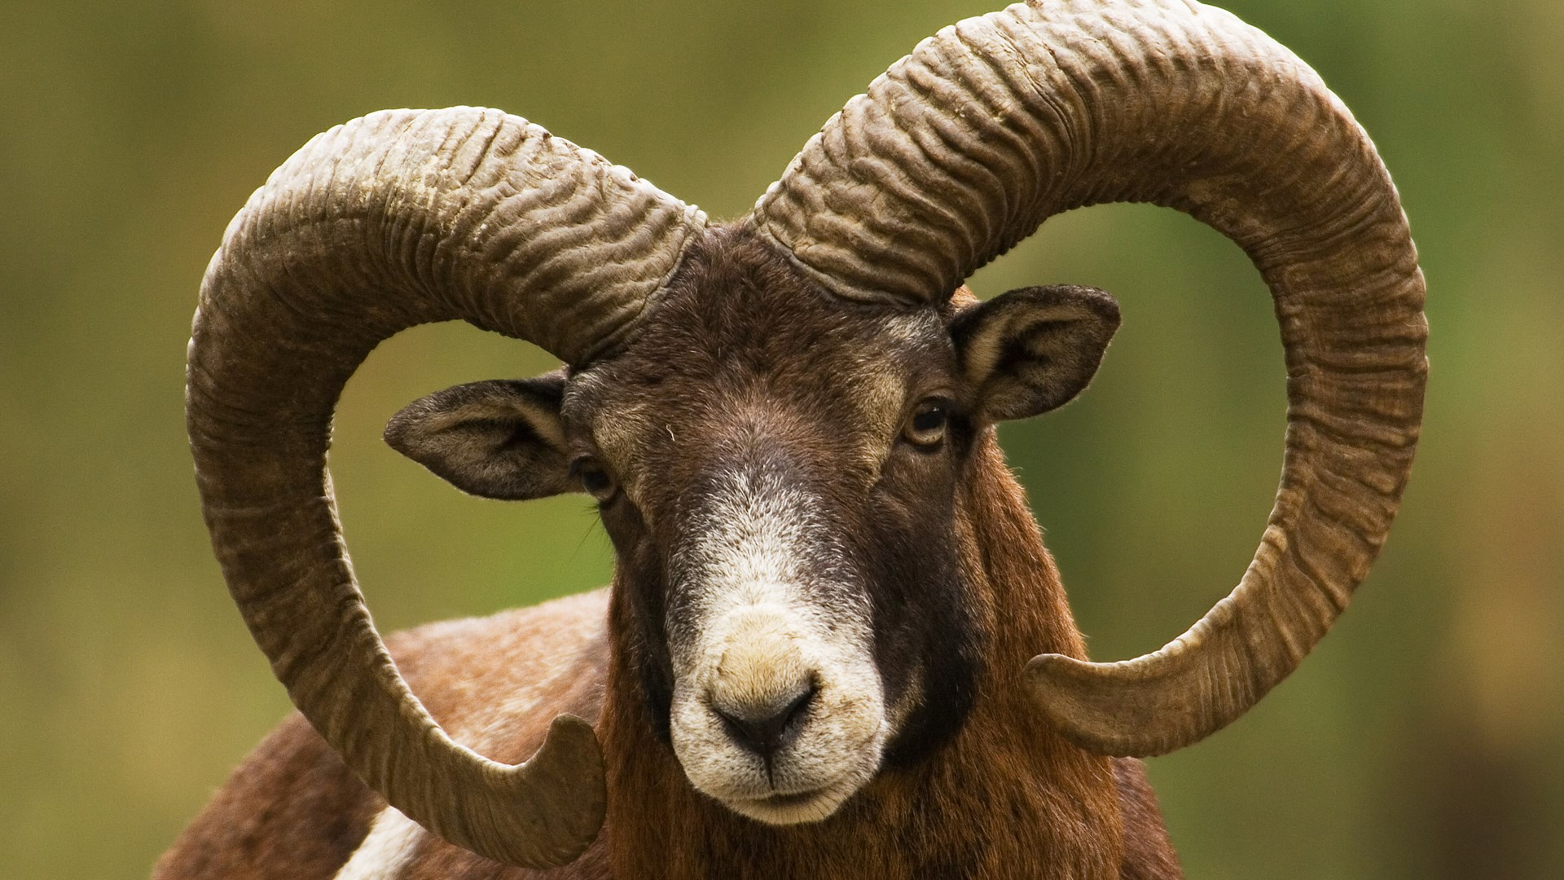
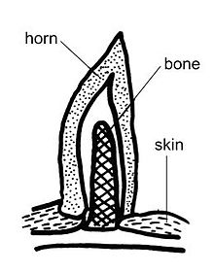
Horns
The term "horn" is also popularly applied to other hard and pointed features attached to the head of animals
Most unique integumentary modification are hoofs & horns.
They are confines to ungulates.
A horn is a permanent pointed projection on the head of various animals that consists of a covering of keratin and other proteins surrounding a core of live bone.
In mammals, true horns are found mainly among the ruminant animals.
Cattle horns arise from subcutaneous connective tissue (under the scalp).
Horns usually have a curved or spiral shape, often with ridges or fluting.
In many species, only males have horns.
Horns start to grow soon after birth and continue to grow throughout the life of the animal.

Slide 17
Types of Horns
Fibrous /Hair Horn: Found in both sexes of rhino horns.
Made up of epidermal strands of keratin & integral part of skin.
True or Hollow Horns : Bovine family exhibit true horn.
Are cylindrical , branched pointed.
Outer part covered by epidermal horny hollow cup.
Prong Horns : Antelope shows prong horns & bony out gtowth of frontal bone our growth hard keratin of epidermal origin.
Antlers : Characteristic of deer family Cervidae.
Restricted to male except Reindeer & Caribou.
These are frontal dermal bone forms antler core.

Slide 18
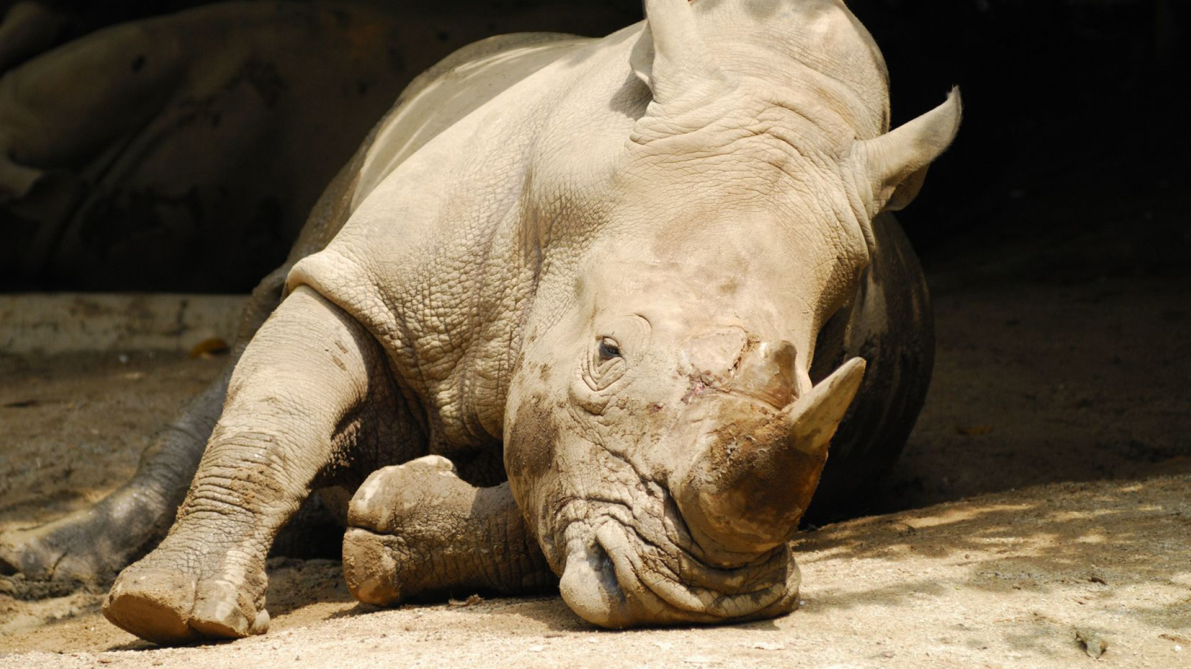
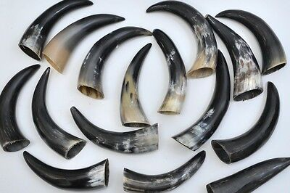
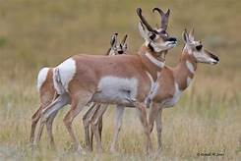
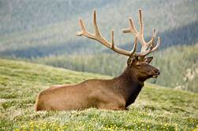
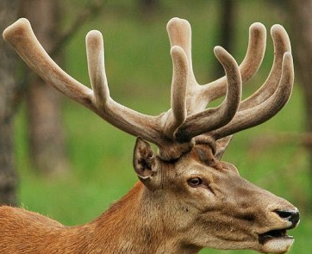

Slide 19
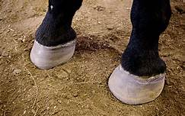
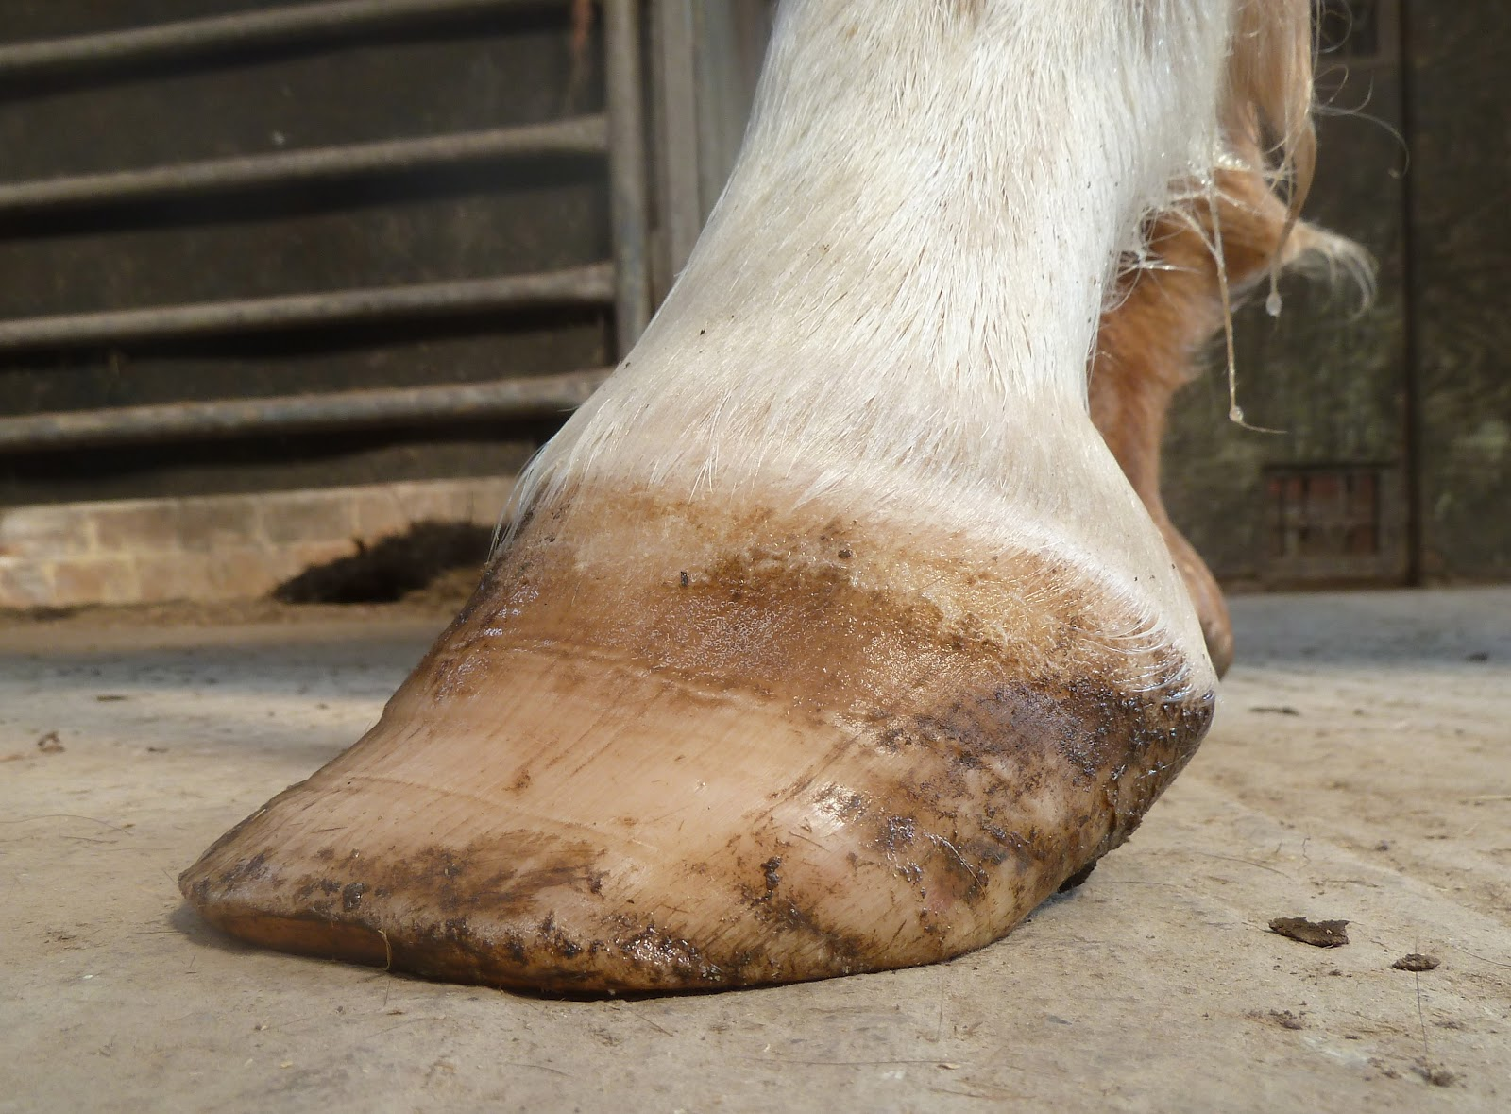
Hoofs
It is modified part stratum corneum at the tip of digits.
Dorsal surface called Unguis & ventral surface is called subunguis.
Horny unguis is nither pointed nor flat but it is “Ú” or “V”Shaped.
A hoof, plural hooves or hoofs, is the tip of a toe of an ungulate mammal, strengthened by a thick and horny keratin covering. Artiodactyls.
Hooves are generally cited as limb structures restricted to placental mammals
The hoof surrounds the distal end of the second phalanx, the distal phalanx, and the navicular bone.
The hoof consists of the hoof wall, the bars of the hoof, the sole and frog and soft tissue shock absorption structures.
Hooves perform many functions, including supporting the weight of the animal, protecting the tissues and bone.

Slide 20
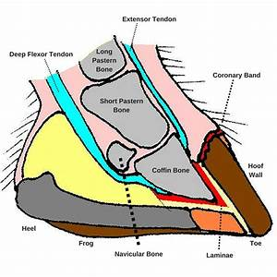
Parts of Hoof

Slide 21
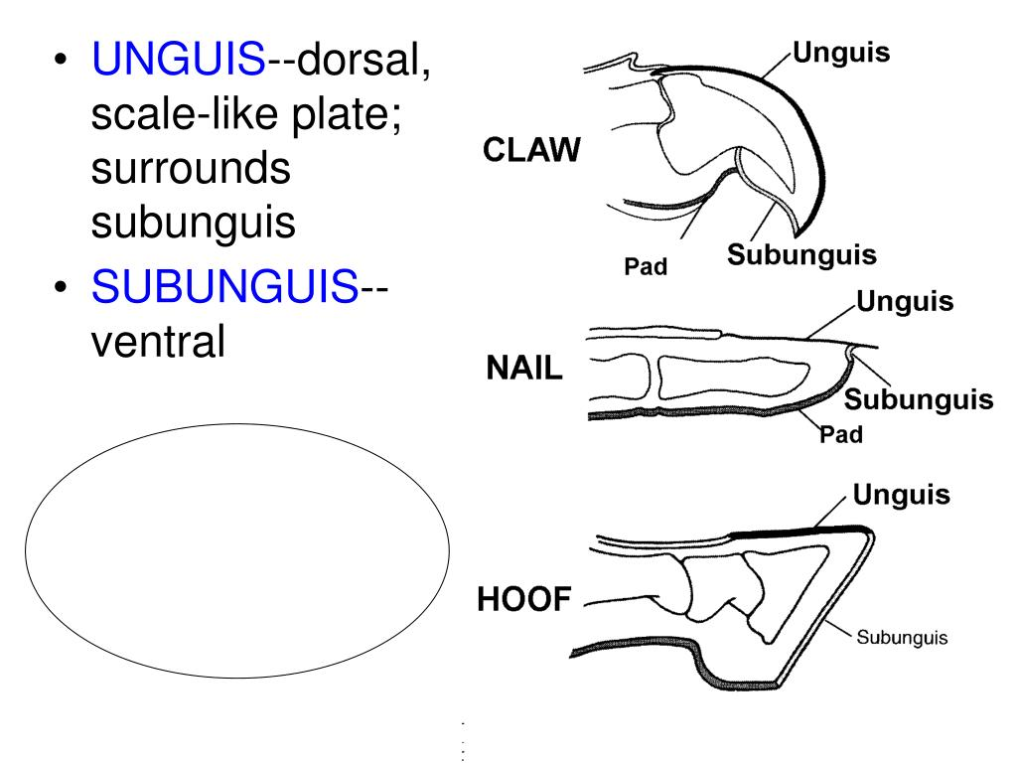
Claws
Claw, also called Talon, narrow, arched structure that curves downward from the end of a digit in birds, reptiles, many mammals, and some amphibians.
It is a hardened (keratinized) modification of the epidermis. Claws may be adapted for scratching, clutching, digging, or climbing.
Amniotes evolved during the late Paleozoic era.
The characteristic that sets amniotes apart from other tetrapods is that amniotes lay eggs that are well-adapted to survive in a terrestrial environment.
Claws in amniotes have similar structure but different function.
Claws is made up of two curved scale like keratin plates.
Large plate is unguis smaller plate is subunguis.
They are completely formed from epidermis.
Besides claws on hind limb one or two sharp claws present on wings of birds.

Slide 22
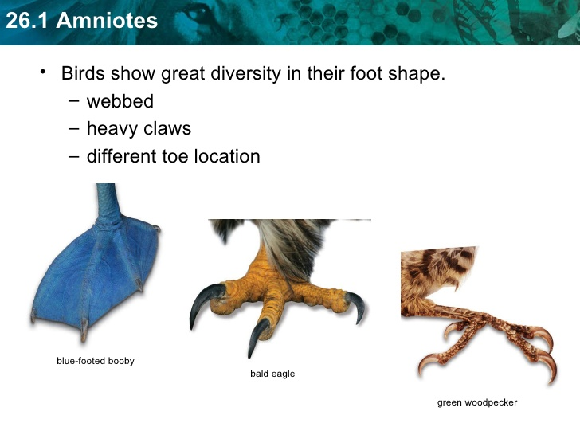
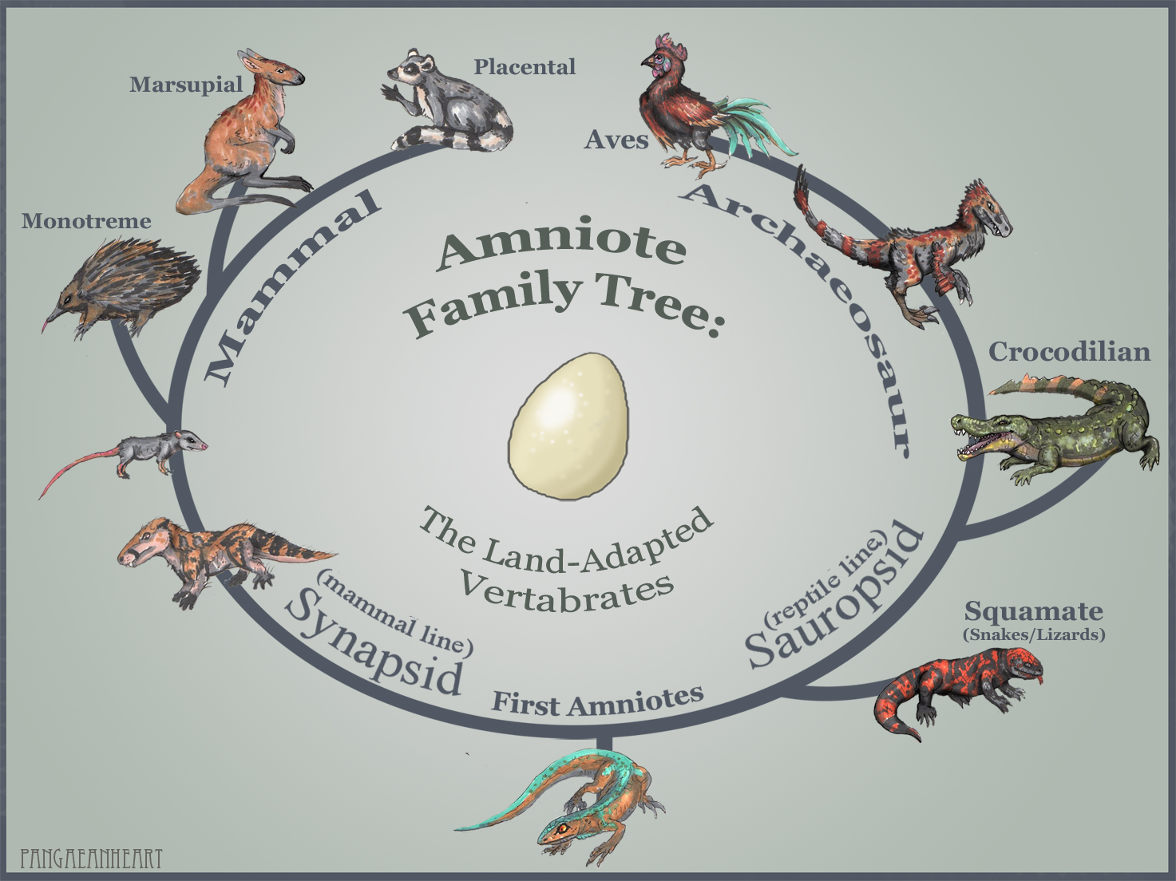

Slide 23
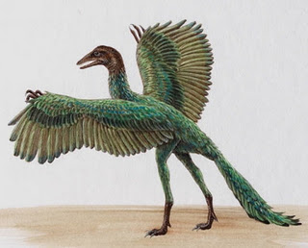
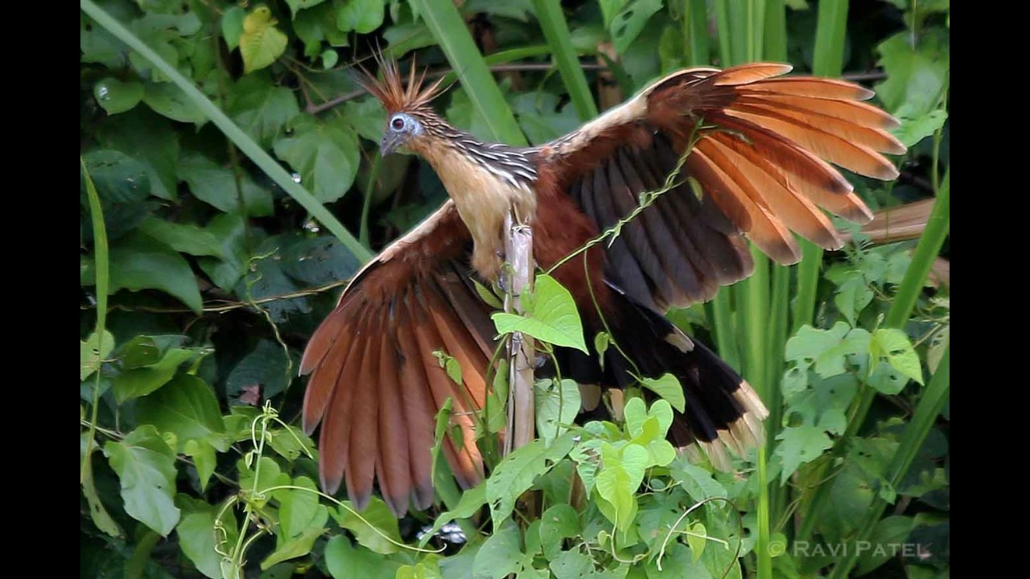
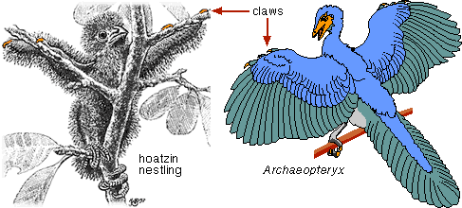
Claws on the wings of the birds
Ostriches , geese, American Pheasants shows claws on the wings for climbing on trees.
In some species of birds can be used for nesting.
Claws varies with respect habit & habitat.
Bird of prey have long sharp and powerful talons.

Slide 24
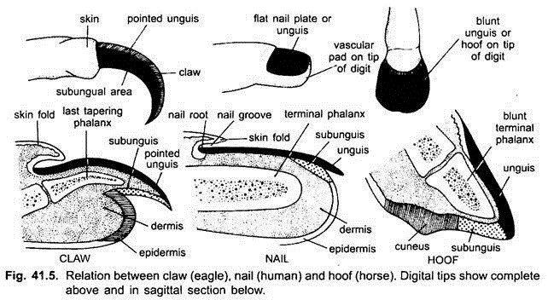

Slide 25
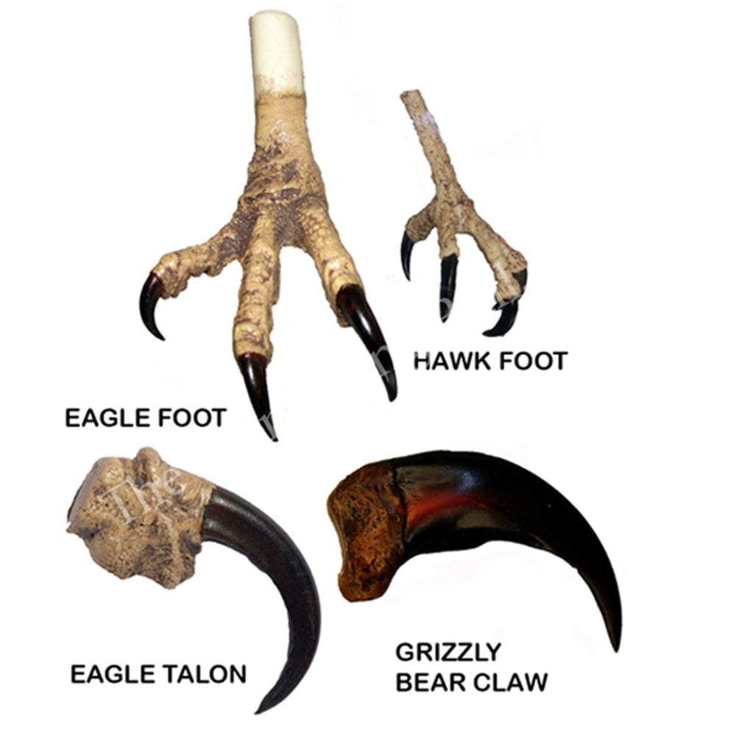

Slide 26
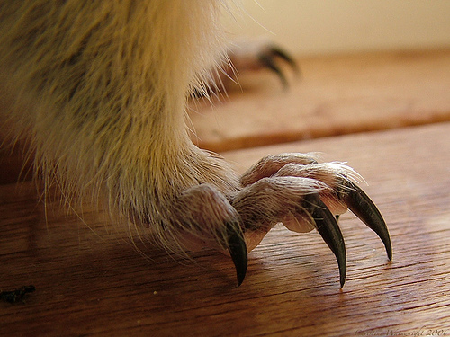
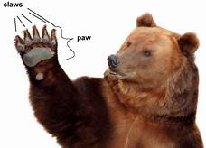
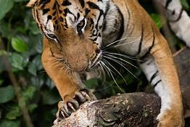
Claws in Mammals
Claws in mammals are identical to reptiles & birds.
Only difference is dermis & epidermis layer.
Dermis & epidermis forms cushion like structure.
Subunguis & S. corneum is of thickened soft keratin.
A claw consists of a dorsal plate called the unguis and a ventral plate called the subunguis.
The unguis is curved both in length and width and encloses the subunguis, which is connected to the digital pad at the distal end of the digit.
In addition to protection, claws assist predator species, such as lions and tigers, in holding their prey.
They provide traction for some arboreal species (e.g., squirrels) when scampering on branches.
Sloths have long curved claws that serve as hooks for hanging.
Digging mammals, such as anteaters and moles, have long claws that help them dig.

Slide 27
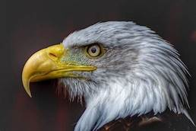
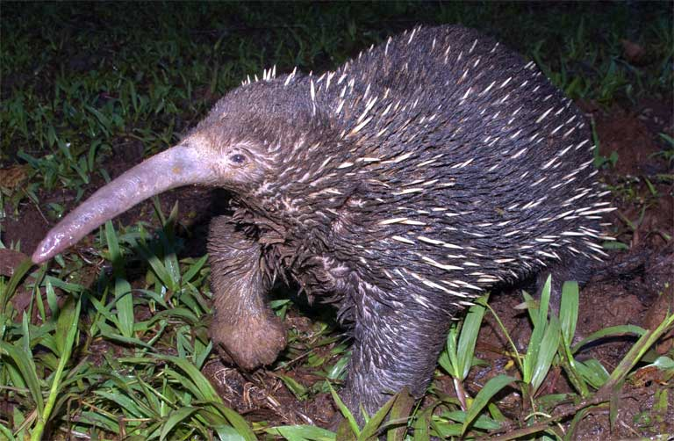
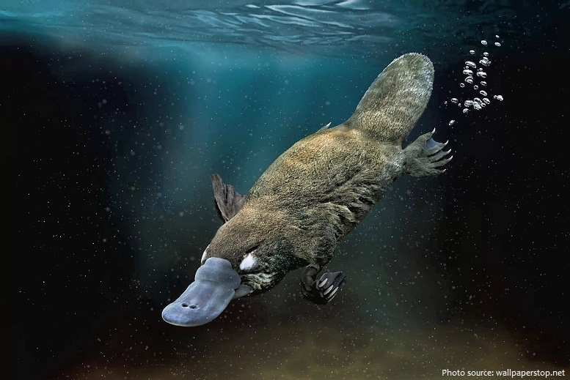
Beaks
Found in birds, turtles, tortoises & duck –billed platypus.
Jaws are covered with hard keratin forms beak.
Beak of duck –billed platypus is non keratinous look like beak of birds.
Mammals has soft flexible beak covered with soft moist skin richly supply with sense organs.
The beak, billor rostrum is an external anatomical structure found mostly in birds.
Also in non-avian dinosaurs and some mammals.
A beak is used for eating and for preening, manipulating objects, killing prey, fighting, probing for food, courtship and feeding young.
The terms beak and rostrum are also used to refer to a similar mouth part in some turtles, cetaceans, anuran tadpoles, monotremes (i.e. echidnas and platypuses, which have a beak-like structure),
Even in sirens, pufferfish, billfishes and cephalopods.
Although beaks vary significantly in size, shape, color and texture, they share a similar underlying structure.
Two bony projections—the upper and lower mandibles—are covered with a thin keratinized layer of epidermis known as the rhamphotheca.
In most species, two holes known as nares lead to the respiratory system.

Slide 28
Carnivorous birds. Birds that feed on vertebrates have strong, hooked beaks with the upper part protruding over the lower part. They are securely ...
Granivorous birds.
Frugivorous birds.
Insectivorous birds.
Wading birds.

Slide 29
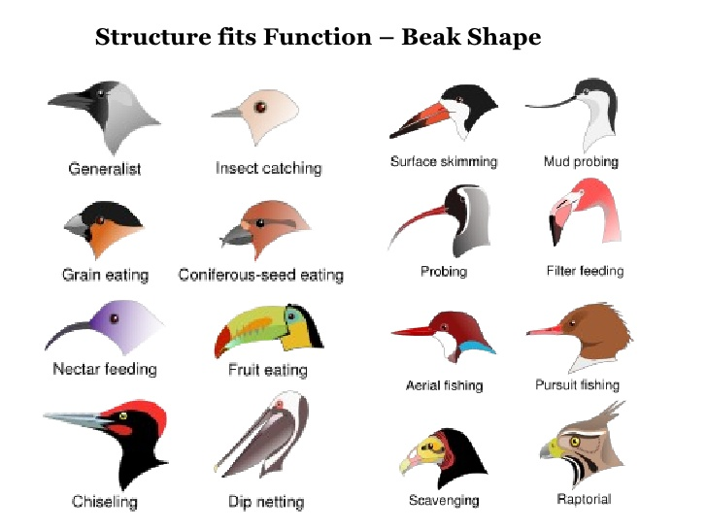

Slide 30
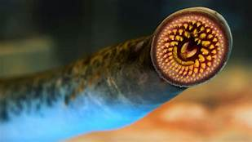
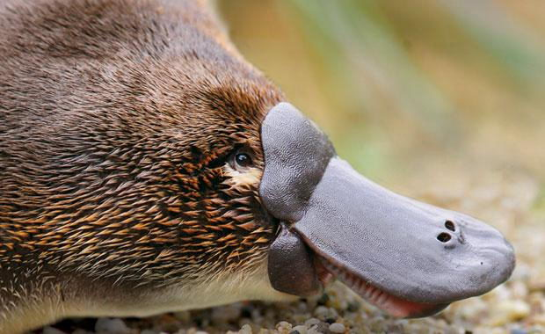
Horny Teeth
Epidermal tooth, any of several hard, horny projections analogous to but not homologous with true teeth (see tooth).
Epidermal teeth are found in the jawless fish (e.g., lampreys), on the edges of the jaws of tadpoles (larval frogs and toads).
In the mouth of the platypus, where horny plates replace the true teeth before birth, and in sirenians (e.g., sea cows) accompanying true teeth.
Teeth are present in all mammals though a secondary toothless condition is found in some mammals.
The adult platypus (Ornithorhynchus) bears epidermal teeth but no true teeth are present.
In platypus embryonic teeth are replaced by horny epidermal teeth in adult.

Slide 31
Hairs in mammals
Mammals exhibit unique modification of S. Corneum.
It forms dense, furry cover entire body
Hairs acts as insulator.
Hair, in mammals, the characteristic threadlike outgrowths of the outer layer of the skin (epidermis) that form an animal’s coat, or pelage.
Hair is present in differing degrees on all mammals.
On adult whales, elephants, sirenians, and rhinoceroses body hair is limited to scattered bristles.
In some animals hairs are sharp quills or spines
In some animal hairs on facials works as sensory organs.

Slide 32
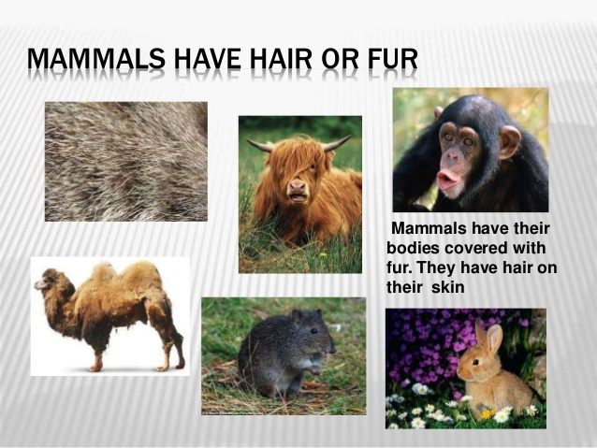

Slide 33
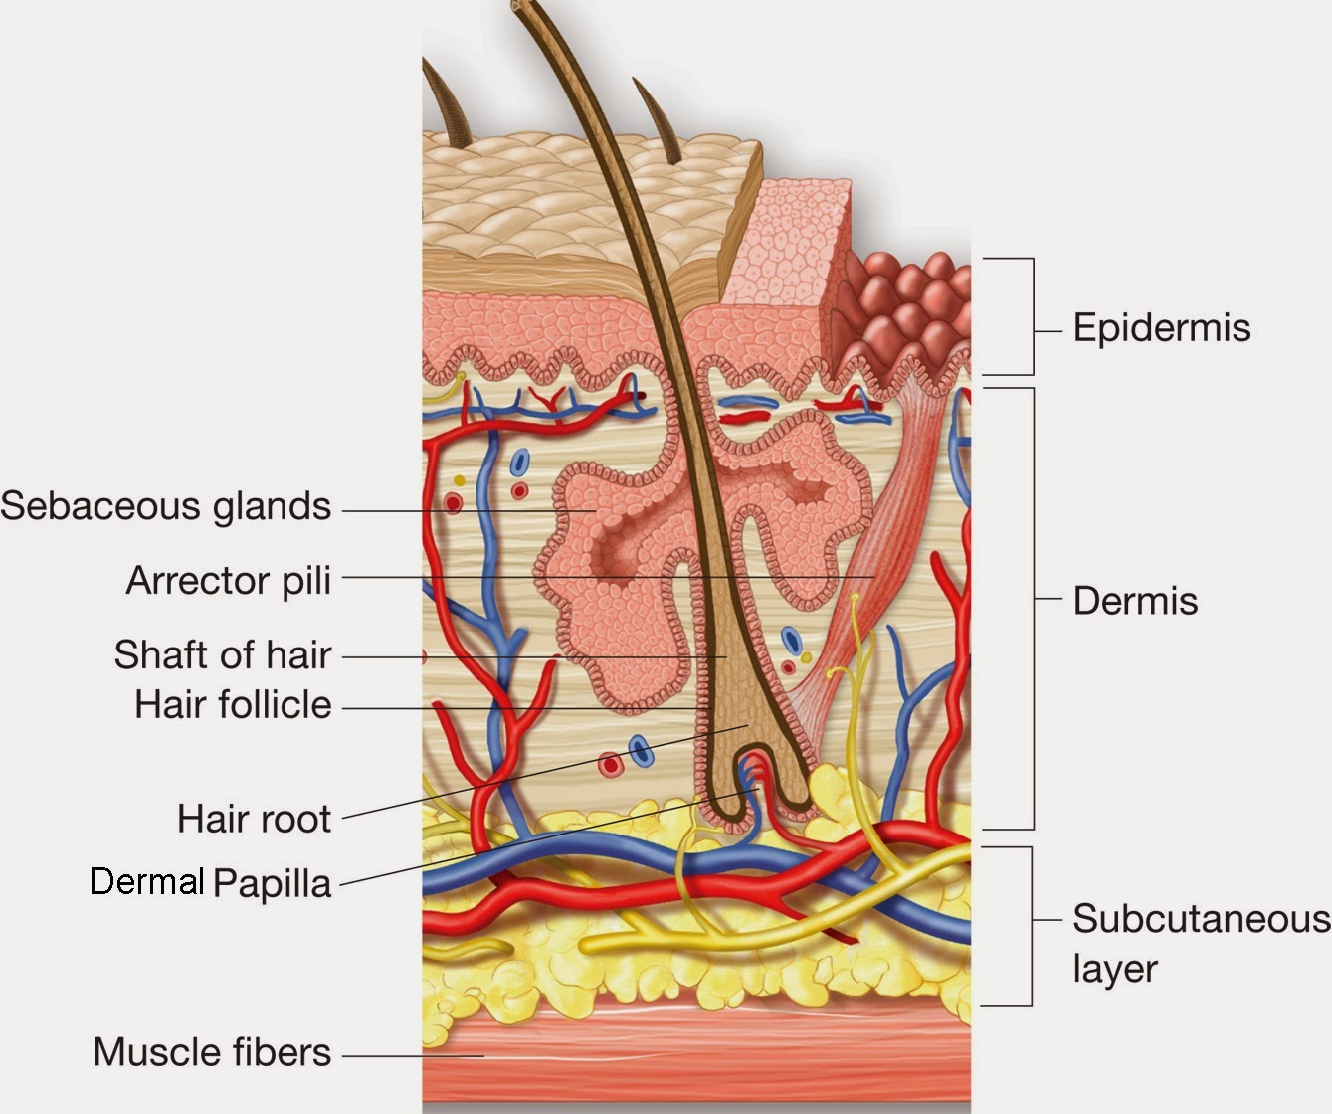
Hair
Is part of the skin that grows hair by packing old cells together.
Attached to the follicle is a sebaceous gland, a tiny sebum-producing gland found everywhere except on the palms, lips and soles of the feet.
The thicker density of hair, the more sebaceous glands are found.
A hair follicle is a tunnel-shaped structure in the epidermis (outer layer) of the skin.
Hair starts growing at the bottom of a hair follicle.
The root of the hair is made up of protein cells and is nourished by blood from nearby blood vessels.
As more cells are created, the hair grows out of the skin.

Slide 34
Epidermal Glands
Epidermal glands are soft derivatives & exocrine in nature.
Classified in to two types.
I Unicellular
Unicellular glands
II Multicellular
Tubular glands
Alveolar or saccular glands
According to function the epidermal glands of vertebrates are of the following types:
Mucous glands
Luminescent organs or Photophores
Multicellular mucous glands
Femoral glands
Urophygial glands
Sudorific or sweat glands
Sebaceous glands
Mammary glands

Slide 35
Types of Glands
a) Holocrine Glands
Holocrine is a term used to classify the mode of secretion in exocrine glands .
Holocrine secretions are produced in the cytoplasm of the cell and released by the rupture of the plasma membrane, which destroys the cell and results in the secretion of the product into the lumen.
Holocrine gland secretion is the most damaging (to the cell itself and not to the host which begot the cell) type of secretion, with merocrine secretion being the least damaging and apocrine secretion falling in between.
Examples of holocrine glands include the sebaceous glands of the skin and the meibomian glands of the eyelid.
The sebaceous gland is an example of a holocrine gland because its product of secretion (sebum) is released with remnants of dead cells.
b) Merocrine Glands
Merocrine or eccrine sweat glands are the common type of sweat glands distributed throughout the body.
They are simple tubular exocrine glands that secrete sweat to the surface of the skin directly.
They are found in the superficial hypodermis. Therefore, they do not extend to the dermis of the skin.
c) Apocrine Glands
In human beings, apocrine glands are concentrated in the underarm and in genital regions.
The glands are inactive until they are stimulated by hormonal changes in puberty.
In other mammals, apocrine glands are more numerous.

Slide 36
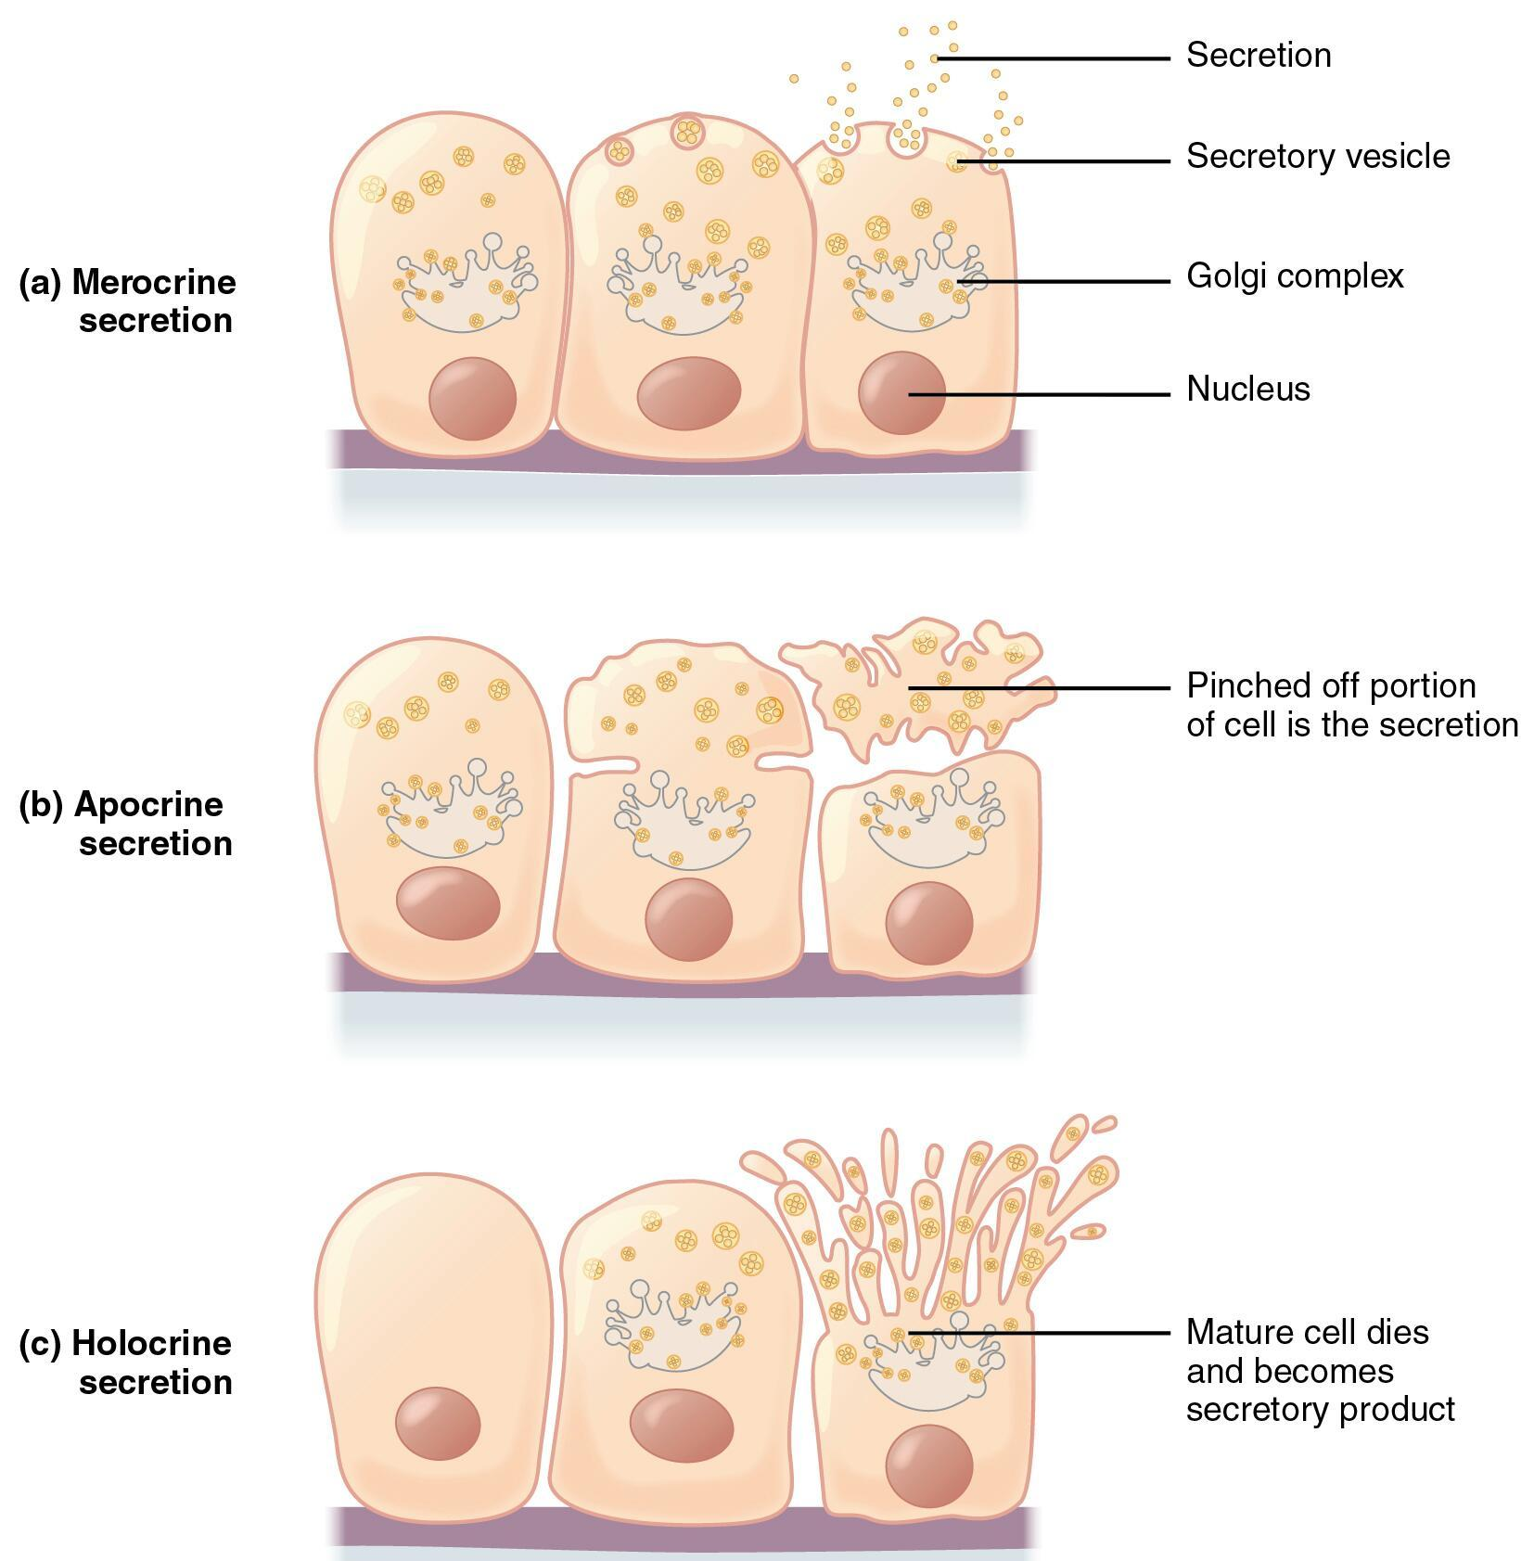

Slide 37
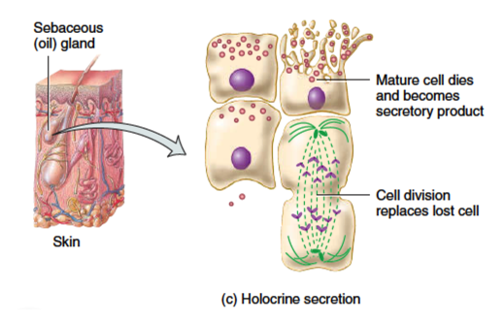
https://youtu.be/o2hKdvRO1Eo

Slide 38
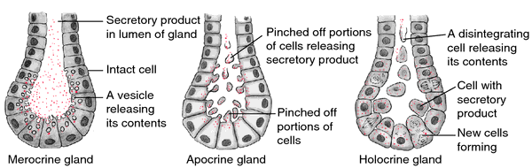

Slide 39
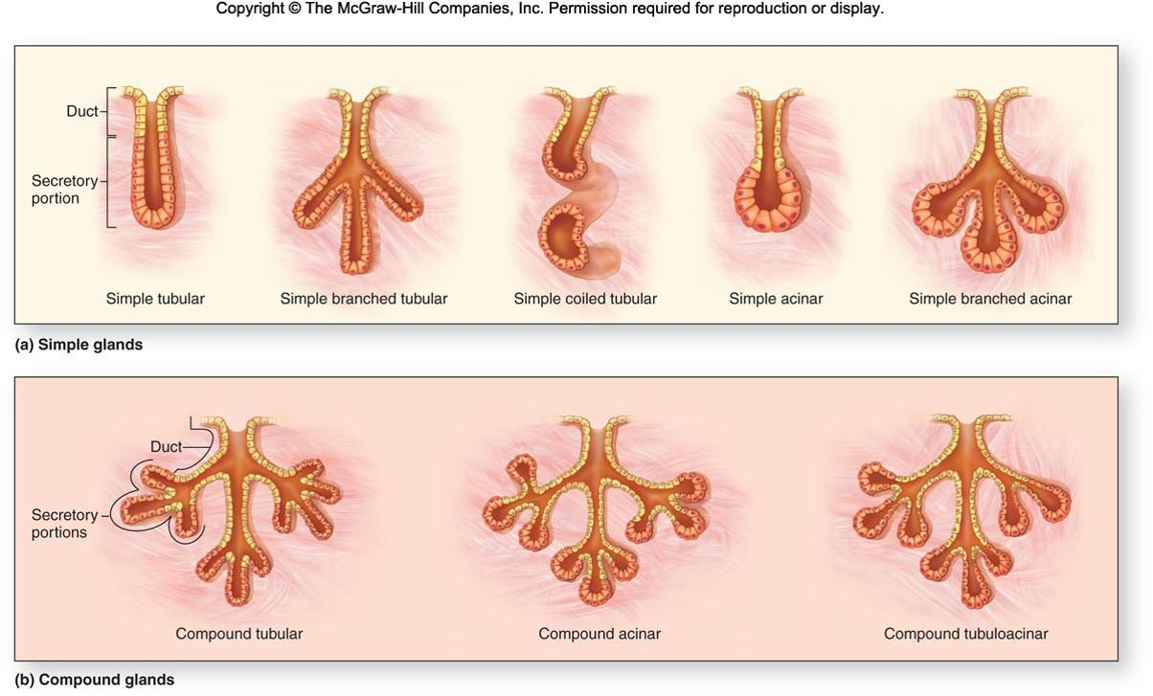

Slide 40
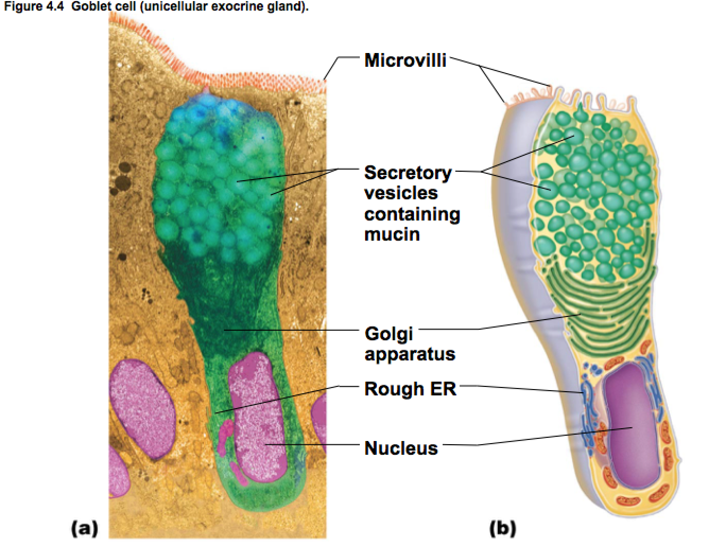
Unicellular glands
Mucus glands are modified epidermal unicellular glands.
Found in lower vertebrates such as Pisces & Amphibians.
Scattered all over the body surfaces.
Secrete water form mucous substance called mucus.
Mucus keeps body soft & Slimy.
Helps animals to prevent from friction in water
It is also germ proof.

Slide 41


Slide 42

Multicellular glands

Slide 43

Poisons glands
In most of fishes & amphibians exhibit presence of Poison glands.
Just like mucus glands they are multicellular & release poison animals disturbed. e.g. sting ray, cat fishes.
Glands associates with spines of fins & serve defensive role.
In amphibians no. of poisons glands are lesser than mucus glands.
They release mucus like substance release contains poisons.

Slide 44

Uropygial glands
Birds have only one integumentary gland present at the base of pygostyle.
It is bilobed with two ducts to dorsal surface on each side.
In birds it is located on the back at the base of the tail, supplies oil that is spread upon the feathers.
In mammals, sebaceous glands provide a grease that serves as a protectant and lubricant for hair and skin.
It is a holocrine gland enclosed in a connective tissue capsule made up of glandular acini
It deposit their oil secretion into a common collector tube ending in a variable number of pores (openings), most usually two.
Each lobe has a central cavity that collects the secretion from tubules arranged radially around the cavity.
The gland secretion is conveyed to the surface via ducts that, in most species, open at the top of a papilla
Birds like Bustards, pigeon & parrot do not have Uropygial glands

Slide 45


Salt glands
The salt gland is an organ for excreting excess salts.
It is found in elasmobranchs (sharks, rays, and skates), seabirds, and some reptiles.
Sharks' glands are found in their rectum.
In birds' and reptiles' in or on the skull in the area of the eyes, nostrils or mouth.
These glands are lobed containing many secretory tubules which radiate outward from the excretory canal at the center.
Secretory tubules are lined with a single layer of epithelial cells.
The diameter and length of these glands vary depending on the salt uptake of the species.
Salt glands maintain salt balance and allow marine vertebrates to drink seawater

Slide 46

Salt glands in sea turtles
Unlike land and freshwater aquatic turtles, sea turtles have a salt gland to rid their bodies of excess salt.
This gland allows sea turtles to drink salt water while maintaining the salt balance in their bodies.
This gland empties into the sea turtles’ eyes.
They would suffer from dehydration quickly.
Unlike land and freshwater aquatic turtles, sea turtles have a salt gland to rid their bodies of excess salt.
This gland allows sea turtles to drink salt water while maintaining the salt balance in their bodies.
https://youtu.be/WZCGRAPN3wM

Slide 47

Ceruminous glands
They are referred as apocrine glands.
Ceruminous glands are specialized sudoriferous glands (sweat glands) located subcutaneously in the external auditory canal.
Ceruminous glands are simple, coiled, tubular glands made up of an inner secretory layer of cells and an outer myoepithelial layer of cells.
Production of ear wax or cerumen is by this glands.
It helps in lubricating & cleaning the external auditory canal. Kills bacteria, waterproof the canal.
It serves barrier for foreign particles.

Slide 48

Feathers
These are unique features in avian.
Feathers are modified a keratin epidermal scales.
Feathers are epidermal growths and outer covering.
Present on dinosaurs, both avian and some non-avian.
They are the most complex integumentary structures found in vertebrates.
They distinguish the extant birds from other living groups.
Although feathers cover most of the bird's bodies, they arise only from certain well-defined tracts on the skin.
They aid in flight, thermal insulation, and waterproofing.
In addition, coloration helps in communication and protection.
Plumology is the name for the science that is associated with the study of feathers.

Slide 49


Slide 50

Feathers Structure

Slide 51

Types of Feathers

Slide 52


Slide 53

Quill Feathers – ( Flight Feathers)
Flight feathers are the long, stiff, asymmetrically shaped, but symmetrically paired.
They are on the wings or tail of a bird.
Those on the wings are called remiges, on the tail are called rectrices.
The primary function of the flight feathers is to aid in the generation of both thrust and lift, thereby enabling flight.
The flight feathers of some birds perform additional functions, like territorial displays, courtship rituals or feeding methods.
In some species, these feathers have developed into long showy plumes used in visual courtship displays, while in others they create a sound during display flights.
Tiny serrations on the leading edge of their remiges help owls to fly silently.
Even flightless birds still retain flight feathers, though sometimes in radically modified forms.

Slide 54

Contour Feathers
One of the feathers that form the surface plumage of a bird, including those of the wings and tail but excluding such specialized types as downs and filoplumes.
Contour feather s (including the flight and tail feathers) define the body outline and serve as aerodynamic devices; filoplumes (hair feathers) and plumules (down feathers) are used principally as insulation, to conserve body heat.

Slide 55


Slide 56


Down Feathers
The down of birds is a layer of fine feathers found under the tougher exterior feathers.
These lie between the quill feathers all over the body.
These are soft feathers present on abdomen region.
Young bird lack counter feathers but covered by down feathers.
These are present when young ones are in nest hence it is called nestling down.
They are with very short calamus with crown at barbs arises from free end.
It has a short or vestigial rachis (shaft), few barbs, and barbules that lack hooks.
They are three types of down: natal down, body down and powder down.
Hooklets are absent.
Function is incubation of eggs, protection of young and retention of body heat.

Slide 57


Slide 58

Filo plumes Feathers
Filo-plumes are usually thin, hair-like feathers which are specialized and may be sensory.
Bristles occur around the beak, nostrils and eyes of many birds.
The long bristles around the beak in effect enlarge the mouth and so help the bird to capture flying insects.
Those about the nose may act as a sift, purifying the air that the bird breathes.
The origins of filoplumes is currently under debate.
Some ornithologists disagree with the theory that filoplumes are degenerate contour feathers.
It believe instead that they are sensitive structures that assist in the nerve endings in the follicle.
It is therefore quite possible the filoplumes play a key role in keeping contours in place during preening, display, and flight.

Slide 59

Filo plumes Feathers Types
1. Plumage : Young birds first plumage called nestling plumage.
These are temporary replaced by quill feathers.
2. Juvenile Plumage : nestling replaced by juvenile plumage.
3. Nuptial Plumage : This is coloration of adult birds

Slide 60
Scales in Fishes
A fish scale is a small rigid plate that grows out of the skin of a fish.
The skin of most fishes is covered with these protective scales, which can also provide effective camouflage through the use of reflection and colouration, as well as possible hydrodynamic advantages.
The term scale derives from the Old French "escale", meaning a shell pod or husk.
Scales vary enormously in size, shape, structure, and extent, ranging from strong and rigid armour plates in fishes such as shrimpfishes and boxfishes, to microscopic or absent in fishes such as eels and anglerfishes.
The morphology of a scale can be used to identify the species of fish it came from.

Slide 61

Types of Scales in Fishes

Slide 62

Scales in Fishes

Slide 63

Placoid Scale
Placoid scales are the tiny, tough scales that cover the skin of elasmobranches.
Placoid scales are similar to that of bony fish, they are more like teeth covered with hard enamel.
Unlike the scales of other fish, these do not grow after an organism has fully matured.
Placoid scales are often called dermal denticles because they grow out of the dermis layer.
Placoid scales are packed tightly together, are supported by spines, and grow with their tips facing backward and laying flat.
These scales function to protect a fish from predators and can even be used to injure or kill prey.
The v-shape of a placoid scale reduces friction during swimming.

Slide 64

Cycloid Scale
Cycloid scales are large, thin, and round or oval in shape, and they exhibit growth rings.
Cycloid scales are smooth-edged scales predominately found in lower order teleost fishes.
Similar to ctenoid scales, they are overlapping allow for greater flexibility in movement.
The surface layer of the scale is comprised of calcium-based salts and the inner layer is predominately collagen.
As a fish grows, its scales grow, adding concentric layers, similar to tree rings.
For certain species, these rings can be counted to estimate the age of a fish.

Slide 65


Ctenoid Scale

Slide 66
Ctenoid Scale
These are the typical overlapping fish scales.
Ctenoid scales resemble cycloid scales but have comb like teeth on their overlapping edge.
They are usually found on fishes with spiny fin rays, such as the perch-like fishes.
These scales contain almost no bone, being composed of a surface layer containing hydroxyapatite and calcium carbonate and a deeper layer is of collagen.
The enamel of the other scale types is reduced to superficial ridges and ctenii.
Ctenoid scales, similar to other epidermal structures, originate from placodes.
Distinctive cellular differentiation makes them exclusive from other structures that arise from the integument.

Slide 67
Dermal Scutes in Reptiles & Birds
A scute or scutum is a bony external plate or scale overlaid with horn, as on the shell of a turtle, the skin of crocodilians, and the feet of birds.
The term is also used to describe the anterior portion of the mesonotum in insects as well as some arachnids.
Scutes are similar to scales and serve the same function.
Scutes are formed in the lower vascular layer of the skin and the epidermal element is only the top surface.
The scutes produce a horny outer layer that is superficially similar to that of scales.
Scutes will usually not overlap as snake scales (but see the pangolin).
The outer keratin layer is shed piecemeal, and not in one continuous layer of skin as seen in snakes or lizards.
The dermal base may contain bone and produce dermal armour.
Scutes with a bony base are properly called osteoderms.
Dermal scutes are also found in the feet of birds and tails of some mammals, and are believed to be the primitive form of dermal armour in reptiles.

Slide 68




