Slide 1
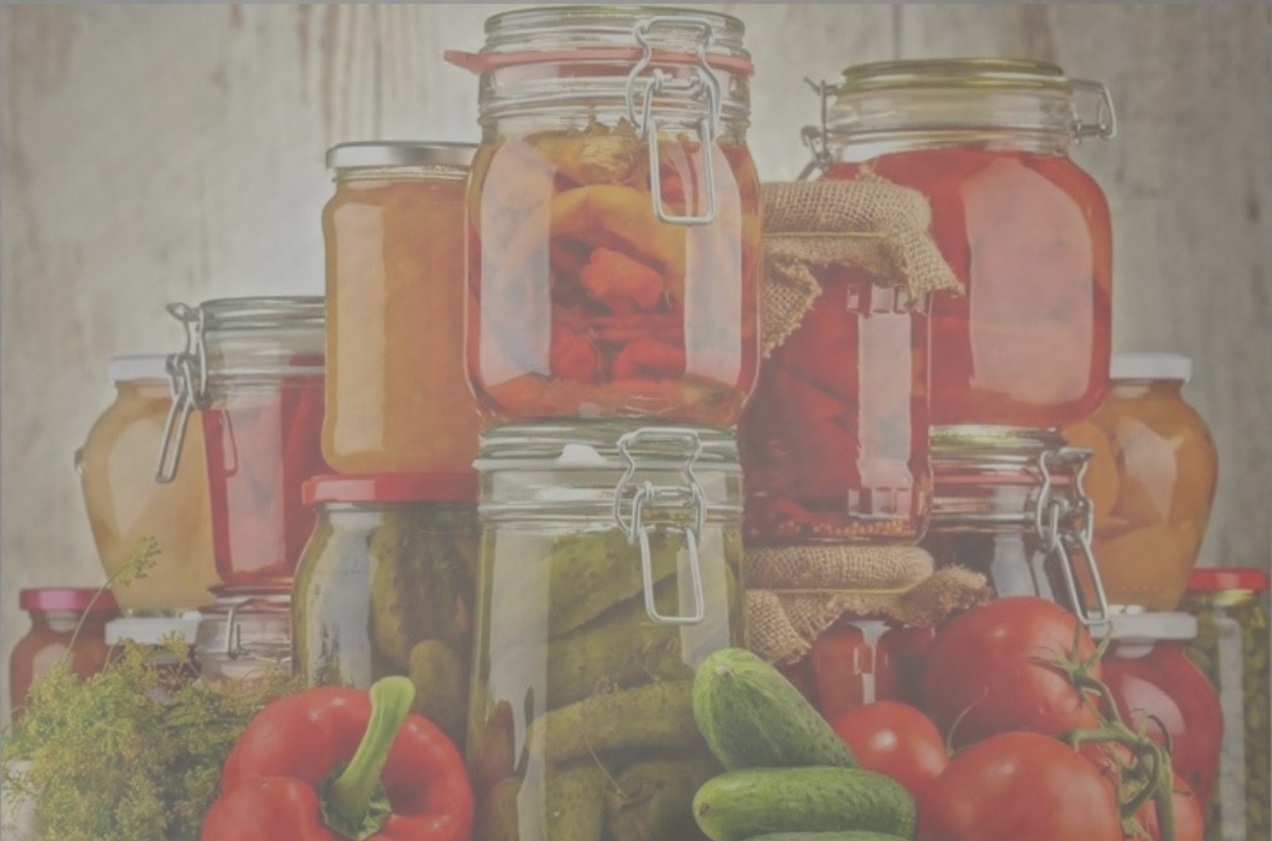
Food Preservation Techniques & Use Of Antioxidant In The Preservation Of Food

Slide 2
Food preservation.
Food preservation may be defined as the process of treating and handling food in such a way as to stop, control, or greatly slow down spoilage and, of course, to minimize the possibility of foodborne illness while maintaining the optimum nutritional value, texture, and flavor.
OR
The term food preservation refers to any one of a number of techniques used to prevent food from spoiling.

Slide 3
Deterioration of foods will result in loss of quality attributes, including flavor, texture, color, and other sensory properties. Nutritional quality is also affected during food deterioration.
It includes methods such as canning, pickling, drying and freeze-drying, irradiation, pasteurization , smoking, and the addition of chemical additives.

Slide 4
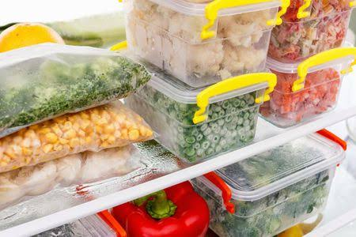
There are various methods of food preservation
1. Freezing
The colder a food is, the slower its rate of deterioration. Bacterial action reduces with refrigeration, while freezing stops it altogether; enzyme activity, however, is only slowed down. Vegetables must be blanched in boiling water first to destroy enzymes and microorganisms, while herbs can be mixed with oil and fruit should be sprinkled with sugar to limit enzyme activity while frozen.

Slide 5
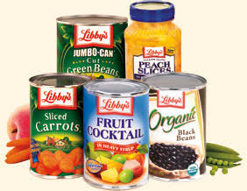
2.Canning
Canning is a method of preserving food in which the food contents are processed and sealed in an airtight container. Canning provides a shelf life typically ranging from one to five years, although under specific circumstances it can be much longer. A freeze-dried canned product, such as canned dried lentils, could last as long as 30 years in an edible state

Slide 6
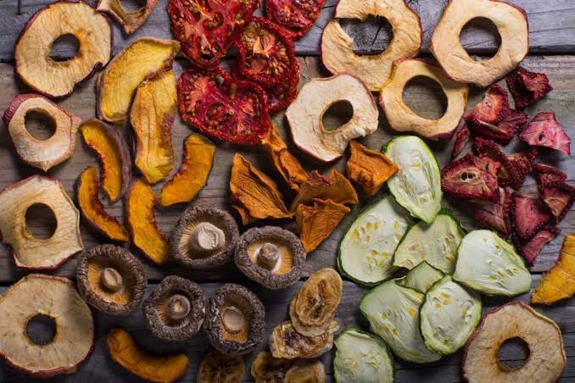
3.Drying
Food drying is a method of food preservation in which food is dried (dehydrated or desiccated). Drying inhibits the growth of bacteria, yeasts, and mold through the removal of water. Dehydration has been used widely for this purpose since ancient times

Slide 7
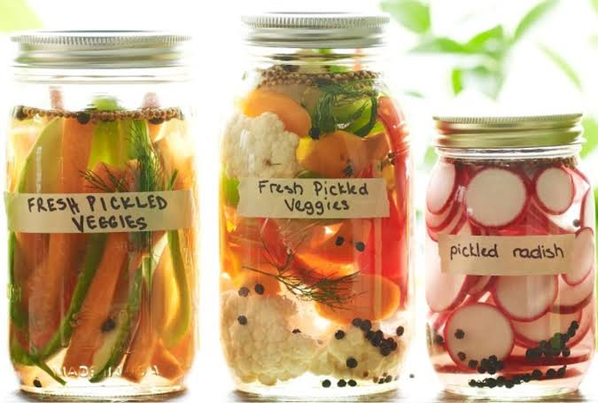
4. Pickling
Pickling is the process of preserving or extending the lifespan of food by either anaerobic fermentation in brine or immersion in vinegar. The pickling procedure will typically affect the food's texture and flavor. Foods that are pickled include meats, fruits, eggs, and vegetables.Pickling can preserve perishable foods for months. Antimicrobial herbs and spices, such as mustard seed, garlic, cinnamon or cloves, are often added.

Slide 8
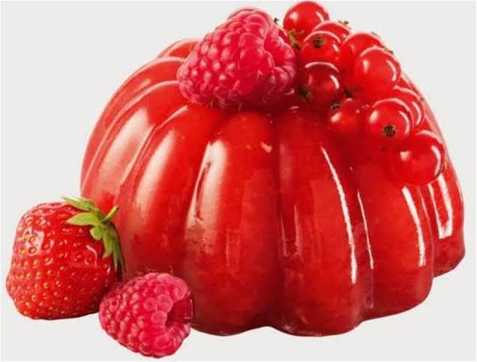
5. Jellying
Jellying is preserving food by cooking in a material that solidifies to form a gel. Fruits are generally preserved as jelly, marmalade or fruit preserves and the jellying agent is pectin that is naturally found in fruit. Sugar is also added.

Slide 9
And there are many more other methods to preserve food.i.e
Sugaring
Salting
Immersion in alcohol
Immersion in olive oil
Vacuum sealing
Smoke, etc.

Slide 10
Antioxidant
Antioxidants are used as food additives to preserve food for a longer period of time. Antioxidants act as oxygen scavengers as the presence of oxygen in the food helps the bacteria to grow that ultimately harm the food.

Slide 11
What is Oxidation?
Oxidation in a food is the process that occurs when food is exposed to oxygen. In food, oxidation is a destructive process leads to the spoilage of food and changes the chemical composition as well as nutritional value of food. To prevent this or delay the process of oxidation, antioxidants foods additives are added in the food. They increases the shelf life of the food.

Slide 12
Popular Antioxidant Added To Foods
1.Ascorbic Acid- E300
Antioxidant vitamins include Ascorbic acid (vitamin C). this antioxidant vitamin is used in beers, cut fruits, dried potatoes and jams.
2.Citric Acid - E330
It is used in biscuits, jams, tinned fruits, alcoholic drinks, cheese and dried soup.It has many uses like it prevents the discoloration of food, increases the anti-oxidant effect of other substances and regulates pH in jams and jellies.

Slide 13
3.Tocopherols - E306
This antioxidant food additive is used in the meat pies and oils to reduce the oxidation of fatty acids and vitamins.
4.Butylated hydroxyanisole (BHA) - E320
Butylated hydroxyanisole (BHA) is used in margarine, oils, crisps and cheese. This antioxidant helps in preventing the reactions leading to the breakdown of fats.

Slide 14
Antioxidants Food Additives List
E300 - Ascorbic acid
E301 - Sodium ascorbate
E302 - Calcium ascorbate
E304 - Fatty acid esters of ascorbic acid
E306 - Tocopherols
E307 - Alpha-tocopherol
E308 - Gamma-tocopherol
E309 - Delta-tocopherol
E310 - Propyl gallate
E311 - Octyl gallate
E312 - Dodecyl gallate
E315 - Erythorbic acid
E316 - Sodium erythorbate
E312 - Dodecyl gallate
E319 - Tertiary-butyl hydroquinone (TBHQ)
E320 - Butylated hydroxyanisole (BHA)
E321 - Butylated hydroxytoluene (BHT)
E330 - Citric Acid

Slide 15
Antioxidants Benefits
There are many benefits of using antioxidant food additives. Antioxidants prevent the blockage of arteries with fatty deposits that prevents the heartattacks.
Also these are associated with the prevention of certain types of cancers, arthritis and more conditions of these kinds.

