Slide 1
WELCOME TO FIRST YEAR
BANKING & INSURANCE!

Slide 2
Revised Syllabus of courses of B. Com. (Banking & Insurance)
Programme at Semester I with effect from the Academic Year 2020-2021
ELECTIVE COURSE (EC)
FINANCIAL ACCOUNTING- 1
Objectives:
1. To show the importance of accounting it’s ways and practices.
2. To understand how to value stock n how accounting of the same Is done
3. To show the way an accounting of issue of share is done and how it affects the
balance sheet.
4. To show different ways of depreciation and accounting of hire purchases
5. To teach the basic final accounts and preparation of different statements

Slide 3
Modules at a glance
Sr.no | Module | No. of Lectures
1 | Introduction to accounting | 12
2 | Classification of income and expenses and accounting standards | 12
3 | Fire insurance claim statement & Hire Purchase | 20
4 | Final Accounts | 16
total |  | 60

Slide 4
Outcome:
Students will be able to develop a logical and practical approach in the area of accounting.
Students will understand the applicability of accounting by studying the topics like accounting standards and hire purchase.
Students will be able to enhance their ability in understanding and absorbing the various topics and courses which will follow in the following semesters .

Slide 5
Sr.no | Modules/Units
1. | Introduction to accounting
 | Meaning, scope, objectives, need, importance and limitations of accounting. Basic accounting terminology. Branches of accounting. Accounting concepts, Conventions and Principles, Double Entry System, Classifications of accounts, rules of debit and credit. Writing of journal and Trial Balance
2. | Classification of Income & Expenses & Accounting Standard
 | Classification of Income, Expenditure and Receipts on the basis of Capital and Revenue. Introduction to Banking Reconciliation Statement and Errors and their Rectification Accounting Standards 1, 2, 3, and 10 (Practical sums)
3. | Fire Insurance Claim Statement & Hire Purchase
 | Fire Insurance Claim Statement using average Clause policy Hire purchase Transaction (calculation of interest , accounting as per asset purchase method only , exclude repossession )
4. | Final accounts
 | Trading Account, Profit and loss account, Balance sheet and Adjustment entries – Opening and Closing Entries

Slide 6
Revised Syllabus of courses of B. Com. (Banking & Insurance)
Programme at Semester II
with effect from the Academic Year 2020-2021
ELECTIVE COURSE (EC)
FINANCIAL ACCOUNTING-ll
Objective :
To remove valuation of every business by valuation its goodwill and shares
To understand the process of buyback
To understand the process of redemption of preference shares
To understand the process of redemption of debentures

Slide 7
Modules at a glance
Sr.no | Module | No. of Lectures
1. | Issue of Shares & Debentures | 15
2. | Buyback of equity of shares | 15
3. | Redemption of Preference shares | 15
4. | Redemption of debentures (excluding buy back of own debentures) | 15
Total |  | 60

Slide 8
Outcome:
Students will be able to develop a logical and practical approach in the area of accounting.
Students will understand the applicability of accounting by studying the topics like Shares and Debentures.
Students will be able to enhance their ability in understanding and absorbing the various topics and courses which will follow in the following semesters .

Slide 9
Sr.no | Modules/Units
1. | Issue of shares & Debentures
 | Introduction , Share capital, Share, Procedure for issue of shares, Accounting entries, Forfeiture of shares, Issue of bonus share, Rights of shares, Surrender of shares, Introduction & Meaning, Definition, Features, Types of Debentures, Distinguish between shares and debentures, Debenture interest, Issue of debenture, Terms of redemption , Accounting entries, Treatment of discounts
2. | Buyback of Equity shares
 | Company Law/Legal Provisions (including related restrictions, power, transfer to capital redemption reserve account and prohibitions) Compliance of conditions including sources, maximum limits and debt equity ratio
3. | Redemption of preference shares
 | Company Law/Legal Provisions for redemption of preference shares in Companies Act Sources of redemption including divisible profits and proceeds of fresh issue of shares Premium on redemption from Security Premium and Profits of Company Capital Redemption Reserve Account – Creation and use
4. | Redemption of Debentures
 | Redemption of debentures by payment from sources including out of capital and/ or out of profits. Debenture Redemption reserve and Debenture redemption sinking fund excluding insurance policy. Redemption of Debentures by conversion into new class of shares or debentures with options – including at par, premium and discount

Slide 10
Revised Syllabus of Courses of B. Com.
(Banking & Insurance)
Programme at Semester I and II
with effect from the Academic Year 2020-2021
Scheme of Evaluation
The performance of the learners will be evaluated in two Components. One component will be the Internal Assessment component carrying 40% marks and the second component will be the Semester-wise End Examination component carrying 60% marks. The allocation of marks for the Internal Assessment and Semester End Examinations will be as shown below:-

Slide 11
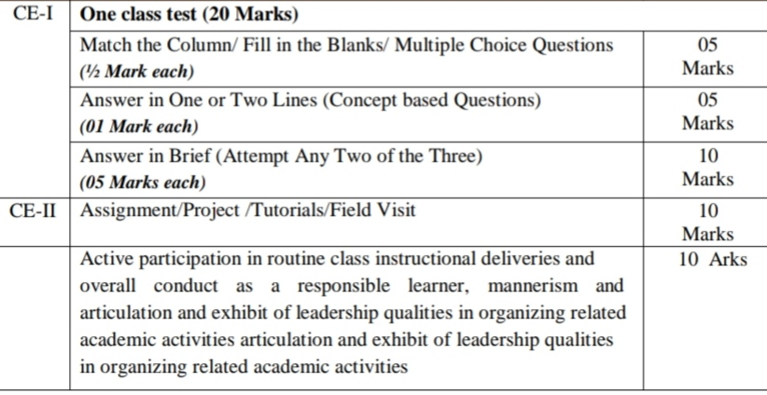
A) | Internal Assessment : 40%
(Internal assessment – courses without practical courses)
Sr.no | Particulars | Marks

Slide 12
B) Semester End Examination: 60 %
1) | Duration : The examination shall be of 2 hours duration
2) | Theory question paper pattern
 | * There shall be four questions each of 15 marks
 | * All questions shall be compulsory with internal choice within the questions
 | * Question may be sub-divided into sub-questions a,b,c….. And the allocation of marks depends on the weightage of the topic

Slide 13
PASSING STANDARD :
The Learners to pass a course shall have to obtain a minimum of 40% marks in aggregate for each course where the course consists of Internal Assessment and Semester End Examination. The learners shall obtain a minimum of 40% marks (i.e. 16 out of 40) in the Internal Assessment and 40% marks in Semester End Examination (i.e. 24 out of 60) separately to pass the course and minimum of Grade E to pass a particular semester. A learner will be said to have passed the course if the learner passes the Internal Assessment and Semester End Examination together.

Slide 14
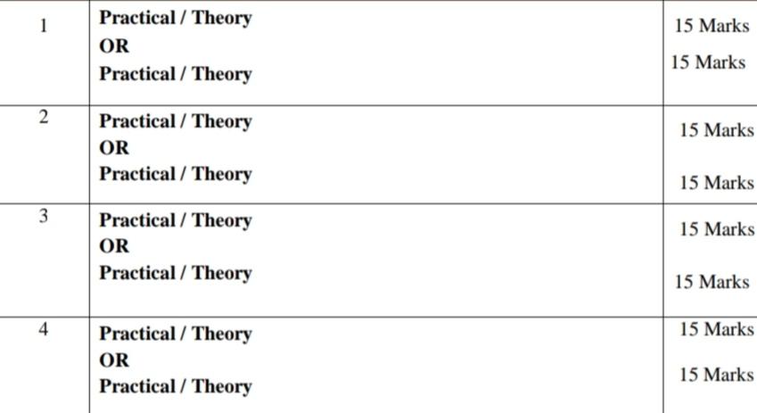
QUESTION PAPER PATTERN
(PRACTICAL COURSES/ THEORETICAL COURSES)
All Questions are Compulsory Carrying 15 Marks each .
Sr.no | Particulars | Marks
NOTE: Practical questions of 15 marks may be divided into two sub questions of 7/8 marks and 10/5 Marks.

Slide 15
IT IS QUIZ TIME!!

Slide 16
Q1) What is the rule for a real account? Debit what comes in, Credit what goes out. Debit all expenses and losses, Credit all incomes and gains. C) Debit the receiver, Credit the giver. D) None of the above.
Q2) What type of an asset is Land & Building ? Current asset Fixed asset intangible asset None of the above
Q3) Accounts relating to persons or the firms is called Real account Personal account Nominal account all of the above
Q4) Drawings accounts is related to : Nominal account Real account Personal account Personal Representative account

Slide 17
Q 5) If cash is brought in business, is it debited or credited? Debit Credit Both Excluded
Q 6)What type of account is Capital account? Nominal account Real account Personal account None of the above
Q7) What is prepared first in the books of accounts? Ledger Journal Trial balance Balance sheet

Slide 18
THANK YOU!

