Slide 1
MARKET BEHAVOUR
PERFECT COMPETITION, MONOPOLY, MONOPOLISTIC COMPETITION ,OLIGOPOLY,

Slide 2
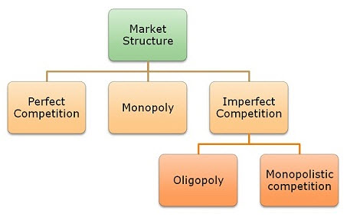

Slide 3
PERFECT COMPETITION

Slide 4
Features of Perfect Competition
Large number of buyers and sellers
Homogenous products and services
Free entry and exit
Perfect information about market condition
Perfect mobility of factors of production
Uniform price level
No transport cost
Difference between firm and industry

Slide 5
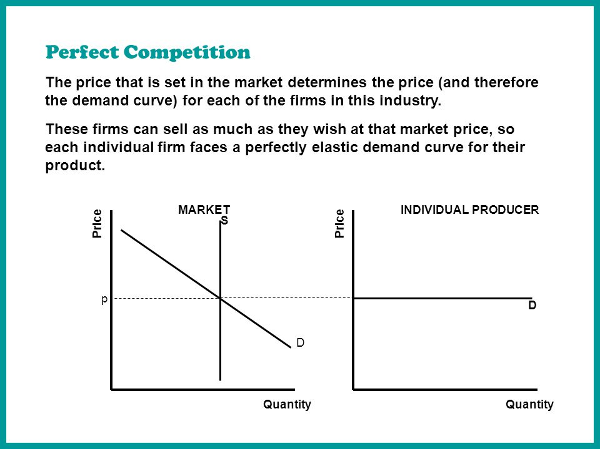
DEMAND CURVE UNDER PERFECT COMPETITION

Slide 6
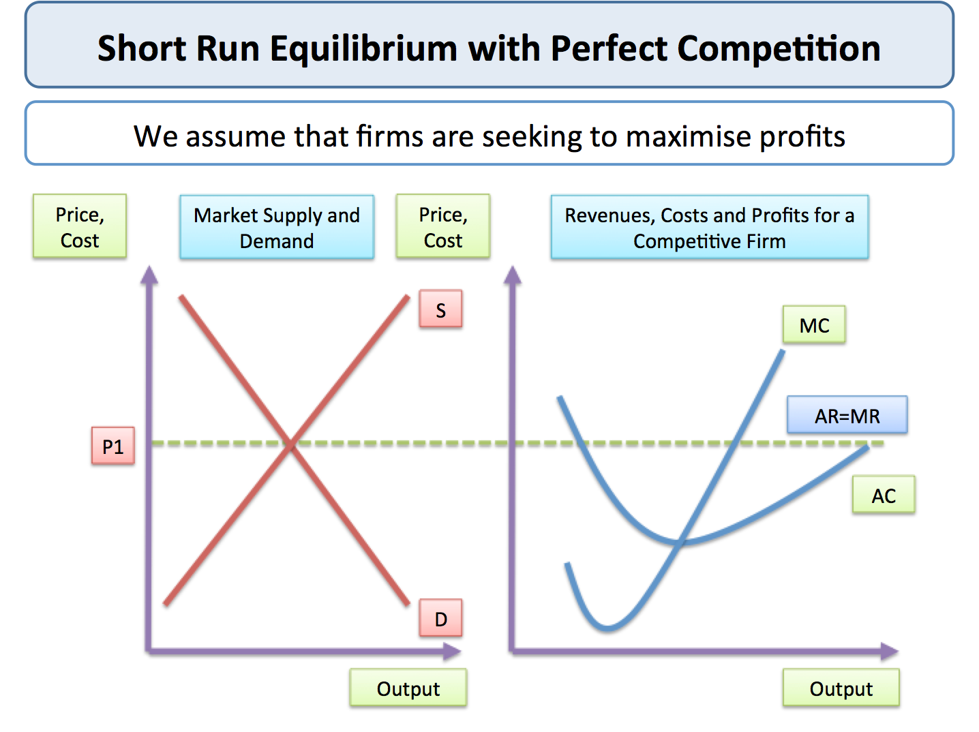

Slide 7
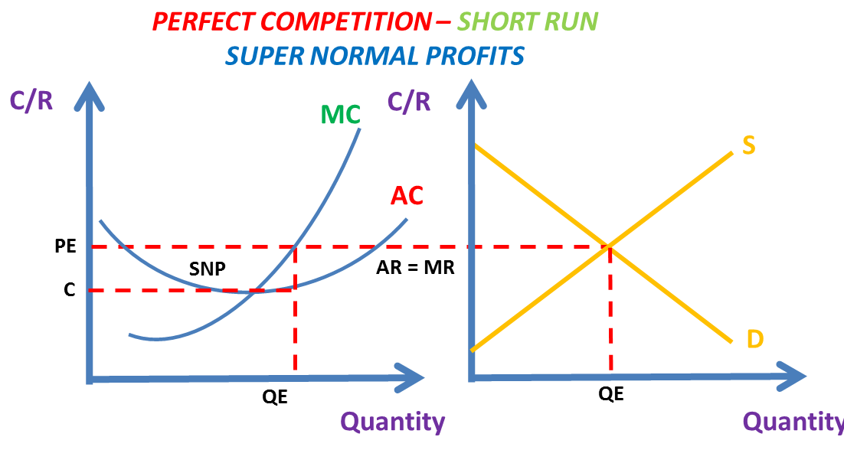

Slide 8
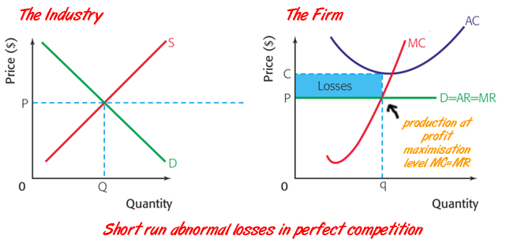

Slide 9
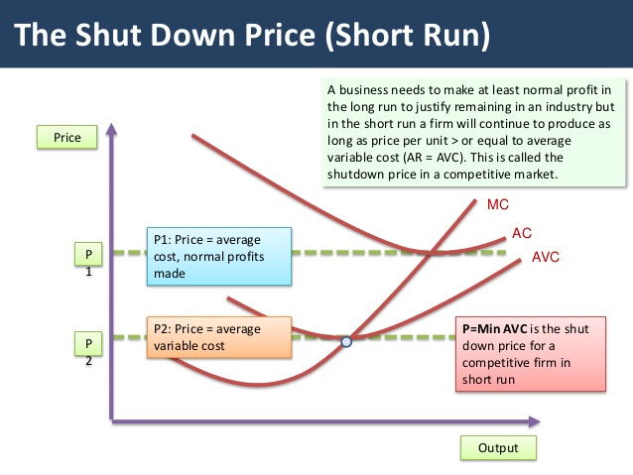

Slide 10
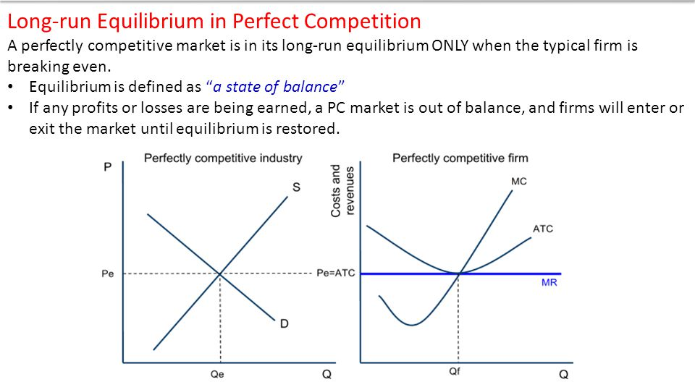

Slide 11
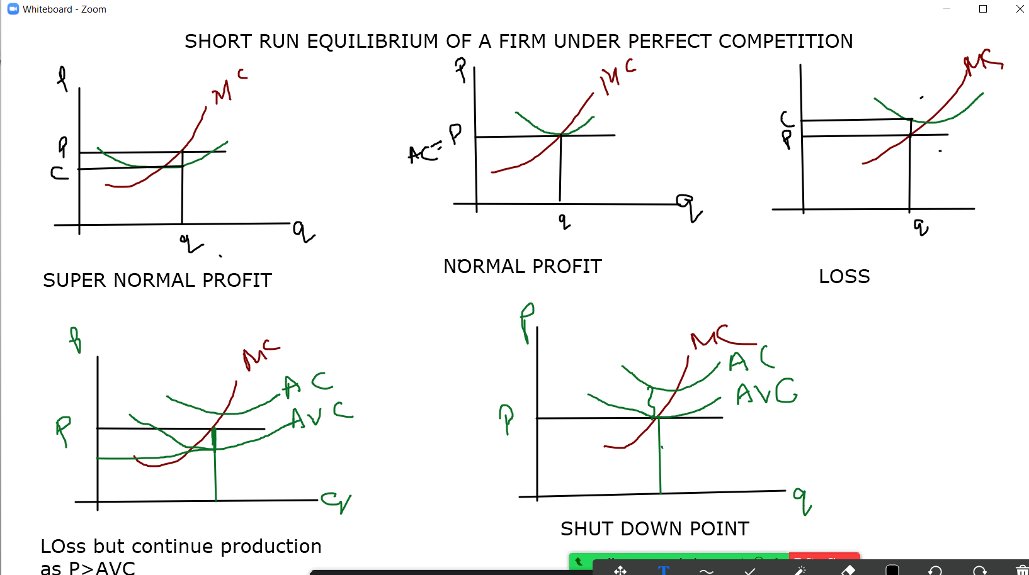

Slide 12
CLASS REVIEW
SHORT RUN CONDITIONS
P=AR=MR
P= AC…..NORMAL PROFIT
P>AC// TR>TC…SUPER NORMAL PROFIT
P<AC// TR<TC…LOSS
AC>P>AVC …LOSS BUT CONTINUE PRODUCTION.
P= AVC..SHUT DOWN POINT
LONG RUN CONDITION
P=AC=MC=AR=MR

Slide 13
MONOPOLY
https://youtu.be/ohMYeUyW1wY

Slide 14
Features of Monopoly
Single seller of a particular good or service
No difference between firm and industry
Large number of buyers
No close substitutes –
cross elasticity of demand is zero
High entry barriers
Monopolist is a price setter/maker

Slide 15
Sources of Monopoly Power
In a monopoly, specific sources generate the individual control of the market. Sources of power include:
Economies of scale
Capital requirements
Technological superiority
No substitute goods
Control of natural resources
Network externalities
Legal barriers
Deliberate actions

Slide 16
CAUSES OF MONOPOLY
Industrial Policy and the Expansion of the Scope of the Private Sector
Government’s Licensing Policy
Import Duties and Market Protection
Patent Rights
High Costs Scare Competition
Ownership of a key resource
Geographic Markets

Slide 17
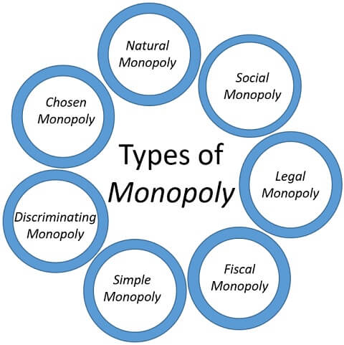

Slide 18
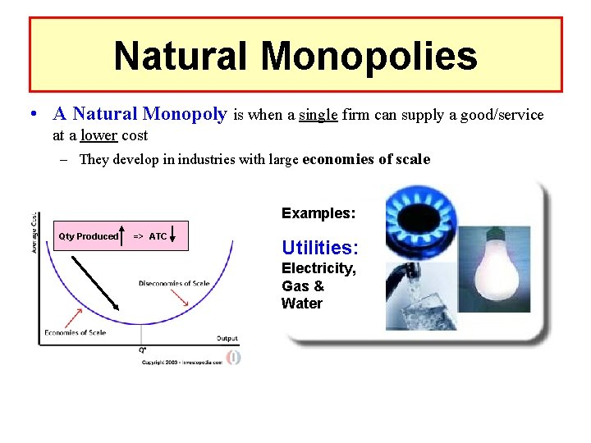

Slide 19
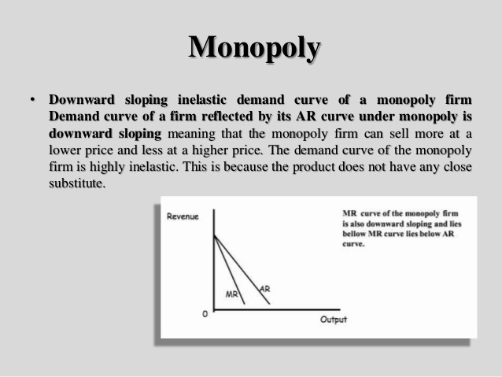
DEMAND CURVE UNDER MONOPOLY

Slide 20
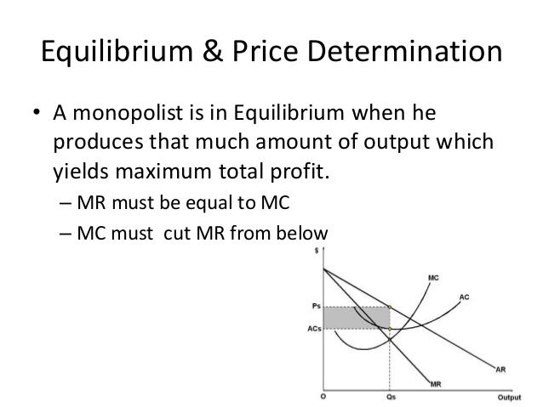

Slide 21
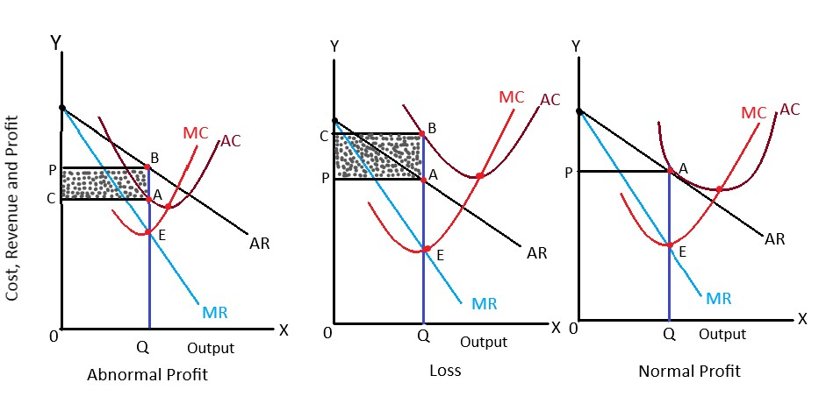
Short Run Equilibrium Under Monopoly
https://youtu.be/z12hRNATSAs

Slide 22
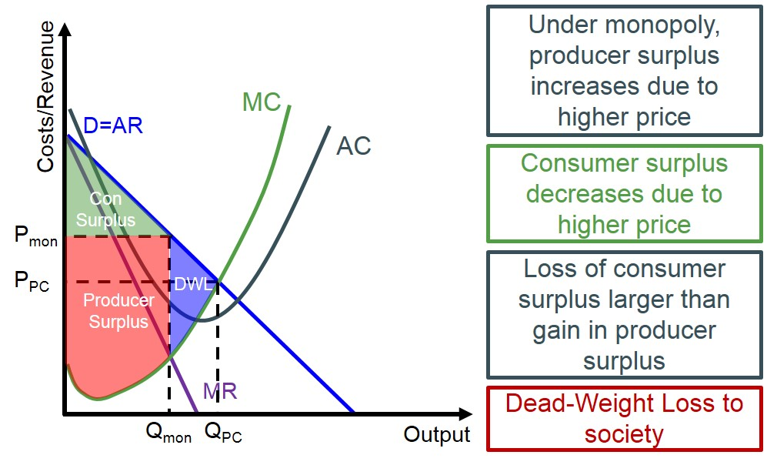

Slide 23
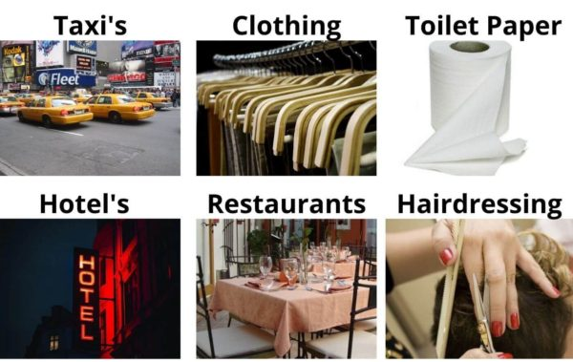
MONOPOLISTIC COMPETITION
https://youtu.be/T3F1Vt3IyNc
https://youtu.be/BCc72Xn310Y

Slide 24
MONOPOLISTIC COMPETITION
Monopolistic Competition refers to a market situation in which there are large numbers of firms which sell closely related but differentiated products. Markets of products like soap, toothpaste AC, etc. are examples of monopolistic competition.
Monopoly + Competition = Monopolistic Competition
Under monopolistic competition, each firm is the sole producer of a particular brand or “product”.
i. It enjoys ‘monopoly position’ as far as a particular brand is concerned.
ii. However, since the various brands are close substitutes, its monopoly position is influenced due to stiff ‘competition’ from other firms.
So, monopolistic competition is a market structure, where there is competition among a large number of monopolists.

Slide 25
Features of Monopolistic Competition:
1. Large Number of Sellers
2. Product Differentiation
3. Selling costs
4. Freedom of Entry and Exit
5. Lack of Perfect Knowledge
6. Pricing Decision
7. Non-Price Competition

Slide 26
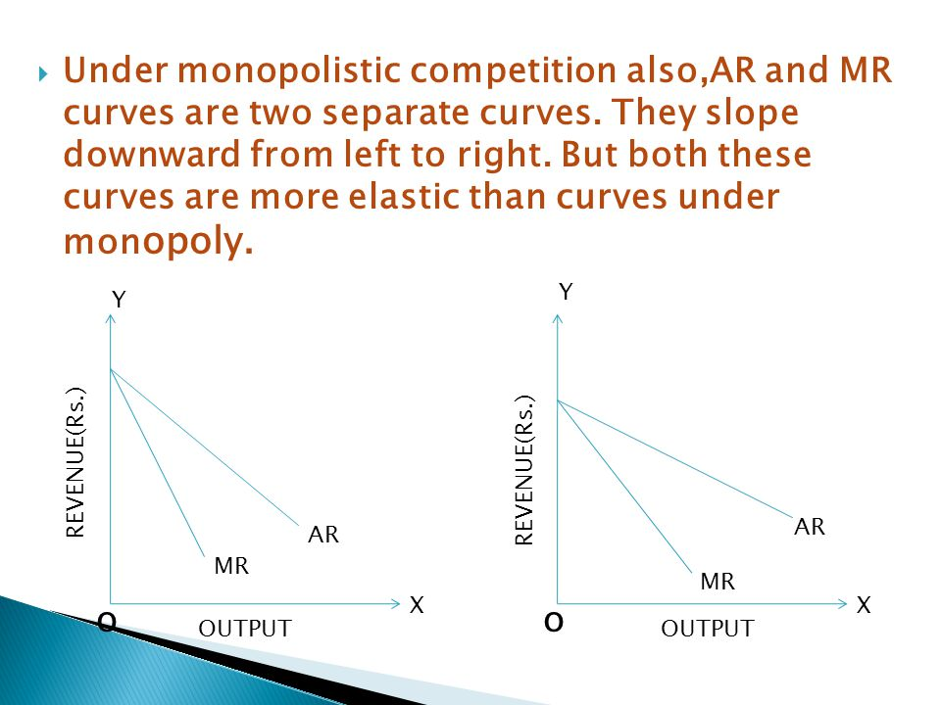
DEMAND CURVE UNDER MONOPOLISTIC COMPETITION

Slide 27
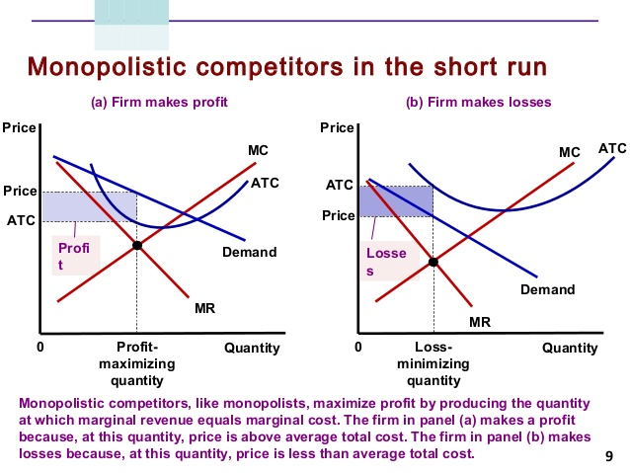

Slide 28
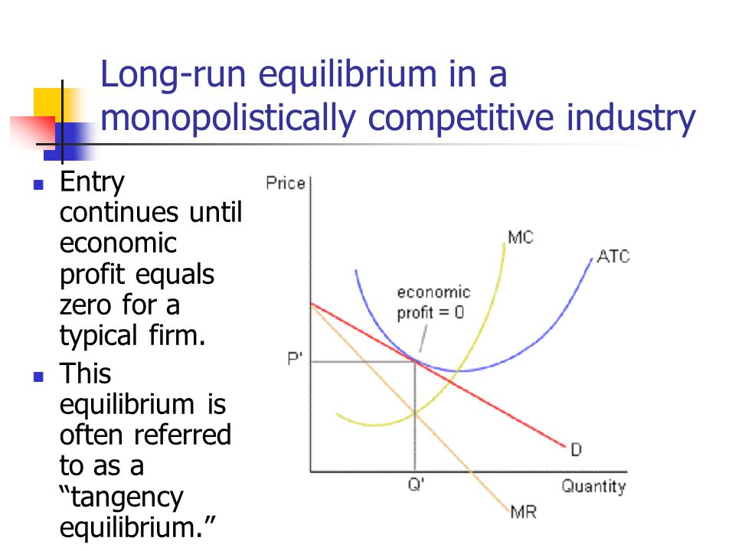

Slide 29
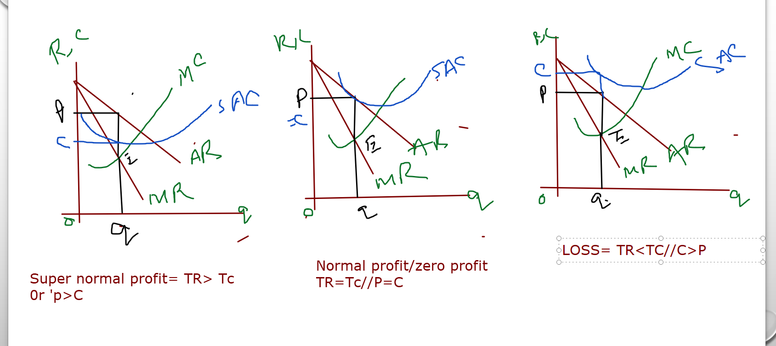
Class review

Slide 30
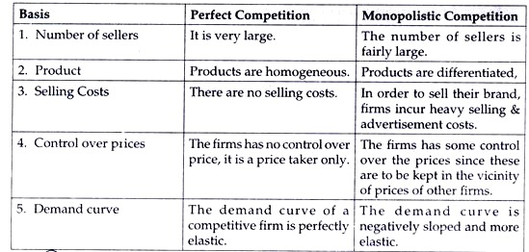
A COMPARATIVE ANALYSIS

Slide 31
OLIGOPOLY

Slide 32
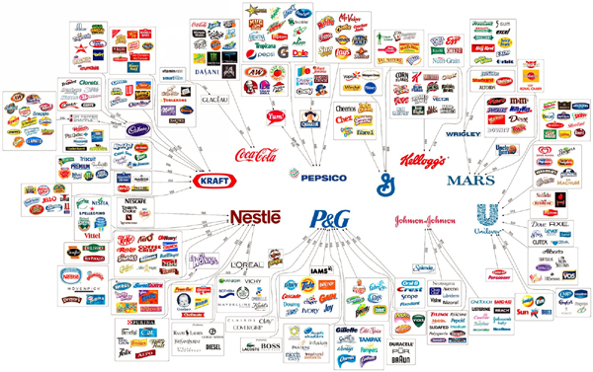

Slide 33
Features of Oligopoly
Few firms
Interdependence
Non-Price Competition
Barriers to Entry of Firms
Role of Selling Costs
Group Behaviour
Nature of the Product
Indeterminate Demand Curve

Slide 34
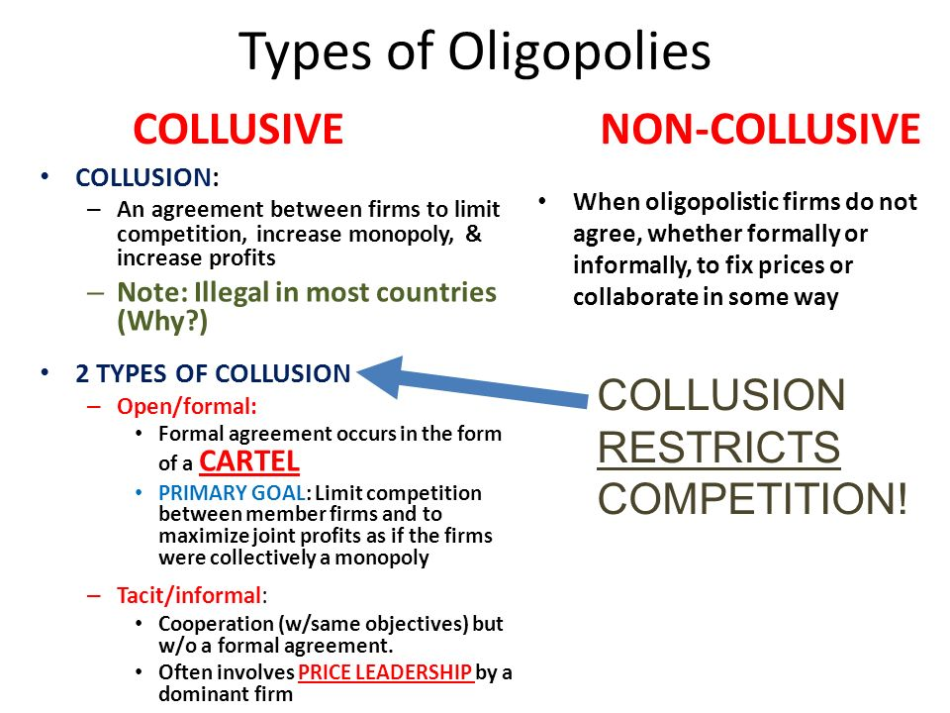

Slide 35
Collusive Oligopoly
Collusive Oligopoly refers to a form of oligopoly in which the competing firms collude so as to minimize competition and maximize joint profit by reducing the uncertainties arising due to rivalry and selling the goods and service at a monopoly price.
In this, the oligopolists enter into a contract to establish the levels of price and output, in the market.
It can be found in the industries where the products sold by the firms are homogeneous. In this type of oligopoly firms know that if they increase or decrease their prices
there will be a shift in the demand curve, as the products offered by all the firm are homogeneous.
And so, the customers can make purchase indifferently from any firm. Hence, it may lead to a huge loss of profit to a price war.
Hence, by deciding not to compete with each one another, they can set up a monopoly price to be charged and an agreement to be reached on the output produced by each firm.

Slide 36
Collusion can be of two types:
Cartels: Producer firms enter into a formal agreement that states the price and output, of each firm that are members of the cartel. So, in a cartel firms jointly fix the price and output policy by way of agreements. For Example OPEC
Price Leadership: There is an implicit understanding between the oligopolists to coordinate prices, wherein the dominant firm initiates the price changes and all the other firms follow, or match the change in

Slide 37
Price Leadership
Price leadership occurs when a leading firm in a given industry is able to exert enough influence in the sector that it can effectively determine the price of goods or services for the entire market.
There are three primary models of price leadership: barometric, collusive, and dominant.
Price leadership is commonly used as a strategy among large corporations.
There are certain economic conditions that make the emergence of price leadership more likely to occur within an industry, including a small number of companies in the industry, entry to the industry is restricted, products are homogeneous, and demand is inelastic.

Slide 38
Types of Price Leadership
Barometric
The barometric price leadership model occurs when a particular firm is more adept than others at identifying shifts in applicable market forces, such as a change in production costs. This allows the firm to respond to market forces more efficiently. For instance, the firm may initiate a price change.
It is possible for a firm with a small market share to act as a barometric price leader if it's a good producer and if the firm is attuned to trends in its market. Other producers may follow its lead, assuming that the price leader is aware of something that they have yet to realize.

Slide 39
Types of Price Leadership
Dominant
The dominant price leadership model occurs when one firm controls the vast majority of the market share in its industry. Within the industry, there are other, smaller firms that provide the same products or services as the leading firm. However, in this model, these smaller firms cannot influence prices.
A dominant price leadership model is sometimes referred to as a partial monopoly

Slide 40
Non-collusive Oligopoly
Non-collusive Oligopoly is the oldest theory of competition. It refers to the oligopoly in which firms are in competition with each other. In a non-collusive or non-cooperative oligopoly, the firms survive in a strategic environment, as they begin with a particular strategy without colluding with competitors.
So, in a non-collusive oligopoly:
Firms are independent of each other.
There are a large number of firms.
Barriers to entry are very less.
It has strict government regulations.
Each firm develops an expectation as to what the rivals firms are about to do.
Therefore, the firms have to consider the possible actions of competitors and how to react. So, a non-collusive oligopoly is characterised by price

Slide 41
Difference Between Collusive and non collusive oligopoly
BASIS FOR COMPARISON | COLLUSIVE OLIGOPOLY | NON-COLLUSIVE OLIGOPOLY
Meaning | A Collusive Oligopoly is one in which the firms cooperate and not compete, with one another with respect to price and output. | A Non-Collusive Oligopoly is one wherein each firm in the industry pursues a price and output policy that is independent of competitors.
Profit | Collective profit | Individual profit
Objective | To reduce competition and to create and maintain entry barriers. | To maintain competition and to work independently as a normal business.
Price and Output decision | Mutual or Interdependent | Independent
Formation of monopoly | Yes | No
Price benefit | Consumers receive fewer price benefits, due to monopoly. | Consumers receive price benefits due to competition between sellers.
Brand Loyalty | No need to incur expenses to create brand loyalty. | Powerful advertisement creates brand loyalty.

Slide 42
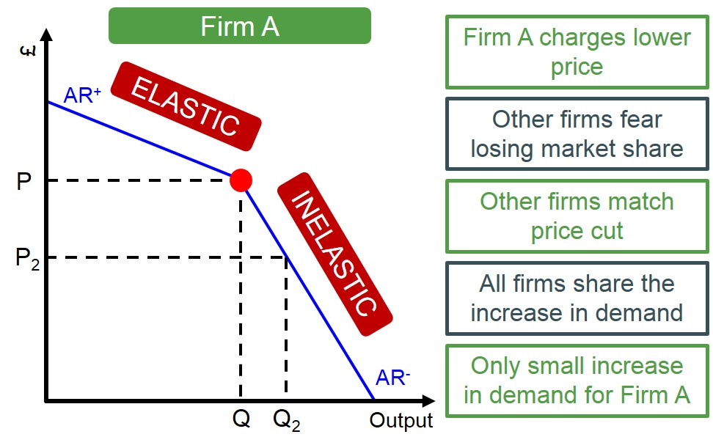
DEMAND CURVE UNDER OLIGOPOLY

Slide 43
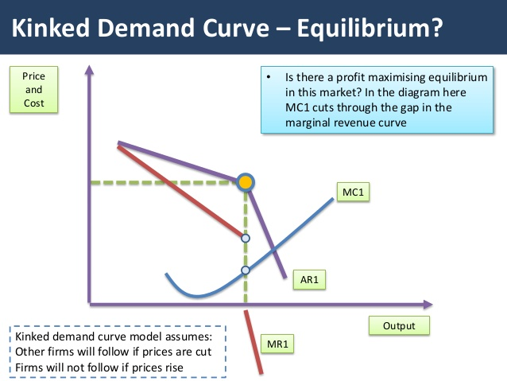
https://youtu.be/PgjKUDm-jsc

Slide 44
Key Differences Between Collusive Oligopoly and Non-Collusive Oligopoly
As we have understood the meaning and concept, let us now take a look at the difference between collusive and non-collusive oligopoly:
Collusive Oligopoly can be defined as the form of oligopoly wherein the sellers eliminate competition by way of a formal or informal agreement. As against, a non-collusive oligopoly is one in which each firm sets its own price and level of output and compete in the market.
In a collusive oligopoly, firms act as a single monopoly and intend to increase their collective profit, instead of individual profit. As against, in a non-collusive oligopoly, the firms intend to increase their own profit and determine the volume of output to be produced, in an assumption that competing firms would not change the quantity supplied by them.
Firms operating under oligopolistic competition often enter into a collusive agreement to avoid uncertainty causing due to interdependence, to avoid price wars and cut-throat competition. On the other hand, the aim of a non-collusive oligopoly is to maintain competition and to work independently as a normal business.

Slide 45
CONT……
4.The price an output decision under collusive oligopoly is mutual and interdependent, whereas, in the case of non-collusive oligopoly, the price and output decision is independent of other firms.
5.In a collusive oligopoly, firms agree to set prices and output jointly, so they act as a single firm, which leads to the formation of a monopoly. But, in a non-collusive oligopoly, as no firms collude with one another and a sense of competition exists among them, monopoly does not form.
6.As collusive oligopoly leads to the creation of a monopoly, consumers receive less benefit, as the products are offered for sale to the consumers at the same price by all the sellers. Unlike, in a non-collusive oligopoly, monopoly does not exist, which results in competition among the seller firms and so, the consumers get price benefits.
7.In a collusive oligopoly, no need to incur expenses to create brand loyalty. On the other hand, in a non-collusive oligopoly aggressive advertisement creates brand loyalty.

Slide 46
