Slide 1
HUMAN RESOURCE MANAGEMENT
TYBAF

Slide 2
Why do we call it as Human Resource Management?

Slide 3
Human: refers to the skilled workforce in an organization.
Resource: refers to limited availability or scarce.
Management: refers how to optimize and make best use of such limited or scarce resource so as to meet the organization goals and objectives

Slide 4
"You must treat your employees with respect and dignity because in the most automated factory in the world, you need the power of human mind. That is what brings in innovation. If you want high quality minds to work for you, then you must protect the respect and dignity. " ---Mr N.R. Narayana Murthy, Chairman Emeritus, Infosys Ltd
"The automation of factories has already decimated jobs in traditional manufacturing, and the rise of artificial intelligence is likely to extend this job destruction deep into the middle classes, with only the most caring, creative or supervisory roles remaining” –
---British theoretical physicist Stephen Hawking

Slide 5
Meaning of HRM
Human Resource Management is the process of recruiting, selecting, inducting employees, providing orientation, imparting training and development, appraising the performance of employees, deciding compensation and providing benefits, motivating employees, maintaining proper relations with employees and their trade unions, ensuring employees safety, welfare and healthy measures in compliance with labour laws of the land and finally following the Orders / Judgements of the concern High Court and Supreme Court, if any

Slide 6
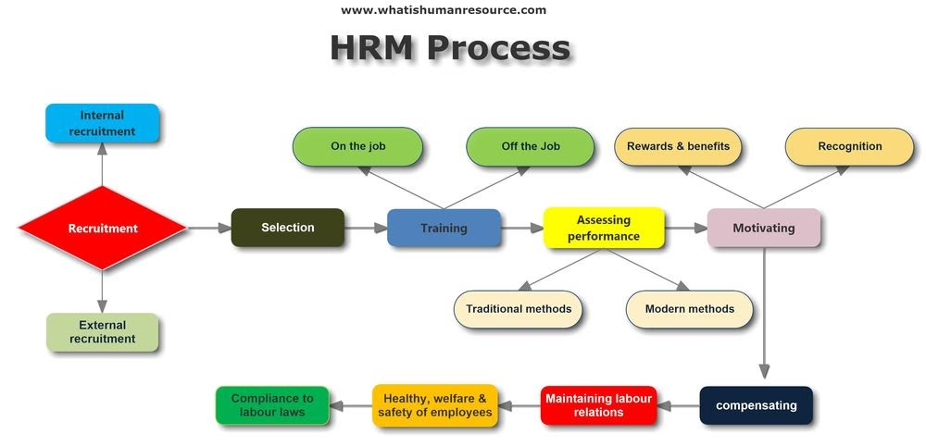

Slide 7
DEFINATION
According to National Institute of Personnel Management of India (NIPM)
“ human resource management is that part of management concerned with people at work and with their relationships within the organization. It seeks to bring together men and women who make up an enterprise, enabling each to make his own best contribution to its success both as an individual and as a member of a working group”.
Edwin Filippo defines- Human Resource Management as “planning, organizing, directing, controlling of procurement, development, compensation, integration , maintenance and separation of human resources to the end that individual, organizational and social objectives are achieved.”

Slide 8
Objectives of HRM
The primary objectives of HRM is to ensure the availability of right people for right jobs so as the organizational goals are achieved effectively.

Slide 9
OBJECTIVES OF HRM
SOCIETAL OBJECTIVES
ORGANISATIONAL OBJECTIVES
PERSONEL OBJECTIVES
FUNCTIONAL OBJECTIVES

Slide 10
SOCIETAL OBJECTIVES
HRM is socially responsible for the needs, demands and challenges of the society. All the resources must be utilized for the benefits and in the interest of the society.
HRM should follow the rules and laws or legal restrictions imposed by the society. It has to develop healthy relations between union and the management

Slide 11
ORGANISATIONAL OBJECTIVES
It consist of recognizing the role and importance of HRM to bring organizational effectiveness.
HRM has to prepare human resource planning, to recruit, select, place , train and develop the human resources, to arrange for performance appraisal and to achieve the organizational objectives like to earn profit, growth and expansion, survival , diversification etc.

Slide 12
FUNCTIONAL OBJECTIVES
To maintain the department's contribution at a level appropriate to the organization’s needs.
Resources are wasted when HRM is either more or less sophisticated to suit the organization’s demand.
The department’s level of service must be tailored to fit the organization its serves.

Slide 13
PERSONEL OBJECTIVES
To assist an employee in achieving their personal goals, so that these goal’s will enhance the individual's contribution in the organization.
Personal objectives of employees must be met if workers are to be maintained, retained and motivated .
Otherwise employee performance and satisfaction may decline and employee may leave the organization

Slide 14
Objectives of HRM
To attain maximum individual development
To mould effectively the human resource and make them favourable to the organization
To establish desirable working relationships
To ensure satisfaction of the workers
To improve the service to the society
To ensure competitive workforce
To help organization achieve its goals
To maintain high morale and good human relationship
To secure integration of all individuals and groups

Slide 15
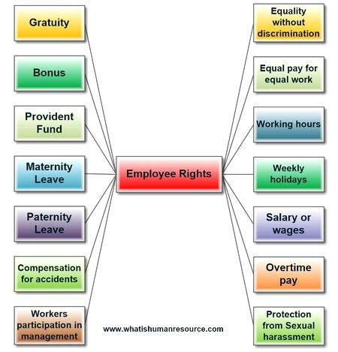

Slide 16
Scope of HRM
HRM in personnel management
HRM in employee welfare
HRM in industrial relations

Slide 17
HRM in personnel management
This is typically direct man power management that involves manpower planning , hiring, training and development , induction and orientation, transfer, promotion, compensation, layoff and retrenchment , employee productivity.

Slide 18
HRM in employee welfare
This particular aspect of HRM deals with working conditions and amenities at workplace. This includes a wide array of responsibilities and services such as safety services , health services, welfare services and health services.
Employee welfare is abut determining employees real needs and fulfilling them with active participation of both management and employee.
In addition to this , it also take care of canteen facility, ret and lunch rooms, transport , medical assistance, education , health and safety.

Slide 19
HRM in industrial relations
Since it is a highly sensitive area, it needs careful interaction with labour or employee union, addressing their grievances and settling the dispute effectively in order to maintain peace and harmony in the organization.
It is about establishing , growing , and promoting industrial democracy to safeguard the interest of both employees and management.

Slide 20
Scope of HRM
1. Human resource planning- identifying requirement of manpower in terms of quantity and quality.
2. Recruitment & Selection- process of shortlisting, appointing best –qualified candidate
3. placement function: placing /fitting the right person for right place of work.
Benefits :- higher efficiency, employee satisfaction, commitment and dedication.

Slide 21
Scope of HRM
4. promotion – upward advancement of employee. Elevation to a higher job accompanied by higher pay and privileges
5. Appraisal of performance-systematic assessment & evaluation of workforce
Benefits:- give idea about the job relevant strength and weakness of employee
6. training and development- teaching or developing skills or knowledge
Benefits : improve skills, acquire knowledge & social skills

Slide 22
Scope of HRM
7. career development - continuous efforts to match the long term needs of employees with the organization.
Method: assigning challenging task, promotion & training.
8. compensation function : employees must be rewarded and recognized for their performances.
HRM is responsible for designing for proper compensation packages.
9. Employee welfare – canteen facility, recreation facility, rest rooms, transport facility,
This facilities help to motivate the employees.

Slide 23
Scope of HRM
10. labour relation – building cordial relationship between employer & employee.
11. employee health and safety – to enhance the wellbeing of the employee organization provides medical aid, PF, Maternity leave, compensation etc.

Slide 24
NATURE/FEATURES OF HRM
Pervasive function
Present in all levels of the management in the organization.
People oriented process
People oriented-HRM is a people oriented process of bringing people and organization together so that goals of each are met properly.
Inherent part of management-
selecting people, training, motivating, appraising their performance for improving their quality in each departments

Slide 25
NATURE/FEATURES OF HRM
. Future oriented-
Effective HRM helps organization meet its goals
Continuous function
HRM is not a one shot deal it requires constant awareness and alertness of human relations in every day operation
Integrating mechanism
HRM maintains cordial relationship between people working at various levels in organization

Slide 26
NATURE/FEATURES OF HRM
Based on human relation
Every person has different need, perception and expectations. The manger should give due attention to these factors.
Challenging function
HRM is a challenging activity as it deals with the people who are always unpredictable. Humans have emotions and sentiments and cannot be treated like machines.

Slide 27


Slide 28
RECRUITMENT
SELECTION
TRAINING
PERFORMANCE APPRAISAL
TRADE UNIONS
DEVELOPMENT

Slide 29
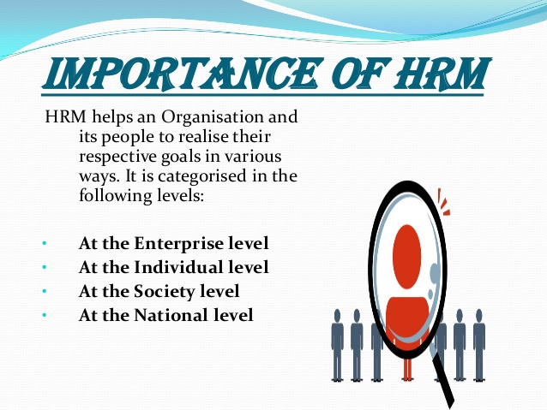

Slide 30
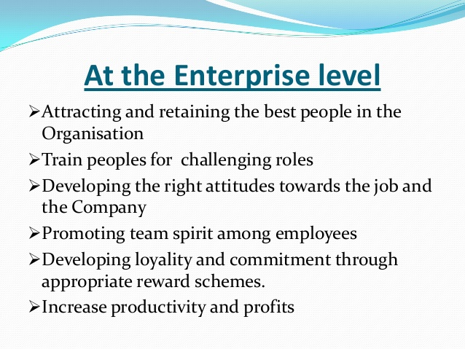

Slide 31
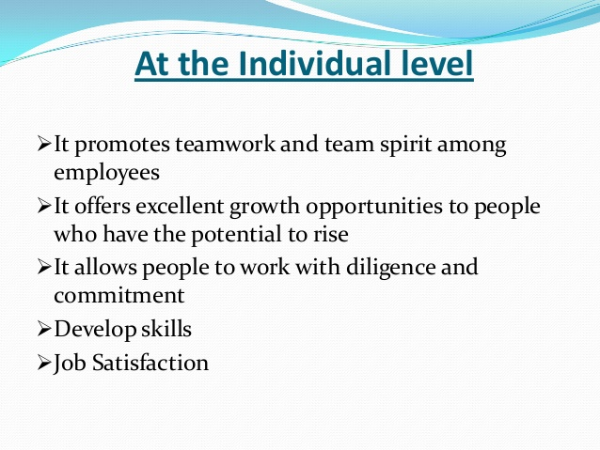

Slide 32
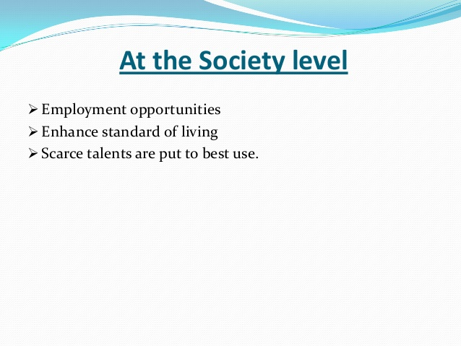

Slide 33
