Slide 1
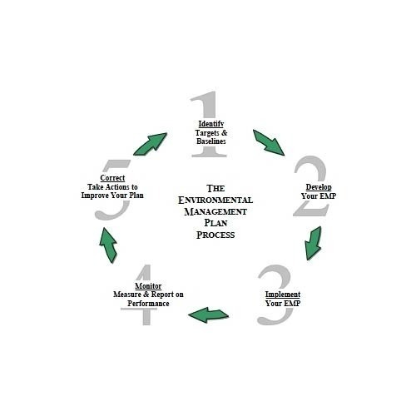


F.Y.B.B.I.-SEMESTER I-FC
UNIT IV- ENVIRONMENTAL MANAGEMENT
SYLLABUS AT A GLANCE
Environmental Management :- Concept,Need & Relevance of Environmental Education
Environmental Impact Assessment,Environmental Audit
Role of Technology in Environmental Management-GIS (Geographical Information System),GPS (Global Positioning System),Remote Sensing as Tools

Slide 2
CONCEPT-ENVIRONMENTAL MANAGEMENT
Management is a distinct process consisting of planning,Organizing,activating,controlling,performed to determine & accompalish the objective by the use of people & resources.
Environmental Management,is a management of- ‘Ecofriendly Development’
Environmental Management is a systematic approach for finding practical ways for saving-Water,Energy,Materials & reducing negative environmental impacts.
It is necessary,as resources are limited & if they are not used properly,they will get exhausted shortly.Remedies to many of the environmental problems are simple & often-Low-Cost,knowledge-intensive,demand -self-discipline,team-work & respect for the needs of future generations.
Environmental Management is not merely a slogan,but an urgent necessity & unless & until serious attention is not paid at every stage,we may reach a point of no-return.We should not forget that Environment & Development,both are one,as development depends on preservation of environment,which provides all necessary reources for Economic Development.
Economic Development should be based on corresponding ecological obligations.If we ignore it,world will enter 22nd Century with food & livelihood scarcity.Thus Environmental Management,is the need of an hour,if we wish to avoid Environmental Problems.

Slide 3
ENVIRONMENTAL MANAGEMENT SYSTEM (EMS)
It is a system & database,which integrates procedures & processes for training of personnel,monitoring,summarizing & reporting of specialized environmental performance information to internal & external stakeholders of a firm.
GLOBAL
LEVELS OF EMS
NATIONAL
LOCAL

Slide 4
THREE LEVELS OF ENVIRONMENTAL MANAGEMENT
Global Level:- Serious environmental problems are taken up at international levels.For e.g.-Need to increase area under forest cover has to be tackled by all countries in order to reduce Global Warming.
National Level :- Every country should have it’s National Policy for Environmental Management.
Local Level :- Environmental Management is also important at local level.For example,every industrial establishment should clear it’s waste before discharging into water bodies or in Air.
NEEDS OF AN EFFECTIVE ENVIRONMENTAL MANAGEMENT
Good knowledge of existing physical & economic environment
Studying the impact of economic activities on environment
Enacting Laws & Regulations, which protect environment
Political will to apply laws & regulations strictly at local,national & international level.

Slide 5
CONCEPT OF ENVIRONMENTAL MANAGEMENT
Concept of Environmental Management includes-
Conservation
Preservation
Sustainable Development
Government tries to protect environment to enable people to take advantage of modern technology & enjoy natural resources
For an industrialist,Environmental Management means taking decision by knowing likely impact of activities on Environment.
Environmental Management involves development of new approaches in following areas :-
Assess the impact of technology on Environment
Estimate economic costs of meeting environmental standards
Encourage public participation in planning of new projects

Slide 6
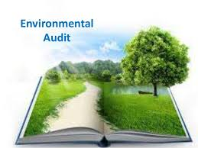
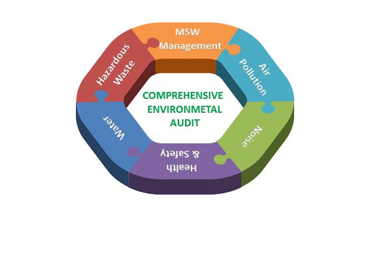
ENVIRONMENTAL AUDIT
Environmental Audit is defined as- “A basic management tool comprising systematic,documented,periodic & objective evaluation of an industry”
It helps management of an industry to assesss effectiveness of it’s overall – ‘Environmental Management System’.
Following are the Aims of-Environmental Audit :-
Assesing possible risks & hazards related to-Manufacturing
Assesing possibility of optimum utilisation of resources
Improving consumption of energy resources
Fixing Priorities & Plans for future environmental establishments
Setting of performance baselines
Creating awareness amongst employees regarding their duties & responsibilities for Environmental Protection.

Slide 7

STAGES OF-ENVIRONMENTAL AUDIT
PRE-VISIT
STAGES OF E.A.
SITE VISIT
POST AUDIT
Pre-Audit ,is planning of Audit Programme.
Site Visit includes meeting with the staff,inspection,checking of records,identification of source of Waste Generation,existing pollution control measures & monitoring facilities.
Post-Audit activities include a written assessment of facilities compliance status.It also includes recommendations to correct deficiencies.
Active & meaningful participation of workers working in industry during the Environmental Audit is very crucial.

Slide 8
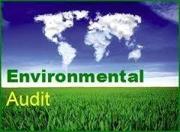


Since 1993, Environmental Audit has become compulsory for all the Indian Industries,along with the-National Environment Tribunal Bill & Public Liability Insurance Bill for strenghthening power of Government to protect environment.

Slide 9

ROLE OF ENVIRONMENT MANAGER
Tackling Environmental issues & problems,related to-Ecology,Natural Resources & Pollution.
Advising management about natural resources,environmental depletion & conservation policy
Conducting Audit of-Energy Consumption.
Keeping informed about-Environmental Legislations
Studying & dissolving-Environmental Conflicts

Slide 10
WHAT IS NEEDED TO BE DONE
We cannot achieve development by-altering,damaging & Degrading Natural Environment.
We need to protect our variety of Ecosystems like- Air,Water,Soil,Forests etc,otherwise they will no longer be able to support life & in turn ,we humans.
Awareness needs to be increased regarding variety of problems associated with Development& their relation with Environment,for e.g.-Global Warming,Green House Effect,Climate Change,Desertificatio,Pollution etc.
One needs to understand limitations of growth,Carrying Capacity of Earth which has further given way to concept of- ‘Sustainable Development’
Widening gap between development & environment needs to be either minimised or removed.There is need for innovative technologies for more efficient use of resources,structural changes need to be brought in for less resource-intensive technologies,a proper & preventive environmental management with long-term environment friendly strategies.We need to live in harmony with nature.
There is a need for systematic approach to understand man-environment relationship & focus on optimum utilisation of resources,by keeping in mind overall development which will sustain us,not only today,but also for future generations to come

Slide 11
DEFINITION-ENVIRONMENTAL MANAGEMENT
Environmental Management (EM) ,can be defined as- “Optimal use of finite resources between different possible uses.Environmental criteria & economic considerations demand such an allocation to be efficient.Simultaneously,the available resources should be protected from degradation and scarce and diminishing resources should be conserved.”
NEW DIMENSIONS IN DEVELOPMENT IDEAS BY ENVIRONMENTAL MANAGEMENT
E.M. widens the scope of planning to include development & enhancement of environmental quality
E.M. looks not only in present but also in future thus,includes sustainable long term feasibility.(Sustainable Development)
Assess the cost to the society & the environment in achieving desired balance between 1st & 2nd dimension above.
E.M. takes into account side-effects of human activities & thereby protects & improves human environment,not only for present,but also for future.
It also involves making of plans & legal evaluation of administrative & technical solutions to variety of environmental issues in terms of both-Preventive & Remedial measures ,taking into account multi-disciplinary approaches to development.
Systematic planning efforts by policy makers directed towards regulating & managing the utilisation of Natural Resources & minimising irreversible damage to the environment due to human activities

Slide 12
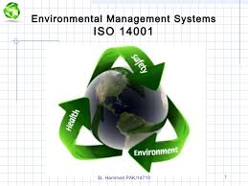
EMS (ENVIRONMENTAL MANAGEMENT SYSTEM)
It is a tool for managing impacts of organisation’s activities on the environment.
It provides structural approach to planning & implementation of environment protection measures.
Most important aspect for an effective EMS is the sincere commitment of any organisation which intends to develop & implement EMS.
Examples of components to be considered while developing EMS :-
Environmental Policy :-It is the statement of what an organisation intends to achieve from EMS.It ensures all environmental activities are consistent with objectives of organisation.
Environmental Impact Identification :-Identification & documentation of actual & potential environmental impacts of an organisation’s operations need to be taken.It can be achieved through undertaking Environmental Audit.
Objectives & Targets :- An Environmental Audit forms basis of determining an organisation’s environmental objectives & targets.An organisation can find benefits in adopting more stringent longer term objectives to encouncourage it to improve it’s performance.In order to improve continually,targets should be regularly reviewed.
Consultation :- Staff & Community consultation should be undertaken before,during and after establishment of EMS.It can also help to improve public perception of company,one of the benefits of implementing EMS.
Operational & Emergency Procedures :-All procedures should be reviewed to ensure that they are compatible with organisation’s environmental Objectives & Targets.Any change should be included with documentation.

Slide 13
Environmental Management Plan :- It details the methods & procedures which an organisation will use in order to meet objectives & targets.
Documentation :- All objectives,Targets,Policies,Responsibilities & Procedures should be documented along with information on Environmental Performance.Documentation is useful for verifying environmental performance to staff,regulators & the community.
Responsibilities & Reporting Structure :- Responsibilities need to be allocated to staff & management to ensure that-EMS is implemented effectively.
Training :- Staff should undergo Environmental Awareness training to familiarise them with their responsibilities for implementing EMS & with the overall environmental policy & objectives of organisation.It provides staff with necessary skill & motivation for the effective implementation of EMS.
Review Audits & Monitoring Compliance :- Review Audits should be undertaken regularly to ensure the EMS is achieving it’s objectives & to refine operational procedures to meet this goal.In order to ensure regulatory & other requirements are being met,it is often necessary to undertake regular Environmental Monitoring.
Continual Improvement :- An important component is-Continual Development.An EMS comes into it’s best use wehen used to review progress towards the targets & objectives set by a company to protect the Environment.The procedures set in place to meet these objectives should be constantly examined to see if they can be improved or if more effective systems can be introduced.

Slide 14

EMS follows :- PDCA Cycle
Plan,Do,Check & Act
This diagram shows process of-First developing an environmental policy,planning EMS & then implementing it.
The process also includes checking the system & acting on it.The model is continuos as EMS is a process of continual improvement in which an organisation is constantly reviewing & revising the syste.
An EMS monitors environmental performance,similar to the way a financial management system monitors expenditure,income & enables regular checks of company’s financial performance.An EMS integrates environmental management into company’s daily operations,long term planning & other quality management systems.
.

Slide 15
Minimise Environmental Liabilities
Maximise-Efficient use of Resources
Reduce Waste
Demonstrate a good Corporate Image
Build-Awareness of Environmental Concern among employees
Gain a better understanding of environmental aspects of business activities
Increase profit,improving environmental performance,through more efficient operations
BENEFITS OF EMS

Slide 16
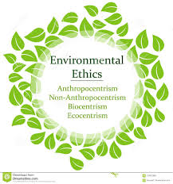
ASPECTS OF ENVIRONMENTAL MANAGEMENT
Ethics are concerned with-What is wrong & Right,irrespective of culture & society.
Environmental Ethics deals with issues related to the rights of individuals which are fundamental to life & well-being,their protection & preservation for future generations & the rights of all living creatures which inhabit on earth.
In short-Environmental Ethics tries to define the moral basis of Environmental Responsibility
ENVIRONMENTAL ETHICS

Slide 17
Environmental Ethics involves following three things :-
To ensure that Earth remains a hospitable place always.It is Anthropocentric view,where it is held that nature has value only when humans utilise it.It is also referred to as-Developmental Ethics,where the basis of idea is progress,wherein a healthy environment depends upon a healthy economic growth for which there is unlimited potential
To consider nature to have an intrinsic value,apart from it’s use as a resource to humans.Thus it is-Preservation Ethics.This view holds that-Nature exists for all species & a healthy environment can provide more raw materials & ensure economic growth against an unhealthy degraded environment.
To work towards a balance of resource use & resource availability,also known as-Conservation Ethics.The focus in this case is on Development,preservation,Population Control & Waste Minimisation.

Slide 18
PROPOSITIONS OF GREAT RELEVANCE TO ETHICAL ISSUES RELATED TO-ENVIRONMENTAL CONCERN
Environmental Destruction is caused largely by consumption pattern of rich.
Worst sufferers of Environmental Destruction are the poor.
Even where nature is being recreated,as in afforerstation,it is being transformed away from the needs of poor and towards those of rich.
Even amongst the poor,the worst sufferers are marginalised cultures & occupations,most of the women.
There cannot be proper economic & social development without holistic understanding of society & nature.
If we care for poor,we cannot allow the Gross Nature Product to be destroyed any further.Conserving & recreating nature has become our highest priority.
The Gross Nature Product will be enhanced only if we can arrest & reverse the growing alienation between people & common property resources.In it,we need to learn a lot from our traditional cultures.
It is impossible to save rural environment or rural people who are dependent,unless we bring about sustainable urban development.

Slide 19
TECHNOLOGICAL ASPECTS
Technology is one of the major factor which has contributed substantially towards degradation of Environment.
Technology is often considered as-Engine of Economic Development.
But due to reckless exploitation & unethical application,technology has resulted into unexpected consequences & brought tragedies.
Thus,there is increasing critisicm against development & use of technology.
However,it should be noted that when one talks about the advantages or disadvantages of technology,even technology also threatens human beings to become an endangered species.
Thus to overcome this aspect,in technology itself solution lies.
New technology which needs to be developed has to primarily focus on the prime concern of environmental protection.It is also often referred to as soft technology.
Soft Technology should be the one that will have minimal impact on the environment.

Slide 20
ECONOMIC ASPECTS
All the measures of environmental management have to be looked into-Cost-Benefit Analysis.
Direct costs of economic development do not consider the costs of impact on Environment
The new economic policies have to consider the two major aspects which have arisen from consideration :-
Polluter Pay
Ecological Taxation
According to these policies, a polluter has to pay a cost for the damage which his unit will be doing to the Environment.European Union (EU) has adopted this method on a large scale & is benefitting from it.
This Polluter Pay Principal is also referred to as- ‘Extended Polluter Responsibility’ or EPR.The polluting unit has also been entrusted with the responsibility to deal with the waste they will be generating and the cost of proper environment friendly waste disposal cost has to be included as the production cost.
The ecological taxation is more or less an extension of the polluter pay principle.In this case,a polluter has to pay high taxes,if his activities are harmful to environment.
One of the best example in this regard is of-European or South East Asian countries,where private transport is discouraged by heavy taxation on two & four wheelers.As more private vehicles lead to higher fuel consumption & thereby pollution;public transport is encouraged & being made more cheaper & comfortable.

Slide 21
SOCIAL ASPECTS
There is a need to minimise conflict between those who have & those who do not have.
Development process that will benefit rich & poor & will ensure –Social Justice, is needed.
In society,an individual is a pime factor.A citizen has to be vigilant about his rights to live in a clean & pollution free environment.
In order to achieve it, it is necessary that,every person should be aware of following :-
Impacts of-Environmental Pollution
How much responsible , he/she is towards Pollution contribution?
How do one’s habits of consumption & waste disposal,pose a problem ?
How can he contribute towards controlling or atleast minimizing pollution ?
How can he support measures to improve quality of environment ?
How can he participate in such programmes & contribute towards the same ?
Participation of people is the base to achieve social justice & environmental safeguards.It is the responsibility of every citizen & not that of a group or few individuals.

Slide 22
ENVIRONMENTAL IMPACT ASSESSMENT (EIA)
The term-EIA (Environmental Impact Assessment,was coined by USA, when preparation of these documents,became compulsory in USA,under-National Environmental Policy Act (NEPA) in 1970.
Requirement of it,in India,started in the year,1980,for major projects.
Scope of EIA :-Studies of it,consist of literature research & field work,to ascertain the baseline conditions & finally the impact assessment,with the help of mathematical,statistical & computer-aided techniques.
The study is completed in following five stages :-
Stage 1 :- Defining the present environment with respect to each of the parameters like-Ecology,Air & Water Quality,Geology,Soils,Hydology,Noise & socio-economic conditions etc.
Stage 2 :- Study different components of project which would have an effect on various aspects of environment.
Stage 3 :-Measures of the quantum & character of pollutants which are discharged
Stage 4 :- Assessment of impact of such pollutants discharged on various aspects of the environment.
Stage 5 :- Recommendation of some measures to reduce the impact of pollutants;if any on the environment to acceptable levels

Slide 23
OBJECTIVES OF EIA
Objectives of EIA are to define the existing environmental conditions in each area of study.
Generally,the area falling within 10 to 15 km radius of the project is studied in detail & area within 30 to 50km radius of project is studied only for major features.
Literature & relevant statistical data is made available by following Departments for EIA :-
Census
Irrigation
Forest
Inland Fisheries
Town & Country Planning
Indian Metereological
Soil Conservation
Field sampling is carried out in case of insufficiency in information,for one year to cover an entire annual cycle of seasonal variations.

Slide 24
WATER USE
LANDUSE
EIA METHODOLOGIES
WATER QUALITY
GEOLOGY
SOILS
HYDROLOGY

Slide 25
Continued..
SURROUNDING AIR QUALITY
METEREOLOGY
EIA METHODOLOGIES
NOISE
TERRESTRIAL ECOLOGY
AQUATIC ECOLOGY
DEMOGRAPHY & SOCIO-ECONOMICS

Slide 26
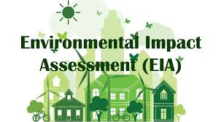
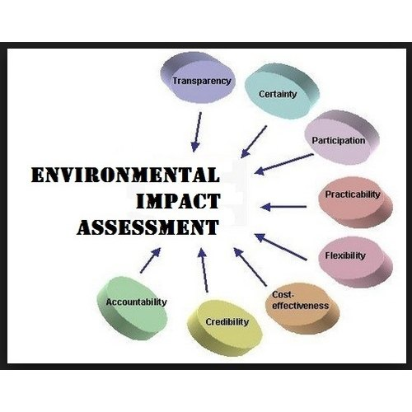
EIA-PROJECT FEATURES
Environmental Impact Assessment includes study of manufacturing process of plant,material utilised,finished products produced,source & quantum of water necessary for operation of plant is calculated & a water balance diagram,illustrating water requirement for different systems is prepared.
EIA is a document,which should not be considered only as a tool for obtaining environmental clearance from the statutory authority but also as a planning guide for large scale “Sustainable Development” programmes.

Slide 27
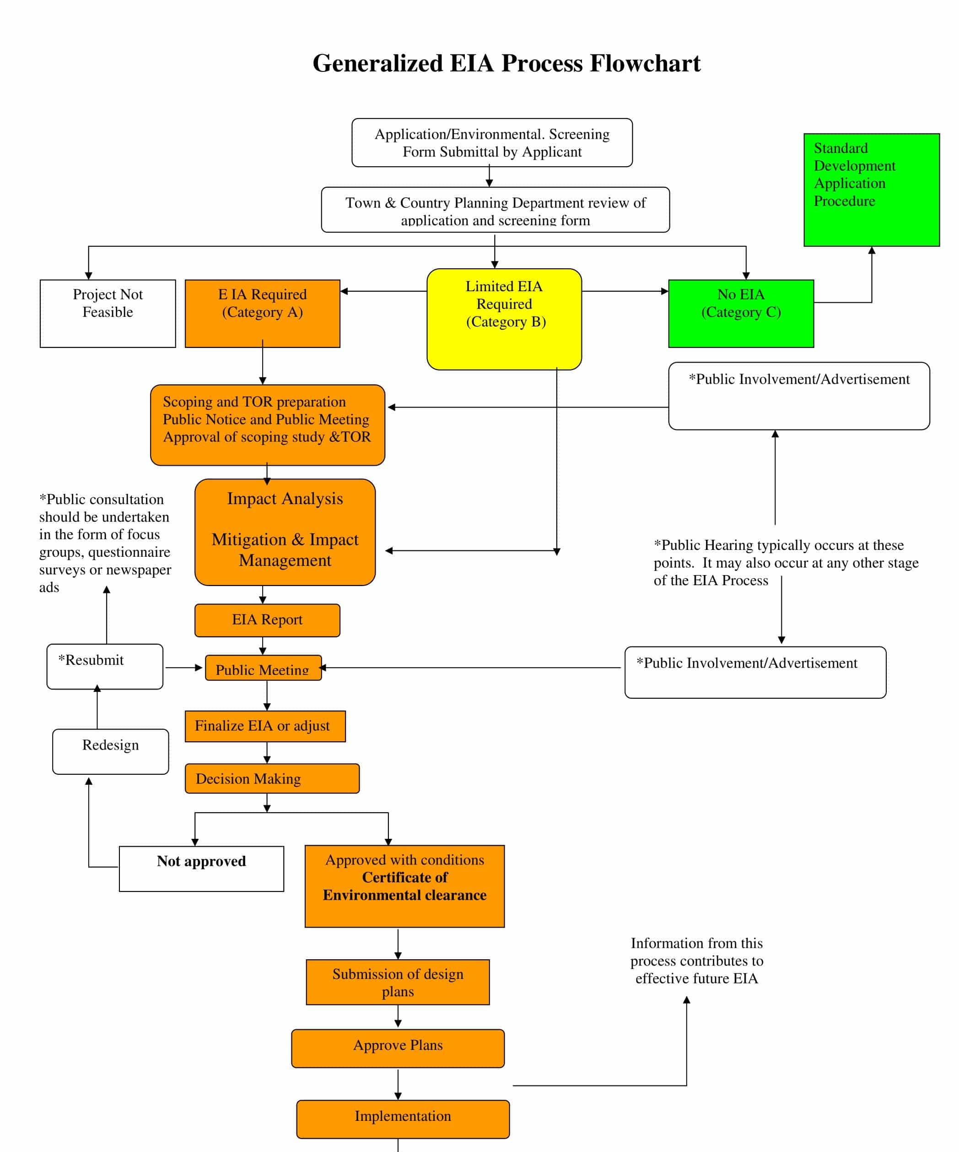

Slide 28

CARBON BANK & CARBON CREDIT
Carbon Bank :- The Clean Development Mechanism (CDM) of Kyoto Protocol permits trading in carbon credits.For this,a number of exchanges have been established.Banks too have entered this lucrative market.Such banks are known as-Carbon Banks.
Carbon Trading :- It is the name given to-Exchange Permits.This exchange may take place within the economy or may take the form of international transactions.
There are 2 types of Carbon Trading,namely,
1) Emission Trading 2) Offset Trading
Carbon trading is a mechanism to-offset & neutralize carbon emission & gain emission rights.
Carbon Credits provide a way to reduce greenhouse gas emissions on an industrial scale by capping total annual emissions & allowing the market to assign a monetory value to any shortfall through trading.
Credits can be exchanged between business or bought & sold in international markets at prevailing market price.
Credits can be used to finance carbon reduction schemes between trading partners.

Slide 29
ENVIRONMENT EDUCATION
Environmental Education /study is the scientific study of the environmental system & the status of it’s inherent or induced changes on organisms.
Environmental Studies is defined as- “The academic Field which systematically studies human interaction with the environment.It is a broad interdisciplinary field of study that includes the natural environment,built environment & the sets of relationship between them.”
According to UNESCO, guiding principles of Environment Education should be as follows :-
Environment Education should be compulsory,right from primary to the post-graduate stage.
It should have an interdisciplinary approach by including Physical,Chemical,Biological as well as socio-cultural aspects of environment.It should build a bridge between biology & technology.
It should take into account the historical perspective, the current & potential historical issues.
It should emphasize the necessity of seeking international cooperation in environment planning.
It should emphasize the importance of Sustainable Development i.e. Economic Development without degrading environment.
It should lay more stress on practical activities & first hand experiences.

Slide 30
IMPORTANCE OF ENVIRONMENT EDUCATION
Environment Education gained importance at global level after the Stockholm Conference on Human Environment, organized by UNESCO in 1972.Soon after this conference,the UNESCO launched the International Environmental Education Programme (IEEP)
Environment Education should be not only the part of education system but also political system,where actions,policies & plans can be formulated & executed at national level.
It must be accessible to assess environmental situation & the conditions leading to damage of Environment.
Protecting environment is the responsibility of everyone,hence Environment Education cannot be confined to one group or society.It is the duty of every individual to save environment.
Environment Education must be a continuous & a lifelong process.It must be practical so that teachings can be implemented directly.
Conserving nature & environment will be much easier if children are taught about depleting resources,environmental pollution,landslides,degradation,sustainability & extinction of plants & animals.
Education is a sort of investment,which turns into valuable asset,with time.In today’s era,children are going away from nature & are involved in virtual world.They have no time to travel around & explore the natural world around them.They should not grow up into adults,who are least bothered about conservation of nature.
Raising an environmentally educated generation is also necessary because of the depleting of natural resources.EE is the need of the day.
EE should encourage social participation.Hence integrating environment education into a curriculum is a wise option to connect students with nature right from childhood.

Slide 31
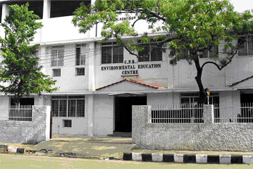

To promote environmental awareness across the nation,the Centre for Environment Education (CEE) was established in August 1984 with a support from –The Ministry of Environment & Forests,Government of India.

Slide 32

ISO (INTERNATIONAL ORGANISATION FOR STANDARDISATION
It is world’s largest developer & publisher of International Standards.
It is a network of National Standards Institutes of 159 countries,one member per country,with a Central Secretariat in Geneva,Switzerland,which coordinates the system.
ISO 14000 helps the organization to :-
Minimize negative impacts of operations on environment
Comply with applicable laws,regulations & other environmentally oriented requirements
Continual improvement in all above
Major objective of ISO 14000 series of norms is- “To promote more effective & efficient environmental Management in an organisation & to provide useful & suitable tools-ones that are cost-effective,system based,flexible,reflect best organisations & best organizational practices available for-Gathering,interpreting & communicating environmentally relevant information.

Slide 33

ISO 14001 is a generic management system standard,meaning that it is relevant to any organization seeking to improve & manage resources more effectively.
It includes the following :-
Single-site to large multi-national companies
Huge risk companies to low-risk service organizations
Manufacturing,process & the service industries,including local Governments
All industry sectors including-Public & Private Sectors
Original equipment manufacturers & their suppliers
ISO defines EMS as- “Part of overall
Management system,which includes organizational structure,planning activities,responsibilities,practices,
procedures,processes & resources for developing,implementing,achieving & maintaining the environmental policy”

Slide 34
List of ISO 14000 Series Standards :-
ISO 14001 :-Environmental Management Systems-Requirements with guidance for use
ISO 14004 :- Environmental Management Systems-General guidelines on principles,systems and support techniques
ISO 14006 :-Environmental Management Systems- Guidelines for incorporating ecodesign
ISO 14015 :- Environmental Assessment of sites & organizations
ISO 14020 Series (14020-14025)-Environmental Labels & declarations
ISO 14030 :- Discusses post-production Environmental Assessment
ISO 14031 :- Environmental Performance Evaluation-Guidelines
ISO 14040 :- It sets guidelines & requirements for water footprint assessments of products,processes & organisations.Includes only air & soil emissions which have impact on water quality in assessment
ISO 14046 2014,Environmental Management :- Water Footprints :- Principles,Requirements & Guidelines
ISO 14050 :- Terms & Definitions
ISO 14062 :- Integrating environmental aspects into product design & development (2002)
ISO 14063 :- Environmental Communication Guidelines & examples (2006)
ISO 14064 :- Measuring,quantifying & reducing Greenhouse Gas Emissions
ISO 19011 :- Specifies one audit protocol for both 14000 & 9000 series standards together

Slide 35
10 MANAGEMENT PRINCIPLES BY ISO 14000 FOR ORGANIZATIONS CONSIDERING EMS
Recognise that Environmental Management is one of the highest priorities of any organization
Establish & maintain communications with both internal & external interested parties
Determine the legislative requirements and those environmental aspects associated with your activities,products & services
Develop a commitment by everyone in the organisation to environmental protection & clearly assign responsibilities & accountability
Promote environmental planning throughout the life cycle of product & process.
Establish a management discipline for achieving targeted performance.
Provide the right resources & sufficient training to achive targeted performance
Evaluate performance against policy,environmental Objectives,targets,make improvements,wherever possible
Establish a process to review ,monitor & audit the environmental Management system to identify opportunities for improvement in performance
Encourage vendors to establish Environment Management System

Slide 36
ADDITIONAL BENEFITS TO INDUSTRIES BY ISO 14000
Less incidents which will result in Liability
Improved Industry-Government relations
Helps in obtaining permits & authorisations
Enhancement of image & market share
Satisfaction on Investment Criteria
Waste Minimisation
Energy Conservation
Better Utilisation of material resources
Cost reduction & increased profitability

Slide 37

ISO 16000
ISO-16000-1:2004 is applicable to indoor environments such as dwelling having living rooms,bedrooms,do it by yourself rooms & cellars,kitchens and bathrooms; workrooms or work places in buildings which are not subject to health & safety inspections in regard to air pollutants (for examples,offices,sales premises ); public buildings (for example hospitals,schools,kindergartens,sport halls,libraries,restaurents,bars,thetres,cinemas & other function rooms) & also cabins of vehicles.
Volatile Organic Compounds (VOC’s),occur in the atmosphere at low levels from natural sources & at relatively high levels from anthropogenic sources.They occur in increasing amounts in outdoor air,indoor air & workplace air respectively.Such compounds may pose a risk to human health or environment.Therefore,there maybe a requirement to monitor these compounds.

Slide 38
ISO 16001 CERTIFICATION
This is a certification for Energy Management Systems.
It is aimed at efficient use of energy so as to reduce energy consumption & thus reducing the cost & present a positive image of organization about it’s environmental commitment.
This certification can be obtained through regulating bodies.
Benefits :-
An embedded energy management reduces the amount of energy used & the efficiency of it’s use which saves on expenses.
A responsible & commited company gives a positive response from the consumers.
Involvement of staff helps to spread the message not only within the company but also outside thus contributing further towards conservation of energy resources.
The Certification helps in standardization of energy management of organization.

Slide 39
ROLE OF TECHNOLOGY IN ENVIRONMENTAL MANAGEMENT
In the field of Environmental Education,IT has a tremendous potential.
Development of internet facilities,World Wide Web,Remote Sensing & Geographical Information System & information through Satellites has generated a wealth of up-to-date information on a number of aspects of environment & health.
Many softwares have been developed for environmental studies,which are user-friendly & can help an early learner to understand Environment.

Slide 40



WORLD WIDE WEB (WWW)
The internet not only provides information,but also helps to a great extent to create interests & makes the user aware about problem,but also more importantly methods by which a he/she can himself contribute towards minimizing his own impact on environment.
The Ministry of-Environment & Forest,Government of India,has created an information system,called- ‘Environmental Information System’ (ENVIS).With it’s headquarter in Delhi,it functions in 25 different stations,allover the country.
The centre works for generating database in areas like-Pollution control,clean technologies,remote sensing,coastal ecology,biodiversity,renewable energy,desertification,wildlife,mangroves,mining,Ecology of-Himalaya Mountain,Western & Eastern Ghats etc.

Slide 41
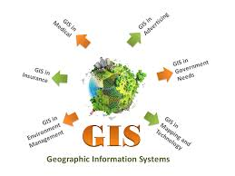
GEOGRAPHICAL INFORMATION SYSTEM
GIS is ‘Computer System that can hold & use data describing places on surface of earth.
It is a set of tools for collecting,storing,retrieving at will,transforming & displaying spatial data from real world for particular set of purposes.
Department of Environment defines GIS as, ‘A system for computing,storing,checking, integrating,manipulating,analysing & displaying data which are spatially referred to the earth.
GIS is more than a series of computer boxes sitting on a desk,as it also includes-Hardware,Software & appropriate procedures.GIS uses spatially referenced or Geographical Data & carries out various management & analysis tasks on these,including their input & output

Slide 42
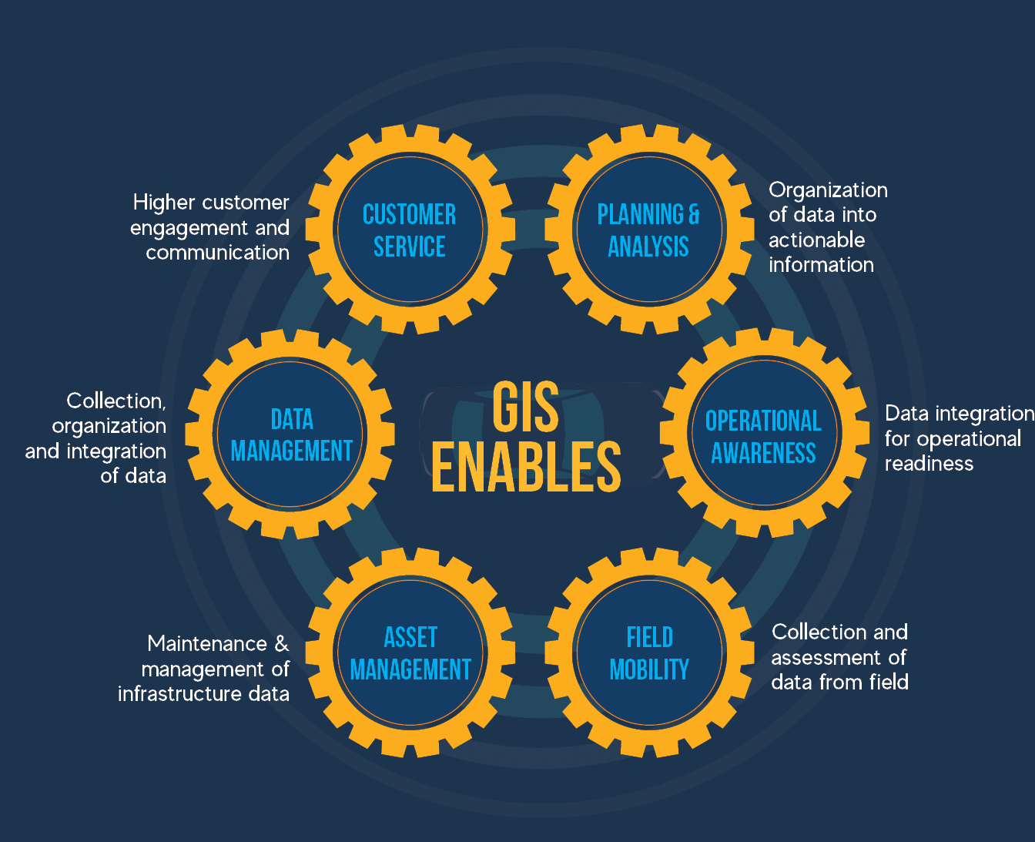
Department of Environment (1987) lists capabilities,which a well-designed GIS should be able to provide :-
Very quick & easy access to very large volumes of data
The ability to :-
Select details by area or theme
Link or merge one data set with another
Analyse spatial characteristics of data
Search for particular characteristics
Updating any data at cheaper rate & quickly
Output capacity (Preparation of maps,graphs & summary statistics) tailored to meet particular needs

Slide 43
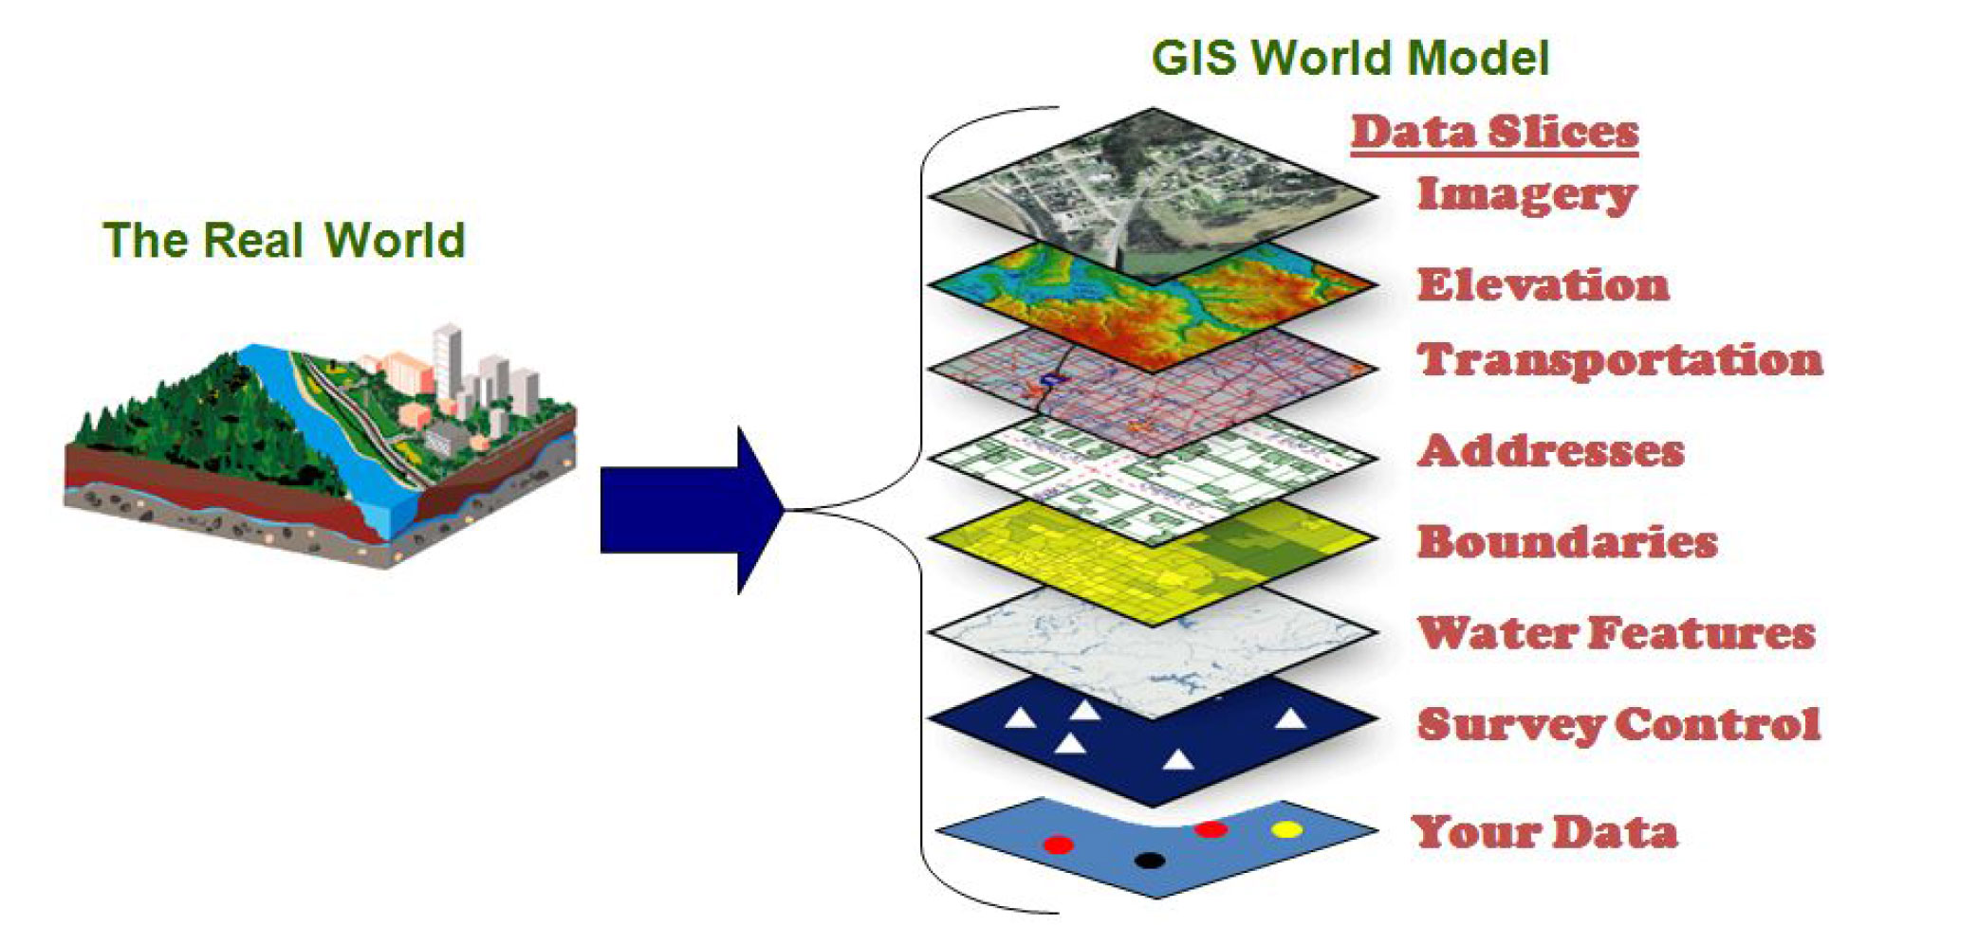

Slide 44
GIS is a technique of superimposing various thematic maps using digital data on a large number of inter-related or interdependent aspects.Variety of useful softwares have been developed in order to work in field of GIS.
Variety of thematic maps containing difital information on different aspects like-
Water Resources
Industrial Growth
Human Settlements
Road Network
Soil Types
Forest Land
Grasslands
Crop Lands
Disaster Management
Counter Terrorism
Law Enforcement
Traffic Management
Are superimposed in a ‘LAYERED FORM’ in computer,using Software.It is very useful & important for future landuse
planning.
The 3D modelling capacity of GIS goes a long way into futuristic environmental planning.
Thus GIS is very useful for the interpretation of-Polluted Zones,degraded lands,crops affected by diseases & helps to check-Umplanned Industrial growth.

Slide 45
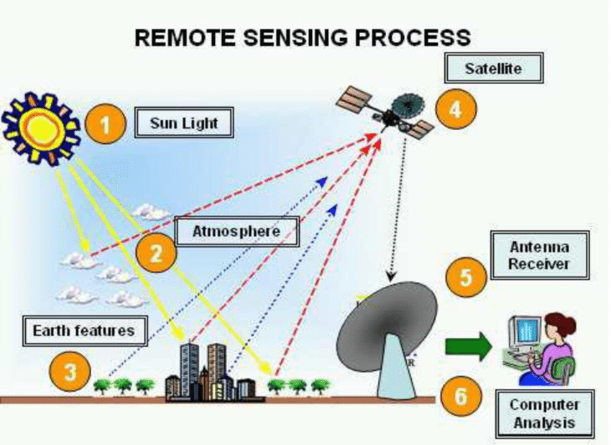
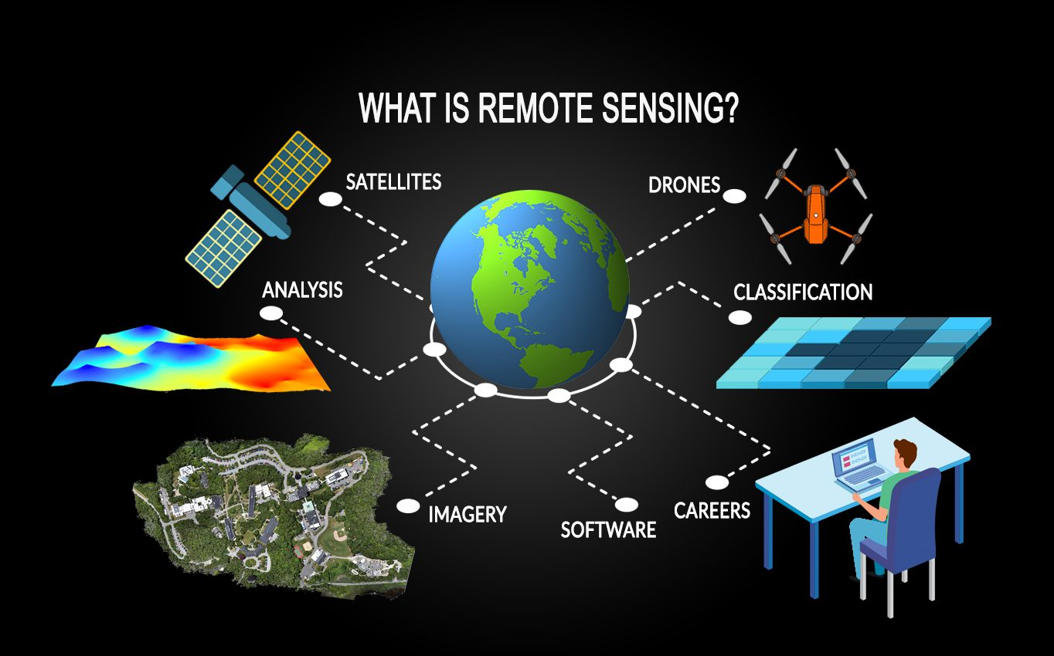
REMOTE SENSING
Observation of earth from space is usually termed as-Remote Sensing & satellites used for the purpose are known as-Remote Sensing Satellites.These satellites are usually deployed in-Sunsynchronous Polar Orbit at a height of 800 to 1000 km.As it passes over both polar rtegions,it is called as Polar Orbit.
Remote Sensing as per Campbell (1987) is the Science of deriving information about earth’s land water areas from images acquired at a distance.It relies upon measurement of electromagnetic energy reflected or emitted from the features of interest.
Use of remotely sensed data in mapping of natural resourceshas become quite popular these days.

Slide 46
FUNCTIONS OF INDIAN REMOTE SENSING SATELLITES
National Watershed Mapping :- Maps have been prepared identifying types & extent of wastelands at the village level for 237 selected districts spread allover the states.
Landuse/Land Cover Mapping :- Nationwide mapping for landuse/land cover on 1:25,000 scale has been carried out for all the states.The data has been provided to the Planning Commission towards-Agro-Climate-Based Regional Planning.
National Drinking Water Technology Mission :- Hydrogeomorphological Maps have been prepared for all the states to identify potential groundwater prospect zones.These maps are being used by the Ministry of Rural Development,State Public Health Engineering Department & State Groundwater Water Departments towards Drinking Water Resources.
Agricultural Drought Monitoring :- Using Satellite based vegetation Index Data,Drought Reports are being generated to assess & monitor agricultural drought at the district levels for 10-Drought Prone States.
Forest Cover Mapping :- Based pn Remote Sensing Data,biennial forest cover mapping to monitor forest cover changes is being carried out by The Forest Survey of India for the entire country.
Crop Acreage & Production Examination :- Satellite Remote Sensing based estimation of crop acreage & production forecast for major crops,covering major parts of the country are being provided to the Department of Agriculture.This project provides information for wheat,rice & sorghum for twelve states,oilseeds in 9 states & Cotton crops in 5 states.

Slide 47
CONTINUED..
Flood Mapping :- Using Satellite Data real time mapping of flooded areas and estimation of damage is being carried out for all major river basins.This information is being provided to-Flood Control Boards,Central Water Commission & State Irrigation Departments towards taking up flood control/Relief Measures.
Project Vasundhara :- Mineral Targeting has been carried out using Satellite Data for Peninsular India.The database is being used by GIS for futher mineral proceeding studies.
Ocean Resources :- Coastal Zone Maps for the entire country have been prepared & information has been provided to the Department of Ocean Development & State Governments.These maps give information on the status of wetlands,estuaries as well as identify prospective sites for Aquaculture.
Marine Resources :- Fishery Potential Charts are being generated using satellite data & the same are being disseminated to all Marine State Fisheries Departments,Fisheries Survey of India & Fishermen Cooperative Societies for improving the fish catch.
Command Area Development :-Satellite based remote sensing data has been used to monitor crops/irrigation status in major command areas in Uttar Pradesh,Karnataka & Andhra Pradesh.This information is provided to Command Area Development Authorities,Central Water Commission & Ministry of Water Resources towards optimising the use of water for irrigation.
Mapping of Saline/Alkaline Soils :- Mapping of saline or alkaline soils & estimation of areas of different types of salt affected land for all the states has been carried out using satellite data towards taking corrective measures.

Slide 48
Environmental Impact Assessment :- Satellite remote sensing data has been used to assess the impact of mining,super-thermal power stations,industries & urbanisation on the environment.Specifically covered areas are-Kudremukh iron-ore mining in Karnataka,mining in Goa,Korba Super-Thermal power station in Madhya Pradesh,Coal mining in Jharia & Chemical Industries in Karnataka.
Urban Studies :- Many new applications in urban studies have been carried out with the help of available satellite data.
For example,urban sprawl,structural plans for cities,guide maps for cities like-Delhi,Bengalooru etc.as well as facility
management.Feasibility studies of the possible routes for express highways & townships have been carried out for the proposed express highway between Bengalooru & Mysore.

Slide 49
DEFORESTATION (RAINFOREST,MANGROVE COLONIES)
FOREST HEALTH & VIGOUR
APPLICATIONS OF GIS DATA
SPECIES INVENTORY
COASTAL PROTECTION (MANGROVE FOREST)
WATERSHED MAPPING

Slide 50
CONTINUED..
HYDROLOGICAL MODELLING
APPLICATION OF GIS DATA
DROUGHT PREDICTION
POLLUTION MONITORING
COASTAL MANAGEMENT

Slide 51


GPS (GLOBAL POSITIONING SYSTEM)
GPS is a set of satellites & control systems which allow a specially designed GPS receiver to determine it’s location anywhere on earth,24 hours a day.
The American system consists of 24 satellites orbiting the earth in high altitude orbits.
These satellites have a 12 hour orbit time & Passover control stations,so that orbits can be closely monitored & their positions are identified precisely.
Satellites & ground based receiverstransmit similarly coded radio signals,so that time delay between transmission & receipt of signal gives the distance between satellite & receiver.
GPS is finding a wide range of applications,varying from navigation(Air,Sea,Land) to mapping & surveying
GPS is currently fully functional- Global Navigation Satellite System (GLONASS).It is an important tool for making.
GPS receivers can determine receiver’s-Location,Speed & Direction.It provides precise time reference used in many applications including scientific study of earthquakes & synchronisations of telecommunication networks.
Developed by United States Department of Defence,it is officially named as -
NAVSTAR GPS (Navigation Satellite Timing And Ranging Global Positioning System).
The Satellite constellation is managed by-United States Air Force 5oth Space Wing.
The cost of maintaining the system is approximately 750 million US $ per year,including the replacement of ageing satellites,R& D.
Despite this fact, GPS is free for civilian use as a Public Goods.

Slide 52
APPLICATIONS OF GPS
GPS allows accurate targeting of various military weapons,including cruise missiles & precision guided munitions.To help prevent GPS guidance from being used in enemy or improvised weaponary,the US government controls export of civilian receivers.
Automobiles can be equipped with GPS receivers at the factory or as after market equipment.Units often display moving maps & information about location,speed,direction & nearby streets & landmarks.
Heavy equipment can use GPS in construction,mining & precision agriculture.The blades & buckets of construction equipment are controlled automatically in GPS based machine guidance systems.Agricultural equipment may use GPS to steeer automatically,or as a visual aid displayed on a screen for the driver.This is very useful for controlled traffic & row crop operations & during spraying.Harvesters with yield monitors can also use GPS to create a yield map of the paddock being harvested.
Surveying :- Survey –Grade GPS receivers can be used to position survey markers,buildings & road construction.
Mapping & Geographic Information System (GIS) :-Most mapping grade GPS receivers use the carrier wave data from only L1 frequency,but have a precise crystal oscillator which reduces errors related to receiver clock Jitter.This allows positioning errors on the order of one meter or less in real-time,with a differential GPS signal received using a separate radio reveiver.By storing the carrier phase measurements & differentially post-processing the data,positioning errors on the order of 10cm are possible with these receivers.

Slide 53
Geophysics & Geology :- High precision measurements of crustal strain can be made with differential GPS by finding the relative displacement between GPS sensors.Multiple stations situated around an actively-deforming area (such as volcano or fault zone), can be used to find strain & ground movement.These measurements can then be used to interpret the cause of deformation,such as a dike or sill.beneath the surface of an active volcano.
Mobile Satellite Communications :- Satellite communication systems use a directional antenna (usually a “Dish”) pointed at a satellite.The antenna on a moving ship or train,for example,must be pointed based on it’s current location.Modern antenna controllers usually incorporate a GPS receiver to provide this information.
Emergency & Location based services :- GPS functionality can be used by emergency services to locate cell phones.The ability to locate a mobile phone is required in United States by E911 emergency services legislation.However as of September 2006,such a system is not in place in all parts of the country.GPS is less dependent on telecommunications network,topology than radiolocation for compatible phones.Assisted GPS reduces the power requirements of the mobile phone & increases the accuracy of location.A phone’s geographic location may also be used to provide location based services including advertising,or other location-specific information.
GPS tracking :- System uses GPS to determine the location of vehicles,persons or pets & to record the position at regular intervals in order to create a log of movements.The data can be stored inside the unit,or sent to a remote computer by radio or cellular mode.Some systems allow the location to be viewed in real-time on the internet with a web browser.

Slide 54
Weather Prediction Improvements :- Measurement of Atmospheric bending of GPS satellite signals by specialised GPS receivers in orbital satellittes can be used to determine atmospheric conditions such as-Air Density,Temperature,Moisture & Electron Density.Such information from a set of six micro-satellites,launched in April 2006,is called the constellation of observing System for Meteorology.
Marketing :- Some market research companies have combined GIS systems & survey-based research to help the companies to decide where to open new branches & to target their advertising,according to usage patterns of roads & the socio-demographic attributes of the residential zones.
Thus,the World Wide Web(WWW),Remote Sensing & Geographical Information System (GIS),Global Positioning
System (GPS) ,play a key role in resource mapping,Environmental Conservation,Environmental Management,Planning & Environmental Impact Assessment (EIA).

