Slide 1
Services Marketing
Unit III

Slide 2
Unit III – Syllabus
Improving Service Quality & Productivity
Service Quality – GAP Model, Benchmarking
Measuring Service Quality – Zone of Tolerance & Improving Service Quality
SERVQUAL Model
Defining Productivity – Improving Productivity
Demand & Capacity Alignment
3

Slide 3
Service Quality

Slide 4
Service quality is an approach to manage business processes in order to ensure full satisfaction of the customers & quality in service provided. It works as an antecedent of customer satisfaction.
If expectations are greater than performance, then perceived quality is less than satisfactory and hence customer dissatisfaction occurs.
Quality is the performance of the Service what the Customers buys.

Slide 5
Dimensions of Service Quality – Christian Groonroos
Technical Quality
“What” of the Service is delivered
Process and types of services offered
Functional Quality
“How” of the Service is delivered
Influenced by attitude, behaviour, appearance, accessibility, courtesy, empathy etc.
A tool for Brand differentiation & preference over competitors

Slide 6
SERVQUAL
SERVQUAL is a service quality framework, developed in the eighties by Zeithaml, Parasuraman & Berry, aiming at measuring the scale of Quality in the service sectors.
SERVQUAL was originally measured on 10 aspects of service quality to measure the gap between customer expectations and experience.

Slide 7
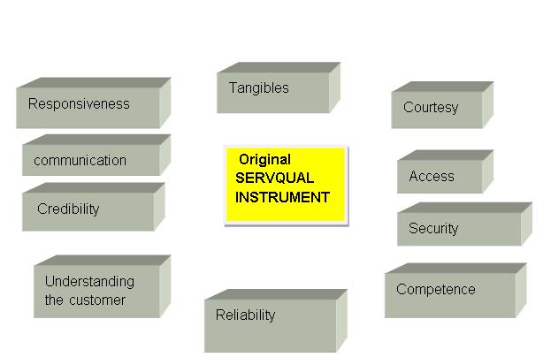

Slide 8
Dimensions | Definition | Example
Credibility | Trustworthiness, believability, honesty | Can I trust the hospital to give an honest opinion? My mechanic will only change parts when it is essential. He will not bill me for parts that he has not changed.
Security | Safety, freedom from risk | Can I use my credit card on the internet without disclosing the detail to others? Can I use my ATM card without fear of others finding out my secret code number?
Access | Approachability and ease of contact | I want my faculty to be available when I need to clear my doubts about the subject. Will the doctor be available to respond to my queries before the operation?

Slide 9
Dimensions | Definition | Example
Communicati on | Listening to customers and keeping them informed | The engineer at the government electricity board never takes customer complains seriously. When they schedule the power cut, the customer is the last one to know about it.
Understandin g the customer | Making the efforts to know the customers and their need. | I wish the receptionist at the dental clinic would not force on me a 4 pm appointment because my office close only at 5 pm.
Tangibles | Physical facilities, equipment, signage, environment, etc. | Is the driver of the hired car dressed in a uniform?
Reliability | Delivery of promised service dependably and accurately | Will the baby-sitter feed the baby at the right time? Will the bus hired for taking my child to school reach safely and on time?

Slide 10
Dimensions | Definition | Example
Responsiveness | Willingness to help and provide prompt service | Good taxi divers help carry the baggage. Will the bus conductor help me get a seat when I am travelling with the child?
Competence | Possession of skills ad knowledge to do the job | Will the travel agent be able to find the cheapest fare for me?
Courtesy | Politeness, respect, consideration and friendliness of the contact person | Will the travel agent be able to find the cheapest fare for me? I like the bus service from Mumbai to Pune because the divers drive safely and are so courteous.

Slide 11
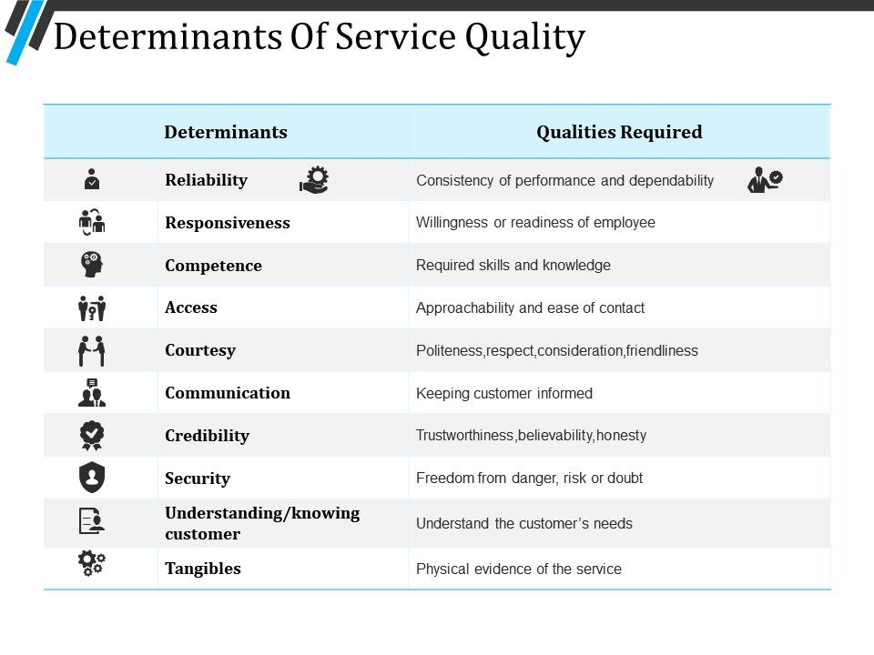
10 Dimensions of Service Quality

Slide 12
In 1988 the 10 components were collapsed into five dimensions (RATER).
Reliability
Tangibles
Responsiveness
Assurance
Empathy.
Parasuraman et al. developed a 22-scale instrument with which to measure customers’ expectations and perceptions (E and P) of the five RATER dimensions.

Slide 13
RATER Analysis - SERVQUAL
Responsiveness
Assurance
Empathy
Reliability
Tangibility

Slide 14
Dimensions of Service Quality
RESPONSIVENESS - Willingness to help customers and provide prompt service
ASSURANCE - Knowledge and courtesy of employees and their ability to convey trust and confidence
TANGIBLES - Factors which the consumer can touch, see, feel, hear Tangibles are used while assessing the physical qualities and before service is experienced
EMPATHY – Power of understanding customer’s feelings and needs that enables that enables the server to take care of the customer and provide personal attention.
Caring, individualized attention the firm provides its customers
RELIABILITY - Ability to perform the promised service dependably and accurately

Slide 15
SERVQUAL Attributes
RELIABILITY
Providing service as promised
Dependability in handling customers’ service problems
Performing services right the first time Providing services at the promised time
Maintaining error-free records
customer questions
EMPATHY
Giving customers individual attention
Employees who deal with customers in a caring fashion
Having the customer’s best interest at heart
Employees who understand the needs of their customers
Convenient business hours
RESPONSIVENESS
Keeping customers informed as to when services will be performed
Prompt service to customers Willingness to help customers
Readiness to respond to customers’ requests

Slide 16
TANGIBLES
Modern equipment
Visually appealing facilities
Employees who have a neat, professional appearance
Visually appealing materials associated with the service
ASSURANCE
Employees who instill confidence in customers
Making customers feel safe in their transactions
Employees who are consistently courteous
Employees who have the knowledge to answer

Slide 17
Criticisms to SERVQUAL
♣
It has been criticized that SERVQUAL's 5 dimensions (RATER) are not universals, and that the model fails to draw on established economic, statistical and psychological theory.
♣
There is little evidence that customers assess service quality in terms of Perception / Expectation gaps.
♣
SERVQUAL focuses on the process of service delivery, not the outcomes of the service encounter.
♣
There is a high degree of intercorrelation between the five RATER dimensions, thus the scores obtained cannot be exact.

Slide 18
SERVQUAL; Good or Bad???
SERVQUAL “remains the most complete attempt to conceptualize and measure service quality” – Nyeck, et al. (2002)
The main benefit to the SERVQUAL measuring tool is the ability of researchers to examine numerous service industries such as healthcare, banking, financial services, and education
Nyeck et al. (2002) reviewed 40 articles that made use of the SERVQUAL measuring tool and discovered “that few researchers concerned themselves with the validation of the measuring tool”, which means it is well anchored as a trusted model.
Service Quality is widely regarded as a driver of corporate marketing and financial performance

Slide 19


Advantages of SERVQUAL
Disadvantages of SERVQUAL
♣ The uniform applicability of the method for all service sectors is difficult.
♣ Enables assessing quality from the perspective
service customer’s
♣ We can track
and
customer perceptions
The use of expectations in measuring service quality has currently come under a lot of criticism.
Does not measure service outcome perceptions.
expectations
over time, together with the
discrepancies between them
♣ Servqual enables comparison to
competitors on common aspects
♣ We can assess the expectations
and perceptions
of internal
– e.g. other
customers departments deal with.
or services we

Slide 20
Methodology of SERVQUAL
The method essentially involves conducting a sample survey of customers so that their perceived service needs are understood.
For measuring their perceptions of service quality for the
numerous questions within each dimension that determines:
The relative importance of each attribute.
A measurement of performance expectations that would relate to an “excellent” company.
A measurement of performance for the company in question.
This provides an assessment of the gap between desired and actual performance.
organization in question, customers are asked to answer
♣ This allows an necessary and controlled
organization to focus its resources where to maximize service quality whilst costs are

Slide 21
Uses of SERVQUAL
To assess a company's service quality along each of the 5 SERVQAL dimensions. E.g. XYZ Events Ltd carries out the servqual survey to know where it stands in the perception of customers.
To track customer's expectations and perceptions over time. E.g. XYZ Events Ltd wants to compare its score of last year against that of the current year to know whether it has improved or has to improve
To compare a company's SERVQUAL scores against competitors. E.g.: XYZ Events Ltd wants to compare its score against that of 1570 Events Ltd to see who is the best.
♣ To identify significantly performance.
and examine customer segments that in their assessment of a company's
differ service
♣ To assess internal service quality (interdepartmental comparison)

Slide 22
Applications of SERVQUAL
Service quality has become an important research topic because of its apparent relationship to costs, profitability, customer satisfaction, and customer retention
SERVQUAL has been a keyword in 41 publications which incorporate both theoretical discussions and applications of SERVQUAL in a variety of industrial, commercial and not-for- profit settings.
Some of the published studies include :
Hotels ,travel and tourism
Car servicing, business schools
Accounting firms, architectural services
Airline catering
Mobile Telecommunications in Macedonia

Slide 23
Conclusions
SERVQUAL is considered very complex, subjective and statistically unreliable. The simplified RATER model however is a simple and useful model for qualitatively exploring and assessing customers' service experiences
It is an efficient model in helping an organization shape up their efforts in bridging the gap between perceived and expected service
SERVQUAL is used to track customer's expectations and perceptions over time to compare the company's SERVQUAL scores against competitors.
Although SERVQUAL's face and construct validity are in doubt, it is widely used in modified forms (RATER) to measure customer expectations and perceptions of service quality.

Slide 24
Perceived Service Quality
Perceptions are judgement of the consumers about the actual service performance or delivery by a company.

Slide 25
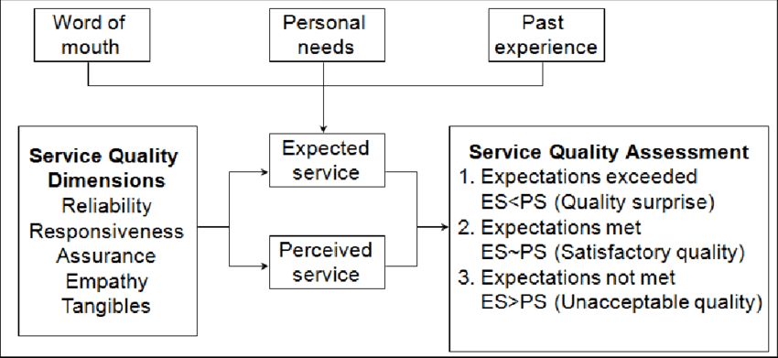
Influencing Expectations

Slide 26
Perceived Quality > Expected Quality
Delighted Customer
Perceived Quality = Expected Quality
Satisfied Customer
Perceived Quality < Expected Quality
Dissatisfied Customer

Slide 27
GAP ANALYSIS / SERVICE QUALITY GAP MODEL

Slide 28
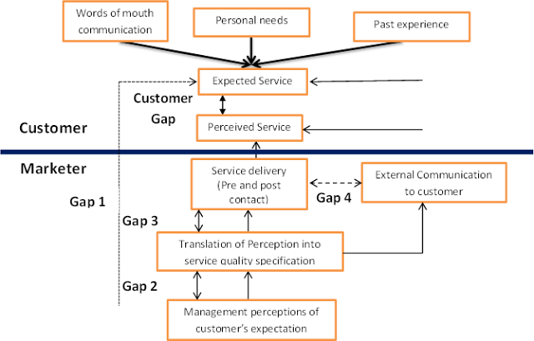

Slide 29
Customer needs & Expectations
Customer
1. The Knowledge Gap
Mgmt definition of Needs
2. The Standards Gap
Translation into design / delivery specifications
4. Internal Communication Gap
3. The Delivery Gap
Execution of design / design specifications
Advertising & Sales Promotion
5. The Perception Gap
6. Interpretation Gap
Custoner perception of product execution
Customer Interpretation of Communication
7. The Service Gap
Customer Experience Relative to Experience

Slide 30
GAP 1: The Knowledge Gap
Customers Expectations (Not knowing what customers expect)
Gap between Consumer Expectation and Company Perception:
This gap arises when the company/management does not correctly perceive what the customers want.

Slide 31
Provider GAP 1
Expected Service
CUSTOMER
GAP 1
Company
COMPANY
Perceptions of
Consumer Expectations

Slide 32
Key factors leading to this gap are:
i. Insufficient marketing research.
ii. Poorly interpreted information about the customer’s expectations.
iii. Lack of communication and understanding between the front lint personnel and the top level management.
Examples:
A wireless telephone service provider may think that their customers want lower tariffs for calls, but the customers may be more concerned with the range of network coverage of the provider.
In a hospital, the administrators may think patients want better food, but patients may be more concerned with the care given by nurses and support staff.

Slide 33
GAP 2: Standards Gap
Management Perception of Customers Expectation (Not selecting the right service design standard)
Gap between Management or Company Perception and Service Standards:
Here the management might correctly perceive what the customer wants, but may not set an appropriate performance standard.

Slide 34
Gap 2 may occur due the following reasons:
i. Lack of planning
ii. Lack of management commitment
iii. Unclear service design.
Examples:
In a Travel and tourism company the management may instruct their employees to respond to booking enquiries of customers fast and efficiently, but the management has not mentioned how fast and efficiently. They have not set standards to their process.
An IT company may ask their employees to solve customer complaints quickly, but it doesn’t mention how quickly (within 24 hours 2 day, 3 days etc.)
Here even though the management or service provider is aware of what the customers want, they aren’t able to satisfy the customers due their lack of planning and standards

Slide 35
GAP 3:
The Delivery Gap
The Gap and difference between specified delivery standards and service providers actual performance
This gap may arise owing to the service personnel. The reasons being poor training, incapability or unwillingness to meet the set service standard.

Slide 36
The possible major reasons for this gap are:
i. Deficiencies in human resource policies such as – ineffective recruitment, role ambiguity, role conflict, improper evaluation and compensation system
ii. Ineffective internal marketing
iii. Failure to match demand and supply
iv. Lack of proper customer education and training.
Examples:
In an upscale restaurant, if the waiter/server is not courteous and hospitable, the customer may become unhappy with the entire service experience even if the food served complies with his quality standards.
In a hair salon franchise like Lakme Salon, the management has set standards and have specifications regarding service quality. If a hair dresser is inexperienced and doesn’t do a good job of cutting their client’s hair, this results in customer dissatisfaction due to GAP3

Slide 37
GAP 4:
The Internal Communication Gap
Gap between Service Delivery and External Communication:
The difference between what company’s advertising and sales people think are product features and what company is actually able to deliver.
Consumer expectations are highly influenced by statements made by company representatives and advertisements. There are numerous factors which influence the customer. This gap arises when these assumed expectations are not fulfilled at the time of delivery of the service.

Slide 38
The discrepancy between actual service and the promised one may occur due to the following reasons:
i. Over-promising in external communication campaign
ii. Failure to manage customer expectations
iii. Failure to perform according to specifications.
Examples:
The hotel printed on the brochure may have clean and furnished rooms, but in reality it may be poorly maintained in this case the customer’s expectations are not met.
A insurance company may promise large returns to the policy holder but in reality, the fine print in the policy may be different than what was promised to the customer.
An individual may go to a shopping mall on his friend’s recommendation, thinking that the 50 % off sale is still on in his favourite store, only to find that the sale concluded the previous day.

Slide 39
GAP 5:
The Perception Gap
Gap between Expected Service and Perceived Service:
The difference between what is delivered and what customers perceive they have received.
This is the gap between what customers expect from the service and what they think they have received. This gap arises when the consumer misinterprets the service quality. This may happen due to customer’s own bias or prejudice. Customer expectation is what the customer expects according to available resources and is influenced by cultural background, family lifestyle, personality, demographics, advertising, experience with similar products and information available online.

Slide 40
Examples:
When a student signs up for an online course, he expects the course to increase his domain knowledge, however, after taking a few lectures online, he may think that he hasn’t received the perceived amount of knowledge.
A doctor may ask the patient to keep visiting him often in a short span of time to show and ensure care, but the patient may interpret this as an indication that something is really wrong with his health.

Slide 41
6. The Interpretation Gap
The difference between service providers communication efforts promise and what a customer thinks was promised by these communication

Slide 42
7. The Service Gap
The difference between what a customer expects to receive and their perception of the service that is delivered.
The final Gap - addition of all above gaps.

Slide 43
Gap 1, 5, 6 & 7 – External Gaps
Gap 2, 3 & 4 --- Internal Gaps

Slide 44
Strategies / Prescriptions for closing Service Gaps
Gap 1 – The Knowledge Gap
Learn what customers wants.
Research, do Complain Analysis, Panels
Direct interaction between managers and customers
Insist on Upward Communication
Turn Information into Action

Slide 45
Strategies / Prescriptions for closing Service Gaps
Gap 2 – The Standards Gap
Establish the Right service Quality Standard
Top Management should insist and commit quality
Communicate quality standards to all
Train, Standardise, clarify and measure performance

Slide 46
Strategies / Prescriptions for closing Service Gaps
Gap 3 – The Delivery Gap
Ensure that Service performance meets standards
Clarify employee roles, ensure the right candidate at right jobs
Look into job satisfaction
Train, motivate, empower, build teamwork amongst all employees
Eliminate role ambiguity and conflicts

Slide 47
Strategies / Prescriptions for closing Service Gaps
Gap 4 – The Internal Communication Gap
Ensure that Communication promises are realistic
Take inputs from operations dept while planning external communications
Make ads that feature real employees in their jobs
Insist sales staff involvement in operations – face to face meet

Slide 48
Strategies / Prescriptions for closing Service Gaps
Gap 5 – The Perception Gap
Keep Customers informed and involved during Service delivery
Brief customers during service delivery, offer tangible evidence to build trust

Slide 49
Strategies / Prescriptions for closing Service Gaps
Gap 6 – The Interpretation Gap
Advertisers select a sample and show all publicity and advertising materials to this selected sample and check their review before going public

Slide 50





Brief Summary Gaps in Service Quality
Gap | Problem | Cause(s)
1. Consumer expectation – mgmt. perception | The service features offered don’t meet customer needs | Lack of marketing research; inadequate upward communication; too many levels between contact personnel and management
2. Management perception – service quality specification | The service specifications defined do not meet management’s perceptions of customer expectations | Resource constraints; management indifference; poor service design
3. Service quality specification – service delivery | Specifications for service meet customer needs but service delivery is not consistent with those specifications | Employee performance is not standardized; customer perceptions are not uniform
4. Service delivery – external communication | The service does not meet customer expectations, which have been influenced by external communication | Marketing message is not consistent with actual service offering; promising more than can be delivered

Slide 51
Measuring & Improving Service Quality
Soft measures—not easily observed, must be collected by talking to customers, employees, or othersProvide direction, guidance, and feedback to employees on
ways to achieve customer satisfaction
Can be quantified by measuring customer perceptions and beliefs
  For example: SERVQUAL, surveys, and customer advisory panels
Hard measures—can be counted, timed, or measured through audits
Typically operational processes or outcomes
Standards often set with reference to percentage of occasions on which a particular measure is achieved
Control charts are useful for displaying performance over time against specific quality standards

Slide 52
Soft Measures includes…..
Key objectives of effective customer feedback system
Key customer-centric SQ measures (Use of mix of customer feedback collection tools) include:
  Total market surveys, annual surveys, transactional surveys
  Service feedback cards
  Mystery shopping
  Analysis of unsolicited feedback—complaints and compliments
  Focus group discussions, and service reviews

Slide 53
Hard Measures include
Hard measures refers to operational process or outcomes and include such data as time, service response times, failure rate and delivery cost of service.
In complex service multiple measures of service quality will be recorded at different points.
In low contact service, many operational measures apply to backstage activities.
Two measures:
Service quality index
Control charts

Slide 54
Benefits of Service Quality
Improve their image in eyes of customers
Improves profitability
Improve staff morale
Increase productivity
Reduce costs
Encourage employee participation
Brings continuous improvement
Minimise price sensitiveness
Increase customer satisfaction
Differentiate from customers

Slide 55
Strategies to manage Service Quality
Setting the Right Standards
Implementing Quality Service – total commitment from all levels of organisation
- Total Quality Management
Monitoring Service Quality
  - Statistical tools
  - Quality function deployment
  - Internal performance Analysis
  - Customer satisfaction analysis
Instill Team efforts

Slide 56
Total Quality Management Concept
Focuses on quality management in terms of costs, quality and delivery
Includes cost-management, business process re-engineering, new product development & customer service

Slide 57
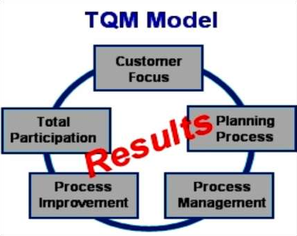
TQM – Total Quality Management
  A collection of principles, techniques, processes, and best practices that over time have been proven effective
  Continuous improvement
  based on the premise that the quality of products and processes is the responsibility of everyone - management, workforce, suppliers, and customers
Have processes that continuously collect, analyze, and act on customer information.
All of the TQM model's elements
work together to achieve results

Slide 58
TQM Techniques
Statistical process control
Process management
Employee participation
Management commitment & leadership
Empowerment & Team building

Slide 59
Pre-requisites for achieving Service Quality
Visionary Leader
Setting High Performance Standards
Management’s commitment & support
Preparing employees – train them to be owners
Frame a planned system for addressing Customer Complaints
Frame a Service Quality Monitoring System
Take Customer feedback

Slide 60
Cause-Effect Analysis – Strategy to improve Service Quality
Facilities, Equipment
Frontstage Personnel
Procedures
Aircraft late to gate
Mechanical Failures
Gate agents cannot process
fast enough
Delayed check-in
procedure
Acceptance of late passengers
Arrive late Oversized bags
Customers
Late/unavailable airline crew
Late pushback
Delayed Departures
Late food service
Late cabin cleaners
Other Causes
Poor announcement of departures
Weight and balance sheet late
Late baggage Late fuel
Weather Air traffic
Materials, Supplies
Backstage Personnel
Information

Slide 61
Service Productivity

Slide 62
Service Productivity
A firm need to ensure that it can deliver quality experience more efficiently to improve its long term profitability.

Slide 63
Defining productivity in service
Productivity measures amount of output produced relative to the amount of inputs.
Improvement in productivity means an improvement in the ratio of outputs to inputs.
Improvements in productivity require an increase in the ratio of output to inputs ;
Cutting resources required to create a given volume of output
Increasing the output obtained from a given level of inputs

Slide 64
Measuring Productivity is a Challenge……
Intangible nature of many service elements makes it hard to measure productivity of service firms, especially for information-based services
Difficult in most services because both input and output are hard to define
Relatively simpler in possession-processing services, as compared to information- and people-processing services
In people processing service, such as hospital - no. of patients treated in year, average bed occupy
Consideration of different variables – difference in patients, difference in outcomes.

Slide 65
Service Productivity, Efficiency & Effectiveness
Efficiency:
Rate at which inputs are converted into outputs.
Eg. Calls per sales representative / customers served per waiter
Emphasis is on quantitative measurement
Objective is to secure maximum output from minimum input

Slide 66
Service Productivity, Efficiency & Effectiveness
Effectiveness: Degree to which firm meets goals
Number of productive & profitable sales calls per representative.
Emphasises on Quality measurement
Objective is to meet customer needs & deliver quality

Slide 67
Strategies for improving Service Productivity
Increased use of technology
Reduce cost by substituting labour
Offers standardised services
Increased availability
Links and involves customer into service delivery system
Builds customer & People relationship
2. Training & Development of Employees
Select the Right employee for the job
Train / Orient
Motivate / Appraise
Employee Empowerment

Slide 68
Strategies for improving Service Productivity
3. Reduce the Service Levels
Reduce quality & quantity of service level
  Eg. A doctor can give less time to each patient.
4. Increase / Diversify Service Offering
Eg. A doctor can start pathology services too
5. Match Demand & Supply
Expand / Shrink Capacity
Expand Demand / Plan Demand

Slide 69
Strategies for improving Service Productivity
6. Learn from Lost Customers
7. Introduce Systems & Technology
Hard Technology Soft Technology
- Machine based -software based
ATM Vending e-bookings
8. Increase Customer Interactions

Slide 70
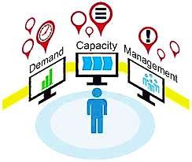

Managing Demand and Capacity

Slide 71
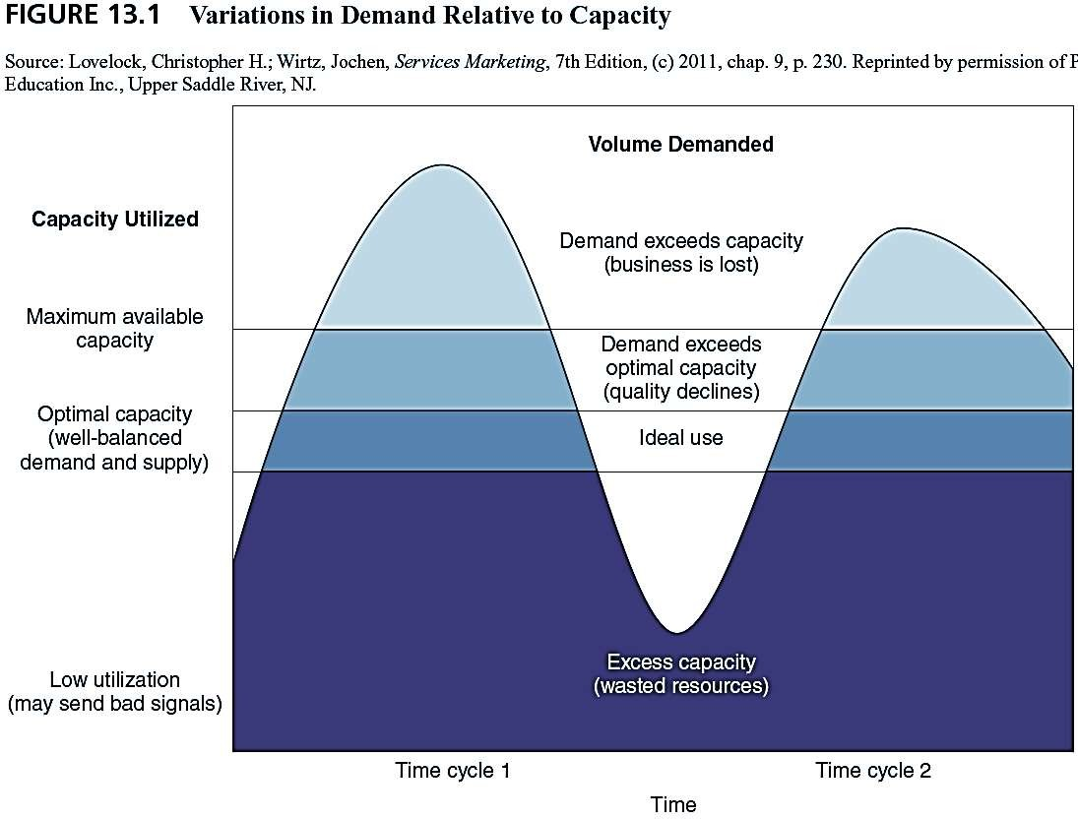
Lack of inventory Capability

Slide 72
Variations in Demand Relative to Capacity
Excess demand: the level of demand exceeds max capacity.
  Some customers will be turned away.
  For customers who do receive service, quality may be lacking because of crowding or overtaxing of staff and facilities
Demand exceeds optimum capacity.
  No one is turned away, but quality may still suffer.
Demand and supply are balanced at optimum capacity.
  Staff and facilities are occupied at ideal level.
  No one is overworked, facilities can be maintained, customers are receiving quality.
Excess capacity: demand is below optimum.
  Resources are underutilized resulting in lower profits.
  Some customers may receive high quality service, but if quality depends on the presence of other customers, customers may be disappointed.

Slide 73
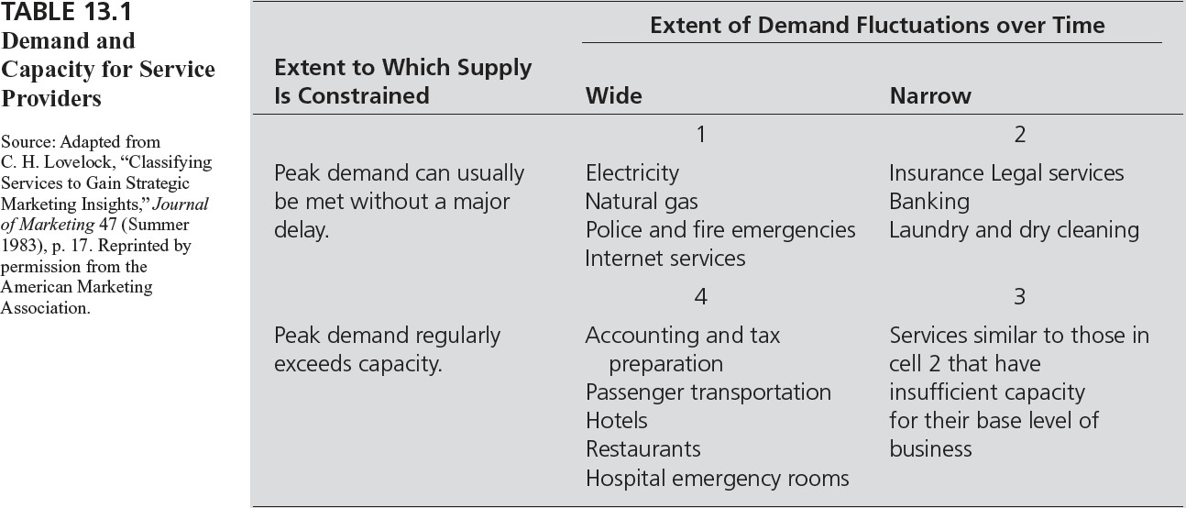
Demand and Capacity for Service Providers

Slide 74
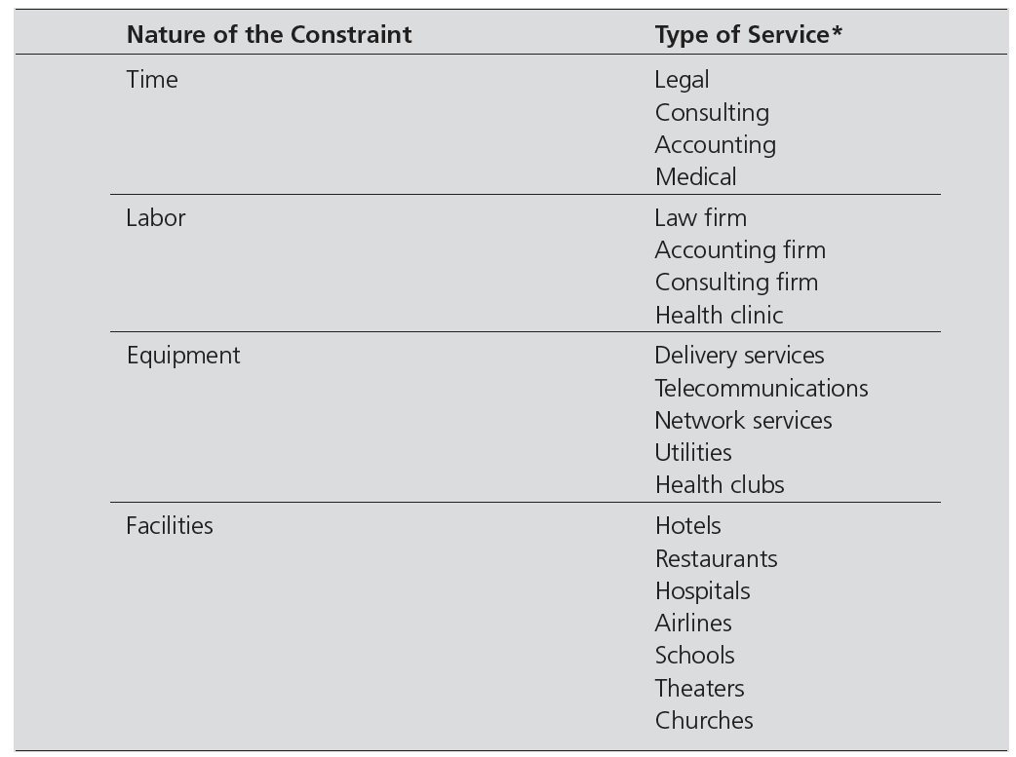
Constraints on Capacity

Slide 75
Optimal Vs. Maximum
Optimal
Maximum
Resources are fully employed but capacity not over used.
Customers are received quality service in a timely manner.
Best Quality
Resources are fully employed
Limited service available capacity
Highest possible

Slide 76
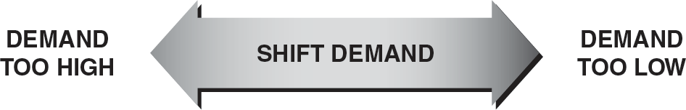
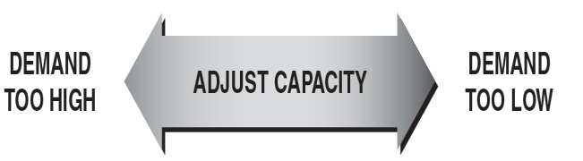
Strategies for Matching Demand and Capacity
Strategies for Shifting Demand to Match Capacity
Strategies for Adjusting Capacity to Match Demand

Slide 77
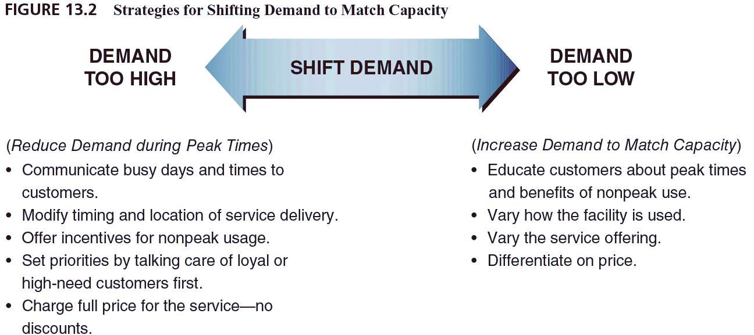
Strategies for Matching Demand and Capacity
Strategies for Shifting Demand to Match Capacity

Slide 78
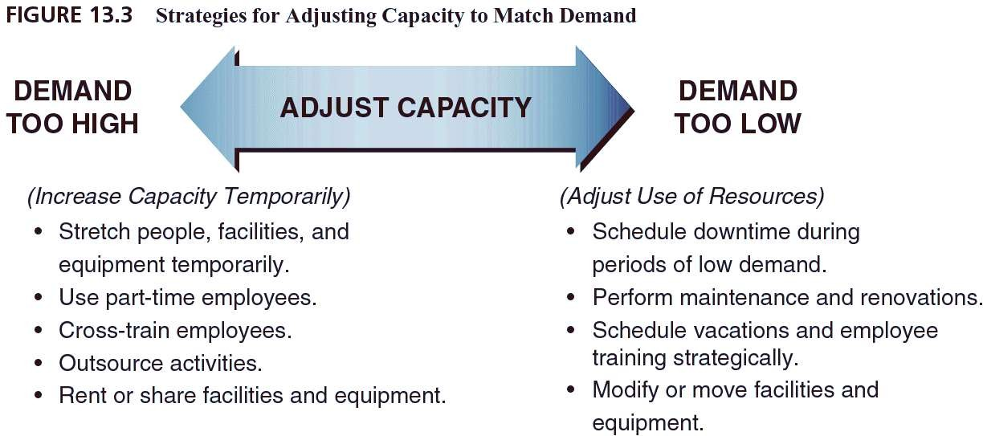
Strategies for Matching Demand and Capacity
Strategies for Adjusting Capacity to Match Demand

Slide 79
Strategies when Demand & Capacity do not match

Slide 80
Strategies when Demand & Capacity cannot be matched
Yield Management
Reservations & Appointments – Airlines, Railways, Healthcare……
Triage – (sorting) – Emergency arrangements are done to manage situation. Eg, emergency rooms are given on basis of critical situation & not in process of the order.
Waiting Lines

Slide 81
Definition
“The process of allocating the right type of capacity to the right kind of customer at the right price so as to maximize revenue or yield.”
Yield =
Actual revenue
Potential revenue
Actual revenue price
=
actual capacity x average actual
Potential revenue =
total capacity x maximum price

Slide 82
200-room Hotel
Max room rate = $100/night
Potential Revenue = 200 x $100 = $20,000
All rooms sold at discounted rate ($50/night)
Yield = (200 x $50) /$20,000 = $10,000/20000 x 100= 50%
Full rate charged, but only 80 rooms sold
Yield = (80 x $100)/$20,000 = $8,000/20000 x100 = 40%
Full rate charged for 80 rooms, discount for remaining 120 rooms
Yield = [(80 x $100) + (120 x $50)]/$20,000 = $14,000/20000 x100 = 70%

Slide 83
Challenges and Risks in Using Yield Management
Loss of competitive focus
Customer alienation
Overbooking
Incompatible incentive and reward systems
Inappropriate organization of the yield management function

Slide 84
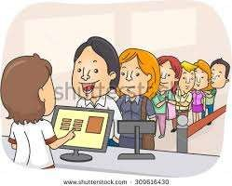
Waiting Line Configurations
Employ operational logic to reduce wait
How to configure the queue?
  Multiple Queue
  Single Queue
  Take a Number

Slide 85
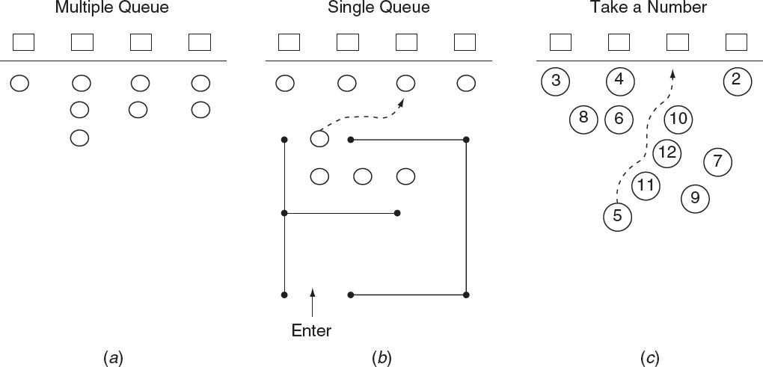
Waiting Line Configurations

Slide 86
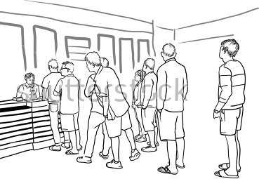
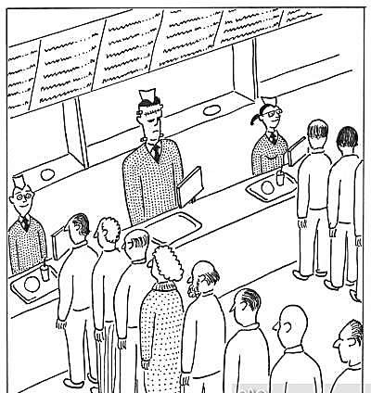
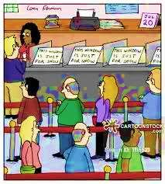

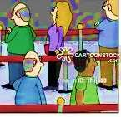
2
8
1
3

Slide 87
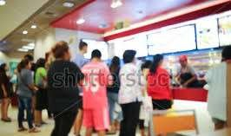
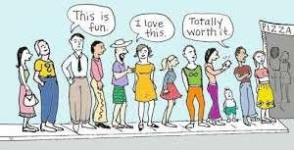
Waiting Line Strategies
Establish a reservation process
Differentiate waiting customers
Importance of the customer
Urgency of the job
Duration of the service transaction
Payment of a premium price
Make waiting more pleasurable

