Slide 1
Utility Theories

Slide 2
Utility-concept, Cardinal Utility Theory, law of Equi-Marghinal Utility, Consumer Surplus, Diamond-Water paradox (for understanding basis only), Ordinal Utility Theory-Indifference curve, Budget line, Consumer equilibrium

Slide 3
Concept of Utility: Generally speaking, utility refers to the degree of pleasure or satisfaction (or removed discomfort) that an individual receives from an economic act.
Concept of Cardinal Utility: Cardinal Utility is the idea that economic welfare can be directly observable and be given a value.
For example, people may be able to express the utility that consumption gives for certain goods.
For example, if a Nissan car gives 5,000 units of utility, a BMW car would give 8,000 units.

Slide 4
The Cardinal Utility Theory
Measures of Utility
Total Utility: Total utility of a fixed quantity of a commodity (TU) is the total satisfaction derived from consuming the given amount of some commodity x.
More of commodity x provides more satisfaction to the consumer.
TU depends on the quantity of the commodity consumed.
Therefore, TUn refers to total utility derived from consuming ‘n’ units of a commodity x.

Slide 5
Marginal Utility: Marginal utility (MU) is the change in total utility due to consumption of one additional unit of a commodity.
In general,
MUn = TUn – TUn-1
where subscript refers to the ‘n’th unit of the commodity.
Total utility and marginal utility can also be related in the following way:
TUn = MU1 + MU2 + … + MUn-1 + MUn
This simply means that TU derived from consuming n units of the commodity is the sum total of marginal utility of first unit (MU1 ), marginal utility of second unit(MU2 ), and so on, till the marginal utility of the ‘n’th unit.

Slide 6
Cardinal utility Analysis was mainly given by neoclassical economists like Jevons, Dupuit, Menger, Walras and Pigou etc. The exponents of this approach regard utility as cardinal concept.
In other words, they hold that utility is a measurable and quantifiable entity.
For example, According to cardinal utility approach, if a person is drinking a glass of water, it will be possible for him to assign some numerical value say 10 utils or 20 utils to the utility derived from it.
This approach is based on following assumptions:
The cardinal measurement of utility- Utility of any commodity can be measured in units called ‘utils’.
Utilities are additive i.e. total utility can be calculated by measuring utility derived from all the units of a commodity consumed.
3) Utility is independent i.e. not related to the amounts of other commodities purchased by the consumer. Further, it is also assumed that it is not affected by utilities of other individuals.
4) Marginal utility of money remains constant: When a person purchases more of a good, the amount of money diminishes and marginal utility of remaining money may increase. This assumption is important as cardinalists have used money as a measure of utility and it is necessary to keep the measuring rod of utility as fixed.

Slide 7
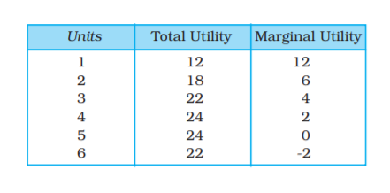
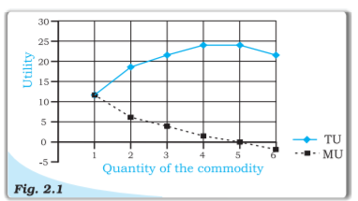
4. Law of Diminishing Marginal Utility:
Law of Diminishing Marginal Utility is one of the most fundamental law of utility analysis. It explains the relationship between utility and quantity of a commodity. This law states that after sufficient quantity of a commodity is consumed, the utility derived from each successive unit decreases, consumption of all other commodities remaining same.

Slide 8
Cardinal utility analysis can be used to derive demand curve for a commodity. An explanation for a downward sloping demand curve rests on the notion of diminishing marginal utility.
The law of diminishing marginal utility states that each successive unit of a commodity provides lower marginal utility.

Slide 9
CONSUMER EQUILIBRIUM THROUGH UTILITY ANALYSIS
Consumer Equilibrium is a situation wherein a consumer gets maximum satisfaction out of his limited income and has no tendency to change his existing expenditure pattern.
A consumer is considered to be extremely satisfied when he allocates his income in such a way that the last rupee spent on each commodity yields the same level of utility.
The concept of consumer equilibrium can be examined under one-commodity model and multicommodity model.

Slide 10
Consumer equilibrium through utility analysis is based on following set of assumptions:
Consumer is rational: This is one of the basic assumption of the law. Consumer is rational i.e. he measures, compares and chooses the best option in order to maximise his utility.
2) Cardinal measurement of utility: Utility can be measured in quantifiable terms.
3) Marginal utility of money is constant: It is assumed that utility is measured in terms of money and utility of money does not change.
4) Fixed income and prices: It is assumed that income of the consumer and prices of goods remain constant.
5) Constant tastes and preferences: It is assumed that taste and preferences of the consumer remain same.

Slide 11
Determination of Consumer Equilibrium:
Consumer equilibrium-One commodity case: Suppose a consumer with fixed income consumes a single commodity x.
He will continue his consumption till a point where marginal utility that he derived from consumption of a unit of commodity is greater than marginal utility of money spent on purchasing that unit.
If the marginal utility of commodity x (MUx) is greater than the marginal utility of money (MUm), then a consumer will exchange his money for a commodity.
Consumer will keep on consuming and spending his money so long as (MUx)>Px(MUm) where Px is the Price of commodity x and MUm is 1(constant), Thus a utility-maximising consumer will be in equilibrium where,
MUx=Px

Slide 12
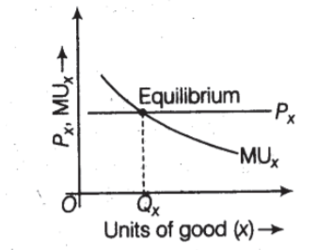
Suppose, the consumer wants to buy a good x costing Rs. 10 per unit. Marginal utility derived from each successive unit (in utils is determined and is given in Table 4.3 (It is assumed that 1 util = Re. 1, i.e. MUm = Re. 1).

Slide 13
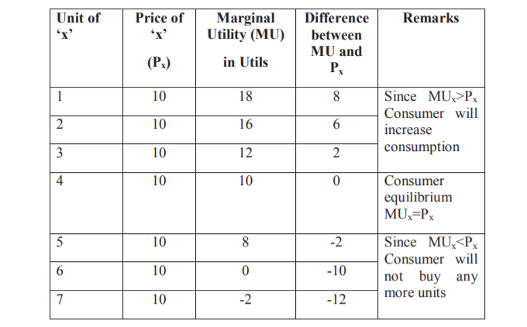

Slide 14
Consumer equilibrium in Multi-commodity case:
Consumer equilibrium in single commodity is unrealistic model in the sense that in real life, consumer consumes a large number of commodities.
This model deals with the equilibrium in case of many commodities. This model works under the assumption of limited income of the consumer and diminishing marginal utility of commodities.
Thus, utility-maximising consumer will first spend money on commodity which yields highest utility, then the second highest and so on.
Finally, a consumer will reach equilibrium when the last rupee he spent on different commodities will yield equal level of utility.
This case of multi-commodities is known as Law of Equi-Marginal Utility.
A consumer having choices of multiple goods distribute their limited income in such a way that the last rupee spent on each commodity yields equal marginal utility.
Suppose a customer consumes only two goods x (with price Px) and y (with price Py). Thus he will try to maximise his utility by equating his marginal utility and prices.

Slide 15
MUx=Px (MUm)
MUy=Py (MUm)
Given these conditions, a consumer will be in equilibrium when:
MUx/ Px (MUm) = MUy/ Py (MUm) Or
MUx/ Px = MUy/Py
(because MU of each unit of money is assumed to be constant at 1)

Slide 16
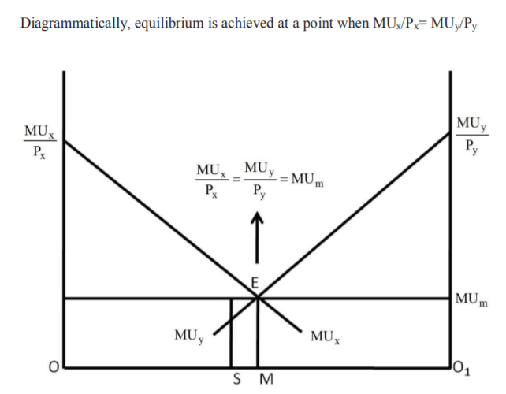

Slide 17
Diamond-Water Paradox
The Paradox of Value is also known as the diamond-water paradox
We understand that water is necessary to our life and that ornaments such as diamonds are not life-sustaining. But water typically has a low market price, while diamond jewellery has a high market price.
One reason is that, in most countries, water is abundant relative to demand whereas diamonds are scarce relative to demand.
The marginal utility of water is low because the supply is abundant, and therefore so is the value.
Value in use i.e. drinking water to satisfy your thirst
Value in exchange – what a resource can be sold for in exchange for other products. Nothing is more useful than water: but it will purchase scarce any thing. The reverse is usually true for expensive jewellery
Changes in perceived utility from consuming different goods and services will have a direct effect on demand.

Slide 18
Ordinal Utility Analysis
Cardinal utility analysis is simple to understand, but suffers from a major drawback in the form of quantification of utility in numbers.
In real life, we never express utility in the form of numbers.
At the most, we can rank various alternative combinations in terms of having more or less utility.
In other words, the consumer does not measure utility in numbers, though she often ranks various consumption bundles.
This forms the starting point of Ordinal Utility Analysis.

Slide 19
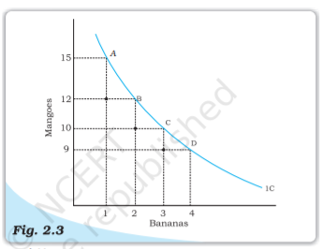
A consumer’s preferences over the set of available bundles can often be represented diagrammatically.
The points representing bundles which give the consumer equal utility can generally be joined to obtain a curve like the one in the diagram.

Slide 20
The consumer is said to be indifferent on the different bundles because each point of the bundles give the consumer equal utility.
Such a curve joining all points representing bundles among which the consumer is indifferent is called an indifference curve.
All the points such as A, B, C and D lying on an indifference curve provide the consumer with the same level of satisfaction.
It is clear that when a consumer gets one more banana, he has to forego some mangoes, so that her total utility level remains the same and she remains on the same indifference curve.
Therefore, indifference curve slopes downward.
The amount of mangoes that the consumer has to forego, in order to get an additional banana, her total utility level being the same, is called marginal rate of substitution (MRS).
In other words, MRS is simply the rate at which the consumer will substitute bananas for mangoes, so that her total utility remains constant. So,
MRS = ∆Y/ ∆X

Slide 21
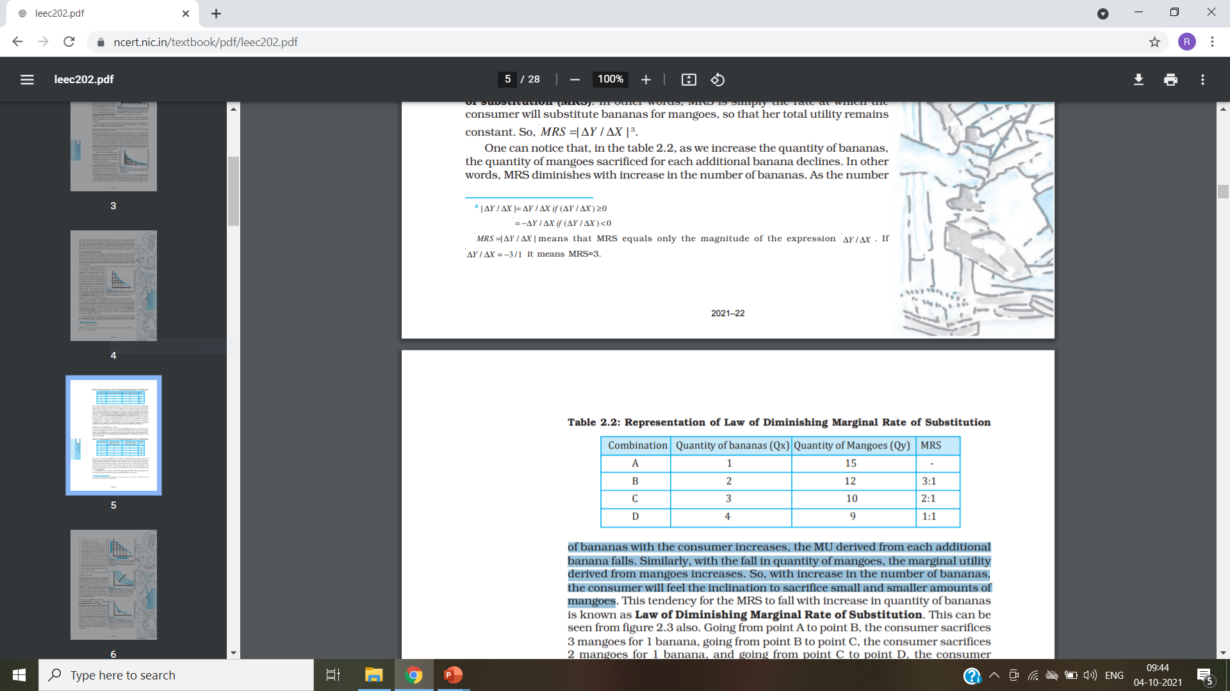

Slide 22
As the number of bananas with the consumer increases, the MU derived from each additional banana falls. Similarly, with the fall in quantity of mangoes, the marginal utility derived from mangoes increases. So, with increase in the number of bananas, the consumer will feel the inclination to sacrifice small and smaller amounts of mangoes.
This tendency for the MRS to fall with increase in quantity of bananas is known as Law of Diminishing Marginal Rate of Substitution.
This can be seen from the diagram. Going from point A to point B, the consumer sacrifices 3 mangoes for 1 banana, going from point B to point C, the consumer sacrifices 2 mangoes for 1 banana, and going from point C to point D, the consumer sacrifices just 1 mango for 1 banana.
Thus, it is clear that the consumer sacrifices smaller and smaller quantities of mangoes for each additional banana.

Slide 23
Community Indifference Curve
Just as an indifference curve pertaining to an individual consumer depicts different combinations of the two commodities which provide equal satisfaction and are, therefore, equally preferred, similarly a community indifference curve or social indifference curve represents such combinations of two commodities which give equal satisfaction to the community and it is indifferent about those combinations.

Slide 24
The community indifference curves are derived by the aggregation of the indifference curves of all the individuals in the society.
Since all combinations on a social indifference curve yield the same level of satisfaction, the increase in the quantity of one commodity must correspond with some decrease in the quantity of other commodity.

Slide 25
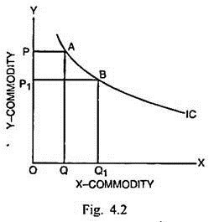
Consequently the community or social indifference curve slopes downwards from left to right as shown below.
In the diagram, IC is the community indifference curve. The two combinations A and B of commodities X and Y are supposed to give equal satisfaction to the community. Combination A includes OQ of X + OP of Y and combination B includes OQ₁ of X + OP₁ of Y. In combination B, as society increases the consumption of X by QQ₁, it reduces at the same time, the consumption of Y by PP₁ so that compensating variation in satisfaction takes place and both the combinations A and B are equally preferred.

Slide 26
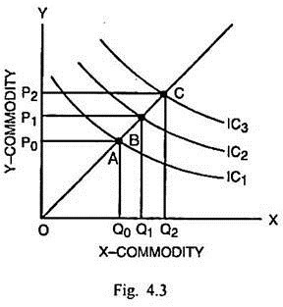
If a series of community indifference curves is shown such that higher the indifference curve, higher is the level of satisfaction from combinations lying upon it and vice-versa, that series of social indifference curves represents the community indifference map, which is shown below.

Slide 27
The slope of the indifference curve is measured by the marginal rate of substitution of X for Y (MRS_{xy}), MRS_{xy} is the quantity of Y which the society gives up in order to have some quantity of X commodity. It is measured by the ratio of a change in quantity of Y commodity to a change in the quantity of X commodity.
MRS_{xy} = – (δy/δx)
As the community increases the consumption of an additional unit of X, it may be willing to give up less and less quantities of Y. Consequently, the MRS_{xy} goes on diminishing and the community indifference curve follows the path of a negatively sloping convex curve to the origin.
Alike the indifference curve of an individual, the community indifference curve has the same set of properties

Slide 28
Consumer’s Budget
The consumption bundles that are available to the consumer depend on the prices of the two goods and the income of the consumer. Given her fixed income and the prices of the two goods, the consumer can afford to buy only those bundles which cost her less than or equal to her income.

Slide 29
Suppose the income of the consumer is M and the prices of bananas (X) and mangoes(Y) are Px and Py respectively.
If the consumer wants to buy Qx quantities of bananas, she will have to spend Px*Qx amount of money.
Similarly, if the consumer wants to buy Qy quantities of mangoes, she will have to spend Py*Qy amount of money.
Therefore, if the consumer wants to buy the bundle consisting of Qx quantities of bananas and Qy quantities of mangoes, she will have to spend Px*Qx + Py*Qy amount of money.
She can buy this bundle only if she has at least Px*Qx + Py*Qy amount of money.
Given the prices of the goods and the income of a consumer, she can choose any bundle as long as it costs less than or equal to the income she has. In other words, the consumer can buy any bundle (Qx, Qy ) such that
M ≥ (Px * Qx) + (Py * Qy)
This is called the consumer’s budget constraint.
The set of bundles available to the consumer is called the budget set.
The budget set is thus the collection of all bundles that the consumer can buy with her income at the prevailing market prices.

Slide 30
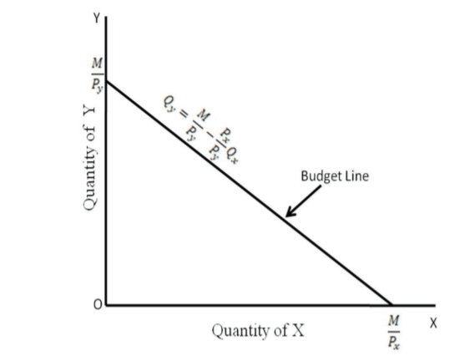
The budget set can be represented with a budget line.
All bundles in the positive quadrant which are on or below the line are included in the budget set.
The equation of the line is -
(Px * Qx) + (Py * Qy) = M
We can rewrite the budget line as:
Py*Qy = M – (Px*Qx)
Dividing both sides by Py yields: Qy = M/Py – (Px/Py)Qx

Slide 31
The line consists of all bundles which cost exactly equal to M. This line is called the budget line. Points below the budget line represent bundles which cost strictly less than M.
Slope of budget line:
As we know that the slope of a curve is calculated as a change in variable on the Y-axis divided by change in variable on the X-axis, slope of the budget line in given example will be number of units of x2, that the consumer is willing to sacrifice for an additional unit of x1.
Slope of Budget Line =
Units of Y willing to Sacrifice/ Units of X willing to Gain
= ∆Y/∆X
This slope of budget line is equal to ‘Price Ratio’ of two goods.
Price Ratio =
Price of X (Px)/Price of Y (Py)
= –Px /Py

Slide 32
Consumer equilibrium is a point of maximum satisfaction for the consumer.
Study of Consumer equilibrium requires some assumptions to be made about the consumer behaviour. These are:
i) Rationality: The consumer is rational. He wants to obtain maximum satisfaction given his income and prices.
ii) Consumer has an indifference map, showing his scale of preference for various combinations of good x and y.
iii) Utility is ordinal: It is assumed that the consumer can rank his preference according to the satisfaction of each combination of goods.
iv) Consistency of choice: It is also assumed that the consumer is consistent in the choice of combination of goods.
v) Consumer has a given and fixed amount of money income to spend on the goods. Thus, consumer has to choose to spend his income on either of the two goods or a combination thereof.
vi) All the units of the goods are homogeneous.
vii) The goods are divisible i.e. they can be divided into small units
viii) Total utility: The total utility of the consumer depends on the quantities of the good consumed.

Slide 33
Conditions of Consumer’s Equilibrium
There are two fundamental conditions of consumer’s equilibrium through Indifference curve approach:
The price line should be tangent to the Indifference curve. It means that at the point of equilibrium the slope of the indifference curve and of the price line should be same.
The slope of Indifference curve indicates MRSxy i.e. –ΔY/ΔX. The slope of the price line indicates the ratio between price of two goods X and Y i.e. Px/Py.
2) Indifference curve should be convex to the point of origin: Marginal rate of substitution of X for Y (MRSxy i.e. Δy/Δx) is equal to the slope of the price line that indicates the ratio between prices of two goods.

Slide 34
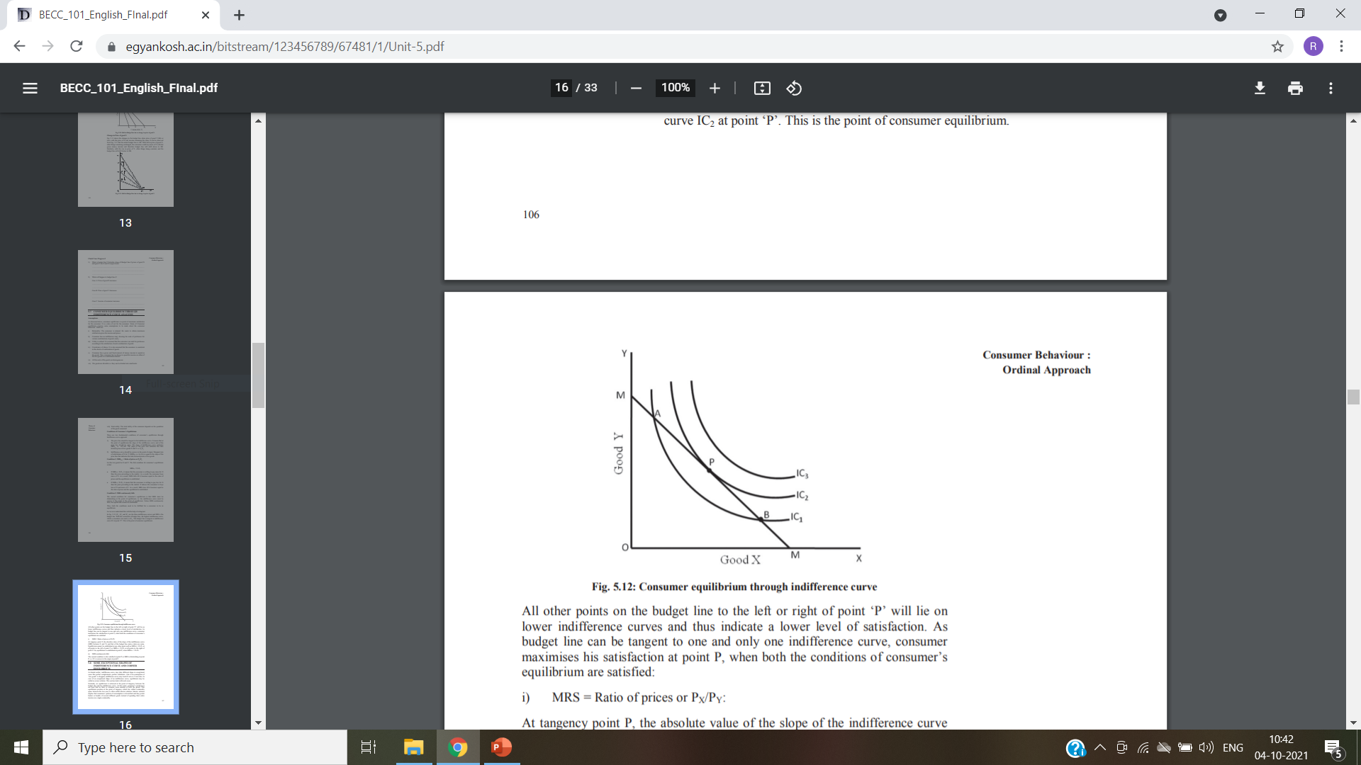
In the diagram, IC1, IC2 and IC3 are the three indifference curves and MM is the budget line. With the constraint of budget line, the highest indifference curve, which a consumer can reach, is IC2.
The budget line is tangent to indifference curve IC2 at point ‘P’. This is the point of consumer equilibrium.

Slide 35
All other points on the budget line to the left or right of point ‘P’ will lie on lower indifference curves and thus indicate a lower level of satisfaction.
As budget line can be tangent to one and only one indifference curve, consumer maximises his satisfaction at point P, when both the conditions of consumer’s equilibrium are satisfied:
MRS = Ratio of prices or PX/PY: At tangency point P, the absolute value of the slope of the indifference curve (MRS between X and Y) and that of the budget line (price ratio) are same. Equilibrium cannot be established at any other point such as MRSxy> PX/PY at all points to the left of point P or MRSxy< PX/PY at all points to the right of point P. So, equilibrium is established at point P, when MRSxy = -PX/PY.
ii) MRS continuously falls: The second condition is also satisfied at point P as MRS is diminishing at point P, i.e. IC2 is convex to the origin at point P.

Slide 36
Revealed Preference Theory
Revealed preference theory, introduced by the American economist Paul Samuelson in 1938, holds that consumers’ preferences can be revealed by what they purchase under different circumstances, particularly under different income and price circumstances.
The theory entails that if a consumer purchases a specific bundle of goods, then that bundle is ‘revealed preferred’ to any other bundle that the consumer could afford, given constant income and prices.

Slide 37
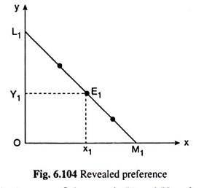
If a consumer buys some collection of goods, A, rather than any of the alternative collections B, C and D and if it turns out that none of the latter collections is more expensive than A, then we say that A has been revealed preferred to the combinations B, C and D or that B, C and D have been revealed inferior to A.

Slide 38
Therefore, if the consumer buys the combination E₁ (x₁, y₁)of the goods X and Y and does not buy the combination E₂(x₂, y₂) at the prices (p¹_{x}, p¹_{y},) of the goods, then we would be able to say that he prefers combination E₁ to combination E₂, if we obtain
We have to note here the difference between “preference” and “revealed preference”. Com­bination A is “preferred” to B implies that the consumer ranks A ahead of B.
But A is “revealed preferred to B” means A is chosen when B is affordable (no-more-expensive).

Slide 39
More formally, suppose the consumer is buying the combination (x₁, y₁) at the price set (p’_{x}, P’_{y}). Let us also suppose that another combination is (x₂, y₂), such that p’x₁ + p’_{y}y₁ ≥ p’_{x}x₂ + p’_{y}y₂. Now, if the consumer buys the most preferred combination subject to his budget constraint, then we will say the combination (x₁, y₁) is strictly preferred to combination (x₂, y₂).

Slide 40
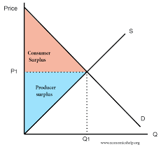
Consumer Surplus
It is the difference between the actual price that the customers pay for a product & the maximum price that they are ready to pay (for a single unit).
Consumer Surplus Formula = Maximum Price Willing To Pay – Actual Price

Slide 41
Let us assume that a customer decides to buy a smartphone and is willing to pay up to Rs. 10000 for that. Now, while browsing through various electronics stores, the customer discovers a store that offers the phone at Rs. 9000.
Given,
Maximum price willing to pay = Rs. 10,000
Actual price = Rs. 9000
Consequently, using the first formula we get,
Consumer Surplus = Rs. 10,000 – Rs. 9000
= Rs. 1000

