Slide 1
Module 2. Marketing Decisions
Part. I
TOPICS
MARKETING MIX - CONCEPT AND ELEMENTS
PRODUCT - PRODUCT DECISIONS ARES
PRODUCT LIFE CYCLE- CONCEPT, MANAGING STAGES OF PLC
Prepared By HARSHADA MHATRE

Slide 2
Meaning : Marketing mix refers to the marketing variables which are combined to sell products to the target market(customer).
In 1960, E.JEROME MC CARTHY in his book “Basic Marketing” popularized a four factor classification , the so called - “4Ps” : Product , Price , Place ( Distribution) and Promotion.
Definition: Marketing-mix
“The basis of marketing operations is the Co-ordination of four key variables, namely: product, price, place, promotion.” - E.Jerome McCarthy.
“Marketing mix is the set of marketing tools that the firm uses to pursue its marketing objectives in the target market. - Philip Kotler
MARKETING MIX
PRODUCT
PRICE
PLACE
PROMOTION

Slide 3


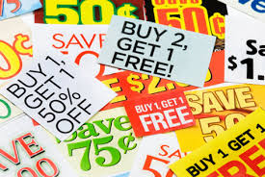
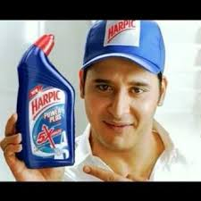
ELEMENTS OF MARKETING MIX
1. PRODUCT – Product can be defined as anything that is offered to the market for consumption that can satisfy a need or want. A product can be IDEA,GOODS OR SERVICE that can be generate customer satisfaction.
2. PRICE- Price is Exchange Value of Product. It is the Monetary value at which seller sells and buyer buys. The Price must be Right.
If Price is too high then customers will prefer competitors product.
If Price is too Low then customers will think product is of low quality.
3. PROMOTION- It involves all the activities which Company undertake to promote and inform about the new product in the market to the customers. Promotion mix consist of Advertising, Public relation , Sales Promotion, Personal selling.
PRODUCT – Any IDEA,GOODS OR SERVICE generating customer satisfaction.
PRICE- The monetary value at which seller sells and buyer buys. (Right price, higher price will discourage buying and less price will force to doubt on the quality. Factors of price- discount, payment period , etc.)
    v/s all prefer coconut

Slide 4
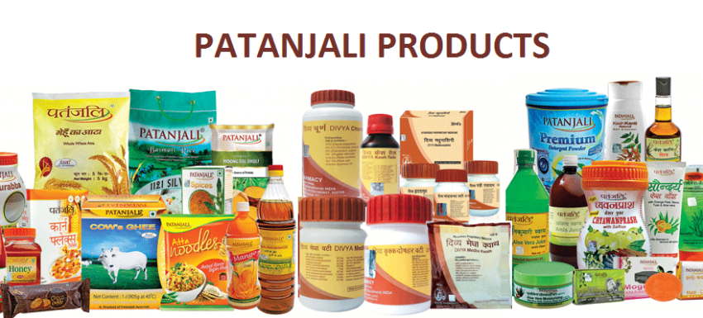
4.PLACE- All the activities that company performs to make a Product available to the target audience is place.
Place mix involves Distribution channels, dealer relations ,areacoverage,transport channels, locations, etc.
5. PACE- It is the Speed at which the marketing decisions and actions are taken by Marketing Manager due to tough competition to gain competitive advantage.
Example : Patanjali launched new line of products at the right time and right price and place to increase sales and remain in market.

Slide 5
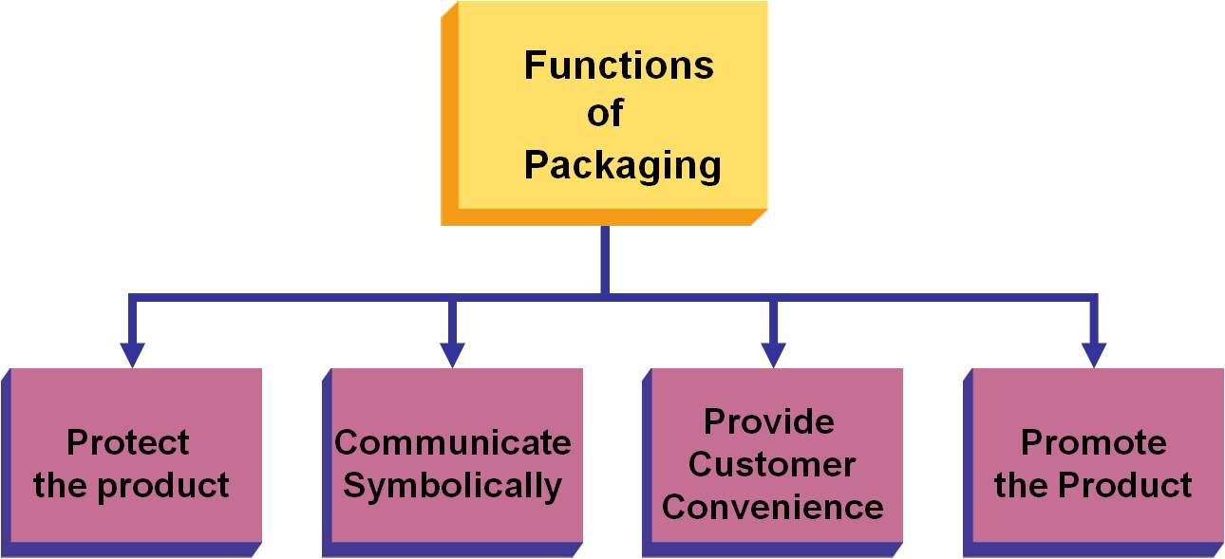
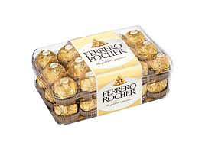
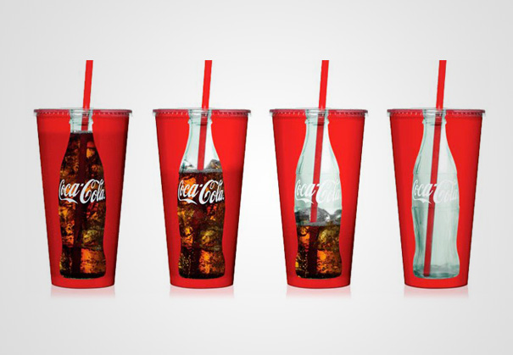
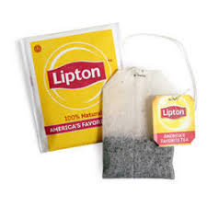
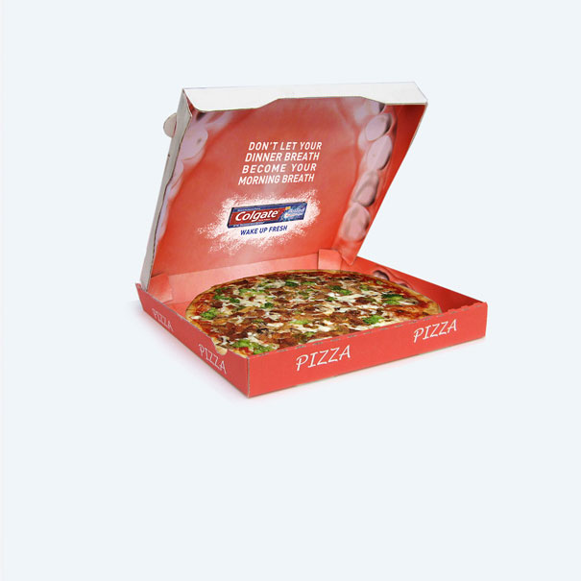
6. PACKAGING- Packaging Consist of all the materials that used to protect goods before they sold.
Creative coca cola
Colgate
high price for high packaging quality
Creative Design
Tea bags for instant use

Slide 6
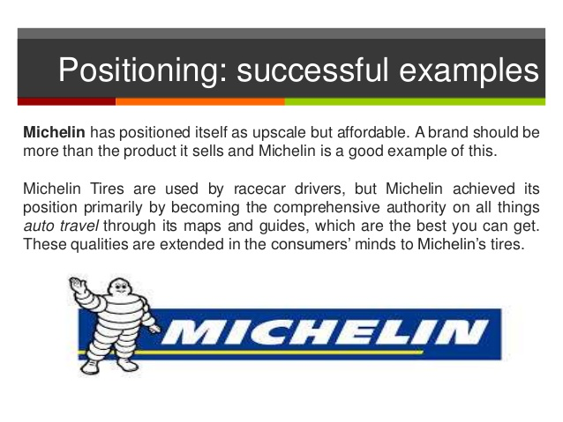
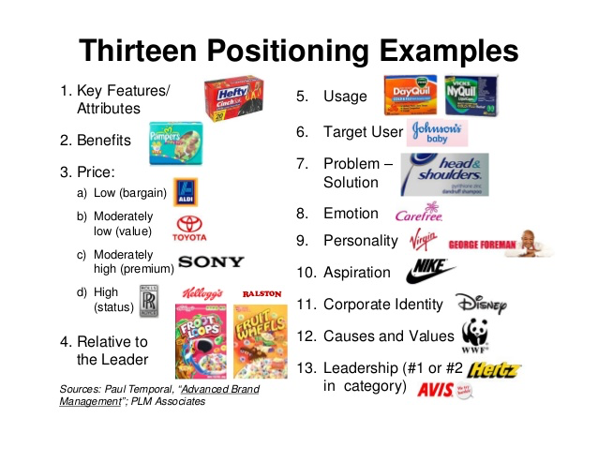
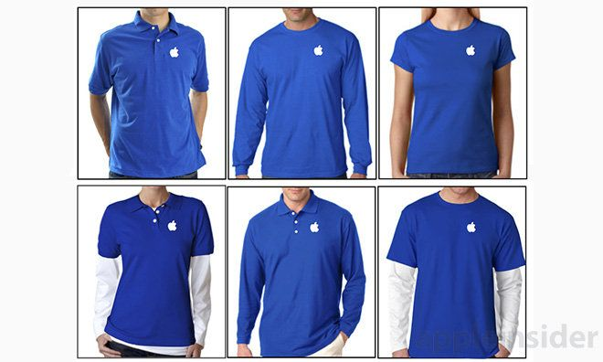
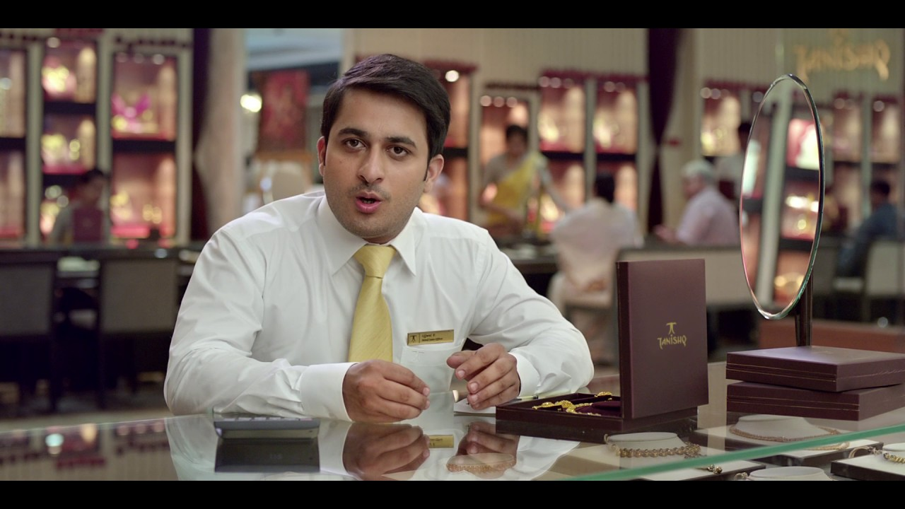
.
7. POSITIONING- Product positioning aims at Creating distinct image of the brand in the minds of target market. Effective positioning helps firm to achieve higher sales and profit.Positioning techniques include- specific product features and use of product.
8. PEOPLE- Quality of Service is judged by customers on the basis of Executives who are providing it. Therefore, company spends on recruiting, selecting, placement, promotion.
Tanishq Employee
Apple employee

Slide 7
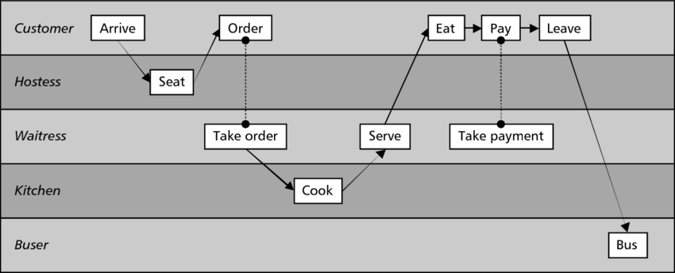
9. PROCESS- It indicates How a service product is delivered to the customer’s. It involves the methods, sequence of action with which the firm delivers the service.
Example: Service Process in Restaurant

Slide 8
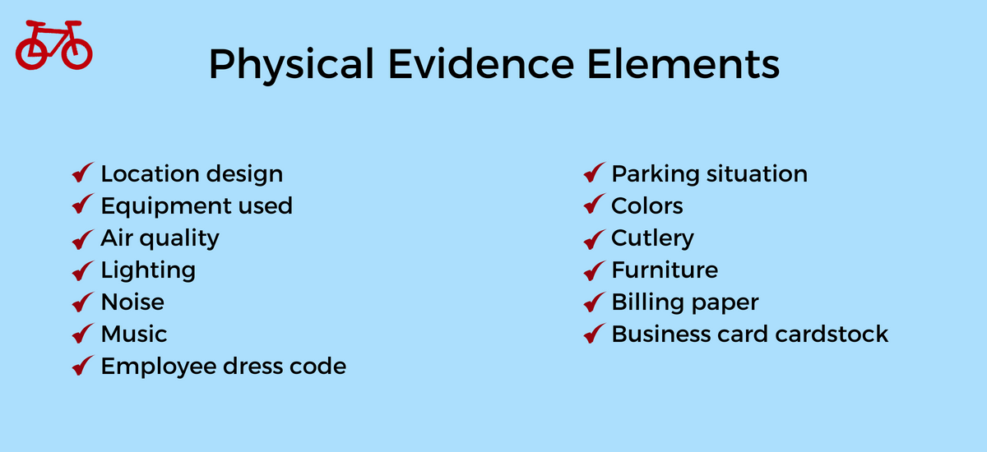
10. Physical Evidence – It plays an important role in creating a good impressions on the customers.

Slide 9

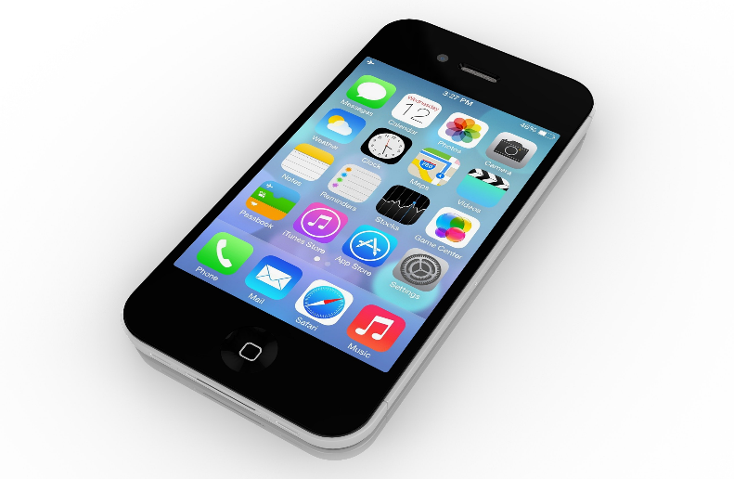
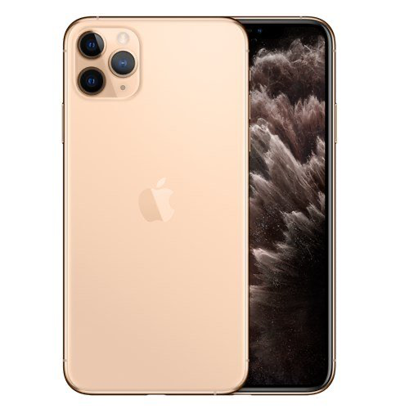
Product decision Areas
1.PRODUCT DESIGN-Product design is the process of creating improved products with proactive design. It focus on creating new and improved products.
For effective design, manager conducts;
Marketing research- to identify customer’s preferences.
Research and development- to modify existing product’s with innovative design.

Slide 10

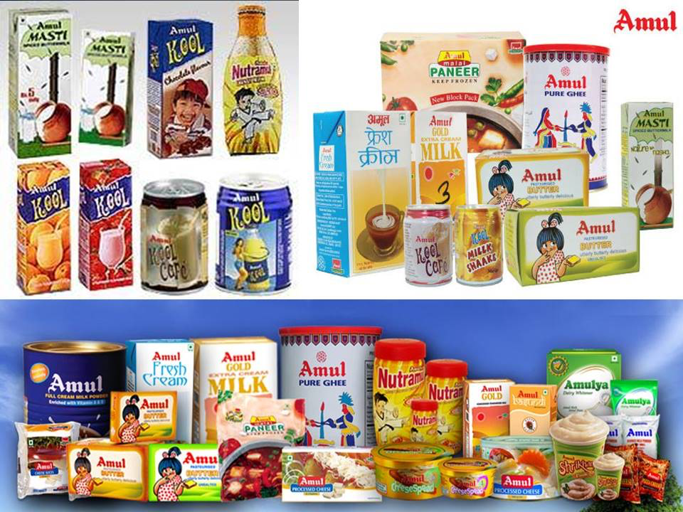
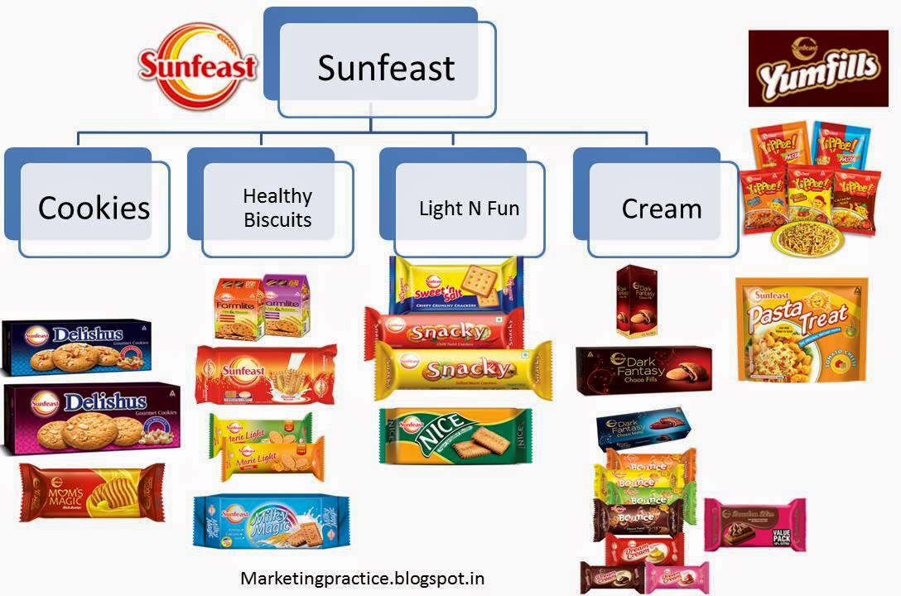
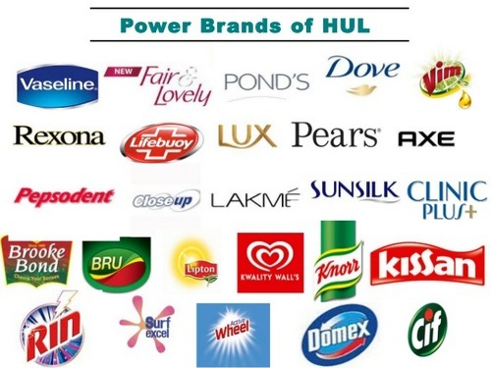
2. PRODUCT MIX/ PRODUCT LINE DECISIONS : the marketer should decide whether to concentrate on one product or deal with a product mix/ product line. Product mix involves a set of product, which a marketer may offer to the market.

Slide 11
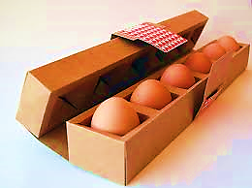
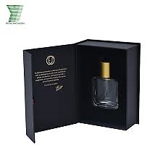
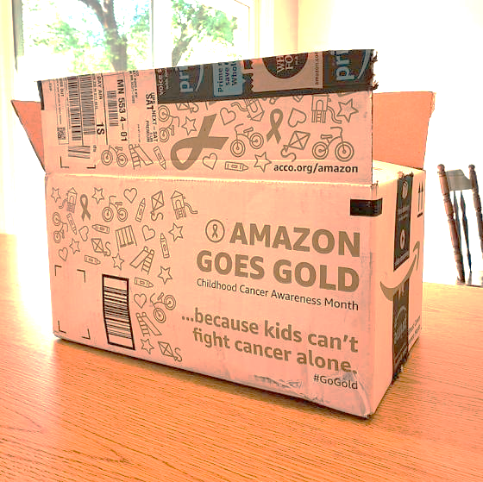
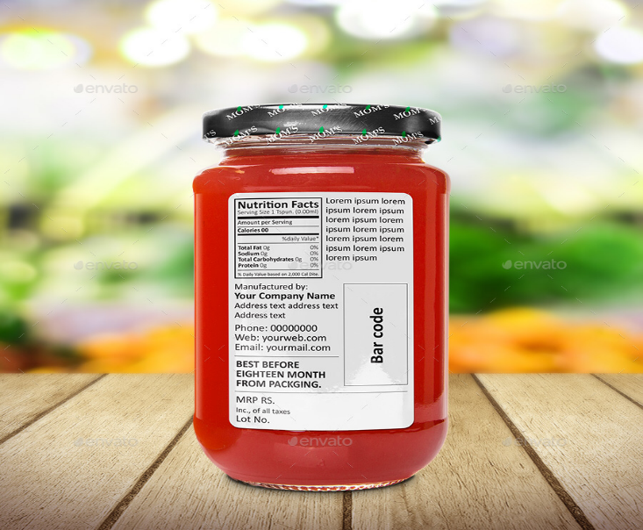
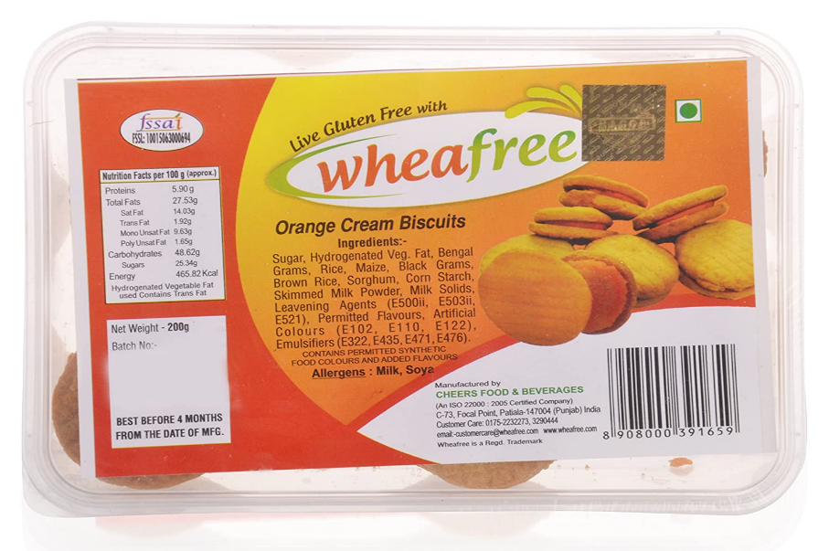
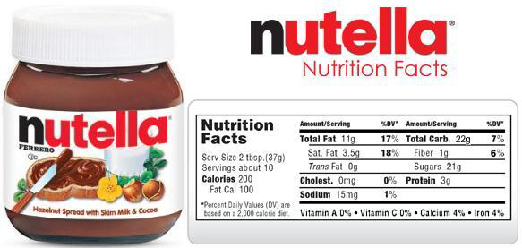
3.PRODUCT PACKAGING- Marketer should design proper packaging to protect, preserve and promote the product.
4. PRODUCT LABELLING- Labelling indicates the contents and instructions (how to use the product) on the product. Labelling can promote the product

Slide 12
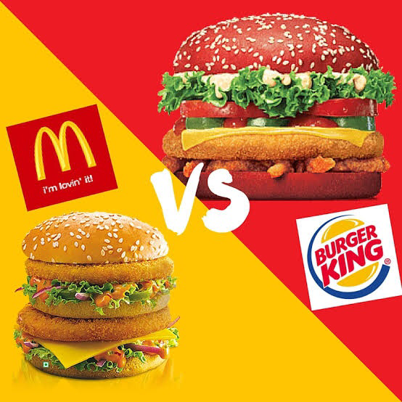
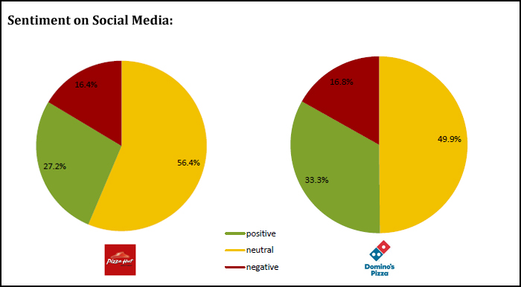
5. PRODUCT PRICING- The marketer should decide pricing on the basis of income of customers, demand for product, competition in marketing, etc.
Example: A. Burger King charges low price as compare to McDonald’s to attract customers.
B. people are ready to pay high price for Domino’s pizza as compare to Pizza Hut due to good taste and High demand.

Slide 13
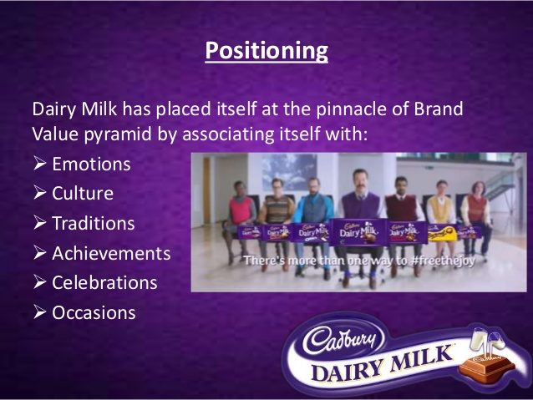

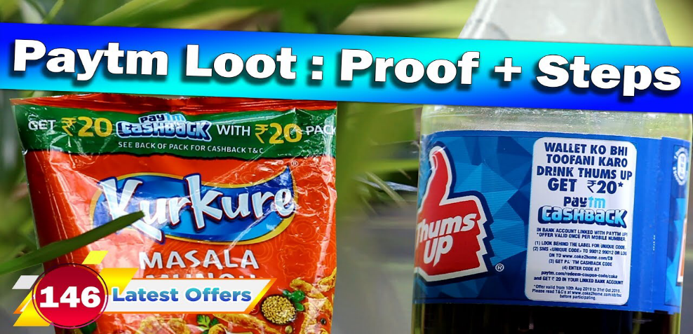

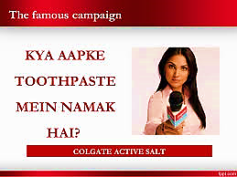
6.PRODUCT POSITIONING- It is a process of Creating distinct image of the product in the mind of customers. Example: Dove soap approached a housewife to give personal appeal to its customers specially housewives.
7.PROMOTION- It includes all Promotional activities to induce and attract the Customers to buy the product.Example: Ad pop ups on sites, banners, hoardings, extra coupons, etc.

Slide 14

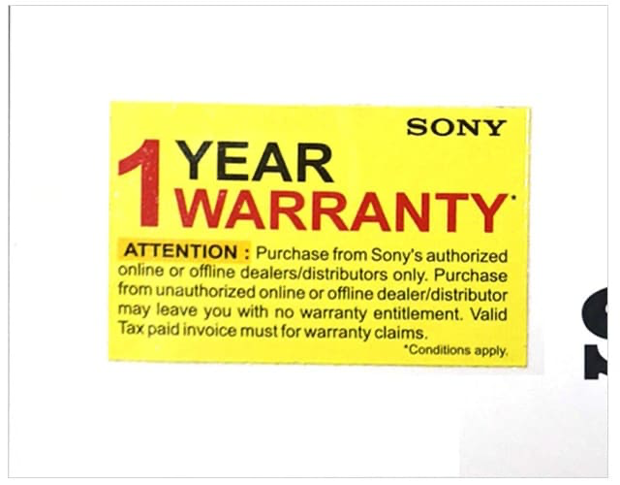


8. PRODUCT WARRANTY- A warranty is a Guarantee or Assurance by manufacturer that product will perform as stipulated. Warranty can be given for entire product or certain parts of the products.
9. AFTER SALE SERVICE- Services to customer after sale of product.
Example : after sale service provided by water filter company

Slide 15

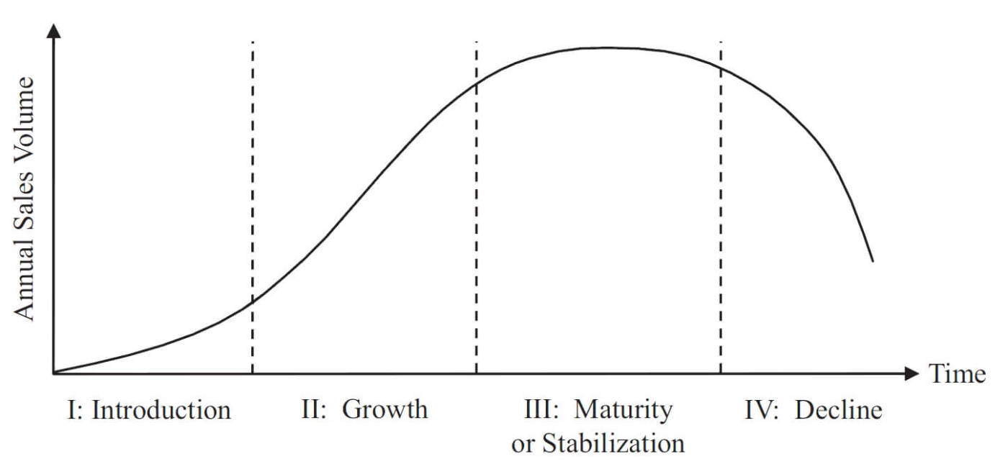
Product life Cycle
Product life cycle is the progression of an Product through the four stages of its time on the market. The four life cycle stages are: Introduction, Growth, Maturity and Decline. Every product has a life cycle and time spent at each stage differs from product to product.

Slide 16
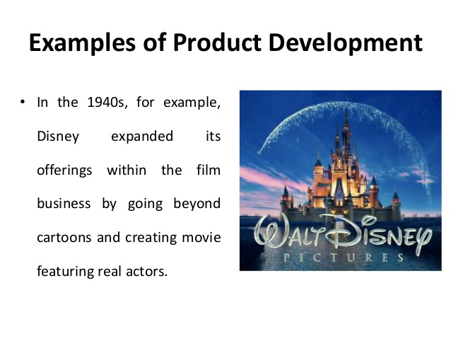
1. Product Development stage
The Product development stage is the first part of the Product Life Cycle. This stage is not only about building the product, it includes carrying out research and testing of the product idea and development of New Product.
Objective: To research and develop a new Product.
Main features of Development stage are:
Developmet of New product ideas.
Research and Development.
Product Tests and Trials
Publicity to create awareness.

Slide 17
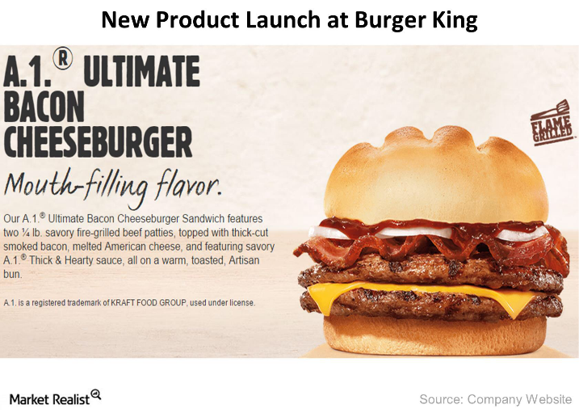
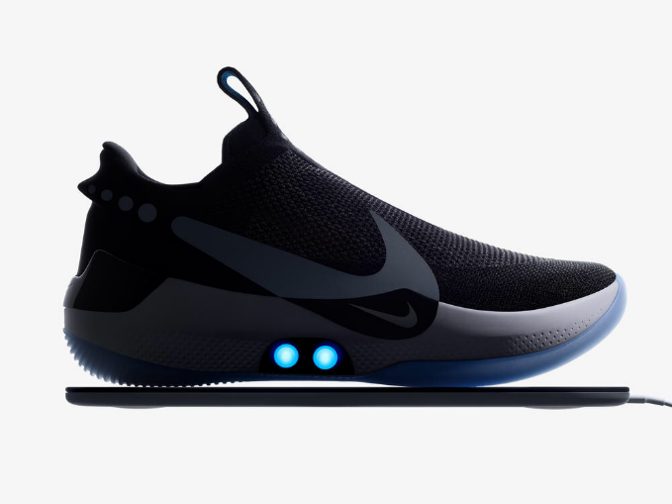
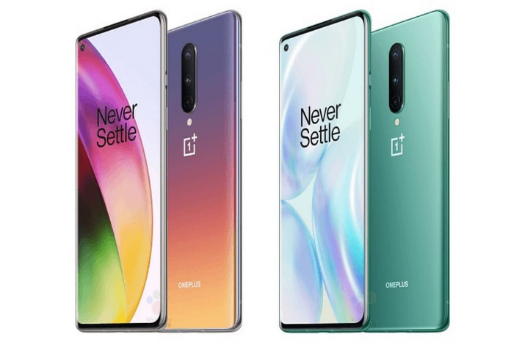

2. Introduction Stage
The introduction stage is the first stage in the product life cycle where a company launched a new Product for first time in the market tries to build awareness about the product or service in a market where there is less or no competition.
Objective: To Create Product awareness.
Main features of Introduction stage are:
Low or Moderate sales.
Limited Product range.
Low Profit.
Highe Promotional Expenditure.
Limited Market Coverage.

Slide 18
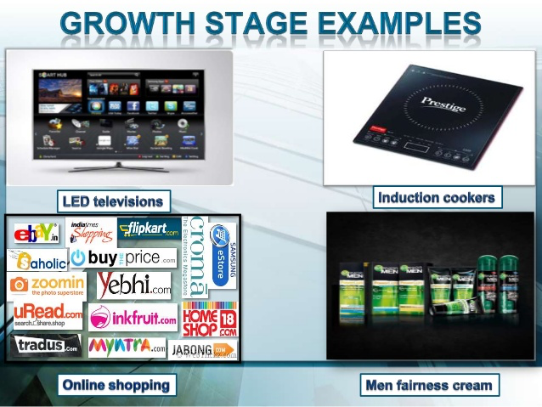
3. Growth Stage
The growth stage is the period during which the product eventually and increasingly gains acceptance among consumers, the industry, and the wider general public. During this stage, the product or the innovation becomes accepted in the market, and as a result sales and revenues start to increase.
Objective: To increase the market share and Profits.
Main features of Growth stage are:
Increase in Market Share.
Rise in Profits
Increase Product Range
Aggressive Promotion and Marketing.

Slide 19
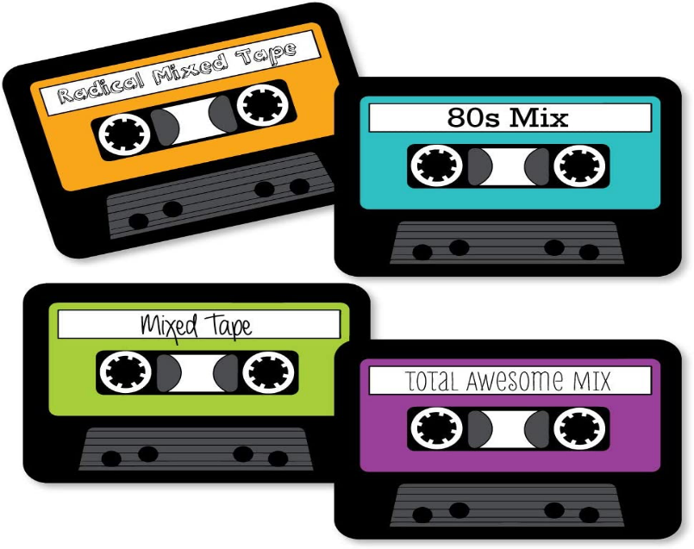
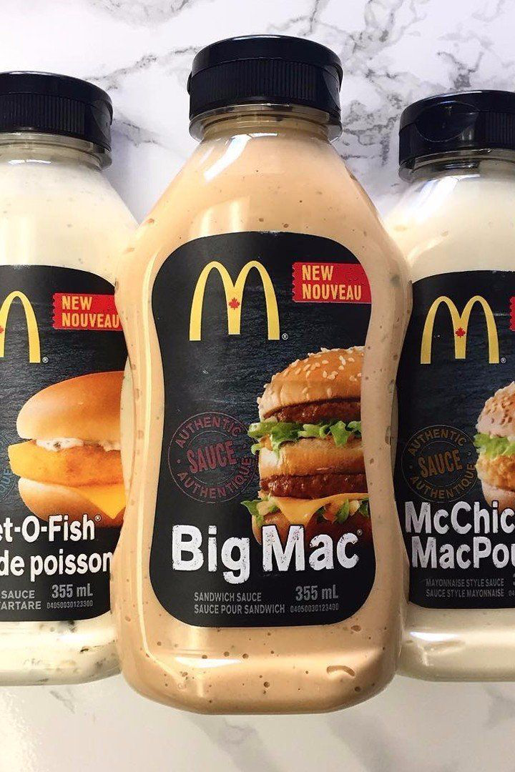

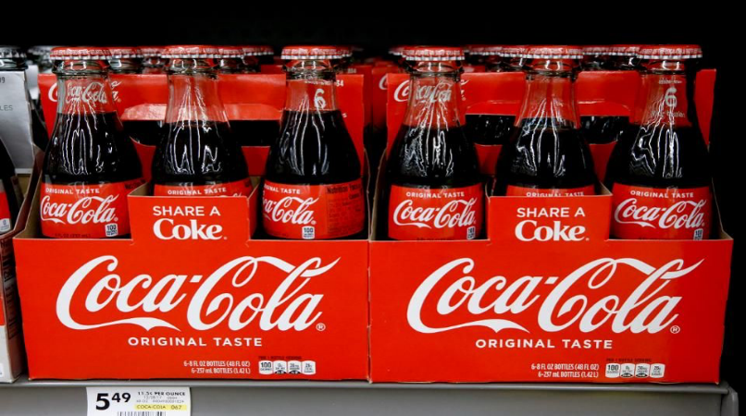
4. Maturity stage
Longest period in the life cycle of a firm, industry, or product, during which sales remain more or less stagnant, and Profit and Market share may tend to decline.
Objective: To defend market share.
Main features of Maturity stage are:
Sales remain more or less Stagnant.
Decline in Profit.
Decline in Market Share.
Retentive advertising.
Intense Competition.

Slide 20
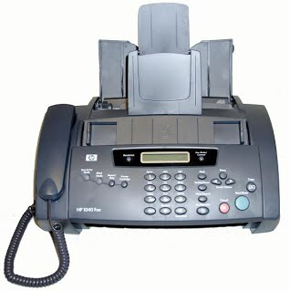
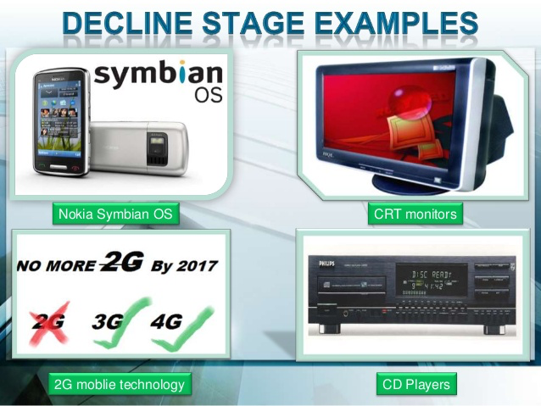
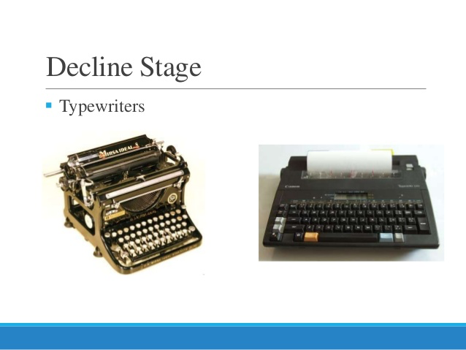
5. Decline stage
A decline is a fall or descent and, in the product life cycle, the decline stage represents similar behavior for products. The decline stage in the product life cycle is when a product dissolves as a result of decreased in demand from customers or negative growth.
Objective: To cut down the costs and reduce the losses.
Main features of Decline stage are:
Decline in sales.
Decline in Profit.
Withdrawal or modification of the product.
Decline in Promotional Expenditure.
Reduction in Distribution .

Slide 21
MANAGEMENT OF PRODUCT LIFE CYCLE
VARIOUS MARKETING STRATEGIES AT PRODUCT LIFE CYCLE STAGES
I. AT INTRODUCTION STAGE
1. PRODUCT STRATEGY – The firm will concentrate on Single product, no product line extension. The firm may spend additional fund for Research and development to improve the product.
2. PRICE AND PROMOTION STRATGIES
a. Rapid Skimming – The Product can be launched at High Price with High Promotional expenditure.
b. Slow Skimming - The Product can be launched at High Price with Low Promotional expenditure.
c. Rapid Penetration-The Product can be launched at Low Price with High Promotional expenditure.
d. Slow Penetration-The Product can be launched at Low Price with Low Promotional expenditure.

Slide 22
3. DISTRIBUTION STRATEGIES-
a.Concentrated Distribution Strategy- Distribution of product through specific dealers in particular market area.
b. Mass Distribution Strategy -Distribution through all possible dealers including national level.
II. AT GROWTH STAGE
1. PRODUCT STRATEGY
a. Product improvement in features, design, shape, etc
b. Introduction of new models
2. PRICE AND PROMOTION STRATEGY
a. PENETRATION PRICING- Firm keeps low price to face competition.
b. PUSH PROMOTION STRATEGY- Trade promotion (incentives) to dealers.
c. PULL PROMOTION STRATEGY- Promotion efforts directed towards customers.
3. DISTRIBUTION STRATEGY-
Firm may focus on New market segments, increase in distribution, new distribution channels.

Slide 23
III. AT MATURITY STAGE
1. PRODUCT MODIFICATION – The firm may focuson Modification of design, features, etc. to increase product performance.
2. PRICE AND PROMOTION STARTEGY- Promotion efforts directed towards customers.
a. PUSH/PULL STRATEGY- Trade promotion (incentives) to dealers.
b. PENETRATION PRICING STRATEGY
3. DISTRIBUTION STRATEGY-
Marketer Focus on profitable segment ,discard unprofitable channel of distribution, exit from unprofitable market areas.

Slide 24
IV. AT DECLINE STAGE
1. PRODUCT STRATEGIES-
a. WITHDRAWAL OF WEAKER BRANDS
b. INTRODUCTION OF NEW PRODUCTS
c. WAIT AND WATCH STRATEGY
2. PRICE AND PROMOTION STRATEGIES- The firm will maintain same price and promotional expenditure may be reduced on the basis of funds.
3. DISTRIBUTION STRATEGY-
a. Focus on profitable segment
b. Focus on Selective segment
c. Distribution through selective cha

