Slide 1
HORTICULTURE

Slide 2
IMPORTANT GARDEN FEATURES

Slide 3
What is garden?
A garden is a planned space, usually outdoors, set aside for the display, cultivation, or enjoyment of plants and other forms of nature.
The garden can incorporate both natural and man-made materials.
Gardening is the activity of growing and maintaining the garden.‎
Flower gardens combine plants of different heights, colors, textures, and fragrances to create interest and delight the senses.
A gardener might also work in a non-garden setting, such as a park, a roadside embankment, or other public space.
Gardens has some important features like pathway, avenues, hedges, edges and lawns.

Slide 4
PATHWAY
Paths for gardens lead from one area of the garden towards a destination, often another section of the garden containing a particular sculpture, specimen or other focal point.
Garden paths and walkways also give the garden landscape some structure along with delineation.
Garden paths may create a pattern in the garden; allow for ease of harvest, pruning and weeding and protect grass or tender plants from being trampled upon.

Slide 5
A curve in the path or an arrangement of a few steps with a plateau from which to view the garden, along with the placement of boulders, statuary and other ornamental objects, water features, gates, seating options and plant specimens all add to the aesthetics of the garden.
Container plants, aromatic plants and those with different sizes, colors and textures complete the vision of the pathway.
Paths for gardens should be wide enough for two people to stroll along together, or at least as wide as a wheelbarrow or other needed garden equipment to fit through — at least 4 feet wide.
The width should also take into consideration the entire feel of the garden, materials for use and whether an inclusion of a nook, bench or other planned garden décor might dictate even wider proportions.

Slide 6
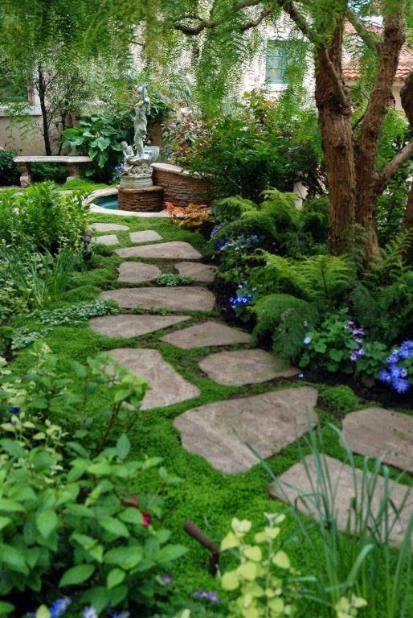
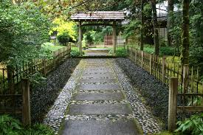
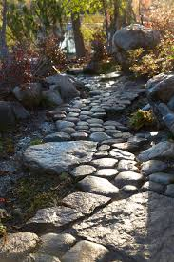
PATHWAYS IN JAPANESE GARDENS

Slide 7
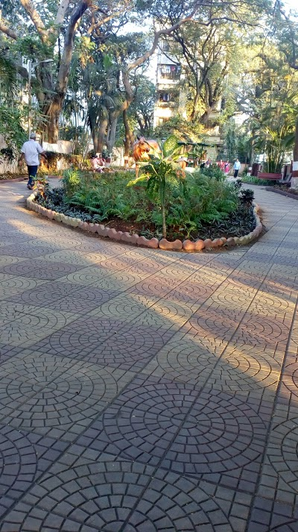
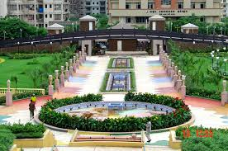
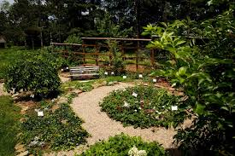
PATHWAYS OF INDIAN GARDENS

Slide 8
AVENUES
In landscaping, an avenue, or allée, is traditionally a straight path or road with a line of trees or large shrubs running along each side, which is used, as its Latin source venire ("to come") indicates, to emphasize the "coming to," or arrival at a landscape or architectural feature.
In most cases, the trees planted in an avenue will be all of the same species or cultivar, so as to give uniform appearance along the full length of the avenue.
In order to enhance the approach to mansions or manor houses, avenues were planted along the entrance drive.
Sometimes the avenues are in double rows on each side of a road. Trees preferred for avenues were selected for their height and speed of growth, such as poplar, beech, lime, and horse chestnut.

Slide 9
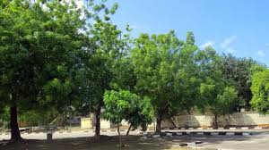
Sometimes tree avenues were designed to direct the eye toward some distinctive architectural building or feature, such as a chapels, gazebos, or architectural follies.
An avenue is the row of trees grown on both sides of roads.
Shade and beauty are the sole criteria to be considered while selecting avenue trees.
The trees should also be selected according to the length and breadth of the road.
Avenues plant are
NEEM
Azadirachta indica

Slide 10
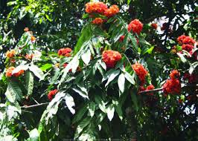
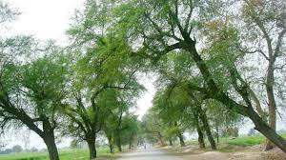
ASHOK TREE
Saraca asoca
SISAM TREE
Dalbergia sissoo

Slide 11
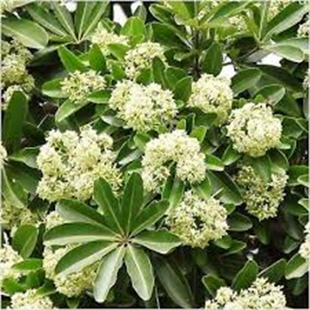
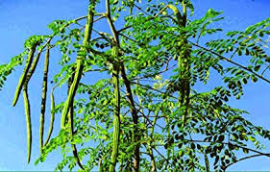
Alstonia scholaris
Moringa oleifera

Slide 12
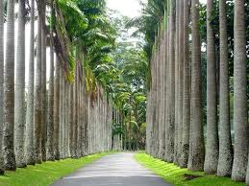
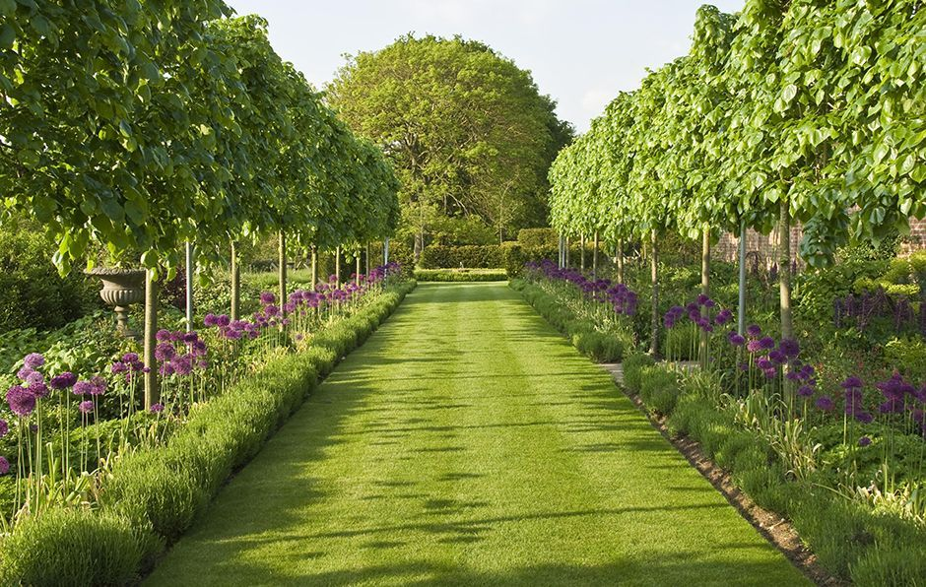
AVENUES IN GARDENS

Slide 13
HEDGES
A hedge or hedgerow is a line of closely spaced shrubs and sometimes trees, planted and trained to form a barrier or to mark the boundary of an area, such as between neighbouring properties.
Often they serve as windbreaks to improve conditionsfor the adjacent crops, as in bocage country.
When clipped and maintained, hedges are also a simple form of topiary.
A hedge may consist of a single species or several, typically mixed at random.

Slide 14
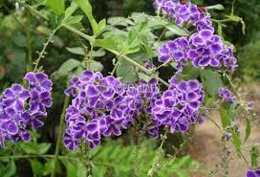
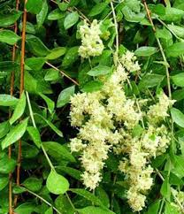
In addition to maintaining the health of the environment, hedgerows also play a huge role in providing shelter for smaller animals like birds and insects
HEDGE PLANTS
Duranta plumeri
Lawsonia inermis

Slide 15
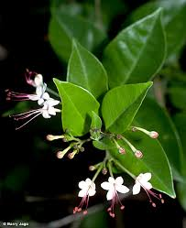
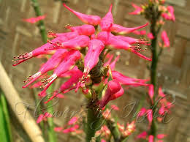
Clerodendron inerme
Pedilanthus tithymaloides

Slide 16
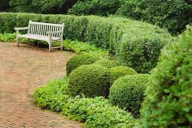
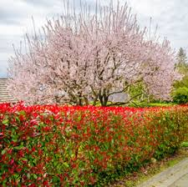
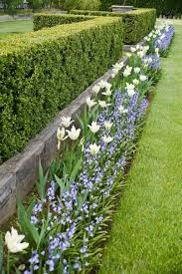
HEDGES IN GARDENS

Slide 17
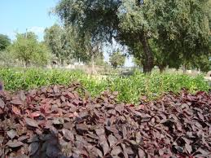
EDGES
Edges are plants which are employed in gardens for dividing beds, borders, roads, walks or path of demarcating spaces allotted for particular purpose.
These are perennial herbs often used as a short border for lawn or ground cover or dividing beds from roads, walks or paths.
These herbs often stand frequent trimming .
Some of the edges plants are
Alternanthera era

Slide 18
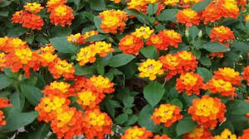
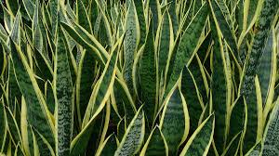
Lantana camara
Sanseivieria trifasciata

Slide 19
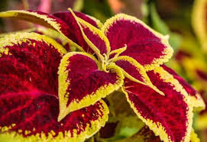
Coleus blumeri
Pedilanthus tithymaloides

Slide 20
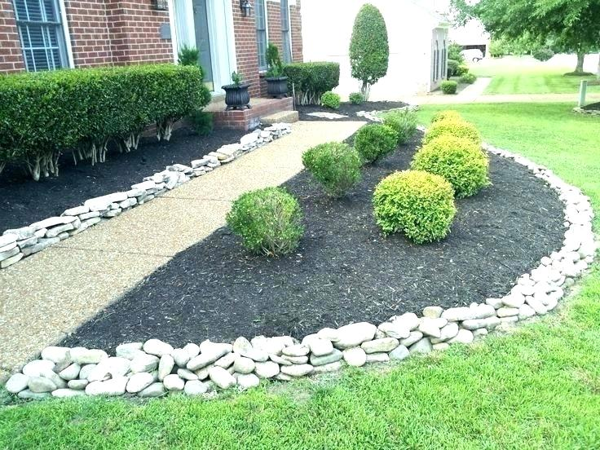
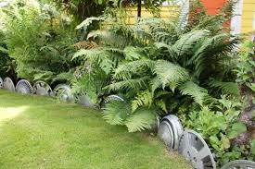
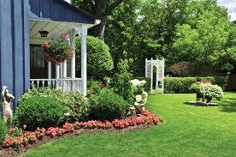
EDGES IN GARDENS

Slide 21
LAWNS
A lawn is an area of soil-covered land planted with grasses and other durable plants such as clover which are maintained at a short height with a lawnmower (or sometimes grazing animals) and used for aesthetic and recreational purposes.
Common characteristics of a lawn are that it is composed only of grass species, it is subject to weed and pest control, it is subject to practices aimed at maintaining its green color (e.g., watering), and it is regularly mowed to ensure an acceptable length,^{[1]} although these characteristics are not binding as a definition.
Lawns are used around houses, apartments, commercial buildings and offices. Many city parks also have large lawn areas. In recreational contexts, the specialised names turf, pitch, field or green may be used, depending on the sport and the continent.

Slide 22
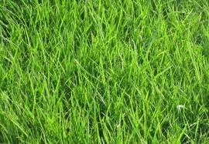
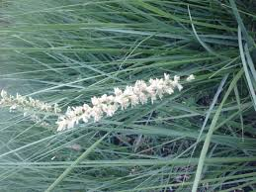
Lawns are used around houses, apartments, commercial buildings and offices.
Many city parks also have large lawn areas. In recreational contexts, the specialised names turf, pitch, field or green may be used, depending on the sport and the continent.
Some plants are
Cynodon dactylon
Eragrostis sinusuroides

Slide 23
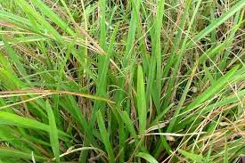
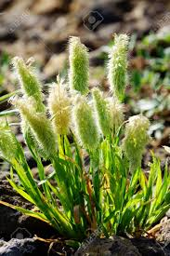
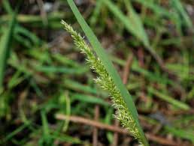
Axonopus fissifolius
Lamarckia aurea
Agrostis stolonifera

Slide 24
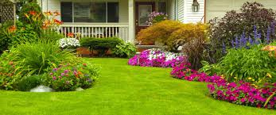
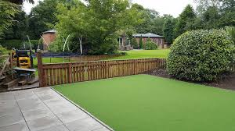
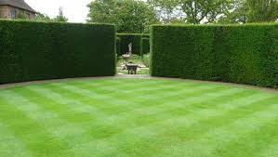
LAWNS IN GARDEN

