Slide 1
UTILITY ANALYSIS
ORDINAL MEASUREMENT

Slide 2
Indifference Curve Approach
Marshall's demand analysis is based on the cardinal measurement of utility. The approach is criticised for two reasons.
1. Utility is a psychological phenomenon and
2. It cannot be measured.
According to Hicks and Allen, utility cannot be measured. It can only be ranked or ordered. The consumer can rank his preference very easily and say which is better than the other.
An indifference curve shows different combinations of two commodities, which give the consumer an equal satisfaction.
An indifference curve is the locus of different combinations of two commodities giving the same level of satisfaction.

Slide 3
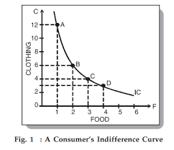
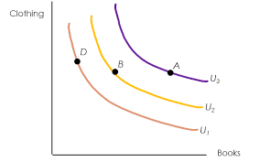
Indifference map is a set of all IC curves. And it shows complete description of consumer’s taste and preferences.

Slide 4
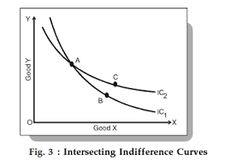
Assumptions of indifference curve analysis
1. The consumer is rational. So, he prefers more goods to less goods.
2. He purchases two goods, X and Y only.
3. The price that a consumer pays for a commodity indicates the level of utility derived by him.
4. His income and price of commodities remains constant.
5. His tastes, preferences, habits remain unchanged.
6. IC is downward sloping and convex to origin.
7. IC never touch each other.

Slide 5
Indifference Schedule
An indifference schedule is a statement of various combinations of two commodities that will equally be accepted by the consumer. The various combinations give equal satisfaction to the consumer. Therefore he is indifferent between various combinations.
Combination | Good X | Good Y | MRS=dY/dX
A | 1 | 12 | -
B | 2 | 8 | 4
C | 3 | 5 | 3
D | 4 | 3 | 2
E | 5 | 2 | 1

Slide 6
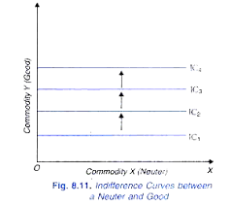
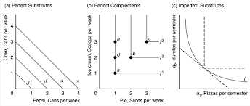
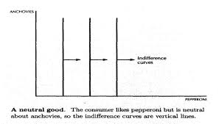

Slide 7
The indifference curve approach is criticized on the following grounds:
a. Assumes that there are only two goods in indifference curve approach. This is not true in the real world as a consumer consumes variety of goods.
b. Fails to provide a clear explanation of consumer behavior
c. Provides combinations that are not based on the principles of economics
d. Ignores risk and uncertainty while analyzing the consumer behavior

Slide 8
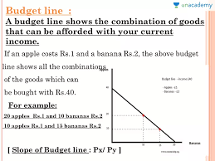
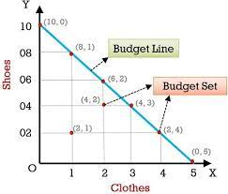
BUDGET LINE:-
PRICE LINE, PRICE-INCOME LINEOUTLAY LINE,

Slide 9
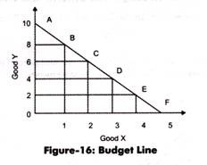
Slope of Budget Line
The slope of the budget line (Figure-16) would be given as:
Slope of the Budget Line = ∆Y/∆X
∆Qy/∆Qx = OA/OF
When X = 0, OA = M/Py
When Y = 0, OF = M/Px
Thus, OA/OF = Px/Py
Therefore, it can be said that the slope of the budget line equals to the price ratio of two goods.
For instance, from Figure-16, it can be seen that the slope at point B equals to 1 unit of X for 2 units of Y. It implies that 2 units of good X. It should be noted that the slope of budget line is negative. For instance, slope is -2 in case of preference B.

Slide 10
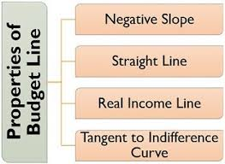
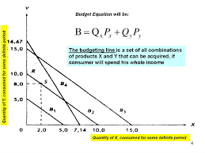
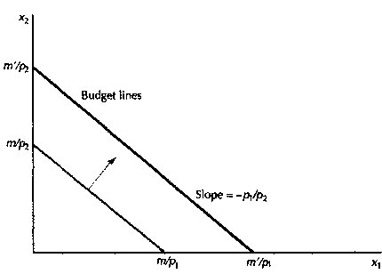

Slide 11
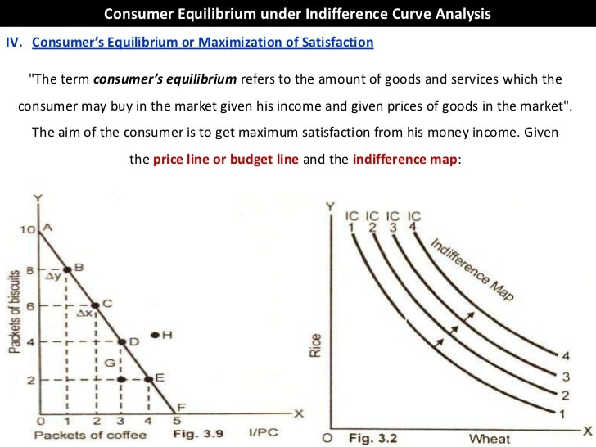
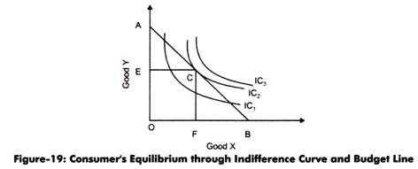
Consumer’s Equilibrium through Indifference Curve and Budget Line:
Consumer’s equilibrium is the point at which consumer attains maximum satisfaction. A consumer is said to be
in equilibrium when the budget line touches indifference curve, with given price and income.
Slope of budget line =Px/Py
Slope of indifference curve= ∆Y/∆X = MRSxy
Thus, Px/Py = MRSxy

Slide 12
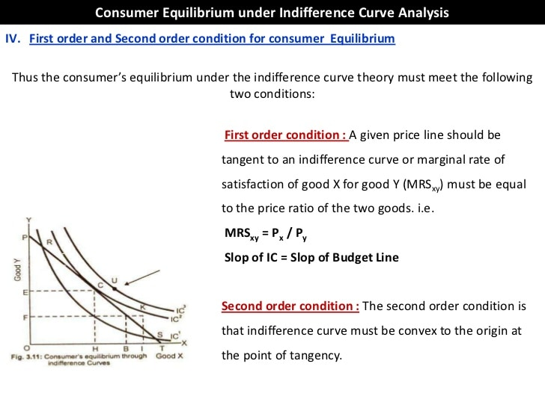

Slide 13
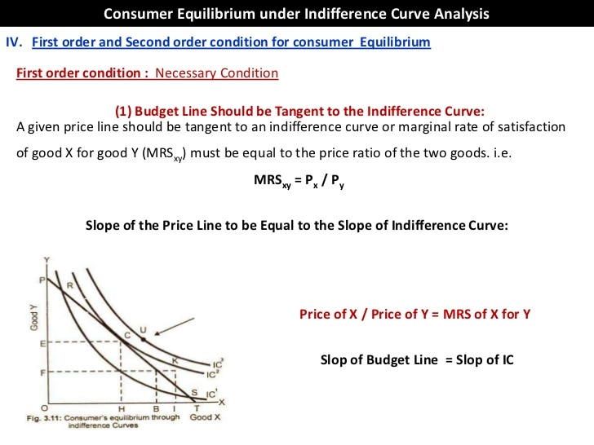

Slide 14
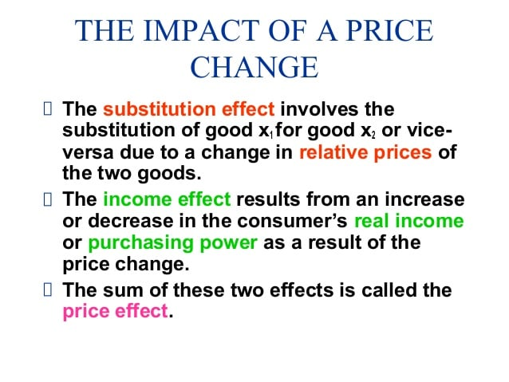
Effects
Income+ substitution= price effect
Associated with change in purchasing power due to change in price
Observed by shift in budget line
Ex:- from A to B
Associated with change in relative price of a good.
Observed by movement along budget line
Ex:- From A to C

Slide 15
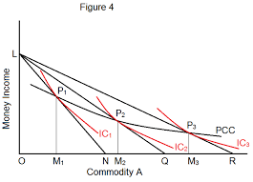
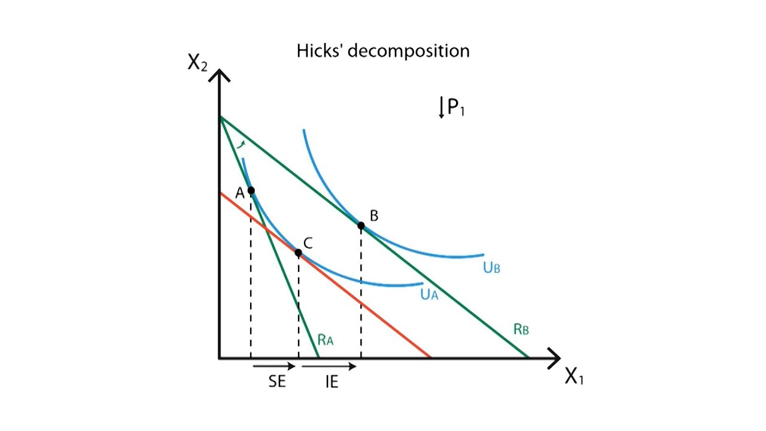

Slide 16
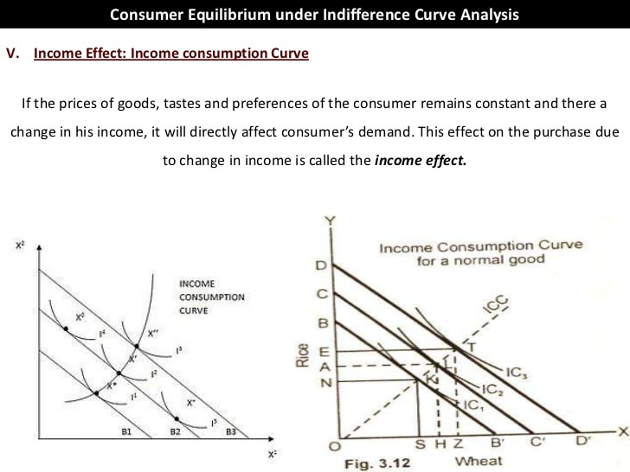

Slide 17
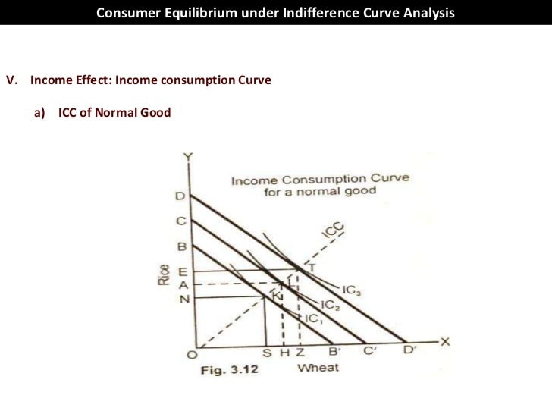
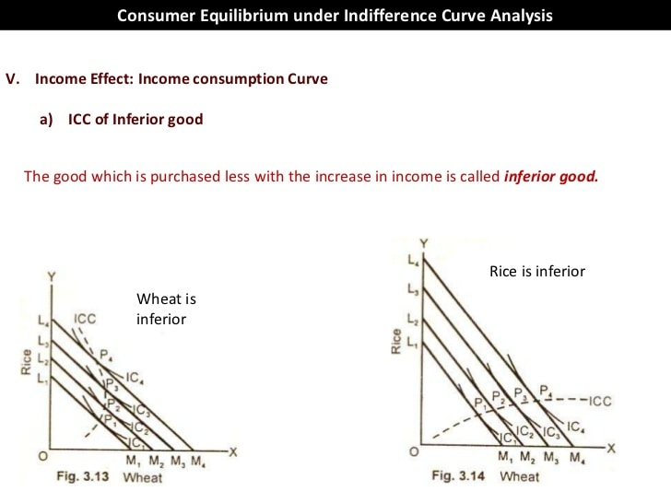

Slide 18
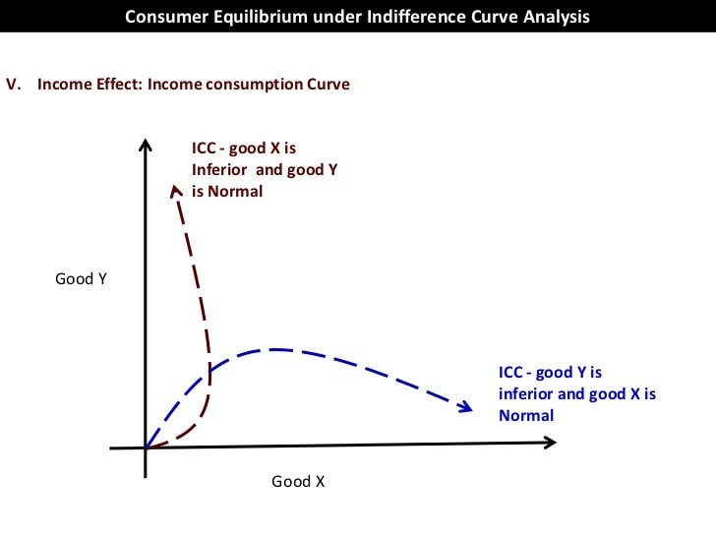
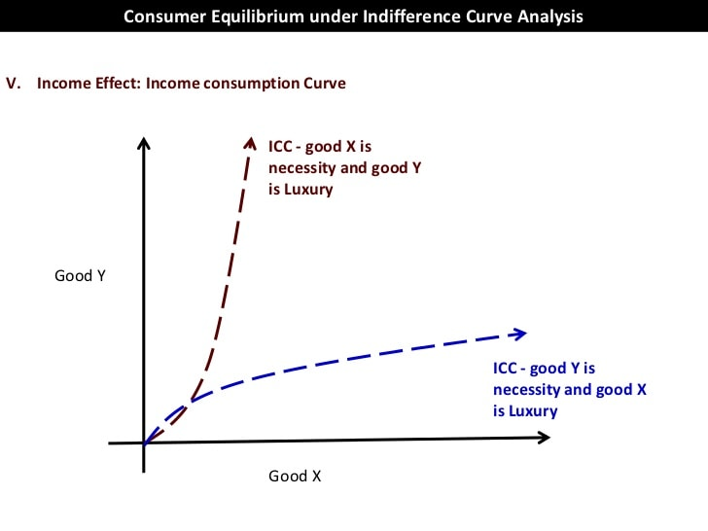

Slide 19
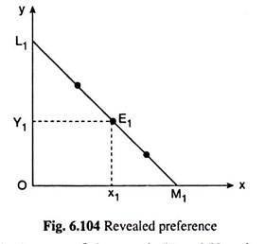
Revealed Preference Theory
Revealed Preference Theory was propounded by Paul Samuelson in 1938. This theory studies the behaviour of the People while they are making choices. This is why it is also termed as Behaviourial Ordinal Utility Theory. Unlike Utility and IC analysis, this method is not introspective (self-analysing). This implies that while the former two assumes that the Consumer knows his/her preferences clearly, based upon which they make their choices, the latter theory (RP) is non-introspective (indeed observational) as it derives preferences based upon previous choices made by the consumers.
if the consumer buys the combination E₁ (x₁, y₁)of the goods X and Y and does not buy the combination E₂(x₂, y₂) at the prices (p¹_{x}, p¹_{y},) of the goods, then we would be able to say that he prefers combination E₁ to combination E_{2.}

Slide 20
ASSUMPTION OF RPT.
The consumer buys and uses only two goods (X and Y). The quantities x and y of these goods are continuous variables.
Both these goods are of MIB (more-is-better) type. This assumption is also known as the assumption of monotonicity. This assumption implies that the ICs of the consumer are nega­tively sloped.
for any particular budget line of the consumer, there would be obtained one and only one equilibrium combination of goods and for any combination to be an equilibrium one, there would be obtained one and only one budget line.
The fourth assumption of the RP theory is known as the weak axiom of RP (WARP). Here we assume that if the consumer chooses the combination E₁(x₁, y₁) over another afford­able combination E₂(x₂, y₂) in a particular price-income situation, then under no circumstances would he choose E₂ over E₁ if E₁ is affordable.
the strong axiom of RP (SARP). if the consumer, under different price-income situations, reveals the combination E₁ as preferred to E₂, E₂ to E₃,…, E_{k-1} to E_{k}, then E₁ would be revealed preferred to E_{k} and E_{k} would never (under no price-income situation) be revealed preferred to E₁.

Slide 21
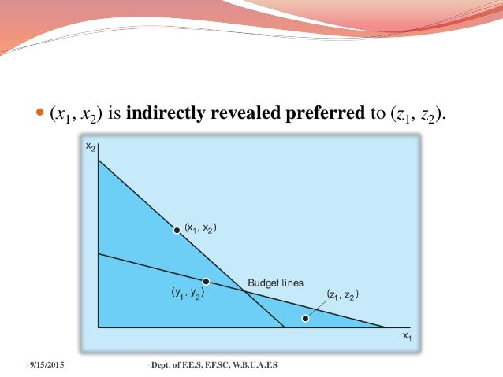
Revealed Preference—Direct and Indirect:
If RP is confined to only two combinations of goods, E₁ and E₂, and if, in a particular price- income situation, E₁ (x₁,y₁) is revealed preferred to combination E₂ (x₂, y₂), then it is said that E₁ is directly revealed preferred to E₂.
But if preferences are considered for more than two combinations and if preferences are established by way of transitivity of RP, then it is a case of indirectly revealed preference. For example, if E₁ is revealed preferred to E₂,…, E_{k-1} to E_{k}, then by SARP, we say E₁ is indirectly revealed preferred to E_{k}.

Slide 22
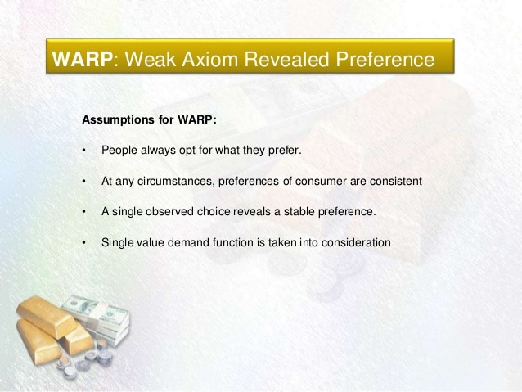
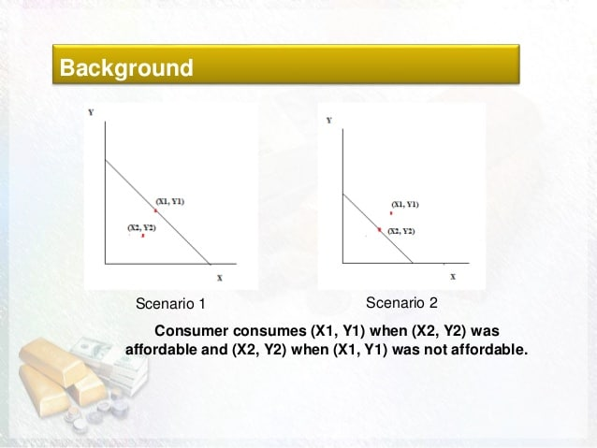

Slide 23
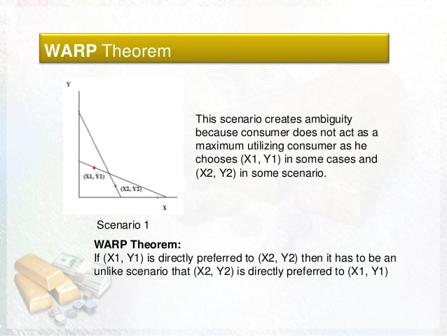


Slide 24
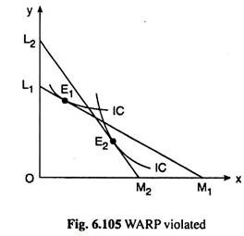
WARP VIOLATION
when the consumer buys combination E₁ on L₁M₁ and E₂ on L₂M₂. Here the preference ordering of the consumer breaks down. It may be verified in Fig. 6.105 that the IC tangent to L₁M₁ at E₁ and the IC tangent to L₂M₂ at E₂ cannot be non-intersecting in this case.

Slide 25
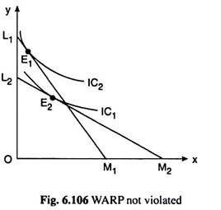
WARP NOT VIOLATED
let us suppose, the consumer buys the combination E₁ on L₁M₁ and the combination E₂ on L₂M₂. Here when he buys E₁ he chooses E₁ over the affordable combination E₂, i.e., E₁ is revealed preferred to E₂. But when he buys E₂, he chooses E₂ over an unaffordable E₁, i.e., E₂ is not revealed preferred to E₁.

Slide 26
SARP:
According to this axiom, if the consumer reveals a combination E₁ (x₁, y₁) as preferred to another combination E₂ (x₂, y₂) and if E₂ (x₂, y₂) is revealed preferred to E₃ (x₃, y₃) then E, would always be revealed preferred to E₃.
This may be called the transitivity of revealed preferences. Now, if the consumer is a utility-maximising one, then the transitivity of revealed preferences would lead to transitivity of preferences—if E₁ is preferred to E₂ and E₂ to E₃, then E₁ would be preferred to E₃.
It is evident that if any of the WARP and SARP is violated, then utility-maximisation cannot be achieved by the consumer.

