Slide 1
Production Possibility Curve

Slide 2
Production Possibility Curve (PPC) is used to explain the basic concepts of scarcity, choice and opportunity cost in economics.
The PPC shows various possible combinations of goods and services that can be produced in an economy in a specific time period with all the factors of production (land, labour and capital) fully and efficiently employed.
The PPC represents graphically alternative produc­tion possibilities open to an economy.

Slide 3
Assumptions
Economy is operating at full employment and full production capacity.
The amount of resources available is fixed.
The state of technology does not change throughout the production.
A Country produces two goods – bread and sewing machines; bread represents consumer goods and sewing machines represent capital goods.

Slide 4
The PPC can be illustrated with the help of a table...
Production Possibilities | Sewing Machines | Bread
A | 15 | 0
B | 14 | 1
C | 12 | 2
D | 9 | 3
E | 5 | 4
F | 0 | 5

Slide 5
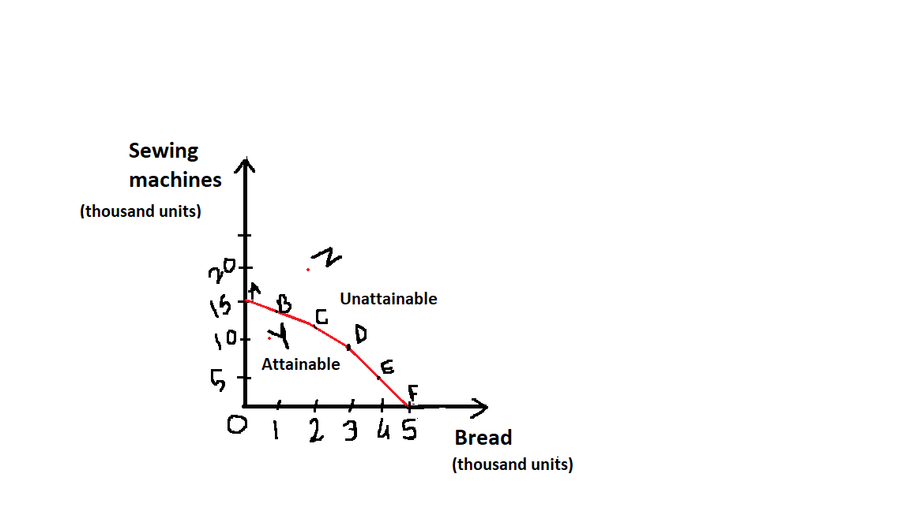
… and a graph.

Slide 6
Points A to F are best possible combinations of resources to enable full utilization and to ensure that the country is at full employment.
If all the factors of production are used for the production of bread, the country can produce 5000 units of bread.
In contrast, if all the resources are used only for the production of sewing machines, it will lead to production of 15,000 units of sewing machines.
Besides these two extremes, there are other possibilities too. E.g. at point C the country can produce 12,000 units of sewing machines and 2000 units of bread.

Slide 7
Points inside PPC are attainable. But it shows inefficiency as the capacity of production is not fully utilized. e.g. at Point Y, only 10,000 units of sewing machines and 1000 units of bread can be produced.
This shows under-utilization of resources. This also leads to unemployment.
The points outside PPC are unattainable. They show the problem of scarcity of resources.
All the points along PPC, from A to F, indicate the concept of choice. The points indicate that a country can choose from all these attainable and efficient production alternatives.
Movement from one point to other on PPC represents the concept of Opportunity Cost.

Slide 8
Scarcity of Resources
In the diagram, point Z shows combination of 2000kg of Bread and 20000 units of sewing machine. This combination is impossible to achieve as it is outside the PPC.
If quantity of reaources increases or technological improvement takes place, the PPC will shift to its right and only then point ‘Z’ will become attainable.
Further, Point ‘B’ allows more production of sewing machine that point ‘C’. 12 thousand seqing machines and 3000 kg bread cannot be simeltaneously.
These conditions indicate scarcity of resources.
If resources had been plenty, any combination of goods in any quantity would have been possible.

Slide 9
Opportunity Cost
Movement from point A to B, and from B to C on PPC indicates that the country will have to sacrifice one option as it moves to other.
At point A, it can produce 15000 units of sewing machine. If it moves to point B, it can not produce the same quantity of sewing machine. To produce 1000 kg of bread it will have to sacrifice 1000 units of sewing machines and produce only 14000 units of it.
Hence, opportunity cost of producing 1000 k.g of bread is 1000 units of sewing machine.

Slide 10
Efficient Utilization of Resources
If the country chooses the combination of point Y, i.e.; if it produces 1000 kg of bread and 10000 units of sewing machine, then it indicates inefficient utilization of resources.
On the contrary, if the country moves on the point ‘B’ or ‘C’, or any point on the PPC, then it shows optimum or efficient utilization of resources.

Slide 11
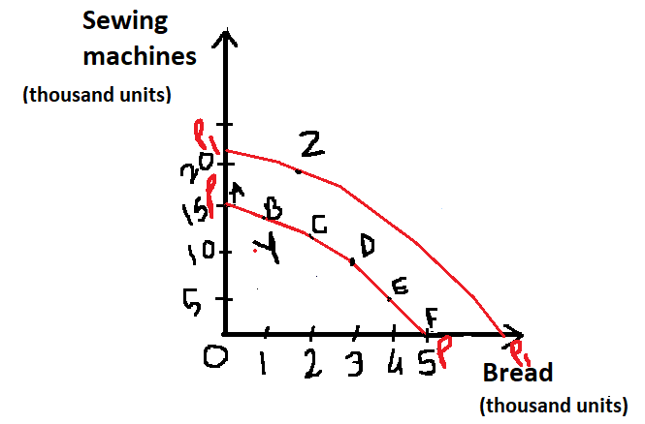
Technological Improvement
If new resources are available or if the level of technology is improved through better method of production and better facilities, then the PPC will shift upward or rightward. As is shown by P₁P₁ curve in the diagram, here the country can produce both the commodities in higher units.
With P₁P₁ production possibility curve, point Z becomes attainable and the points on PP will now represent under-utilization of the capacity.

