Slide 1
BUSINESS RESEARCH METHODS
Dr.Rupal Shroff

Slide 2
Topics
What is research and types of research
How to formulate a research question
Literature review and its purpose
Research Design
Data collection
Data Analysis

Slide 3


Do you ever Wonder ???
Is television going to survive in digital eye or will it become obsolete like digital camera?

Slide 4

The Sun rises in the East ?????

Slide 5


Examples of Research questions
Does negative news interest people more than positive news?

Slide 6

Examples of Research questions
What are the factors motivate young people to commit violence?

Slide 7
Examples of Research questions
What factors contribute to a low turnout among women voters in elections in Pakistan?

Slide 8

Examples of Research questions
Do students think about the career options first before choosing education or careers come second?

Slide 9
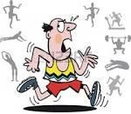
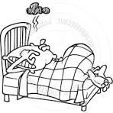
Examples of Research questions
Does exercise improve the quality of sleep?

Slide 10
What is Research ????
RE…….
………………SEARCH
https://www.youtube.com/watch?v=EEuul8hBip8
https://www.youtube.com/watch?v=v50ct9xJVKE

Slide 11
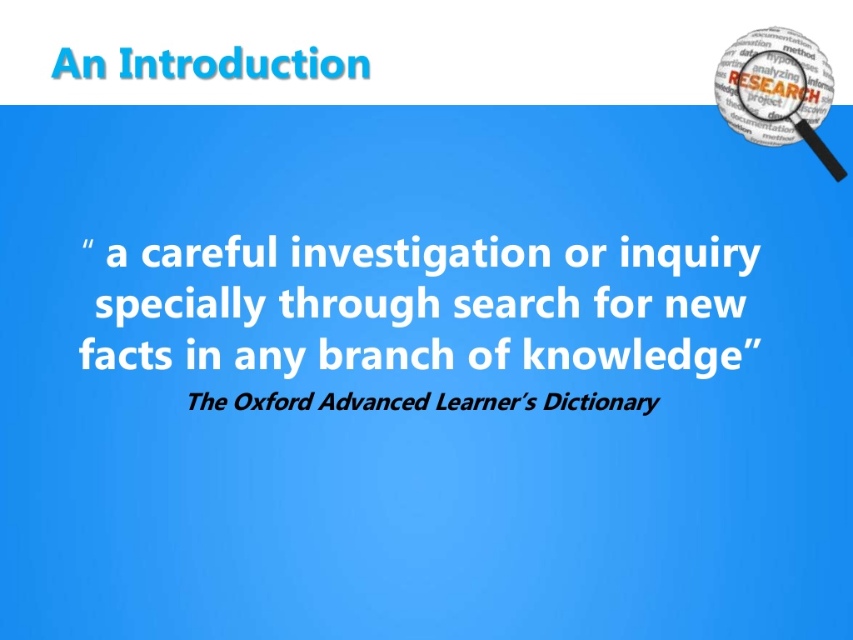

Slide 12

Research
The systematic, rigorous investigation of a situation or problem in order to generate new knowledge or validate existing knowledge.
An endeavour to discover new or collate old facts etc by the scientific study of a subject or by a course of critical investigation

Slide 13
Nature/ Features/ Characteristics of Research
Follows a scientific methodology
Objective & Logical
Empirical study
Purposeful investigation
Conducts observation & experimentation
Development of Theories / Principles
Studies Complex human behaviour

Slide 14
Objectives of Research
To identify the real problems and find solutions
To acquire information
To develop new scientific laws
To verify existing laws & theories
To predict events

Slide 15
Objectives of Research
To develop cause-effect relationships between variables
To establish generalisations
To extend knowledge
To develop innovative ideas

Slide 16
Importance/ Need / Relevance of Research in Business
Research
Business Decisions
Social Sciences & Research
Government Decisions

Slide 17
Importance/ Need / Relevance of Research in Business
Product Development
Reduction in Cost
Marketing Mix Decisions
Competitive Advantage
Human Resource Development
Financial Management
Corporate Social Responsibility
Corporate Image

Slide 18
SCOPE / SIGNIFICANCE OF RESEARCH
  RESEARCH FOR DECISION MAKING
  Throws light on risks and uncertainty
  Identify alternative courses of action
  Helps in economic use of resources
  Helps in project identification

Slide 19
  Solves investment problems
  Solves pricing problems
  Solves allocation problems
  Solves decision making issues in HR
  Solves various operational and planning problems of business and industry

Slide 20
  Provides the basis for all government policies in our economic system.
  Helps social scientists in studying social relationships and in seeking answers to various social problems.
  For students, research means a careerism or a way to attain a high position in the social structure.
  For professionals in research, it may mean a source of livelihood.

Slide 21
  For philosophers and thinkers, research means the outlet for new ideas and insights.
  For literary men and women, research means development of new styles and creative work.
  For analysts and intellectuals, research means generalizations of new theories.

Slide 22
Types of Research
Pure
Empirical
Scientific & Social Research
Conceptual
Historical
Applied
Descriptive
Analytical
Exploratory
Causal Research
Ex-post facto Research

Slide 23
Pure/ Fundamental/ Basic Research https://www.youtube.com/watch?v=JEZjwlDNEHY
Basic (aka fundamental or pure ) research is driven by a scientist's curiosity or interest in a scientific question. The main motivation is to expand man's knowledge, not to create or invent something. There is no obvious commercial value to the discoveries that result from basic research.
  For example, basic science investigations probe for answers to questions such as:
    How did the universe begin?
    What are protons, neutrons, and electrons composed of?
    What is the specific genetic code of the fruit fly?

Slide 24
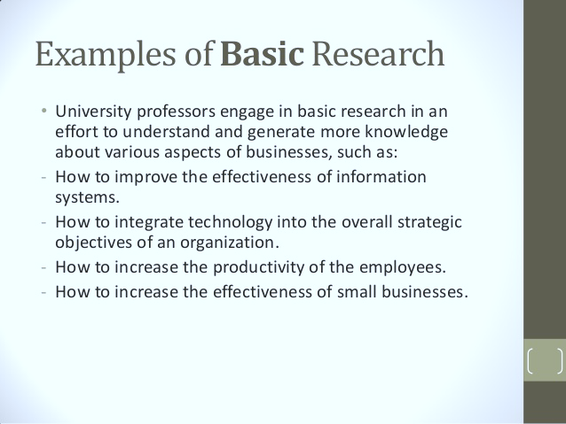

Slide 25

FEATURES OF BASIC RESEARCH

Slide 26
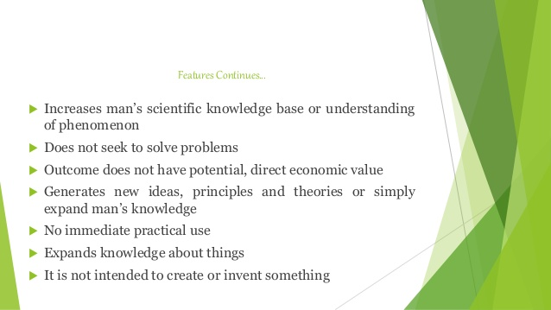
FEATURES CONTINUED

Slide 27
Applied research
Applied research refers to scientific study and research that seeks to solve practical problems. Applied research is used to find solutions to everyday problems, cure illness, and develop innovative technologies, rather than to acquire knowledge for knowledge's sake.
  For example, applied researchers may investigate ways to:
    Improve agricultural crop production
    Treat or cure a specific disease
    Improve the energy efficiency of homes, offices, or modes of transportation

Slide 28
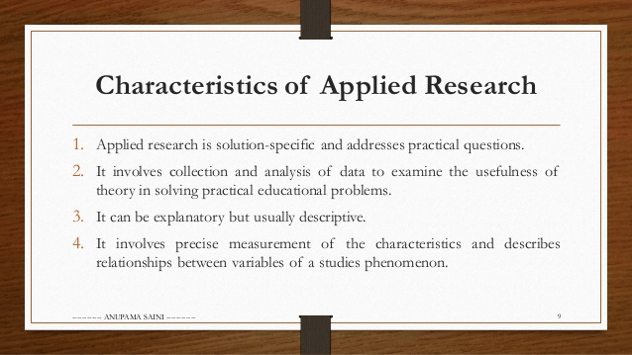
Features of Applied Research

Slide 29
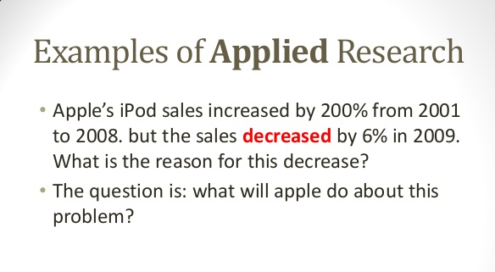

Slide 30
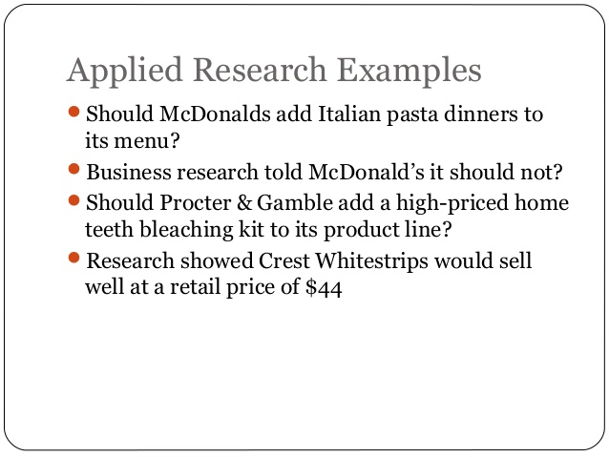

Slide 31

Examples

Slide 32
COMPARATIVE ANALYSIS
BASIC RESEARCH
Domain driven with intention to increase theoretical knowledge.
Gain new knowledge
Main motivation is to expand man’s knowledge.
Done for intellectual pleasure of learning.
Applied Research
Demand driven with intention to solve specific problem.
Designed to solve practical problem of the modern world.
Applied research can take basic research further where applicable.
Done to test theories in the field to achieve better result

Slide 33
Descriptive Research
Descriptive research refers to research that provides an accurate portrayal of characteristics of a particular individual, situation, or group. Descriptive research, also known as statistical research.
These studies are a means of discovering new meaning, describing what exists, determining the frequency with which something occurs, and categorizing information.
  For example,
    finding the most frequent disease that affects the children of a town.

Slide 34
DESCRIPTIVE AND ANALYTICAL RESEARCH
DESCRIPTIVE RESEARCH
Descriptive research is a fact finding investigation which are aimed at describing the characteristics of an individual, situation or a group stating the state of affairs as it exist at present.
In descriptive research, Researcher has no control over variables. They have to report what has happened or what is happening

Slide 35
OBJECTIVE OF DESCRIPTIVE RESEARCH
To discover causes.
Surveys and fact finding enquiries of different kind.
Purpose is the description of the state of affairs as it exist at present.
Ex Post Facto research
Researcher has no control over variable. He can only report what is happening.

Slide 36
Nature of descriptive study
Descriptive research are aimed at gathering information about existing condition
this research collect data to test the hypotheses or to answer questions concerning the current status of the studies.
this study reports the way things are. They have no control over variables.
This study is criticised for having descriptive finding rather than predictive findings.

Slide 37
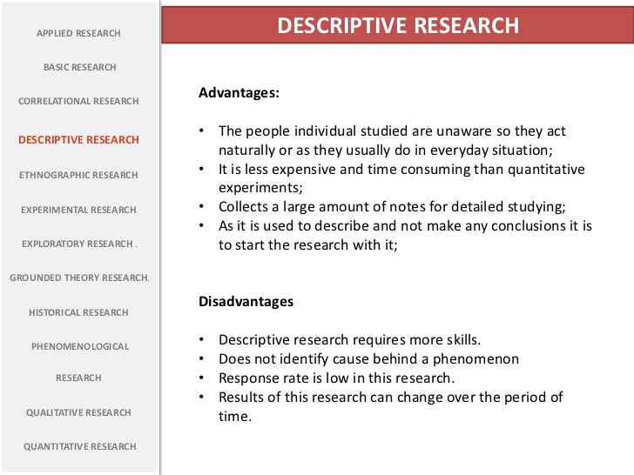
Advantages and disadvantages of descriptive research

Slide 38
ANALYTICAL RESEARCH
in depth study and evaluation of available information in an attempt to explain complex phenomenon.
The researcher has to use facts or information already available and analyse this to make critical evaluation.
This research involves secondary data.
The aim of this research is to establish causal relationship.
It works within fixed variables
Eg why sale of groceries have increased during lockdown.
https://www.youtube.com/watch?v=kaoWPEzvf9A

Slide 39
Experimental research
An experiment research is a study in which a treatment, procedure, or
program is intentionally introduced and a result or outcome is observed.
  Eg: bp level measure

Slide 40
Exploratory and History research
Exploratory research is a type of research conducted for a problem that has not been clearly defined. Exploratory research helps determine the best research design, data collection method and selection of subjects.
Historical research is research involving analysis of events that occurred in the
remote or recent past

Slide 41
TO ASSIST IN FORMULATING HYPOTHESES
TO FORMULATE PROBLEM FOR MORE DETAILED AND PRECISE INFO
WHEN EXPLORATOEY RESEARCH ARE DONE
TO UNDERSTAND SUCH PROBLEM FOR WHICH NO PRIOR INFORMATION IS AVAILABLE
TO SELECT POSSIBLE CAUSES FROM NUMBER OF ALTERNATIVES
TO ESTABLISH PRIORITIES AMONG RESEARCH PROBLEM FOR FURTHER RESEARCH

Slide 42
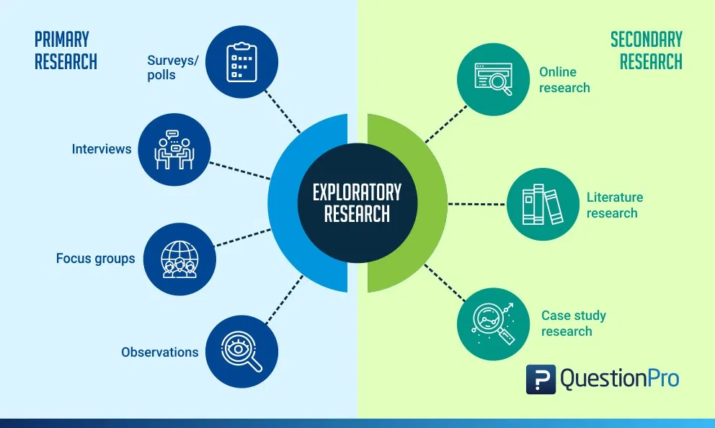

Slide 43
CHARACTERISTICS OF EXPLORATORY RESEARCH
They are not structured studies
It is usually low cost, interactive and open ended.
It will enable a researcher answer questions like what is the problem? What is the purpose of the study? And what topics could be studied?
To carry out exploratory research, generally there is no prior research done or the existing ones do not answer the problem precisely enough.
It is a time consuming research and it needs patience and has risks associated with it.
The researcher will have to go through all the information available for the particular study he is doing.
There are no set of rules to carry out the research per se, as they are flexible, broad and scattered.
The research needs to have importance or value. If the problem is not important in the industry the research carried out is ineffective.
The research should also have a few theories which can support its findings as that will make it easier for the researcher to assess it and move ahead in his study
Such a research usually produces qualitative data, however in certain cases quantitative data can be generalized for a larger sample through use of surveys and experiments.

Slide 44
ADVANTAGES OF EXPLORATORY RESEARCH
The researcher has a lot of flexibility and can adapt to changes as the research progresses.
It is usually low cost.
It helps lay the foundation of a research, which can lead to further research.
It enables the researcher understand at an early stage, if the topic is worth investing the time and resources and if it is worth pursuing.
It can assist other researchers to find out possible causes for the problem, which can be further studied in detail to find out, which of them is the most likely cause for the problem.
DISADVANTAGES OF EXPLORATORY RESEARCH
Even though it can point you in the right direction towards what is the answer, it is usually inconclusive.
The main disadvantage of exploratory research is that they provide qualitative data. Interpretation of such information can be judgmental and biased.
Most of the times, exploratory research involves a smaller sample, hence the results cannot be accurately interpreted for a generalized population.
Many a times, if the data is being collected through secondary research, then there is a chance of that data being old and is not updated.

Slide 45
CONCEPTUAL AND EMPIRICAL RESEARCH
CONCEPTUAL RESEARCH:
Conceptual research is a type of research that is generally related to abstract ideas or concepts.
It doesn’t involve any practical experimentation.
This type of research typically involves observing and analyzing information already present on a given topic.
Conceptual research can be used to solve real-world problems.
In simple words, a conceptual framework is the researcher’s synthesis of the literature (previous research studies) on how to explain a particular phenomenon.
EXAMPLE:The most famous example of a conceptual research is Sir Issac Newton. He observed his surroundings to conceptualize and develop theories about gravitation and motion.

Slide 46
Advantages of Conceptual Research
Conceptual research mainly focuses on the concept of the research or the theory that explains a phenomenon. What causes the phenomenon, what are its building blocks and so on. It’s research based on pen and paper.
This type of research heavily relies on previously conducted studies, no form of experiment is conducted which save time, efforts and resources. More and relevant information can be generated by conducting conceptual research.
Conceptual research is considered as the most convenient form of research. In this type of research, if the conceptual framework is ready only relevant information and literature needs to be sorted.

Slide 47
EMPIRICAL RESEARCH
Empirical research is basically a research that uses empirical evidence.
Empirical evidence refers to evidence verifiable by observation or experience rather than theory or pure logic.
Empirical research is research studies with conclusions based on empirical evidence. Moreover, empirical research studies are observable and measurable.
Empirical evidence can be gathered through qualitative research studies or quantitative research studies.

Slide 48
ACTION RESEARCH:
It is an evaluative study for solving a problem or for improving an existing situation.
Example: social science research.
CASE STUDY RESEARCH:
It is an indepth, comprehensive study of a person, social group a process or a situation. It gives insight to the unique feature of the case understudy. This type of research are very popular
SURVEY STUDY:
It is a fact finding study and involve collection of data directly from a population or a sample.it requires expert and imaginative planning, careful analysis and rational interpretation of the finding. Survey is conducted in natural setting and seek response directly from respondent

Slide 49
VARIABLES
Variables are anything that has a quantity or quality that varies.
A variable takes varying values.
A variable is a result of some force or itself a force that cause change in other variable.
Thus there are dependent and independent variables.
A variable is a concept or abstract idea that can be described in measurable terms. In research, this terms refer to measurable characteristics, qualities, traits or attributes of a particular individual, object or situation being studies.
Eg age, income

Slide 50
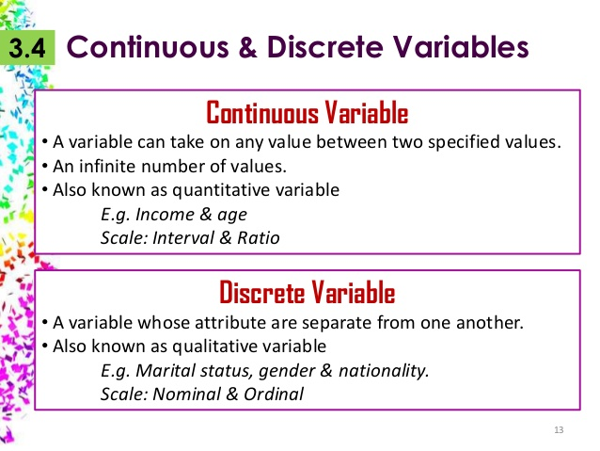
Important Concepts in Research
Variables – any characteristic that can be quantifies or qualified

Slide 51
Concepts in Research
Dependent Variable - When one variable is dependent upon or is a consequence of other variable, it is termed as Dependent Variable
Eg. Height is dependent upon gender, height is dependent
Independent Variable – The variable that is antecedent to or purposefully changes the dependent variable, it is independent variable.
Eg. Height is dependent on age, height is dependent & age is independent

Slide 52
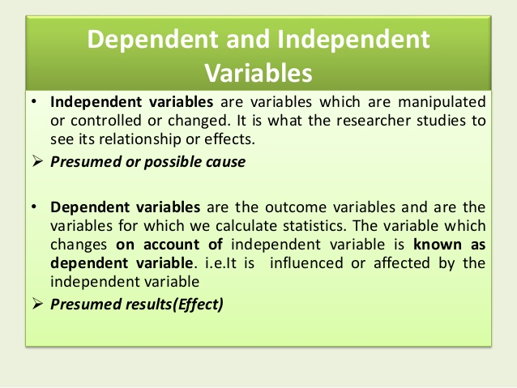

Slide 53
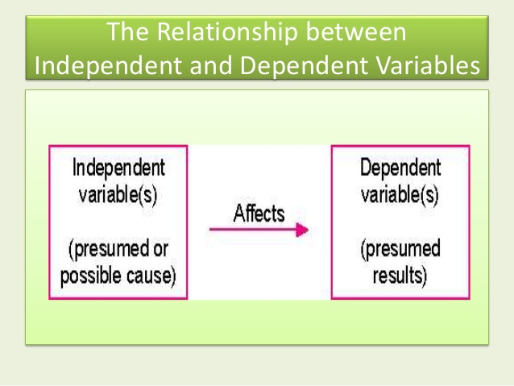

Slide 54
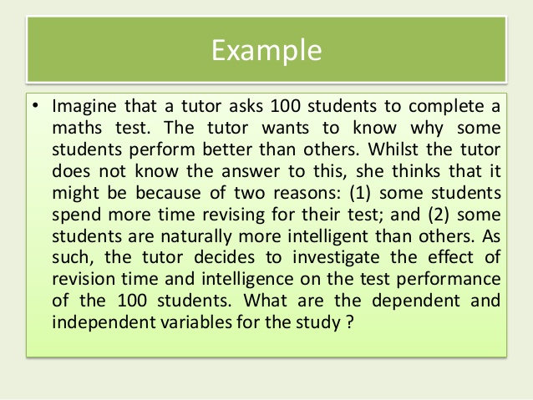
EXAMPLE

Slide 55
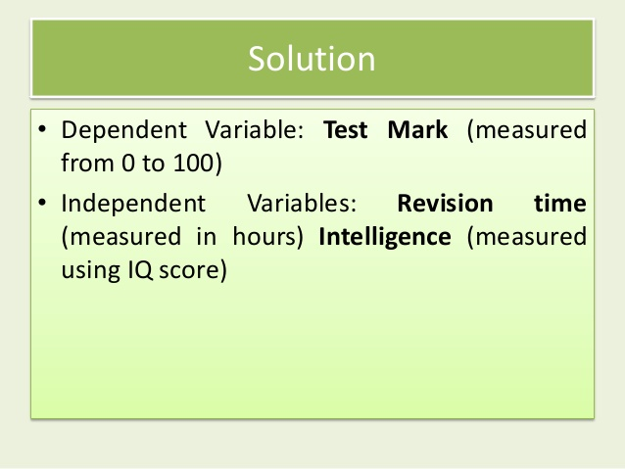

Slide 56
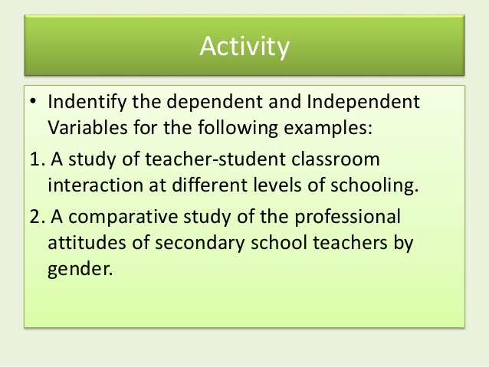

Slide 57
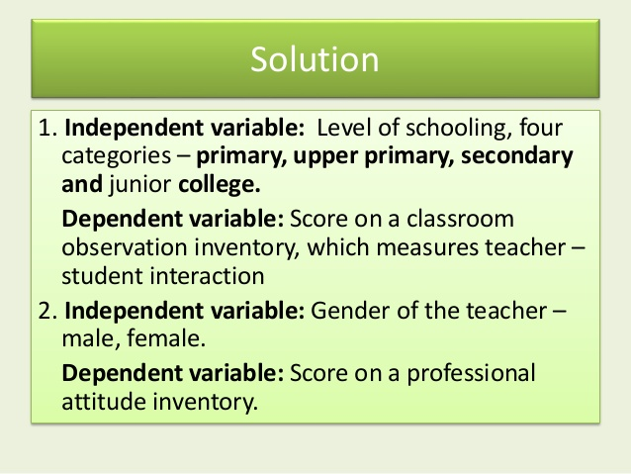

Slide 58
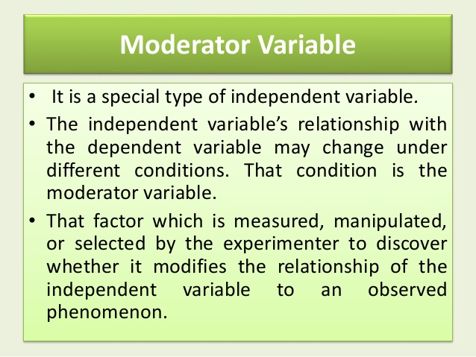

Slide 59
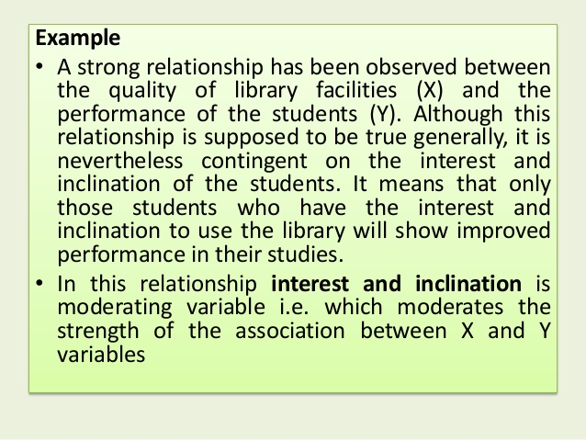

Slide 60
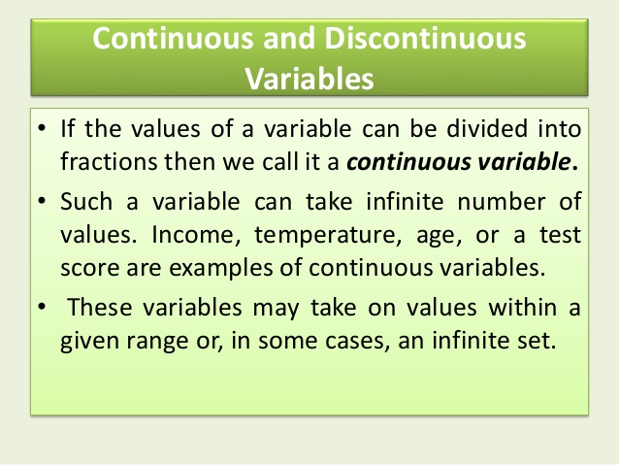

Slide 61
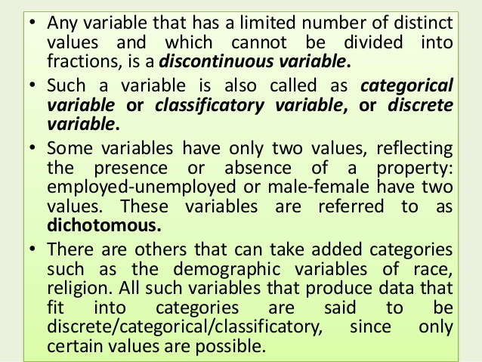

Slide 62
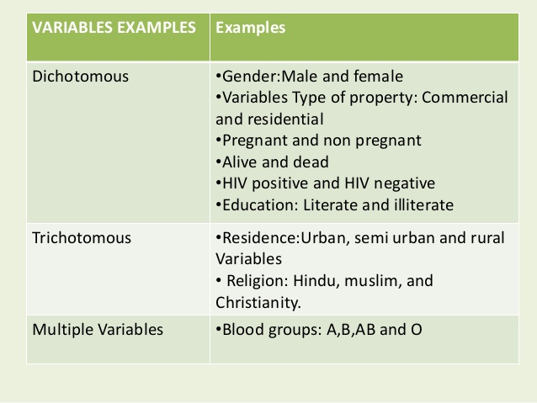

Slide 63
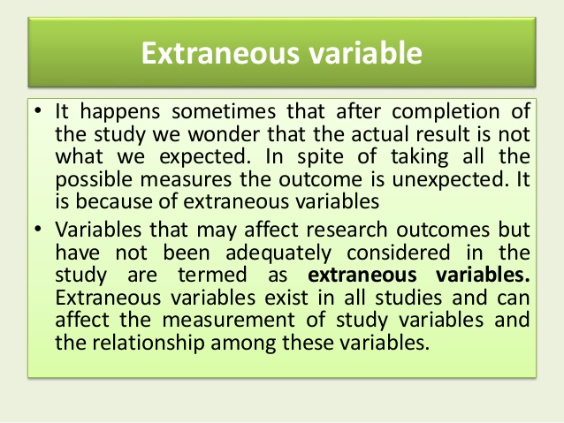

Slide 64
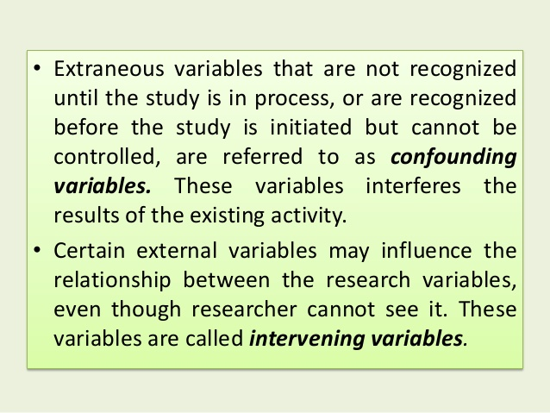

Slide 65
Research Process
Formulating the Research problem
Decide the Objectives of Research
Developing the Hypothesis
Preparing the Research Design
Determine Sample Design
Collecting the Data
Processing of Data
Analysis & Interpretation of Data
Hypothesis testing
Generalizations & Interpretations
Report Preparation
Extensive Literature Survey

Slide 66
https://www.youtube.com/watch?v=V8ndAyxkxtA

Slide 67
FORMULATION OF RESEARCH PROBLEM
Selecting the Research Topic
Any question that we want answered and any assumptions or assertion that we want to challenge or investigate can become a research problem or a research topic for our study.
Formulating problem might be easy but it require considerable of subject and research methodology.
.

Slide 68
Research Problems
Research Problem
Those related to state of nature
Those related to relationship between variables

Slide 69
Decide Objectives of Research
S – Specific
M - Measurable
A – Attainable Act as a guide to the Researcher
R – Related to the Problem that he has to achieve
T – Time bound

Slide 70
Research Process
Formulating the Research problem
Decide the Objectives of Research
Developing the Hypothesis
Preparing the Research Design
Determine Sample Design
Collecting the Data
Processing of Data
Analysis & Interpretation of Data
Hypothesis testing
Generalizations & Interpretations
Report Preparation
Extensive Literature Survey

Slide 71
Literature Survey
A brief summary of already published research work.
Journals, Books, Articles, Research Reports
Helps to re-construct and assert the Objectives of Study
Creates a background for entire research work
These references should be added in Bibliography

Slide 72


Purposes of Literature review
Determine if proposed research is actually needed.
  Even if similar research published, researchers might suggest a need for similar studies or replication.
Narrow down a problem.
  It can be overwhelming getting into the literature of a field of can help you understand where you need to focus your efforts.
study. A literature review
Generate hypotheses or questions for further studies.

Slide 73
Purposes of Literature review
Background knowledge of the field of inquiry
Facts
Eminent scholars
Parameters of the field
The most important ideas, theories, questions and
hypotheses.
Knowledge of the methodologies common to the field and a feeling for their usefulness and appropriateness in various settings.

Slide 74




Literature review
Locate different types of resources.
Decide which resources might be suitable.
Select most appropriate resources.
Revise research questions if necessary

Slide 75
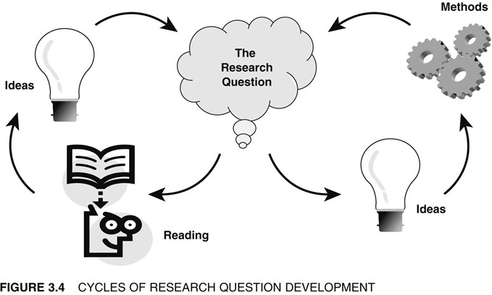
Literature review purpose

Slide 76
Research Process
Formulating the Research problem
Decide the Objectives of Research
Developing the Hypothesis
Preparing the Research Design
Determine Sample Design
Collecting the Data
Processing of Data
Analysis & Interpretation of Data
Hypothesis testing
Generalizations & Interpretations
Report Preparation
Extensive Literature Survey

Slide 77
Developing the Hypothesis
Hypothesis is a statement that suggests a proposed answer / a supposition to the research problem
A tentative assumption made in order to draw out and test its logical consequences

Slide 78
Research Process
Formulating the Research problem
Decide the Objectives of Research
Developing the Hypothesis
Preparing the Research Design
Determine Sample Design
Collecting the Data
Processing of Data
Analysis & Interpretation of Data
Hypothesis testing
Generalizations & Interpretations
Report Preparation
Extensive Literature Survey

Slide 79
Research Design/Methodology
The research design is the master plan specifying the methods and procedures for collecting and analyzing the needed information.
Grand Plan for conduct of actual research
A reference document during the execution of research project
Indicates method of research, instruments to be used in research, sampling method etc

Slide 80
Research Design
Answers the following Questions :
What is the nature of study ?
What type of data is required ?
How to collect required data ?
How much funds will be needed ?
How much time will be required ?

Slide 81
Research Process
Formulating the Research problem
Decide the Objectives of Research
Developing the Hypothesis
Preparing the Research Design
Determine Sample Design
Collecting the Data
Processing of Data
Analysis & Interpretation of Data
Hypothesis testing
Generalizations & Interpretations
Report Preparation
Extensive Literature Survey

Slide 82

Deciding Sample Design
A small representative of the entire concerned population.

Slide 83
Research Process
Formulating the Research problem
Decide the Objectives of Research
Developing the Hypothesis
Preparing the Research Design
Determine Sample Design
Collecting the Data
Processing of Data
Analysis & Interpretation of Data
Hypothesis testing
Generalizations & Interpretations
Report Preparation
Extensive Literature Survey

Slide 84
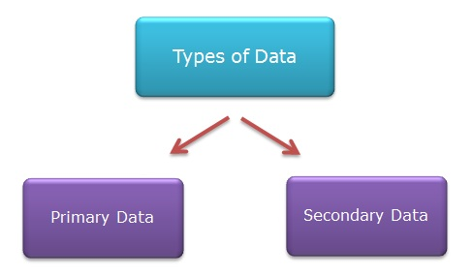
Data Collection
Here the Research moves from Planning stage to its execution stage.

Slide 85
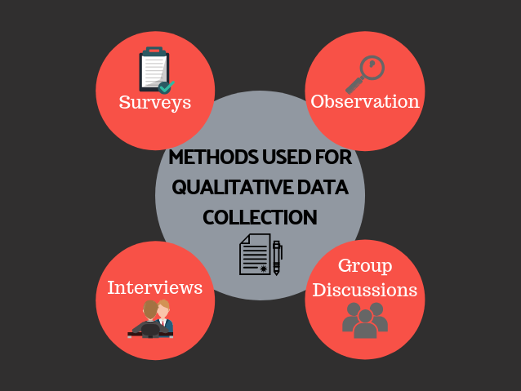

Slide 86
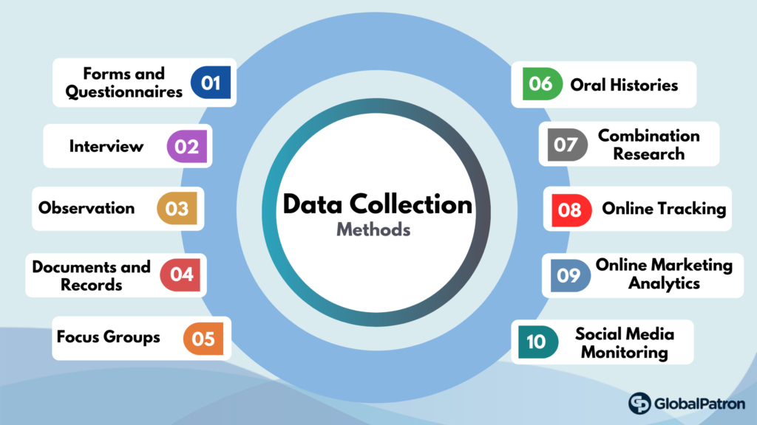

Slide 87
Research Process
Formulating the Research problem
Decide the Objectives of Research
Developing the Hypothesis
Preparing the Research Design
Determine Sample Design
Collecting the Data
Processing of Data
Analysis & Interpretation of Data
Hypothesis testing
Generalizations & Interpretations
Report Preparation
Extensive Literature Survey

Slide 88
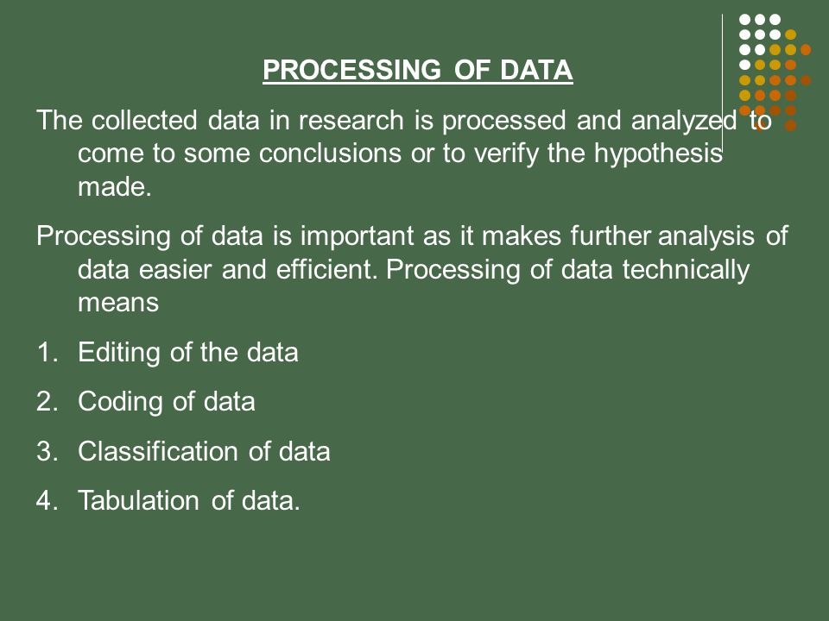
Data Processing
The process through which facts and figures are collected, coded and classified into meaningful information.

Slide 89
Research Process
Formulating the Research problem
Decide the Objectives of Research
Developing the Hypothesis
Preparing the Research Design
Determine Sample Design
Collecting the Data
Processing of Data
Analysis & Interpretation of Data
Hypothesis testing
Generalizations & Interpretations
Report Preparation
Extensive Literature Survey

Slide 90
Analysis & Interpretation of Data
Analysis of data - Logical arrangement of data to facilitate quick analysis for drawing conclusions
Interpretation of data – The process of reading & interpreting data in precise form to draw inferences.
Reads the collected facts into meaningful precise inferences

Slide 91


Slide 92
Research Process
Formulating the Research problem
Decide the Objectives of Research
Developing the Hypothesis
Preparing the Research Design
Determine Sample Design
Collecting the Data
Processing of Data
Analysis & Interpretation of Data
Hypothesis testing
Generalizations & Interpretations
Report Preparation
Extensive Literature Survey

Slide 93
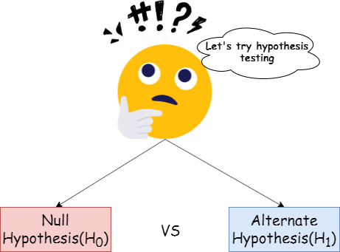
Hypothesis Testing
The researcher now tests the assumption (hypothesis) that he had made earlier.

Slide 94
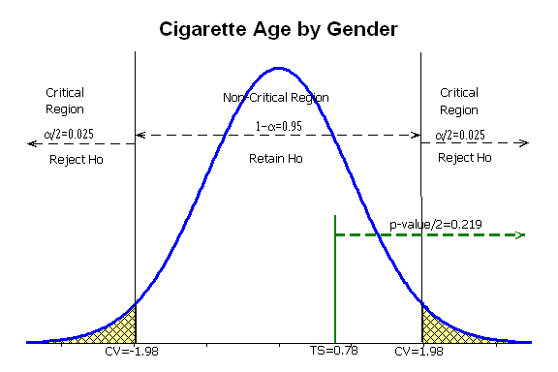

Slide 95
Research Process
Formulating the Research problem
Decide the Objectives of Research
Developing the Hypothesis
Preparing the Research Design
Determine Sample Design
Collecting the Data
Processing of Data
Analysis & Interpretation of Data
Hypothesis testing
Generalizations & Interpretations
Report Preparation
Extensive Literature Survey

Slide 96

Preparation of Research Report
Complete, compact, precise, self-explanatory document

Slide 97
Definition of research design
Research design is the framework of research methods and techniques chosen by a researcher. The design allows researchers to hone in on research methods that are suitable for the subject matter and set up their studies up for success.
Research Design is the conceptual structure within which research is conducted

Slide 98
Need and importance of research design
Smooth sailing of various research operation.
Making research efficient. Yielding maximum information with minimum expenditure.
Ensure timely execution of research work.
Facilitate organisation of resources.
Facilitate collection of relevant data.
Help to monitor expenses.
Provide direction to firld staff.
Help to select method and technique.
Achievement of research objevtive is enabled.

Slide 99
RESEARCH DESIGN
EXPLORATORY
CONCLUSIVE
DESCRIPTIVE
CAUSAL
CROSS SECTIONAL
LONGITUDINAL
SAMPLE SURVEY
SINGLE CROSS SECTIONAL
MULTIPLE CROSS SECTIONAL

Slide 100
The goal of exploratory research is to discover ideas and insights
Descriptive research is usually concerned with describing a population with respect to important variables
Causal research is used to establish cause and effect relatinships between variables

Slide 101
Exploratory Research Design
Conducted for gaining better insight into a problem
Evaluate feasibility of a research project
Formulation of a statement
Provide theoretical basis to a hypothesis.
Provide alternative approaches to the problem
Establish possibilities for further research
Used when researcher has vague idea about the study
Help in saving time and money.
Example: exploring possibility of selling particular juice in an area.

Slide 102
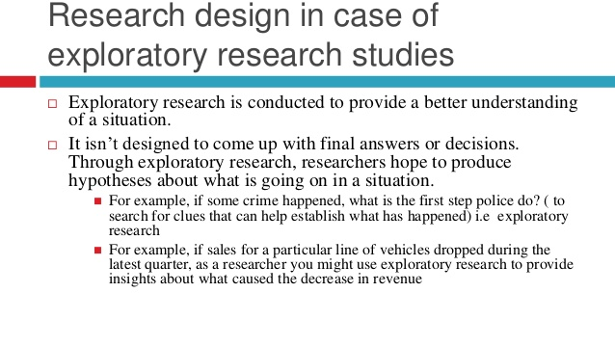
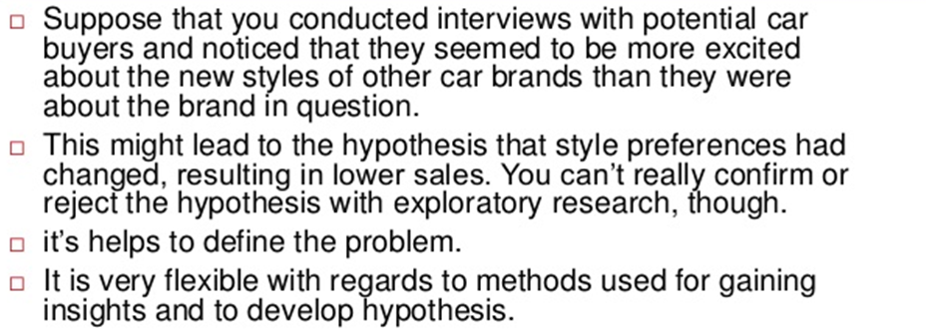
Examples of exploratory research

Slide 103
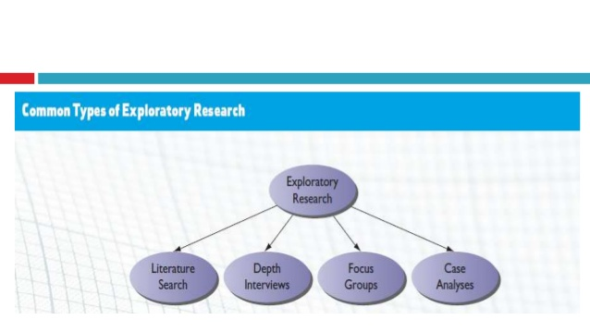
METHODS AVAILABLE TO CONDUCT EXPLORATORY RESEARCH

Slide 104
DESCRIPTIVE RESEARCH DESIGN
Descriptive research is typically concerned with describing problem and its solution.
Descriptive research requires clear specification of who, what, when, where and how of the research. Descriptive design is directed to answer these questions.
Methods of descriptive design
Case study
Naturalistic observation
Survey.

Slide 105
PURPOSE FOR USING DESCRIPTIVE RESEARCH ARE
TO describe something eg market characteristics and functions.
To describe characteristics of certain group.
To determine proportion of people who behave in a certain way.
To make specific predictions.
To determine relationships between variables

Slide 106
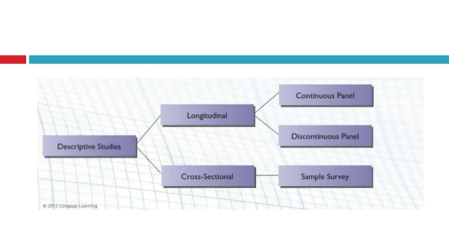
TYPE OF DESCRIPTIVE RESEARCH DESIGN

Slide 107
EXPLANATORY RESEARCH DESIGN
Main aim of research design is to identify any casual links between the factors or variables that pertain to research problem.
Sometime it is refer to as analytical study.
Explanatory research design focuses on explaining the structure in detailed manner.
Purpose of explanatory research is to
Increasing understanding
The flexibility of sources.
Better conclusion.

Slide 108
Sources of hypothesis
Hunch or Intuition
Research of others
Consultations
Theory
Analogy
Observation
Culture
Continuity of research

Slide 109
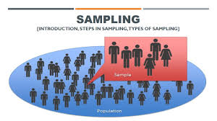

Slide 110
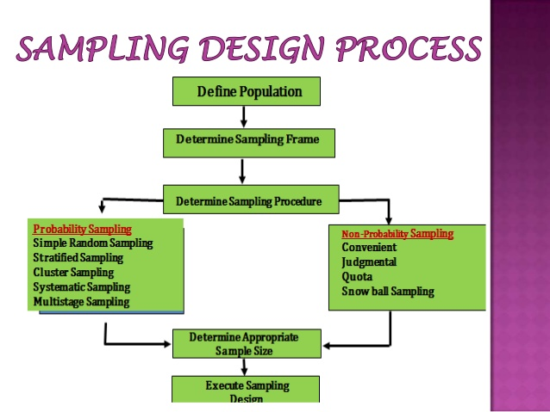

Slide 111
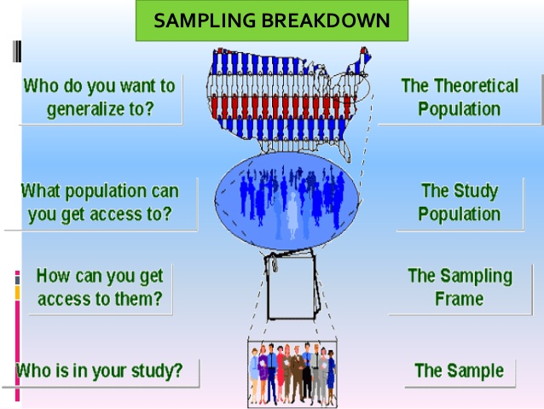

Slide 112
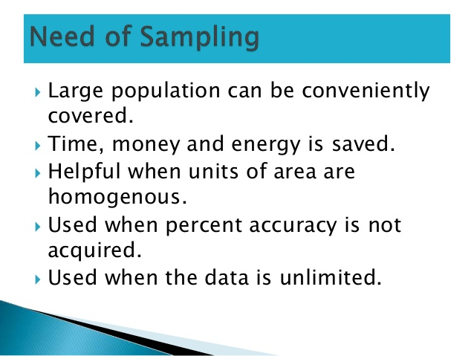

Slide 113
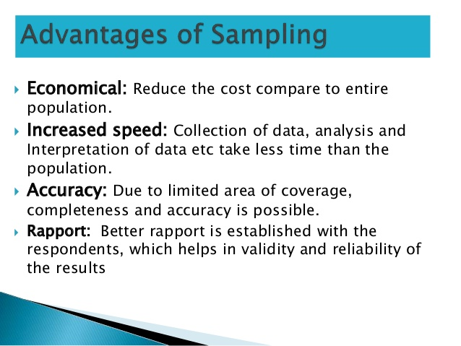

Slide 114
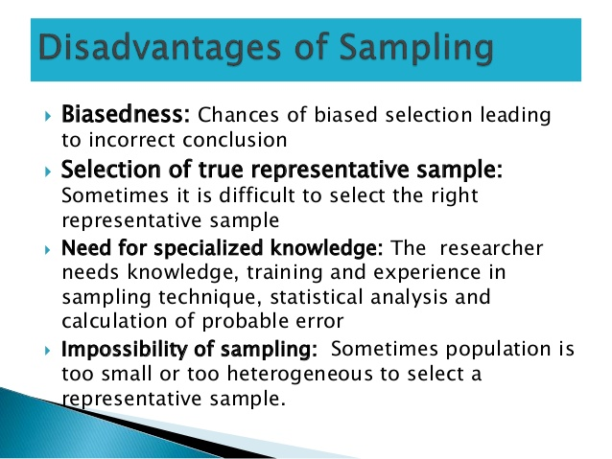

Slide 115
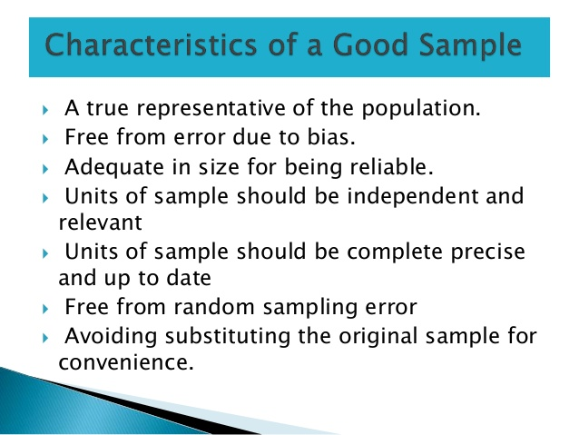

Slide 116
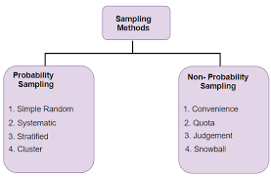

Slide 117
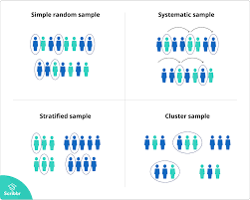

Slide 118
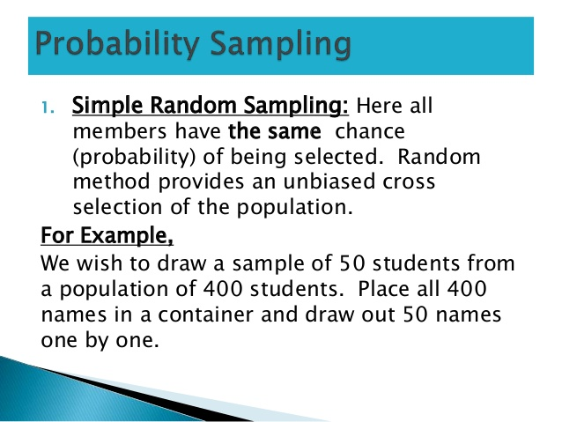

Slide 119
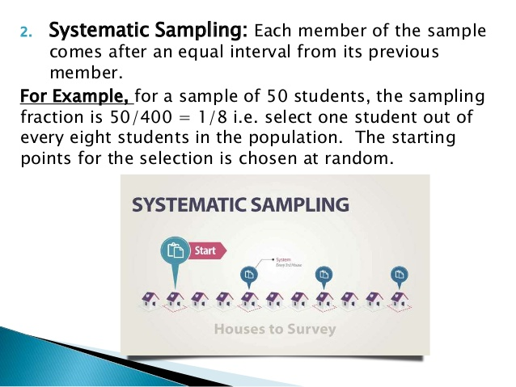

Slide 120
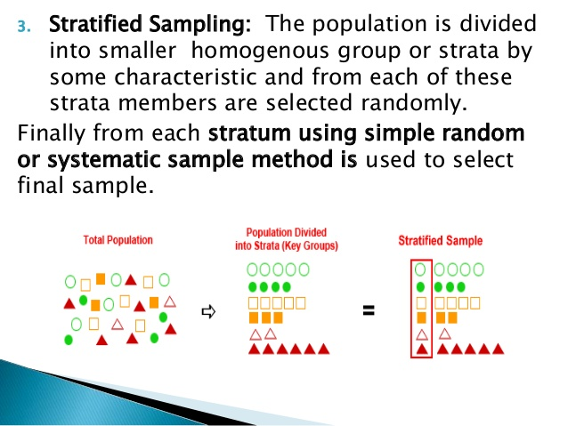

Slide 121
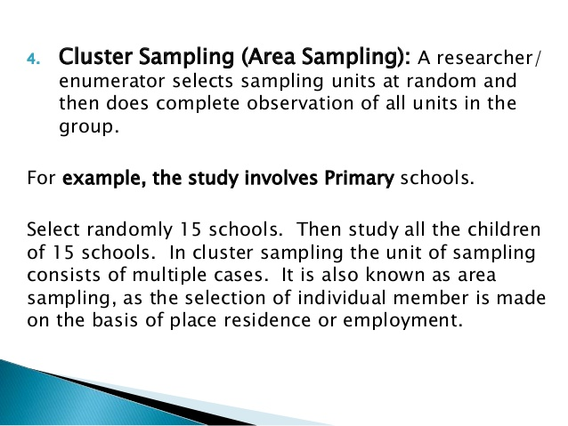

Slide 122
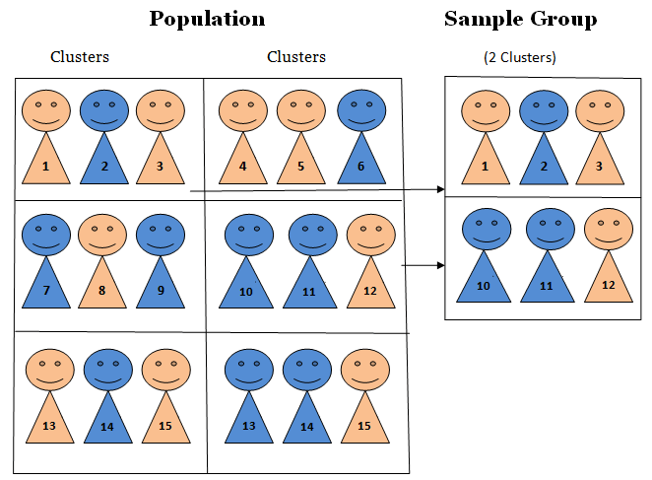

Slide 123
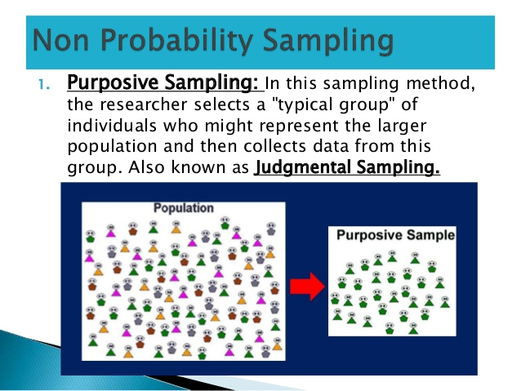

Slide 124


Slide 125


Slide 126


Slide 127


Slide 128


Slide 129


Slide 130


Slide 131


Slide 132


Slide 133


Slide 134
TECHNICAL TERMS USED IN SAMPLING
Population= It is the total number of elements with certain characteristics which forms the subject of study in a particular survey. Population can be of any group of people or objects having similarity with one another.
Census= it means complete enumeration or counting of population with respect to a specified time and well defined objectives.
Sample=It is a small portion of or a part of the population taken up for intensive examination and study purpose. A sample is a small part of the entire population having similar characteristics of the population.
Sampling Unit=it is the basis on which the sample is selected. Eg college teachers; student group; train traveller.
Sampling error: It refers to the difference between a sample estimate and the value to the population parameter obtained by complete count.
Sampling Frame=it is a list, directory, register of members, index or other records of population from which the sample can be selected. Eg telephone directory; admission register of college etc.

Slide 135
THE SAMPLING PROCESS
Decide data need
Decide the geographical area
Define the population
Select the sampling frame
Select the sampling unit
Select the sampling method
Select the sample size
Select the sample

Slide 136
DECIDE THE DATA NEED= Define and identify data requirement. This could be understood by studying the nature of the problem.
DECIDE THE AREA: defining geographical boundaries of the area to be surveyed. Eg conducting sample survey of TV viewers is too general but survey of viewers watching SONY TV is specific.
DEFINE THE POPULATION=deciding the population from which data will be selected.
Example OBJ to find out TV viewing habit of all men in the age group of 18-25 in Mumbai Western Zone.
SELECTING THE SAMPLING FRAME= a perfect sampling frame is one in which every element of the population is represented only once.
Sampling frame should be adequate, complete, no duplication, accuracy and convenience.
SELECT THE SAMPLING UNIT= it is the basic unit containing the elements of the population to be sampled. The sampling unit may be members of the population or within specified age group, income group etc.
SELECTING SAMPLING METHOD= 2 method of sampling are there. Probability sampling is scientific and without bias. Non Probability sampling is one wherein sampling unit are not selected by chance but by choice.
SELECT THE SAMPLE SIZE: to select appropriate size following issues should be considered.
Data need and purpose of research
Statistical method to be used.
Method of sampling.
Availability of time and money.

Slide 137
BASIS GOVERNING SAMPLE SELECTION
Purpose of survey
Measurability
Degree of precision
Information about population
The nature of population
Geographical area of the study
Financial resources
Time limitation
Economy

Slide 138
PURPOSE OF SURVEY
If researcher intends to generalise findings based on sample survey then appropriate probability sampling should be used.
Example: students enjoy physical learning more than online learning.
The choice of particular type of probability sampling depends on the geographical area of the study, and the size and nature of the study.
For understanding general phenomenon under study, non probability sampling are used.
Example: study to understand online buying behaviour compared to offline buying pattern.
https://www.youtube.com/watch?v=pTuj57uXWlk
https://www.youtube.com/watch?v=Gs-gLeYuDZw

Slide 139
MEASURABILITY
Where research objective requires statistical inference, the sample should be drawn by using simple random sampling or stratified random sampling depending on whether the population is homogenous or heterogenous
DEGREE OF PRECISION
A high degree of precision of result requires probability sampling.
Where crude result will also serve the purpose, convenient non random sampling like quota sampling is enough..

Slide 140
NATURE OF THE POPULATION
If the population is homogenous simple random sampling will do but if the the population is heterogenous stratified random sampling is required.
GEOGRAPHICAL AREA OF THE STUDY
If the area covered in the survey is huge and size of the population large then, multi stage cluster sampling would be most appropriate. On the other hand if population is small then normal probability sampling will do.

Slide 141
FINANCIAL RESOURCES
If finance is not a constraint then most appropriate sample should be selected.
TIME LIMITATION
If time is limited then researcher has to compromise and use simple random sampling in place of stratified sampling
INFORMATION ABOUT POPULATION
Exploratory study can be done with non probability sampling to gain better idea about the population. After gaining sufficient knowledge about the population through the exploratory study, appropriate probability sampling design can be created

Slide 145


Slide 153

Simple Random Sampling

Slide 156


Slide 158
Cluster Sampling

Slide 166
TECHNICAL TERMS USED IN SAMPLING
Population= It is the total number of elements with certain characteristics which forms the subject of study in a particular survey. Population can be of any group of people or objects having similarity with one another.
Census= it means complete enumeration or counting of population with respect to a specified time and well defined objectives.
Sample=It is a small portion of or a part of the population taken up for intensive examination and study purpose. A sample is a small part of the entire population having similar characteristics of the population.
Sampling Unit=it is the basis on which the sample is selected. Eg college teachers; student group; train traveller.
Sampling error: It refers to the difference between a sample estimate and the value to the population parameter obtained by complete count.
Sampling Frame=it is a list, directory, register of members, index or other records of population from which the sample can be selected. Eg telephone directory; admission register of college etc.

Slide 167
THE SAMPLING PROCESS
Decide data need
Decide the geographical area
Define the population
Select the sampling frame
Select the sampling unit
Select the sampling method
Select the sample size
Select the sample

Slide 168
DECIDE THE DATA NEED= Define and identify data requirement. This could be understood by studying the nature of the problem.
DECIDE THE AREA: defining geographical boundaries of the area to be surveyed. Eg conducting sample survey of TV viewers is too general but survey of viewers watching SONY TV is specific.
DEFINE THE POPULATION=deciding the population from which data will be selected.
Example OBJ to find out TV viewing habit of all men in the age group of 18-25 in Mumbai Western Zone.
SELECTING THE SAMPLING FRAME= a perfect sampling frame is one in which every element of the population is represented only once.
Sampling frame should be adequate, complete, no duplication, accuracy and convenience.
SELECT THE SAMPLING UNIT= it is the basic unit containing the elements of the population to be sampled. The sampling unit may be members of the population or within specified age group, income group etc.
SELECTING SAMPLING METHOD= 2 method of sampling are there. Probability sampling is scientific and without bias. Non Probability sampling is one wherein sampling unit are not selected by chance but by choice.
SELECT THE SAMPLE SIZE: to select appropriate size following issues should be considered.
Data need and purpose of research
Statistical method to be used.
Method of sampling.
Availability of time and money.

Slide 169
BASIS GOVERNING SAMPLE SELECTION
Purpose of survey
Measurability
Degree of precision
Information about population
The nature of population
Geographical area of the study
Financial resources
Time limitation
Economy

Slide 170
PURPOSE OF SURVEY
If researcher intends to generalise findings based on sample survey then appropriate probability sampling should be used.
Example: students enjoy physical learning more than online learning.
The choice of particular type of probability sampling depends on the geographical area of the study, and the size and nature of the study.
For understanding general phenomenon under study, non probability sampling are used.
Example: study to understand online buying behaviour compared to offline buying pattern.
https://www.youtube.com/watch?v=pTuj57uXWlk
https://www.youtube.com/watch?v=Gs-gLeYuDZw

Slide 171
MEASURABILITY
Where research objective requires statistical inference, the sample should be drawn by using simple random sampling or stratified random sampling depending on whether the population is homogenous or heterogenous
DEGREE OF PRECISION
A high degree of precision of result requires probability sampling.
Where crude result will also serve the purpose, convenient non random sampling like quota sampling is enough..

Slide 172
NATURE OF THE POPULATION
If the population is homogenous simple random sampling will do but if the the population is heterogenous stratified random sampling is required.
GEOGRAPHICAL AREA OF THE STUDY
If the area covered in the survey is huge and size of the population large then, multi stage cluster sampling would be most appropriate. On the other hand if population is small then normal probability sampling will do.

Slide 173
FINANCIAL RESOURCES
If finance is not a constraint then most appropriate sample should be selected.
TIME LIMITATION
If time is limited then researcher has to compromise and use simple random sampling in place of stratified sampling
INFORMATION ABOUT POPULATION
Exploratory study can be done with non probability sampling to gain better idea about the population. After gaining sufficient knowledge about the population through the exploratory study, appropriate probability sampling design can be created

