Slide 1
Stress and Conflict

Slide 2

Are you stressed?
What stresses you our?
How do you currently deal with stress?

Slide 3
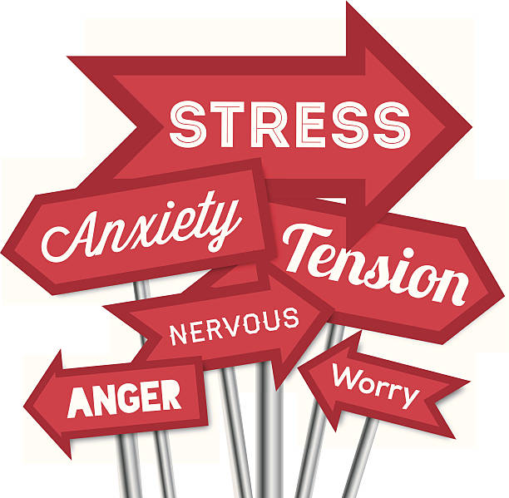
What Is Stress?
Stress can be defined as any type of change that causes physical, emotional, or psychological strain.
Stress is your body's response to anything that requires attention or action.
Everyone experiences stress to some degree. The way you respond to stress, however, makes a big difference to your overall well-being.
Sometimes, the best way to manage your stress involves changing your situation. At other times, the best strategy involves changing the way you respond to the situation.

Slide 4
Signs
Stress can be short-term or long-term. Both can lead to a variety of symptoms, but chronic stress can take a serious toll on the body over time and have long-lasting health effects.

Slide 5
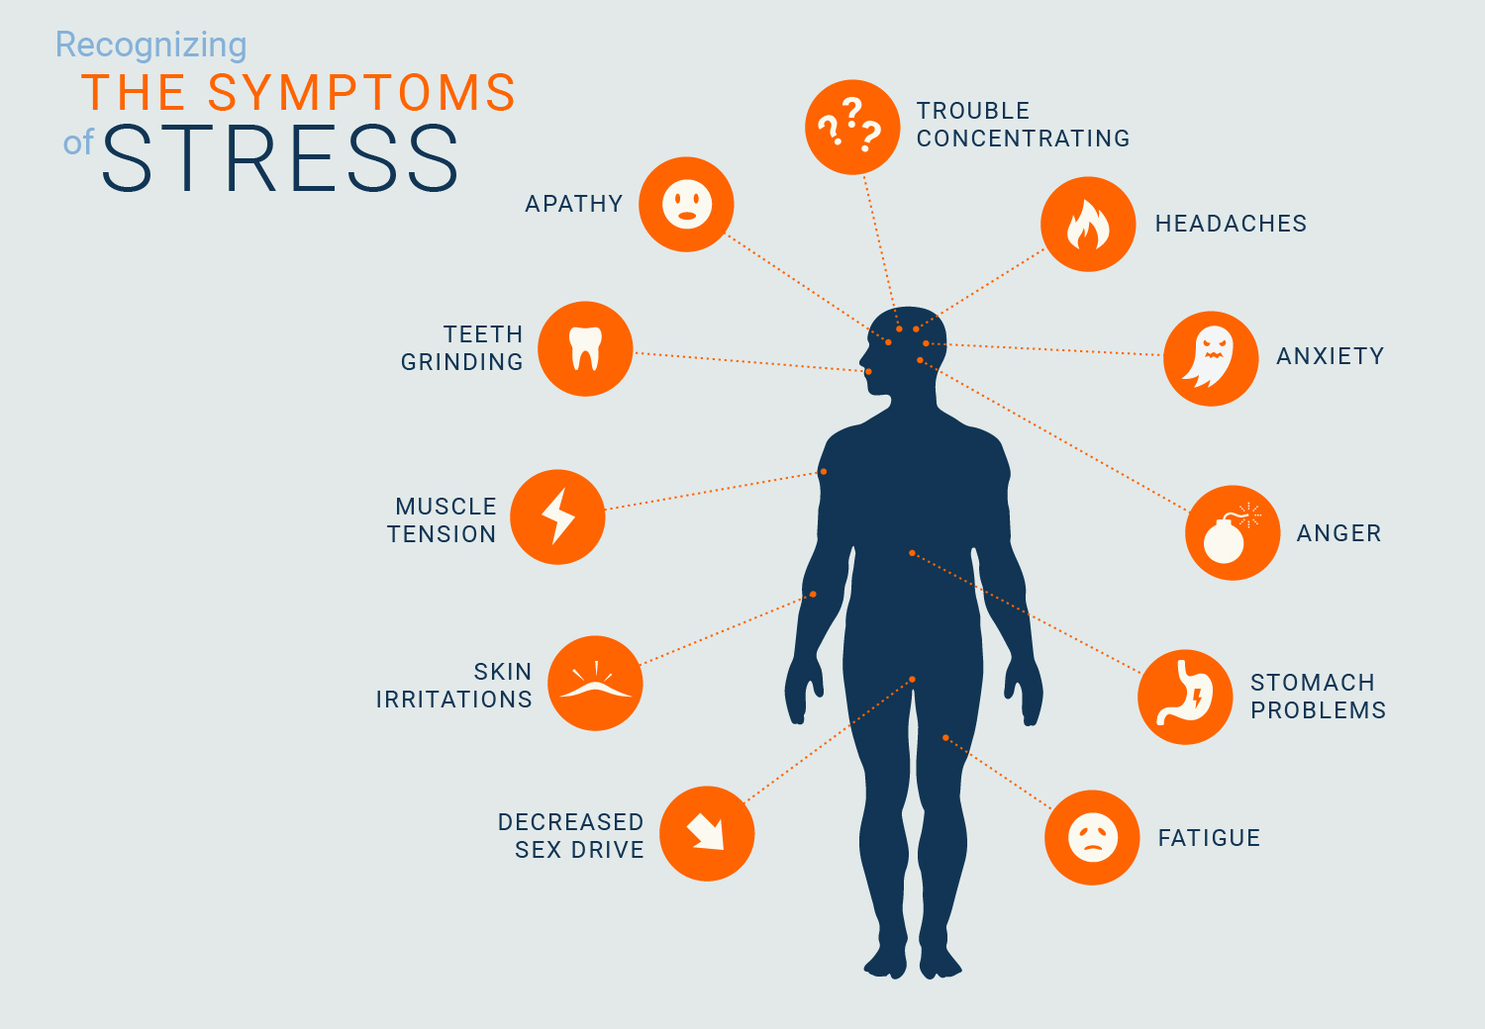
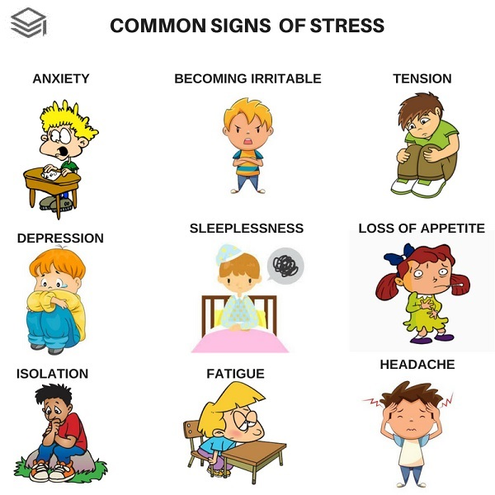
Some common signs of stress include:

Slide 6
Identifying Stress
Stress is not always easy to recognize, but there are some ways to identify some signs that you might be experiencing too much pressure.
Sometimes stress can come from an obvious source, but sometimes even small daily stresses from work, school, family, and friends can take a toll on your mind and body.

Slide 7
Psychological signs such as difficulty concentrating, worrying, anxiety, and trouble remembering
Emotional signs such as being angry, irritated, moody, or frustrated
Physical signs such as high blood pressure, changes in weight, frequent colds or infections, and changes in the menstrual cycle and libido
Behavioral signs such as poor self-care, not having time for the things you enjoy, or relying on drugs and alcohol to cope

Slide 8
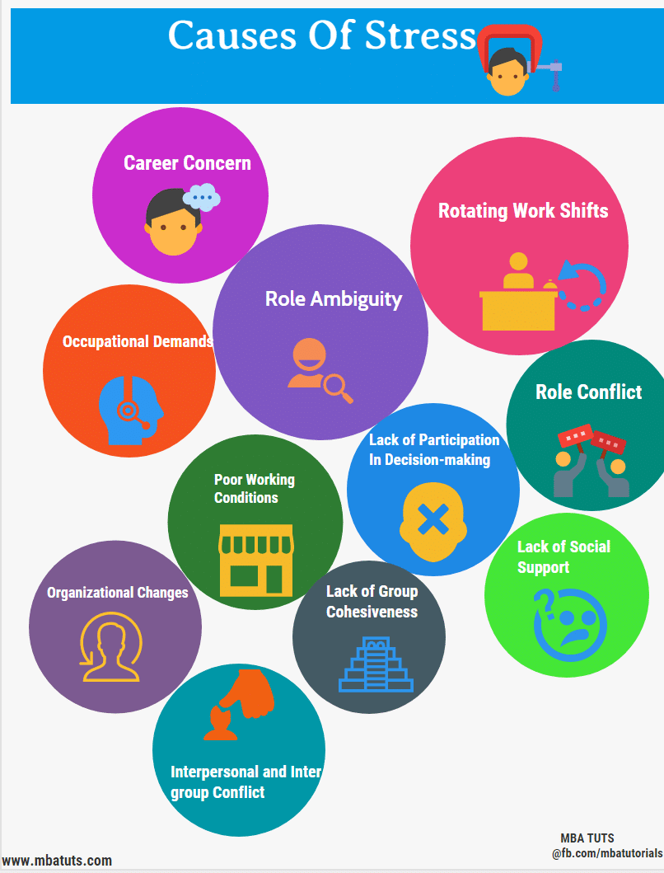
Causes
There are many different things in life that can cause stress.
Some of the main sources of stress include:
Work,
Finances,
Relationships,
Parenting,
Day-to-day Inconveniences.

Slide 9
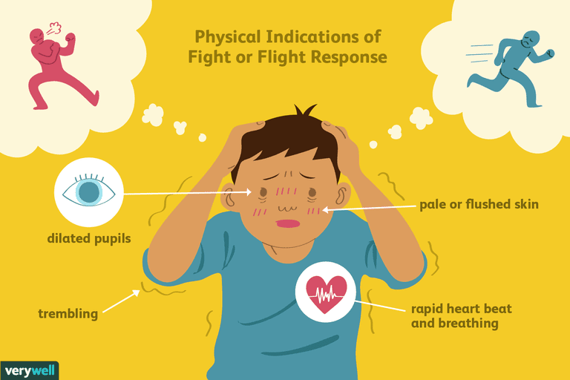
Stress can trigger the body’s response to a perceived threat or danger, known as the fight-or-flight response.
During this reaction, certain hormones like adrenaline and cortisol are released. This speeds the heart rate, slows digestion, shunts blood flow to major muscle groups, and changes various other autonomic nervous functions, giving the body a burst of energy and strength.

Slide 10
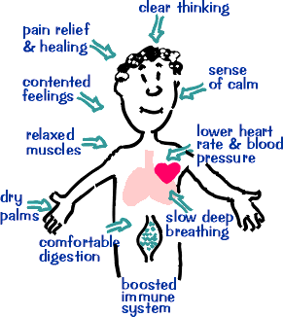
When the perceived threat is gone, systems are designed to return to normal function via the relaxation response.
But in cases of chronic stress, the relaxation response doesn't occur often enough, and being in a near-constant state of fight-or-flight can cause damage to the body.

Slide 11
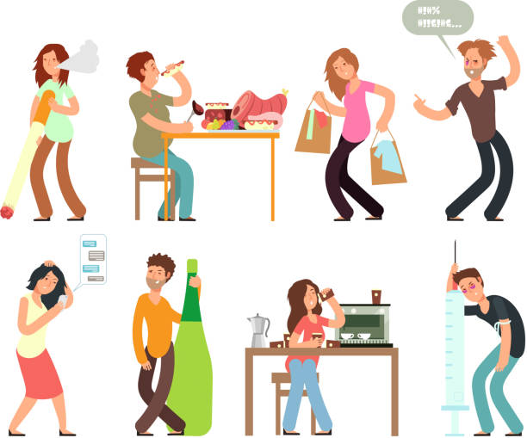
Stress can also lead to some unhealthy habits that have a negative impact on your health.
For example, many people cope with stress by eating too much or by smoking. These unhealthy habits damage the body and create bigger problems in the long-term.

Slide 12
Types of Stress
Some of the different types of stress that you might experience include:
Acute stress: Acute stress is a very short-term type of stress that can either be positive or more distressing; this is the type of stress we most often encounter in day-to-day life.
Chronic stress: Chronic stress is stress that seems never-ending and inescapable, like the stress of a bad marriage or an extremely taxing job; chronic stress can also stem from traumatic experiences and childhood trauma.
Episodic acute stress: Episodic acute stress is acute stress that seems to run rampant and be a way of life, creating a life of ongoing distress.

Slide 13
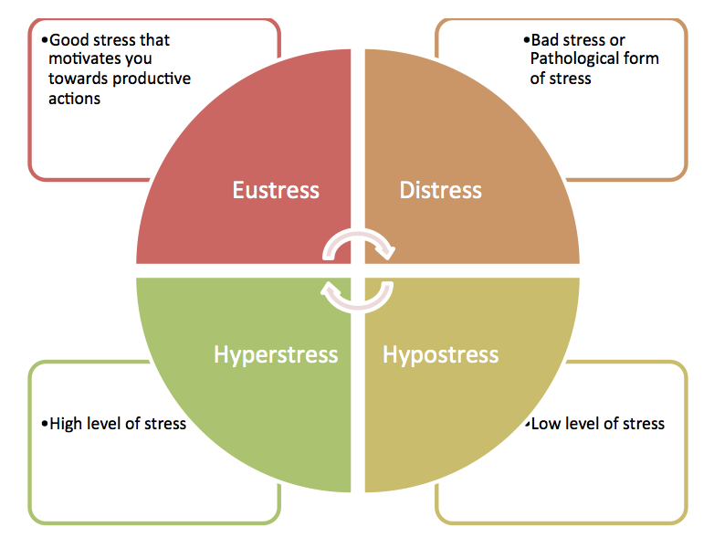

Slide 14
Impact of Stress
The connection between your mind and body is apparent when you examine the impact stress has on your life.
Feeling stressed out over a relationship, money, or your living situation can create physical health issues. The inverse is also true.
Health problems, whether you're dealing with high blood pressure or you have diabetes, will also affect your stress level and your mental health. When your brain experiences high degrees of stress, your body reacts accordingly.

Slide 15
Serious acute stress, like being involved in a natural disaster or getting into a verbal altercation, can trigger heart attacks, arrhythmias, and even sudden death. However, this happens mostly in individuals who already have heart disease.
Stress also takes an emotional toll. While some stress may produce feelings of mild anxiety or frustration, prolonged stress can also lead to burnout, anxiety disorders, and depression.
Chronic stress can have a serious impact on your health as well. If you experience chronic stress, your autonomic nervous system will be overactive, which is likely to damage your body.

Slide 16
Stress-Influenced Conditions
Diabetes
Hair loss
Heart disease
Hyperthyroidism
Obesity
Sexual dysfunction
Tooth and gum disease
Ulcers

Slide 17
Treatment
Stress is not a distinct medical diagnosis and there is no single, specific treatment for it.
Treatment for stress focuses on changing the situation, developing stress coping skills, implementing relaxation techniques, and treating symptoms or conditions that may have been caused by chronic stress.
Some interventions that may be helpful include therapy, medication, and complementary and alternative medicine (CAM).

Slide 18
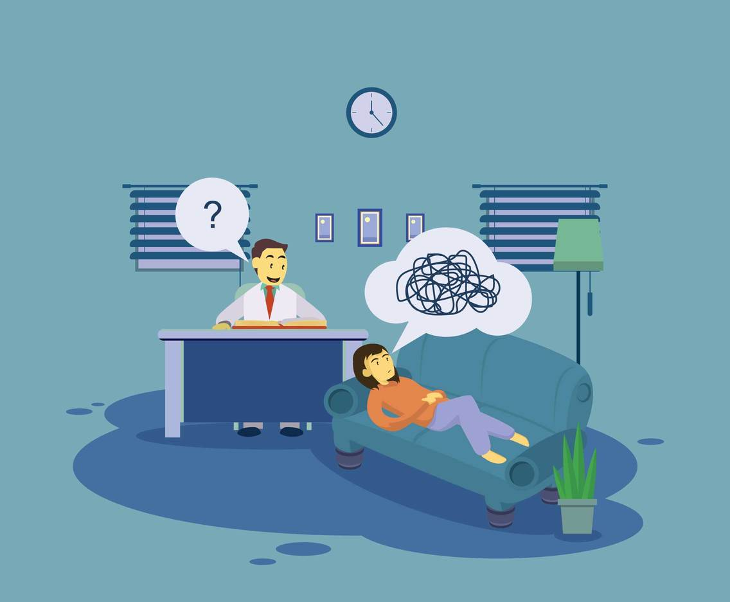
Psychotherapy
Some forms of therapy that may be particularly helpful in addressing symptoms of stress including cognitive behavioral therapy(CBT) and mindfulness-based stress reduction (MBSR).
CBT focuses on helping people identify and change negative thinking patterns, while MBSR utilizes meditation and mindfulness to help reduce stress levels.

Slide 19
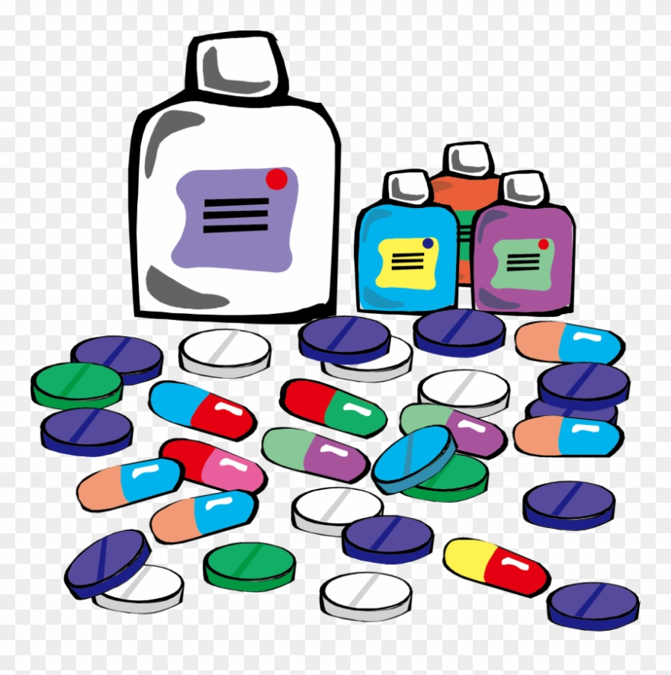
Medication
Medication may sometimes be prescribed to address some specific symptoms that are related to stress. Such medications may include sleep aids, antacids, antidepressants, and anti-anxiety medications.
Some complementary approaches that may also be helpful for reducing stress include acupuncture, aromatherapy, massage, yoga, and meditation.

Slide 20
Coping
Although stress is inevitable, it can be manageable. When you understand the toll it takes on you and the steps to combat stress, you can take charge of your health and reduce the impact stress has on your life.
Learn to recognize the signs of burnout. High levels of stress may place you at a high risk of burnout. Burnout can leave you feeling exhausted and apathetic about your job. When you start to feel symptoms of emotional exhaustion, it's a sign that you need to find a way to get a handle on your stress.
Try to get regular exercise. Physical activity has a big impact on your brain and your body. Whether you enjoy Tai Chi or you want to begin jogging, exercise reduces stress and improves many symptoms associated with mental illness.

Slide 21
Take care of yourself. Incorporating regular self-care activities into your daily life is essential to stress management. Learn how to take care of your mind, body, and spirit and discover how to equip yourself to live your best life.
Practice mindfulness in your life. Mindfulness isn't just something you practice for 10 minutes each day. It can also be a way of life. Discover how to live more mindfully throughout your day so you can become more awake and conscious throughout your life.

