Slide 1
Mobile Agents and WAP
Module 3

Slide 2
Mobile Agents
Mobile Agents are the composition of computer software and data that can autonomously move from one computer to another computer and continue its execution on the destination computer.
In other words, you can say that An Mobile Agent is an autonomous program that is capable of moving from host to host in a network and interact with resources and other agents.
In this process, the chance of data loss is scarce because the state of the running program is saved and then transported to the new host.
It allows the program to continue execution from where it left off before migration.

Slide 3
The most significant advantage of mobile agents is the possibility of moving complex processing functions to the location where you have enormous amounts of data and that have to be processed.
Mobile Agents are also called as transportable agents.
They are classified into two types:
Mobile Agents with pre-defined path: They have a static migration path.
Mobile Agents with undefined path i.e., Roamer: They have dynamic migration paths. The mobile agents choose their path according to the present network condition.

Slide 4
Features of Mobile Agents
The mobile agents are autonomous with intelligence, social ability, learning, and the most important feature is their mobility.
They are independent in nature, self-driven and do not require a corresponding node for communication.
They can work efficiently even after the user gets disconnected from the network.

Slide 5
Properties
Autonomy:-Independent to user
Adaptive learning:-adaptive in environment
Mobility:-jumping from one node to another node
Rationality:-Do not divert from its goal.

Slide 6
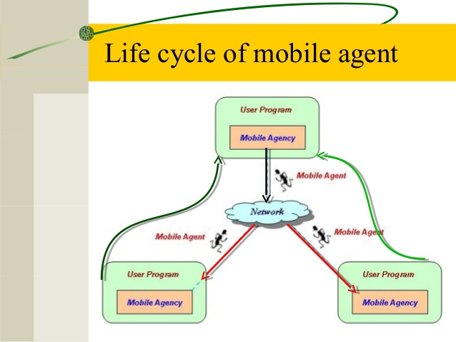
Life Cycle of Mobile Agents
The life cycle of mobile agents ensures the following conditions:
They can adapt to the environment. For example, either home or foreign environment.
They are capable of switching among the positions of one node to another.
They are autonomous and focused on the final output.

Slide 7
Advantages of Mobile Agents
Mobile Agents are autonomous and self-driven in nature.
They are maintenance-friendly or easily maintainable.
They are Fault-tolerant. It means they are able to operate without an active connection between client and server.
They reduce the compilation time.
They provide less delay in the network.
They provide fewer loads on the network.
They facilitate parallel processing. It means they can be asynchronously executed on multiple heterogeneous network hosts.
They provide dynamic adaptation in which their actions are dependent on the state of the host environment.

Slide 8
Disadvantages of Mobile Agents
The most significant disadvantage of mobile agents is their security. They are less secured
Applications of Mobile Agents
Mobile Agents are applied in a wide range of domains such as E-commerce, traffic control, network management, robotics, data-intensive applications etc.
They are also used in grid computing, parallel computing, distributed computing and mobile computing etc.

Slide 9
Security Issues
Mobile agent systems provide a computing infrastructure upon which mobile agents belonging to different and potentially untrusted users can execute.
The communication medium is inherently insecure.
In this scenario, a variety of attacks can be conceived.
Unauthorized users may eavesdrop network traffic and observe agents in action, or worse an active intruder may modify the code, data or state of an agent in transit.
Agents may attack the agent platform (host) supporting their execution to gain unauthorized access to resources.
Note that some of these problems are typical in conventional distributed (client/server) systems and are solved by cryptographic techniques.

Slide 10
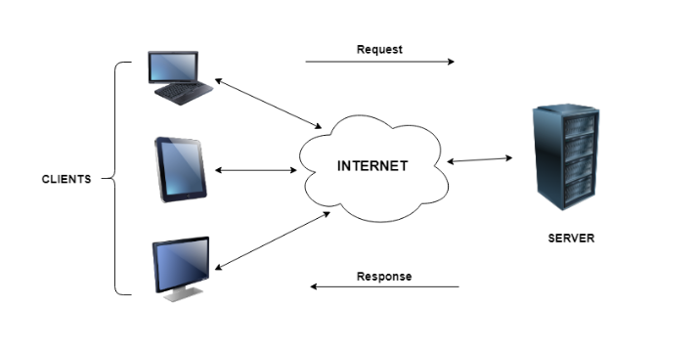
Client-Server Approach
In client server computing, the clients requests a resource and the server provides that resource.
A server may serve multiple clients at the same time while a client is in contact with only one server.
Both the client and server usually communicate via a computer network but sometimes they may reside in the same system.

Slide 11
How the Client-Server Model works ?
Client: When we talk the word Client, it mean to talk of a person or an organization using a particular service. Similarly in the digital world a Client is a computer (Host) i.e. capable of receiving information or using a particular service from the service providers (Servers).
Servers: Similarly, when we talk the word Servers, It mean a person or medium that serves something. Similarly in this digital world a Server is a remote computer which provides information (data) or access to particular services.

Slide 12
Advantages of Client-Server model:
Centralized system with all data in a single place.
Cost efficient requires less maintenance cost and Data recovery is possible.
The capacity of the Client and Servers can be changed separately.

Slide 13
Disadvantages of Client-Server model:
Clients are prone to viruses, Trojans and worms if present in the Server or uploaded into the Server.
Server are prone to Denial of Service (DOS) attacks.
Data packets may be spoofed or modified during transmission.
Phishing or capturing login credentials or other useful information of the user are common and MITM(Man in the Middle) attacks are common.

Slide 14
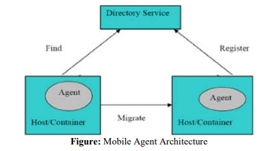
Mobile Agent Based Approach
The architecture gives the structure of the system which consists of some components, their individual functionalities and their interrelationship with each other.
The basic architecture of the mobile agent can be thought of as a client sends out an agent who travels the network visiting servers in order to perform some required action.

Slide 15
Agent Manager: Agent manager has few responsibilities as it:
Sends agents to and receives agents from remote hosts.
Prepares agents for transport by serializing the agent.
Reconstructs received agents and creates the agents execution context.
Security Manager: Responsibilities of security manager are:
Authenticates agents before allowing execution.
Automatically invoked when the agents tries to use any system resource or tries for any unauthorized activity.
Protects the host and agent from unauthorized access.

Slide 16
Directory Manager: Lists names and addresses of services and agents
The agent first migrates to remote container and registers itself to the Directory Services.
When any other agent needs to find some agent it contacts the Directory Services for help.
Language: The architecture of a mobile agent system describes the flow of information among the various components of the system.
The language used for the efficient transfer of data and provides the developer with the tools to efficiently implements the system.
Most current agent systems are implemented on top of the Java Virtual Machine (JVM), which provides object serialization and basic mechanism to implement weak mobility.

Slide 17
Agent Platform:
Mobile agents are the basis of the emerging technology which makes it easier to design, implement and maintain distributed systems.
Mobile agents have the unique ability to transport themselves from one system in a network to another.
We found that mobile agents reduce network traffic, overcome network latency and most importantly their ability to operate asynchronously and autonomously.
It helps us to construct more robust and fault tolerant systems

Slide 18
Advantages
Mobile agent moves computation code to data, and the intermediate results passing are reduced. The network bandwidth consumption is reduced.
The agents do not require a continuous connection between machines. The client can dispatch an agent into the network when the network connection is healthy , then it can go offline.
Agent operates asynchronously and autonomously, and the user doesn't need to monitor the agent as it roams in the Internet. This saves time for the user , reduces communication costs, and decentralizes network structure.

Slide 19
Disadvantages
The main problem with mobile agent is security, which is still an area of research on its own.
In an agent system with a low level of security, the mobile agent may harm the host or the host may harm the mobile agent.

Slide 20
Mobile Computing
Mobile Computing is a technology that allows transmission of data, voice and video via a computer or any other wireless enabled device without having to be connected to a fixed physical link.
Thus, having such a big coverage diameter, it is one of the fastest and most reliable sectors of computing technology field.
The main concept involves −
  Mobile communication
  Mobile hardware
  Mobile software

Slide 21
Mobile communication
The mobile communication in this case, refers to the infrastructure put in place to ensure that seamless and reliable communication goes on.
These would include devices such as protocols, services, bandwidth, and portals necessary to facilitate and support the stated services.
The data format is also defined at this stage.
This ensures that there is no collision with other existing systems which offer the same service.
That is, the signals are carried over the air to intended devices that are capable of receiving and sending similar kinds of signals.

Slide 22
Mobile Hardware
Mobile hardware includes mobile devices or device components that receive or access the service of mobility.
They would range from portable laptops, smartphones, tablet Pc's, Personal Digital Assistants.
These devices will have a receptor medium that is capable of sensing and receiving signals.
These devices are configured to operate in full- duplex, whereby they are capable of sending and receiving signals at the same time.
They don't have to wait until one device has finished communicating for the other device to initiate communications.

Slide 23
Mobile software
Mobile software is the actual program that runs on the mobile hardware.
It deals with the characteristics and requirements of mobile applications.
This is the engine of the mobile device. In other terms, it is the operating system of the appliance. It's the essential component that operates the mobile device
Since portability is the main factor, this type of computing ensures that users are not tied or pinned to a single physical location, but are able to operate from anywhere.
It incorporates all aspects of wireless communications.

Slide 24
Advantages
Location Flexibility
Saves Time
Enhanced Productivity
Ease of Research
Entertainment
Streamlining of Business Processes

Slide 25
Wireless Application Protocol
WAP stands for Wireless Application Protocol.
It is a protocol designed for micro-browsers and it enables the access of internet in the mobile devices.
It uses the mark-up language WML (Wireless Markup Language and not HTML), WML is defined as XML 1.0 application.
It enables creating web applications for mobile devices.
In 1998, WAP Forum was founded by Ericson, Motorola, Nokia and Unwired Planet whose aim was to standardize the various wireless technologies via protocols.

Slide 26
WAP stands for Wireless Application Protocol. The dictionary definition of these terms are as follows −
Wireless − Lacking or not requiring a wire or wires pertaining to radio transmission.
Application − A computer program or piece of computer software that is designed to do a specific task.
Protocol − A set of technical rules about how information should be transmitted and received using computers.

Slide 27
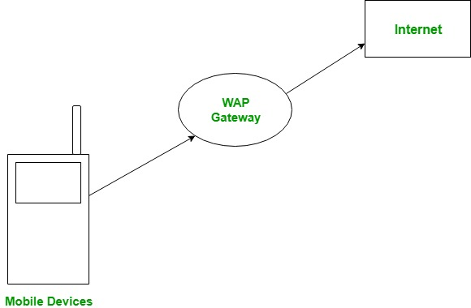
WAP protocol was resulted by the joint efforts of the various members of WAP Forum.
In 2002, WAP forum was merged with various other forums of the industry resulting in the formation of Open Mobile Alliance (OMA).

Slide 28
WAP is the set of rules governing the transmission and reception of data by computer applications on or via wireless devices like mobile phones.
WAP allows wireless devices to view specifically designed pages from the Internet using only plain text and very simple black-and-white pictures.

Slide 29
WAP is a standardized technology for cross-platform, distributed computing very similar to the Internet's combination of Hypertext Markup Language (HTML) and Hypertext Transfer Protocol (HTTP), except that it is optimized for:
  low-display capability
  low-memory
  low-bandwidth devices, such as personal digital assistants (PDAs), wireless phones, and pagers.
WAP is designed to scale across a broad range of wireless networks like GSM, IS-95, IS-136, and PDC.

Slide 30
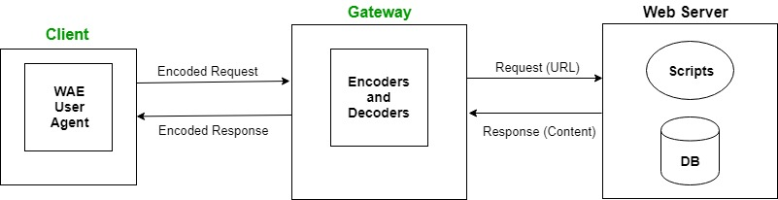
WAP Model:
The user opens the mini-browser in a mobile device.
He selects a website that he wants to view.
The mobile device sends the URL encoded request via network to a WAP gateway using WAP protocol.

Slide 31
The WAP gateway translates this WAP request into a conventional HTTP URL request and sends it over the internet.
The request reaches to a specified Web server and it processes the request just as it would have processed any other request and sends the response back to the mobile device through WAP gateway in WML file which can be seen in the micro-browser.

Slide 32
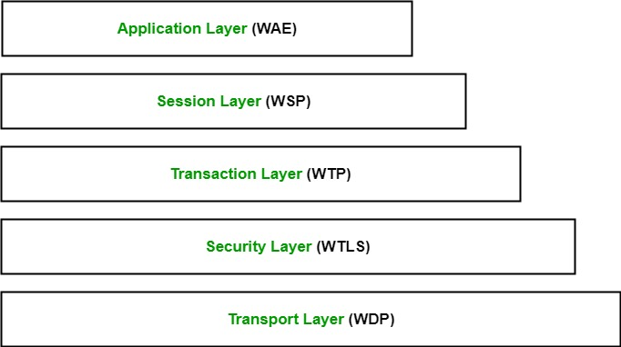
WAP Protocol stack:

Slide 33
Application Layer:
This layer contains the Wireless Application Environment (WAE). It contains mobile device specifications and content development programming languages like WML.
Session Layer:
This layer contains Wireless Session Protocol (WSP). It provides fast connection suspension and reconnection.
Transaction Layer:
This layer contains Wireless Transaction Protocol (WTP). It runs on top of UDP (User Datagram Protocol) and is a part of TCP/IP and offers transaction support.

Slide 34
Security Layer:
This layer contains Wireless Transaction Layer Security (WTLS). It offers data integrity, privacy and authentication.
Transport Layer:
This layer contains Wireless Datagram Protocol. It presents consistent data format to higher layers of WAP protocol stack.

Slide 35
Benefits of WAP
Subscribers
It is crucial that the subscribers benefit from using WAP based services. The key benefits can be summarized as −
  Portability
  Easy to use
  Access to a wide variety of services on a competitive market
  The possibility of having personalized services
  Fast, convenient, and efficient access to services
  To fulfil as many customers needs as possible, WAP devices will be available in various form factors, e.g. pagers, handheld PCs, and phones

Slide 36
Operators
The operator's benefits may include −
Address new market segments of mobile users by enabling a wider range of mobile VAS.
Use the flexibility of WAP as a tool to differentiate from competitors
Attractive interface to services will increase usage
Increased revenues per user due to higher network utilization
Convenient service creation and maintenance including short time-to-market
Replace expensive customer care centers with WAP based services
WAP services are designed to be independent of the network, implying that an operator who runs different types of networks only have to develop its services ones
An open standard means that equipment will be provided by many manufacturers

Slide 37
Service Providers
Create a service once, make it accessible on a broad range of wireless networks
Address new market segments by launching innovative mobile VAS. Keep old customers by adapting existing Internet services to WAP
Keep old customers by adapting existing Internet services to WAP
Convenient service creation and maintenance
Creating a WAP service is no harder than creating an Internet service today since WML and WMLScript are based on well-known Internet technology
Use standard tools like ASP or CGI to generate content dynamically
Utilize existing investments in databases, etc that are the basis of existing Internet services

Slide 38
Manufacturers
WAP scales across a broad range of mobile networks, meaning that WAP implementations can be used in devices supporting different types of networks.
The expected wide adoption of WAP implies that economies of scales can be achieved, meaning that the huge mass-market can be addressed
The fact that WAP is designed to consume minimal amount of memory, and that the use of proxy technology relieves the CPU, means that inexpensive components can be used in the handsets
Seize the opportunity to introduce new innovative products

Slide 39
Tools Providers
Today, we have a number of tools available for creating applications for the web. Content developers have become accustomed to the convenience that tools like FrontPage and Dreamviewer provides. Tools providers will be able to −
Reuse and modify existing products to support WAP or even integrate WAP support in existing tools.
Address a new customer base in the wireless community.

Slide 40
Web Server and Client (Web Browser)
A software application used to access information on the World Wide Web is called a Web Browser.
When a user requests some information, the web browser fetches the data from a web server and then displays the webpage on the user’s screen.
Common web browsers include Microsoft Internet Explorer, Google Chrome, Mozilla Firefox, and Apple Safari.

Slide 41
The primary function of a web browser is to render HTML, the code used to design or "mark up" webpages.
Each time a browser loads a web page, it processes the HTML, which may include text, links, and references to images and other items, such as cascading style sheets and JavaScript functions.
The browser processes these items, then renders them in the browser window.

Slide 42
History of Web Browser
Today web browsers are easily accessible and can be used on devices like computer, laptops, mobile phones, etc. but this evolution of making browsers available for easy use took many years.
Given below are some salient points which one must know with regard to the history of web browsers:
“World Wide Web” was the first web browser created by Tim Berners Lee in 1990. This is completely different from the World Wide Web we use today
In 1993, the “Mosaic” web browser was released. It had the feature of adding images and an innovative graphical interface. It was the “the world’s first popular browser”

Slide 43
After this, in 1994, Marc Andreessen (leader of Mosaic Team) started working on a new web browser, which was released and was named “Netscape Navigator”
In 1995, “Internet Explorer” was launched by Microsoft. It soon overtook as the most popular web browser
In 2002, “Mozilla Firefox” was introduced which was equally as competent as Internet Explorer
Apple too launched a web browser in the year 2003 and named it “Safari”. This browser is commonly used in Apple devices only and not popular with other devices
Finally, in the year 2008, Google released “Chrome” and within a time span of 3 years it took over all the other existing browsers and is one of the most commonly used web browsers across the world

Slide 44
Functions of Web Browser
Our dependency on the Internet has massively increased. Stated below are functions of web browsers and how are they useful:
The main function is to retrieve information from the World Wide Web and making it available for users
Visiting any website can be done using a web browser. When a URL is entered in a browser, the web server takes us to that website
To run Java applets and flash content, plugins are available on the web browser

Slide 45
It makes Internet surfing easy as once we reach a website we can easily check the hyperlinks and get more and more useful data online
Browsers user internal cache which gets stored and the user can open the same webpage time and again without losing extra data
Multiple webpages can be opened at the same time on a web browser
Options like back, forward, reload, stop reload, home, etc. are available on these web browsers, which make using them easy and convenient

Slide 46
Types of Web Browser
The functions of all web browsers are the same. Thus, more than the different types there are different web browsers which have been used over the years.
1. World Wide Web
The first web browser ever
Launched in 1990
It was later named “Nexus” to avoid any confusion with the World Wide Web
Had the very basic features and less interactive in terms of graphical interface
Did not have the feature of bookmark

Slide 47
2. Mosaic
It was launched in 1993
The second web browser which was launched
Had a better graphical interface. Images, text and graphics could all be integrated
It was developed at the National Center for Supercomputing Applications
The team which was responsible for creating Mosaic was lead by Marc Andreessen
It was named “the world’s first popular browser”

Slide 48
3. Netscape Navigator
It was released in 1994
In the 1990s, it was the dominant browser in terms of usage share
More versions of this browser were launched by Netscape
It had an advanced licensing scheme and allowed free usage for non-commercial purposes

Slide 49
4. Internet Explorer
It was launched in 1995 by Microsoft
By 2003, it has attained almost 95% of usage share and had become the most popular browsers of all
Close to 10 versions of Internet Explorer were released by Microsoft and were updated gradually
It was included in the Microsoft Windows operating system
In 2015, it was replaced with “Microsoft Edge”, as it became the default browser on Windows 10

Slide 50
5. Firefox
It was introduced in 2002 and was developed by Mozilla Foundation
Firefox overtook the usage share from Internet Explorer and became the dominant browser during 2003-04
Location-aware browsing was made available with Firefox
This browser was also made available for mobile phones, tablets, etc.

Slide 51
6. Google Chrome
It was launched in 2008 by Google
It is a cross-platform web browser
Multiple features from old browsers were amalgamated to form better and newer features
To save computers from malware, Google developed the ad-blocking feature to keep the user data safe and secure
Incognito mode is provided where private searching is available where no cookies or history is saved
Till date, it has the best user interface

Slide 52
Apart from these, Opera Mini web browser was introduced in 2005 which was specially designed for mobile users.
Before the mobile version, the computer version “Opera” was also released in 1995.
It supported a decent user interface and was developed by Opera Software.

